Slide 1

WebMail-less Mailing and Designing IITK-Flix
ME N T O R E D B Y :
R a j v a r d h a n V e r m a
S h o b h i t S h a r m a
AAYUSH SINGH
KANAV SINGH CHOUHAN
SAMYAK JAIN
PRAKHAR SHRIVASTAV
RAGHAV MADAN
G R O U P - 1

Slide 2

QUESTION ONE
CHAT APPLICATION

Slide 3
Question 1:
Question asked to create a two-way chat application with a server and client using UDP Monitor app.

Slide 4
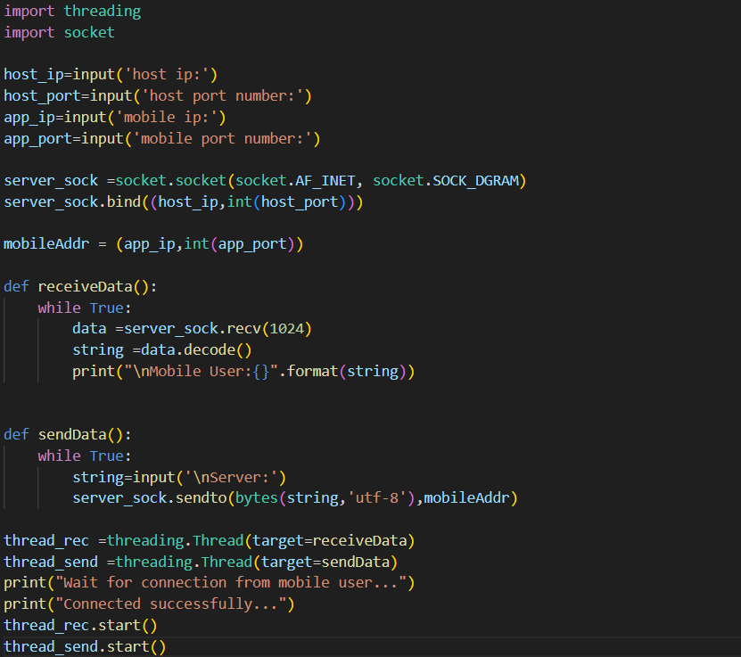
Solution:

Slide 5
Approach: To get such two-way communication we can create a server file using socket programming which comprises of two function one to send the data and one to receive from mobile user. And then running them on different threads to run them simultaneously.

Slide 6
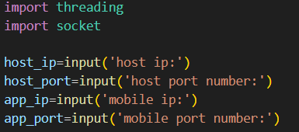
//Importing the required library(socket and threading)
//Taking the required inputs such host’s IP address, Port number, etc.

Slide 7

//Creating a UDP socket for server.
//Binding it to the IP address and port no. of the server

Slide 8
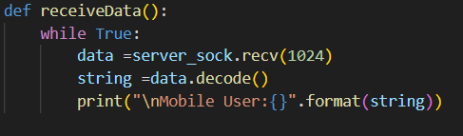
//Defining a function to receive the message from the mobile user.
//In this function we are receiving an encoded data from the mobile user and then we are decoding it to display it.

Slide 9
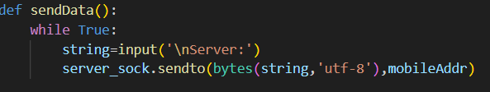
//Defining a function to send the message from server.
//In this function we are sending an encoded data to the mobile user.

Slide 10
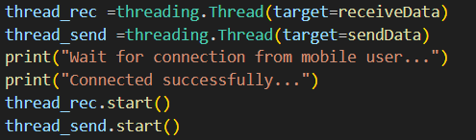
//Defining two threads, one to receiving function and other for sending.
//Running both the thread to receive and send data simultaneously.

Slide 11
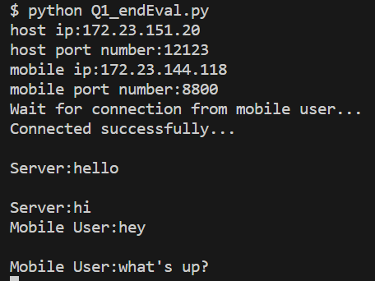
Output:

Slide 12
QUESTION TWO
EMAIL SERVER USING SMTP

Slide 13
Question 2:
This question asked to send email using smtp server.

Slide 14

Solution:

Slide 15
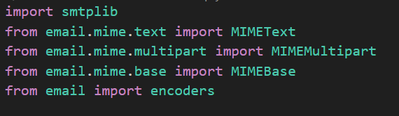

Solution:
//Importing the required libraries
//Then setting up the port number and the server's name.

Slide 16
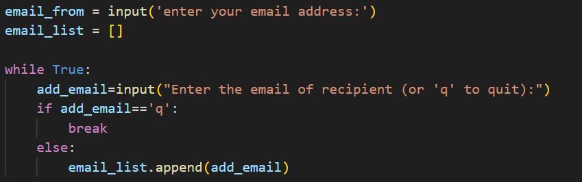
//Taking input of sender’s address
//And of list of receivers(CC (s)) in a list of receiver.

Slide 17
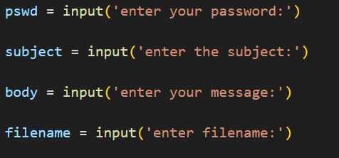

//Taking remaining necessary inputs such as password, subject, etc.
//Defining a function to send the email to receivers and passing list of receiver in argument

Slide 18
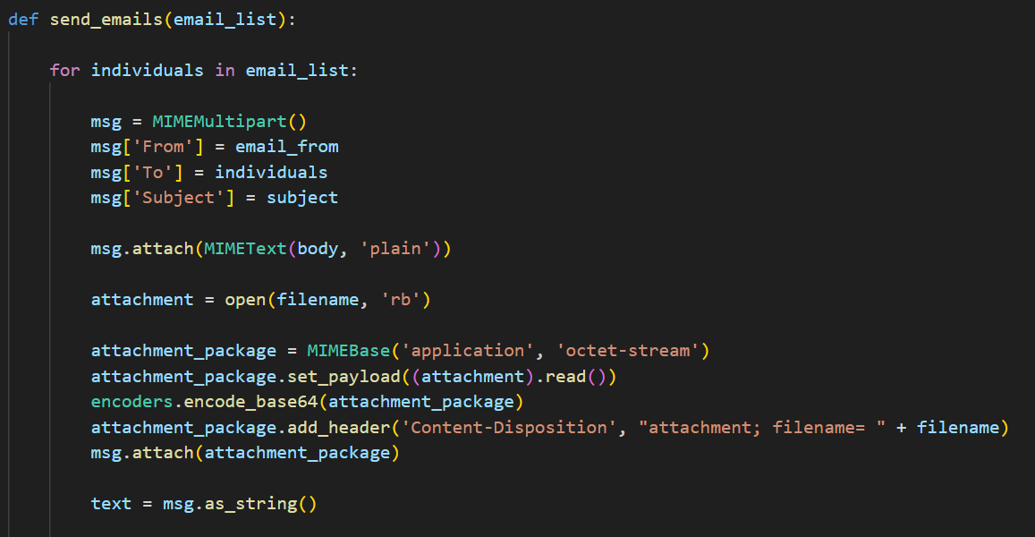
Here, we defined an object to define the parts of the email, attaching the
body of the email, input the file name which is to be attached to the mail and
opening the file in python as a binary. Here, r is for read and b for binary.

Slide 19
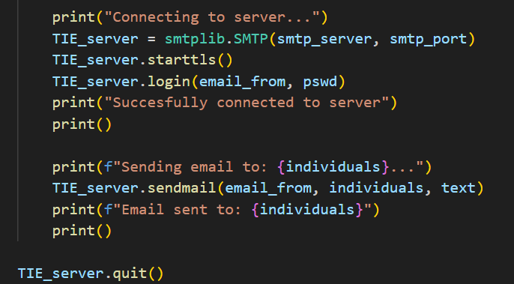

After connecting to the server, we build communication using TLS which is a primary use case of TLS is encrypting the communication between web applications and servers.
Then we login using the given credentials and send the email to receivers
//Executing the function

Slide 20
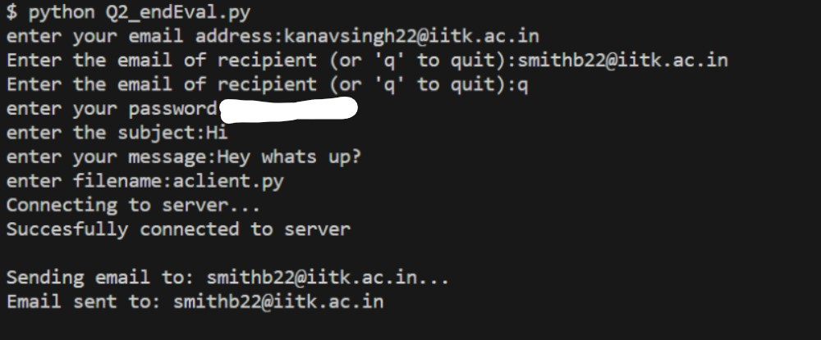
Output:

Slide 21
THANK YOU
Group - 1

