Slide 1
Implemente DSatur
Jiacheng Liu
March 5, 2017

Slide 2
Outline
Generate Graphs : 2 problems
Max heap and Data Structures
Dsatur
Experiments and Results

Slide 3
K4,4 has 4*(4-1)/3=6 edges
1
2
Suppose we set density=0.5, which means choosing 3 edges.
There are C(6,3)=20 possibilities when choosing edges randomly.
3
4
The number of colors actually related to the isomorphic graphs.
+
4
+
4
=
20
12
Type 1
Type 2
Type 3
1.Choose two middle nodes:
C(4,2)=6
2. C(4,2)*2=12
Choose one node in the middle:
C(4,1)=4
Choose one node to left:
C(4,1)=4

Slide 4

Generate graphs
Problem 1
Random ? No, different weight!
I can’t solve this problem. ☹
I know it’s difficult
It is equivalent to the problem of “how many isomorphic trees/graphs are there, given n nodes.”

Slide 5


Generate graphs
Problem 2:
Not connected
Generate a spanning tree (to be honest, this is also biased)
Density d is modified to

Slide 6
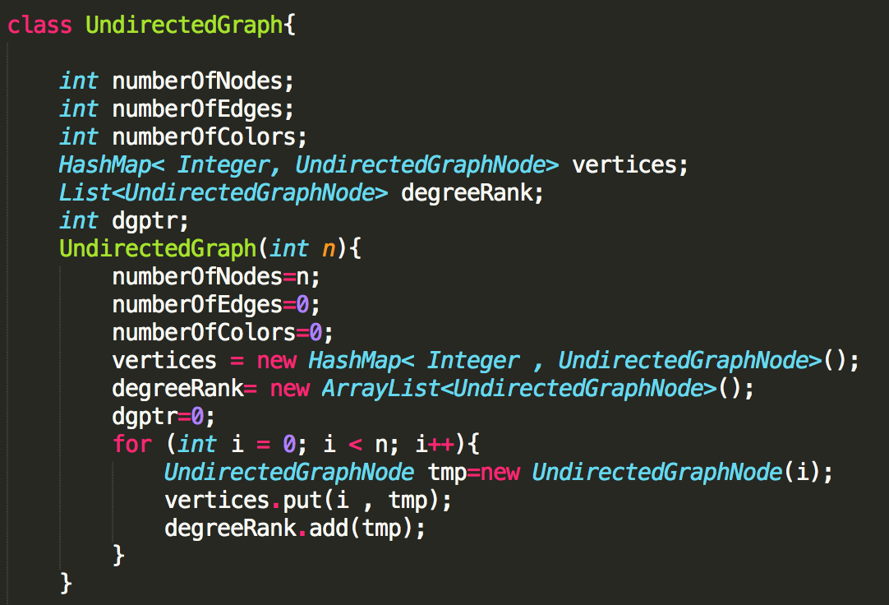
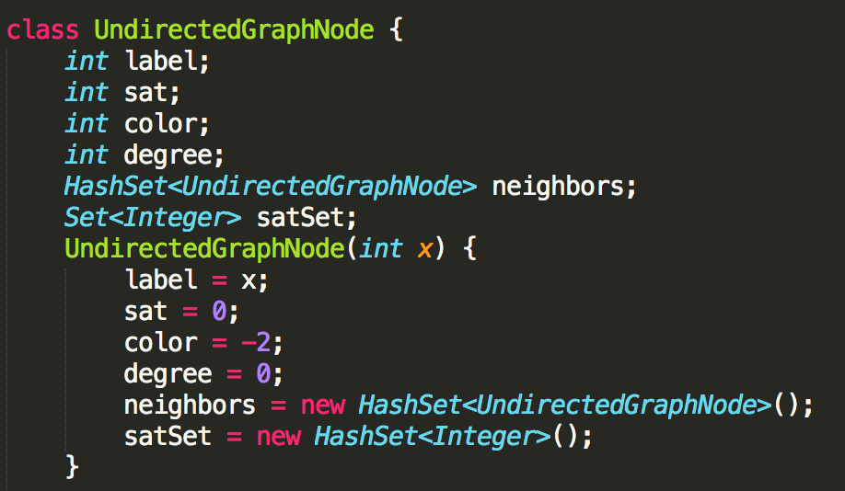
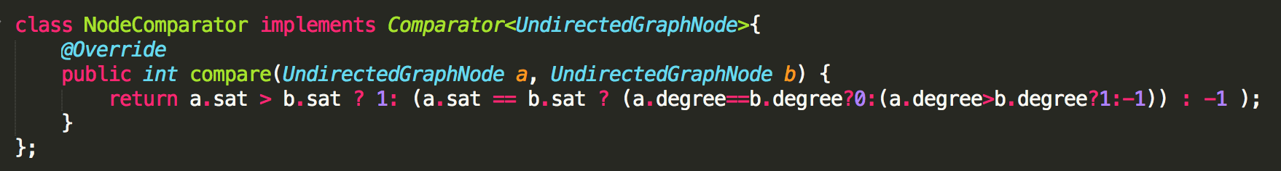
Graph classes

Slide 7
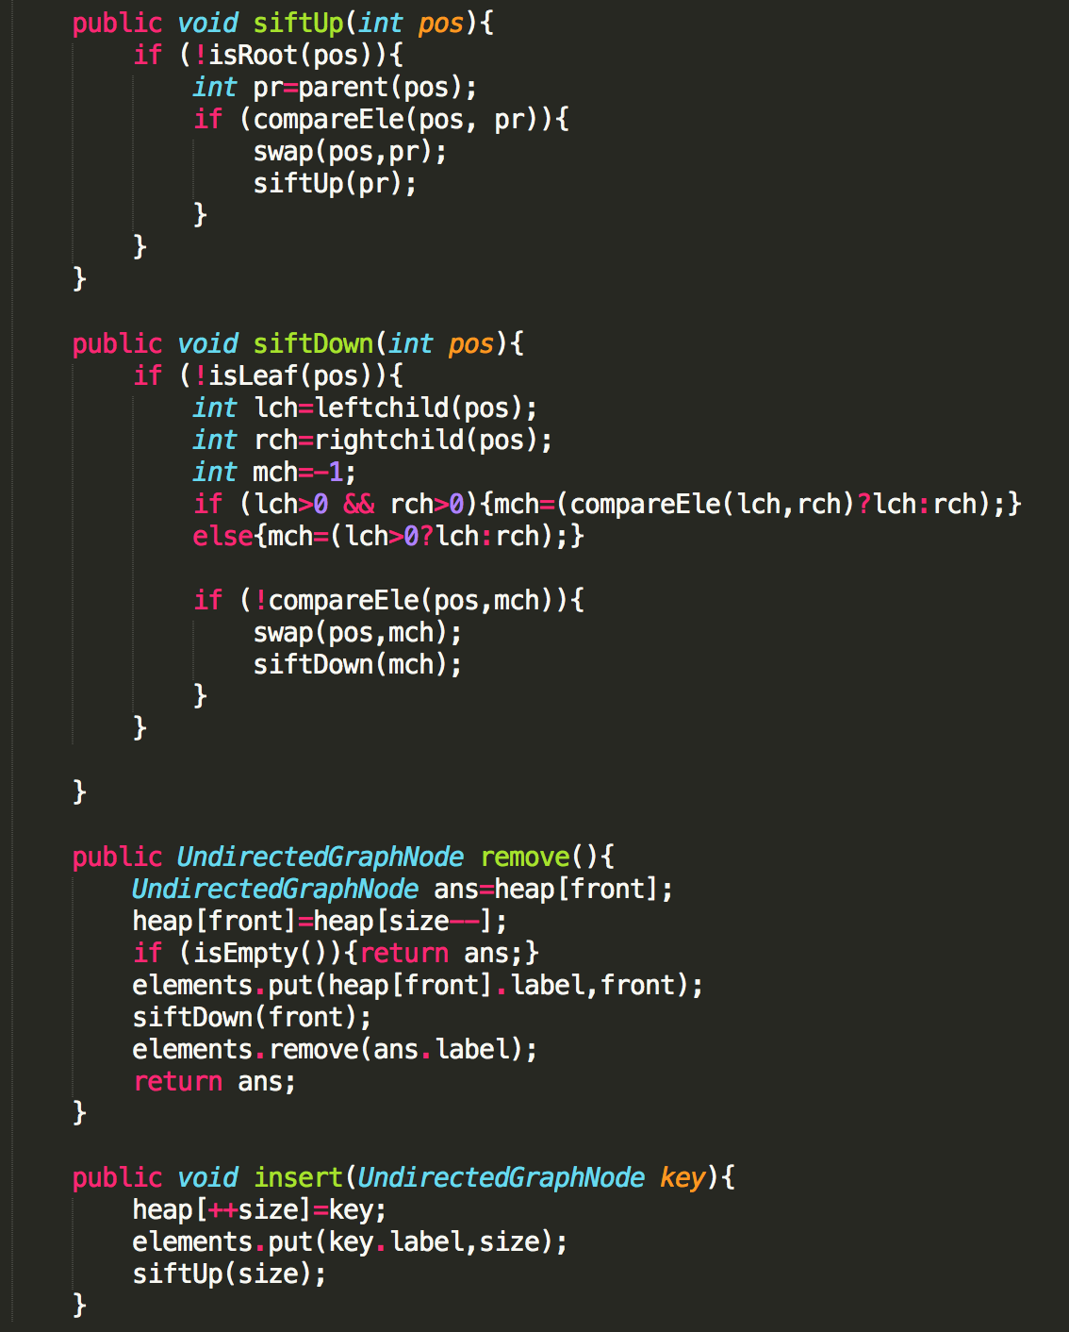
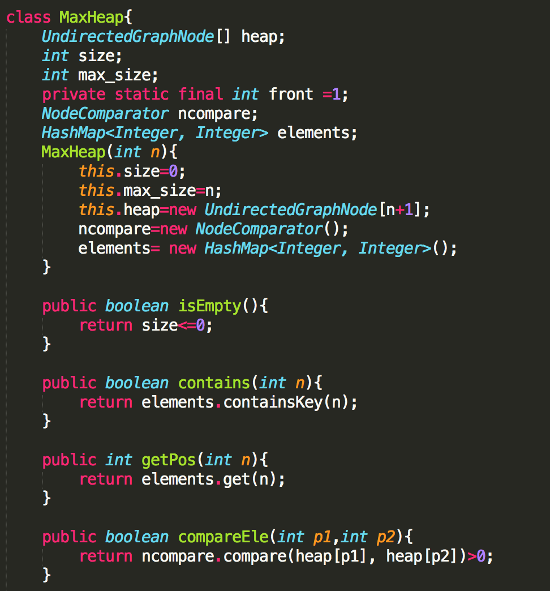
Max heap

Slide 8
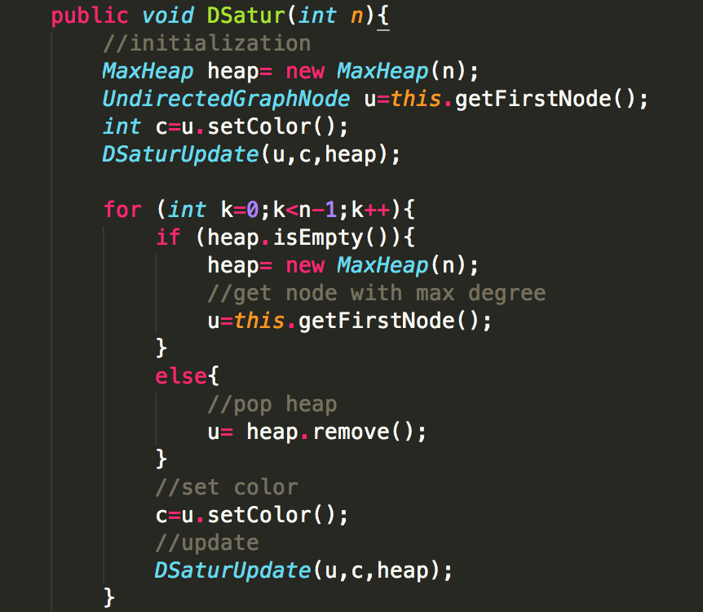
DSatur

Slide 9
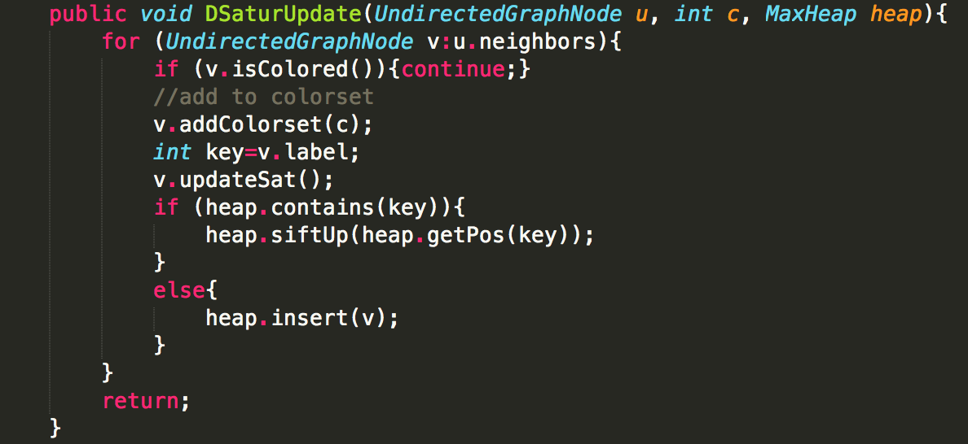
DSatur Update
In order to obtain a better constant,

Slide 10
Experiments
Mac jdk1.8
Density {0.3, 0.5, 0.65, 0.75 } * |V| {10, 20, 30, … 100}
For each (density, |V|) combination , generate 100 graphs
Annotations
Minimum Number of colors needed - y
Density - d
Number of vertices - |V|

Slide 11
Results: Running Time

Slide 12
Results: Density, |V| and y

Slide 13
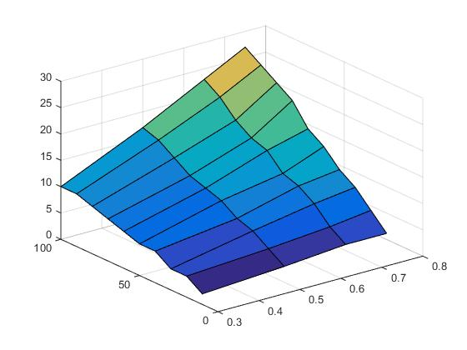
Results: Density ~ Slope
Regression Statistics
Multiple R | 0.999116432
R Square | 0.998233645
Adjusted R Square | 0.994700934
Standard Error | 0.005308416
density square | density | slope
0.09 | 0.3 | 0.0885
0.25 | 0.5 | 0.1521
0.4225 | 0.65 | 0.2055
0.5625 | 0.75 | 0.2588
Observation | Predicted Y | Residuals | Standard Residuals
1 | 0.089171575 | -0.000671575 | -0.219124086
2 | 0.149279385 | 0.002820615 | 0.92032116
3 | 0.209529449 | -0.004029449 | -1.314744514
4 | 0.25691959 | 0.00188041 | 0.61354744
 | Coefficients | Standard Error | t Stat | P-value
Intercept | 0.042350448 | 0.030681787 | 1.380312297 | 0.39913714
X Variable 1 | 0.28893726 | 0.12146247 | 2.378819244 | 0.253341627
X Variable 2 | 0.069389245 | 0.127444401 | 0.544466796 | 0.682590837

Slide 14
Results: Conclusion

Slide 15
Thanks for listening
Q&A

