Slide 1
Context Aware Chat-bot
Eric Liu
Kerwin Zhou
Qiaozhi Li
Brandon Olson
Bhavana Gudi

Slide 2
Problem Description
Problem:
Inputs given to a chatbot can have multiple meanings.
How do we resolve the true meaning
Goal:
Create a system that enables a chatbot to respond relevantly to user given prompts that may contain semantic ambiguity
Example Prompts:
What does a watch look like?
In this case “watch” is a homograph

Slide 3
Homographs Examples
In Statements
Notes:
We focus on a specific type of homographs.

Slide 4
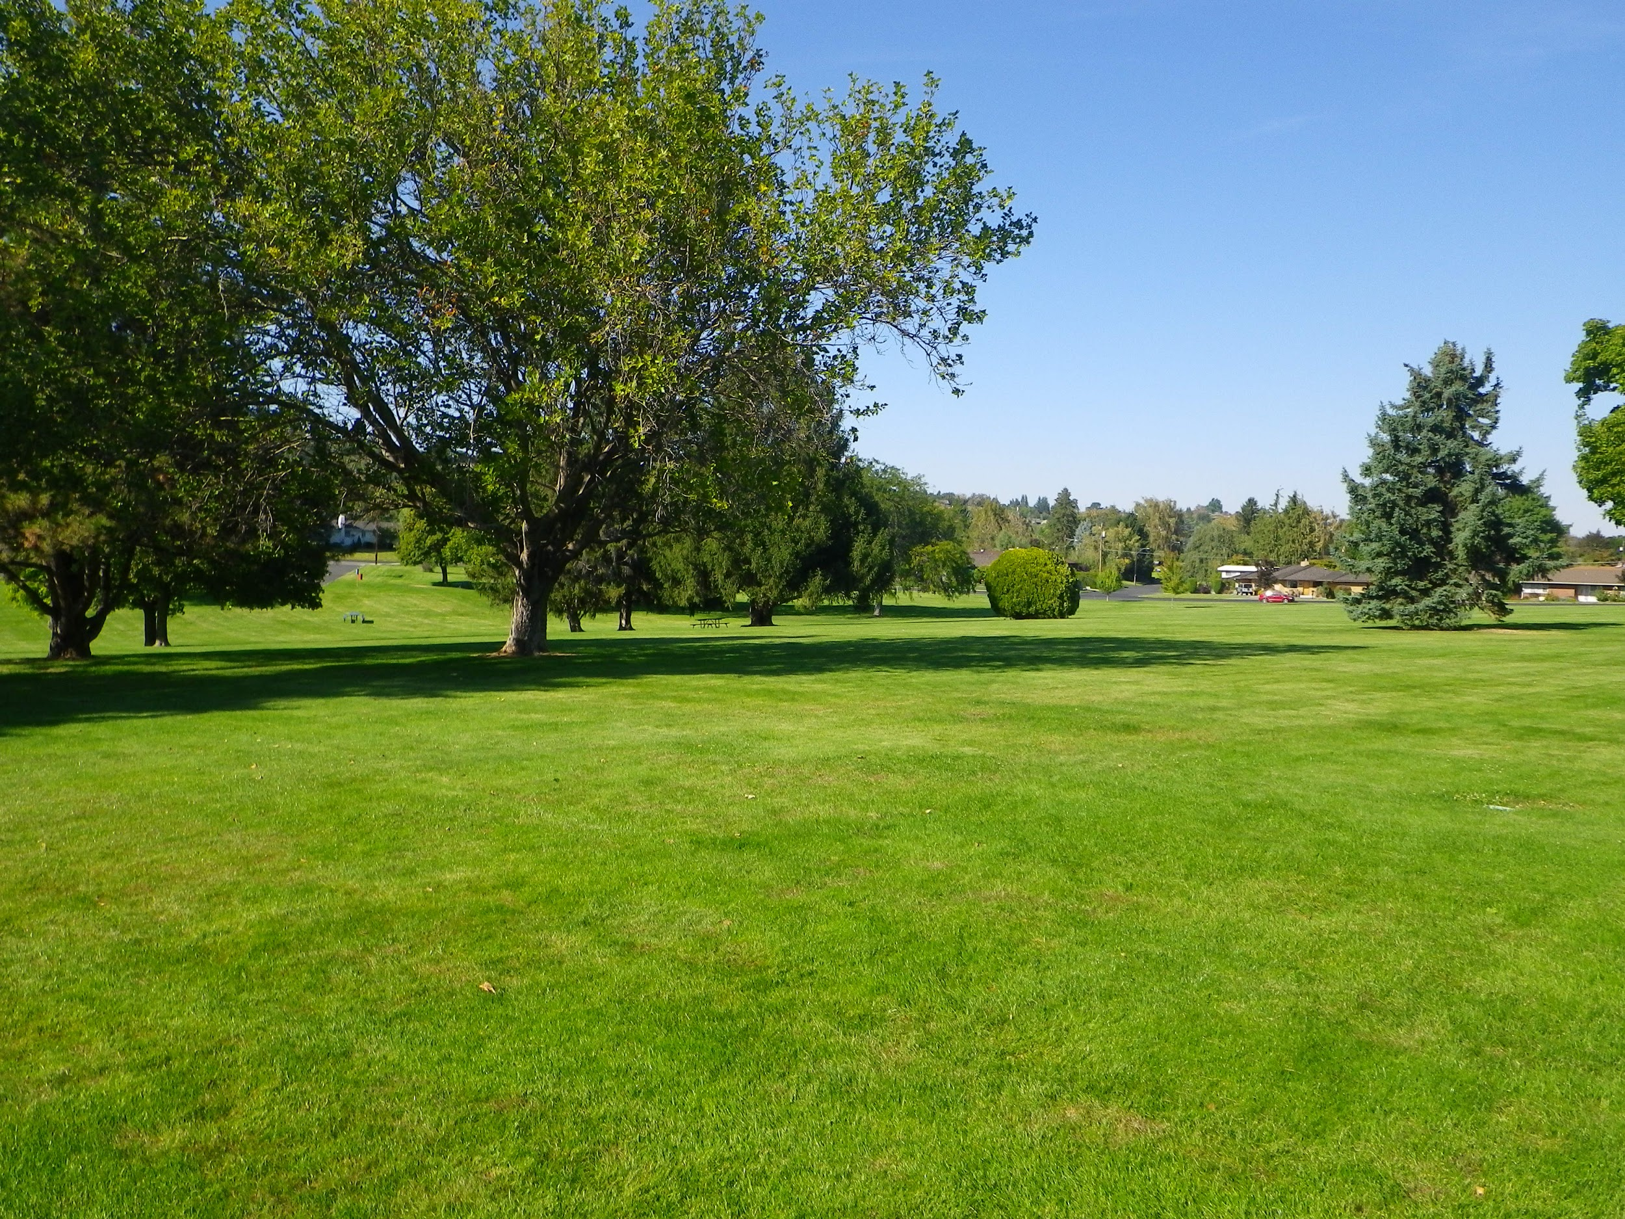

Park
Want to go the park.

Slide 5
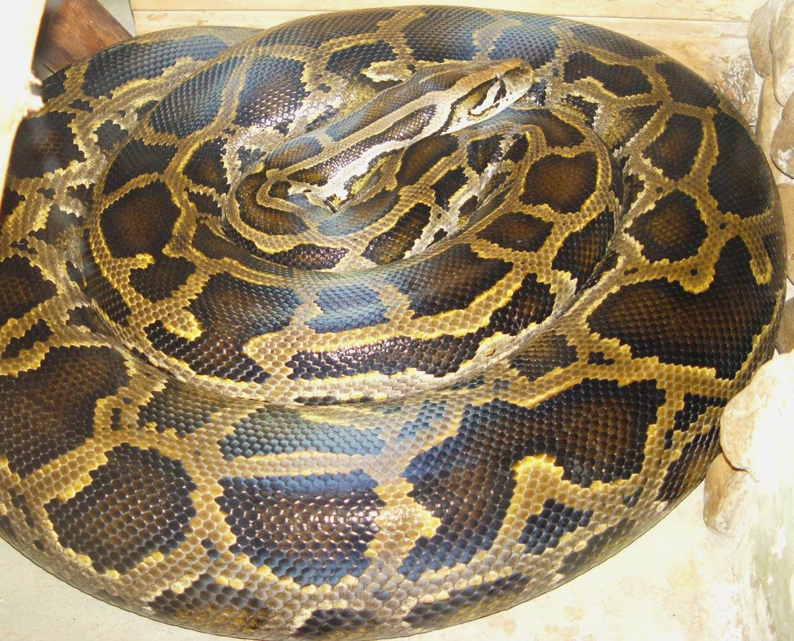

Python
Is python popular?

Slide 6
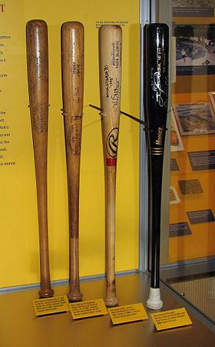

Bat
How much for that bat?

Slide 7


Watch
I built a watch over the summer.

Slide 8
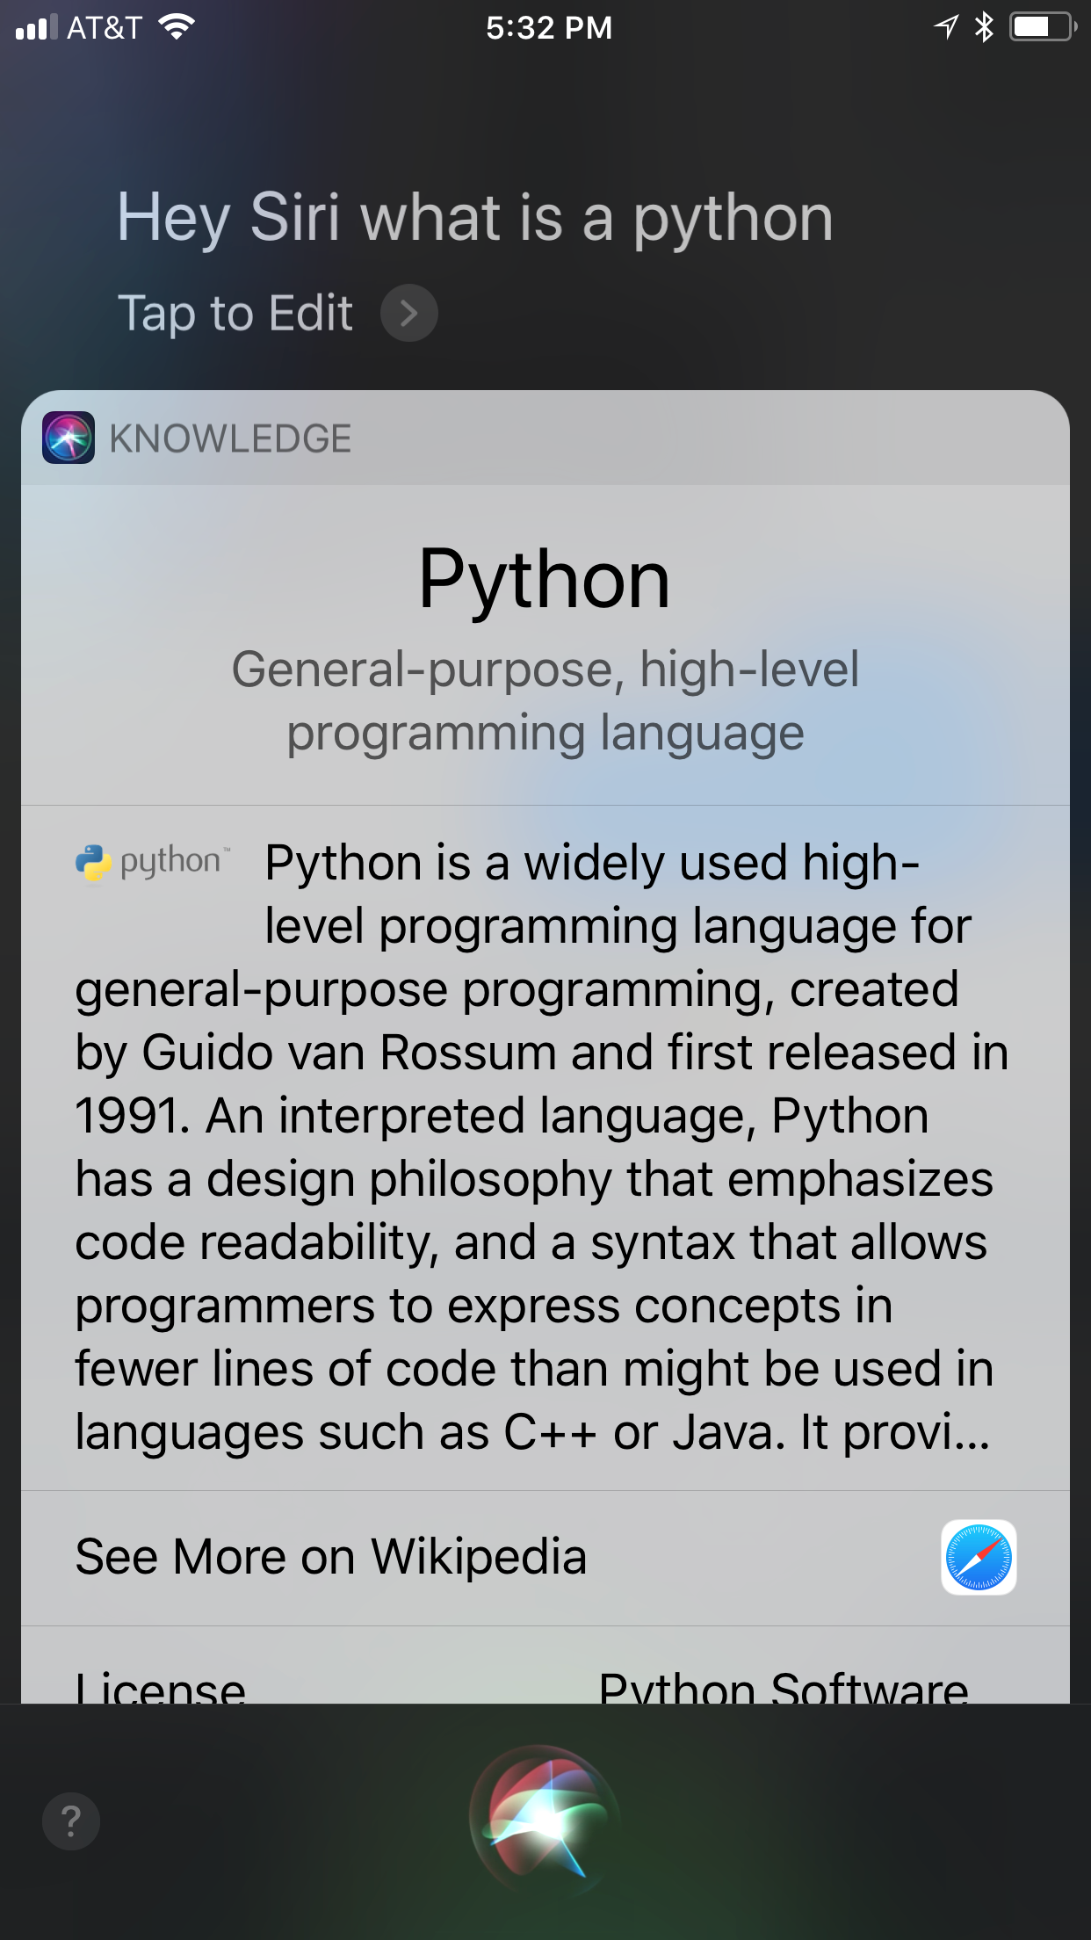
Motive
Interacting with computers naturally
Current bots don’t always understand
Chatbots highlight this problem well

Slide 9
Solution - Intuition
Some approaches to this problem:
Part of speech (POS)
Does not always work
Constrict the domain
Not general
Interview the user
Not automated
Resolve domain through context
Requires multiple inputs
Moc User Input:
>>> When were castles first used?
>>> What does a watch look like?

Slide 10
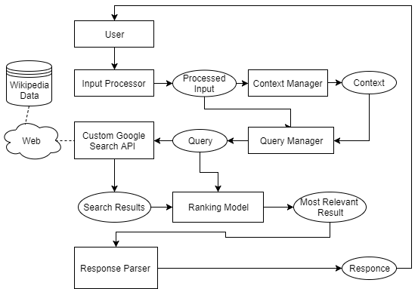
Solution -
High Level Flow
Core components:
Context of the conversation
Web Search
Google Search API
Wikipedia database
Result Ranking Model
Response Parser
Notes:
The idea is to use internet as our knowledge base.

Slide 11
Dataset & Experiments
Currently the chatbot only uses the Wikipedia corpus
Test Cases:
Proof of Concept Test
Accuracy test
List of Homographs , 50 words
Human judgers - results are correct?

Slide 12
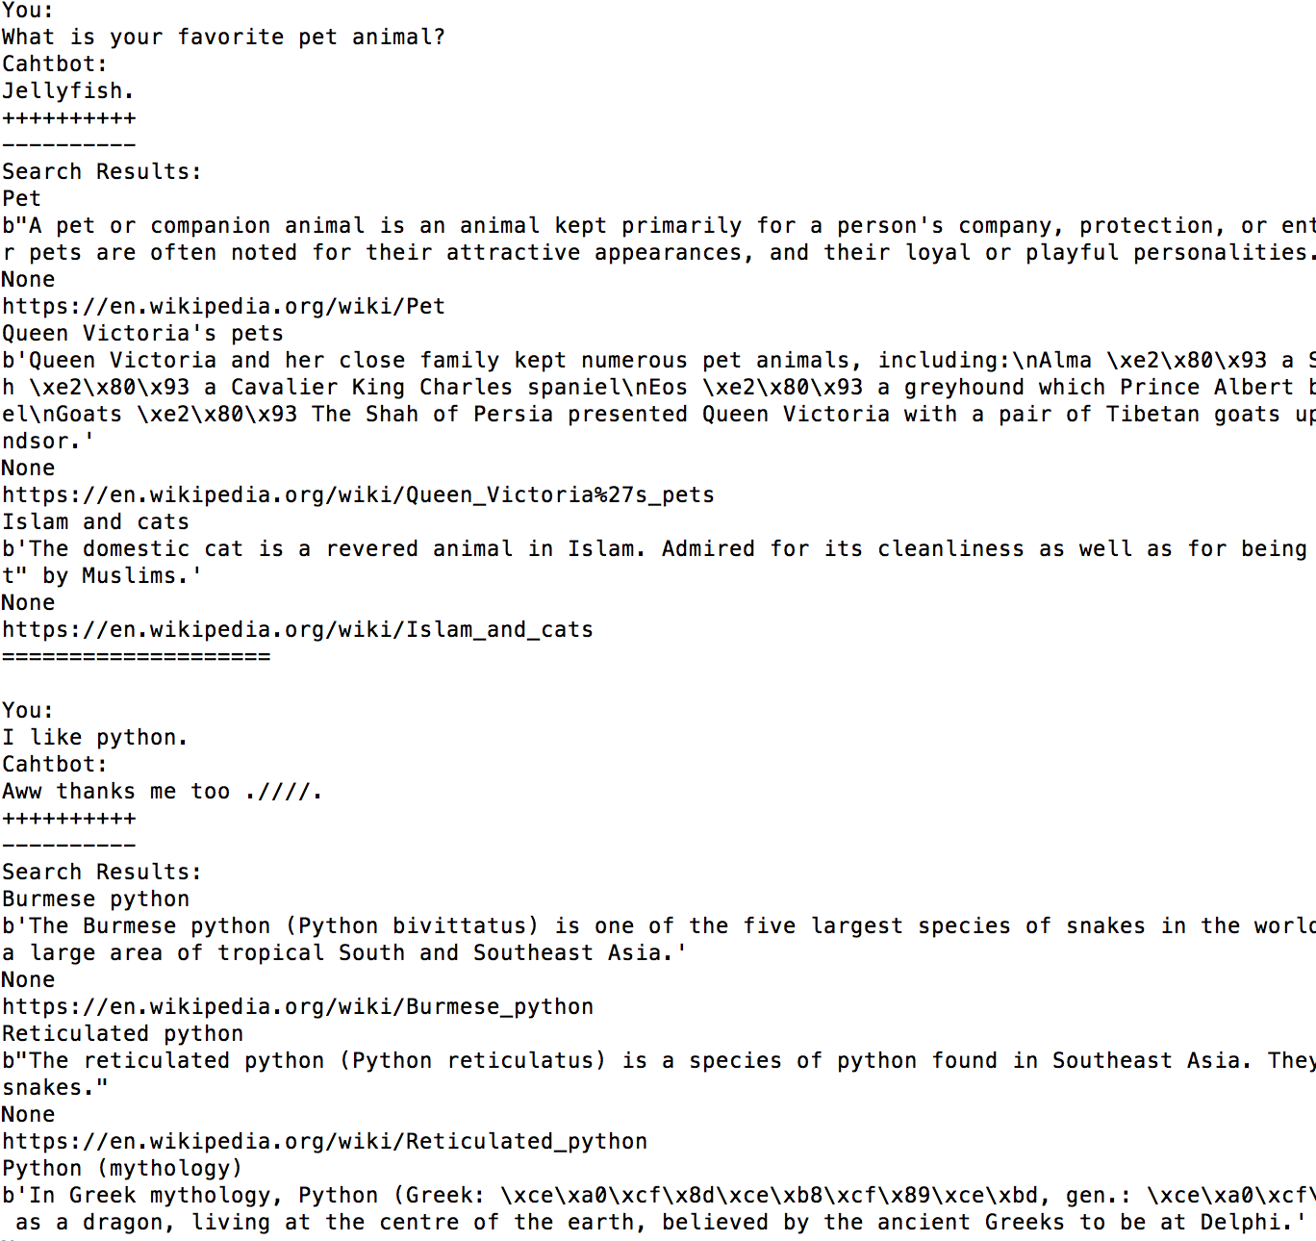
Results Analysis and Evaluation:
Proof of concept
1 | 2

Slide 13
Results Analysis and Evaluation:
Experiments
Accuracy:
Failures Analysis:
POS tagger failures
Really subtle meanings
i.e. , Rock n.
- an unintelligent person
93 %

Slide 14
Cons & Pros
Advantages:
Real time response
Up to date knowledge
Easy to plug into existing applications
Limitations:
Cold start problem
100 queries/day - for free API we use
Rapid changes in context - Context Change Detection

Slide 15
Conclusions & Future Work
It works.
Everyone learns a lot.
Future Work
More Task-oriented
Combine the results with Google Search Trend
Generating Human Friendly Answers
Connect with voice recognition techs, Better UI

Slide 16
References
List of Homographs - wiki https://en.wikipedia.org/wiki/List_of_English_homographs
List of Homographs https://www.dailywritingtips.com/homograph-examples/
Simsim API http://developer.simsimi.com/api
Google Search API
https://developers.google.com/custom-search/json-api/v1/using_rest
Github link for our codes
https://github.com/kanbei7/IR-Project
6. Learning Symmetric Collaborative Dialogue Agents with Dynamic Knowledge Graph Embeddings
https://nlp.stanford.edu/pubs/he2017collaborative.pdf
7. BUILDING INTELLIGENT AGENTS THAT LEARN TO RETRIEVE AND EXTRACT INFORMATION
http://ftp.cs.wisc.edu/machine-learning/shavlik-group/eliassi-rad.thesis.pdf

