Slide 1

Predicting flight delays
Ananya Shrivastava
Kanchan Chowdhari
Sai Srujan Reddy Vontary
Sujhan Das

Slide 2
Introduction
Flight delay is inevitable, and it plays an important role in both profits and loss of the airlines.
Delays and cancellations affect both passengers and air carriers. By resulting in increased travel time and increased expenses on food and lodging, they cause stress among passengers. Further, they disrupt the purpose of air travel — rapid, affordable and safe — and make the passengers distrust airlines.
Through this project, we shall be:
Visualizing various kinds of delays with respect to time and airports
Determining similar clusters of delays and distance
Predicting delays less than or more than the average delay time
Predicting elapsed time of flights due to delays

Slide 3
Dataset Description
Source: https://www.kaggle.com/fabiendaniel/predicting-flight-delays-tutorial/data?select=flights.csv
Features of the Metadata:
Each entry of our dataset corresponds to a flight and we see that more than 5,800,000 flights have been recorded in 2015. These flights are described according to 31 variables.
YEAR, MONTH, DAY, DAY_OF_WEEK: dates of the flight
AIRLINE: An identification number assigned by US DOT to identify a unique airline
ORIGIN_AIRPORT and DESTINATION_AIRPORT: code attributed by IATA to identify the airports
SCHEDULED_DEPARTURE and SCHEDULED_ARRIVAL : scheduled times of take-off and landing
DEPARTURE_TIME and ARRIVAL_TIME: real times at which take-off and landing took place
DEPARTURE_DELAY and ARRIVAL_DELAY: difference (in minutes) between planned and real times
DISTANCE: distance (in miles)

Slide 4
Data Cleansing
The following columns were dropped as they don’t have any significance in the analysis
"TAIL_NUMBER", "TAXI_OUT","WHEELS_OFF", "WHEELS_ON", "TAXI_IN", "SCHEDULED_ARRIVAL"
Only null values of the CANCELLATION_REASON were kept as the rest were out of scope.
The AIR_SYSTEM_DELAY column was further filtered based on not null values
A sample data on 5% on original dataset count with no replacement was created for our analysis. Our sample data set now consists of 53,107 rows.

Slide 5
Sample Data
 | Column Name | Data type
1 | year | int
2 | month | int
3 | day | int
4 | day_of_week | int
5 | airline | string
6 | flight_number | int
7 | origin_airport | string
8 | destination_airport | string
9 | scheduled_departure | int
10 | departure_time | int
11 | departure_delay | int
12 | scheduled_time | int
 | Column Name | Data type
13 | elapsed_time | int
14 | distance | int
15 | scheduled_arrival | int
16 | arrival_time | int
17 | arrival_delay | int
18 | diverted | int
19 | cancelled | int
20 | cancellation_reason | string
21 | air_system_delay | int
22 | security_delay | int
23 | airline_delay | int
24 | late_aircraft_delay | int
25 | weather_delay | int

Slide 6
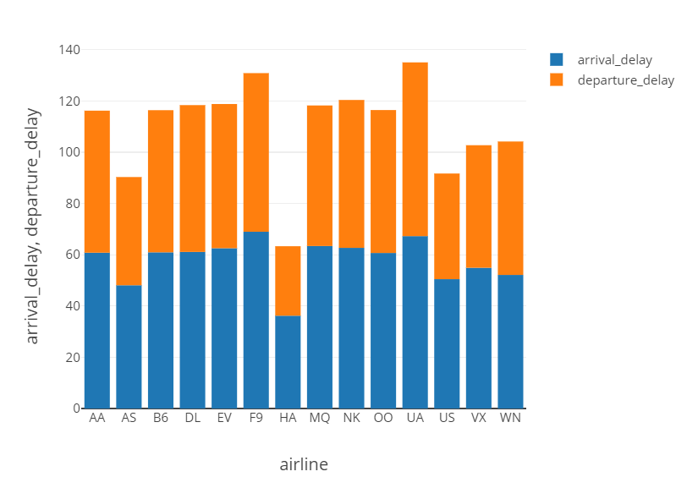
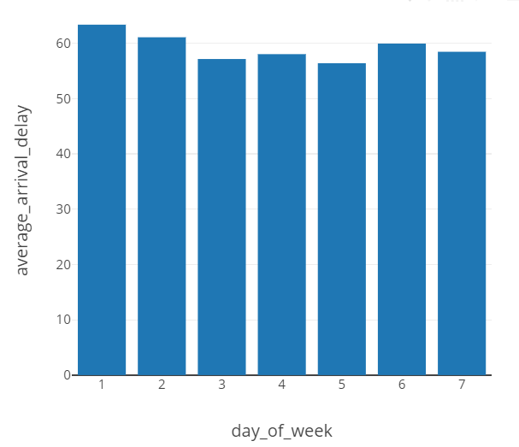
Visualization of Data Distribution
Airlines VS Departure and Arrival delay
Day of Week VS Average Arrival Delay

Slide 7
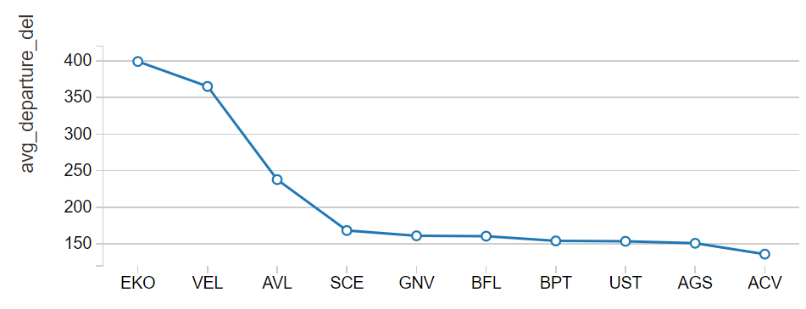
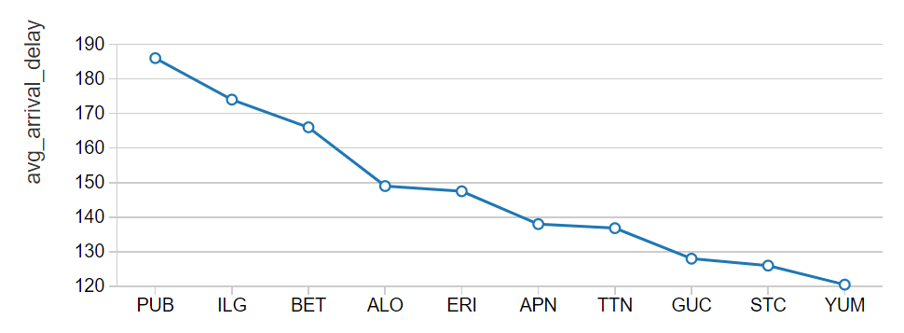
Visualization of Data Distribution
Origin airport VS Average departure delay
Destination airport VS Average arrival delay

Slide 8
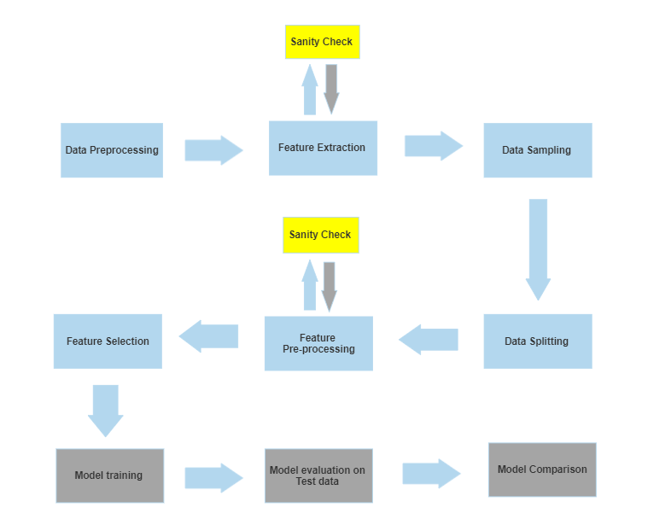
Model Flowchart

Slide 9


Machine Learning Models
K Means Clustering Model
Logistic Regression Model
Technologies used:
GBT Classifier Model
Naïve Bayes Model
Linear Regression Model

Slide 10
K Means Clustering Model
A cluster refers to a collection of data points aggregated together because of certain similarities. K-means algorithm identifies k number of centroids, and then allocates every data point to the nearest cluster, while keeping the centroids as small as possible.
Results:
The centroids are:
Centroid 1: [831 52 57]
Centroid 2: [2456 52 60]
Centroid 3: [1626 53 58]
Centroid 4: [531 52 59]
Centroid 5: [1104 55 60]
Centroid 6: [245 53 59]
Input columns:
distance, departure_delay, arrival_delay
Steps:
A Vector assembler transforms the input columns into a single vector
A pipeline is used to pass the data through indexer and assembler
Fit and transform the pipeline on the dataset
Define a K-means object with k = 6
Train the k-means model and evaluate the cluster centers

Slide 11
Logistic Regression Model
Logistic regression is a statistical model that in its basic form uses a logistic function to model a binary dependent variable.
New Input columns created:
Created new column total_delay = arrival_delay + departure_delay
Created binary column delay_status ->0 if total_delay < 110 min ->”less delayed”
1 if total_delay > 110 min ->”more delayed”
Input- distance,air_system_delay,security_delay,airline_delay,late_aircraft_delay,weather_delay
Output- delay_status
Steps:
Perform random split with training data having 70% and testing data having 30% of the total dataset.
Pipeline to pass the data through the assembler
Fit and transform the pipeline on the dataset.
Train and fit the model to compute predictions of target variable.
Results:
The area under the curve is 0.9523
The accuracy of the model is 96 %
Below is the confusion matrix for logistic regression model is:
[[2229 54]
[ 79 1023]]

Slide 12
GBT Classifier Model
Gradient boosting is a type of machine learning boosting. It relies on the intuition that the best possible next model, when combined with previous models, minimizes the overall prediction error. The key idea is to set the target outcomes for this next model in order to minimize the error.
Input is the same as Logistic Regression Model
Steps:
Use pipeline to pass the data through the assembler
Fit and transform the pipeline on the dataset.
Train and fit the model to compute predictions of target variable.
Results:
The area under the curve is 0.9485
The accuracy of the model is 95.74%
Below is the confusion matrix for Gradient Boosted Trees model is:
[[2224 59]
[ 85 1017]]
12

Slide 13
Naïve Bayes Model
It is a classification technique based on Bayes' Theorem with an assumption of independence among predictors. In simple terms, a Naive Bayes classifier is used to predict the probability of different class based on various attributes.
Input columns- src_airport_index, dst_airport_index, elapsed_time, air_system_delay, security_delay, airline_delay, late_aircraft_delay, weather_delay
Steps:
Use a string indexer for our string data type input columns.
Use a scaler and normalizer to improve accuracy and fit of the model
After scaling and normalizing, the data is passed through the assembler via the pipeline.
Fit the trained data and transform test data.
Results:
The area under the curve is 0.8556
Naive Bayes Model Accuracy: 87.14%
Below is the confusion matrix for Naive Bayes Model Accuracy model is:
[[2057 226]
[ 209 893]]
13

Slide 14
Linear Regression Model
Linear Regression is a machine learning algorithm based on supervised learning. It performs a regression task. Regression models a target prediction value based on independent variables.
For this model, instead of predicting the delay status, we predict the factors affecting the elapsed time.
Input columns: departure_delay, distance, arrival_delay
Ouptut column: Elapsed time = elapsed between departure from the origin airport gate to the arrival at the destination airport gate.
Results:
R squared value is 0.9574
Root mean squared error value is 16.12
Mean squared error value is 259.91
Steps:
Perform random train-test split ->70% - 30%
Build a pipeline to pass the data through assembler
Fit and transform the pipeline on the dataset.
Train and fit LR model to compute predictions of target variable.

Slide 15
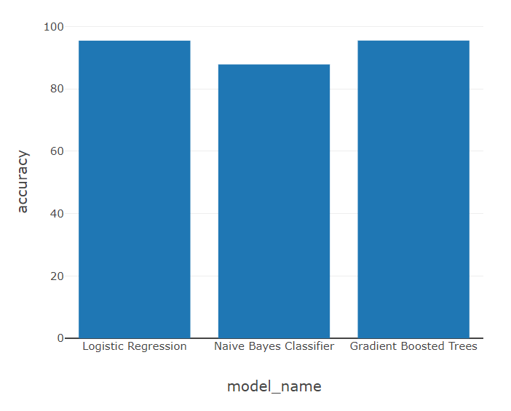
Model Comparison for Classification models
Gradient Boosted Classifier model performs the best when it comes to categorical value prediction.
Linear Regression performs well when it comes to continuous value prediction.
15

Slide 16
Challenges Faced and Solutions..
No | Challenges | Solutions
1. | Presence of null values and negative values | Performed Data Cleaning process
2. | Difficulty in finding right set of inputs | Performed sanity testing on different combinations of input values
3. | Accuracy of Naïve Bayes model didn’t improve for binary classification | Used standard scaler and normalizer
16

Slide 17
Business Conclusion
One of the initial steps to estimate flight delays thereby increase customer satisfaction and incomes of airline agencies
Predicting delays will decrease the risk of losing valuable customers, improve airlines' revenues and costs through reduced fuel and potential rebooking costs
There are uncountable flights operating everyday. Hence, this is a significant business problem to analyze and provide solutions for which we have implemented through this Big Data project.
17

Slide 18
Thank You!

