Slide 1

Mental Health Insights: Leveraging Chatbot-Driven Analysis for Therapist Dashboard Automation
Team members:
Jaswanth Reddy Kancham
Likitha Kukunarapu
Venkata Anantha Reddy Arikatla
Abhiram Varanasi

Slide 2

Introduction:
In the realm of mental health, solving problems is crucial. Therapists deal with lots of patient data, taking notes on each person they see. To assist them, employing data technologies can significantly decrease their workload while boosting efficiency.
In our project, implementing chatbot-driven analysis within therapist dashboards can simplify and expedite their tasks. This enables them to devote more time to assisting patients. While seemingly straightforward, this approach holds immense potential to revolutionize mental health care.

Slide 3
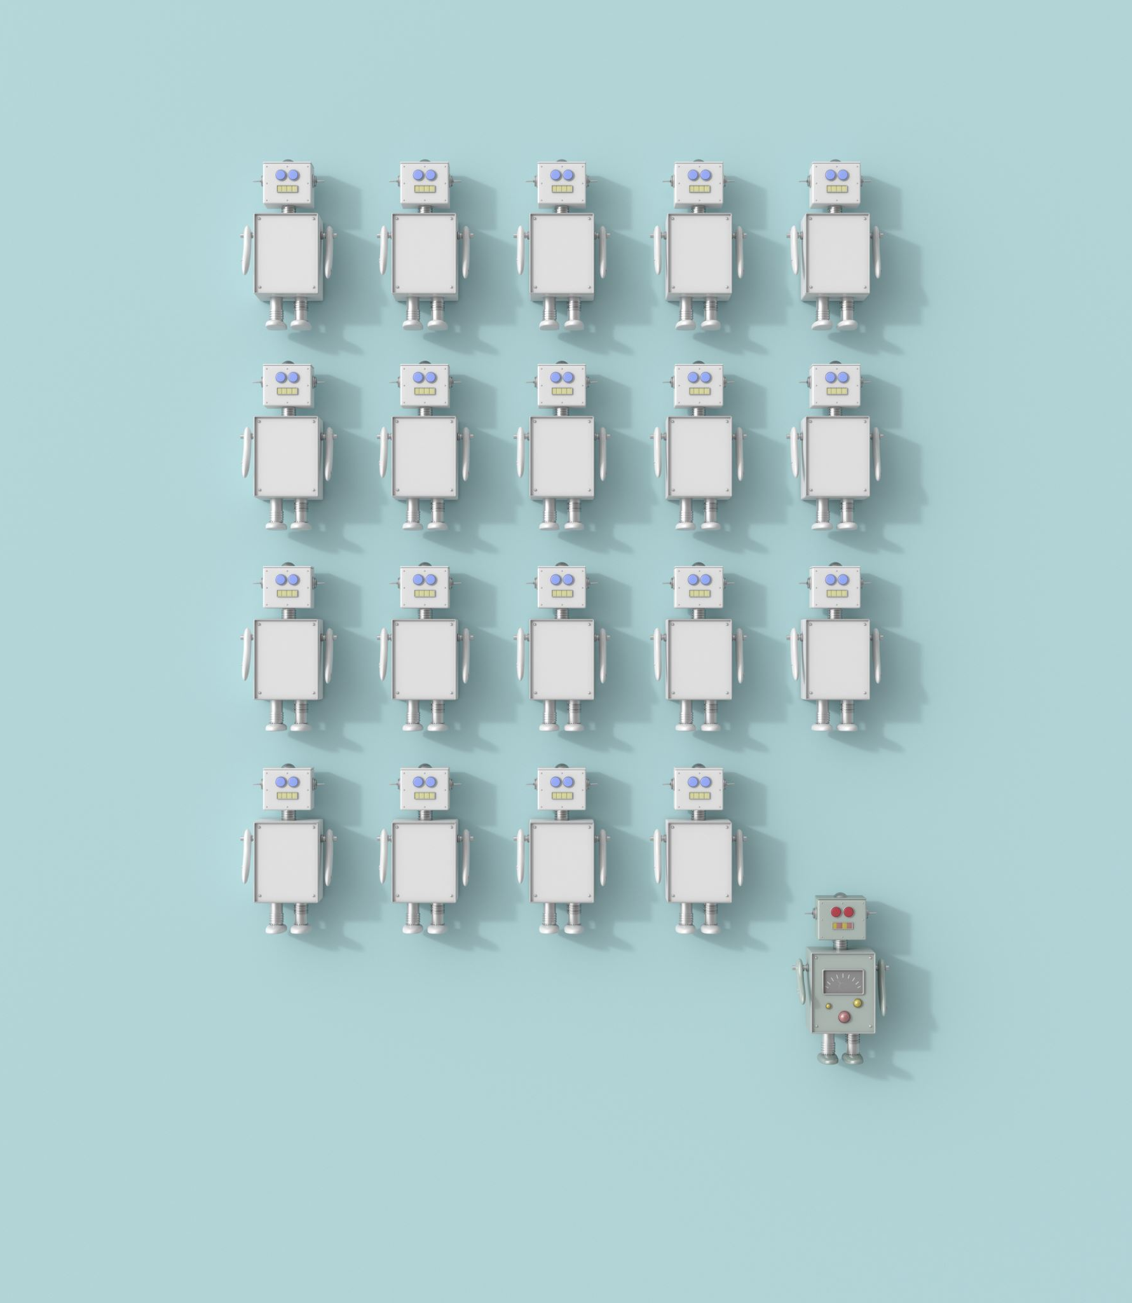
Project Description:
We propose to develop a chatbot that collects comprehensive data related to mental health from clients, including mood fluctuations, stress levels, behavioural patterns, and treatment adherence. This chatbot will serve as a convenient and non-intrusive tool for clients to record their experiences and provide real-time updates to therapists.
Behind the scenes, we will employ advanced machine learning models, developed using Python, to analyze the collected data and identify patterns indicative of depression and other mental health conditions. These models will leverage natural language processing (NLP) techniques to extract meaningful insights from free-text responses and structured data inputs. Upon analysis, the models will generate a Tableau Data Extract (TDE) file containing aggregated insights and trends.
The generated TDE file will automatically feed into a Tableau dashboard, providing therapists with dynamic visualizations and summaries of client data. These visualizations will include trend analyses, correlation matrices, sentiment analyses, and predictive models highlighting potential risk factors or areas for intervention. Therapists will be able to customize the dashboard to suit their preferences and focus areas, enabling personalized insights tailored to each client's unique needs.
By integrating chatbot-driven data collection, machine learning analysis, and Tableau visualization, our project seeks to empower therapists with timely, actionable insights to enhance their decision-making and improve client outcomes in the field of mental health care.

Slide 4
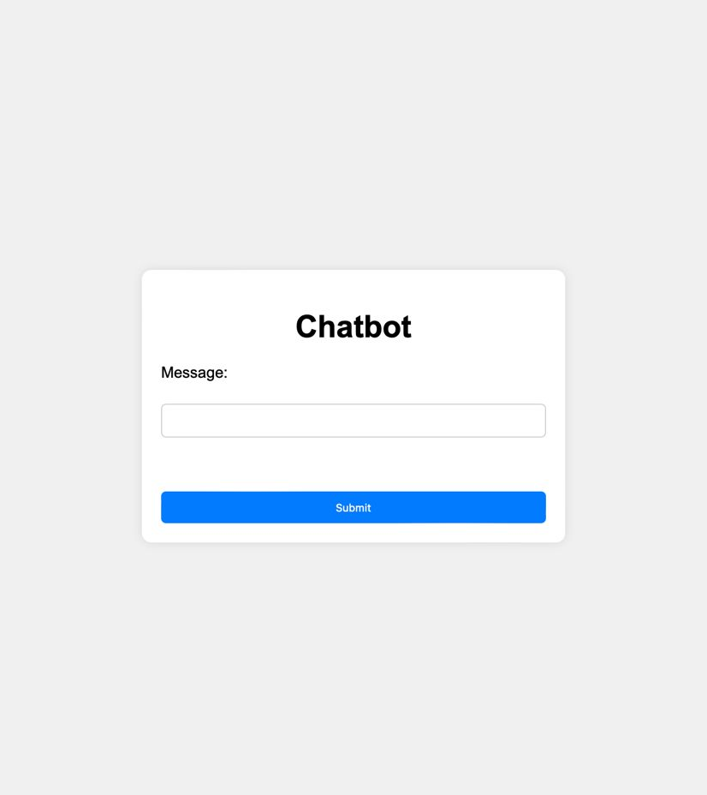
Process:
Creating a ChatBot

Slide 5

Sentimental Analysis
1. Message Retrieval: Upon receiving the user's message, Flask captures it from the frontend interface and forwards it to the sentiment analysis script for further examination.
2. Preprocessing: The text undergoes preprocessing steps like tokenization, removal of stop words, and stemming or lemmatization to ensure its readiness for sentiment analysis.
3. Sentiment Analysis: Utilizing NLP libraries the sentiment analysis script deciphers the emotional tone of the user's message. These libraries offer pre-trained models or lexicons for assessing sentiment, enabling the assignment of sentiment scores to words or phrases in the message.
4. Score Calculation: After assigning sentiment scores to different parts of the text, the sentiment analysis script computes an overall sentiment score, typically ranging from negative to positive, with neutral in between.
5. Output Generation: The sentiment analysis script generates an output containing the sentiment score for the user's message. This output is then relayed back to the frontend for display or further processing.

Slide 6
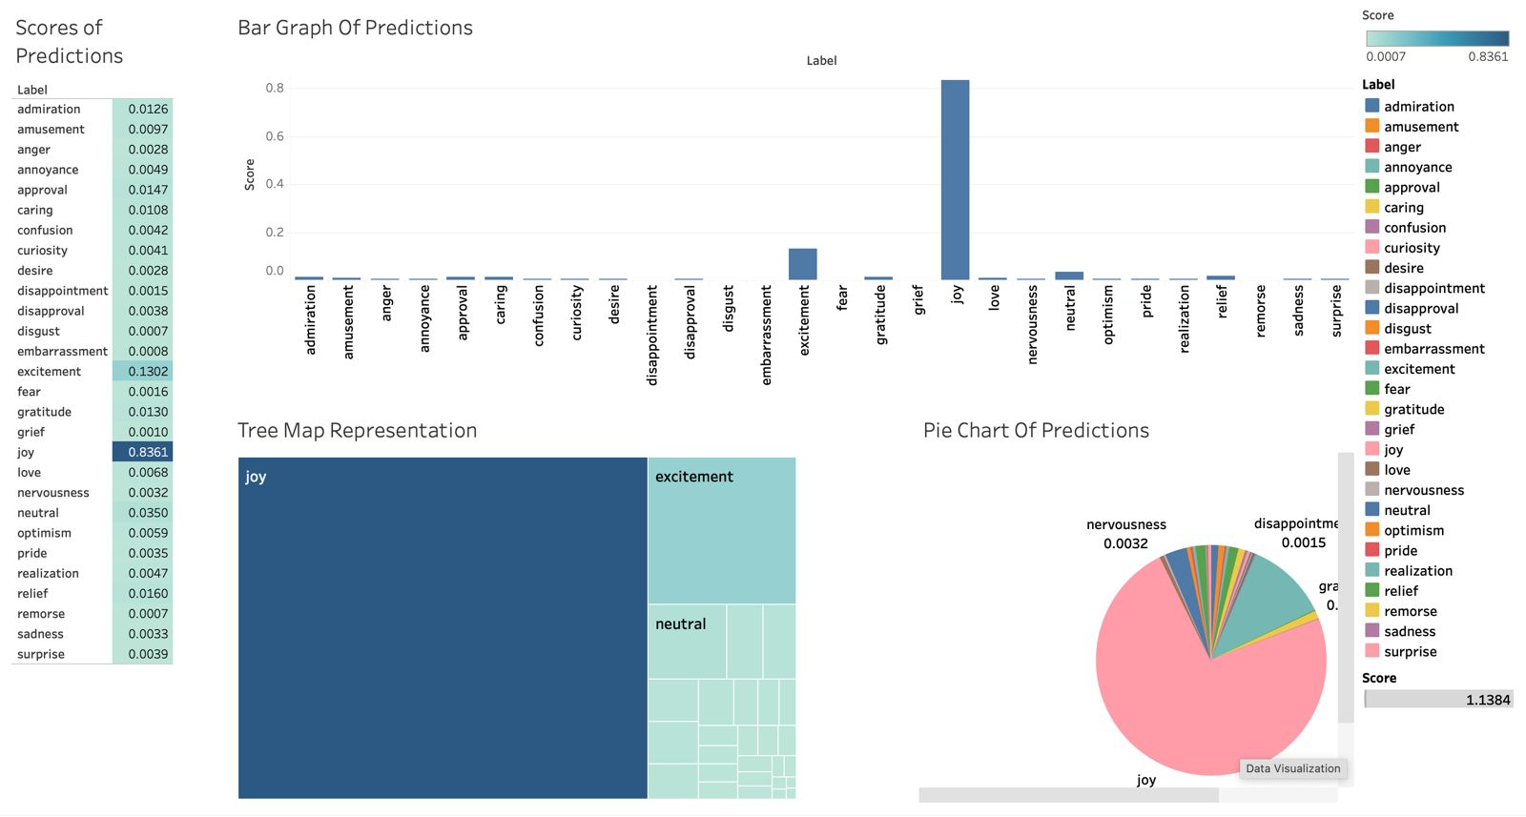
Integration with Tableau Dashboard

Slide 7
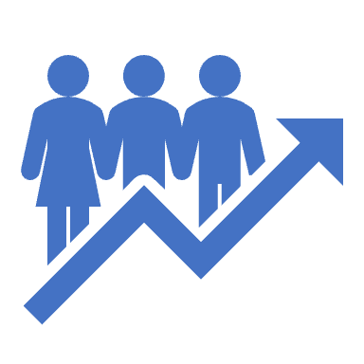
Potential Impact
It has potential to further to analyze by adding transcript of online meeting with the client, adding notes of therapist into the chatbot
Visualizing overall patient data and each individual filters
We successfully implemented the functionalities of the workflow

Slide 8

THANK YOU!
DEMO!!

