Slide 1
Specification document

Slide 2
Meeting agenda
Introduction and Background
Example specification document

Slide 3
Introduction and Background
ต้องอยู่ในระดับที่ dev เข้าใจกันได้
Requirements
Review
Analysis
Design
Review
Development
IT Test
Review
User Test
Review
 Specification document I
Requester ⇒ICD
ICD⇒ Requester
ICD⇒ Requester
Requester ⇒ICD
Project flow

Slide 4
PROJECT NAME
Specification document
Example

Slide 5
Specification Document Agenda
Features and role
UI design
Flow program (May be revised after development)
ER Diagram (May be revised after development)
Test case scenarios (May be revised after development)
Tools
Location source
Source code
Database location
Web host
Api host
Example

Slide 6
1. Plan

Slide 7
2. Features and role
Example

Slide 8
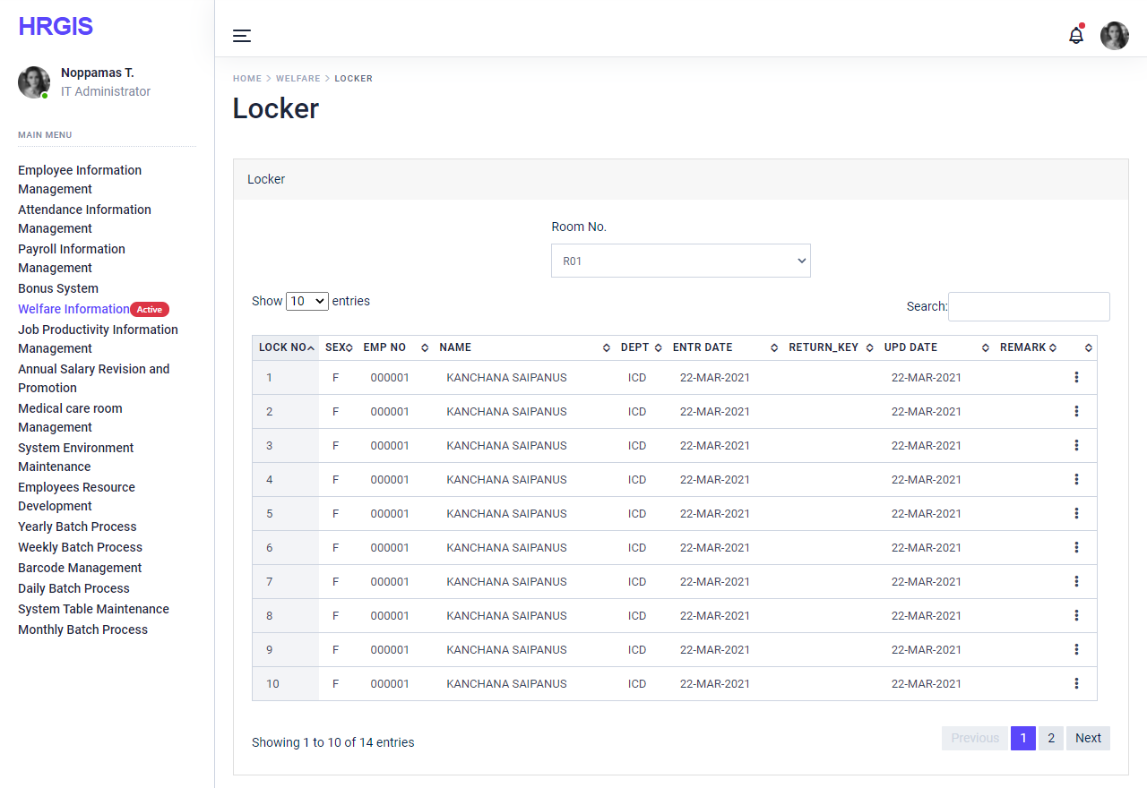
3. UI Design
Example

Slide 9
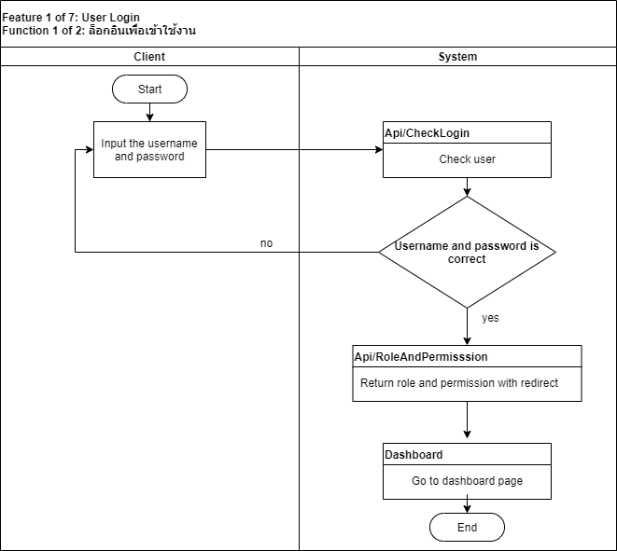
4. Flow program
Feature 1 of 7: User Login
Function 1 of 2: ล็อกอินเพื่อเข้าใช้งาน

Slide 10
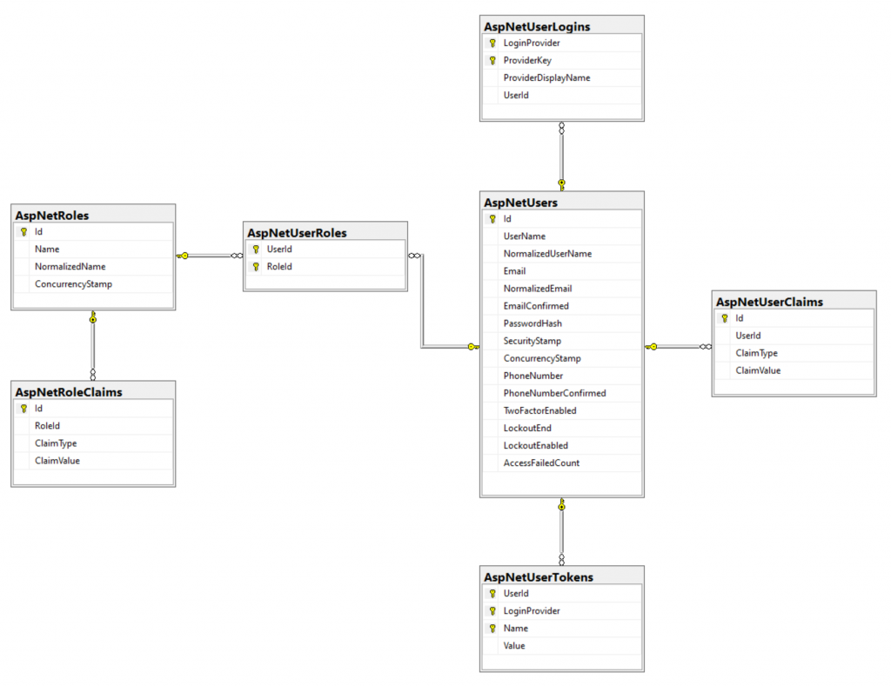
5. ER diagram
Example

Slide 11
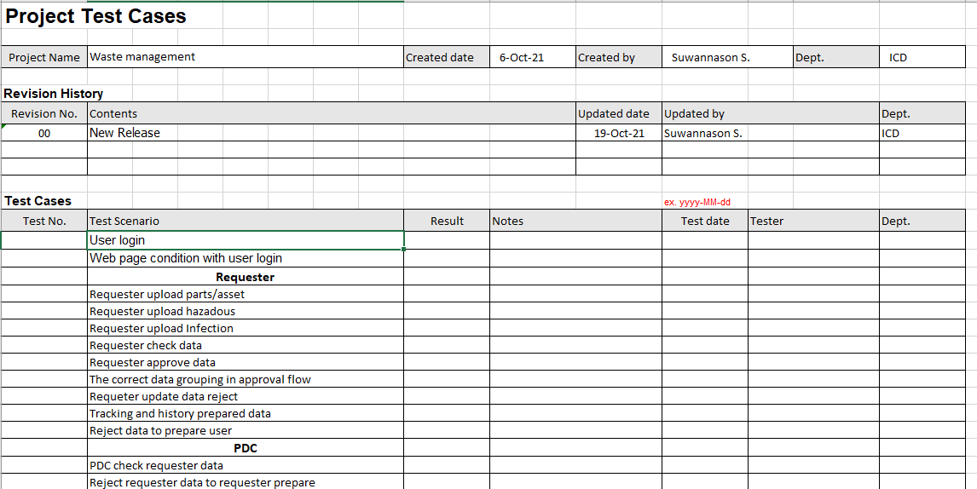
6. Test case scenarios
Example

Slide 12
7. Tools
Stack | Tool
ASP.NET Core 5 Angular jQuery | Visual Studio Code
DevExpress | Visual Studio 2019 on cptsvs545
Source Control | VisualSVN Server
Example

Slide 13
8. Location source
Source | Location
Source code | Dept/20_App/Project_name
Database location | CPTSVS52T/SQLEXPRESS; DATABASE_NAME
Web host | http://cptserver01/project_name
Api host | http://cptserver01/api/project_name
Example

Slide 14
Thank you

