Slide 1
Retail Executive Dashboard
Generated Automatically with Python

Slide 2
Executive Summary
Total Sales: $19,587,081
Total Profit: $4,450,296
Total Orders: 5,000
Average Order Value:
$3,917.42

Slide 3
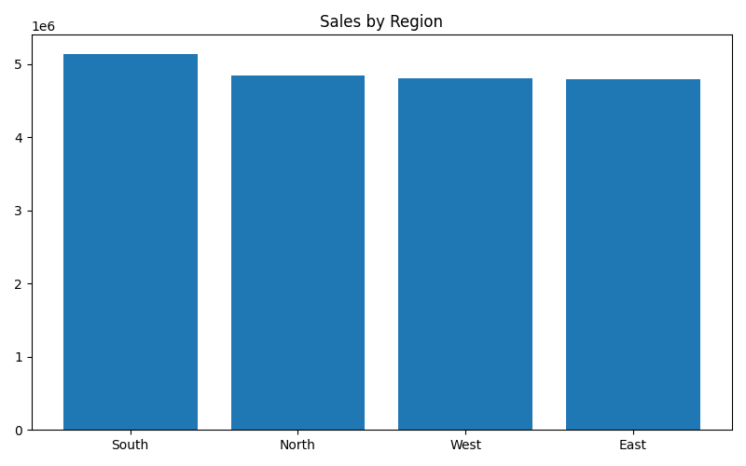
Sales by Region

Slide 4
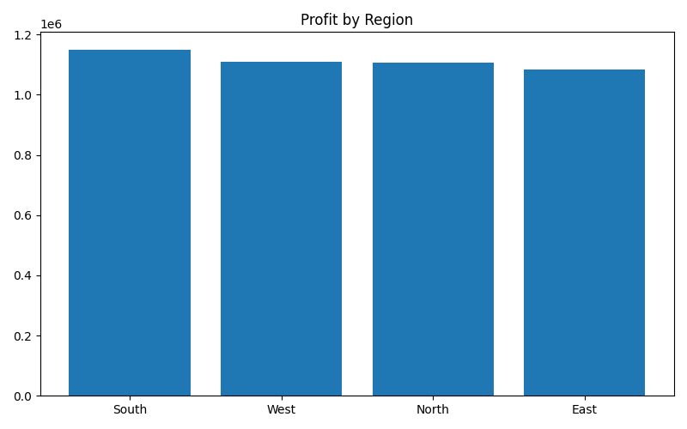
Profit by Region

Slide 5
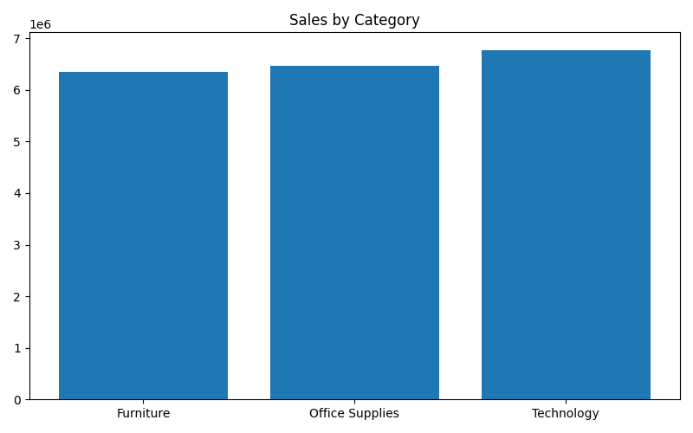
Sales by Category

Slide 6
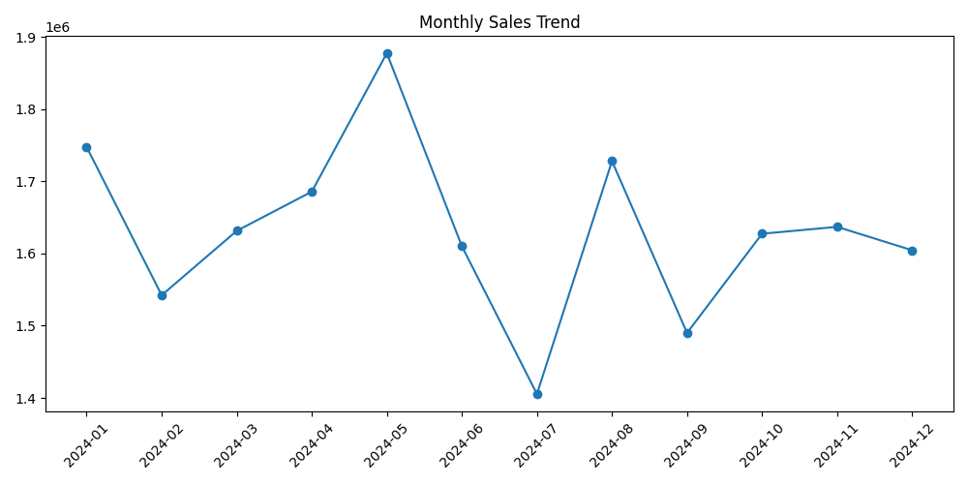
Monthly Sales Trend

Slide 7
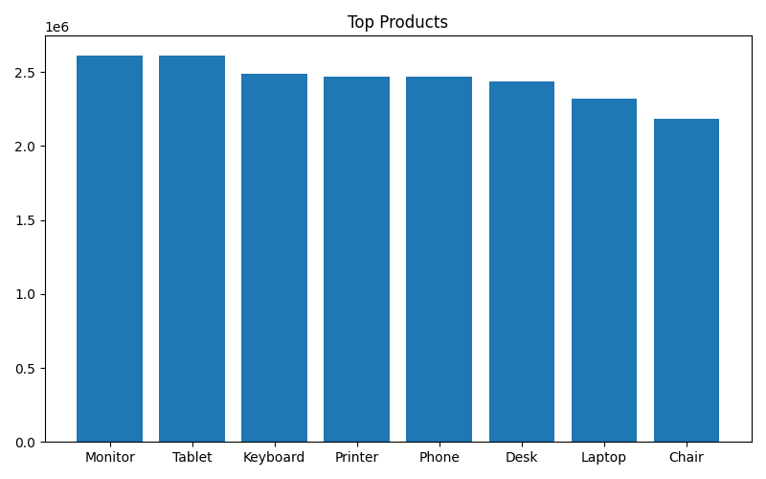
Top Products

Slide 8
Key Business Insights
Highest Revenue Region:
South
Highest Profit Region:
South
Top Selling Product:
Monitor
Revenue Generated:
$5,144,206

Slide 9
Thank You
End of Automated Executive Report

