Slide 1
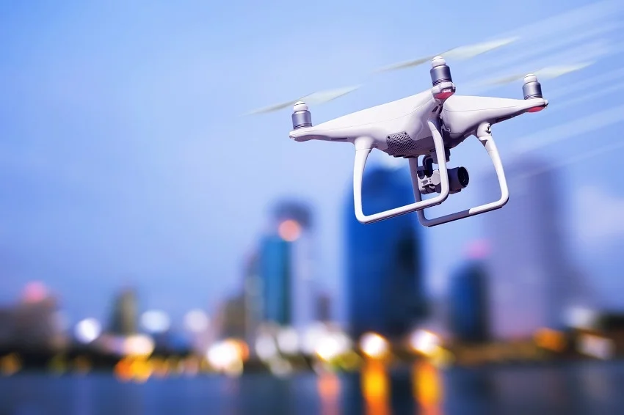

Research Task in Air Transport and Logistics
Group 4
Chair of Air Transport Technology and Logistics
Winter Semester 2025/26
09 December 2025

Slide 2
Table of Content
Provided Data
Data Cleaning & Feature Extraction
Definition of different phase of flight
Phase Segmentation
Physics Based Parameter and Equation
Efficiency and Evaluation Metrics

Slide 3
Research Topic & Motivation
Research Topic:
Energy consumption modeling for UAVs using flight data and mission parameters
Why this research?
Help to understand how speed, altitude, wind affect energy use
Safe Return-to-Home(RTH) decision
Support mission feasibility and endurance planning
How we are doing this research?
Data collection and cleaning
Use UAV flight datasets
2. Feature extraction and data segmentation
Segment flights(climb, cruise, hover, descent, taxi)
3. Model development
Build physics-based model
Build data-driven model
4. Validation & Comparison
Compare prediction using MAE, RMSE, MAPE
Notes:
Good morning every one.my name is Kanchan bansal. Our research topic is energy consumption model for UAVs using flight data and mission parameter. The goal of our research is to understand how flight parameter such as wind , altitude, speed etc affect the energy use which helps us safe to return home decision and also support mission feasibility.
How we are doing this research. First we collected the data and clean data. Then we extracted features and segmented data into differet phase . Then develop two model physics based model and data driven model at the end validate and compare the use using mean absolute error , root mean square error and mean absolute error.

Slide 4
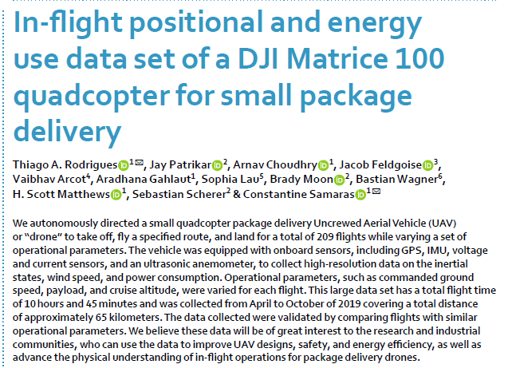
Provided Data
Given UAV Flight Data includes:
Fight number
Date and time
Predefined Altitude
Position (x,y,z directions)
Acceleration(x,y,z directions)
Orientation (x,y,z,w direction)
Battery status(voltage, current)
Wind speed and angle
Payload
Notes:
we use data set Dji Matrics 100 quadcopter which contain data of 209 flights. The data includes :

Slide 5
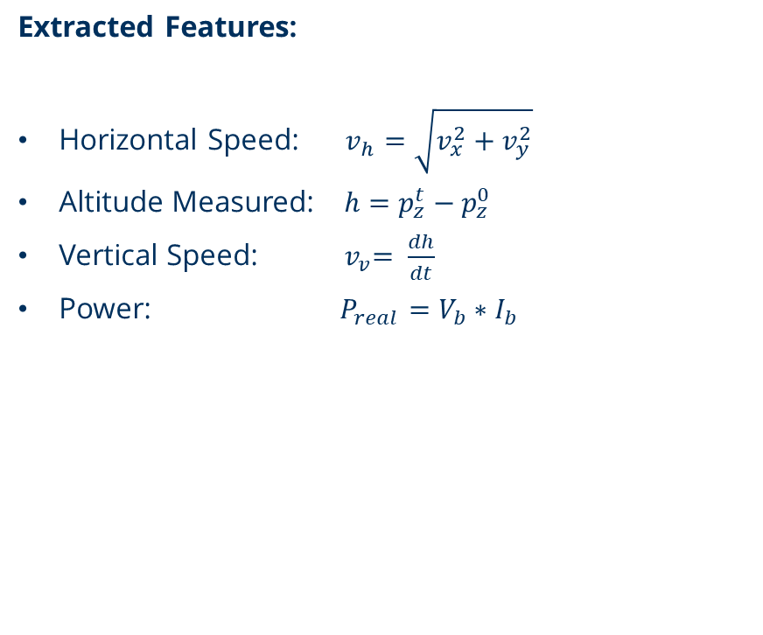
Data Cleaning & Feature Extraction
Data cleaning Steps:
Converted date + time to unified timestamps
Removed duplicates and sorted by flight and time
Applied physical limits to remove impossible values
Wind Speed > 60m/s
Battery voltage > 30V
Velocity > 50 m/s
Sanity check Results: Already clean data set and ready to use.
Notes:
First we did data cleaning for example converted the date and time in unified time stamps, remove all duplicate and immposible values such as wind speed grater than 60 m/s , battery voltagegrater than 30 v and velocity grater than 50 m/s
. Then extracted features such as horizontal spped using velocity in x and y direction and altitude using position at time stamp t minus position at time stamp 0 . Vertical velocity using derivative of altitude and power using formula voltage multiply current

Slide 6
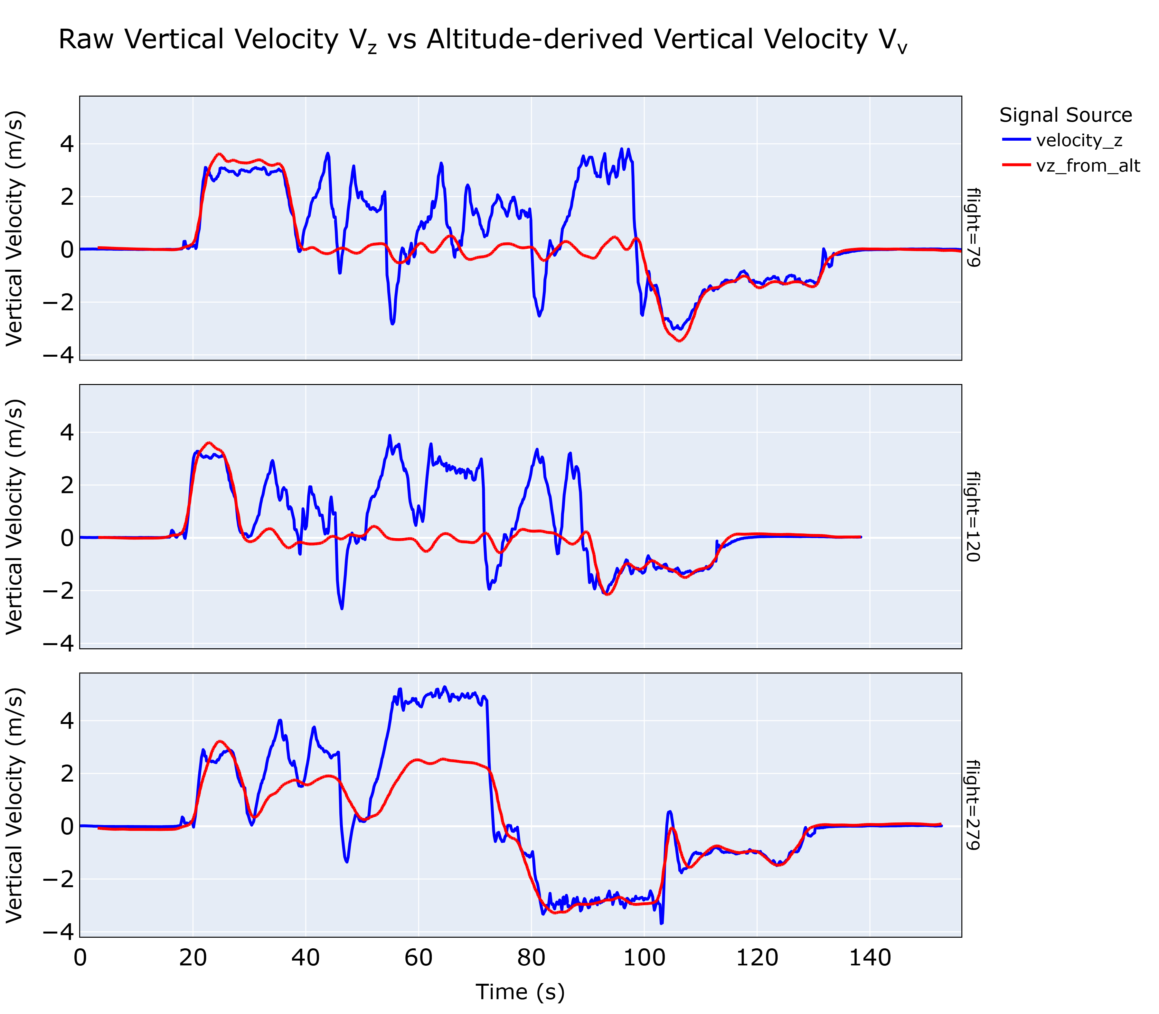
Use of vertical speed v_{v} from altitude instead of raw v_{z}
Reason:
Raw velocity v_{z} is noisy and unstable, especially in cruise phase.
Noise in v_{z} leads to incorrect phase segmentation.
v_{z} from altitude gives a physics-consistent vertical speed profile
Notes:
Why we used altitude derived vertical velocity instead of using raw velocity. We can see clearly in graph raw velocity is very noisy and unstable especially in cruise phase which lead to false phase identification. That why we decided to use altitude derived vertical velocity for our data analysis.

Slide 7
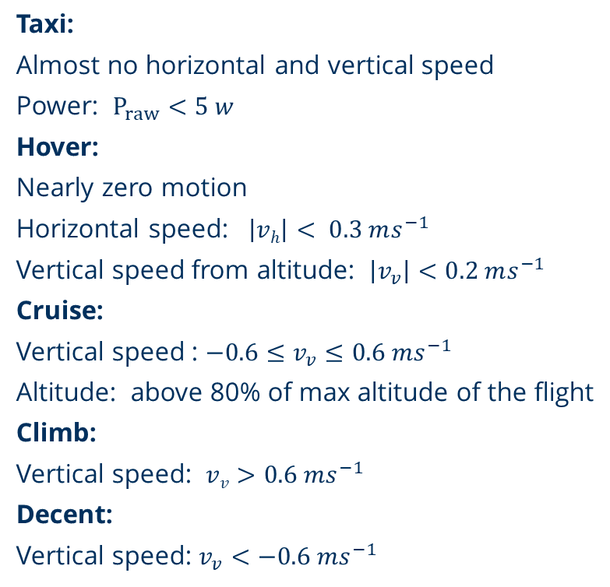
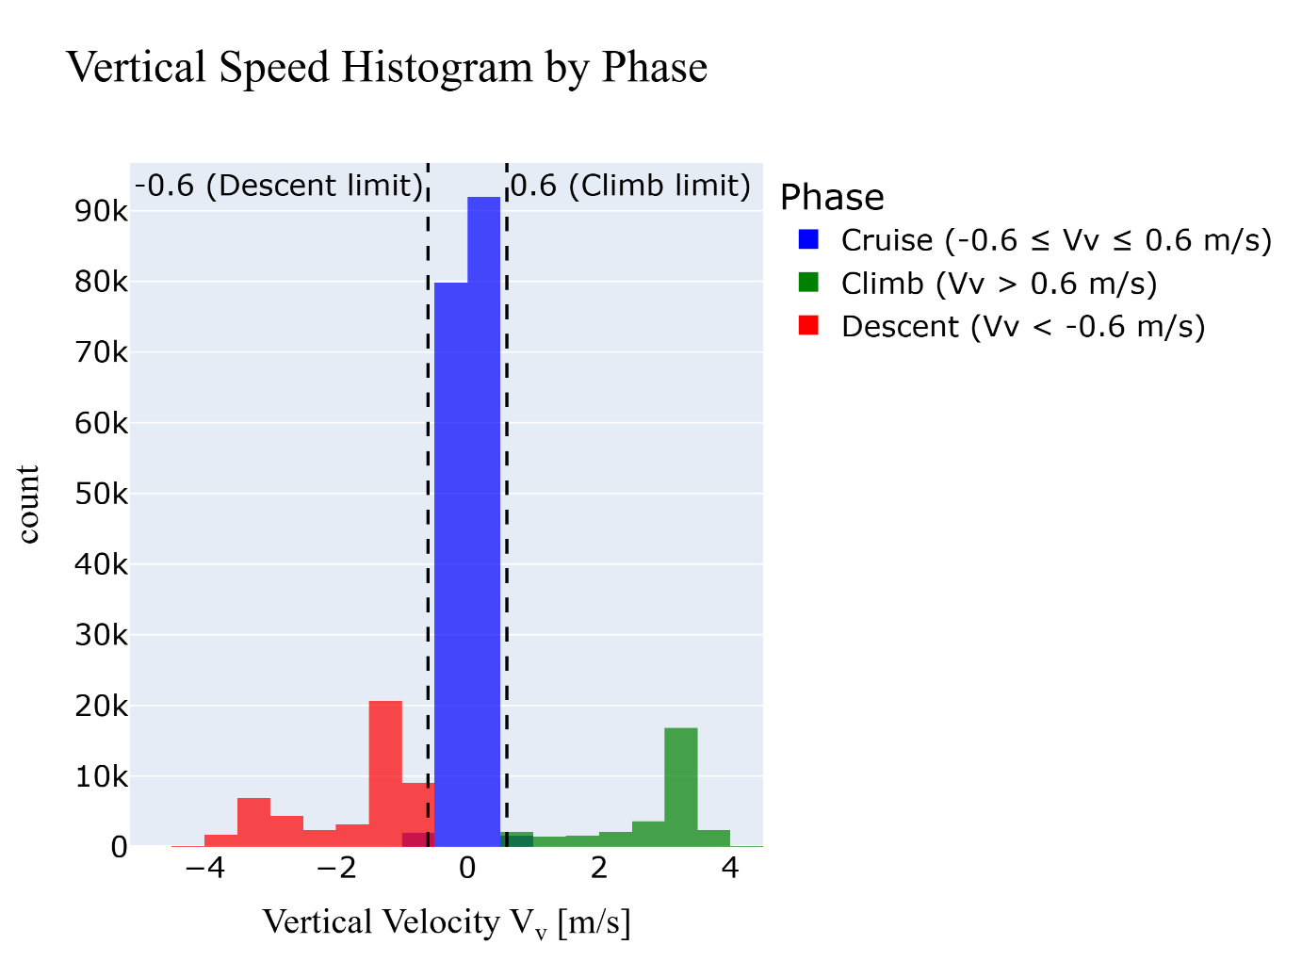

Definition of different phase of flight
Notes:
Definiton of different phases:
we define the phase using vertical velocity. The blue part in diagram which lies between the -06 to 0.6 we considered as cruise phase because in cruise phase vertical velocity is near to zero. The red part show negative value of velocity so we consider as decent part and where the velocity greater than 0.6 m/s we consider it as climb phase. We divided the taxi and hover using the power where power is less than 5v we consider it as taxi.

Slide 8
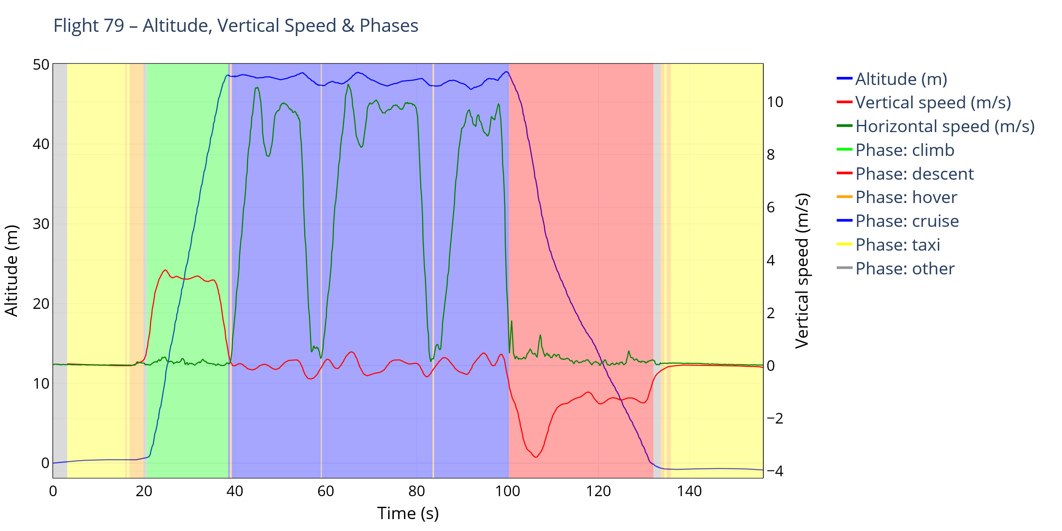
Phase Segmentation
Notes:
We can see clearly phase segmentation by graph. X axis show time in second y axis show altitude and vertical speed. Yellow colour shows taxi phase, green shows climb, blue shows cruise phase and red show descent part and orange part shows hover but the gray part show other phase. But in our data set gray part is only less then four percent.

Slide 9
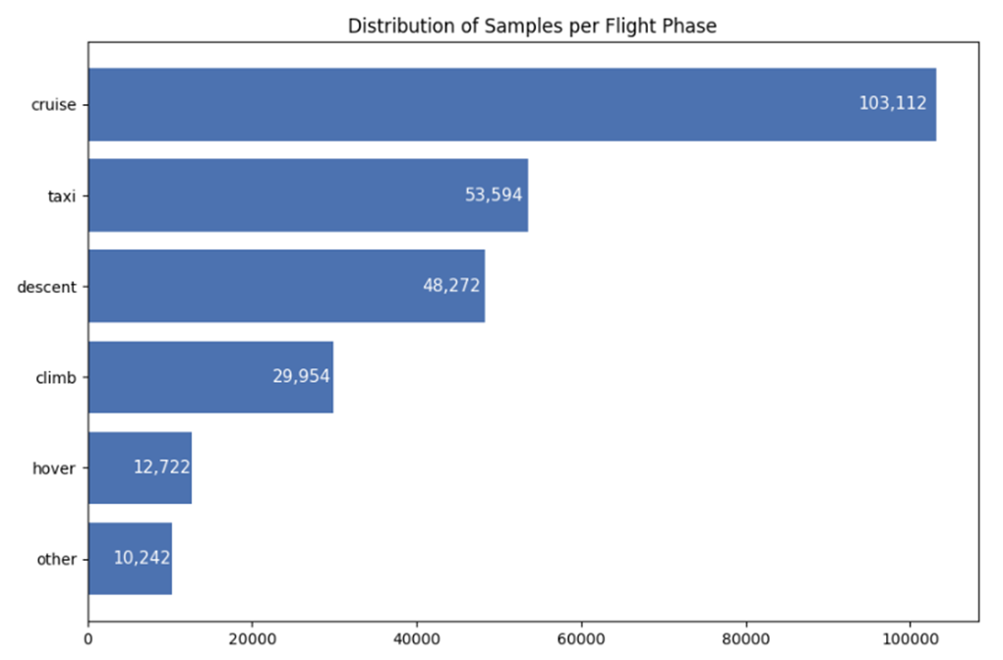
Phase segmentation distribution
Cruise dominates the dataset with more than 100k samples.
Taxi and “other” phases are excluded from physic model because they are not steady aerodynamic conditions.
Understanding this distribution is important because it shows which phases the model will be most influenced by.
Notes:
This slide shows how much data we have for each flight phase. Cruise has the most samples, which means our models will learn mostly from cruise behavior .Taxi and other phases are removed from physic model because physics formulas don’t apply there. Understanding of this distribution is important because it influences which phases the model can predict more accurately.”

Slide 10
Physics based power model development
Parameter | Symbol | Value
Gravity | g | 9.81 ms⁻²
Air Density | ρ | 1.225 kgm⁻³
Empty mass | m_{o} | 3.68 kg
Payload | p | 0, 0.25, 0.5, 0.75 kg
Total mass | M | m0 + p
Weight | W | m.g
Rotor radius | R_{prop} | 0165 m
Disk area of one rotor | A_{rot = πR2} | 0.085 m²
Total rotor area | A_{tot =} A_{rot . 4} | 0.34 m²
Parameter | Symbol | Value
Drag coefficient | C_{d} | 0.85
Reference frontal area | S_{ref} | 0.07 m²
Wind speed | v_{wind} | Data set
Wind angle | θ | Data set
Wind in x-direction | w_{x} | - v_{wind} .cos(θ)
Wind in y direction | w_{y} | -v_{wind} sin(θ)
Notes:
First we defined our parameter : such as gravity, air density empty mass take from Dji 100 matrix manual and payload is given in data. The drag cofficent value is taken from research paper and wind speed and wind angle from data set and wind in x direction and y direction are calculated by using wind spped and wind angle.

Slide 11
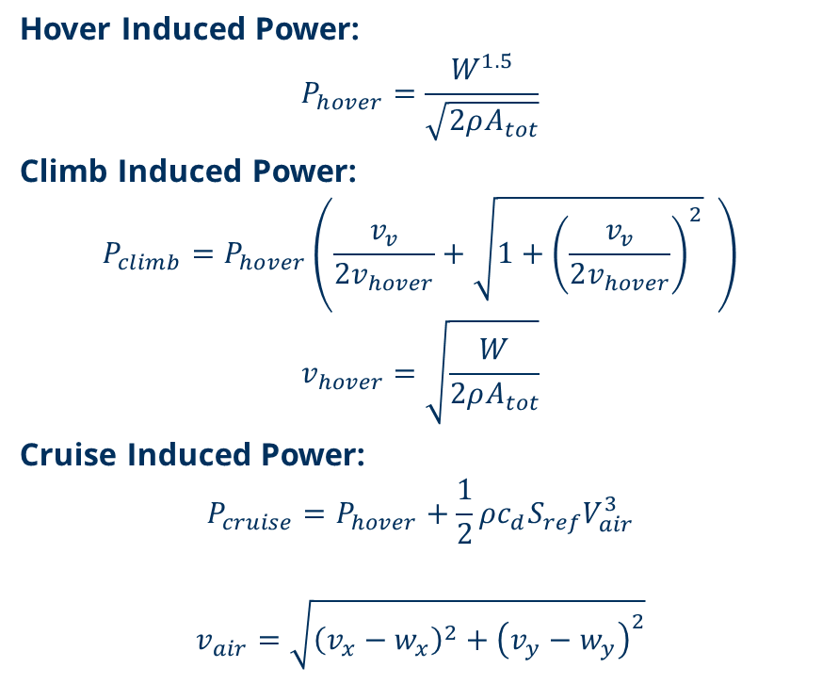
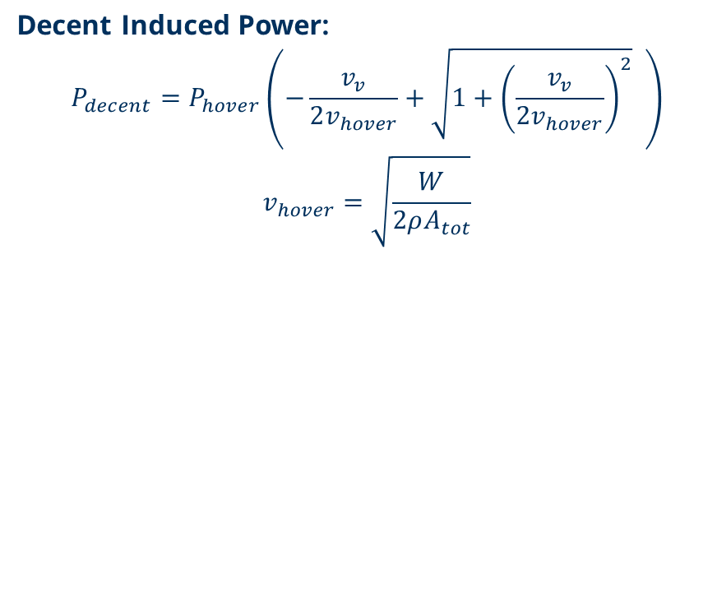
Physics equations for different phases
Phase | Sample | Mean Power (w) | Min Power (w) | Max Power (w)
Hover | 12722 | 252.07 | 236.92 | 312.92
Climb | 29954 | 321.79 | 248.01 | 405.35
Decent | 48272 | 231.11 | 170.79 | 300.04
Cruise | 103112 | 300.52 | 236.92 | 773.26
Notes:
Next part was prepared by my teammate Phoebe. Unfortunately she fell ill last night and had to be hospitalized . There fore i am presenting her part today.
Next Physic equation for different phases. As we know each flight phase has different aerodynamic requirements, so we use different equations. For example, “During hover, the rotors must generate thrust equal to the aircraft’s weight, and climb includes additional power to overcome gravity, “Cruise is equal to hover power plus the extra power needed to overcome drag while flying forward.” and “Descent needs less power due to gravity These physics equations give us a theoretical baseline for how much energy the UAV should consume under ideal conditions. “The table summarizes average power use in different flight phases. Climb consumes the most power, descent the least.

Slide 12
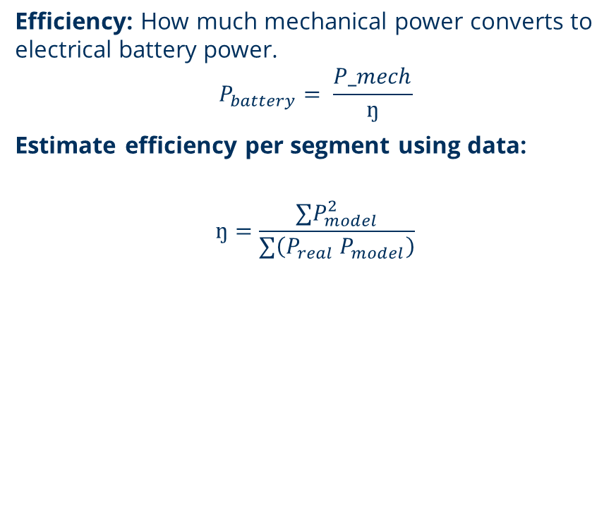
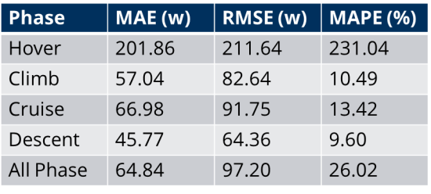
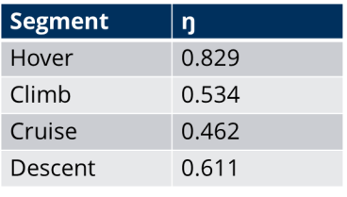
Efficiency and evaluation Metrics
Mean Absolute Error(MAE):
Shows how far predicted power is from real power
Root Mean square Error(RMSE):
Shows how big error between model and real power
Mean Absolute Percentage Error (MAPE):
Measures accuracy in percent (%)
Notes:
Next efficiency is calculated by comparing model power to real power
We used the least squres liner regression to find best value of efficiency for each phase.
We fit a straight line through all the data points and slop of that line give us value of eta for each phase.
As a result we can see hover has high erorr. We can say that Model performs poorly in hover phase.
But climb, cruise and decent error are much lower.
Overall error is only 26 percent showing model perform good but not perfect.

Slide 13
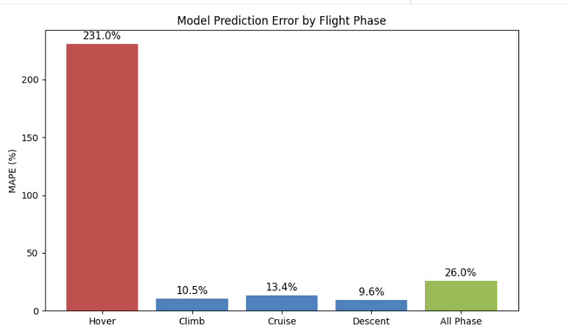
Discussion
Hover is the most unstable phase
UAV continuously adjusts roll, pitch, and yaw to maintain position.
High sensitivity to wind & turbulence
Even small gusts cause large power fluctuations (±50–120 W).
Ideal physics model underestimates hover power. Hover formula does not include:
Rotor profile power
Wind effects
Real hover power is much higher than theoretical hover power → Results in large prediction errors
Notes:
Now question arises why hover has highst error?
Becuase uav contantly adust roll, pitch, yaw to maintain positon . even small gusts cause large power fluctuations . Our physic equation does not consider Rotor profile power and wind effect.

Slide 14
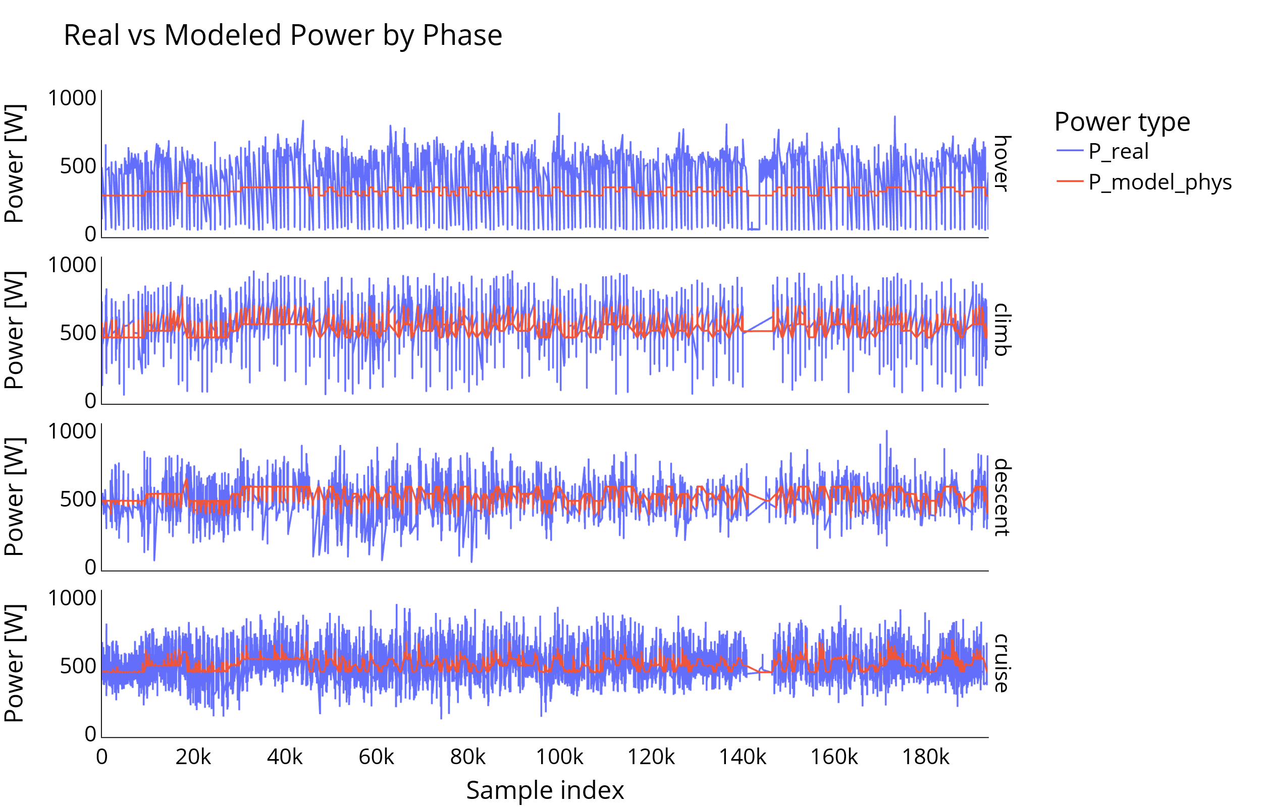
Real Power vs Model Power
Notes:
The diagram show real power and physic model power. Blue line show real power and red line show model power. In hover we can seen red line is smother and and lower then real power . This show model underestimate hover power . In other phases the model prediction follows the real power more closely.

Slide 15
References
Abeywickrama, H., Jayawickrama, B. A., Chathuranga, D., & Munasinghe, S. (2018). Comprehensive modeling of quadrotor energy consumption. International Journal of Aerospace Engineering, 2018, 1–16.
Bangura, M., & Mahony, R. (2014). Real-time model predictive control for quadrotors. Australasian Conference on Robotics and Automation.
DJI. (2015). Matrice 100 specification sheet
Dorling, K., Heinrichs, J., Messier, G. G., & Magierowski, S. (2017). Energy consumption model for UAV flight. IEEE Transactions on Vehicular Technology, 66(1), 376–385.
Gupta, L., Jain, R., & Vaszkun, G. (2016). Survey of important issues in UAV communication networks. IEEE Communications Surveys & Tutorials, 18(2), 1123–1152.
Hossen, M., et al. (2021). Deep learning-based UAV power consumption prediction. IEEE Access, 9, 134662–134673.
Leishman, J. G. (2006). Principles of helicopter aerodynamics (2nd ed.). Cambridge University Press.
Liu, X., et al. (2020). Machine learning models for UAV energy estimation. Sensors, 20(18), 5152.

Slide 16
Thank You

