Slide 1
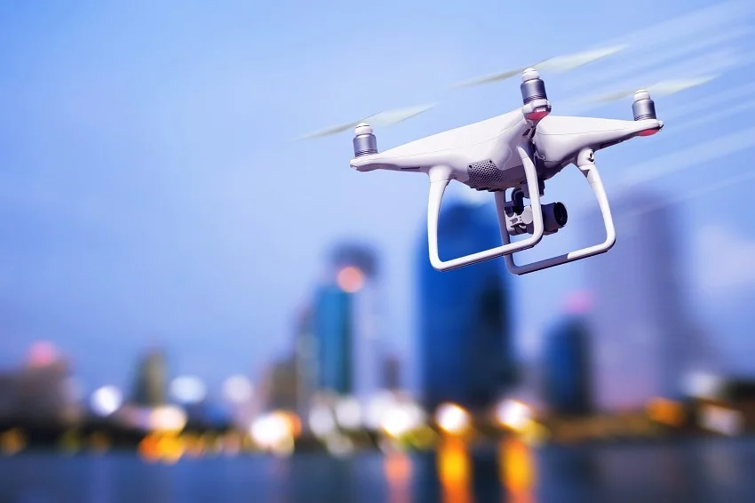
Research Task in Air Transport and Logistics
GROUP 4
Chair of Air Transport Technology and Logistics
Winter Semester 2025/26
11 November 2025

Slide 2
Table of Contents
Literature Review
Research Framework and Methodology
Drone Characteristics
Expected Outcome
Reference

Slide 3
LITERATURE REVIEW
Key Findings from Prior Research:
UAV energy consumption is influenced by thrust, drag, altitude, payload, speed and climb rate.
Different flight phases (climb, cruise, hover, descent) exhibit different power profiles
2. Modeling Approaches in Literature
Physics–Based Model ¹ : Equations derived from an air taxi performance study; parameters from public data sources.
Data-Driven Model : Machine learning methods such as Random Forest, Linear Regression and Neural Network for comparison and validation.

Slide 4
RESEARCH FRAMEWORK AND METHODOLOGY
Models
UAV Dataset M100
Mavic 3E/3T
Data Analysis Feature Extraction
Physics-based Energy Model
Data-driven Model
Application Demonstration
Comparison Validation

Slide 5
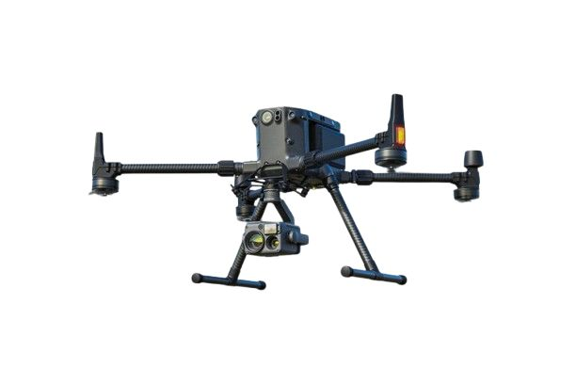
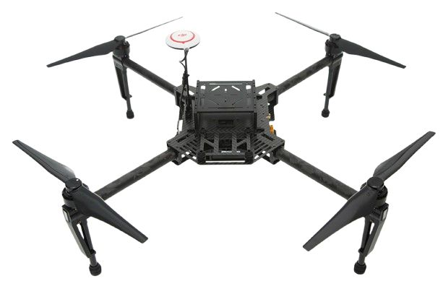
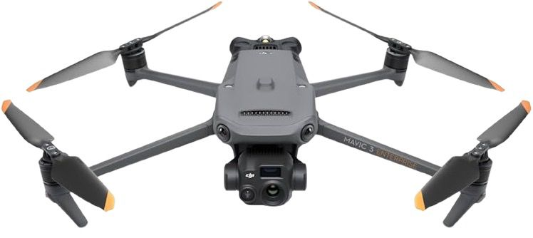
DRONE CHARACTERISTICS
MODEL | UAV | ROLE | WEIGHT | FLIGHT TIME | REMARK
 | M100 | Physical model base | 2.3 kg | 22 min | Modular, research-grade UAV
 | M300 | Validation (AI model) | 6.3 kg | 45 min | Too heavy, high power demand
 | Mavic 3T | Validation (AI model) | 0.92 kg | 55 min | Lightweight, efficient, ideal for testing

Slide 6
EXPECTED OUTCOME
Through this research, our aim to achieve the following outcomes:
A validated physics-based UAV energy model developed using DJI M100 flight data.
A data-driven model trained on M100 and validated using other model data to evaluate cross-UAV generalization.
Comparative performance analysis using MAE, RMSE and MAPE.
Identification of dominant flight parameters influencing UAV energy consumption (especially during cruise).
Demonstration of how the models can support energy-aware UAV mission planning and Return-To-Home decision logic.

Slide 7
REFERENCES
https://www.researchgate.net/publication/354887685_Air_taxi_flight_performance_modeling_and_application
https://datashare.tu-dresden.de/s/EYAHRBXCiqy8t7A
https://kilthub.cmu.edu/articles/dataset/Data_Collected_with_Package_Delivery_Quadcopter_Drone/12683453
https://dl.djicdn.com/downloads/m100/M100_User_Manual_EN.pdf
https://link.springer.com/article/10.1007/s11227-025-07105-0

