Slide 1
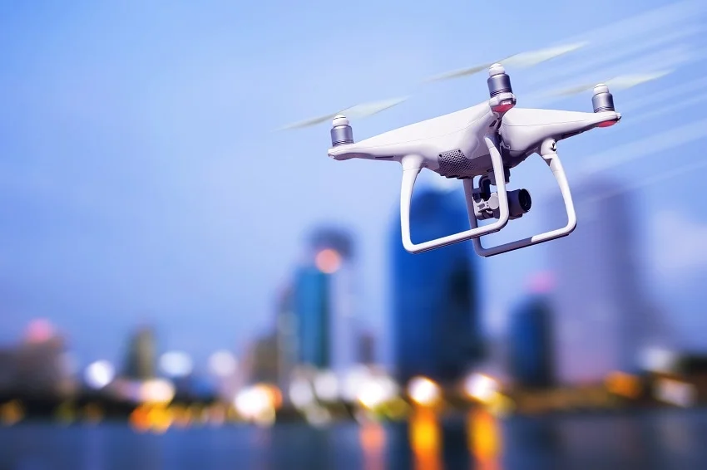

Research Task in Air Transport and Logistics
Group 4
Chair of Air Transport Technology and Logistics
Winter Semester 2025/26
30 January 2025

Slide 2
Table of Content
Provided Data
Data Cleaning & Feature Extraction
Definition of Phases of Flight
Phase Segmentation
Physics Based Model
Data Driven Model
Model Validation and Comparison
Feasibility Check

Slide 3
Research topic & motivation
Research Topic:
Energy consumption modeling for UAVs using flight data and mission parameters
Why this research?
Help to understand how speed, altitude, wind affect energy use
Safe Return-to-Home(RTH) decision
Support mission feasibility and endurance planning
How we did this research?
Data collection and cleaning
Use UAV flight datasets
2. Feature extraction and data segmentation
Segment flights(climb, cruise, hover, descent, taxi)
3. Model development
Build physics-based model
Build data-driven model
4. Validation & Comparison
Compare prediction using MAE, RMSE, MAPE
Mission feasibiliy check
Notes:
Good morning every one.my name is Kanchan bansal. Our research topic is energy consumption model for UAVs using flight data and mission parameter. The goal of our research is to understand how flight parameter such as wind , altitude, speed etc affect the energy use which helps us safe to return home decision and also support mission feasibility.
How we are doing this research. First we collected the data and clean data. Then we extracted features and segmented data into differet phase . Then develop two model physics based model and data driven model at the end validate and compare the use using mean absolute error , root mean square error and mean absolute error.

Slide 4
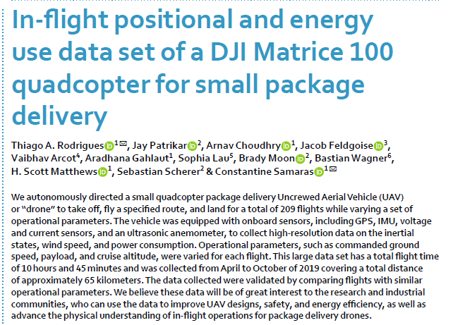
Provided data
Given UAV Flight Data includes:
Fight number
Date and time
Predefined Altitude
Position (x,y,z directions)
Acceleration(x,y,z directions)
Orientation (x,y,z,w direction)
Battery status(voltage, current)
Wind speed and angle
Payload
Notes:
we used data set Dji Matrics 100 quadcopter which contain data of 209 flights. The data includes :

Slide 5

Data cleaning & feature extraction
Data cleaning Steps:
Converted date + time to unified timestamps
Removed duplicates and sorted by flight and time
Applied physical limits to remove impossible values
Wind Speed > 60m/s
Battery voltage > 30V
Velocity > 50 m/s
Sanity check Results: Already clean data set and ready to use.
Extracted Features:
Horizontal Speed: $V_{h}=\sqrt{v_{x}^{2}+v_{y}^{2}}$
Height: $h=p_{z}^{t}−p_{z}^{0}$
Vertical Speed: $v_{v}=\frac{dh}{dt}$
Power : $P=V∗I$

Slide 6
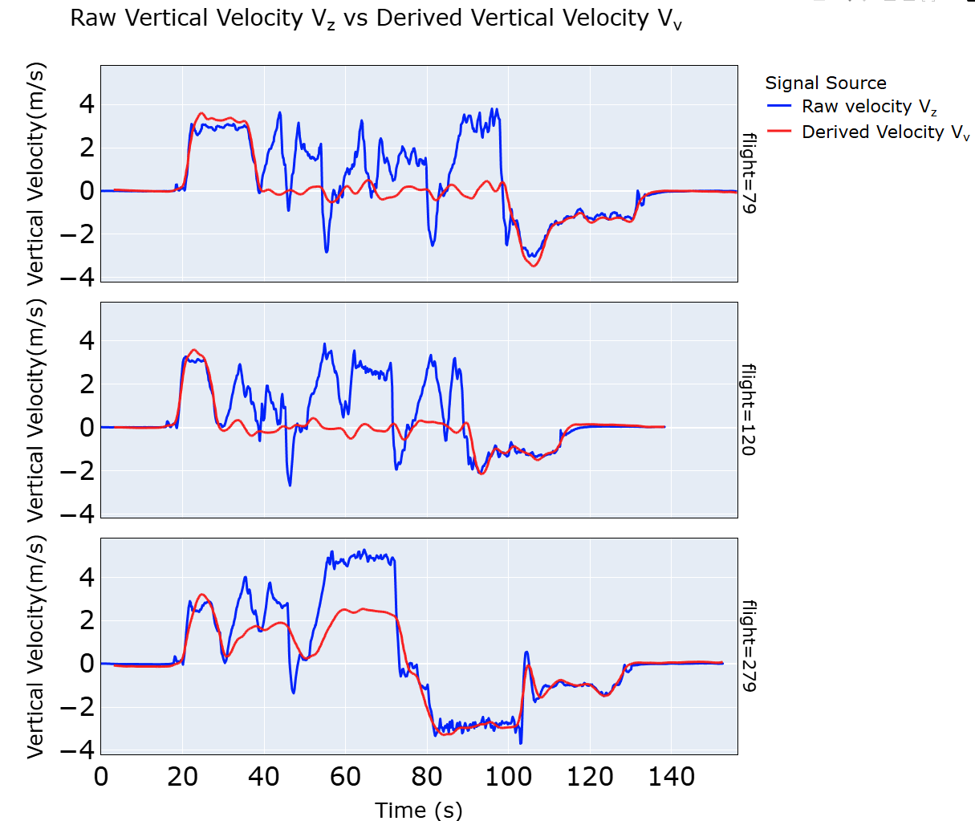
Use of derived vertical velocity v_{v} instead of raw velocity
Reason:
Raw velocity v_{z} is noisy and unstable, especially in cruise phase.
Noise in v_{z} leads to incorrect phase segmentation.
v_{v} gives a physics-consistent vertical speed profile
Notes:
Why we used altitude derived vertical velocity instead of using raw velocity. We can see clearly in graph raw velocity is very noisy and unstable especially in cruise phase which lead to false phase identification. That why we decided to use altitude derived vertical velocity for our data analysis.

Slide 7
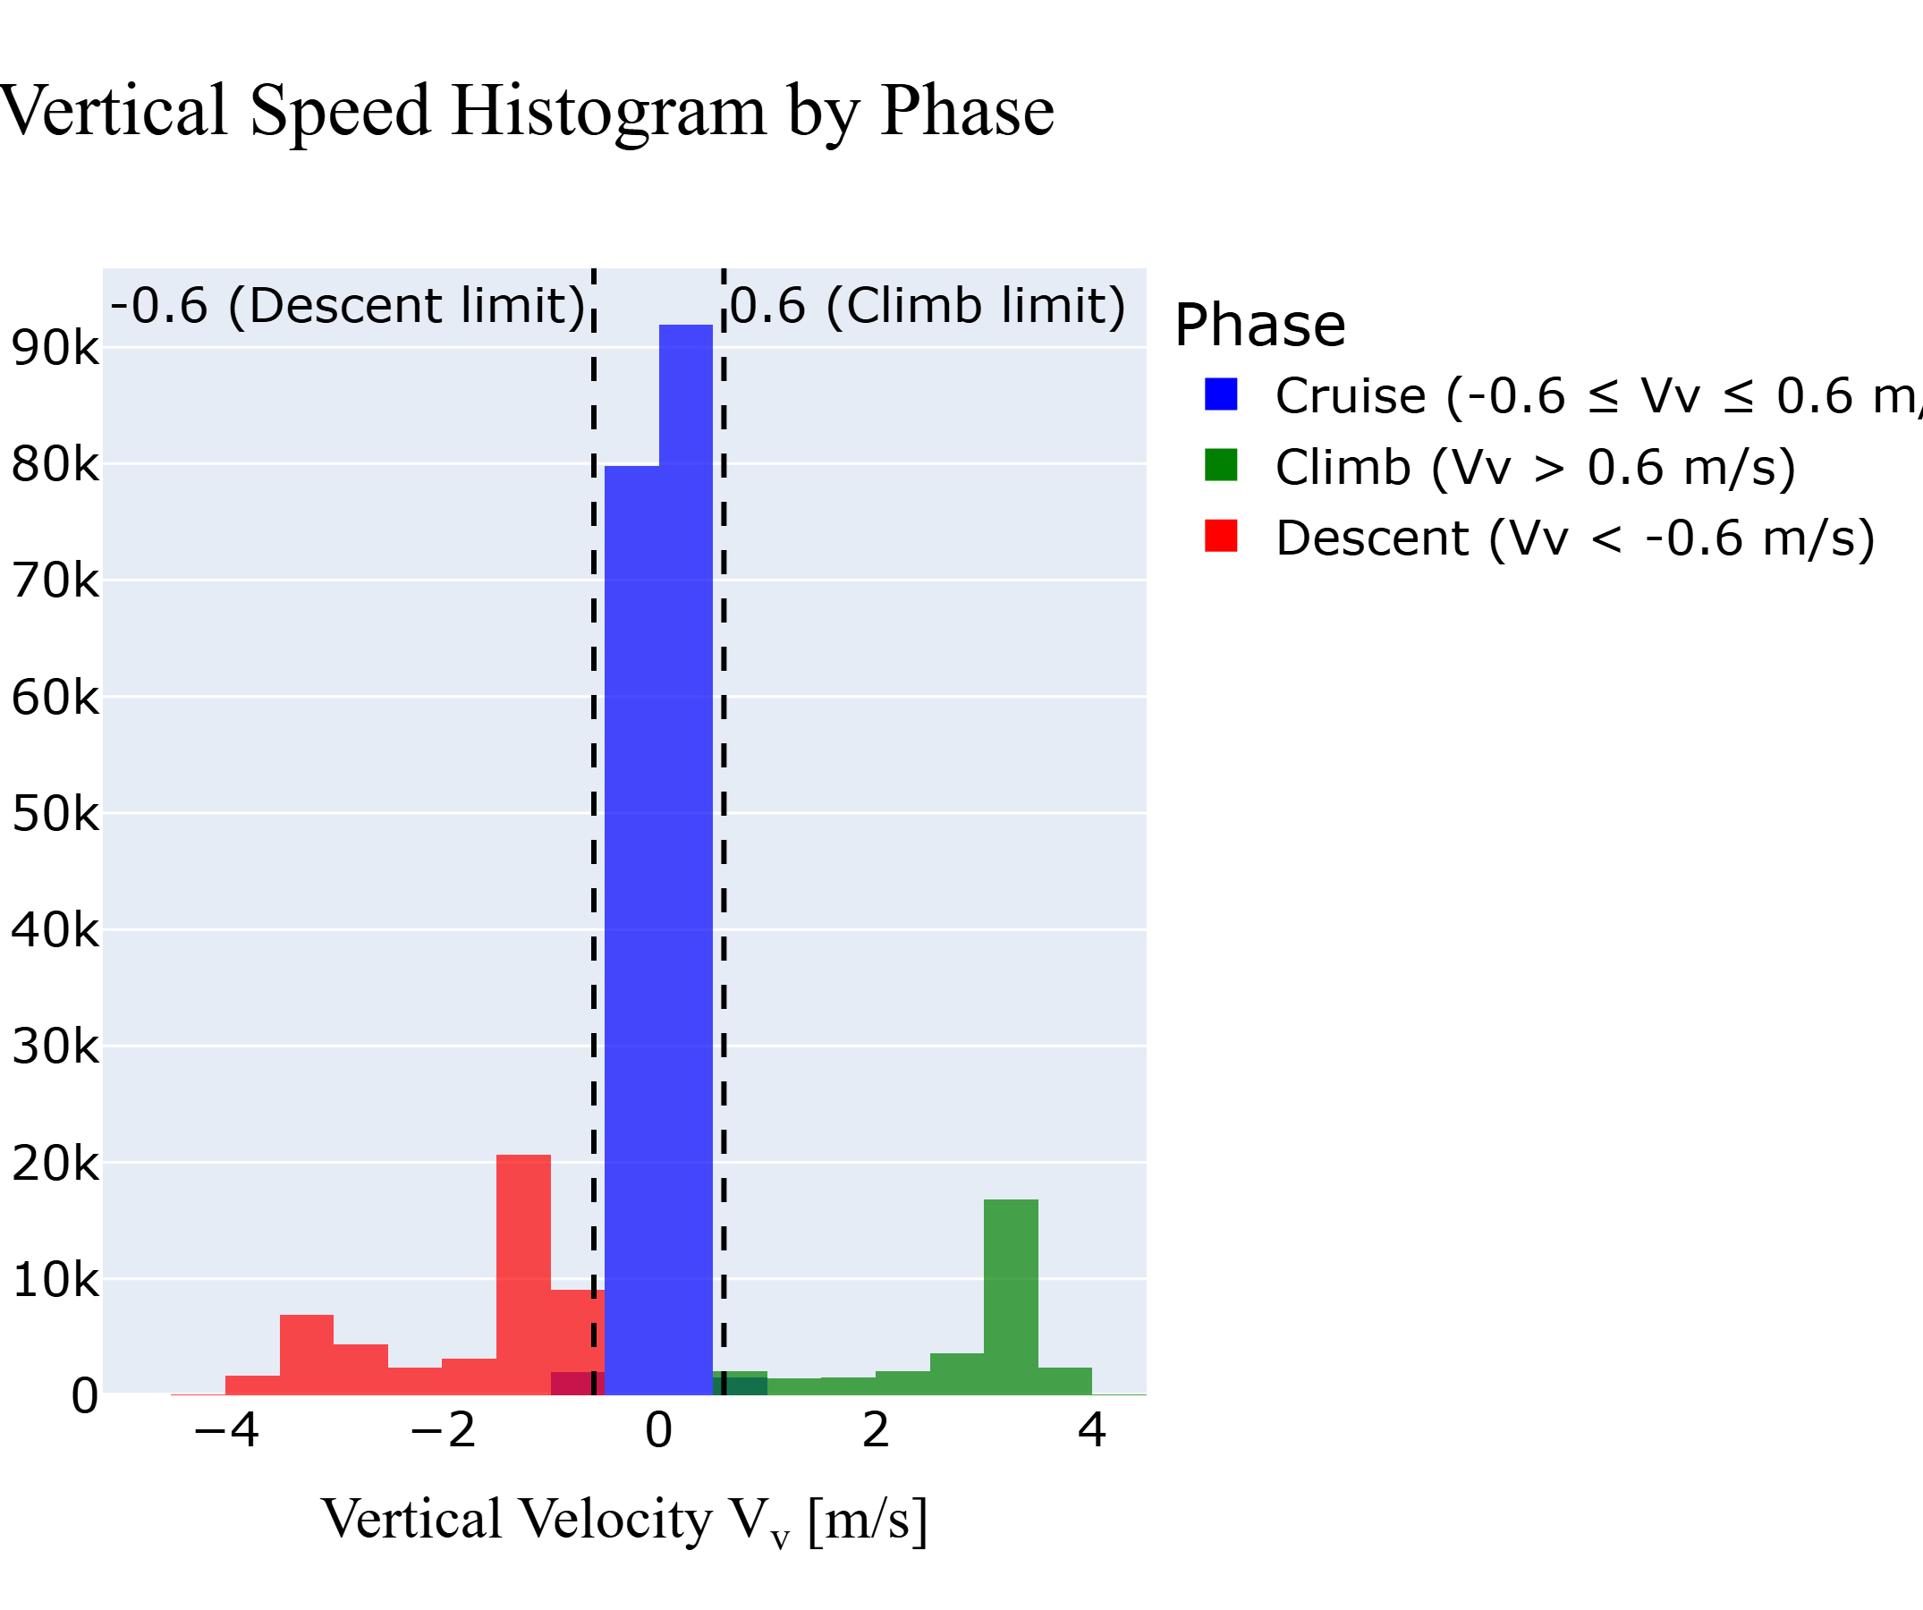
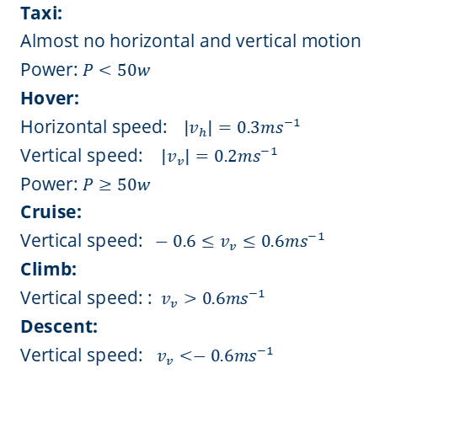
Definition of different phase of flight
Taxi:
Almost no horizontal and vertical motion
Power: $P<50w$
Hover:
Horizontal speed:$|v_{h}|=0.3ms^{−1}$
Vertical speed: $|v_{v}|=0.2ms^{−1}$
Power: $P≥50w$
Cruise:
Vertical speed: $−0.6≤v_{v}≤0.6ms^{−1}$
Climb:
Vertical speed: : $v_{v}>0.6ms^{−1}$
Descent:
Vertical speed: $v_{v}<−0.6ms^{−1}$

Slide 8
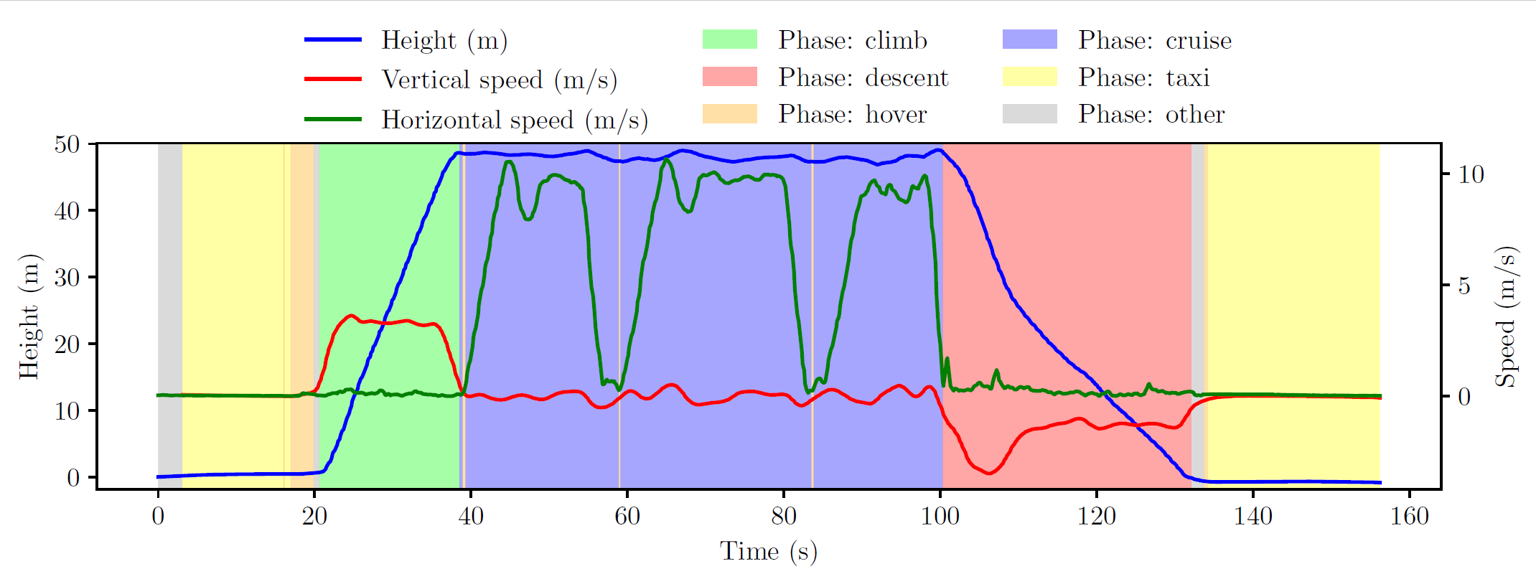
Phase segmentation (flight 79)
Notes:
We can see clearly phase segmentation by graph. X axis show time in second y axis show altitude and vertical speed. Yellow colour shows taxi phase, green shows climb, blue shows cruise phase and red show descent part and orange part shows hover but the gray part show other phase. But in our data set gray part is only less then four percent.

Slide 9
Physics based power model development
Parameter | Symbol | Value
Gravity | g | 9.81 ms⁻²
Air Density | ρ | 1.225 kgm⁻³
Takeoff mass | m_{o} | 3.68 kg
Payload | p | 0, 0.25, 0.5, 0.75 kg
Total mass | M | m0 + p
Weight | W | m.g
Rotor radius | R_{prop} | 0.165 m
Disk area of one rotor | A_{rot = πR2} | 0.085 m²
Total rotor area | A_{tot =} A_{rot . 4} | 0.34 m²
Parameter | Symbol | Value
Drag coefficient | C_{d} | 0.32
Reference frontal area | S_{ref} | 0.06 m²
Wind speed | v_{wind} | Data set
Wind angle | θ | Data set
Wind in x-direction | w_{x} | - v_{wind} .cos(θ)
Wind in y direction | w_{y} | -v_{wind} sin(θ)
Notes:
Now I will move on to the physics-based power model used in this study.
The goal of this model is to estimate the UAV’s power consumption using physical principles and flight parameters. First, we define the physical constants and UAV parameters.The empty mass of the DJI Matrice 100 is 3.68 kilograms, and the payload varies between 0 and 0.75 kilograms depending on the flight.
This allows us to compute the total mass and the corresponding weight for each time step. each with a radius of 0.165 meters.
From this, the rotor disk area is calculated, resulting in a total rotor area of 0.34 square meters.

Slide 10
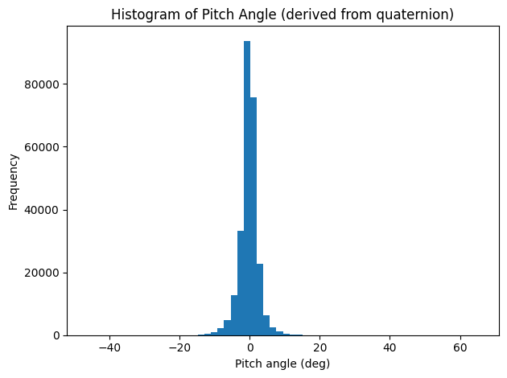
Physics based power model development
Pitch angle:
Derived from onboard quaternion data
orientation_x / y / z / w (from dataset)
Strongly concentrated around 0°
Indicates near-level attitude during flight
→ Cd = 0.32 adopted for ~0° fuselage pitch,
consistent with literature on near-level multirotor flight.
Histogram of Pitch Angle:
Notes:
Here we analyze the pitch angle derived from the onboard quaternion data.
As shown in the histogram, the pitch angle is strongly concentrated around zero degrees, indicating that the UAV operates predominantly in a near-level attitude.
Therefore, it is appropriate to adopt a drag coefficient corresponding to a fuselage pitch angle close to zero.
In this work, a value of Cd equals 0.32 is selected, consistent with published aerodynamic studies of multirotor UAVs.

Slide 11
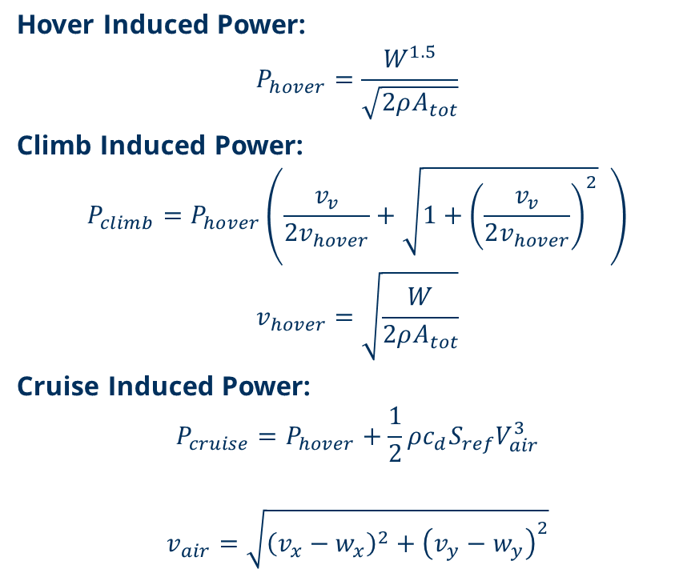
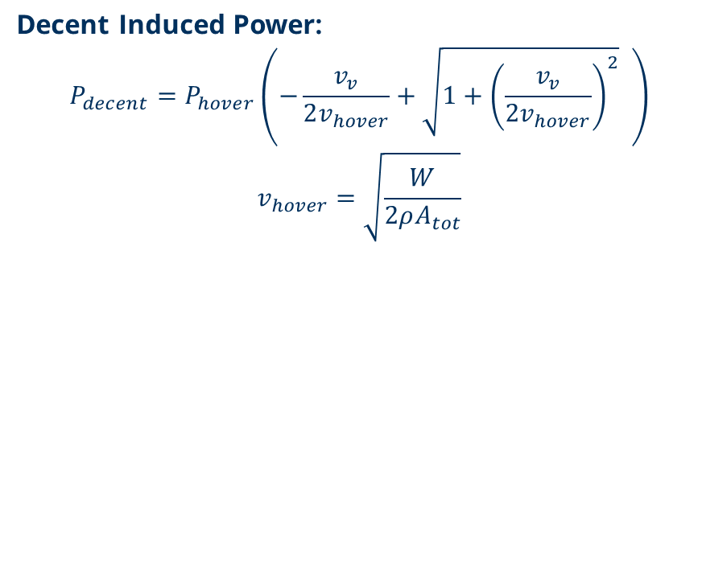
Physics equations for different phases
Notes:
Next Physic equation for different phases. As we know each flight phase has different aerodynamic requirements, so we use different equations. For example, “During hover, the rotors must generate thrust equal to the aircraft’s weight, and climb includes additional power to overcome gravity, “Cruise is equal to hover power plus the extra power needed to overcome drag while flying forward.” and “Descent needs less power due to gravity These physics equations give us a theoretical baseline for how much energy the UAV should consume under ideal conditions. “The table summarizes average power use in different flight phases. Climb consumes the most power, descent the least.

Slide 12
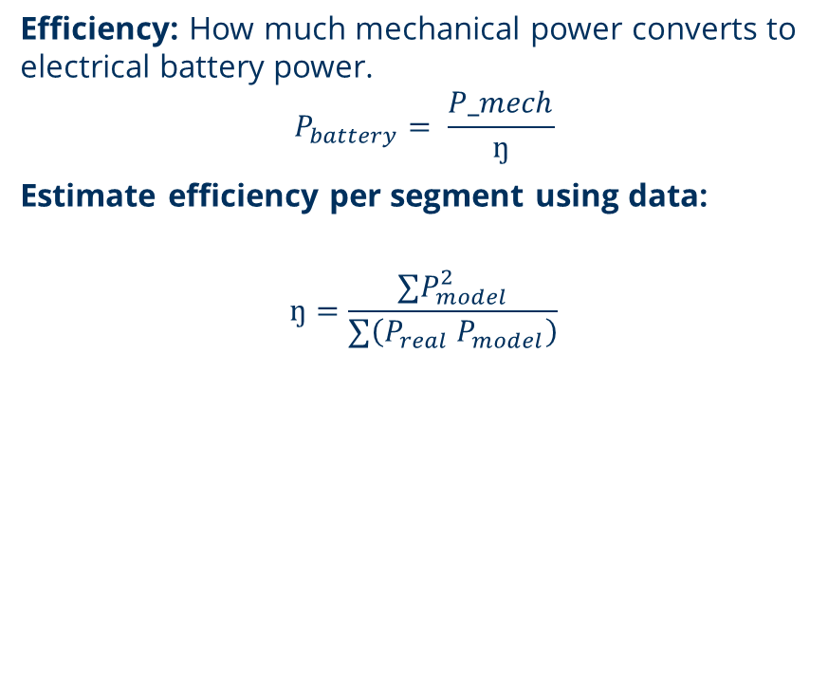
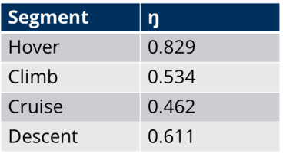
Efficiency and evaluation metrics
Root Mean square Error(RMSE):
Shows how big error between model and real power
Mean Absolute Error(MAE):
Shows how far predict power is from real power
Mean Absolute Percentage Error (MAPE):
Measures accuracy in percent (%)
Segment | MAE (W) | RMSE (W) | MAPE (%)
Hover | 185.36 | 196.14 | 84.86
Climb | 56.99 | 82.64 | 10.48
Decent | 45.71 | 64.36 | 9.58
Cruise | 54.79 | 73.81 | 11.01
All Phase | 59.33 | 83.53 | 14.24
Notes:
Hover exhibits the highest efficiency because the rotors operate close to their optimal design point with minimal aerodynamic drag, whereas cruise and climb require additional power to overcome drag and produce higher thrust, leading to increased propulsion losses.

Slide 13
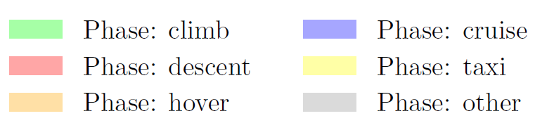
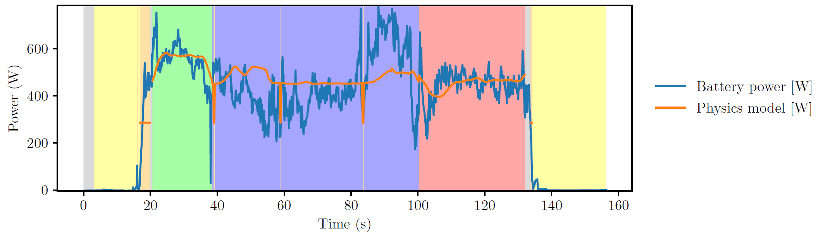
Representation of physic model (flight 79)
Notes:
This slide shows a comparison between real battery power and the physics-based model for flight 79.
The blue line is the measured battery power from the UAV.
The orange line is the power predicted by the physics model.
The background colors show different flight phases, such as climb, cruise, descent, hover, and taxi.
During the climb phase, the model follows the general increase in power quite well.
In the cruise phase, the model gives a smooth and stable power value.
It does not follow all small fluctuations, but it matches the average power level.
During descent, the predicted power decreases, which is consistent with the real data.
The biggest difference appears in the hover phase, where the real power changes very quickly.
The physics model cannot capture these fast changes.
Overall, this figure shows that the physics-based model can describe the general power trend, but it is less accurate for fast and dynamic behaviors, especially during hover.

Slide 14
Data driven energy model
Method/Technique:
Random Forest Regression
Why Random Forest?
Capture nonlinear relationships
Well suited for tabular data
Performs reliably with limited datasets
Provide feature importance
Robust to noise and outliers
How to use:
Use Scikit-learn library
Train model using 80% data
Validate model using 20% data
Feature use:
Horizontal and vertical speed
Linear acceleration (x,y,z)
Angular acceleration(x,y,z)
wind speed and wind angle
Payload mass
Flight phase (climb, cruise, descent, hover)
Attitude (roll, pitch, yaw)
Height change

Slide 15
Outcomes
Feature analysis:
To understand which input parameters drive model’s predictions
To verify that model follows UAV flight physics
To ensure model is reliable for mission planning
Error Evaluation:
Low prediction error across cruise, climb, descent
Hight variability during hover
Overall prediction error is below 10%
Phase | MAE | RMSE | MAPE (%)
Cruise | 31.8 | 42.9 | 6.4
Climb | 28.8 | 41.2 | 5.4
Decent | 28.1 | 41.6 | 6.4
Hover | 43.3 | 71.1 | 20
All Phase | 31 | 44.2 | 6.9
Parameter | Relative importance (%)
Vertical velocity | 25
Payload mass | 16
Vertical acceleration | 15
Hover Phase Indicator | 8

Slide 16
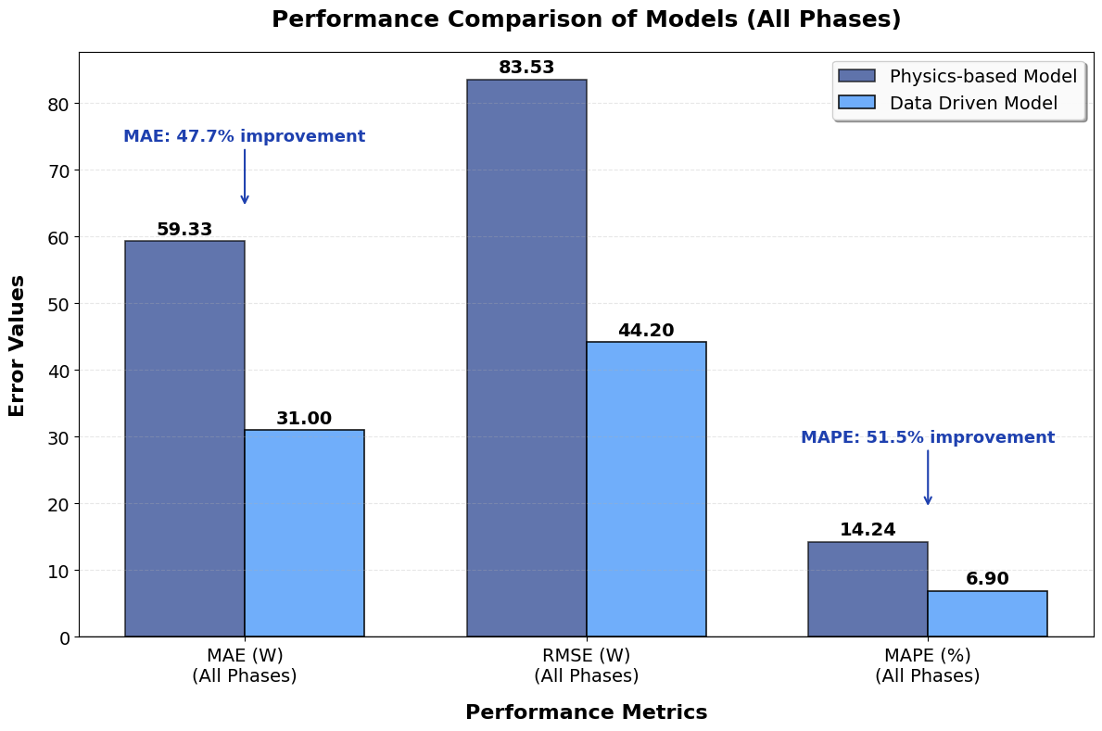
Model comparison
Physics-Based Model Results:
Mean Absolute Error: 59 watts
Root Mean Square Error : 84 watts
Mean Absolute Percentage Error: 14%
Random Forest Technique Results:
Mean Absolute Error : 31 watts
Root Mean Square Error : 44 watts
Mean Absolute Percentage Error : 7%
Key Finding:
Random Forest - 45-50% more accurate

Slide 17
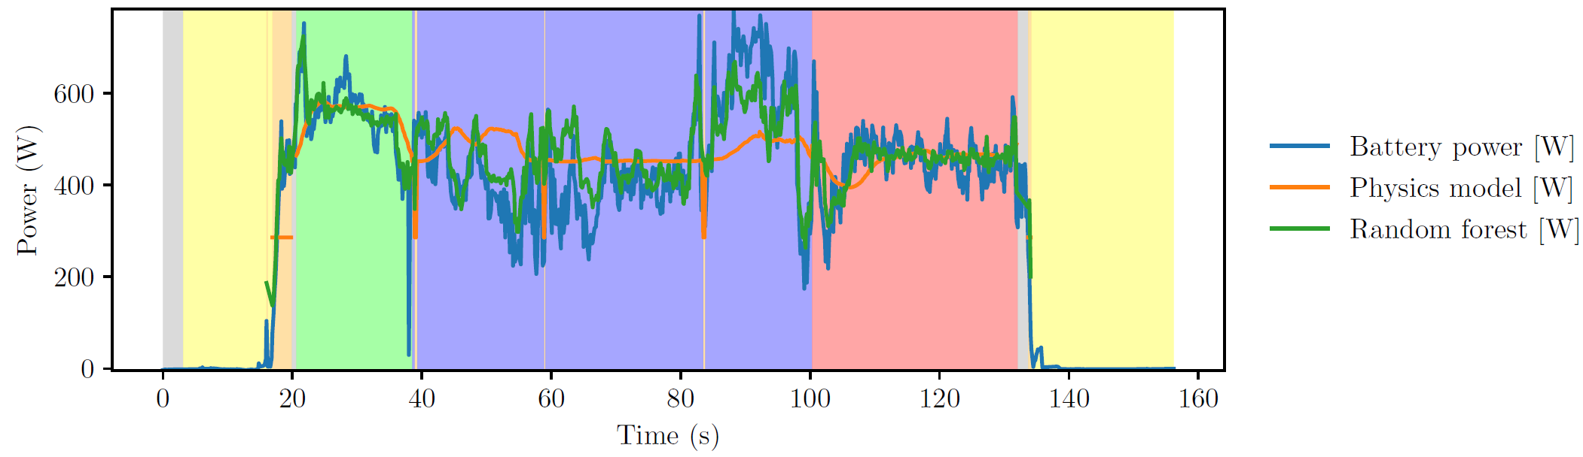
Representation of two models (flight 79)

Slide 18
Interpretability and generalization
Interpretability:
How input parameter influence predicted energy
Physics based model:
Based on analytical equations
Input parameters have clear physical meaning
Direct relationship between inputs and power
High transparency and explainability
Data driven model (Random Forest):
Ensemble of multiple decision trees
Final prediction is average of many trees
No explicit physical equation
Feature analysis provides moderate interpretability
Generalization to new flight condition:
How model performs on unseen flight conditions
Perform well within trained parameter range
Limited performance outside training range
Retraining needed for new UAVs or conditions

Slide 19
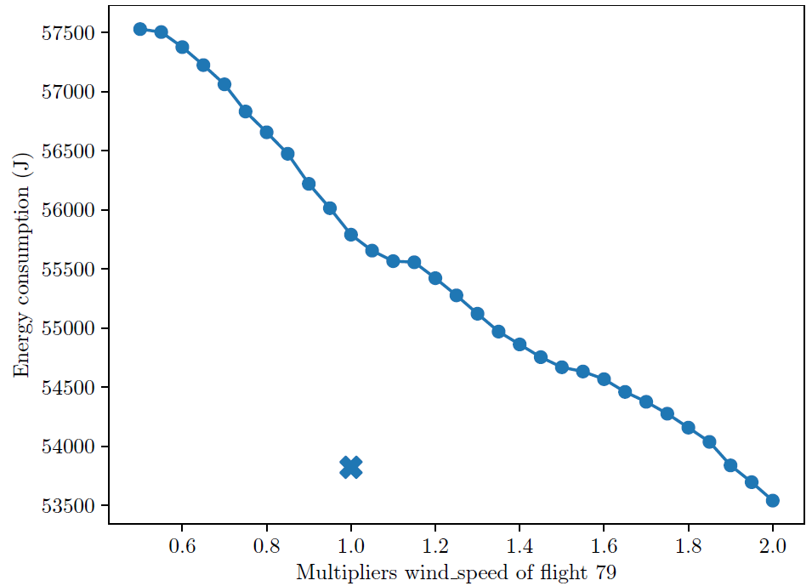
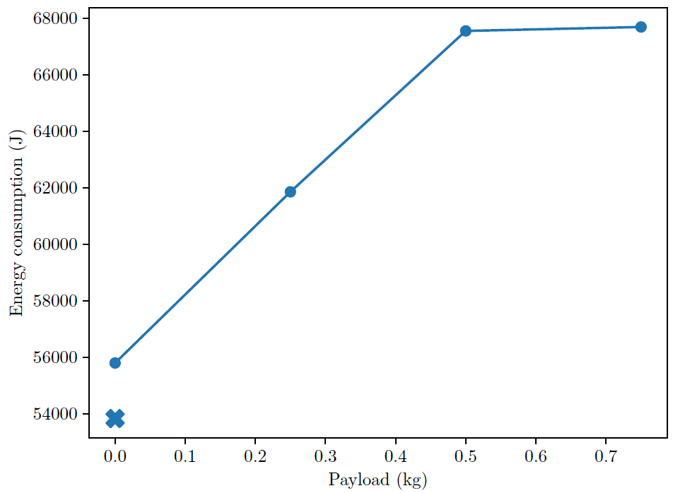

Mission feasibility check on flight 79
Effect of payload:
Effect of wind speed:

Slide 20
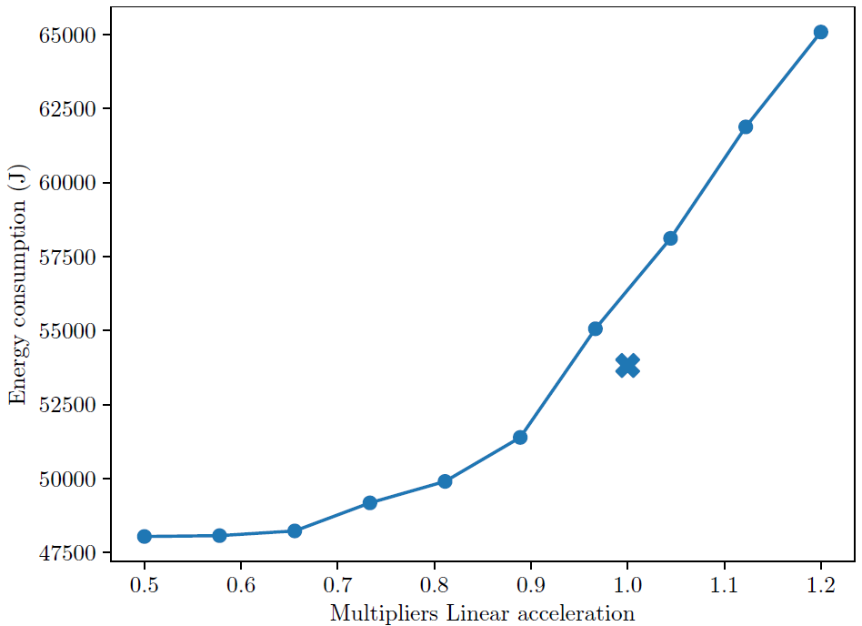
Mission feasibility check on flight 79
Effect of Linear acceleration:
Feasibility assessment:
Sensitivity analyses define expected energy demand under varying operating conditions.
Predicted energy demand can be compared with available battery capacity in real time.
Increasing deviation from baseline reduces available energy margin.
Energy thresholds provide a quantitative basis for feasibility assessment and RTH decisions

Slide 21
Conclusion
The AI-driven energy model achieved higher prediction accuracy than the physics-based model
The physics-based model provided strong interpretability but limited in capturing dynamic effects
The AI model showed moderate interpretability
The predicted mission energy enables a feasibility check and supports Return-to-Home decision logic
Generalization and hover behaviour remain key limitations

Slide 22
References
Abeywickrama, H., Jayawickrama, B. A., Chathuranga, D., & Munasinghe, S. (2018). Comprehensive modeling of quadrotor energy consumption. International Journal of Aerospace Engineering, 2018, 1–16.
Bangura, M., & Mahony, R. (2014). Real-time model predictive control for quadrotors. Australasian Conference on Robotics and Automation.
DJI. (2015). Matrice 100 specification sheet
Dorling, K., Heinrichs, J., Messier, G. G., & Magierowski, S. (2017). Energy consumption model for UAV flight. IEEE Transactions on Vehicular Technology, 66(1), 376–385.
Gupta, L., Jain, R., & Vaszkun, G. (2016). Survey of important issues in UAV communication networks. IEEE Communications Surveys & Tutorials, 18(2), 1123–1152.
Hossen, M., et al. (2021). Deep learning-based UAV power consumption prediction. IEEE Access, 9, 134662–134673.
Leishman, J. G. (2006). Principles of helicopter aerodynamics (2nd ed.). Cambridge University Press.
Liu, X., et al. (2020). Machine learning models for UAV energy estimation. Sensors, 20(18), 5152.

Slide 23
Thank You

Slide 24
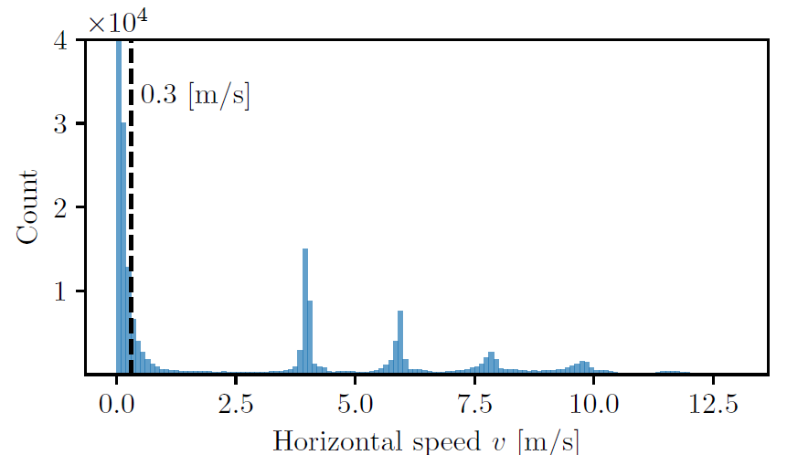
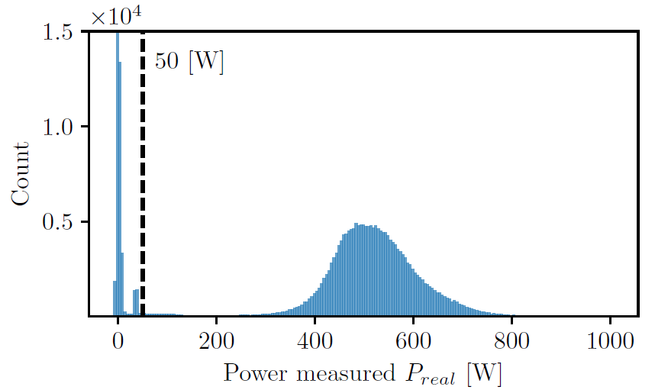
Extra material
Horizontal Speed histogram:
Power:

Slide 25
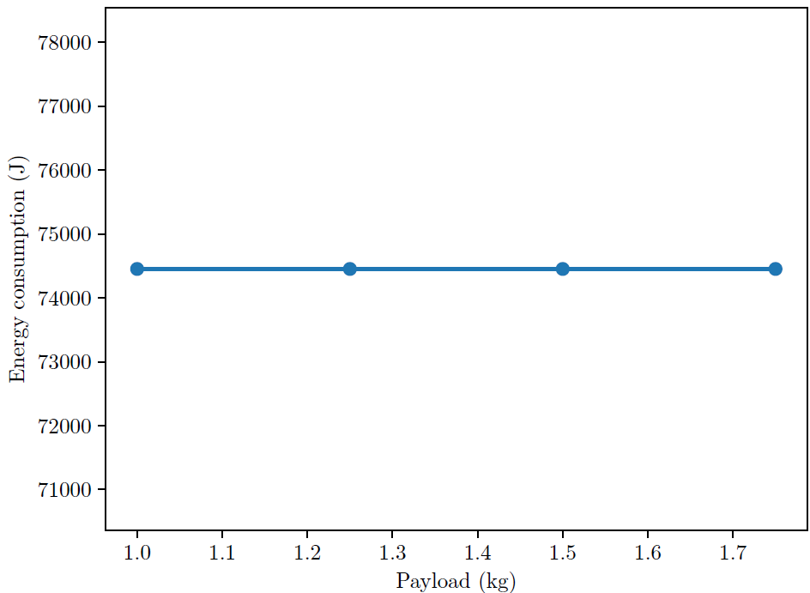
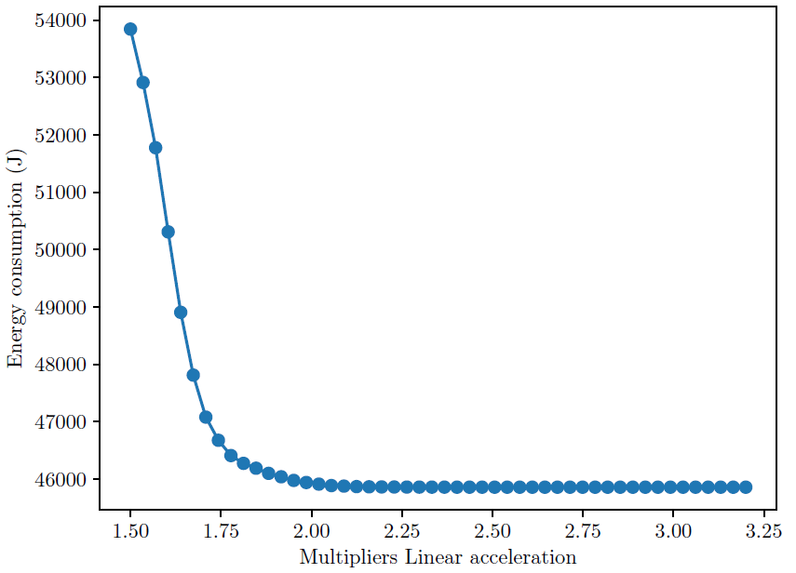
Extra slides
Payload:
Linear acceleration:

