Slide 1
Smart Meters
G. HARI BABU, M.Tech.,(Ph.D)
ASSISTANT PROFESSOR

Slide 2
Features and functions of Smart Meters – Functional specification – category of Smart Meters – Automatic Meter Reading (AMR) and Advanced Metering Infrastructure (AMI) drivers and benefits – AMI protocol – Demand Side Integration: Peak load, Outage and Power Quality management

Slide 3
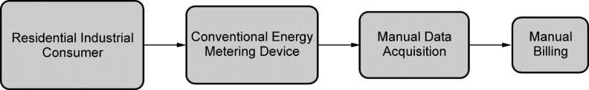
Conventional Metering System
The most widely used electricity meter is known as electromechanical accumulation meter, which measures the consumption.
The measurement is created as a record of
consumption based on time intervals.
Since accumulation meters cannot be operated or controlled remotely.
Due to this billing was performed manually.
Hence, the billing periods were too long as months.
These systems were considered as a primitive and unreliable management system against malicious interventions.

Slide 4
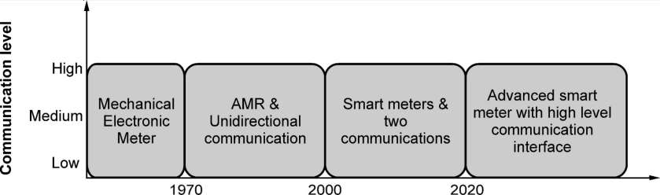
Evolution of Metering Systems
AMR (Automatic Meter Reading): one way communication between meters to reader.
AMI (Advanced Metering Infrastructure) system: two way communication for various applicants namely residential and industrial sector.
Such system with the supports information and communication technology, energy consumption data can be measured, collected, analyzed and managed.

Slide 5
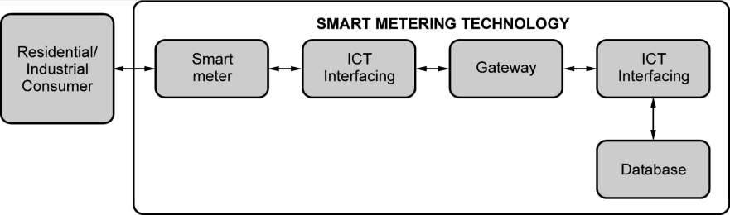
Smart Metering System
Smart metering is a technology which connects grid, consumer loads, generation and transmission network, and asset management through intelligent integration via Home Area Network (HAN) and Wide Area Networks (WANs).

Slide 6
Functionalities of Smart Meters
Provides instant and accurate consumption data
Communicates with remote monitoring center
Provides data base for analyzing and assessment of power quality
Processes control commands received from monitoring and control station
Performs scheduled operations
Interacts with interfacing devices and home energy
management system (HEMS)
Detect and prevent power losses
Tamper detection and energy theft interventions

Slide 7
Types of Smart Meters
Based on the type of LAN (Local Area Network), categorization of smart meter system technologies has been defined.
Radio Frequency (RF) and Power Line Carrier (PLC) are the two types of smart meter systems.
Depending on the demographic and business needs, the utility selects any of these two types of system.
The transmitted data is used for utility billing and outage management in a smart grid.

Slide 8
Types of Smart Meters
Radio Frequency (RF) smart meter systems.
  Mesh technology based RF smart meter: communicates with each node to form a LAN cloud.
  Point to Point technology: a direct communication to a
data collector
  When compared to mesh type, point to point RF technologies yields better throughput.
PLC type smart meter systems.
  The measurements and data communication is enabled across the utility power lines from the meter to a collection point.
  The data is then delivered to the utility data systems for processing at a central location.

Slide 9
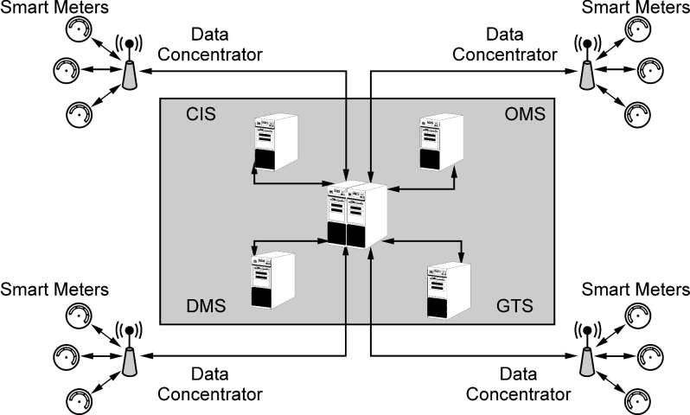
Smart Metering Infrastructure
Smart metering architecture is purely dependent on ICT interface.

Slide 10
Metering Data Management System (MDMS)
MDMS acts as a data acquisition system from smart metering.
The data collected are processed, evaluated, and stored for performing actual status analysis of distribution network.

Slide 11
Outage Management System (OMS)
The power quality parameters of grid are monitored by OMS.
The detection of any fault or disturbance situations in
a grid is reported to MDMS immediately.
The OMS neglects data transmitted at high frequencies while considers low frequency detection signals.

Slide 12
Geographical Information System
(GIS)
A better decision making process is supported by GIS, where the geographical data of smart meters and customer premises are collected.
A common platform to store, to analyze and to display geographical information on asset management and under or over loaded substations is executed by GIS service.

Slide 13
Customer Information System (CIS)
The CIS is essential to make sure customer services for generating reliable billing services.
The data from GIS is provided to CIS.
This data assists the billing operation.
During consumption rate detection and billing operation, the GIS data provides information including geographical location.
The user interaction with database namely user account, consumption rates with time stamps are managed by this system.

Slide 14
Distribution Management System (DMS)
DMS supervises the whole architecture for tracking the power quality and load demand.
Such tracking supports in decision making and
estimation of load utilized.

Slide 15
Smart Meter - Benefits
Provides additional information such as Total Harmonic Distortion (THD) rates, frequency rates, power quality, peak load times and specific interval data.
Supports rapid detection of outages, assisting to troubleshooting and self-healing processes, and also reports the causes of outages.
Uses Data Management Unit (DMU) for secure transmission of the acquired and processed data.
Creates a smart environment where control for disconnection or reconnection of customer premises can be done remotely.

Slide 16
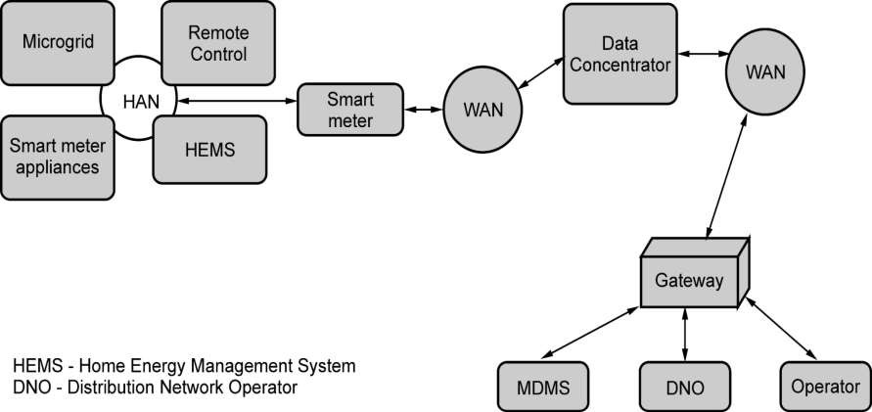
Communication Architecture in
Smart Metering Infrastructure

Slide 17
Communication Architecture in
Smart Metering Infrastructure
As the data size of residential smart meter is lower than 100 KB / day, data concentrators are required to support the massive data transmission between NAN and WAN connection nodes.
A WAN is a network which comprises several NANs for exchanging information between smart meters and monitoring center.
A licensed frequency bands and technologies such as General Packet Radio Service (GPRS) are employed as the communication medium of a WAN.

Slide 18
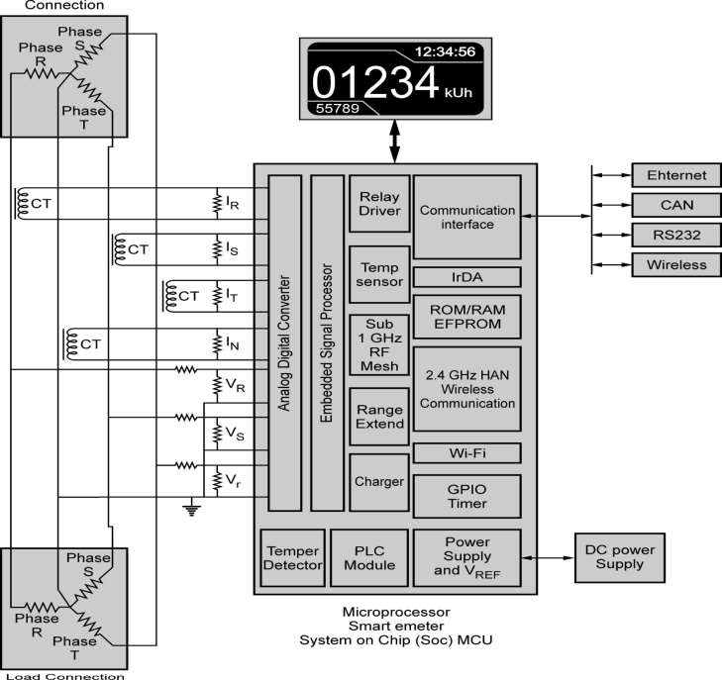
Hardware of Smart Meter

Slide 19
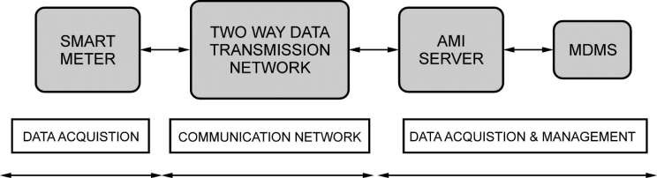
Advanced Metering Infrastructure (AMI)
Smart metering unit, communication network and data acquisition and management unit are the important components of AMI architecture.
The components of AMI system are associated with fault detection and localization, protection, isolation, energy efficiency, asset management and remote control.
Smart sensors, smart meters and AMI systems are highly needed to yield a sophisticated DMS.

Slide 20
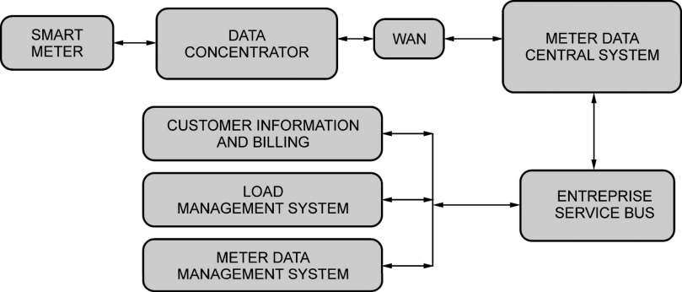
Block Diagram of AMI
Meter Data Central (MDC) is a system where data gathered from every single smart meter and concentrator are transferred to a unique central database.
MDM is built on top of MDC system for processing
billing systems.

Slide 21
Benefits of AMI Platforms
Operational benefits: AMI benefits the entire grid by
  improving the accuracy of meter reads,
  energy theft detection and response to power outages,
  while eliminating the need for on-site meter reading.
Financial benefits: AMI brings financial gains to utility by
  reducing equipment and maintenance costs,
  enabling faster restoration of electric service during outages and
  streamlining the billing process.
Security benefits: AMI technology enables
  enhanced monitoring of system resources, which mitigates system intrusion and cyber attacks.
21

Slide 22
Benefits of AMI Platforms
Customer benefits: AMI benefits electric customers
  by detecting meter failures early,
  accommodating faster service restoration, and
  improving the accuracy and flexibility of billing.
Further, AMI allows for
  time-based rate options that can help customers save
money and
  manage their energy consumption.
22

Slide 23
AMI Protocols and Standards
The ability of two or more components or systems to exchange information and use the information exchanged is defined as interoperability of a system.
Standard development organizations
  Institute of Electrical and Electronics Engineers (IEEE)
  International Electrotechnical Commission (IEC)
  American National Standards Institute (ANSI) &
  National Institute of Standards and Technology (NIST)
Different vendors produce different devices that are integrated to AMI.
There should not be any compatibility problem during data transmission, reception and its processing.
23

Slide 24
AMI Protocols and Standards
Multimedia standards:
  wire line communication and
  cellular communications
Data transmission standards:
  Internet Protocol (IP),
  Transmission Control protocol (TCP),
  Usage based Dynamic Pricing (UDP) and
  Hypertext Transfer Protocol (HTTP)
24

Slide 25
AMI Protocols and Standards
Application specific standards:
  IEC 61850: Substation automation, integration of RES and SCADA
  IEC 61970: Control centers for T&D
  IEC 61968: Common Information Model (CIM) and AMI back office interface
  IEC TC57: interoperability layers, domains and zones
  IEC 62351: support and security services for managing
the operation of network
  ANSI C.12: American National Standard for Electricity Meters - accuracy and performance
25

Slide 26
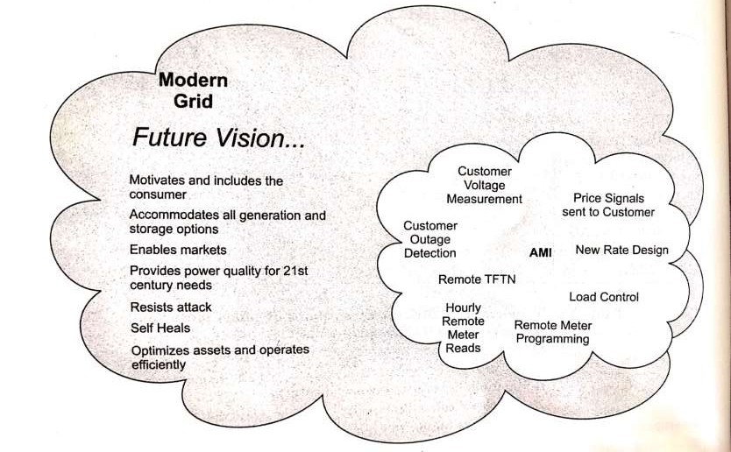
AMI Needs in the Smart Grid
26

Slide 27
AMI Needs in the Smart Grid
Confidentiality
Accountability
Integrity
Availability
Authorization
27

