Slide 1
UNIT-V
FORCE & SOUND TRANSDUCERS

Slide 2
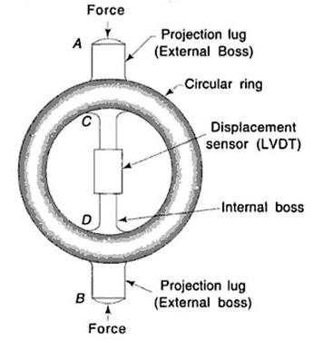
Proving Ring
Definition: A mechanical force transducer designed to measure static tensile or compressive forces by converting force into displacement.
Construction: Made of a circular high-strength elastic steel ring with external bosses (projection lugs) for applying load and an internal displacement sensor (like an LVDT or micrometer) attached across its diameter.

Slide 3
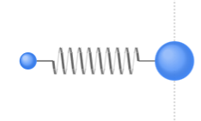
Working Principle: Operates on Hooke's Law (F = -kx). Applied force deforms the ring elastically; measuring the diametral deflection allows force calculation via a calibration curve.
Key Specs & Applications:
  Pros: High accuracy/reliability, no power required, handles large static forces.
  Cons: Unsuitable for dynamic high-frequency forces, susceptible to mechanical wear.
  Uses: Calibration of load cells, testing machines, materials labs.

Slide 4
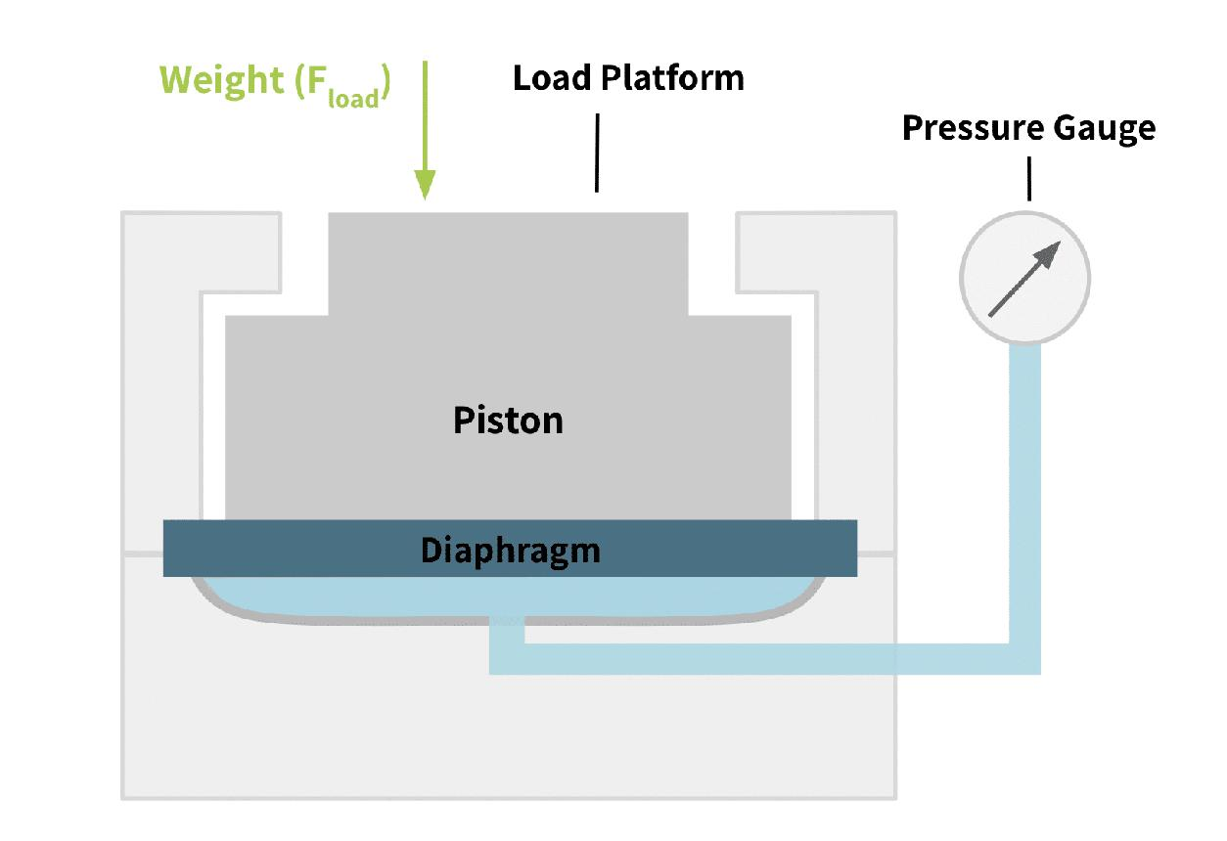
2. Hydraulic Load Cell
Definition: Converts mechanical force or weight into hydraulic fluid pressure.
Construction: Consists of an elastic diaphragm or piston, an oil-filled hydraulic chamber, a pressure sensing element, and an indicator.

Slide 5
Working Principle: Applied load depresses the piston, compressing the incompressible fluid. Fluid pressure increases proportionally to force:
F=P×AF = P times AF=P×A
Where:
F = Applied force (N)
P = Hydraulic pressure (N/m²)
A = Area of piston (m²)
Pros & Cons: Heavy overload capacity, no electricity needed at sensing head; but bulkier with slower response times and potential fluid leakage.

Slide 6
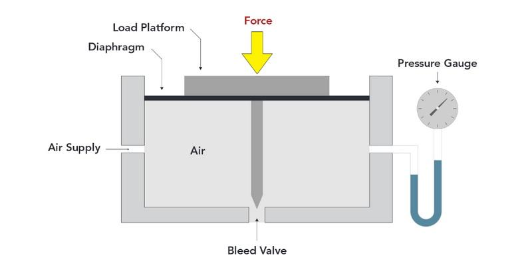
Pneumatic Load Cell
Definition: Converts applied force into proportional air pressure variations.
Construction & Working:
Features a flexible diaphragm over an air chamber with a nozzle/bleed-valve arrangement. Applied force depresses the diaphragm, altering the nozzle clearance and changing internal air pressure.
F∝PF
Where:
F = Applied force
P = Pneumatic pressure

Slide 7
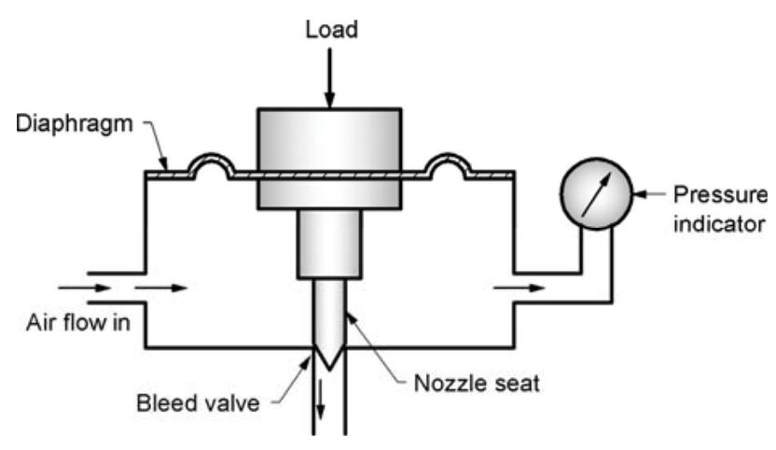
Pros & Cons: Explosion-proof (no electrical sparks, ideal for hazardous/clean sites); requires continuous compressed air supply and responds relatively slowly.

Slide 8
4. Dynamometers
Definition: Devices used to measure force, torque, and power output of machines (engines, motors, turbines).
Governing Equation:
P=2πNT60P = \frac{2\pi NT}{60}P=602πNT​
Where:
P = Power (W)
N = Speed (rpm)
T = Torque (N·m)
Classification:
  Absorption Dynamometers: Absorbs and dissipates machine energy as heat/electricity (e.g., Prony brake, Hydraulic, Eddy current).
  Transmission Dynamometers: Measures torque/power during normal operation without absorbing power (e.g., Strain gauge, Torsion dynamometers).

Slide 9
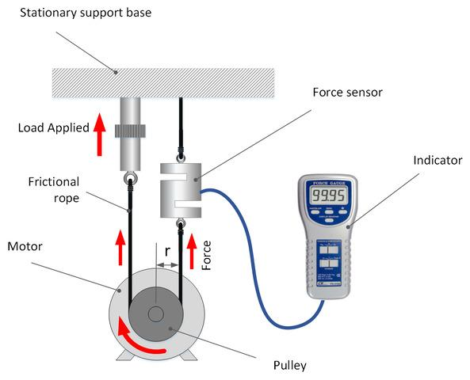
Construction
A typical dynamometer consists of:
Rotor/shaft – connected to the machine under test.
Braking mechanism – provides resistance to motion.
Torque measuring arrangement – measures torque produced.
Speed measuring device – measures rotational speed.
Display unit – indicates power output.

Slide 10
Gyroscopes
Definition: Motion transducers used to measure or maintain orientation, angular velocity, and angular acceleration.
Working Principle: Operates on the conservation of angular momentum
L=IωL = Iω
Where:
L = Angular momentum
I = Moment of inertia
ω = Angular velocity
A high-speed spinning rotor mounted on gimbals maintains its orientation in space despite frame movement.
Types: Mechanical (rotating mass), Optical (FOG, Ring Laser), and MEMS (vibrating micro-structures).
Applications: Aircraft/ship navigation, spacecraft attitude control, smartphones, and robotics.

Slide 11
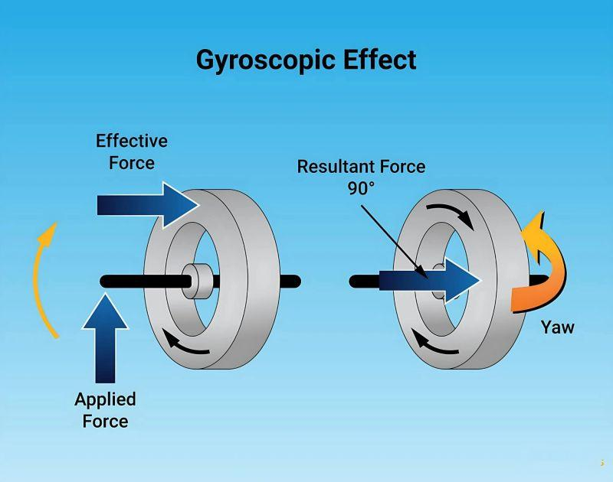
Construction
A conventional gyroscope consists of:
Rotor (spinning wheel) – rotates at high speed.
Gimbal system – allows free rotation about different axes.
Frame/support structure – holds the assembly.
Sensing element – detects angular movement.

Slide 12
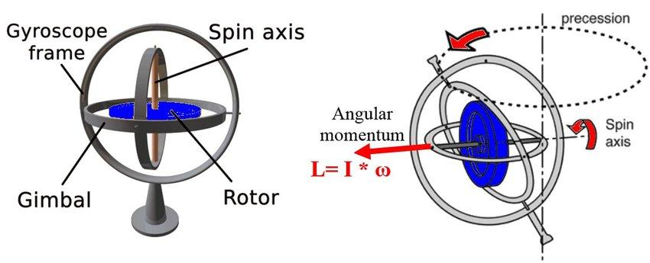
Working
The rotor is rotated at high speed.
Due to angular momentum, the rotor maintains its orientation.
When the body rotates, the gyroscope detects the change in orientation.
This movement is converted into an electrical signal.

Slide 13
Sound Level Meter (SLM)
Definition: Measures sound intensity/loudness in Sound Pressure Level (SPL) units expressed in decibels (dB).
Mathematical Formula:
SPL=20log⁡10(PP0) dBSPL = 20 \log_{10}\left(\frac{P}{P_0}\right) \text{ dB}SPL=20log10​(P0​P​) dB
Where:
P = Measured sound pressure
P₀ = Reference sound pressure (20 µPa)
Signal Flow:
Microphone → Preamplifier → Frequency Weighting Network → Amplifier → Display Unit

Slide 14
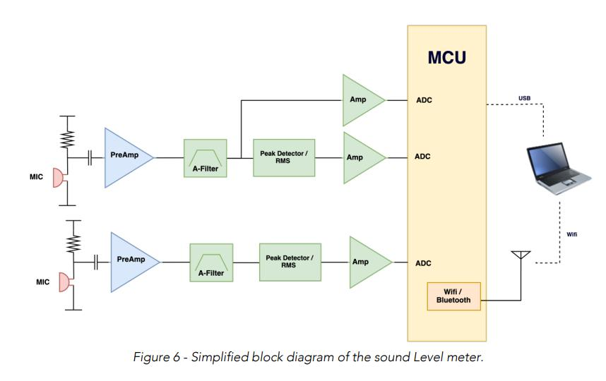
Working
The microphone detects sound waves and converts them into an electrical signal.
The preamplifier increases the weak signal strength.
The frequency weighting circuit adjusts the response according to human hearing characteristics (A, C, Z weighting).
The amplifier increases the signal level.
The display unit shows the sound level in decibels (dB).

Slide 15
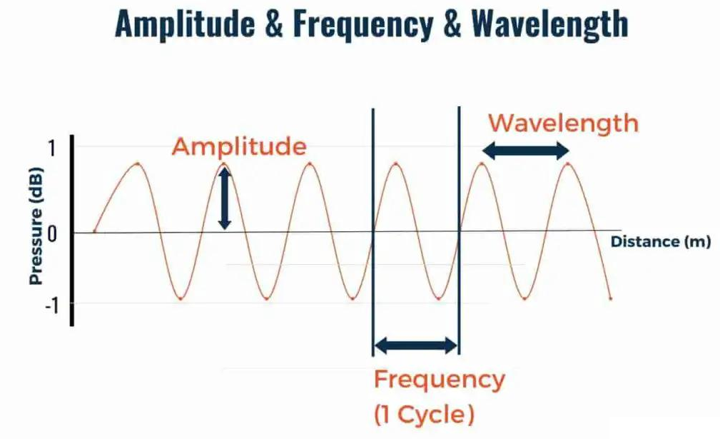
Sound characteristics
Sound is a form of mechanical energy that travels through a medium (solid, liquid, or gas) as pressure waves. The important characteristics of sound are:

Slide 16
1. Frequency (Pitch)
Frequency is the number of vibrations or cycles produced per second.
It determines the pitch (highness or lowness) of sound.
Unit: Hertz (Hz)
f=1/Tf=\frac{1}{T}f=T1​
Where:
f = Frequency
T = Time period
Example: A whistle has high frequency, while a drum has low frequency.
2. Amplitude (Loudness)
Amplitude is the maximum displacement of sound wave particles from their mean position.
It determines the loudness or intensity of sound.
Greater amplitude → louder sound.
Unit: Decibel (dB) is used for sound level measurement.

Slide 17
3. Wavelength
Wavelength is the distance between two successive compressions or rarefactions in a sound wave.
Unit: metre (m)
λ=vf\lambda=\frac{v}{f}λ=fv​
Where:
λ = Wavelength
v = Velocity of sound
f = Frequency
4. Velocity (Speed of Sound)
Velocity is the distance travelled by a sound wave per unit time.
It depends on the medium and temperature.
v=fλv=f\lambdav=fλ
Approximate speed in air: 343 m/s at 20°C

Slide 18
5. Quality (Timbre)
Quality is the characteristic that helps us distinguish between sounds having the same pitch and loudness.
It depends on the waveform and harmonics.
Example: A piano and violin producing the same note can be distinguished by their quality.

Slide 19
Microphones (Acoustic Transducers)
General Principle: Converts acoustic sound energy into mechanical diaphragm vibrations, which are then transduced into electrical signals.
Conversion:
Sound waves → Mechanical vibration → Electrical signal
Construction
A basic microphone consists of:
Diaphragm – thin membrane that vibrates when sound waves strike it.
Transducer element – converts diaphragm vibration into an electrical signal.
Magnet and coil / capacitor plates – depending on microphone type.
Output terminals – provide the electrical output signal.

Slide 20
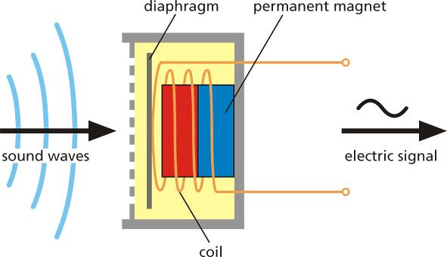
Working
Sound waves strike the diaphragm and make it vibrate.
The vibration is converted into a corresponding electrical signal.
The electrical output represents the original sound waveform.

Slide 21
Types Comparison:
  Dynamic: Operates via electromagnetic induction (moving coil inside a magnetic field); robust for live performances.
  Condenser: Operates via variable capacitance (diaphragm forms flexible capacitor plate); high sensitivity and wide frequency response.
  Carbon: Works on variable resistance of compressed carbon granules; used in classical telephony.
  Piezoelectric: Generates voltage when sound pressure mechanically stresses a piezoelectric crystal.

