Slide 1

INDIAN INSTITUTE OF TECHNOLOGY KHARAGPUR
DEPARTMENT OF MECHANICAL ENGINEERING
PARAMETRIC ANALYSIS AND OPTIMISATION OF AN ETHANOL-FUELLED SI ENGINE
ANSYS Chemkin-Pro 2025 R2
ME60111 | INTERNAL COMBUSTION ENGINE
Group 11 · Academic Year 2026
Department of Mechanical Engineering | Internal Combustion Engine
01

Slide 2
Objectives, Methodology & Project Team
OBJECTIVES
GROUP 11
01
Engine inputs
500–3000 RPM; start −15° to −5°CA; burn 10°–50°CA.
Member
Roll Number
02
Performance targets
Maximise indicated torque and power; minimise ISFC.
Raksha Gupta
23ME10066
03
Otto comparison
Compare indicated thermal efficiency with the ideal Otto-cycle benchmark.
04
Isolated effects
Change one input while holding the other two fixed.
Kanchan Potdar
23ME10038
METHODOLOGY
Saloni
23ME10074
01
Model setup & baseline
Import the ethanol mechanism; configure engine geometry and baseline settings.
02
Full-factorial study
Vary three inputs and execute 150 Chemkin-Pro simulation cases.
Nagineni Lakshmipravallika
23ME10053
03
Python analysis & optimisation
Find best sampled settings and compare them with the ideal Otto cycle.
Pranjali Khatua
23ME10060
Department of Mechanical Engineering | Internal Combustion Engine
02

Slide 3
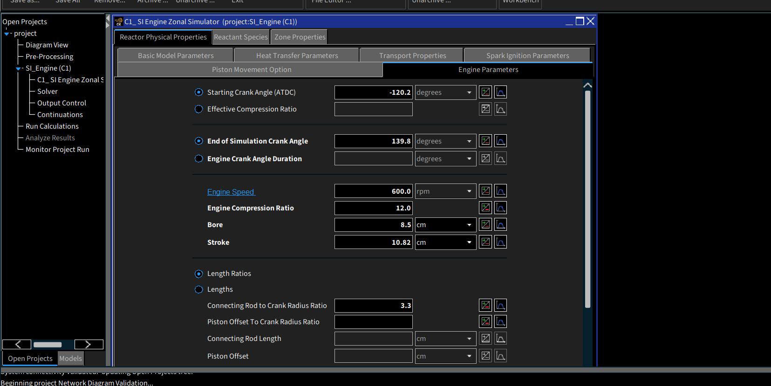
Engine Configuration & Model Assumptions
Figure 1. SI Engine Zonal Simulator — geometry and operating parameters
ENGINE CONFIGURATION
Parameter | Value
Fuel / oxidiser | Ethanol / air; 21% O₂, 79% N₂
Compression ratio | 12
Bore / stroke | 8.5 / 10.82 cm
Rod/crank ratio | 3.3
Baseline speed | 600 RPM
Initial temperature / pressure | 353 K / 1 atm
Wiebe parameters | n = 2; b = 5
Negative crank angle = before top dead centre (BTDC). TDC = top dead centre; °CA = crank-angle degrees.
Input simulation interval: −120.2° to 139.8°CA. Baseline inputs are distinct from the 150-case sweep.
MODEL ASSUMPTIONS
Two-Zone Combustion
Prescribed Combustion
Cylinder charge is represented as burned and unburned gas zones.
Combustion process is specified through Wiebe profile with specified timing.
Detailed Chemistry
Zero Wall Heat Loss
Kinetic and thermodynamic data is used instead of a single global reaction
Baseline output assumes zero wall heat loss.
Department of Mechanical Engineering | Internal Combustion Engine
03

Slide 4



Reaction Mechanism & Performance Relations
ETHANOL–AIR CHEMISTRY
INDICATED PERFORMANCE
Ethanol is an oxygenated fuel. Its overall stoichiometric combustion is:
INDICATED POWER
$$P_{i} = \frac{2πNT_{i}}{60}$$
C₂H₅OH + 3O₂ → 2CO₂ + 3H₂O
80
chemical species
INDICATED THERMAL EFFICIENCY
$$η_{th,i} = \frac{P_{i}}{{\dot{m}}_{f} LHV}$$
349
reactions
INDICATED SPECIFIC FUEL CONSUMPTION
The supplied mechanism resolves radicals and intermediates.
Reaction pathways influence heat release.
Temperature-dependent properties describe changing gas states.
$$ISFC = \frac{{\dot{m}}_{f}}{P_{i}}$$
PERFORMANCE DEFINITIONS & UNITS
N: RPM Tᵢ: indicated torque (N·m) Pᵢ: indicated power (W) ṁf: fuel mass flow (kg/s) LHV: lower heating value
With fuel flow in kg/s and power in W, multiply ṁf/Pᵢ by 3.6 × 10⁹ to report ISFC in g/kWh.
Department of Mechanical Engineering | Internal Combustion Engine
04

Slide 5
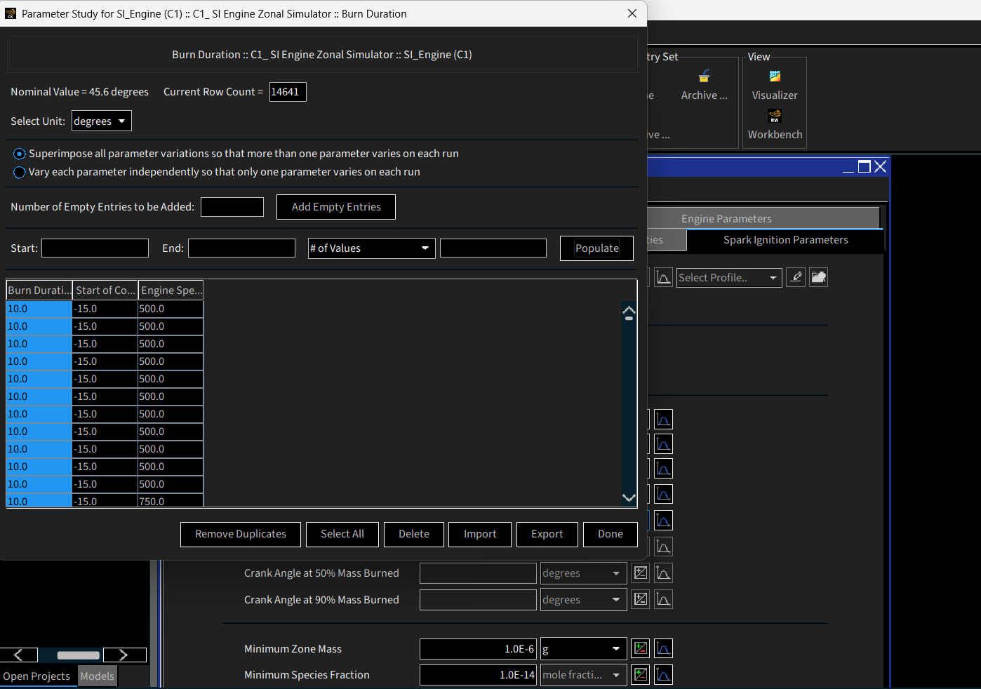
Numerical Methodology & Parameter Study
PARAMETER RANGES
Figure 2. Parameter study configured in Chemkin-Pro
Input | Range | Levels
Engine speed | 500–3000 RPM | 6
Combustion start | −15° to −5°CA | 5
Burn duration | 10°–50°CA | 5
6 × 5 × 5 = 150 SIMULATIONS
Six engine speeds, five combustion start angles and five burn durations form a full-factorial study.
Mechanism &
Setup
→
Parameter
Variations
→
Chemkin-Pro
Runs
→
Python
Processing
→
Optimisation
01
02
03
04
05
Department of Mechanical Engineering | Internal Combustion Engine
05

Slide 6
Effect of Engine Speed
FIXED: Start = −10°CA | Burn duration = 30°CA
Figure 3(a). Indicated torque vs engine speed
KEY OBSERVATIONS
01
Nearly constant torque
Indicated torque changes only slightly over 500–3000 RPM.
02
Power rises with RPM
Figure 3(b). Indicated power vs engine speed
Since Pᵢ = 2πNTᵢ/60,
nearly constant torque means power increases approximately with rotational speed.
Department of Mechanical Engineering | Internal Combustion Engine
06

Slide 7
Effect of Combustion Start Angle
FIXED: Speed = 1500 RPM | Burn duration = 30°CA
Figure 4(a). Indicated torque vs combustion start
KEY OBSERVATIONS
Advancing combustion raises torque in this fixed slice
01
Moving from −5°CA toward −15°CA improves torque when burn duration is fixed at 30°CA.
02
Efficiency also increases
Figure 4(b). Indicated efficiency vs combustion start
Earlier heat release produces more useful indicated work in this specific slice.
03
Timing interacts with duration
This trend applies only at 30°CA burn duration. Start angle interacts strongly with burn duration; see Slide 9.
Department of Mechanical Engineering | Internal Combustion Engine
07

Slide 8
Effect of Burn Duration
FIXED: Speed = 1500 RPM | Start = −10°CA
Figure 5(a). Indicated torque vs burn duration
KEY OBSERVATIONS
01
Intermediate fixed-slice optimum
Torque peaks around 20°CA for the fixed −10°CA start condition.
Long combustion shifts heat release later
02
Figure 5(b). Indicated ISFC vs burn duration
More energy is released after expansion begins, reducing useful pressure and work.
03
ISFC therefore increases
At long burn durations, less useful indicated work is obtained per unit fuel energy.
Longer combustion shifts more heat release into later expansion stroke, reducing useful work and increasing isfc.
Department of Mechanical Engineering | Internal Combustion Engine
08

Slide 9
Parameter Interactions & Optimisation
Figure 6(a). Indicated Torque at 1000 RPM
Figure 6(b). Indicated Power at 3000 RPM
Figure 6(c). Indicated ISFC at 1000 RPM
Each objective is shown at the RPM corresponding to its best sampled condition.
Combustion start (°CA)
Combustion start (°CA)
Combustion start (°CA)
MAX TORQUE
MAX POWER
MINIMUM ISFC
34.990 N·m
10.991 kW
241.315 g/kWh
1000 RPM · −5°CA start · 10°CA burn
3000 RPM · −5°CA start · 10°CA burn
1000 RPM · −5°CA start · 10°CA burn
Preferred start angle changes with burn duration: start-angle × burn-duration interaction.
Department of Mechanical Engineering | Internal Combustion Engine
09

Slide 10
Optimal Operating Conditions
Objective | Best result | Speed | Start | Burn
Maximum indicated torque | 34.990 N·m | 1000 RPM | −5°CA | 10°CA
Maximum indicated power | 10.991 kW | 3000 RPM | −5°CA | 10°CA
Minimum indicated ISFC | 241.315 g/kWh | 1000 RPM | −5°CA | 10°CA
Maximum indicated efficiency | 53.797% | 1000 RPM | −5°CA | 10°CA
PHYSICAL INTERPRETATION
01
Short burn near TDC
A 10°CA burn concentrates heat release near TDC, which can favour useful early-expansion work.
02
Combustion phasing
Early heat release can add compression-side work; late/prolonged burning releases energy after significant expansion.
03
Power
With nearly constant torque, Pᵢ = 2πNTᵢ/60 explains maximum sampled power at 3000 RPM.
The optimum lies on the tested start-angle and burn-duration boundaries; therefore, the true optimum may lie outside the evaluated range.
Department of Mechanical Engineering | Internal Combustion Engine
10

Slide 11
Otto Cycle Efficiency Comparison
IDEAL AIR-STANDARD OTTO CYCLE
Figure 7. Ideal Otto and maximum simulated indicated efficiencies
1
η
= 1 −
Otto
r
γ−1
r = 12 γ = 1.4
62.99% — Ideal air-standard Otto benchmark (γ = 1.4)
53.80% — Maximum simulated Chemkin-Pro indicated efficiency
Difference: 9.19 percentage points
The Otto expression assumes constant γ = 1.4. Chemkin-Pro uses temperature- and composition-dependent thermodynamic properties and finite-duration combustion.
The 9.19-point difference reflects different model assumptions and should not be interpreted as a single physical loss.
Department of Mechanical Engineering | Internal Combustion Engine
11

Slide 12
Conclusions & Limitations
KEY NUMERICAL RESULTS
34.990 N·m
10.991 kW
241.315 g/kWh
53.80%
Maximum torque
Maximum power
Minimum ISFC
Maximum indicated efficiency
CONCLUSIONS
LIMITATIONS
Combustion phasing matters
Boundary-limited optimisation
Start and duration jointly affect useful expansion work.
Best timing and duration are on the tested boundaries.
Different speed optima
Idealised heat transfer
Maximum sampled torque: 1000 RPM; power: 3000 RPM.
Zero wall heat transfer excludes a real-engine loss mechanism.
Ideal benchmark is higher
Prescribed combustion
Simulated indicated efficiency: 53.80%; ideal Otto: 62.99%.
Real flame propagation depends on turbulence, ignition, mixture and geometry.
The optimum lies on the tested start-angle and burn-duration boundaries; therefore, the true optimum may lie outside the evaluated range.
No experimental validation
Validate predicted pressure/performance against measured data in future work.
FUTURE WORK: Extend the parameter range beyond −5°CA start and below 10°CA burn duration, followed by a finer local sweep if physically/model-wise permissible.
Department of Mechanical Engineering | Internal Combustion Engine
12

Slide 13
Group 11 Contributions
GROUP 11 · PRIMARY CONTRIBUTIONS
Member | Roll Number | Primary Contribution
Raksha Gupta | 23ME10066 | Baseline simulation
Kanchan Potdar | 23ME10038 | 150-case parameter study
Saloni | 23ME10074 | Performance optimisation and Otto comparison
Nagineni Lakshmipravallika | 23ME10053 | Python data analysis and visualisation
Pranjali Khatua | 23ME10060 | Technical report and presentation
REFERENCES / SOURCES
Problem 11 course brief; supplied 80-species/349-reaction mech.dat; Chemkin-Pro project.inp and project.out (SI zonal / Wiebe setup); cleaned_150_cases.csv and analyze_group11.py (results and Otto calculation).
Department of Mechanical Engineering | Internal Combustion Engine
13

Slide 14
Questions?
Department of Mechanical Engineering | Internal Combustion Engine
14

