Slide 1
Customer Behaviour Analytics
By Kanchan,Mutturaj

Slide 2
Understanding Customer Buying Behaviour
Can you Identify Your Best Customers?
Do You Know Who your worst customers ?
Do you know which customers you just lost and which one’s you are about to loose?
Can you identify loyal customers, who buy often, but spend very little?
Can you target customer who are willing to spend most at your store?

Slide 3
A Walk Through Analysis
Cohort Analysis
Getting to know your customer better
Very efficient from Business Development Perspective
Examine where cash flow is coming from and understand the health of your business.
Easily see how much monthly or quarterly revenue driven from newer or older cohorts.

Slide 4
A Walk Through Analysis
Recency Frequency and Monetary Analysis
It is a easiest form of customer database segmentation
Based on User Activity data
Can be applied to activity related data that has measurable value and is repeatable.
E.g. E-Commerce, Social Media, Gaming, Discussion boards, Lead managements, etc.

Slide 5
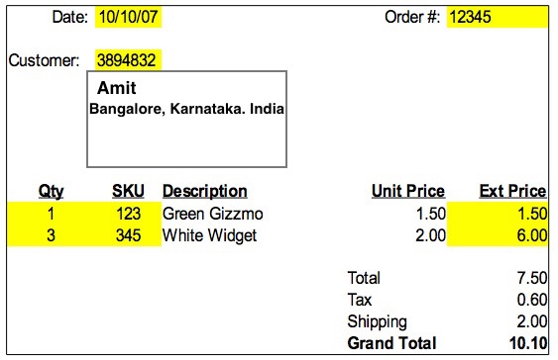
Receipt

Slide 6
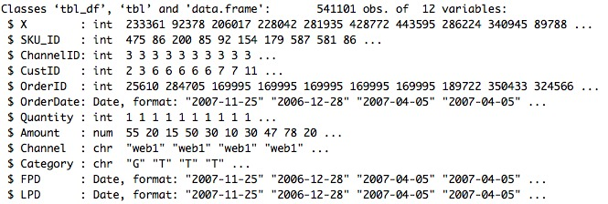
Summary

Slide 7
Steps Followed
Importing data
EDA
Cohort Analysis
Finding Tenure and Breadth of the Customer
RFM Segmentation
Recency Segmentation
Frequency and Monetary Segmentation
Business Recommendations

Slide 8
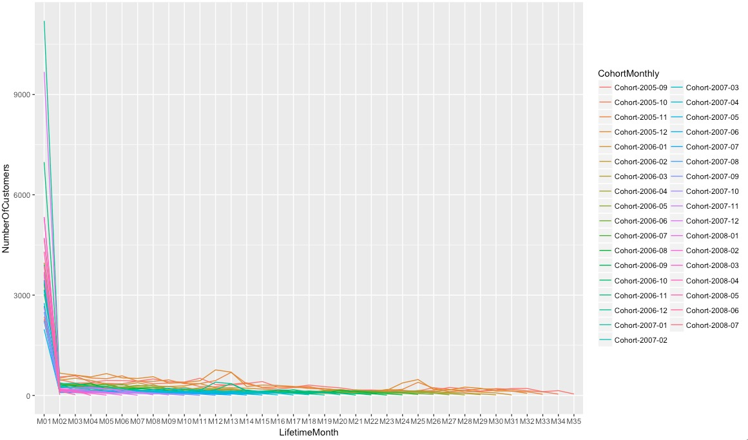
Cohort Analysis

Slide 9
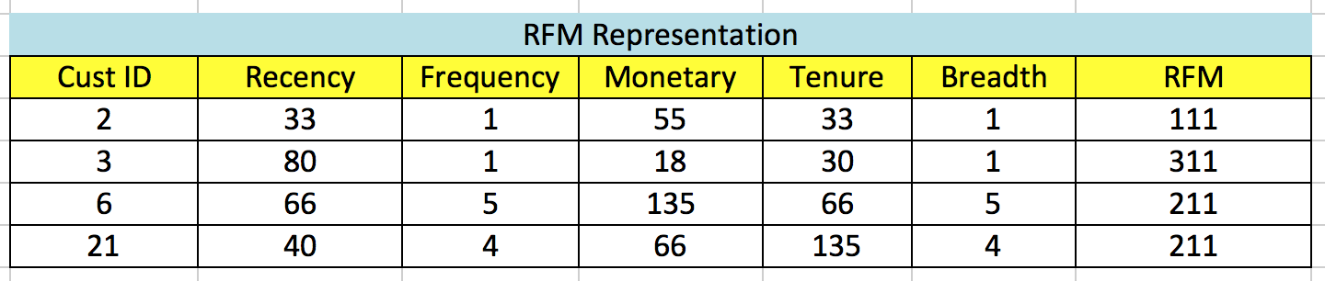
RFM Representation

Slide 10
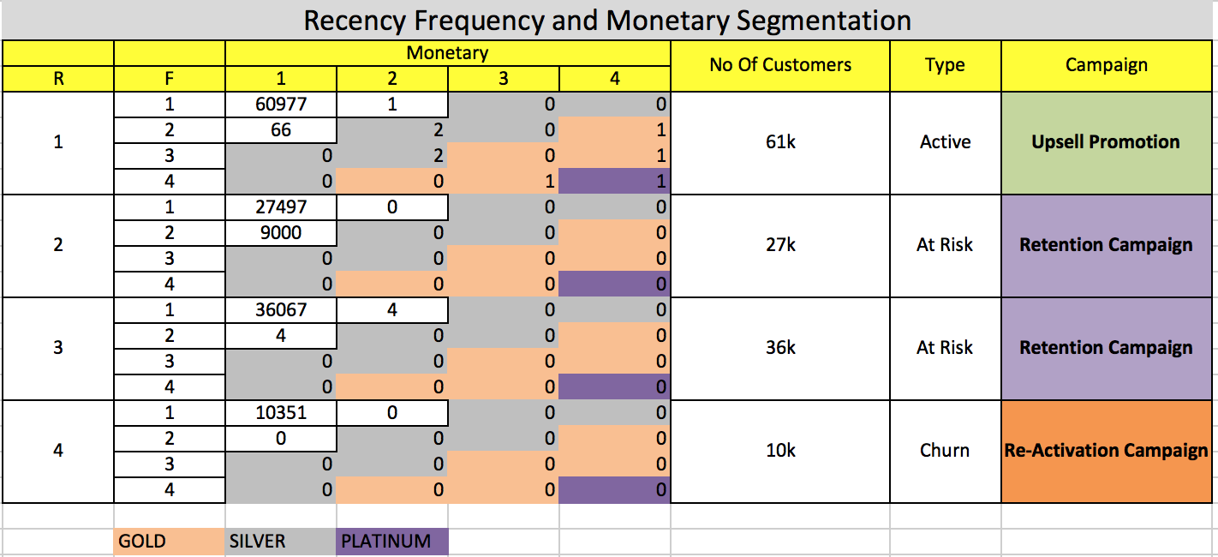
RFM Segmentation

Slide 11
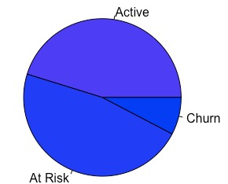
Pie Chart

Slide 12
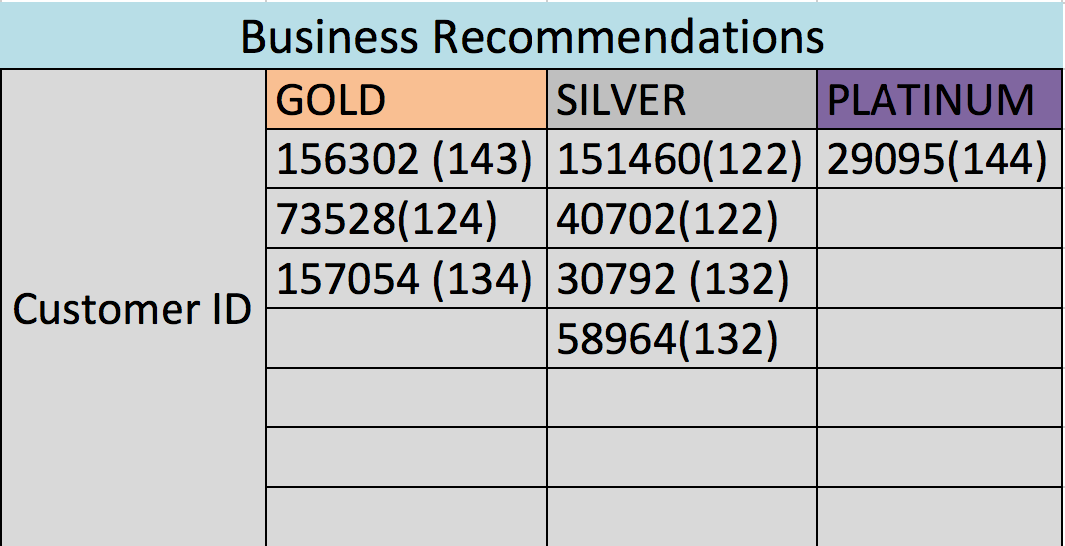

Slide 13
Thank You

