Slide 1
Maven

Slide 2
What is Maven ?
Why Maven ?
What is Pom.xml ?
Build Lifecycle
Dependency and Plugins
Transitive dependency , multi module project
Tips and trics

Slide 3
What is Maven ?
Maven is a software project management and comprehension tool primarily used with Java-based projects but that can also be used to manage projects in other programming languages like C# and Ruby. Maven helps manage builds, documentation, reporting, dependencies, software configuration management (SCM), releases and distribution.
Many integrated development environments (IDEs) provide plug-ins or add-ons for Maven, thus enabling Maven to compile projects from within the IDE.

Slide 4
Why Maven ?
Before maven , we had Ant has build tool. This needs lot of configuration like where the source code exists , where the output should be stored and many more.
Maven uses Convention over Configuration, which means developers are not required to create build process themselves.
Item | Default
source code | ${basedir}/src/main/java
Resources | ${basedir}/src/main/resources
Tests | ${basedir}/src/test
Complied byte code | ${basedir}/target
distributable JAR | ${basedir}/target/classes

Slide 5
Pom.xml?
POM stands for Project Object Model
It is fundamental unit of work in Maven
It is an XML file that resides in the base directory of the project as pom.xml
POM also contains the goals and plugins. While executing a task or goal, Maven looks for the POM in the current directory. It reads the POM, gets the needed configuration information, and then executes the goal. Some of the configuration that can be specified in the POM are following
- project dependencies
- plugins
- goals
- build profiles
- project version
- developers
- mailing list

Slide 6
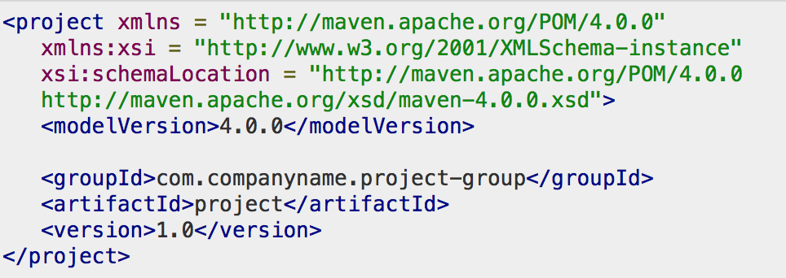
POM Example
It should be noted that there should be a single POM file for each project.
All POM files require the project element and three mandatory fields: groupId, artifactId, version.
Projects notation in repository is groupId:artifactId:version.

Slide 7
Super POM
The Super POM is Maven’s default POM. All POMs inherit from a parent or default (despite explicitly defined or not). This base POM is known as the Super POM, and contains values inherited by default.
Maven use the effective POM (configuration from super pom plus project configuration) to execute relevant goal. It helps developers to specify minimum configuration detail in his/her pom.xml. Although configurations can be overridden easily.
mvn help:effective-pom -Doutput=pom_eff.xml or mvn help:effective-pom

Slide 8
Build Lifecycle Basics
There are three built-in build lifecycles: default, clean and site.
The default lifecycle handles your project deployment, the clean lifecycle handles project cleaning, while the site lifecycle handles the creation of your project's site documentation.
Phases of default lifecycle
validate - validate the project is correct and all necessary information is available
compile - compile the source code of the project
test - test the compiled source code using a suitable unit testing framework. These tests should not require the code be packaged or deployed
package - take the compiled code and package it in its distributable format, such as a JAR.
verify - run any checks on results of integration tests to ensure quality criteria are met
install - install the package into the local repository, for use as a dependency in other projects locally
deploy - done in the build environment, copies the final package to the remote repository for sharing with other developers and projects.

Slide 9
Dependency
Dependency management is a core feature of Maven. Managing dependencies for a single project is easy. Managing dependencies for multi-module projects and applications that consist of hundreds of modules is possible. Maven helps a great deal in defining, creating, and maintaining reproducible builds with well-defined classpaths and library versions.
Transitive Dependency
- Excluded/Optional Dependencies
Dependency scope
Dependency management
- Importing dependency

Slide 10
Plugins
Plugins are artifacts that provide goals to Maven. Furthermore, a plugin may have one or more goals wherein each goal represents a capability of that plugin. For example, the Compiler plugin has two goals: compile and testCompile. The former compiles the source code of your main code, while the latter compiles the source code of your test code.
Build plugins :- will be executed during the build and they should be configured in the <build/> element from the POM.
Reporting plugins :- will be executed during the site generation and they should be configured in the <reporting/> element from the POM.
Third Party plugins :- tidy plugin

Slide 11
Multi module project
A multi-module project is built from an aggregator POM that manages a group of submodules. In most cases, the aggregator is located in the project’s root directory and must have packaging of type pom.
Now, the submodules are regular Maven projects, and they can be built separately or through the aggregator POM.
By building the project through the aggregator POM, each project that has packaging type different than pom will result in a built archive file.
The significant advantage of using this approach is that we may reduce duplication.

Slide 12
Tips :-
To get dependency tree of your project
mvn dependency:tree
To get all plugins used of your project
mvn -B dependency:resolve-plugins
To get latest version of plugin
mvn versions:display-plugin-updates
Assume you need to use different local repository
mvn install -Dmaven.repo.local=/alternate/repo/location
If you want to skip test cases
mvn clean install -Dmaven.test.skip=true –U

Slide 13
Thank you ☺

