Slide 1
GIT
BHARATH KUMAR
17/12/2018

Slide 2
Version Control System
Version Control System (VCS) is a software that helps software developers to work together and maintain a complete history of their work.
VCS:
• Allows developers to work simultaneously.
• Does not allow overwriting each other’s changes.
• Maintains a history of every version.
Types of VCS:
• Centralized version control system (CVCS)
• Distributed/Decentralized version control system (DVCS)

Slide 3
About Git
Created by Linus, creator of Linux, in 2005
– Came out of Linux development community – Designed to do version control on Linux kernel
Goals of Git:
– Speed
– Support for non-linear development (thousands of parallel branches)
– Fully distributed – Able to handle large projects efficiently

Slide 4
Creating a Git repo
To create a new local Git repo in your current directory:
$ git init
- This will create a .git directory in your current directory.
Set the name and email for Git to use when you commit:
$ git config --global user.name "Bugs Bunny”
$ git config --global user.email bugs@gmail.com
– You can call git config –list to verify these are set.

Slide 5
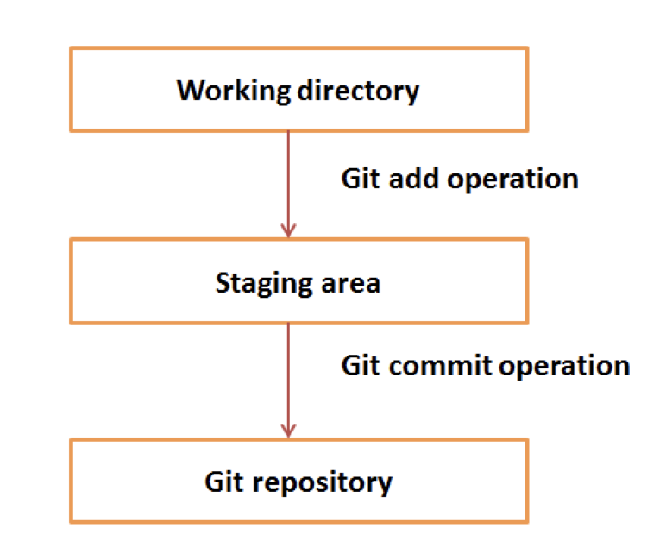
GIT ARCHITECTURE

Slide 6
GIT TERMINOLOGIES
Branches
Branch is created to work on a new feature
Clone
Pull
Push
Add
Commit ..etc
NOTE: $ git –help --- it will list out all git commands

Slide 7
Add and commit a file
The first time we ask a file to be tracked, and every time before we commit a file, we must add it to the staging area:
$ git add Hello.java Goodbye.java
Note: Hello.java and Goodbye.java are sample files
Takes a snapshot of these files, adds them to the staging area.
To move staged changes into the repo, we commit:
$ git commit –m "Fixing bug #22"

Slide 8
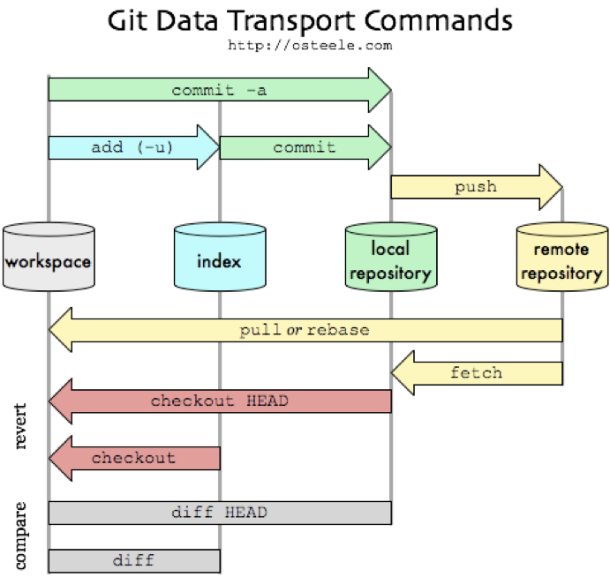
GIT WORKFLOW DIAGRAM

Slide 9
Viewing/undoing changes
To view status of files in working directory and staging area:
$ git status or git status –s (short version)
To see what is modified but unstaged:
$ git diff
To see a list of staged changes:
$ git diff --cached
To see a log of all changes in your local repo:
$ git log or git log --oneline (shorter version)
1677b2d Edited first line of readme
258efa7 Added line to readme
0e52da7 Initial commit
$ git log -5 (to show only the 5 most recent updates), etc.

Slide 10
Branching and merging
Git uses branching heavily to switch between multiple tasks.
To create a new local branch:
$ git branch name
To list all local branches: (* = current branch)
$ git branch
To switch to a given local branch:
$ git checkout branchname
To merge changes from a branch into the local master:
$ git checkout master $ git merge branchname

Slide 11
Interaction LOCAL remote repo
Push your local changes to the remote repo. Pull from remote repo to get most recent changes.
To fetch the most recent updates from the remote repo into your local repo, and put them into your working directory:
$ git pull origin master
To put your changes from your local repo in the remote repo:
$ git push origin master

Slide 12
GitHub
GitHub.com is a site for online storage of Git repositories.
– You can create a remote repo there and push code to it.
– Many open source projects use it, such as the Linux kernel.
– You can get free space for open source projects, or you can pay for private projects.

Slide 13
THANK YOU

