Slide 1
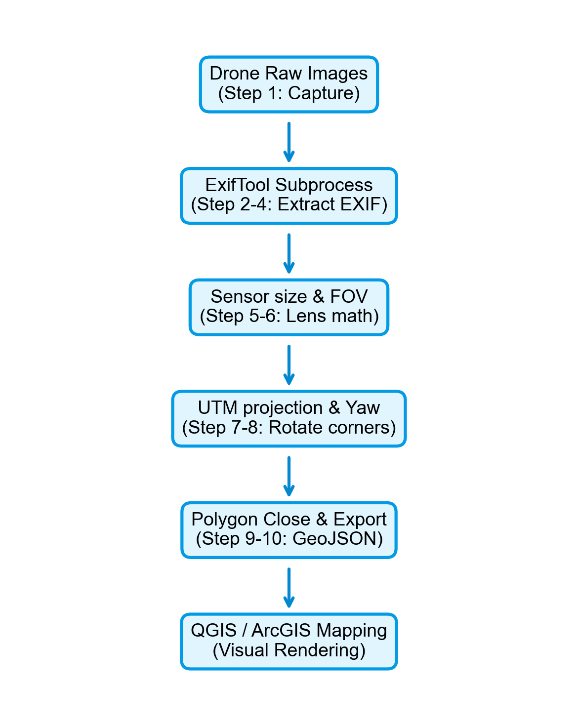
10-STEP GIS FOOTPRINT WORKFLOW
• Project Phase 1: Automated image telemetry processing.
• Steps 1-4 (Collection & Extraction):
- Raw images from DJI drone flight are collected (Step 1).
- ExifTool parses binary EXIF metadata automatically (Step 2-4).
- Extracts: GPS location (Lat/Lon/Alt), flight height, and yaw/pitch orientation.
• Steps 5-6 (FOV Calculation):
- Physical sensor specifications are mapped to compute horizontal/vertical FOV.
• Steps 7-8 (Ground Footprint Corners Projection):
- Combines camera viewing angles, drone altitude, and yaw rotation coordinates.
• Steps 9-10 (Polygon Building & GIS Export):
- Loops coordinates as a polygon, and exports footprints in WGS 84 GeoJSON.

Slide 2
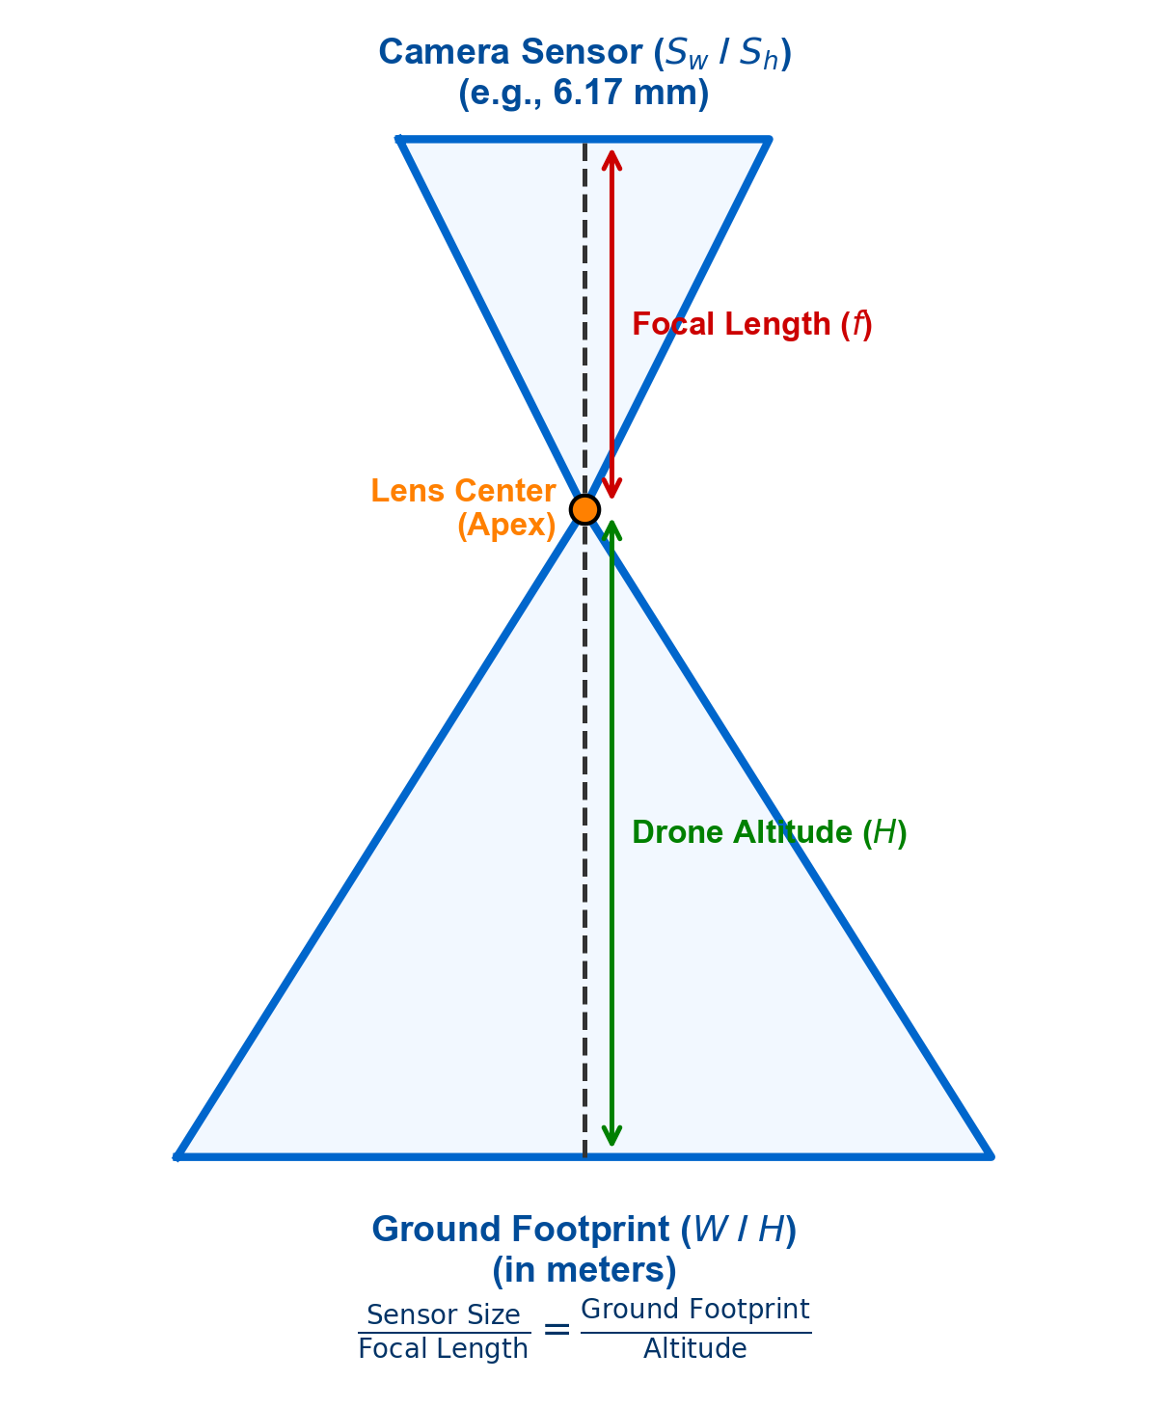
MATHEMATICAL FOOTPRINT COMPUTATION
• Objective: Calculate the physical ground dimensions of the camera sensor's Field of View (FOV) using flight parameters.
• Camera Field of View (FOV) Angles:
- fov_h = 2 * math.atan(sensor_width_mm / (2 * focal_length_mm)) = 81.20°
- fov_v = 2 * math.atan(sensor_height_mm / (2 * focal_length_mm)) = 51.35°
• Aspect Ratio Height Adjustment (Correction):
- Widescreen 16:9 images crop the physical sensor height to sensor_height_mm = 3.47 mm.
- Resolves a +33% scale error caused by using the native physical 4.55 mm height.
• Ground Dimensions Covered by Photo (Meters):
- ground_width = 2 * relative_alt * math.tan(fov_h / 2) ≈ 1.71 * relative_alt
- ground_height = 2 * relative_alt * math.tan(fov_v / 2) ≈ 0.96 * relative_alt
• Direct Scaling Equivalence (Mathematical Proof):
- Footprint (W or H) = (Sensor dimension * Altitude) / Focal length
- Identical to trigonometric projection because tan(arctan(x)) = x.

Slide 3
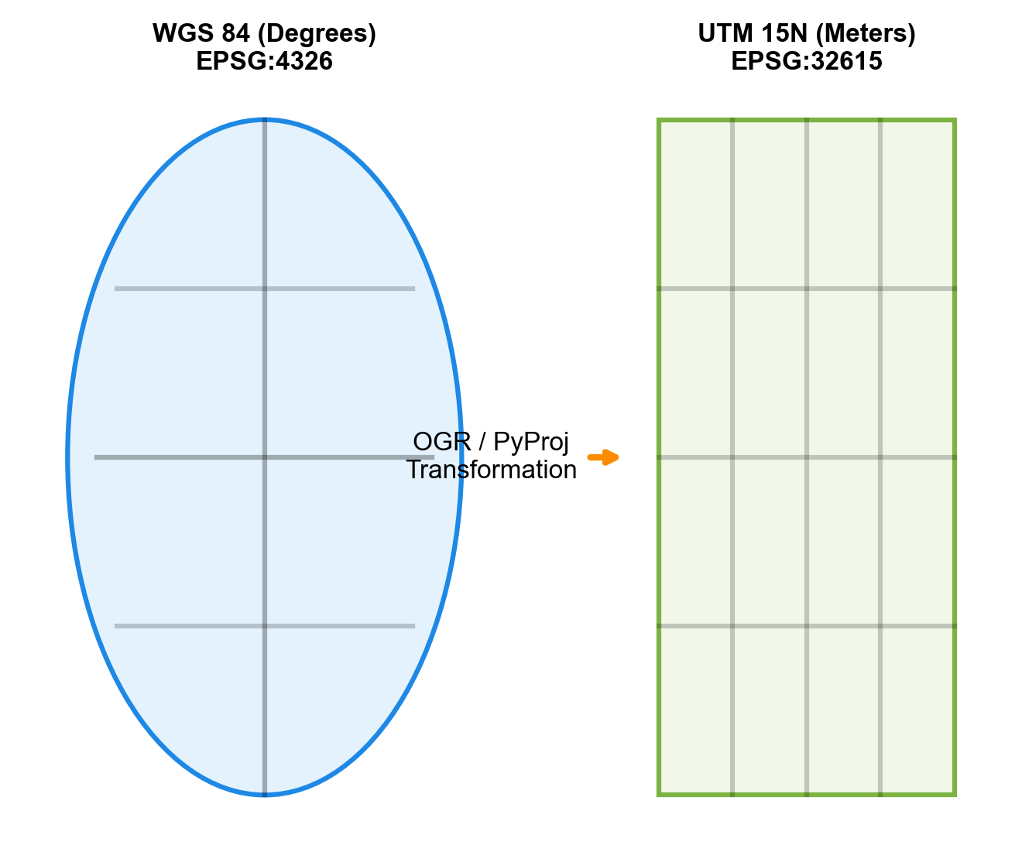
GEOMETRIC POLYGON GENERATION
• Objective: Translate calculated physical ground dimensions into spatial map coordinates to create 2D vector polygons.
• 1. Calculate Unrotated Local Metric Corners (Meters centered at camera 0,0):
- half_w = ground_width / 2.0
- half_h = ground_height / 2.0
- local_corners = [ (-half_w, half_h), (half_w, half_h), (half_w, -half_h), (-half_w, -half_h) ]
(Orientation: +y is Local North, +x is Local East)
• 2. Geospatial Grid Projection:
- Converts GPS center (WGS 84 degrees) to flat map meters (UTM Zone 15N) using pyproj.
• 3. Apply 2D Rotation Matrix (Gimbal Yaw θ):
- X_rot = X_drone + X_local * cos(yaw) + Y_local * sin(yaw)
- Y_rot = Y_drone - X_local * sin(yaw) + Y_local * cos(yaw)
• 4. Closed Loop & GeoJSON Export:
- Join corners sequentially (TL ➔ TR ➔ BR ➔ BL) and repeat TL at the end to close the geometry ring.
- Convert corners back to GPS degrees and write to a standardized GIS GeoJSON file.

Slide 4
INTERACTIVE MAP VISUALIZERS (C++ & PYTHON)
• Interactive 3D Canvas: Renders point cloud (color-coded by height), flight nodes, and footprints.
• Dynamic Photo Warping Overlay:
- Applies QTransform matrix to translate, rotate, and scale photos over the point cloud.
• GDAL Elevation Querying:
- Queries float32 elevation values from dsm.tif raster in real-time under the mouse cursor.
• Dynamic UI sidebar layout (Qt6 Widget structures):
- Dynamic list selection connects photo markers directly to metadata table.
- ScrollArea wrapper prevents layout clipping on small monitors.
- QTableWidget details every EXIF metadata tag (copyable via Ctrl+C).

Slide 5
UAV METADATA STANDARDS & FAIR PRINCIPLES
• Research Objective: Compare metadata schemas to ensure UAV data interoperability.
• Why Metadata Standards Matter: Drone missions produce heterogeneous formats. Standardized tags ensure files are easily discovered and loaded.
• FAIR Principles for Drone Data:
- Findable: Standard search terms and unique IDs.
- Accessible: Files are open and queryable through API catalogs.
- Interoperable: Common schemas allow direct import into QGIS, ArcGIS, or Python.
- Reusable: Complete details on sensor calibration and coordinates.
• Key Barrier: Traditional XML schemas (ISO) are heavy, while raw vectors (GeoJSON) lack rich sensor calibration attributes.

Slide 6
GEOGRAPHIC METADATA: ISO 19115 & ISO 19139
• ISO 19115 (Metadata Schema): The cornerstone international standard for geographic metadata.
- Defines elements describing geographic datasets (spatial range, data quality, lineage, sensor).
• ISO 19139 (XML Schema Implementation):
- Details how ISO 19115 elements must be structured inside XML files for machine exchanges.
• OGC (Open Geospatial Consortium) Standards:
- Standardizes services like CSW (Catalog Service for Web) to publish and search ISO XML documents.
• Main Limitation: Complex XML encoding makes them difficult for cloud software and web APIs to read rapidly.

Slide 7
CLOUD-OPTIMIZED FORMATS (COG & COPC)
• GeoTIFF vs. Cloud Optimized GeoTIFF (COG):
- Standard GeoTIFF has to be read entirely to query an elevation point.
- COG organizes elevation cells into HTTP range request tiles.
- Allows GIS apps to query terrain elevation in milliseconds over a network without downloading the full gigabyte file.
• LAS/LAZ vs. Cloud Optimized Point Cloud (COPC):
- LAZ files are compressed point clouds but lack spatial indexes.
- COPC structures point clouds as an octree layout inside a LAZ file.
- Enables streaming of points based on resolution and bounding boxes.

Slide 8
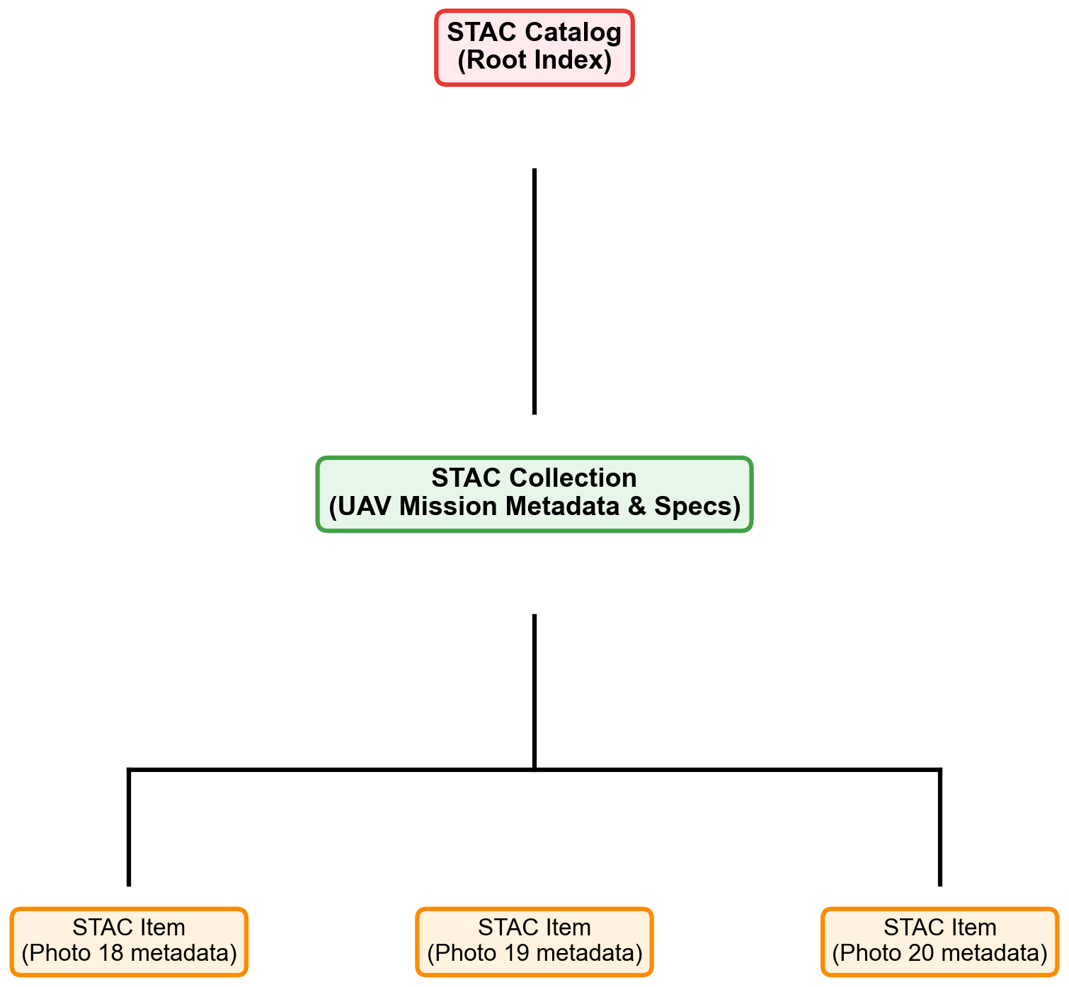
SPATIOTEMPORAL ASSET CATALOG (STAC)
• STAC Specification: A modern JSON-LD metadata standard built to catalog geospatial assets (photos, DEMs, point clouds).
• Three core components in the STAC hierarchy:
- STAC Catalog: The root JSON file indexing the structure.
- STAC Collection: Groups related UAV images, documenting camera specs, focal length, and spatial boundaries.
- STAC Item: GeoJSON-based metadata document describing a single image, linked to the raw JPG asset.
• STAC API: Defines a standard RESTful query API to search drone photos by time ranges and footprint bounding boxes.

Slide 9
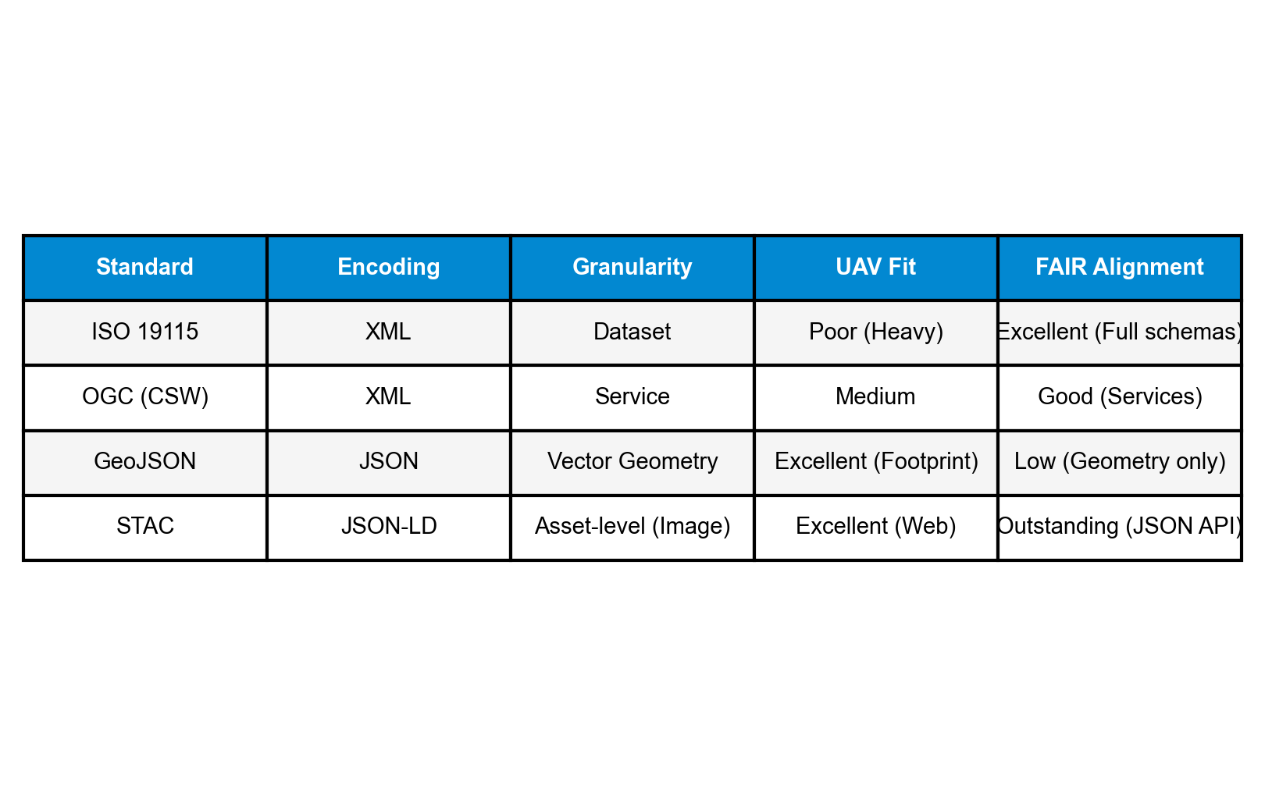
COMPARATIVE ANALYSIS FOR UAV INTEROPERABILITY
• ISO Standards: Heavyweight, structured for formal catalogs, but difficult to implement for single uav frames.
• GeoJSON: Excellent vector format for footprints, but lacks metadata tags for camera calibration and gimbal angles.
• STAC: Combines the best of both worlds. Represents footprints in GeoJSON while storing rich camera assets and flight telemetry in structured JSON-LD properties.
• Recommendation for UAV GIS Workflows:
- Store raw telemetry in STAC Items.
- Export footprint boundaries as GeoJSON features.
- Stream elevation and point clouds via COG and COPC.

Slide 10
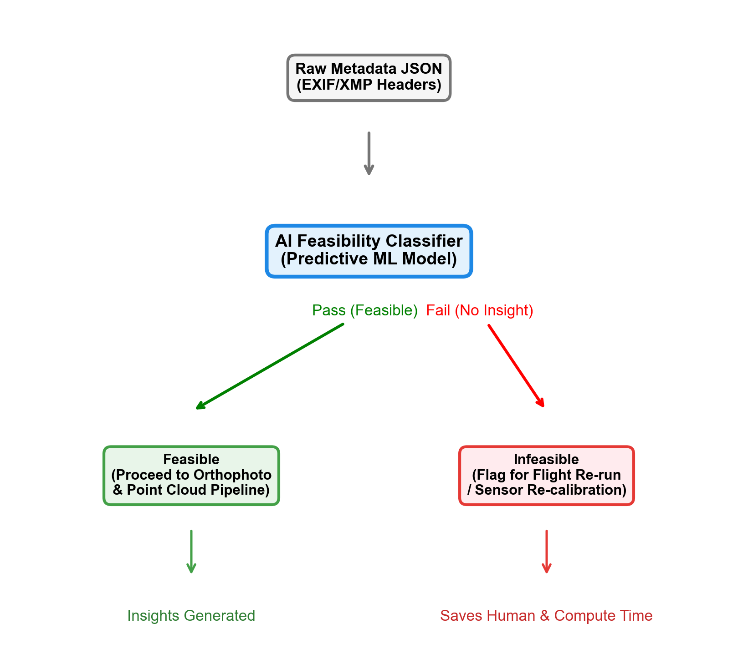
FUTURE SCOPE: AI-DRIVEN METADATA DIAGNOSTICS
• The Core Problem: Processing massive drone datasets (orthomosaics/point clouds) consumes days of computing time, only to discover later that poor raw metadata yields no usable spatial insights.
• AI-Driven Pre-filtering Solution: Develop a predictive machine learning classifier to inspect EXIF/XMP headers before executing the photogrammetry pipeline.
• Key Diagnostics Checked by AI Model:
- Telemetry completeness (GPS coverage gaps, altitude flags).
- Flight safety and quality (pitch/roll stability, speed vectors).
- Radiometric readiness (exposure index, sensor brightness levels).
• Actionable Outcomes:
- PASS: Dataset is marked feasible and proceed automatically to processing.
- FAIL: Flight flagged immediately for re-run or sensor maintenance, saving critical human and computational resources.

