Slide 1

Embedded Systems
DIGITAL
THERMOMETER
WITH LCD DISPLAY
Measuring temperature using TMP36 and displaying it on a 16×2 LCD
Presented by
Kancharla Shaarvaani

Slide 2
INTRODUCTION
Temperature Sensing is an important function in embedded systems, where a physical temperature is converted into an electrical signal that can be processed by a microcontroller.
In this project, a TMP36 temperature sensor is interfaced with an Arduino UNO to measure the surrounding temperature.
The Arduino reads the sensor output, processes the temperature value, and sends the result to a 16×2 LCD for user-readable display.
This project demonstrates the fundamental concept of sensor interfacing and data visualization in embedded systems.
The implementation is carried out using Tinkercad simulation, providing a virtual environment for circuit design, Arduino programming, and functional testing.

Slide 3
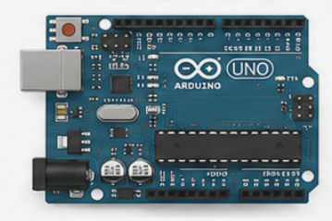
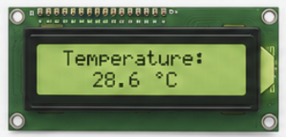
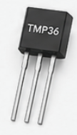
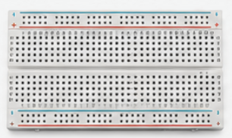

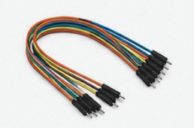

OBJECTIVES
To design a digital temperature measurement system using Arduino UNO.
To interface the TMP36 temperature sensor with the microcontroller.
To measure and process the temperature reading.
To display the measured temperature on a 16×2 LCD.
To verify the complete system through Tinkercad simulation.
COMPONENTS USED
Arduino UNO
TMP36 Temperature Sensor
16×2 LCD Display
10 kΩ Potentiometer
Resistor
Breadboard
Jumper Wires
Tinkercad (Software)

Slide 4
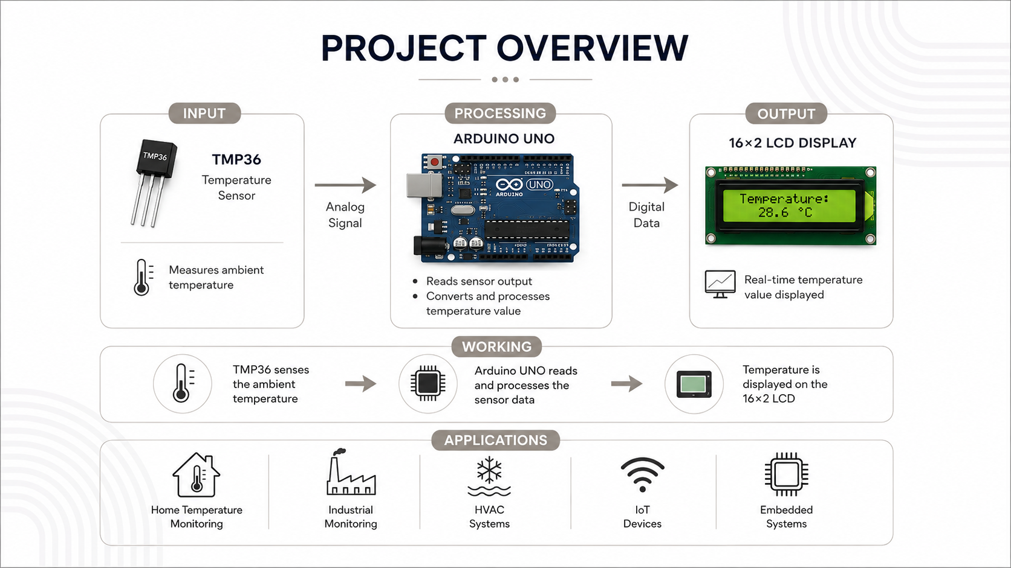

Slide 5
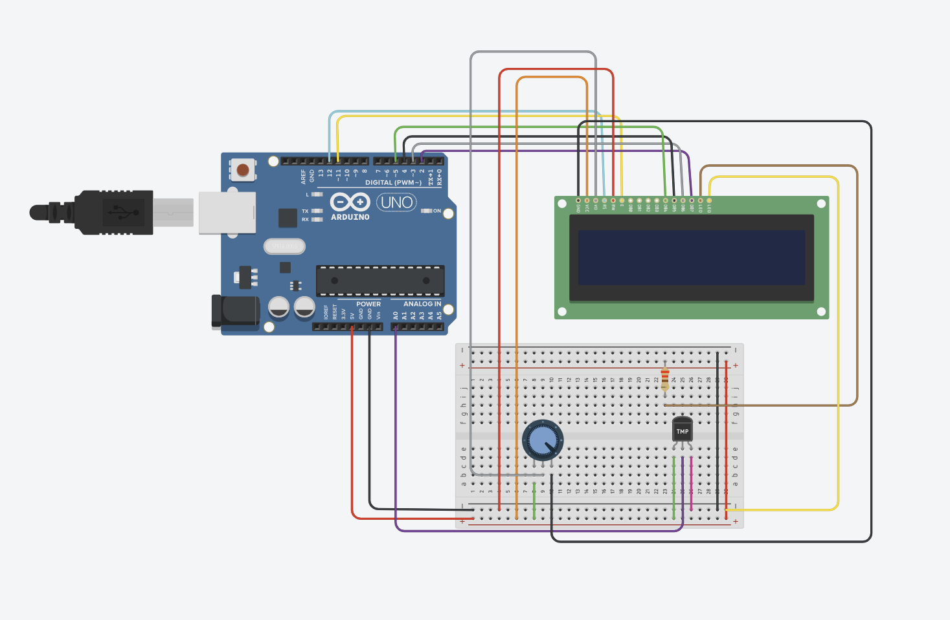
CIRCUIT DIAGRAM

Slide 6
WORKING PRINCIPLE
1. Temperature Sensing
The TMP36 senses the ambient temperature and produces a corresponding analog voltage.
2. Signal Acquisition
The analog output from the TMP36 is connected to an analog input of the Arduino UNO, which reads
the sensor voltage using its Analog-to-Digital Converter.
3. Temperature Calculation
Arduino processes the Analog-to-Digital Converter reading and converts the sensor voltage into a
temperature value.
4. LCD Display
The calculated temperature is sent to the 16×2 LCD, where it is displayed for the user.
5. Continuous Monitoring
The Arduino repeatedly reads the sensor and updates the LCD, allowing the temperature to be
monitored continuously.

Slide 7
PROGRAM CODE
// include the library code:
#include <LiquidCrystal.h>
// initialize the library with the numbers of the interface pins
LiquidCrystal lcd(12, 11, 5, 4, 3, 2);
//declaring the variables
int degree;
double realDegree;
String lcdBuffer;
void setup() {
// setting up the LCD's number of columns and rows:
lcd.begin(16, 2);
degree = 0;
realDegree = 0;
lcd.print("Today's temp:");
// Print a message to the LCD.
}
void loop()
{
degree = analogRead(0);
realDegree = (double)degree/1024;
realDegree *= 5;
realDegree -= 0.5;
realDegree *= 100;
//farahnite's formula
realDegree = (9.0/5)*(realDegree) + 32;
lcd.setCursor(0,1);
// setting the cursor to column 0, line 1
String output = String(realDegree) + String((char)178) + "F";
lcd.print(output);
}

Slide 8
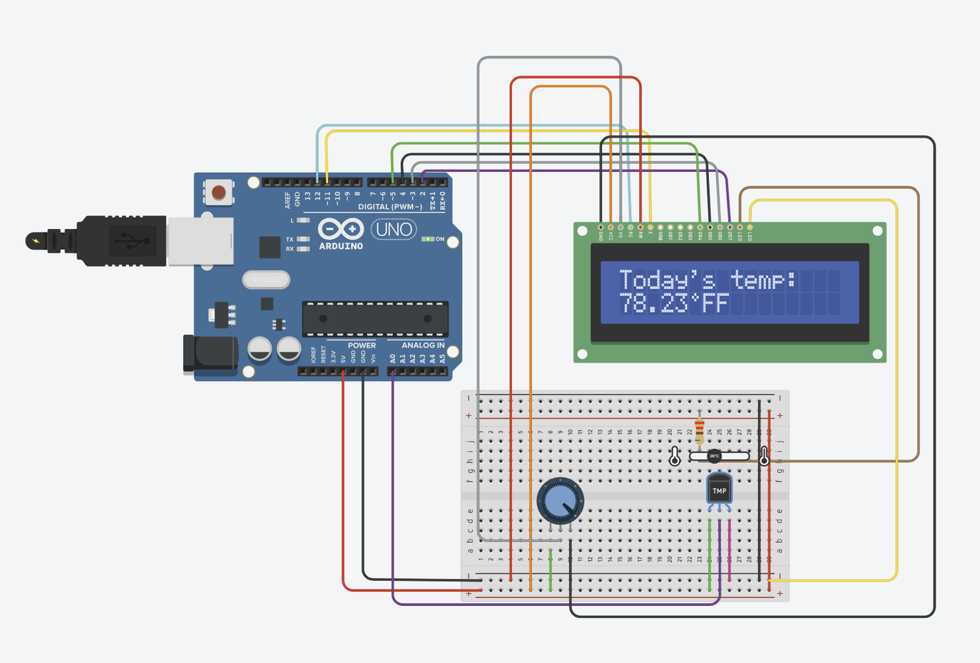
SIMULATION OUTPUT

Slide 9
CONCLUSION
Successfully designed and simulated a digital temperature monitoring system using Arduino UNO and TMP36.
The TMP36 sensor provides the temperature input, which is processed by the Arduino.
The measured temperature is successfully displayed on a 16×2 LCD.
The project demonstrates practical implementation of sensor interfacing, analog-to-digital conversion, Arduino programming, and LCD interfacing.
The complete system was verified through Tinkercad simulation.
Future Scope
Temperature data logging
IoT-based remote monitoring
Mobile/cloud-based visualization
Temperature threshold alerts

Slide 10
THANK YOU
Presented by
Kancharla Shaarvaani

