Slide 1
Name:K.Thanushka
BRANCH/SECTION:CSE-SEC1
ROLL NUMBER:26000030

Slide 2
CASE 7:
Electronics store website
Develop an online electronics catalog for laptops, smartphones, accessories, and smart devices. Include product comparison tables, specifications, discount labels, category filters, and product detail layouts.

Slide 3
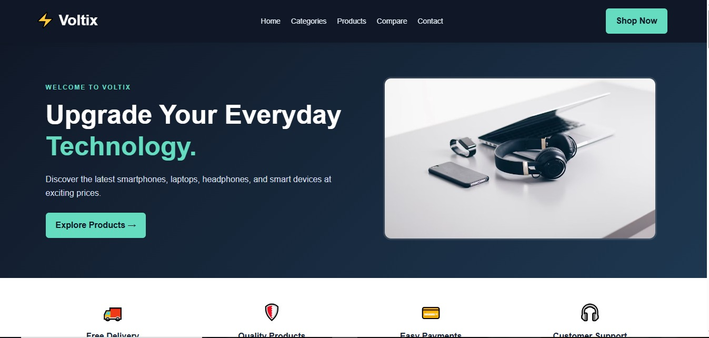

Slide 4
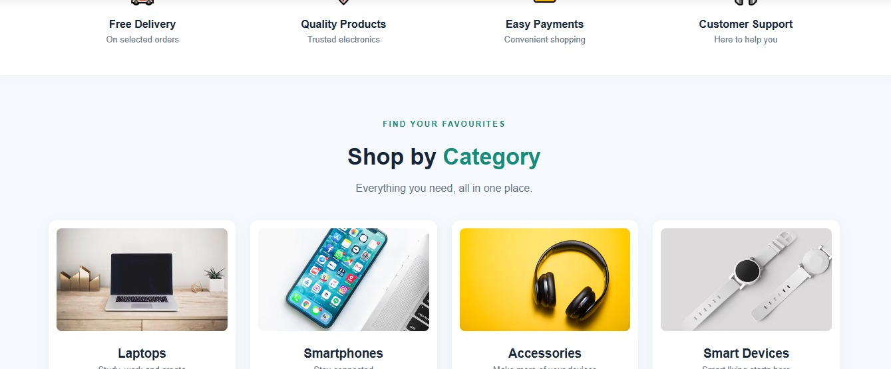

Slide 5
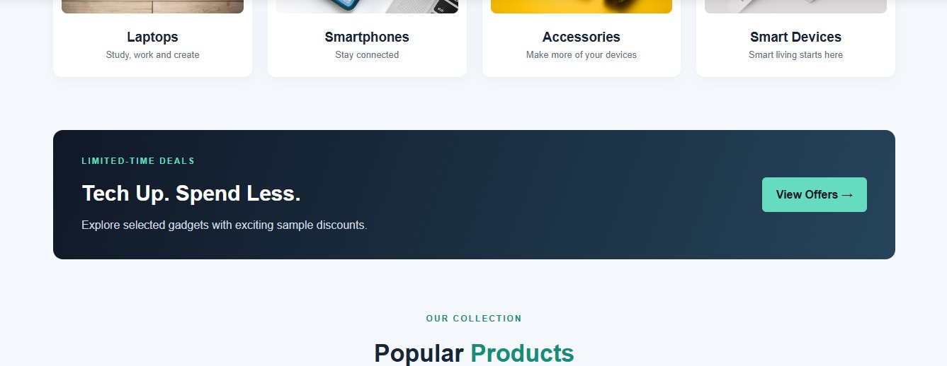

Slide 6
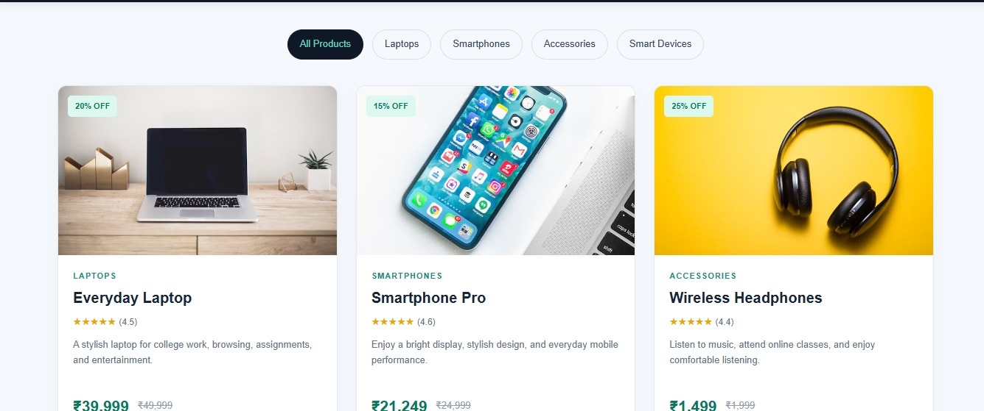

Slide 7
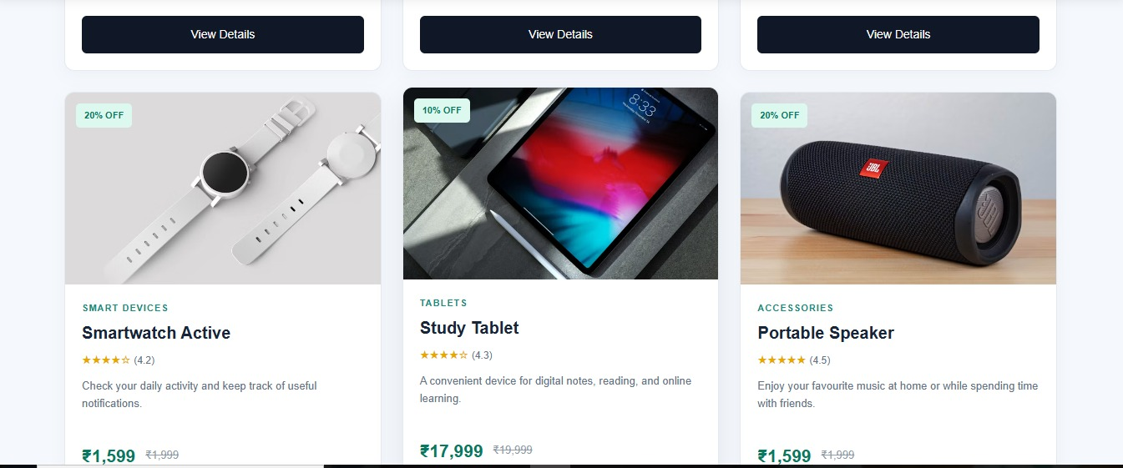

Slide 8
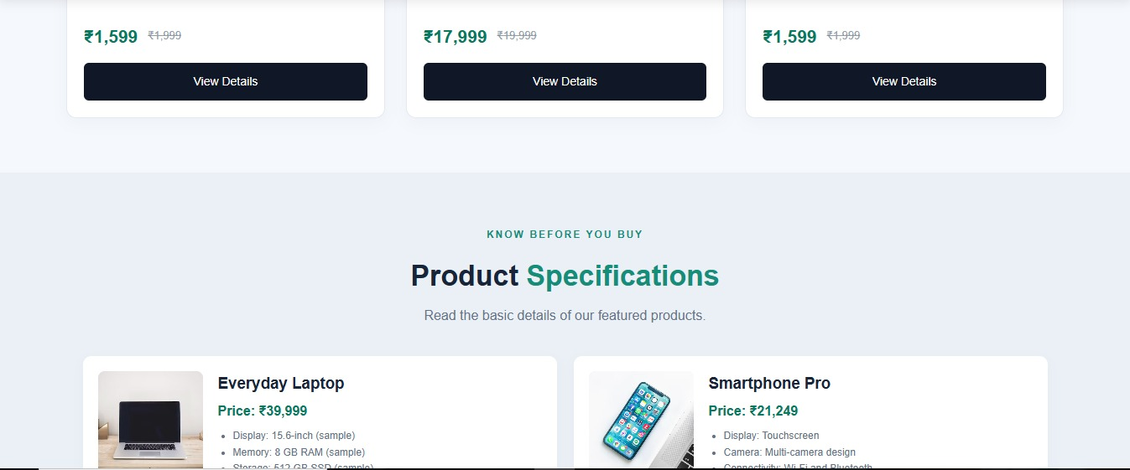

Slide 9
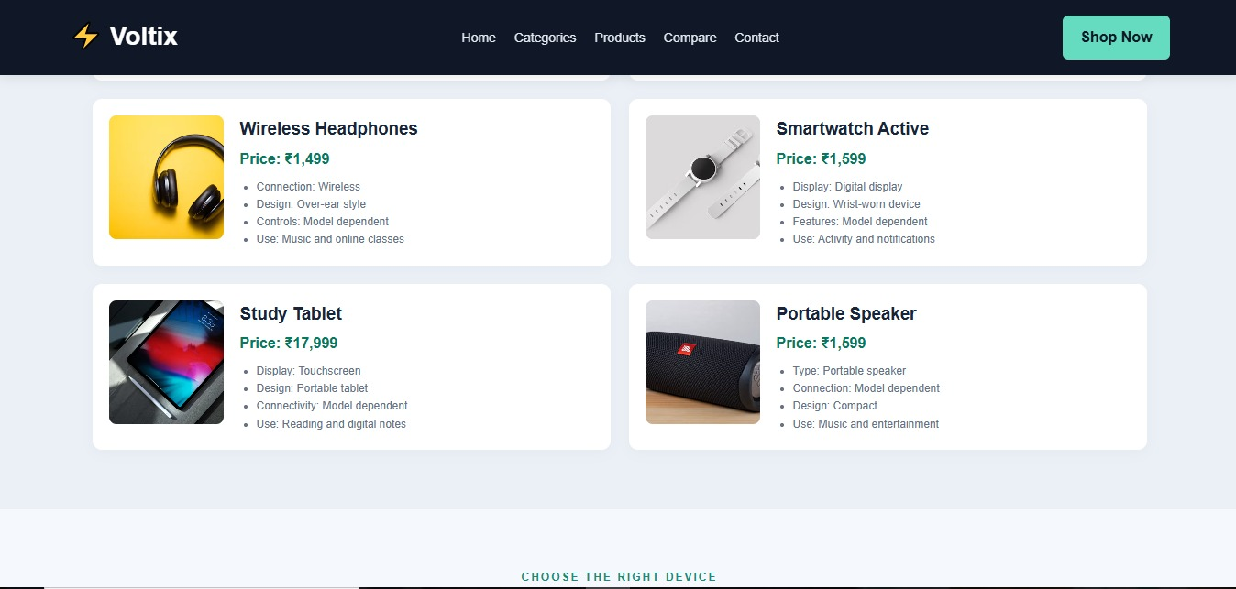

Slide 10
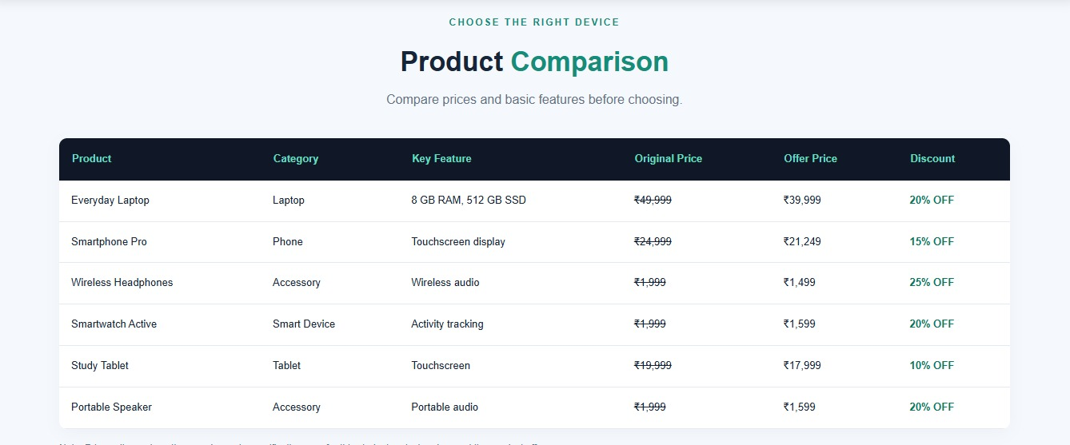

Slide 11
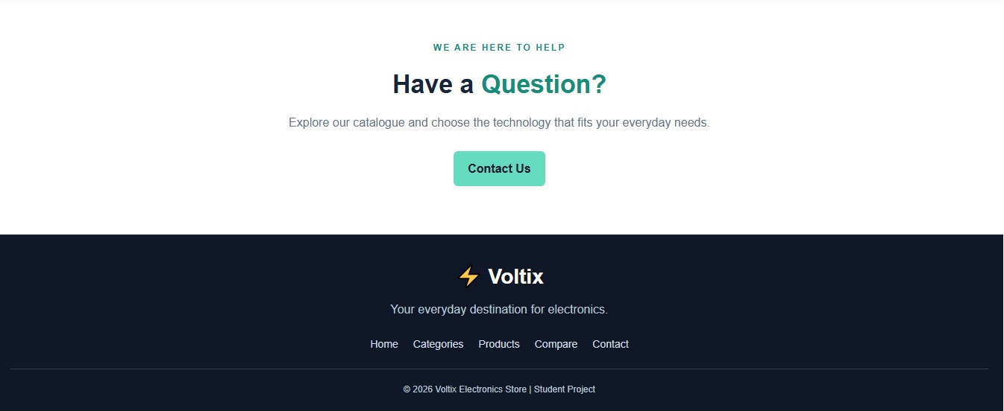

Slide 12
CASE 8:
Online food ordering website
Design a food ordering interface with restaurant details, menu categories, food images, prices, special offers, customer reviews, and order buttons. Use card layouts, attractive backgrounds, and mobile-friendly navigation.

Slide 13
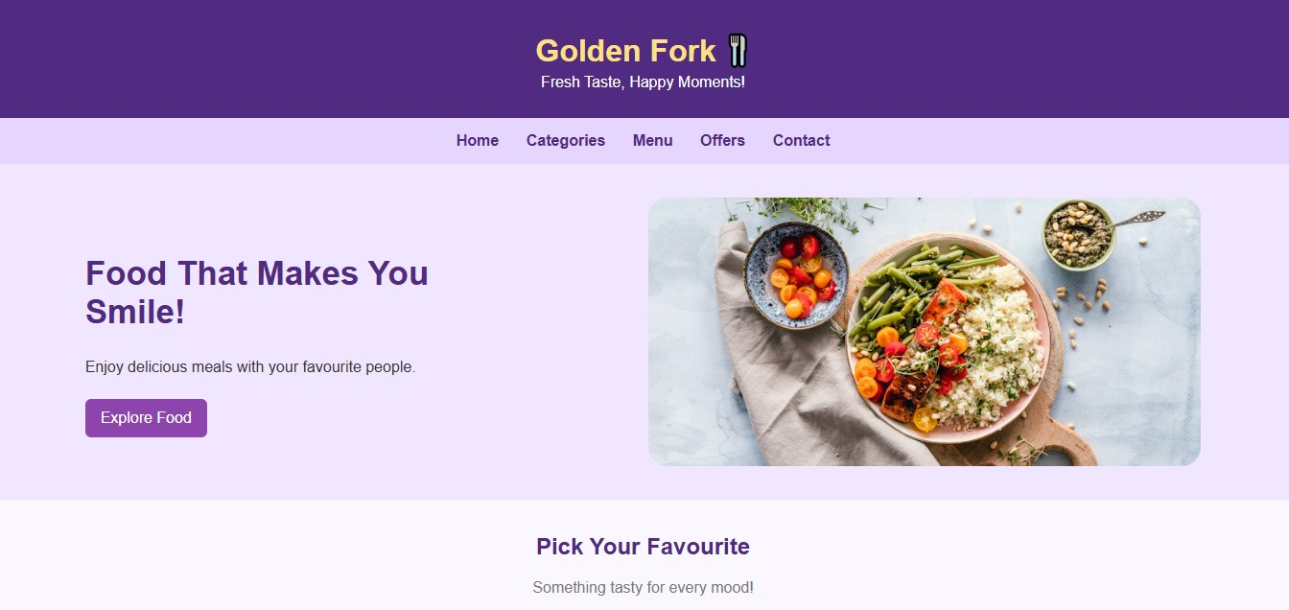

Slide 14
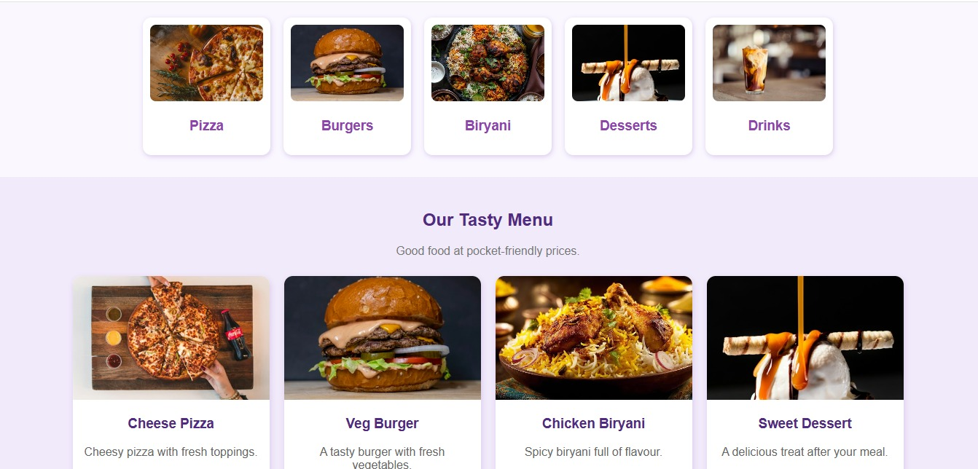

Slide 15
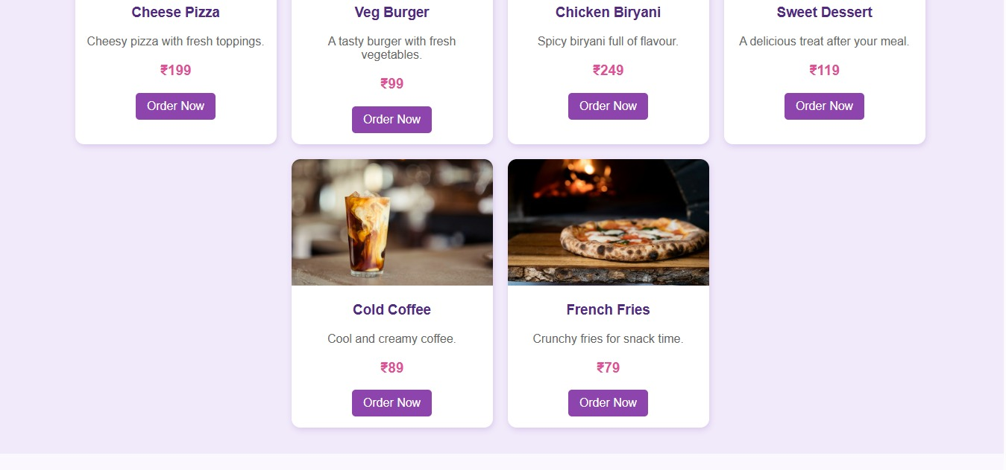

Slide 16
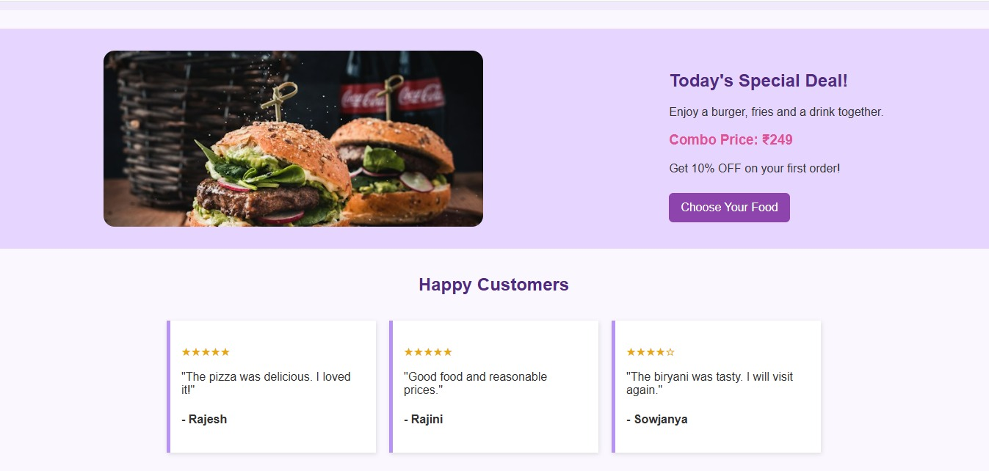

Slide 17
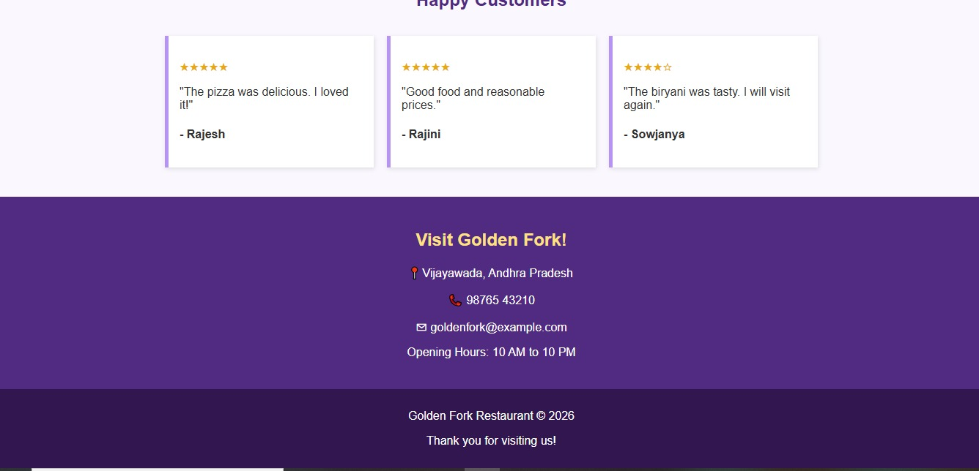

Slide 18
CASE :19
Adventure and Trekking website
website showcasing trekking routes, camping trips, difficulty levels, trip schedules, equipment checklists, safety guidelines, and package prices. Use image overlays and visually distinct information panels.

Slide 19
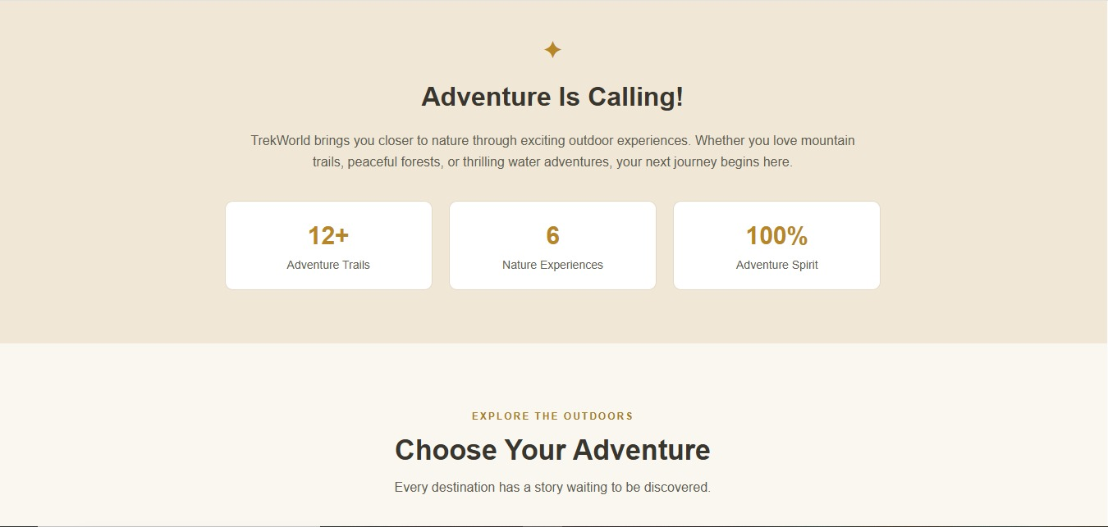

Slide 20
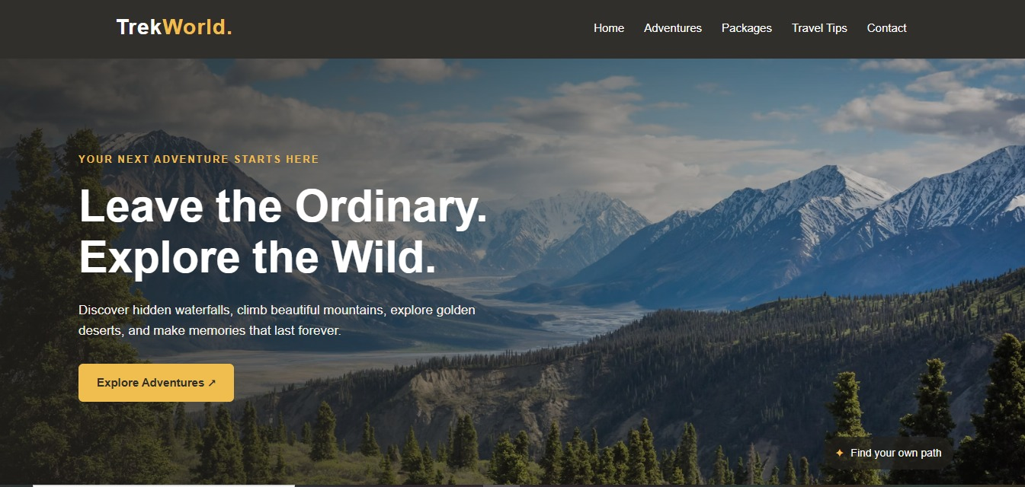

Slide 21
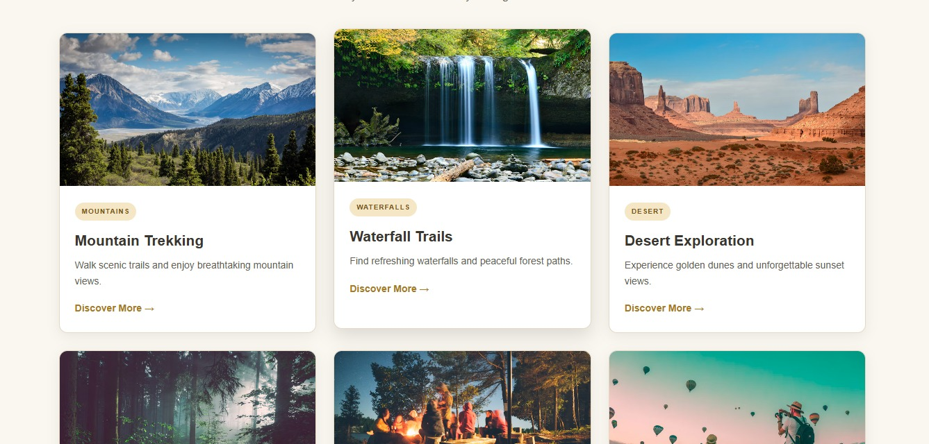

Slide 22
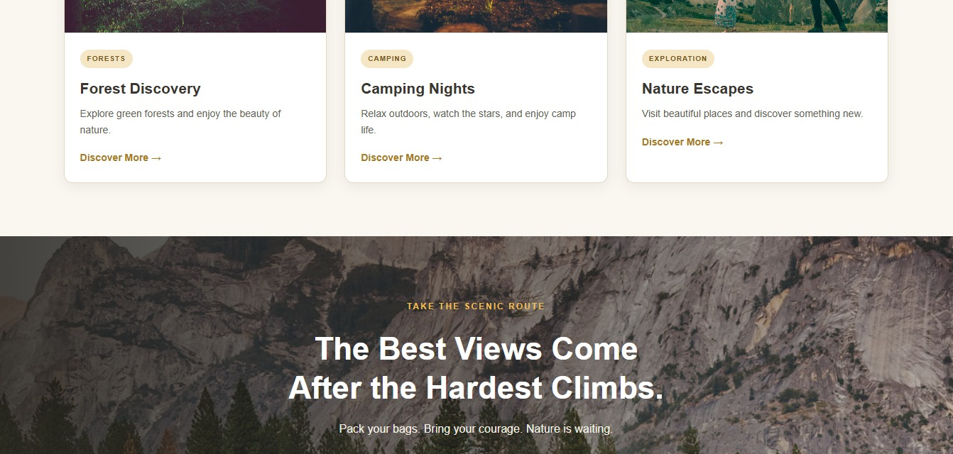

Slide 23
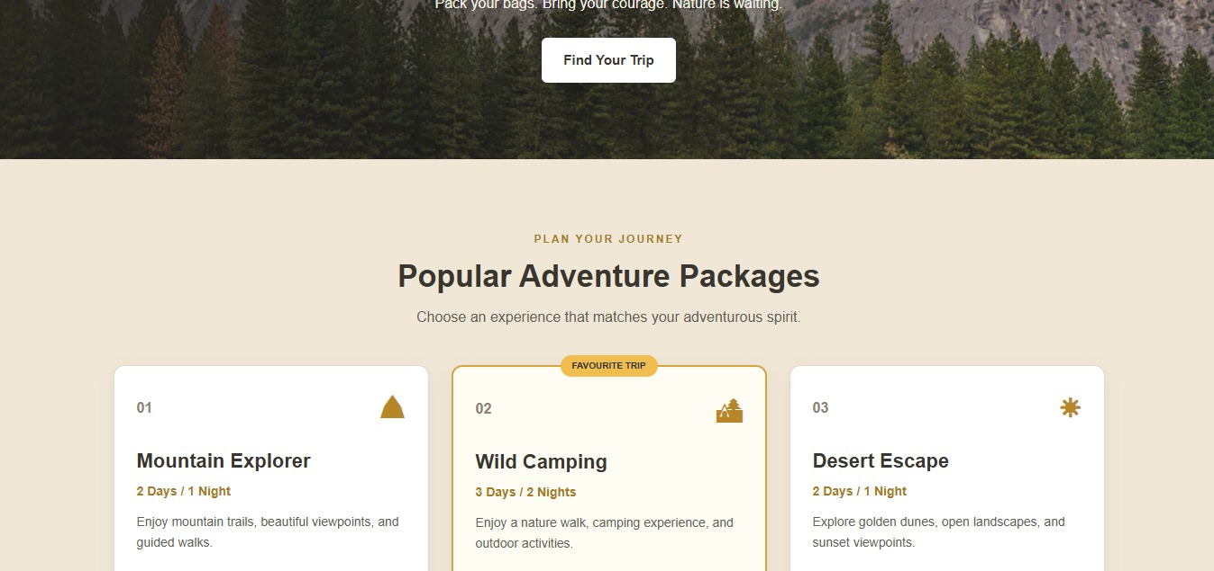

Slide 24
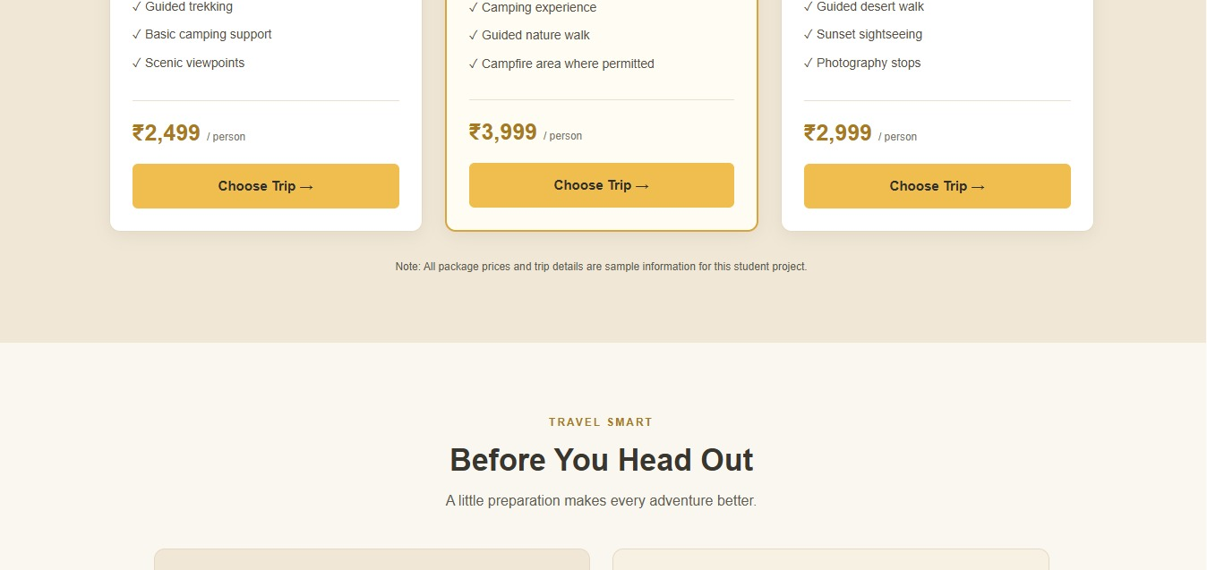

Slide 25
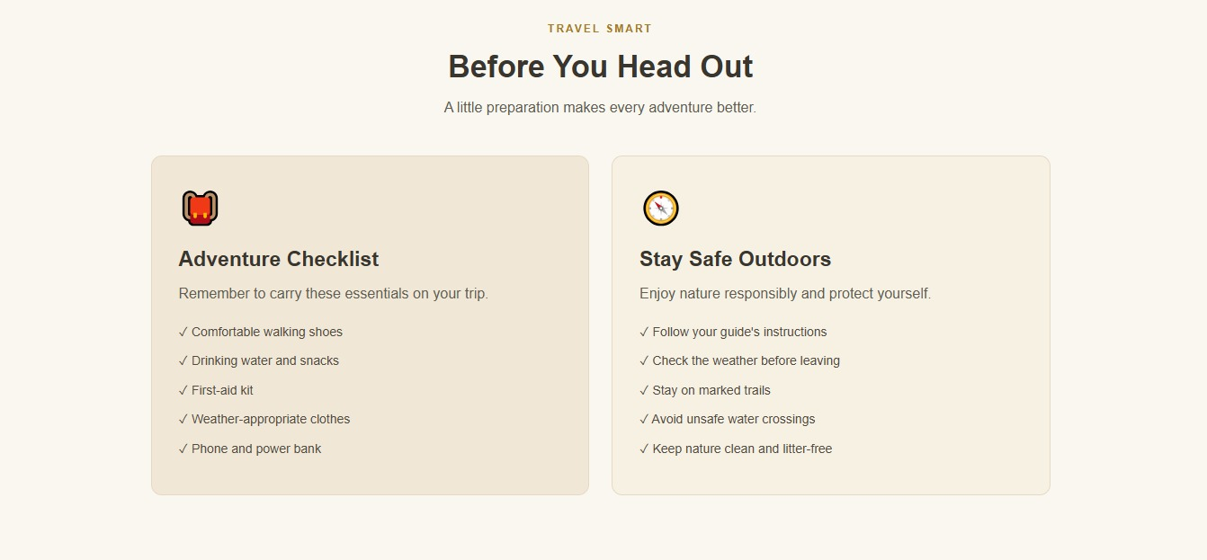

Slide 26
