Slide 1
AtliQ Hospitality Analysis

Slide 2
Problem Statement:
Atliq Grands owns multiple five-star hotels across India. They have been in the hospitality
industry for the past 20 years. Due to strategic moves from other competitors and ineffective
decision-making in management, Atliq Grands are losing its market share and revenue in the
luxury/business hotels category. As a strategic move, the managing director of Atliq Grands
wanted to incorporate “Business and Data Intelligence” in order to regain their market share
and revenue.
However, they do not have an in-house data analytics team to provide them with these
insights. Their revenue management team had decided to hire a 3rd party service provider to
provide them with insights from their historical data.

Slide 3
Main KPIs for Atliq Hospitality:
Occupancy Percentage: 57.45%
Total Revenue: ₹499.18 million
Average Ratings: 3.62
Success Rate: 74.89%
Cancellation Rate: 24.39%

Slide 4
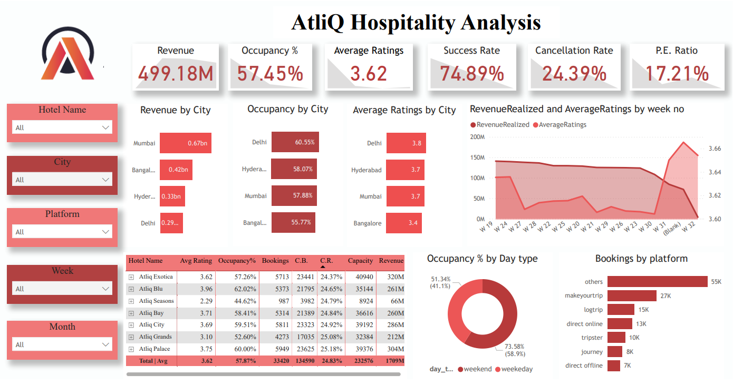

Slide 5
Key Insights:
The hotel with the highest occupancy rate is Atliq Blu, boasting an average occupancy of 62.02%.
Hotels located in Delhi have the highest average occupancy, reaching 60.55%.
Over the past three months, total revenue from all hotels amounted to ₹1.71 billion.
Out of a total of 232,576 rooms, only 57.87% are occupied, resulting in 97,985 vacant rooms.
Week 24 recorded the highest revenue across all weeks, totaling ₹139.6 million.
AtliQ Exotica outperforms all seven types of properties, generating ₹320 million in revenue, with an average rating of 3.62, an occupancy rate of 57%, and a cancellation rate of 24.4%.
Delhi has the lowest revenue generation among the cities.

Slide 6
Employee Attrition Analysis

Slide 7
Problem Statement:
XYZ company which was established a few years back is facing around a 15% attrition rate for a couple of years. And it's majorly affecting the company in many aspects. In order to understand why employees are leaving the company and reduce the attrition rate XYZ company has approached an HR analytics consultancy for analyzing the data they have. You are playing the HR analyst role in this project and building a dashboard which can help the organization in making data-driven decisions.

Slide 8
Main KPIs for Employee Attrition Analysis:
Total Employees: 4,410
Active Employees: 3,699
Attrition Rate: 16.1% (711 employees)
Average Age: 36.92 years

Slide 9
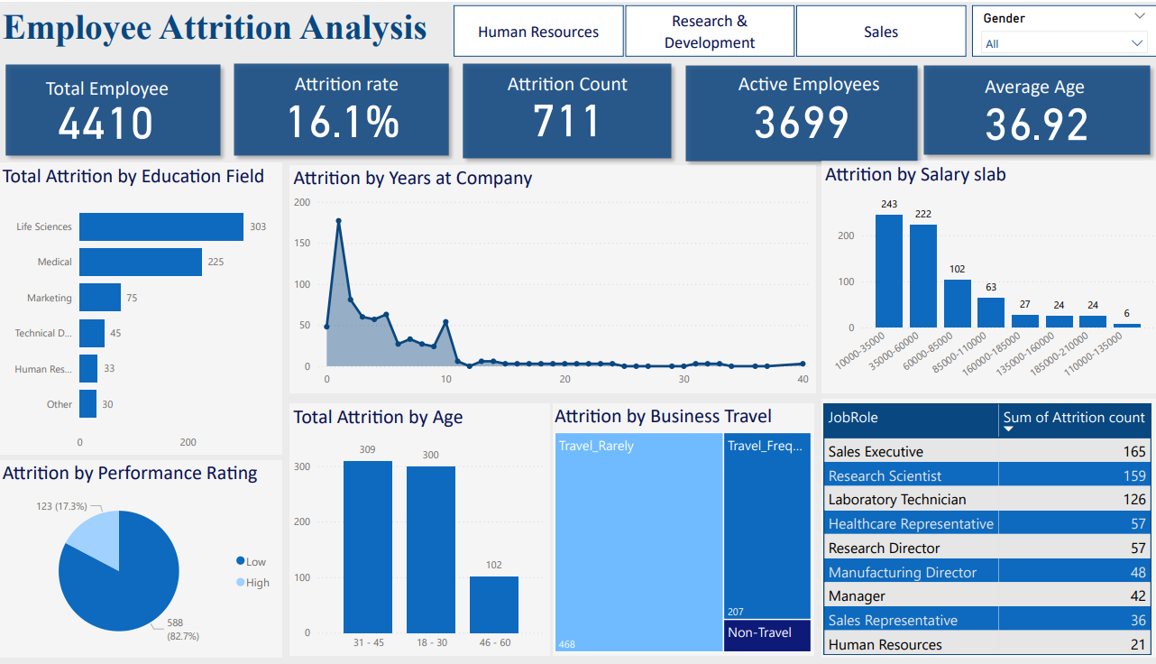

Slide 10
Key Insights:
By Education Field: The highest attrition is in Life Sciences (303), followed by Medical (225), and Marketing (75).
By Age Group: The majority of attrition occurs in the 31-45 age group (309), with 300 in the 18-30 group and 102 in the 46-60 group.
By Job Role: The highest attrition is among Sales Executives (165), Research Scientists (159), and Laboratory Technicians (126).
By Salary Slab: The highest attrition occurs in the $10,000-$35,000 salary range (243), with significant numbers in the $35,000-$60,000 range (222).
By Performance Rating: 82.7% of employees rated high have left, compared to 17.3% rated low.
By Business Travel: Most attrition is among employees who travel rarely (468), followed by frequent travelers (207).

Slide 11
Analyzing Amazon Sales data

Slide 12
Problem Statement:
Sales management has gained importance to meet increasing competition and the need for improved methods of distribution to reduce cost and to increase profits. Sales management today is the most important function in a commercial and business enterprise.

Slide 13
Main KPIs:
Total Revenue: $137.35 million
Total Profit: $44.17 million
Total Cost: $93.18 million
Units Sold: 513,000
Total Profit by Order Priority:
High: $48.75 million
Low: $36.63 million
Medium: $33.12 million
Critical: $18.86 million

Slide 14
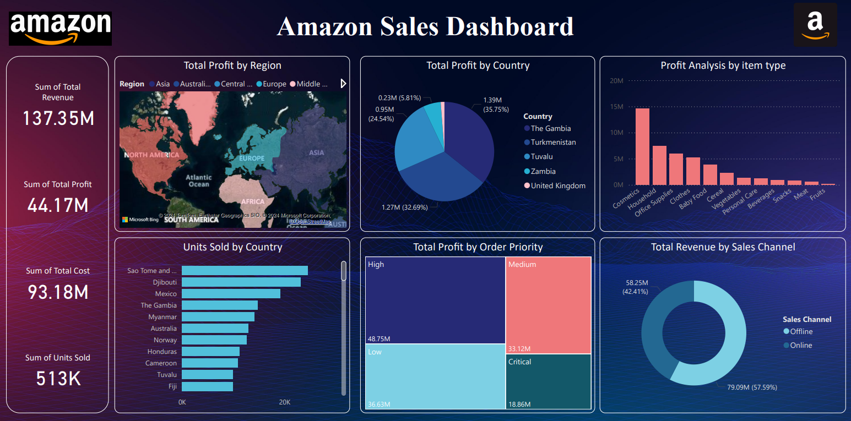

Slide 15
Key Insights:
The United Kingdom generated the highest profit among all countries, amounting to $1.39 million.
Zambia, The Gambia, Tuvalu, and Turkmenistan had lower profits of $1.27 million, $0.95 million, $0.23 million, respectively.
Online sales accounted for 57.59% of the total revenue, contributing $79.09 million.
Offline sales made up 42.41% of the total revenue, contributing $58.25 million.
The highest units sold were in Mexico, Australia, and Norway.
Cosmetics, household items, and office supplies were the top-performing categories in terms of profit.
Asia and Europe regions generated significant profits, indicating strong market presence.

Slide 16
Thank You!

