Slide 1
CREDIT EDA CASE STUDY
By
Santoshi rupa Bagadi
Amirdha parthasarthy

Slide 2
Problem statement
There are two types of risks associated with any type of loan requests. They are:
H0: If the applicant is likely to repay the loan, then not approving the loan results in a loss of business to the company.
H1: If the applicant is not likely to repay the loan, i.e. he/she is likely to default, then approving the loan may lead to financial loss for the company.
** Analysis of data set has been done on Python Jupyter notebook **

Slide 3
Analysis done
Steps:
Check the missing values i.e. which to handle, how to handle.
Check outliers: check data imbalance, ratio of imbalance
Top 10 correlation for the client with payment difficulties other variables within Application DF and Previous App DF
Which correlation is more relevant.

Slide 4
Analysis of application data set

Slide 5

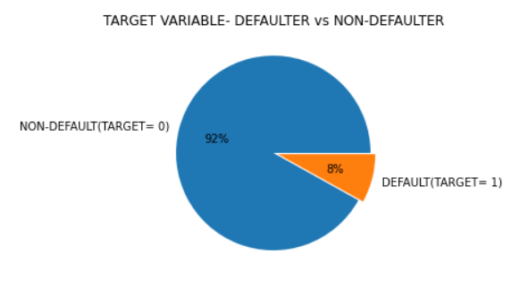
Checking for imbalances
Calculating imbalance percentage of target column:
There is clearly an imbalance between people who defaulted (only 8%) and people who didn't default(about 92%)..

Slide 6
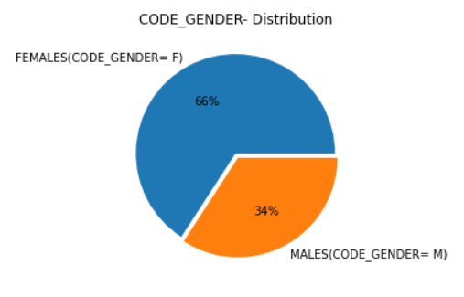
Checking for imbalances
Calculating imbalance percentage of gender type column

Slide 7
Univariate analysis for Categorical variables

Slide 8
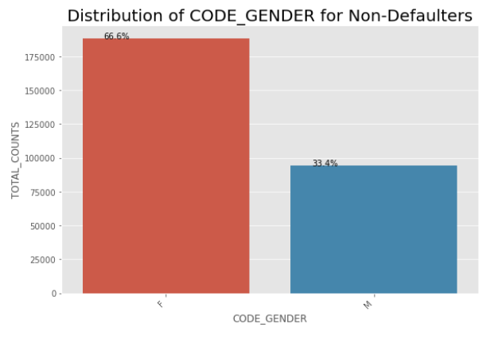
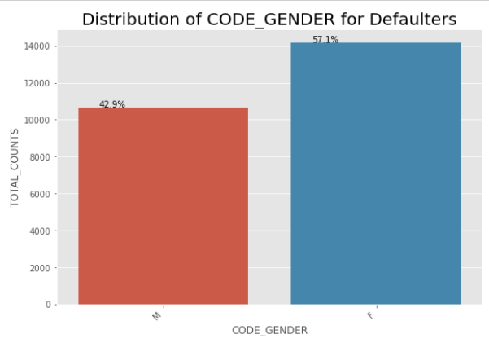
Distribution of gender
Points to be concluded from the graph:
67% of the Non-Defaulters are Females and 57% of Defaulters are Females.
33% of the Non-Defaulters are Males and 43% of Defaulters are Males.
The rate of Defaulting in Females is much lower than in Males.
But the total count of females defaulting loan is seen more because more females are applying for loans than males.

Slide 9
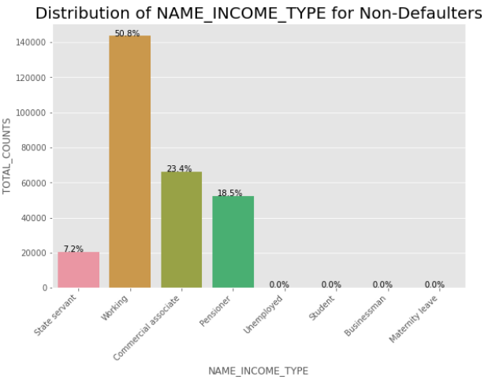
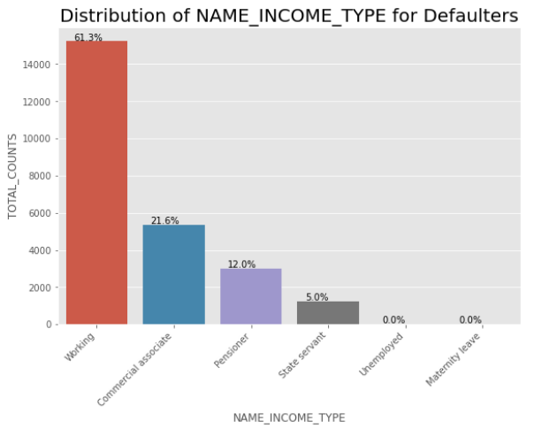
Distribution of Income TYPE
Points to be concluded from the graph:
Students and Businessman never default the loans.
Majority of loans are given to Working people.
Working people comprise 51% of Non-Defaulters and 61% of Defaulters.
The chances of Working people Defaulting the loan is higher.

Slide 10
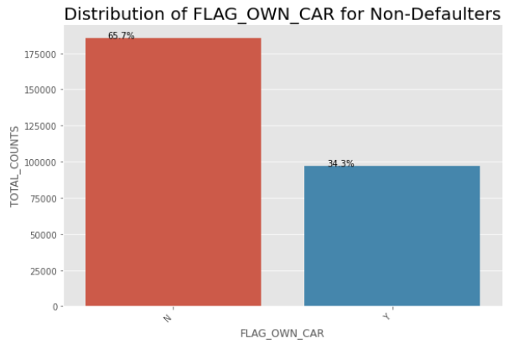
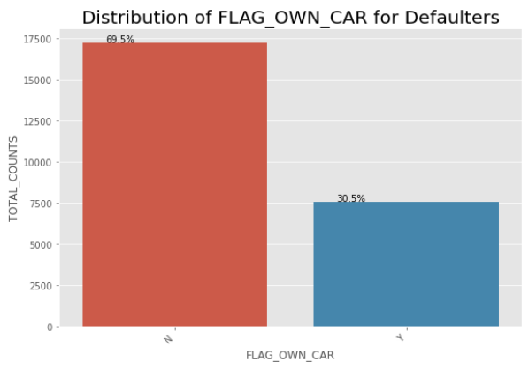
Distribution of car owners
Points to be concluded from the graph:
People who own car show low percentage of defaulting loans than people who doesn't own car.
People who doesn't own cars are high in number to take loans.

Slide 11
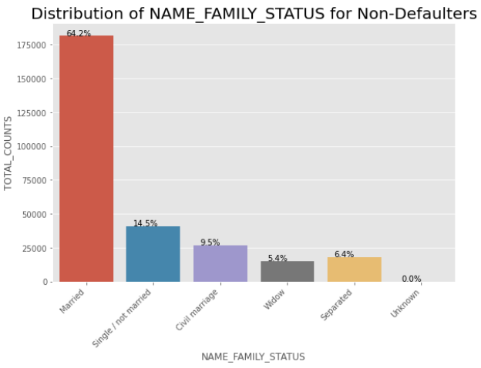
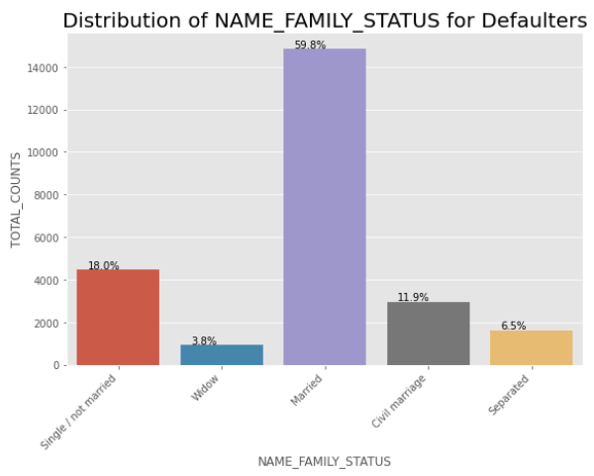
Distribution of FAMILY NAME STATUS
Points to be concluded from the graph:
The Married people are in majority to get loans.
The Married ones have 64% for Non-Defaulters and 60% for Defaulters.
The Single/not married ones have 15% for Non-Defaulters and 18% for Defaulters.
So, there is more risk of defaulting the loans by Single/ not married people.

Slide 12
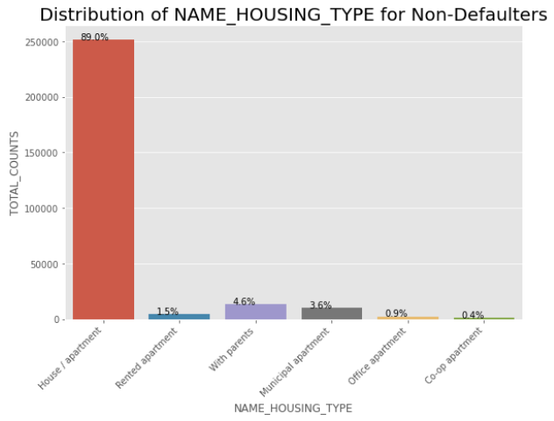
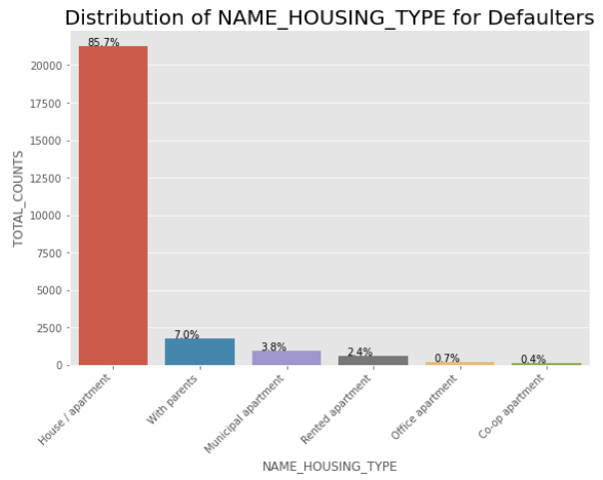
Distribution of HOUSING TYPE
Points to be concluded from the graph:
The people with own house/apartment tend to apply for more loans than other types.
They constitute about 89% of Non-Defaulters and 86% of Defaulters, so they are not risky.
The people who live with parents comprise of 4.6% of Non-Defaulters and 7.0% of Defaulters.
So, its risky to give loans to those who live with parents and those living in Rented apartment.

Slide 13
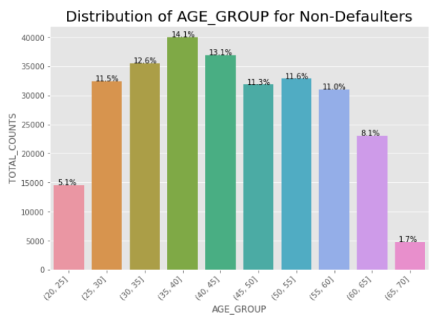
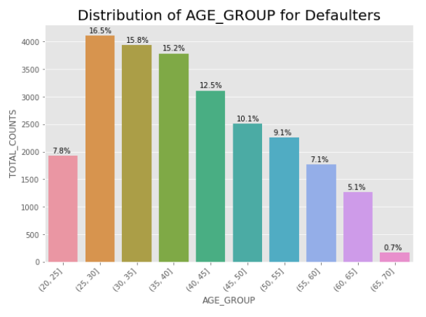
Distribution of AGE GROUP
Points to be concluded from the graph:
The people in the higher age groups have very low rate of defaulting the loans(as the salary increases with experience, they are less chances of defaulting)
The people who are in the age group 25-30 have higher rates of defaulting , so they are risky group to give loans.

Slide 14
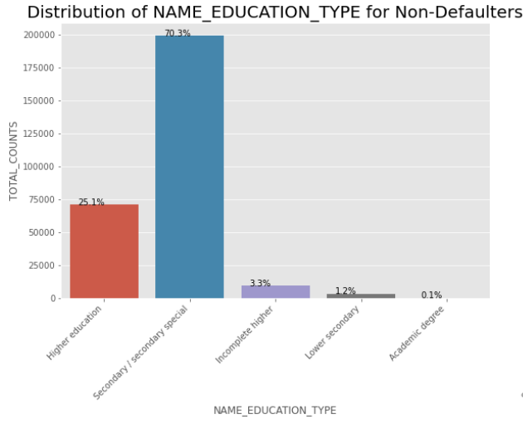
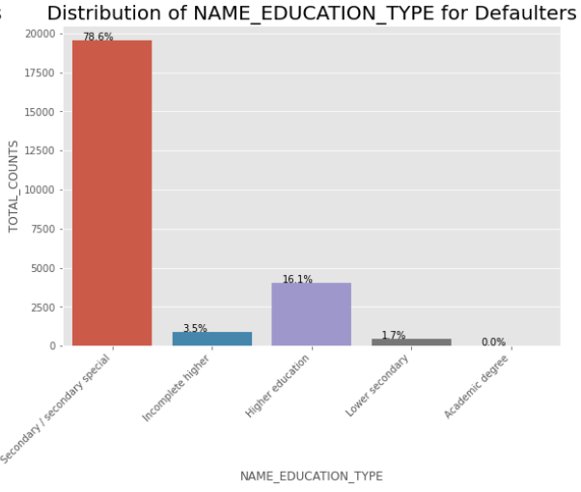
Distribution of EDUCATION TYPE
Points to be concluded from the graph:
The people who are in Secondary/Secondary special are the majority loan appliers among all the other classes.
They are the only risky group as they constitute 70% of Non-defaulters and 79% of Defaulters.

Slide 15
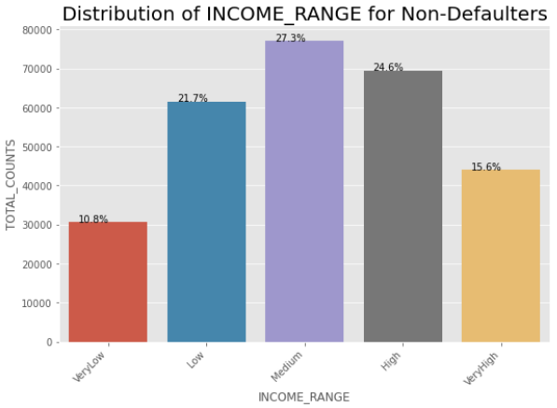
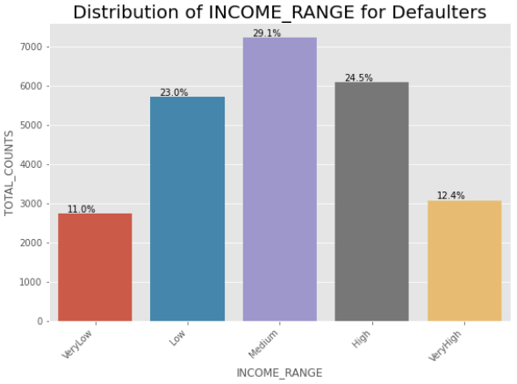
Distribution of INCOME RANGE
Points to be concluded from the graph:
All the income range people almost equally default the loans.
The veryHigh income range ones are the people who are less likely to default.

Slide 16
Univariate analysis for CONTINOUS VARIABLES

Slide 17
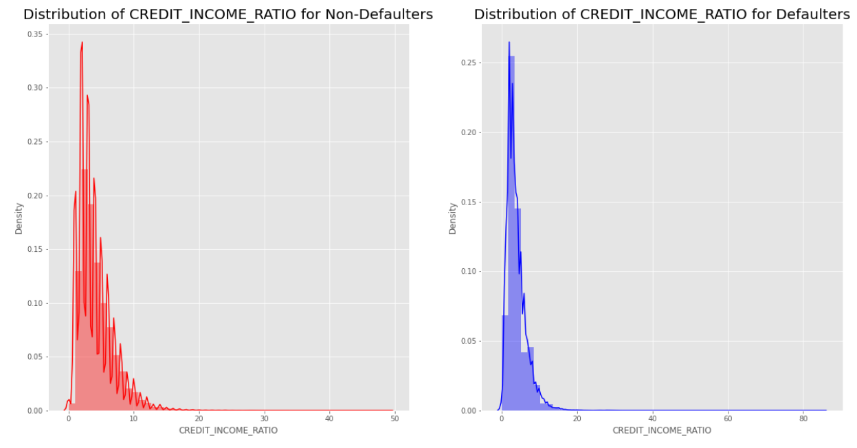
Distribution of credit income ratio
Points to be concluded from the graph:
There is no much difference that can be plotted from this column,as the non-defaulters and defaulters are almost in equal rate.
There is a little chance of people with more than 50 Credit_Income_Ratio to default than others.

Slide 18
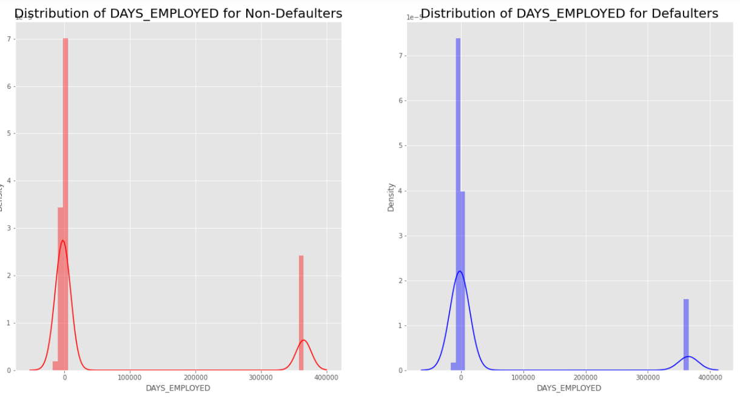
Distribution of days employed
Points to be concluded from the graph:
The people who are employed for less number of days have high chances of defaulting, so they are highly risky.

Slide 19
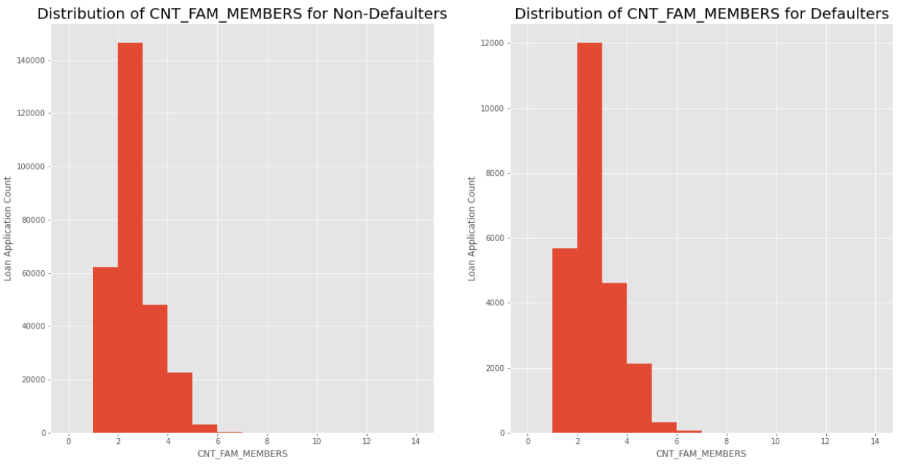
Distribution of count of family members
Points to be concluded from the graph:
The family with 3 members are more likely to take a loan. They are non-defaulters. So, they are not risky group.
No conclusion can be drawn from the plots as the possibility for everyone is almost same.

Slide 20
Bivariate Analysis for Numerical variables

Slide 21
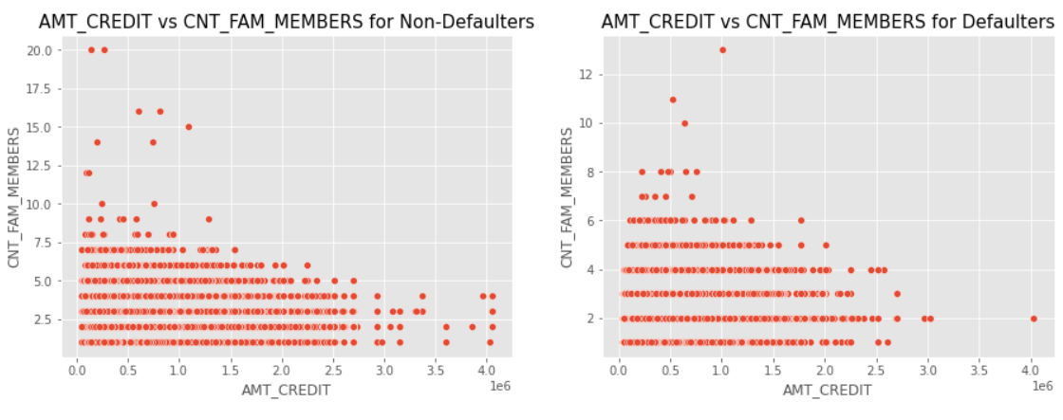
Distribution of count of family members
Points to be concluded from the graph:
The plots are equally likely to get same density for low amount credit group and less family members.
People with big families and larger amount credit seem to default very rare. So, they are less risky group.

Slide 22
Analysis of previous application data set

Slide 23
Univariate analysis

Slide 24
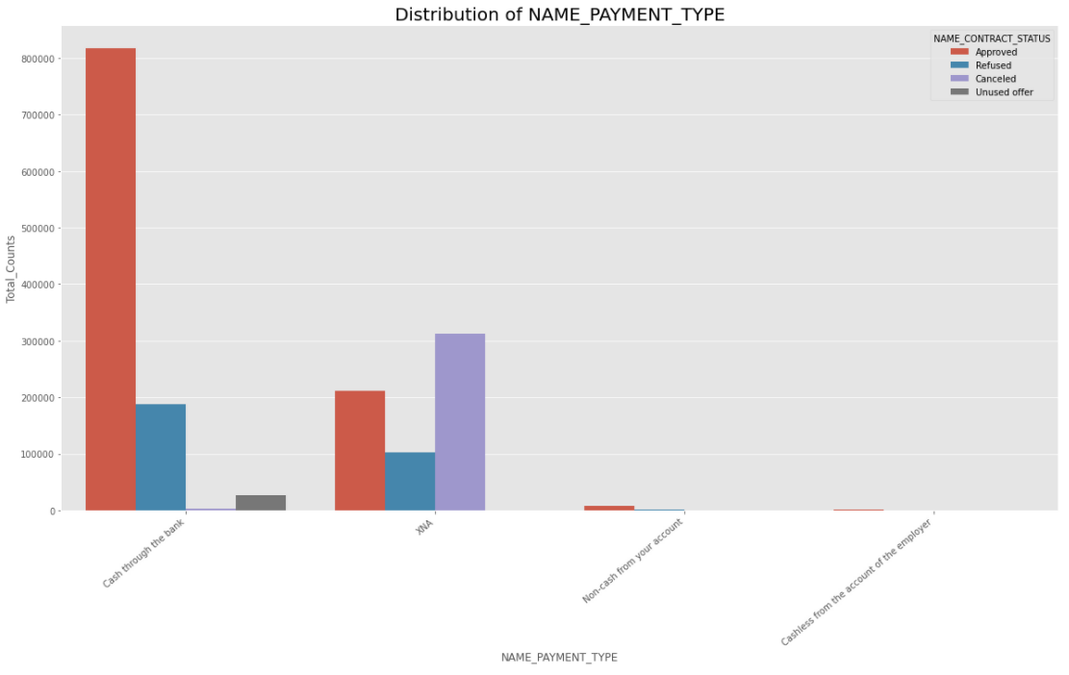
Distribution of name payment type
Points to be concluded from the graph:
Most of the clients prefer to repay the loans by 'Cash through the bank'.

Slide 25
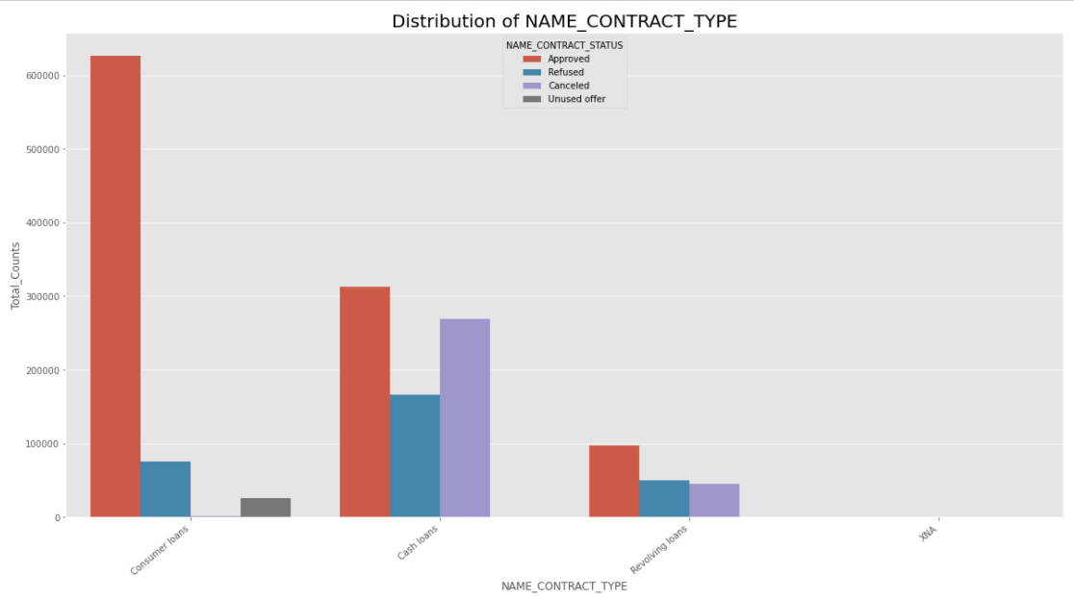
Distribution of name contract type
Points to be concluded from the graph:
Most of the applications are from Cash loans and they are most refused type.

Slide 26
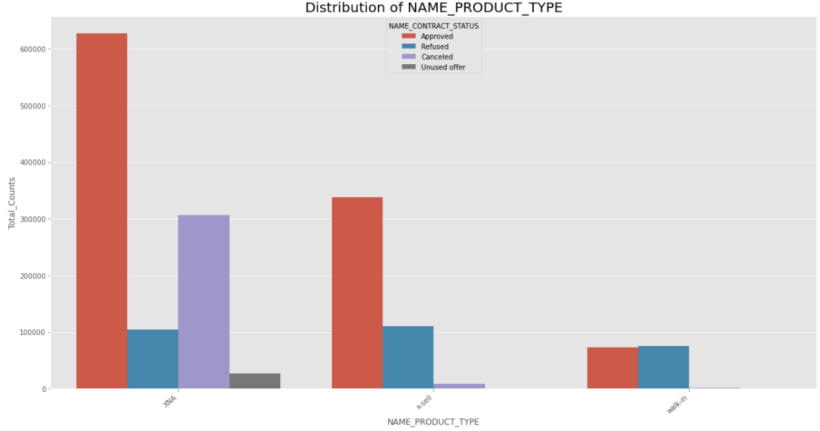
Distribution of name product type
Points to be concluded from the graph:
Most of the preferable mode for customers is sell product type.

Slide 27
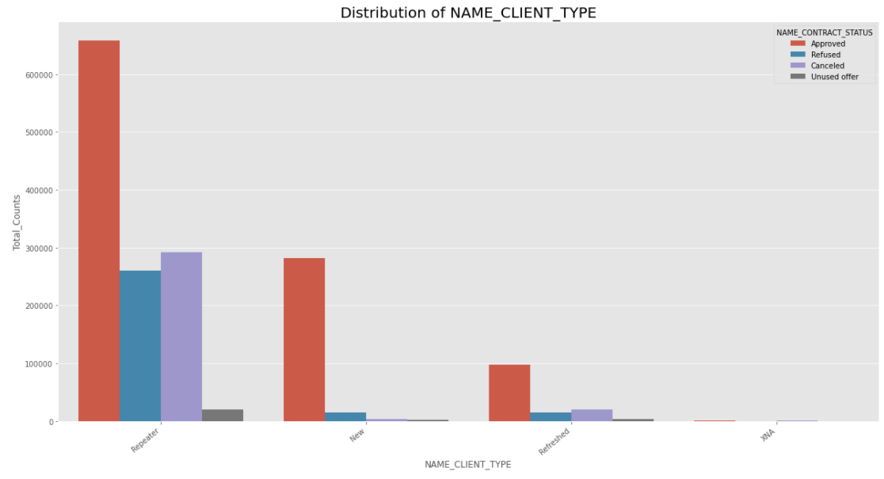
Distribution of name client type
Points to be concluded from the graph:
Most of the clients applying for loans are of the Repeaters type.
There are often chances of rejection of their loans.

Slide 28
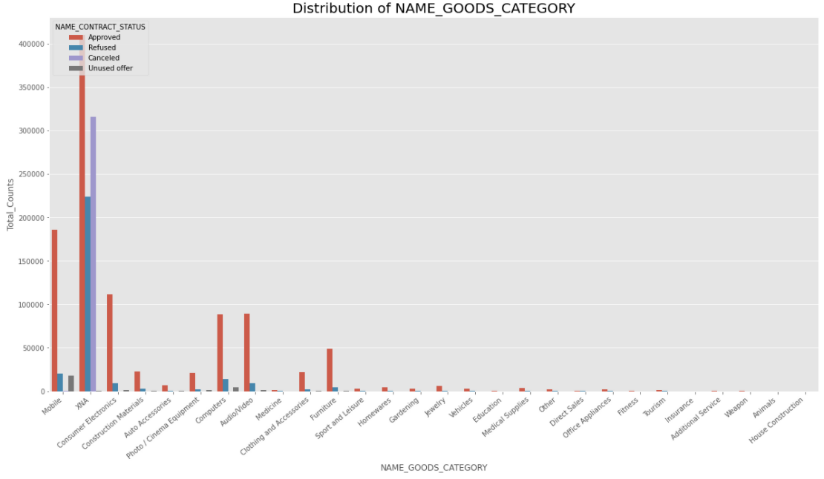
Distribution of name goods category
Points to be concluded from the graph:
Most of the customers getting approval for loans for Mobile, consumer, computers, audio/video, furniture type of Goods category.

Slide 29
Bivariate analysis using pair plots (Numerical Columns)

Slide 30
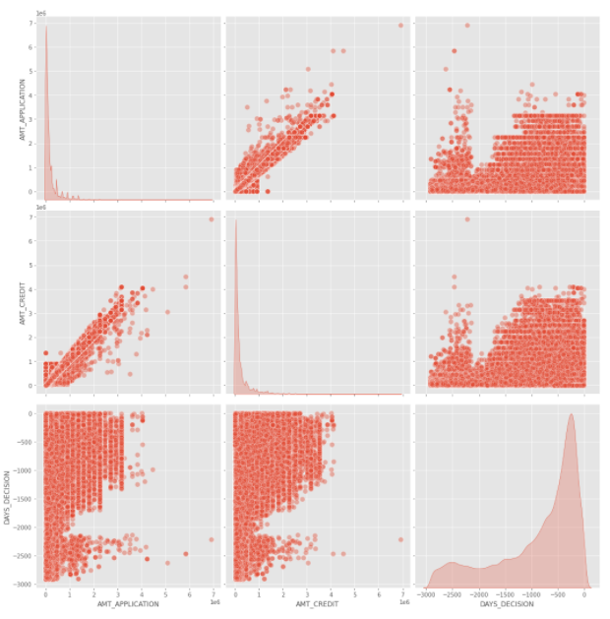
Points to be concluded from the graph:
The final credit amount given to the customer depends upon the application amount specified by the customer which includes the cost of goods for which he wants the loan.

Slide 31
Bivariate analysis using boxplots(Categorical vs Numerical)

Slide 32
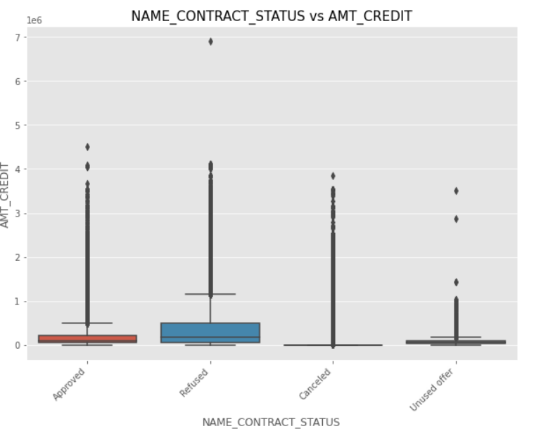
Distribution of name contract status vs credit amount
Points to be concluded from the graph:
When the Credit Amount is too low, the status of the loan is either Cancelled or unused.

Slide 33
Merging Application Dataset with Previous Application Dataset.

Slide 34
Univariate analysis of the combined dataset.

Slide 35
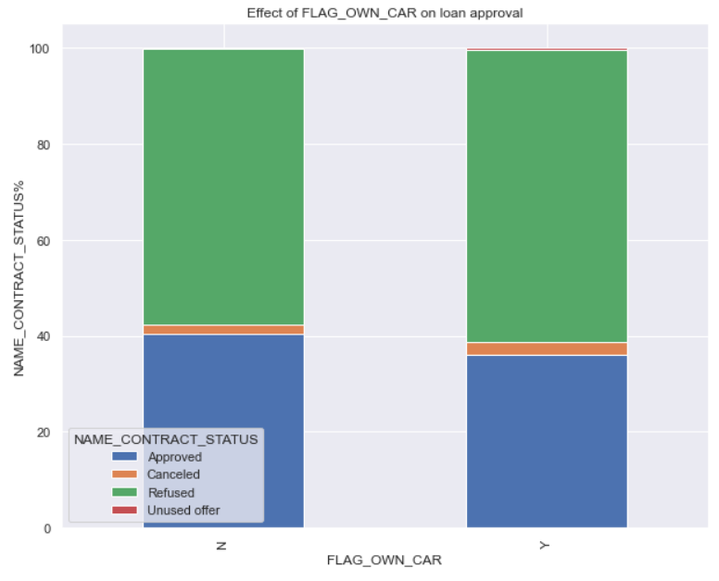
Effect of FLAG OWN CAR
Points to be concluded from the graph:
Its clear from the above plot that there is no effect of car ownership on Approval or Rejection of loan. Earlier, we saw that the people who owned the car have less chances of defaulting so the bank can take weightage of this in considering the Approval of loan.

Slide 36
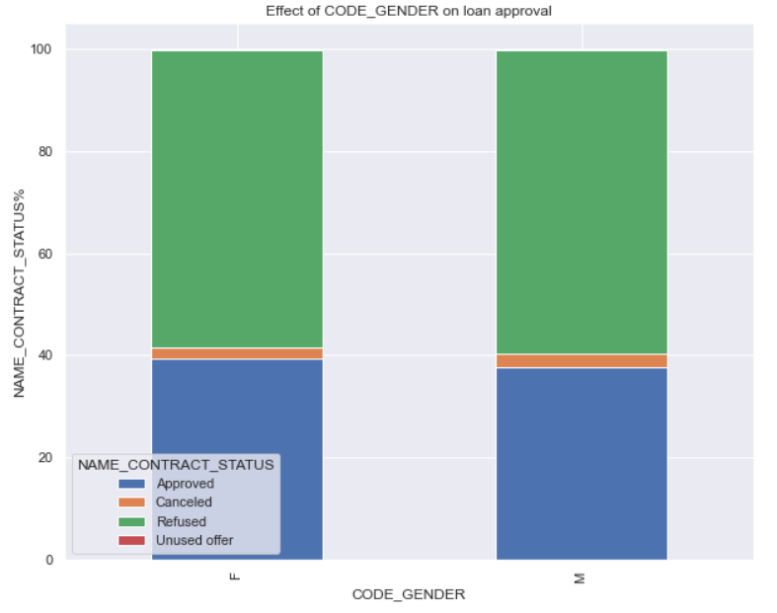
Effect of gender
Points to be concluded from the graph:
Its clear from the above plots that gender doesn't have any impact on approval or rejection of loan. Earlier we plotted and inferred that females have lesser chances of default than males, so the bank can consider this data and give more weightage to women on loan Approval.

Slide 37
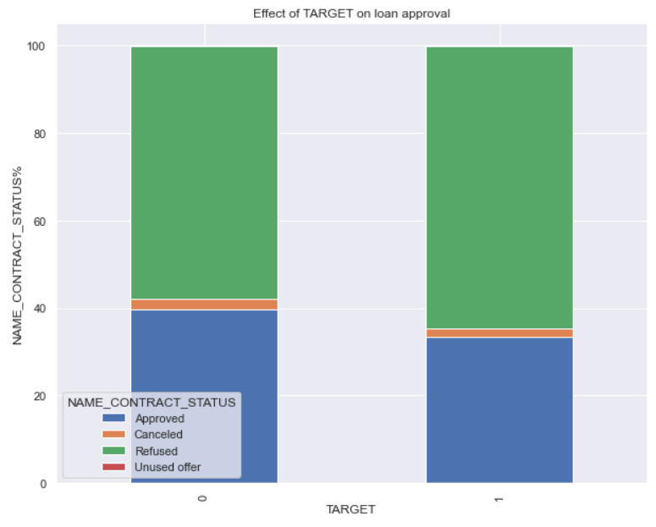
Effect of target
Points to be concluded from the graph:
Its clear from the above plot that the people who were approved for loan earlier have less chances of Defaulting or they are non-defaulters(TARGET=0) People who were rejected for a loan earlier have more chances of defaulting(target=1),defaulters. The bank should give their weightage to the non-defaulters who were given a loan earlier.

Slide 38
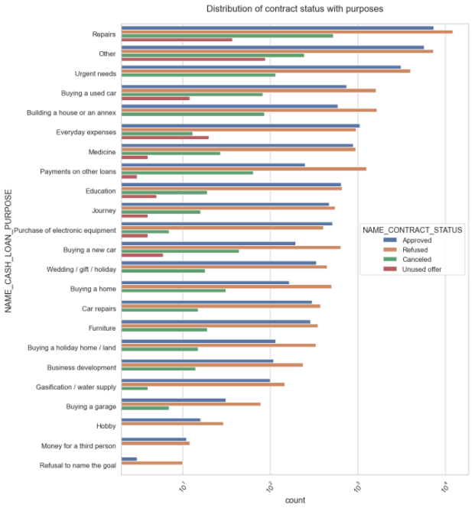
Distribution of contract status with purposes
Points to be concluded from the graph:
Loan purposes like Education, Buying a new car, Buying a garage, Buying a home, Hobby, Furniture etc are likely to do payments without difficulties.
Loan purposes with Repairs are likely to face more difficulties for payments on time.
Focus can be given on Loans with the purpose which have minimal payment difficulties.

Slide 39
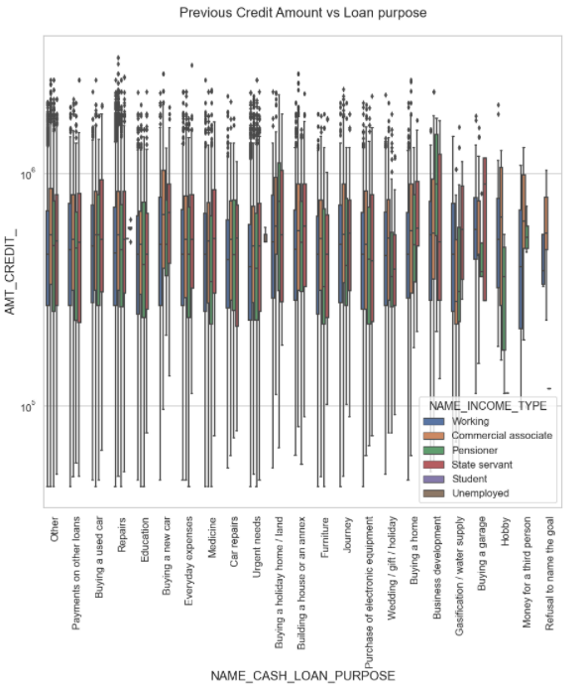
Bivariate analysis for the combined dataset
Points to be concluded from the graph:
The Credit Amount taken is higher for Purposes like Buying a home, Business development, Buying a land, Buying a house.
The income type of State servant has the higher credit amount taken.

Slide 40
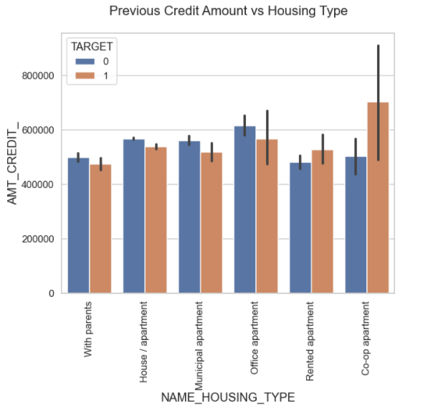
Bivariate analysis for the combined dataset
Points to be concluded from the graph:
The credit amount is more for house/apartment type, office apartment type is more for Non-defaulters.
The credit amount is more for co-op apartment type for defaulters.
Banks should avoid loans for housing type of co-apartments as there are more number of defaulters.
Banks should focus on giving loans for With parents,House/apartment, Office apartment type of housing for successful payments.

Slide 41
Conclusion
Banks should focus on Name_contract_type "Student", "Businessman" and "pensioner" with Housing type "other than co-op-apartment" for successful payments.
Banks should focus less on Income_type "Working" because they have more number of unsuccessful payments.
Loans for the purpose "Repair" should be given less focus as they have large number of unsuccessful payments.
Loans for the housing type "With parents" should be given more focus as they are less likely to default.

Slide 42
Thank you …

