Slide 1
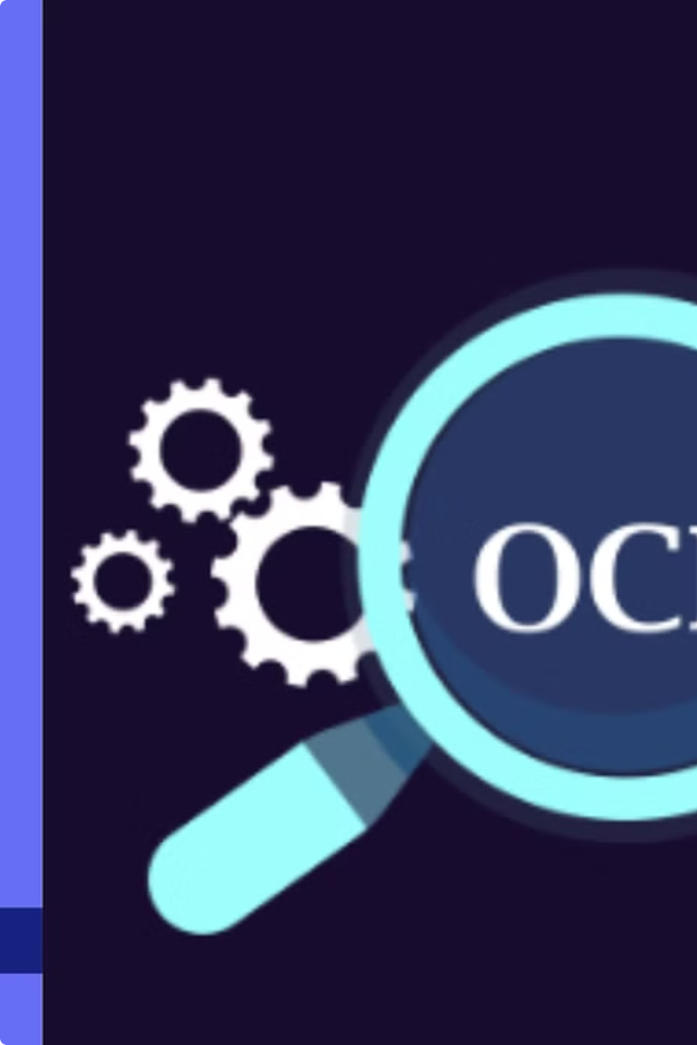

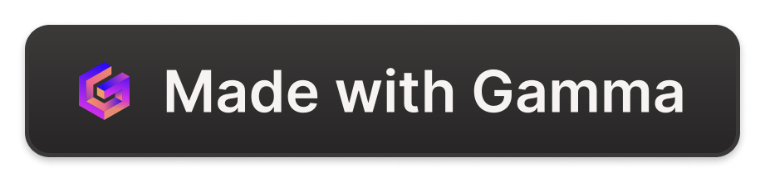
Introduction to OCR and Tesseract
Optical Character Recognition (OCR) is a powerful technology that allows computers to digitize and extract text from images and documents. Tesseract is a widely-used, open-source OCR engine that can recognize text in a variety of languages, including the complex Telugu script.
by Mohan Krishna Madarapu

Slide 2
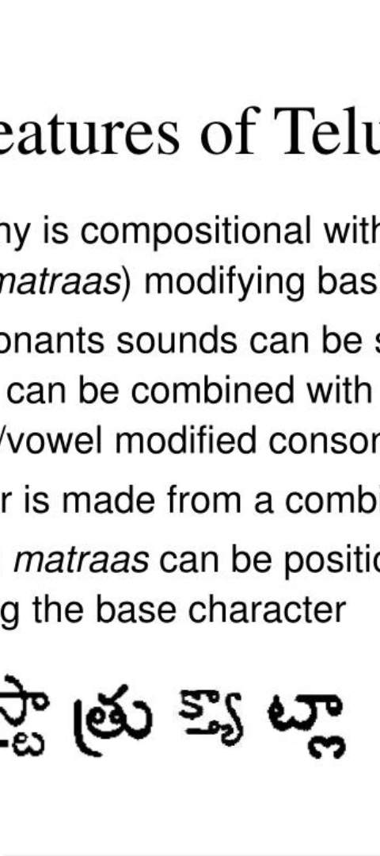
Challenges of Telugu Text Extraction
1
Complex Script
2
Lack of Standardized Datasets
The Telugu language has a unique script with many characters and complex ligatures, making it challenging for OCR systems to accurately recognize.
High-quality datasets of Telugu text images are scarce, hindering the development and training of accurate OCR models.
3
Varied Font Styles
Telugu text appears in a wide range of font types and styles, further complicating the task of recognition.

Slide 3
Preparing the Dataset
Data Collection
Data Annotation
Dataset Augmentation
Gather a diverse set of Telugu text images from various sources, including books, websites, and scanned documents.
Manually label the text in the images to create a ground truth dataset for training and evaluating the OCR model.
Apply data augmentation techniques, such as rotation, scaling, and noise addition, to increase the size and diversity of the training dataset.

Slide 4
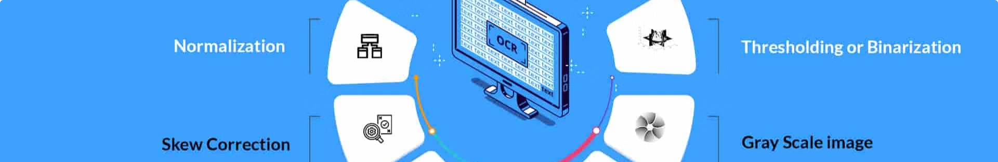
Preprocessing the Images
Noise Removal
Binarization
Apply various filtering techniques to remove unwanted elements and enhance the text regions.
Convert the input images to black and white to simplify the text extraction process.
1
2
3
Skew Correction
Straighten the text lines to ensure accurate character alignment and recognition.

Slide 5
Configuring Tesseract for Telugu
Language Model
Tesseract Engine
Train a custom language model for the Telugu script to improve Tesseract's character recognition accuracy.
Customize the Tesseract engine parameters, such as the page segmentation mode and the character whitelist, to optimize performance for Telugu text.
Dictionary Integration
Preprocessing Workflow
Integrate a comprehensive Telugu dictionary to help Tesseract correct spelling errors and improve the overall text extraction quality.
Develop a robust preprocessing pipeline to enhance the input images and further improve the accuracy of the Telugu OCR system.

Slide 6



Implementing the OCR Model
Python Integration
Deep Learning Approach
Performance Optimization
Leverage the Tesseract Python API to seamlessly integrate the OCR engine into your application.
Explore the use of deep learning techniques, such as Convolutional Neural Networks (CNNs), to further enhance the OCR accuracy for Telugu text.
Implement strategies to optimize the OCR model's speed and efficiency, ensuring real-time processing of large volumes of Telugu text.

Slide 7
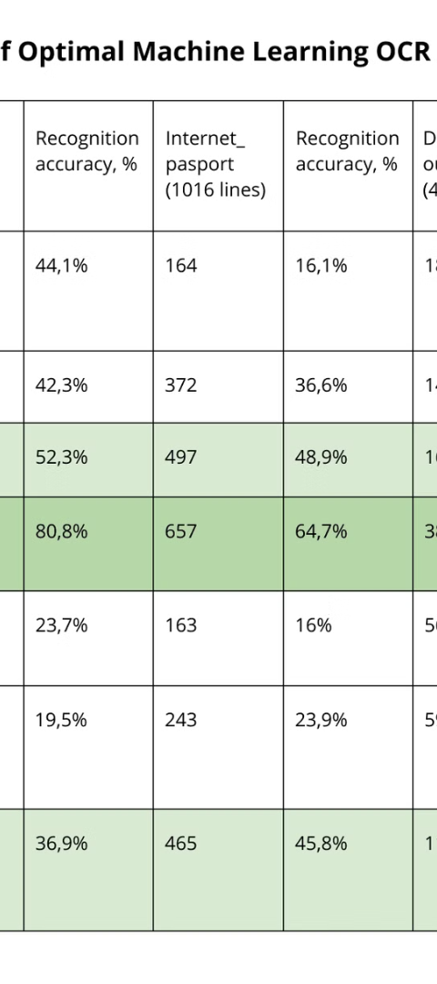



Evaluating the Model's Performance
Accuracy Metrics
Measure the OCR model's performance using standard metrics, such as character error rate (CER) and word error rate (WER).
Human Evaluation
Conduct user studies to assess the readability and usability of the extracted Telugu text for real-world applications.
Benchmark Comparisons
Compare the developed OCR model's performance with other state-of-the-art Telugu text extraction solutions.

Slide 8
Conclusion and Future Improvements
Key Achievements
Overcoming Challenges
Developed a robust OCR model for Telugu text extraction using Tesseract
Addressed the complexities of the Telugu script and the lack of standardized datasets
Implemented novel preprocessing techniques and deep learning approaches to enhance accuracy
Customized Tesseract's language model and engine parameters for optimal Telugu OCR performance
Achieved state-of-the-art results in Telugu text recognition
Explored ways to further improve the OCR model's speed and efficiency for real-time applications

