Slide 1
LAN Messaging Application Using Network Programming
By Oussama Kandakji 4766
Supervised by Dr. Mahmoud doughan

Slide 2
Outline
Introduction
Objective
What is a computer network?
How do devices communicate?
Switching Concept
TCP Communication
Definition
TCP vs. UDP
TCP Communication Mechanism
Client-Server Based LAN Messaging App
What is a Socket?
The system’s Architecture
Connection to the Server
Message Forwarding
Conclusion

Slide 3
Outline
Introduction
Objective
What is a computer network?
How do devices communicate?
Switching Concept
TCP Communication
Definition
TCP vs. UDP
TCP Communication Mechanism
Client-Server Based LAN Messaging App
What is a Socket?
The system’s Architecture
Connection to the Server
Message Forwarding
Conclusion

Slide 4
Objective
A Client-Server-based Local Area Network Messaging Application:
Messaging and update tracking is crucial in today’s enterprises and companies
Users, communication, and messaging are handled by a Server that handles
Authentication
Session Establishment
Message Forwarding
Session Termination
Clients connect to the Server in order to access this service
Both, the Clients and Server are on the same LAN without going outside to the internet or another network
It will provide lower latency and immunity to loss of integrity or eavesdropping

Slide 5
Outline
Introduction
Objective
What is a computer network?
How do devices communicate?
Switching Concept
TCP Communication
Definition
TCP vs. UDP
TCP Communication Mechanism
Client-Server Based LAN Messaging App
What is a Socket?
The system’s Architecture
Connection to the Server
Message Forwarding
Conclusion

Slide 6
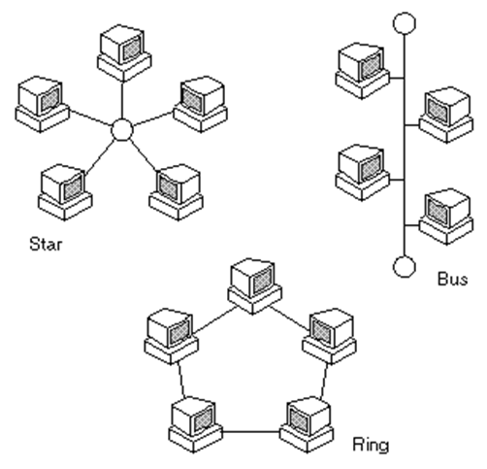
What is a Computer Network?
Networks in telecommunication are defined as a group of two or more terminal nodes which are linked together to enable telecommunication between them
Computer networks, or data networks that involve digital telecommunications which allows nodes to share resources
The data links are established over cable media such as wires (Serial or Twister Pair) or optic cables, or wireless media such as WiFi
Widely used when it comes to using the internet, file sharing, online shopping, and receiving updates inside and outside an enterprise via mail or direct messaging

Slide 7
Outline
Introduction
Objective
What is a computer network?
How do devices communicate?
Switching Concept
TCP Communication
Definition
TCP vs. UDP
TCP Communication Mechanism
Client-Server Based LAN Messaging App
What is a Socket?
The system’s Architecture
Connection to the Server
Message Forwarding
Conclusion

Slide 8
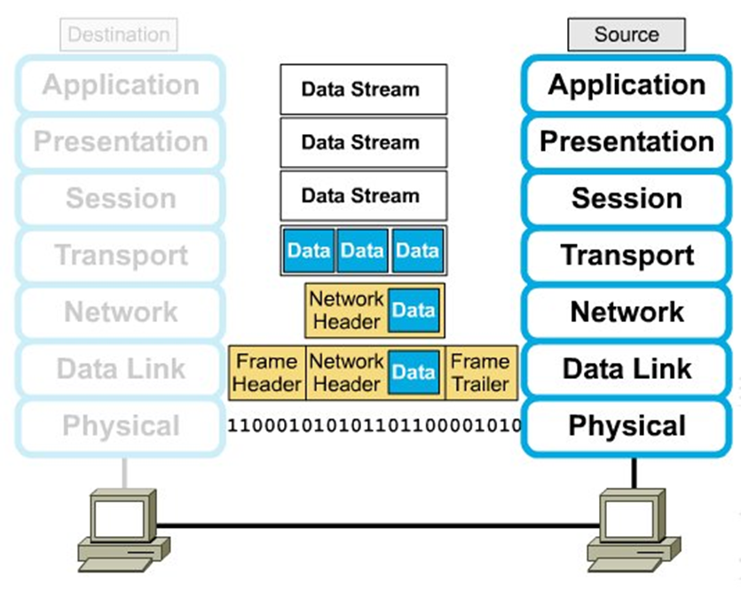
OSI Model
Each end-device when communicating with another entity, its data passes through the 7-layers of the OSI Model
The OSI Model was create to ease the understanding of the representation of data in networks
When a device is sending data, the data passes from top to bottom while changing its form at each layer, and the opposite happens when receiving
The higher we go, the closer to the user when get
Our main focus will be on the Transport, Network, and Data Link Layers

Slide 9
U-shaped Communication
The communication between the two devices occurs in a u-shaped manner from source to destination
Data is segmented in the transport layer while adding source and destination port numbers
The source and destination IP addresses are added in the network layer
The source and destination MAC addresses are added in the data link layer
At the destination, the headers and trailers are check and removed while going up at each layer

Slide 10
Outline
Introduction
Objective
What is a computer network?
How do devices communicate?
Switching Concept
TCP Communication
Definition
TCP vs. UDP
TCP Communication Mechanism
Client-Server Based LAN Messaging App
What is a Socket?
The system’s Architecture
Connection to the Server
Message Forwarding
Conclusion

Slide 11
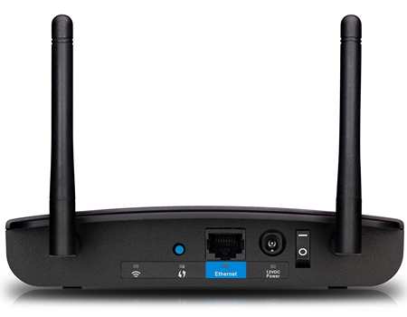
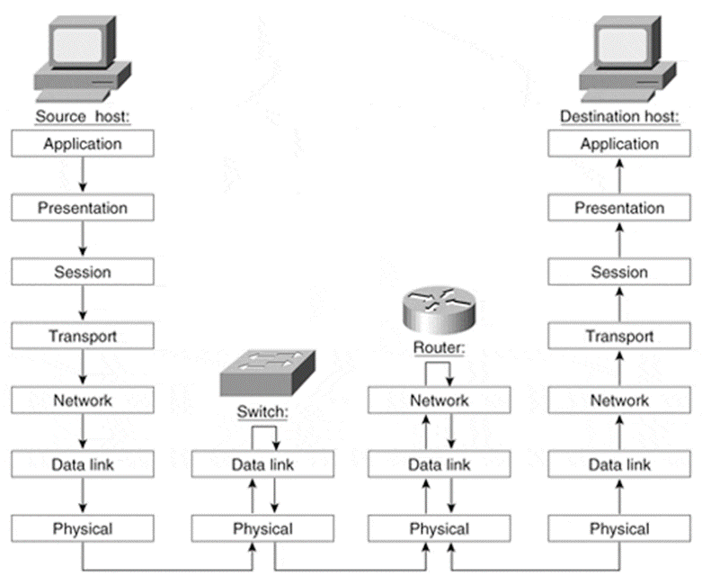
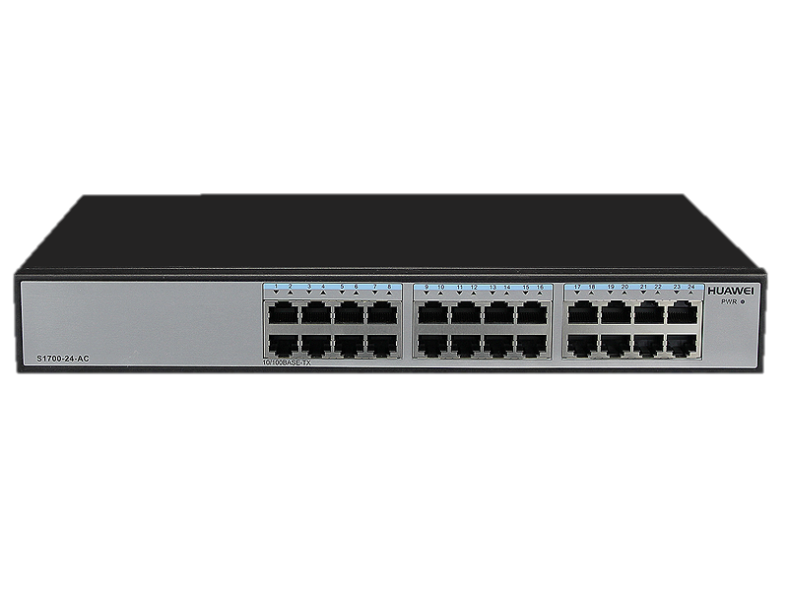
Switching
Switching is the type of traffic forwarding that occurs when traffic is on the same LAN
This type of traffic forwarding uses the source and destination MAC addresses to deliver data frames
Switching is a Data Link Layer operation, thus does not go to the network and higher layers
Examples of Layer 2 devices are switches and access points

Slide 12
Outline
Introduction
Objective
What is a computer network?
How do devices communicate?
Switching Concept
TCP Communication
Definition
TCP vs. UDP
TCP Communication Mechanism
Client-Server Based LAN Messaging App
What is a Socket?
The system’s Architecture
Connection to the Server
Message Forwarding
Conclusion

Slide 13
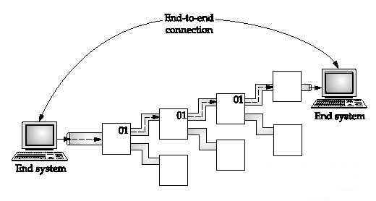
Transmission Control Protocol
It is a transport layer protocol that provides connection-oriented communication between two devices
Connection-oriented communication is crucial for services that cannot handle any loss of information during communication like messaging, mail services, or file transfer services
It provides slower but reliable data transmission by:
Session Establishment
Flow Control
Error Correction
Retransmission in case of loss of data
Ordered Delivery using Sequence Numbers

Slide 14
Outline
Introduction
Objective
What is a computer network?
How do devices communicate?
Switching Concept
TCP Communication
Definition
TCP vs. UDP
TCP Communication Mechanism
Client-Server Based LAN Messaging App
What is a Socket?
The system’s Architecture
Connection to the Server
Message Forwarding
Conclusion

Slide 15
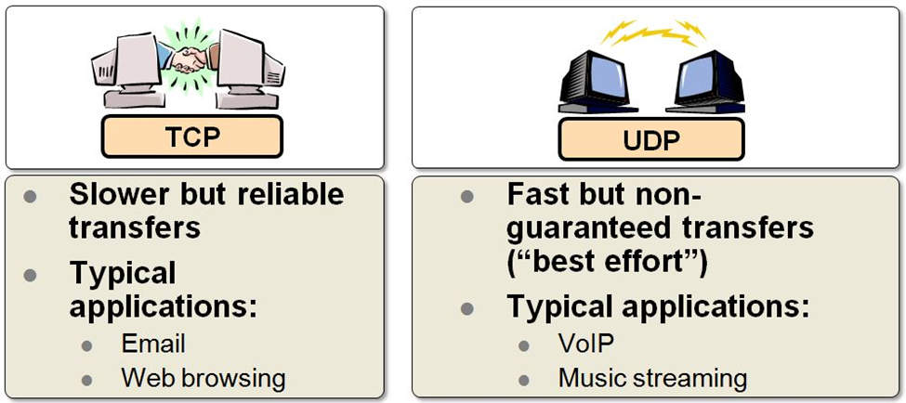
TCP vs. UDP
UDP (User Datagram Protocol) is the rival of TCP in the transport layer
UDP is a connectionless communication protocol which provides best effort transmission
UDP is Widely used for audio and video communication since these services cannot handle any latency
Fast but not guaranteed delivery
Non ordered delivery

Slide 16
Outline
Introduction
Objective
What is a computer network?
How do devices communicate?
Switching Concept
TCP Communication
Definition
TCP vs. UDP
TCP Communication Mechanism
Client-Server Based LAN Messaging App
What is a Socket?
The system’s Architecture
Connection to the Server
Message Forwarding
Conclusion

Slide 17
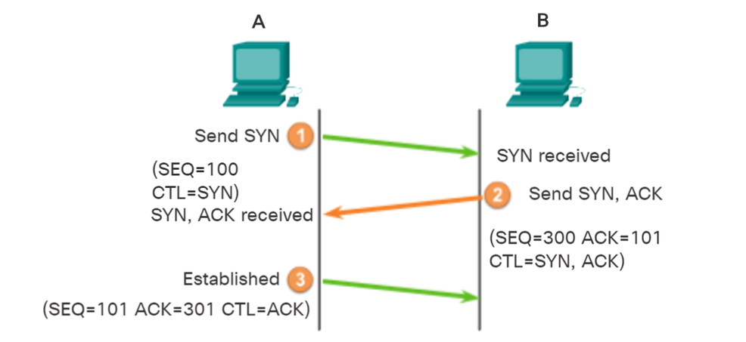
TCP Session Establishment
A TCP connection is established in three steps:
The initiating client requests a client-to-server communication session with the server by sending a SYN request with an initial sequence number
The server acknowledges the client-to-server communication session and requests a server-to-client communication session (SYN Request and ACK Response)
The initiating client acknowledges the server-to-client communication session (ACK Response)

Slide 18
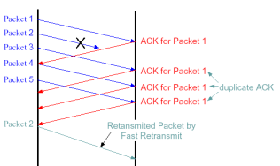
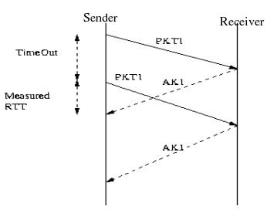
Reliable Transmission and Retransmission
TCP uses a sequence number to identify each byte of data
Acknowledgements (Acks) are sent with a sequence number by the receiver of data to tell the sender that data has been received to the specified byte.
There are two techniques to let the sender realize that the lost packet was lost:
Duplicate Acknowledgement based retransmission
The receiver acknowledges a the last received packet again on the receipt of another data packet ()
The sender knows that the sent packet was lost and sends it again
Timeout-based retransmission
the sender sets a timer that is a conservative estimate of when that packet will be acknowledged
If the sender does not receive an ack by then, it transmits that packet again
in case a retransmit timer has fired and still no acknowledgement is received, the next timer is set to twice the previous value (up to a certain threshold)

Slide 19
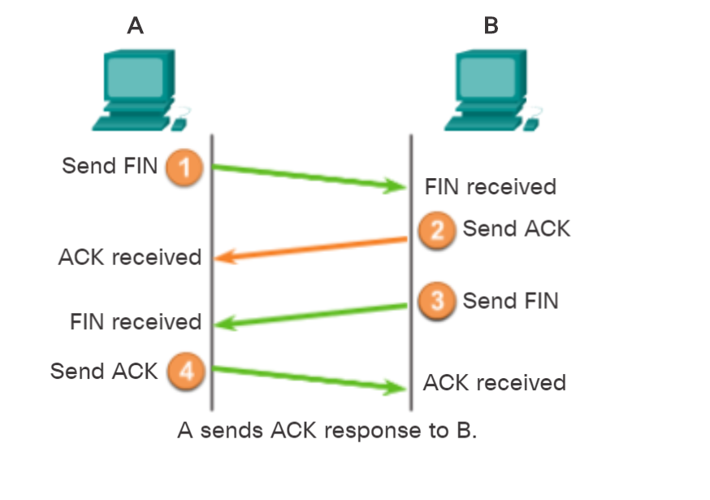
Session Termination
When the client has no more data to send in the stream, it sends a segment with the FIN flag set
The server sends an ACK to acknowledge the receipt of the FIN to terminate the session from client to server
Server sends a FIN to the client to terminate the server-to-client session
The client responds with an ACK to acknowledge the FIN from the server
when all segments have been acknowledged, the session is closed

Slide 20
Outline
Introduction
Objective
What is a computer network?
How do devices communicate?
Switching Concept
TCP Communication
Definition
TCP vs. UDP
TCP Communication Mechanism
Client-Server Based LAN Messaging App
What is a Socket?
The system’s Architecture
Connection to the Server
Message Forwarding
Conclusion

Slide 21
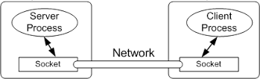
What is a Socket?
The messaging service is implemented and configured using Socket Programming
A socket is a combination of a Network Layer entity (IP Address) and a Transport Layer entity (Port Number)
The IP address identifies the logical locations in the network
The port number identifies the service that is being access (HTTP:80, FTP:20,21)

Slide 22
Outline
Introduction
Objective
What is a computer network?
How do devices communicate?
Switching Concept
TCP Communication
Definition
TCP vs. UDP
TCP Communication Mechanism
Client-Server Based LAN Messaging App
What is a Socket?
The system’s Architecture
Connection to the Server
Message Forwarding
Conclusion

Slide 23
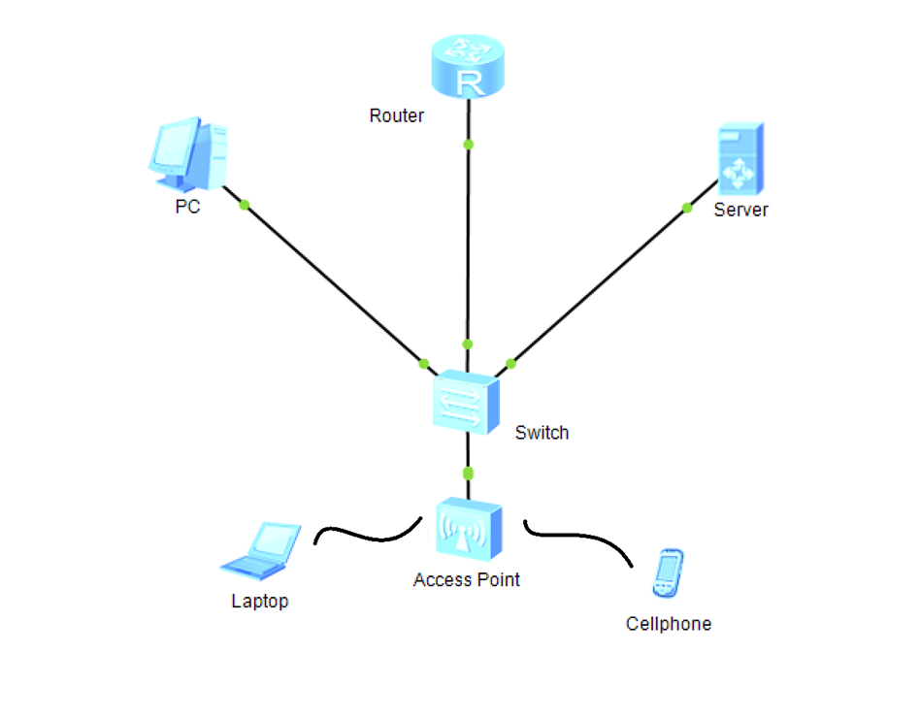
The System’s Architecture
The system consists of a Client-Server architecture both found inside the same Local Area Network
The Server has a static IP address and holds a specific port number for the service it is providing
The Server also handles user authentication as soon as a client tries to connect
As soon as clients are authenticated, they can access the service and be able to send and receive messages and updates
Clients use the Server’s socket to connect to it.
Port 10000 is used.

Slide 24
Outline
Introduction
Objective
What is a computer network?
How do devices communicate?
Switching Concept
TCP Communication
Definition
TCP vs. UDP
TCP Communication Mechanism
Client-Server Based LAN Messaging App
What is a Socket?
The system’s Architecture
Connection to the Server
Message Forwarding
Conclusion

Slide 25
Connection to the Server
When the server starts, it binds its local IP address to a port number and starts the listening phase where it starts listening to connection requests and accepts them subsequently
The client runs the application on a machine and automatically tries to connect to the server using the preconfigured IP address and port number
The server starts an authentication process where the client inserts the credentials and the server establishes a connection with an SQLite database and searches for entries in the users table
Password are hashed using SHA512
if the client has been authenticated by the server, the client is now able to send and receive messages from and to other clients in the LAN and is added to the list of connections on the server
For each client, the server runs a thread which is a piece of code that runs in parallel with the original code in order to serve clients simultaneously

Slide 26
Outline
Introduction
Objective
What is a computer network?
How do devices communicate?
Switching Concept
TCP Communication
Definition
TCP vs. UDP
TCP Communication Mechanism
Client-Server Based LAN Messaging App
What is a Socket?
The system’s Architecture
Connection to the Server
Message Forwarding
Conclusion

Slide 27
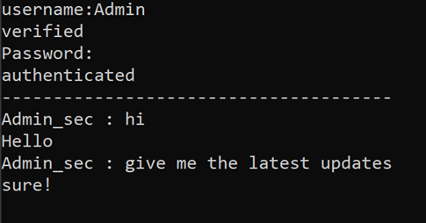
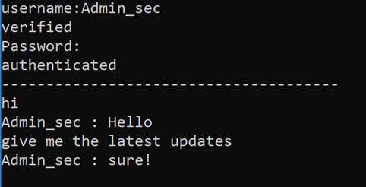
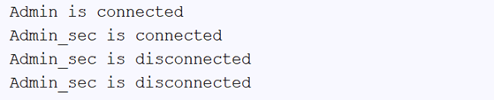
Forwarding Messages
What the serves does after authenticating the client, is to launch a thread for the connecting client to keep receiving send messages from that client
When data is received, the server sends the message to all the other connected clients except the sending one
The server shows which users have connected and which have disconnected
Exception handling on both sides is important to prevent crashing
The data exchanged among clients is being switched using the MAC addresses of the source and destination device

Slide 28
Outline
Introduction
Objective
What is a computer network?
How do devices communicate?
Switching Concept
TCP Communication
Definition
TCP vs. UDP
TCP Communication Mechanism
Client-Server Based LAN Messaging App
What is a Socket?
The system’s Architecture
Connection to the Server
Message Forwarding
Conclusion

Slide 29
Conclusion
Many services are being implemented over networks whether over the internet or not
Such services can be of great benefit to businesses and enterprises
A Client-Server-based Local Area Network Messaging service is advantageous for getting and providing updates
It has low latency
It provides a level of security since traffic is circulating inside the LAN

Slide 30
Q & A
Thank YOu

