Slide 1

Telangana Growth Analysis
Overview
Stamp Registration
Transportation
TS-iPASS

Slide 2
Objective: • Analyze trends and patterns within each department. • Identify growth opportunities and areas needing attention • Find correlation among these departments

Slide 3
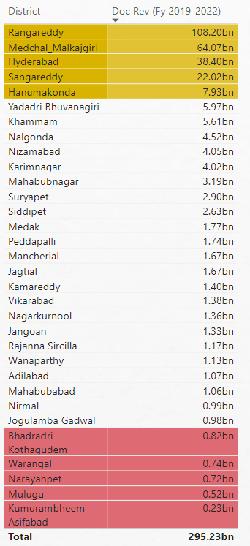
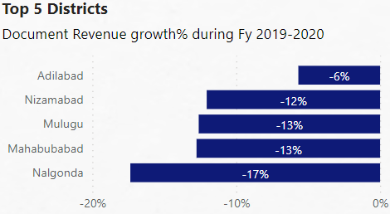
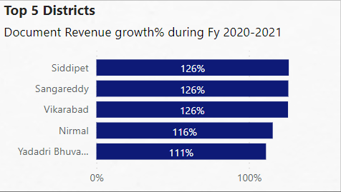
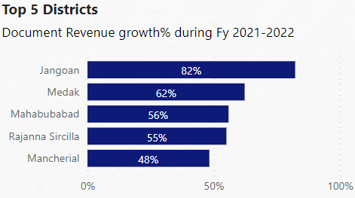
How does the revenue generated from document registration vary across districts in Telangana. List down the top 5 districts that showed the highest document registration revenue growth between FY 2019 and 2022.
Since Hyderabad is a industrial hub, The districts around Hyderabad has more land value . So Rangareddy, Medchal_Malkajgiri , Sangareddy has more land value . So its Document Revenue growth is higher than other Districts
Hyderabad & Medchal_Malkajgiri are known as cash cows of Telangana

Slide 4
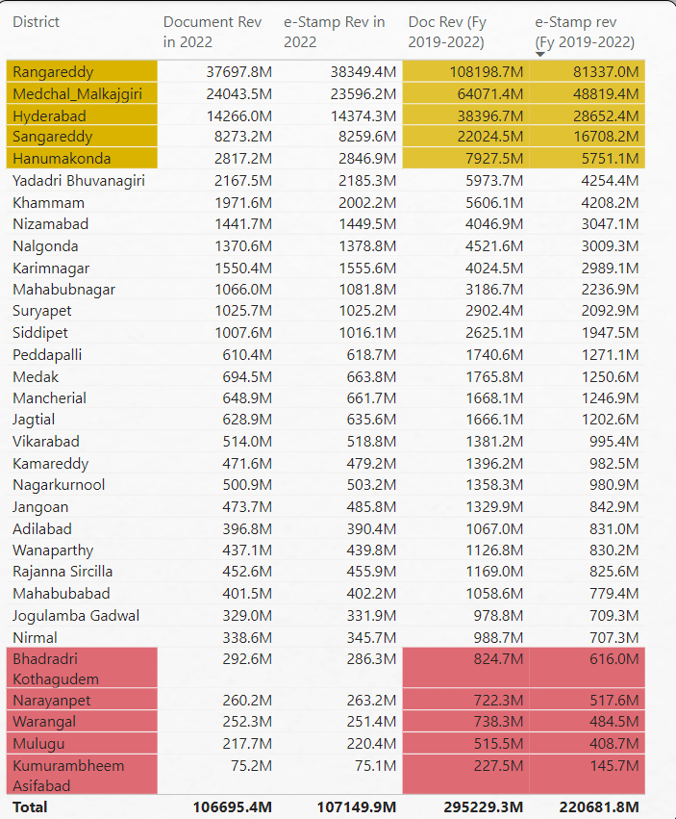
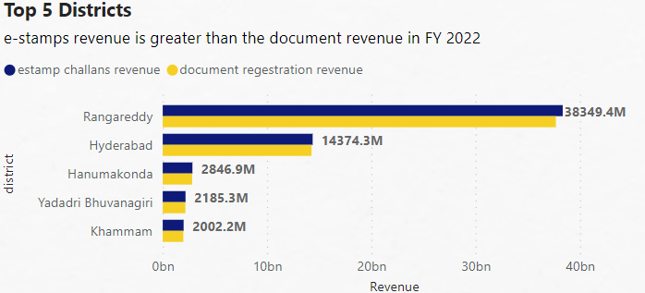
How does the revenue generated from document registration compare to the revenue generated from e-stamp challans across districts List down the top 5 districts where e-stamps revenue contributes significantly more to the revenue than the documents in FY 2022
Without any surprise , The districts which shows higher e-Stamp Revenue is the same district which shows higher Document Revenue

Slide 5
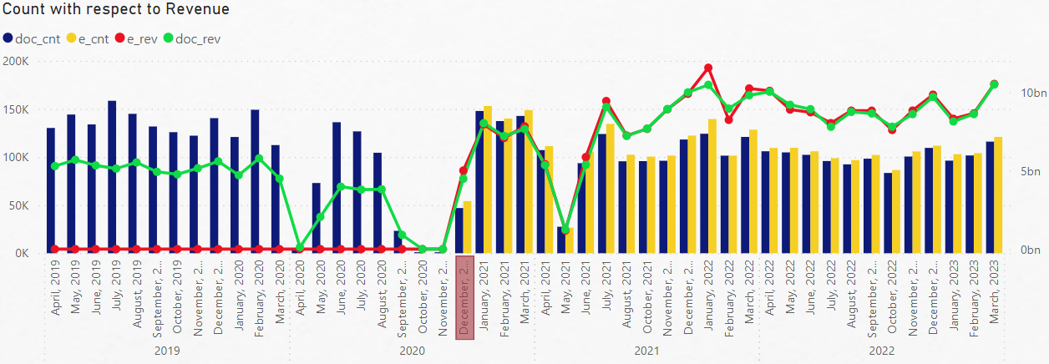
3. Is there any alteration of e-Stamp challan count and document registration count pattern since the implementation of e-Stamp challan? If so, what suggestions would you propose to the government?
We can observe that before December 2020, the average document Revenue is around 6 billion . But after December 2020 where e-Stamp comes into picture, the average revenue of both Document revenue and e-stamp Revenue is around 10 billion . The reason

Slide 6
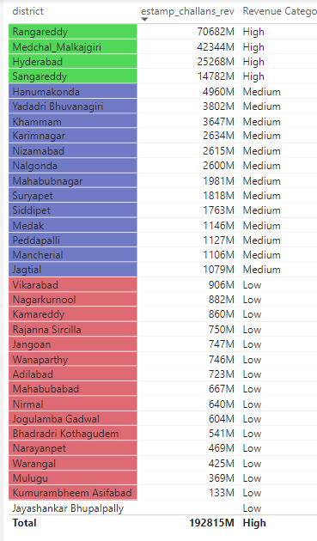
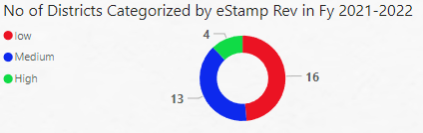
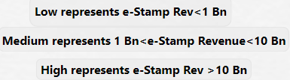
4. Categorize districts into three segments based on their stamp registration revenue generation during the fiscal year 2021 to 2022.

Slide 7
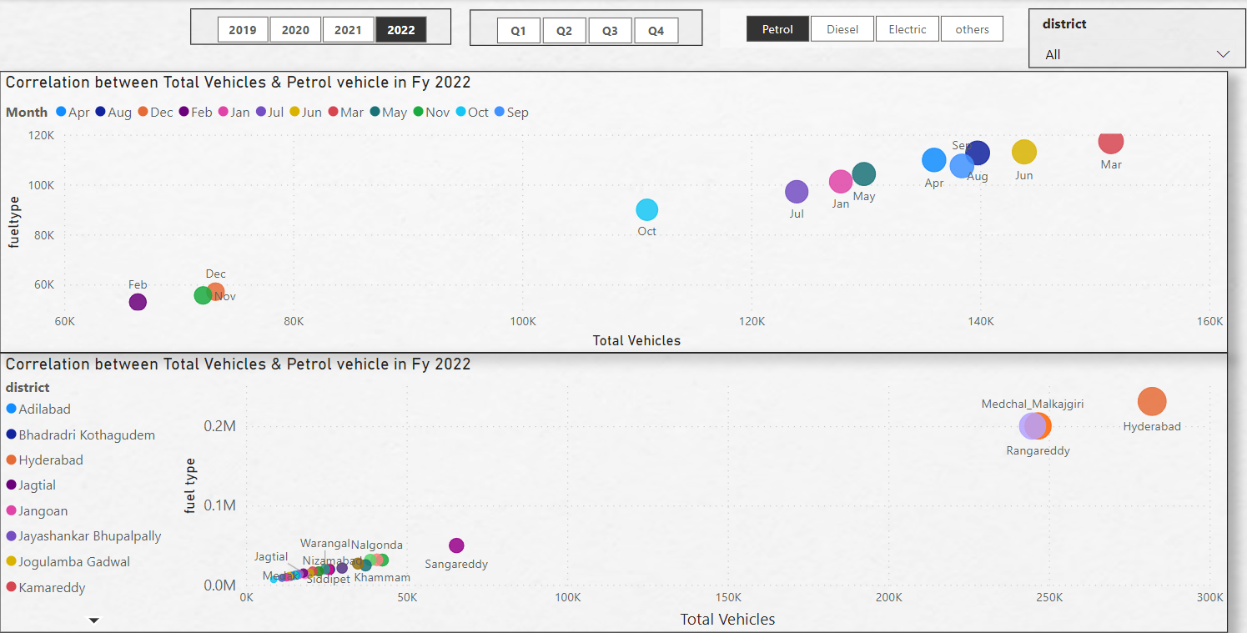
Transportation
5. Investigate whether there is any correlation between vehicle sales and specific months or seasons in different districts. Are there any months or seasons that consistently show higher or lower sales rate, and if yes, what could be the driving factors? (Consider Fuel-Type category only)
Petrol
Year month district
2019 Oct Hyderabad followed by Rangareddy, Medchal_Malkajgiri
2020 Oct Hyderabad followed by Rangareddy ,Medchal_Malkajgiri
2021 Oct Hyderabad followed by Rangareddy ,Medchal_Malkajgiri
2022 mar Hyderabad followed by Rangareddy , Medchal_Malkajgiri
All year Oct Hyderabad
Diesel
Year month district
2019 Oct Medchal_Malkajgiri followed by Rangareddy, Hyderabad
2020 Oct Medchal_Malkajgiri followed by Rangareddy, Hyderabad
2021 jun Medchal_Malkajgiri followed by Rangareddy, Hyderabad
2022 jun Medchal_Malkajgiri followed by Rangareddy, Hyderabad
All year Oct Medchal_Malkajgiri
Electric
Year month district
2019 Aug Hyderabad followed by Rangareddy, Medchal_Malkajgiri
2020 mar Hyderabad followed by Rangareddy ,Medchal_Malkajgiri
2021 mar Hyderabad followed by Rangareddy ,Medchal_Malkajgiri
2022 mar Hyderabad followed by Rangareddy , Medchal_Malkajgiri
All year mar Hyderabad
others
Year month district
2019 Aug Hyderabad
2020 mar Hyderabad
2021 mar Hyderabad
2022 mar Hyderabad
All yea mar Hyderabad

Slide 8
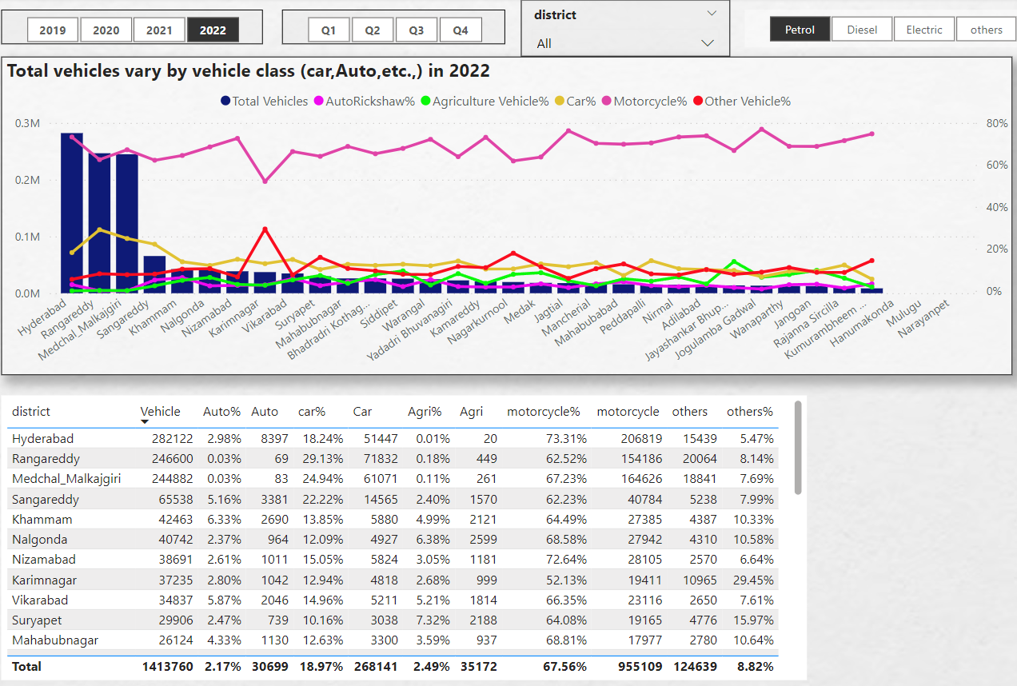
6. How does the distribution of vehicles vary by vehicle class (Motor Cycle, Motor Car, Auto Rickshaw, Agriculture) across different districts? Are there any districts with a predominant preference for a specific vehicle class? Consider FY 2022 for analysis.

Slide 9
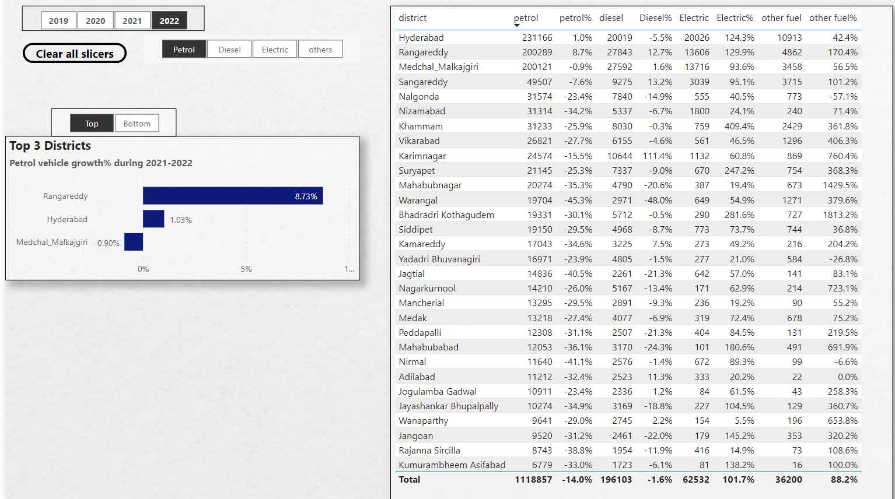
7. List down the top 3 and bottom 3 districts that have shown the highest and lowest vehicle sales growth during FY 2022 compared to FY 2021? (Consider and compare categories: Petrol, Diesel and Electric)

Slide 10
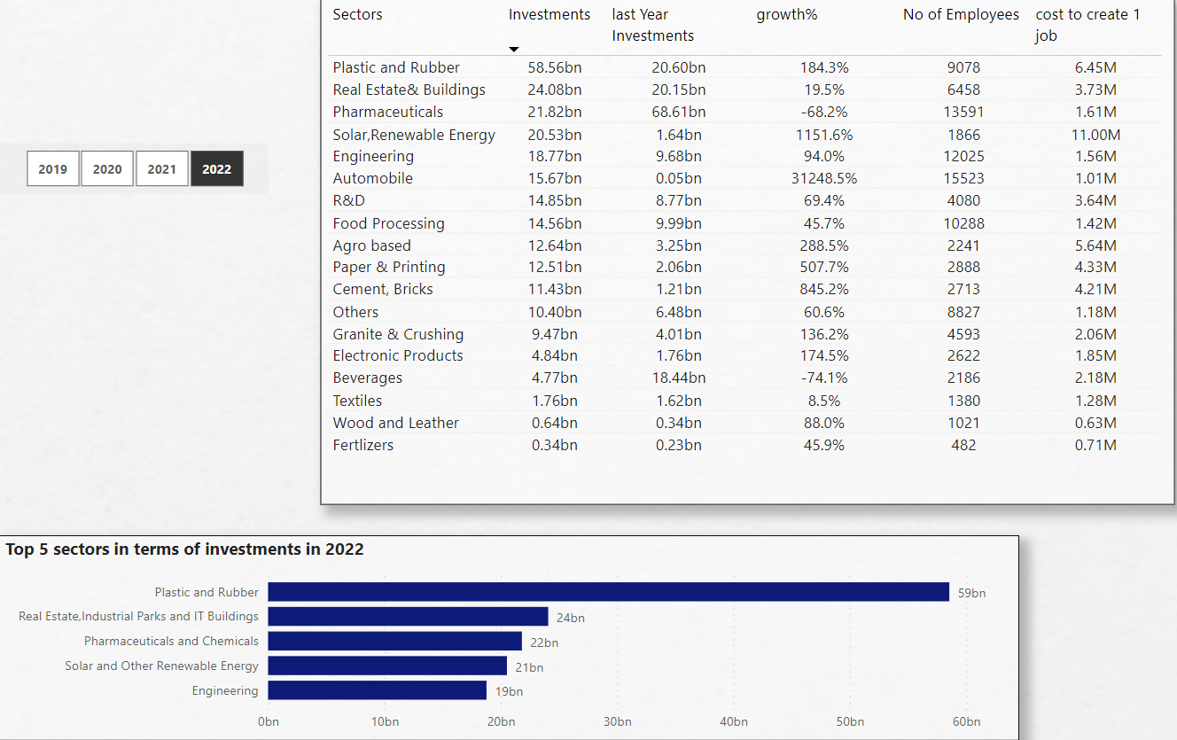
Ts-IPASS
8. List down the top 5 sectors that have witnessed the most significant investments in FY 2022.

Slide 11
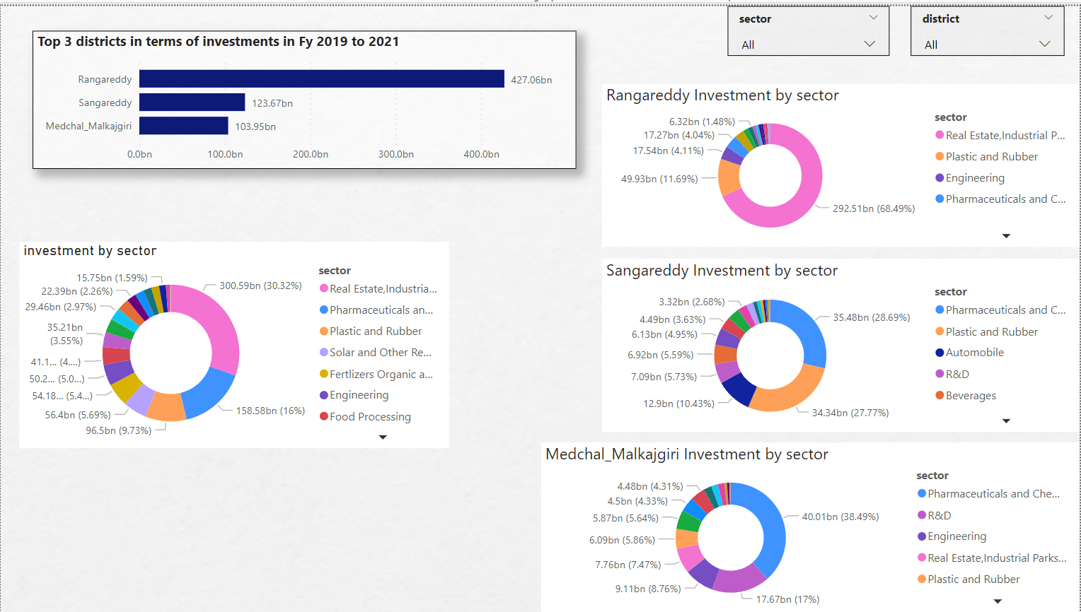
9. List down the top 3 districts that have attracted the most significant sector investments during FY 2019 to 2022? What factors could have led to the substantial investments in these particular districts?

Slide 12
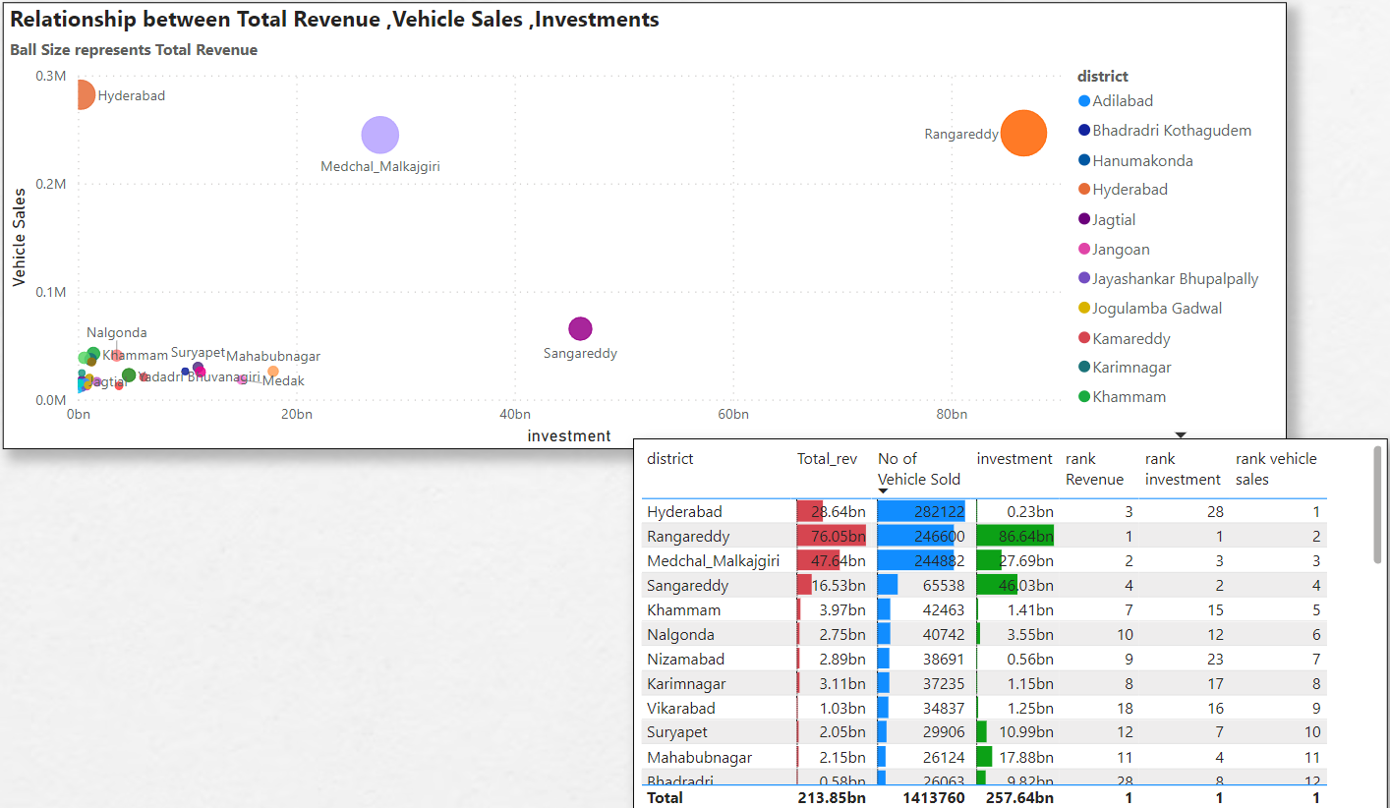
10. Is there any relationship between district investments, vehicles sales and stamps revenue within the same district between FY 2021 and 2022?

Slide 13
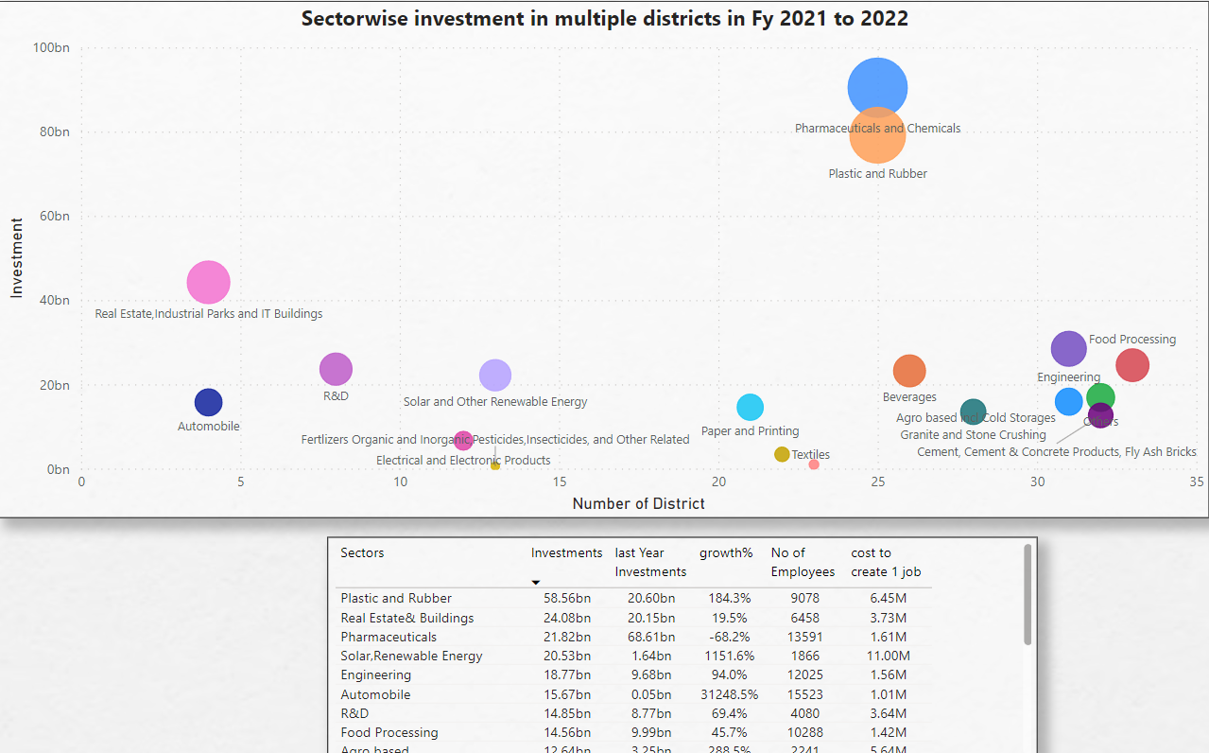
11. Are there any particular sectors that have shown substantial investment in multiple districts between FY 2021 and 2022?

Slide 14
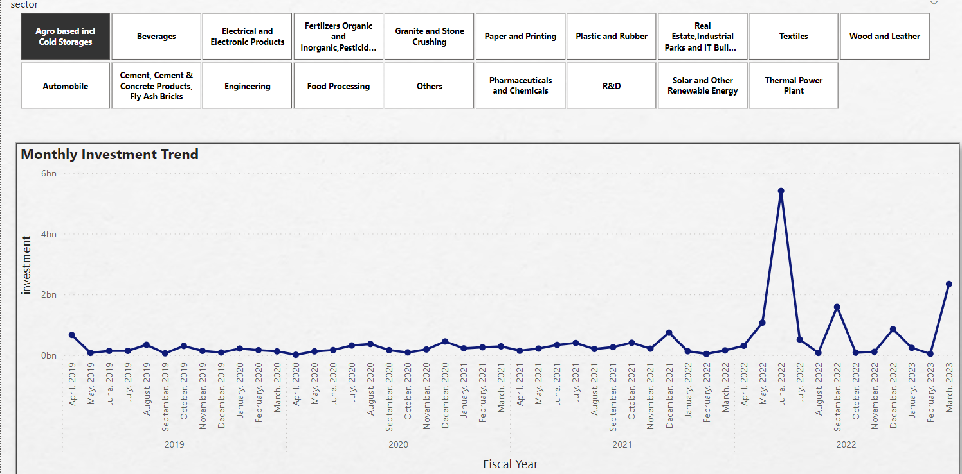
12. Can we identify any seasonal patterns or cyclicality in the investment trends for specific sectors? Do certain sectors experience higher investments during particular months?

Slide 15
1. What are the top districts to buy commercial properties in Telangana? Justify your answer.
Hyderabad Rangareddy
Sangareddy
Medchal Malkajgiri
The above districts are the districts to buy commercial properties. Since commercial properties are buy to do business , these districts have better infrastructure compared to other districts of Telangana . Because investment, Vehicle sale, Document revenue are high in this district which indicates these districts have better infrastructure and better environment to do business

Slide 16
2. What significant policies or initiatives were put into effect to enhance economic growth, investments, and employment in Telangana by the current government? Can we quantify the impact of these policies using available data?
To diversify the growth of Telangana among the districts we have to develop several industrial hub just like Hyderabad
By giving Subsidy to encourage to do business in other under developed district . Especially Tax concession while doing business in under developed district Analyzing every district natural resource and encourage to do business related to that resources.
Telangana is ranked 8th in Gross value added value added industry Manufacture of pharmaceuticals, medicinal, clinical and botanical products constitute about 29% of the GVA within the manufacturing sector, followed by manufacture of electrical equipment (11%), manufacture of other non-metallic mineral products (9 %) and manufacturing of food products (9 %) .

Slide 17
3. Provide top 5 Insights & 5 recommendations to Telangana government for sustained growth in the next 5 years based on your analysis
The dismal performance of industrial sector and particularly manufacturing sector is the main reason for high dependence on agriculture sector for employment (74%) in the State.
The government of Telangana has rightly recognized that economic growth should be accompanied by the shift in employment from agriculture to industry and services sectors.
Services sector can absorb only skilled workers while unskilled and semi-skilled workers can be absorbed by industrial sector, that too in manufacturing sector. Hence, there is every need to focus on growth and development of manufacturing sector in Telangana State. Make existing industry more competitive
High quality goods at the most competitive price, which establishes “Made in Telangana-Made in India” as a brand with high global recognition.
Innovate, Incubate, and Incorporate

