Slide 1

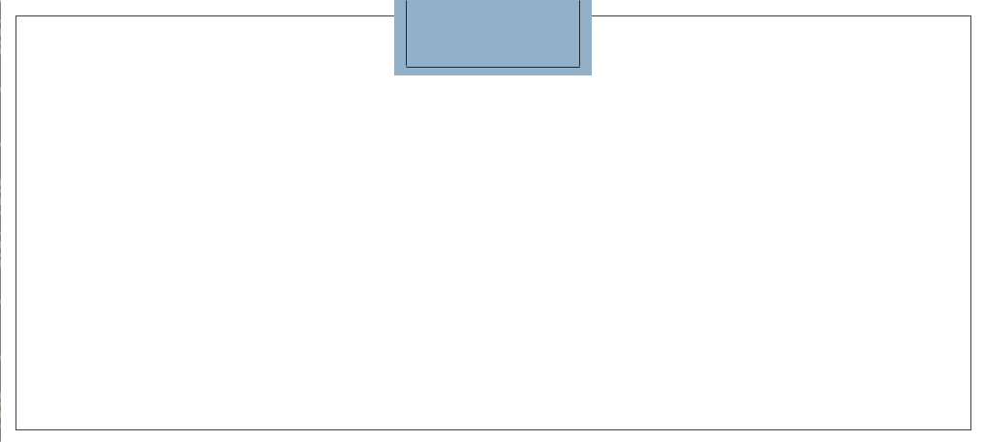
Machine Learning Approach to Predict Autism Spectrum Disorder
By:
Nishant Koradia(202118009)
Dhairya Lakhani(202118012)
Kandarp Parmar(202118027)
Vidhi Shah(202118037)

Slide 2
1. Introduction
2. Project Overview
3. Dataset Overview
4. Data Pre-Processing
CONTENTS
5. Exploratory Data Analysis
6. Model Implementation
7. Evaluation Strategy
8. Algorithm Analogy
9. ROC Curve
10. Conclusion

Slide 3

INTRODUCTION
Autism spectrum disorder is a condition related to brain development that impacts how a person perceives and socializes with others, causing problems in social interaction and communication. The term “spectrum” refers to the wide range of symptoms and behavior a person might have. Autism is a “disorder” so it can’t be cured, but if diagnosed early a person can be given treatment to maximize person’s ability to function by reducing autism symptoms and supporting development and learning.
Group 10 | Machine Learning Approach to Predict Autism Spectrum Disorder

Slide 4
PROJECT OVERVIEW
According to Centers for Disease Control and Prevention(CDC) about 1% of the world’s population has ASD (i.e. 7,50,00,000 people). The number of people diagnosed with ASD in the United States and other countries has increased since the 1970s and particularly since the late 1990s but, it is not clear if the increase is related to the changes in the criteria used to diagnose ASD or if the condition has truly become more common over time. Looking at this situation with the help of the Supervised Classification Learning Algorithms we will construct a model which will predict if a person has autism or not based on several scientific etiology, symptoms and factors affecting ASD.
Group 10 | Machine Learning Approach to Predict Autism Spectrum Disorder

Slide 5
DATASET OVERVIEW
We have taken dataset from UCI Machine Learning Repository. It contain data for different groups child(4 to 11 years) adolescence(12 to 16 years) and adult (16 and above). Dataset has 20 independent features which are:
age: age of the individual in years
gender: gender of an individual
ethnicity: belonging of an individual to a social group
jaundice: whether individual has jaundice at time of birth
autism: whether an immediate family member of individual has autism
relation: Relation of test giver with suspected individual
contry_of_res: Country of Residence of the individual.
used_app_before: any prior screening for ASD.
age_desc: Age Category
10. – 19. A1-A10 Score: 1(YES)/ 0(NO) based on the question asked in screening.
20. Result: Count of 1(YES) for the questions.
21.Class: Whether a individual has Autism or not(YES/NO).

Slide 6
DATA PRE-PROCESSING
Data preprocessing is a technique used to transform RAW data into a useful and efficient format.
Using “dropna” from pandas we have removed “NULL” value rows from our dataset.
In our columns, we have string values but they are categorical so we have applied One-Hot-Encoding using the “get_dummies” method from pandas into convert binary values after which our dataset consists of 955 rows and 114 columns.
Then we have divided our whole dataset into training and testing sets we have kept 70% for training and 30% for testing, also we have set random_state to 42 so it chooses the same values from the dataset in training and testing every time.
Group 10 | Machine Learning Approach to Predict Autism Spectrum Disorder

Slide 7
EXPLORATORY DATA ANALYSIS
Before proceeding to apply any algorithm, we take a moment to visualize the ASD data set using the Matplotlib and Seaborn module of Python.
We first generate count of people having ASD or not. The countplot shows the distribution of the data which belongs to the ‘ASD class’ whereas the blue one showing the distribution of the data which are non-autistic. This gives us our first impression of the internal connections of some of the above mentioned features that are present in our data set.
We also plotted heatmap to understand covariance between all variables of dataset.
In same way, we plotted many graphs which helped us to understand and visualize our dataset and also prepared our data for model implementation.
Group 10 | Machine Learning Approach to Predict Autism Spectrum Disorder

Slide 8
MODEL IMPLEMENTATION
k-Nearest Neighbors(kNN)
Decision Trees
Logistics Regression
Support Vector Machines(SVM)

Slide 9
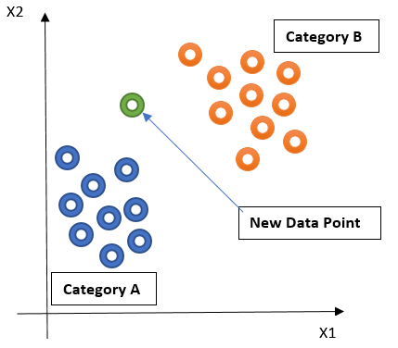
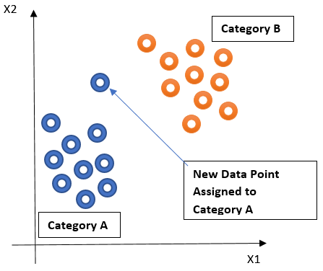
k-NEAREST NEIGHBORS (kNN)
Befor kNN
After kNN
Group 10 | Machine Learning Approach to Predict Autism Spectrum Disorder

Slide 10
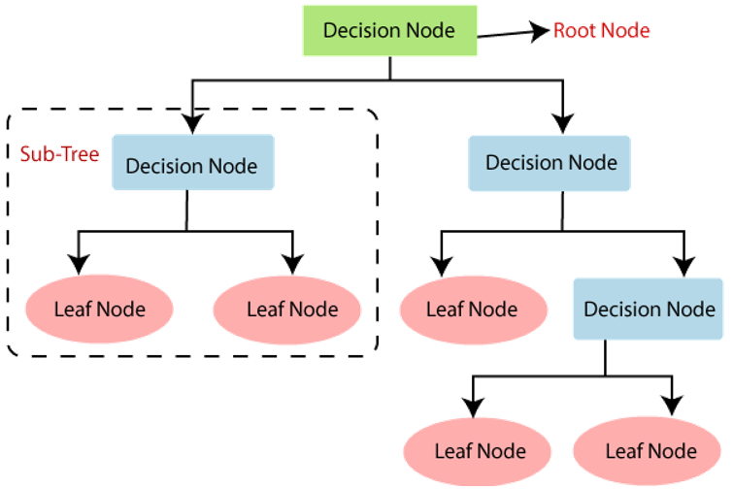
DECISION TREE
Group 10 | Machine Learning Approach to Predict Autism Spectrum Disorder

Slide 11
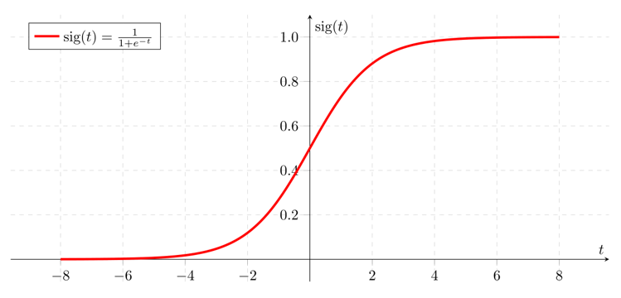
LOGISTIC REGRESSION
Group 10 | Machine Learning Approach to Predict Autism Spectrum Disorder

Slide 12
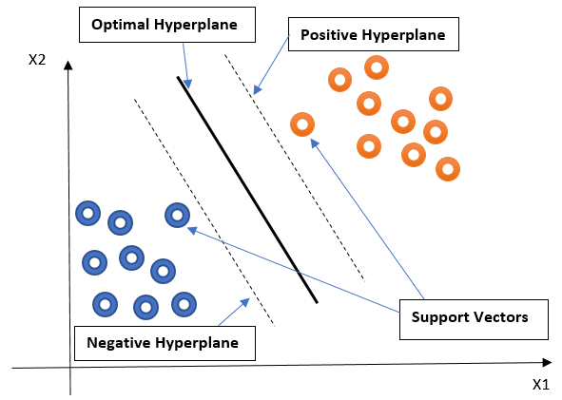
SUPPORT VECTOR MACHINES(SVM)
Group 10 | Machine Learning Approach to Predict Autism Spectrum Disorder

Slide 13
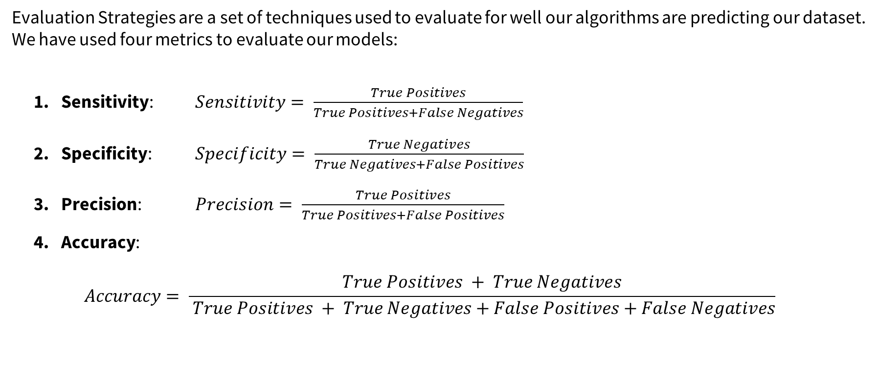
EVALUATION STRATEGY
Evaluation Strategies are a set of techniques used to evaluate for well our algorithms are predicting our dataset. We have used four metrics to evaluate our models:
Sensitivity: $Sensitivity= \frac{True Positives}{True Positives+False Negatives}$
Specificity: $Specificity= \frac{True Negatives}{True Negatives+False Positives}$
Precision: $Precision= \frac{True Positives}{True Positives+False Positives}$
Accuracy:
$$Accuracy= \frac{True Positives + True Negatives}{ True Positives + True Negatives+False Positives+False Negatives}$$

Slide 14
ALGORITHM ANALOGY
Model | Sensitivity | Specificity | Precision | Accuracy
k-Nearest Neighbors Classifier | 0.250 | 1.0 | 1.0 | 0.979094
Decision Tree | 1.000 | 1.0 | 1.0 | 1.000000
Logistic Regression | 0.875 | 1.0 | 1.0 | 0.996516
Support Vector Machine(SVM) | 1.000 | 1.0 | 1.0 | 1.000000
Group 10 | Machine Learning Approach to Predict Autism Spectrum Disorder

Slide 15
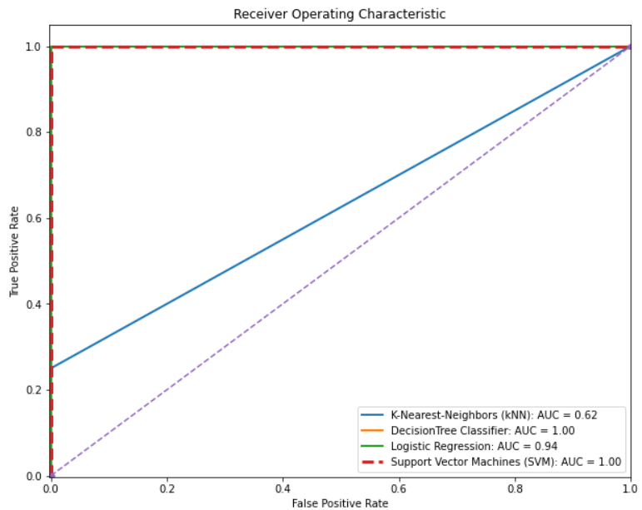
ROC CURVE
Group 10 | Machine Learning Approach to Predict Autism Spectrum Disorder

Slide 16
CONCLUSION
Screening of Autism at early age should be fundamental step towards understanding traits of Autism. Although there is no cure of Autism in terms of Medicine, but one can be benefitted by certain therapies and behavioral changes.
Talking about our project, we analyzed datasets of Child, Adolescent and Adult of Autism screening. From results, it can be derived that for this dataset Decision Trees and SVM(Linear) is predicting with 100% Accuracy.
Decision Trees can easily predict continuous and discrete variables, also it is non-parametric.
SVM(Linear) is able to create decision boundary on hyperplane with maximum margin because our data is linearly separable. Also, classes of all testing data is predicted accurately because of proper classification of classes linearly.
We also derived that k nearest neighbors is predicting with 97.9% accuracy because it is not efficient towards outliers. Logistic is also predicting with 99.65% accuracy because there is some multicollinearity between some features and also it is giving highest running-time among all 4 algorithms.
Further it can be concluded that Decision Tress is the best model for screening of Autism as it is giving 100% Accuracy and it is taking least time to run the algorithm and significantly very less than SVM(Linear).
Group 10 | Machine Learning Approach to Predict Autism Spectrum Disorder

Slide 17
THANK YOU!

