Slide 1

Breast Cancer Prediction using Principle Component Analysis(PCA)
GROUP NO: 4
Nishant Koradia, 202118009
Kandarp Parmar, 202118027
Dhairya Lakhani, 202118012
Vidhi Shah, 202118037

Slide 2
1. Introduction
2. Dataset Description
3. Methods Used
4. Evaluation Metrics(Without PCA)
CONTENTS
5. PCA Overview
6. Steps for Principle Components
7. Solution to the Problem
8. Evaluation Metrics(With PCA)
9. Conclusion

Slide 3

INTRODUCTION
According to studies over 9.5 million people died due to cancer, among different type of cancer Breast Cancer and Lung Cancer were the most common cancers in the world comprising 12.5% and 12.2% of the total cases which were registered in 2020 and causes has steadily increased over the last decade, which is a bad news for world population.
Taking one of the most common cancer Breast Cancer into consideration, let us see what are the factors and the symptoms related. The factors include:-
Age: women with age (>50) are more likely to get breast cancer.
The individual’s history of cancer: If a woman has cancer in one breast, then there are high chances that the woman might have cancer in the other breast too.
Family History of breast cancer: a woman is breast cancer-prone if in her family her mother, sister, daughter, or any female relative is having breast cancer.
The other factors include Chid bearing and Menstrual History also which have less but a significant impact on a woman to have breast cancer.
Group 4 | Breast Cancer Prediction using Principle Component Analysis(PCA)

Slide 4
DATASET DESCRIPTION
The breast cancer data includes 569 examples of cancer biopsies, each with 31 columns. Our target variable is cancer diagnosis and 30 are numeric-valued laboratory measurements. The diagnosis is coded as "Malignant" to indicate malignant or "Benign" to indicate benign.
The other 30 numeric measurements comprise the mean, standard error and worst (i.e. largest) value for 10 different characteristics of the digitized cell nuclei, which are as follows:-
radius (mean of distances from center to points on the perimeter)
texture (standard deviation of gray-scale values)
perimeter
area
smoothness (local variation in radius lengths)
compactness (perimeter^2 / area - 1.0)
concavity (severity of concave portions of the contour)
concave points (number of concave portions of the contour)
symmetry
fractal dimension ("coastline approximation" - 1)
Group 4 | Breast Cancer Prediction using Principle Component Analysis(PCA)

Slide 5



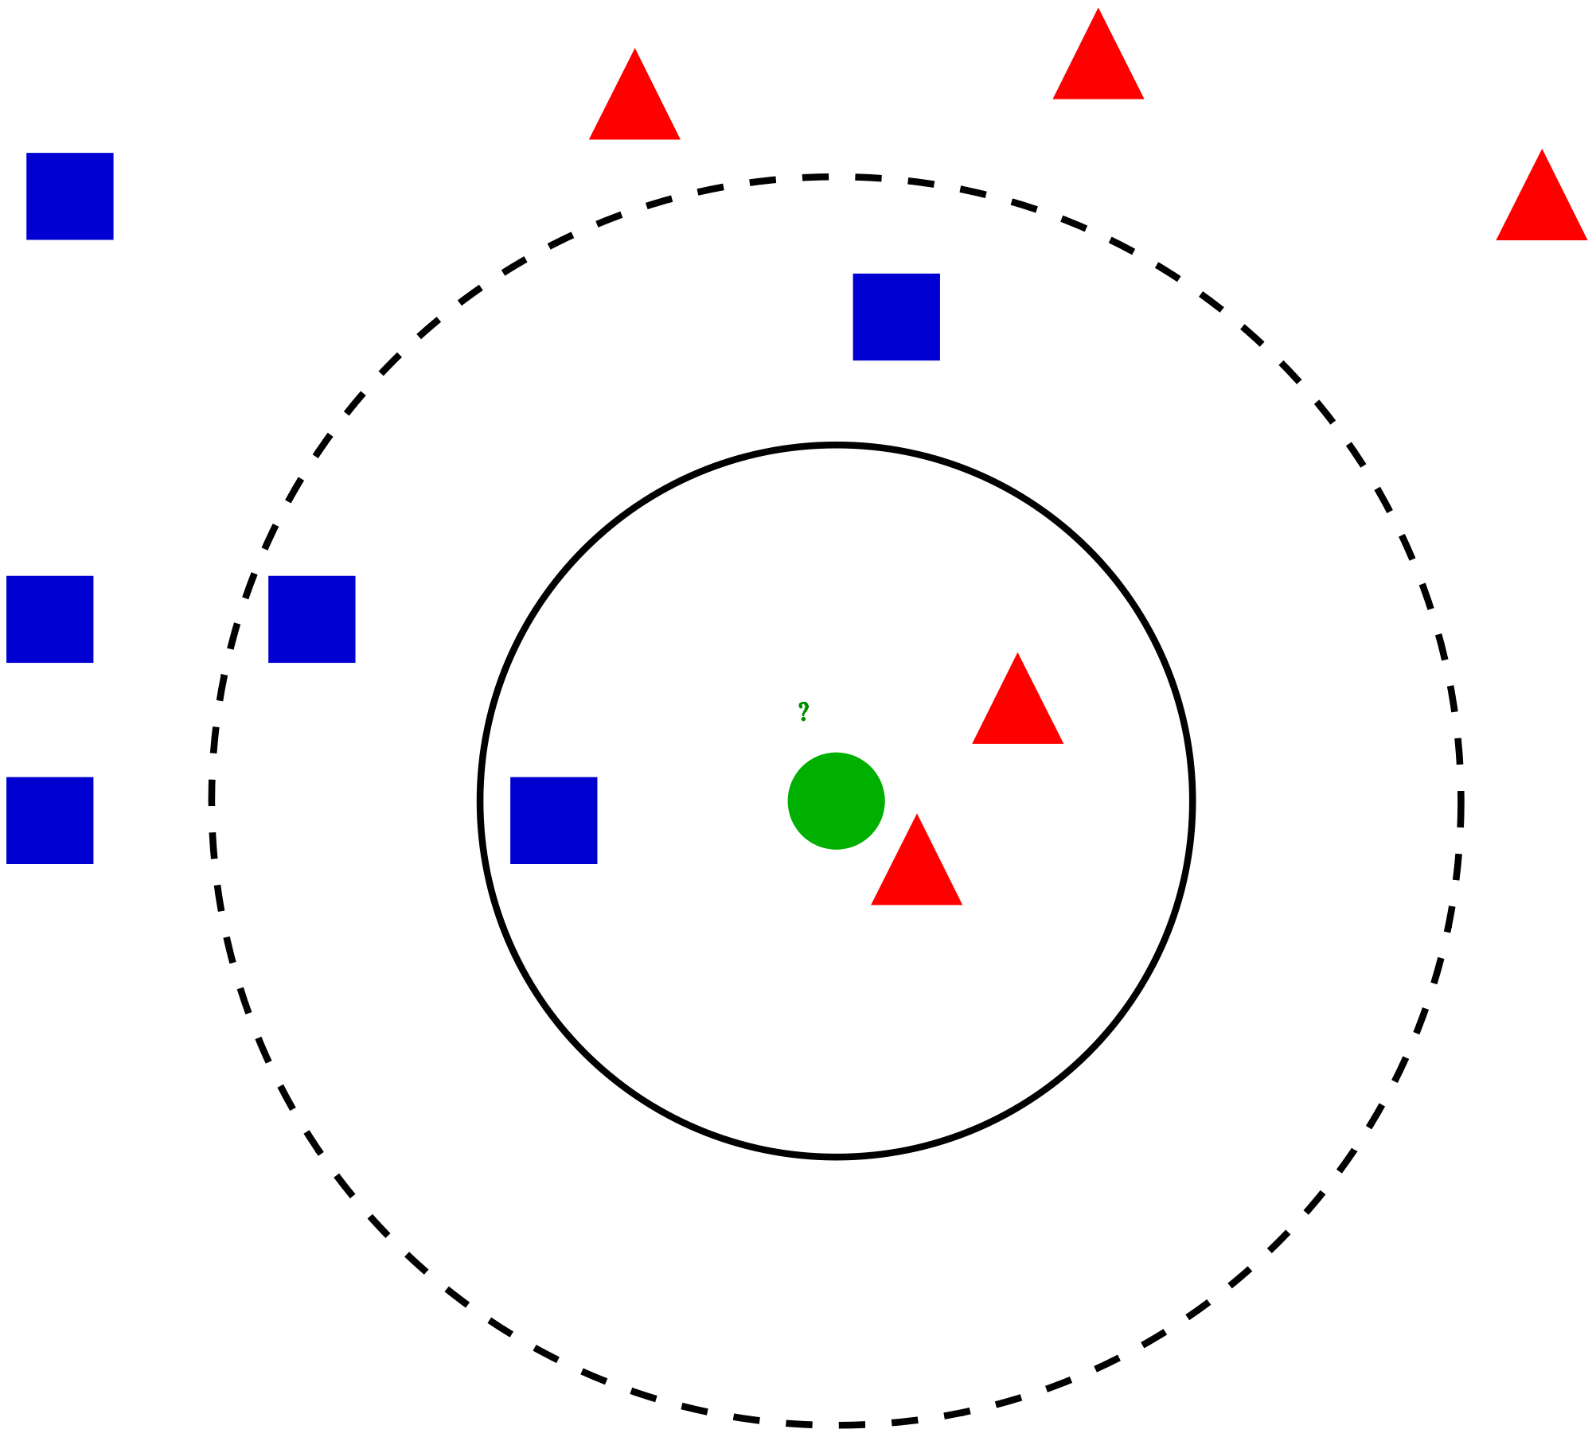



METHODS USED
Methods Used
With Principle Component Analysis(PCA)
RandomForest Classifier
Logistic Regression
SVM(linear)
k-Nearest-Neighbors Classifier
Without Principle Component Analysis(PCA)
Group 4 | Breast Cancer Prediction using Principle Component Analysis(PCA)

Slide 6
EVALUATION METRICS (Without PCA)
First of all, we applied all four machine learning models on raw dataset without applying PCA to understand the accuracy of the models and running time.
After applying it, we got the following results,
Model | Accuracy
k-Nearest-Neighbors Classifier | 0.929825
RandomForest Classifier | 0.964912
Logistic Regression | 0.964912
SVM(linear) | 0.956140
Group 4 | Breast Cancer Prediction using Principle Component Analysis(PCA)

Slide 7
PCA OVERVIEW
In our dataset, we have 30 features with us from which retrieval of useful information is not possible. So, we have to do dimensionality reduction of features from which we can visualize things in a better way. For dimensionality reduction, we use Principal Component Analysis (PCA). But first, we have to see what is PCA?
PCA is a linear dimensionality reduction approach (algorithm) that converts a collection of correlated variables (p) into a smaller k number of uncorrelated variables called principal components while preserving as much variance as feasible in the original data. PCA is an unsupervised machine learning approach that finds relevant variables that may be used for subsequent regression, grouping, and classification tasks apropos of Machine Learning.
PCA is a linear dimensionality reduction approach (algorithm) that converts a collection of correlated variables (p) into a smaller k number of uncorrelated variables called principal components while preserving as much variance as feasible in the original data. PCA is an unsupervised machine learning approach that finds relevant variables that may be used for subsequent regression, grouping, and classification tasks apropos of Machine Learning.
Group 4 | Breast Cancer Prediction using Principle Component Analysis(PCA)

Slide 8
STEPS FOR PRINCIPLE COMPONENTS
STEP 1
Standardize the dataset.
STEP 2
Calculate the covariance matrix for the features in the dataset.
STEP 3
Calculate the eigenvalues and eigenvectors for the covariance matrix.
STEP 4
Sort eigenvalues and their corresponding eigenvectors.
STEP 5
Pick k eigenvalues( >1 ) and form a matrix of eigenvectors.
STEP 6
Transform the original matrix.
Group 4 | Breast Cancer Prediction using Principle Component Analysis(PCA)

Slide 9
SOLUTION TO THE PROBLEM
We have seen that we have 31 columns in our dataset, and working with this big dataset and extracting useful information looks difficult. Thus now we are reducing our dataset to 6 principal components which will makes our calculation easy and understanding better. But, why did we selected 6 component vectors , why not more than or less than that? The answer to this question is we are using Kaiser’s rule for selecting principal components which tells us that if the eigenvalue is greater than 1 than it should be considered and if it is less than 1 than we can drop that column and not consider as a principal component. By this method we get the principal components which gives us the maximum variance explained. In our dataset we got 88.76% variability with the six principal components and only 11.24% of variance is loss.
Group 4 | Breast Cancer Prediction using Principle Component Analysis(PCA)

Slide 10
EVALUATION METRICS (With PCA)
After applying PCA, we considered those components only as an attribute and applied again all four Machine Learning models which we applied for without PCA to understand the difference and how PCA is helping in improving accuracy.
The results of that are as follows:-
Model | Accuracy
k-Nearest-Neighbors Classifier | 0.956140
RandomForestClassifier | 0.956140
Logistic Regression | 0.982456
SVM(linear) | 0.982456
Group 4 | Breast Cancer Prediction using Principle Component Analysis(PCA)

Slide 11
RESULTS AND ANALYSIS
When we consider PCA in theory, at that time it doesn’t makes much sense and understanding of concepts but, when it comes to practical implementation then we see that it speeds up training and testing sets, which can increase the model accuracy with a considerable amount by predicting more accurately. And also it is evitable from the accuracy scores which shows that for 3 models accuracy increases and for 1 model accuracy decreases. Also we can see from the scree plot which gives us the (elbow curve), that the eigen values are taking values less than one ( <1 ) from the principal component numbered 5 but we are taking the values from 0 which makes total to 6 so, we have taken n_components to be 6. Further calculating eigenvalues, eigenvectors and following the mentioned steps finally we obtain better predictions and better accuracy.
Group 4 | Breast Cancer Prediction using Principle Component Analysis(PCA)

Slide 12
CONCLUSION
The primary purpose of this study is to create and execute a novel computation for predicting malignant and benign cancer due to which we are implementing models on our data and calculating accuracy of the particular model. In order to get more accuracy, we are implementing all the supervised learning models on our dataset before doing PCA and also after doing PCA. We saw that after performing component analysis we get more accuracy comparatively to the accuracy before PCA. And also it can be further implied that running time is also decreasing significantly after applying PCA as we are considering only six components instead of 30 features. Thus, we can say that model is very robust and works better after PCA and it can predict in better way which can further imply to work in a real world issue where we can predict an individual’s cancer as malignant and benign which can save their lives.
Group 4 | Breast Cancer Prediction using Principle Component Analysis(PCA)

Slide 13
THANK YOU!

