Slide 1
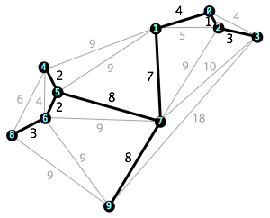
Minimum Spanning Trees
Kyle Anderson, Cole Pierce

Slide 2
Prim’s Algorithm
Initialize the minimum spanning tree with a vertex chosen at random.
Find all the edges that connect the tree to new vertices, find the minimum and add it to the tree.
Keep repeating step 2 until we get a minimum spanning tree.

Slide 3
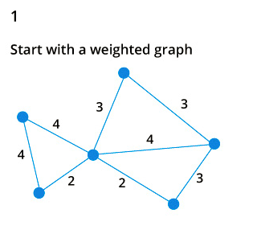
Prim’s Algorithm

Slide 4
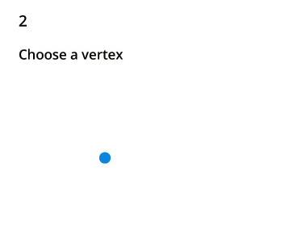
Prim’s Algorithm

Slide 5
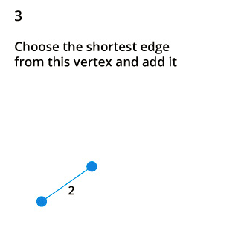
Prim’s Algorithm

Slide 6
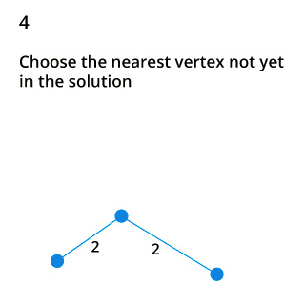
Prim’s Algorithm

Slide 7
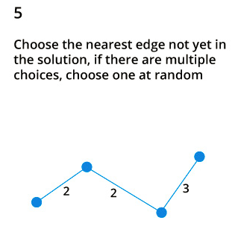
Prim’s Algorithm

Slide 8
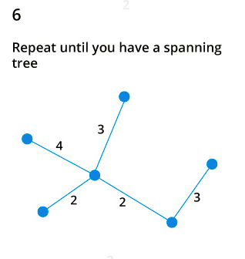
Prim’s Algorithm

Slide 9
Kruskal’s Algorithm
Sort all the edges from low weight to high
Take the edge with the lowest weight and add it to the spanning tree. If adding the edge created a cycle, then reject this edge.
Keep adding edges until we reach all vertices.

Slide 10
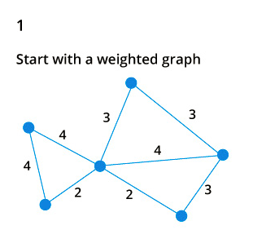
Kruskal’s Algorithm

Slide 11
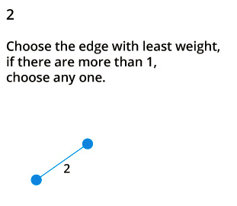
Kruskal’s Algorithm

Slide 12
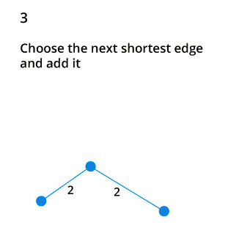
Kruskal’s Algorithm

Slide 13
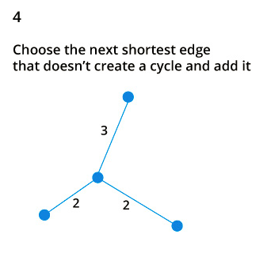
Kruskal’s Algorithm

Slide 14
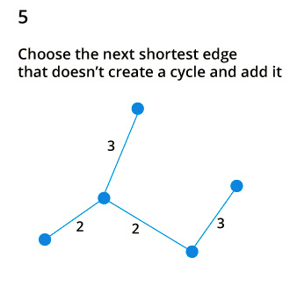
Kruskal’s Algorithm

Slide 15
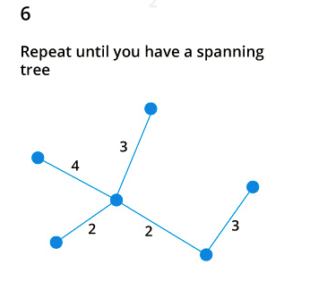
Kruskal’s Algorithm

Slide 16
Flow of our Program
Choose the number of vertices.
Randomly generated graph with n vertices outputted to file.
File parsed into Graph : [Vertex] [Edge].
Run Prim’s/Kruskal’s on the Graph.
Output each step to text and GraphViz format.

Slide 17
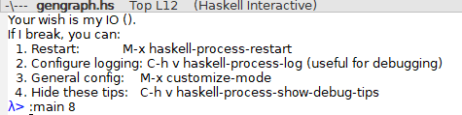
Choose the number of vertices

Slide 18
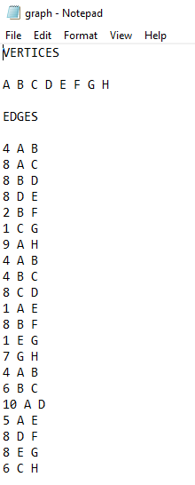
Randomly generated graph with n vertices outputted to file

Slide 19
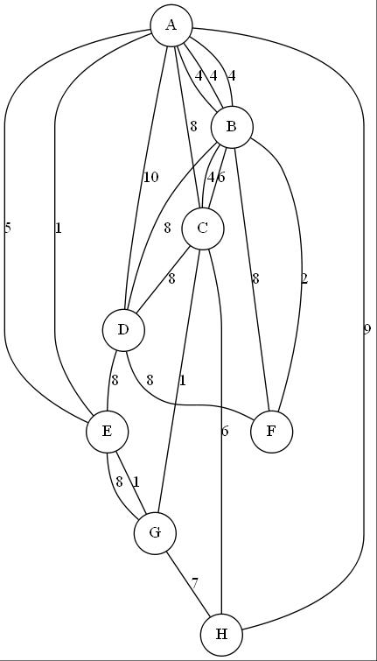
Initial Graph

Slide 20

Prim step 1

Slide 21
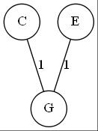
Prim step 2

Slide 22
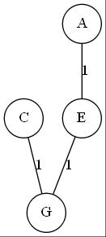
Prim step 3

Slide 23
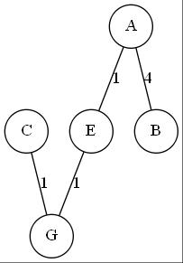
Prim step 4

Slide 24
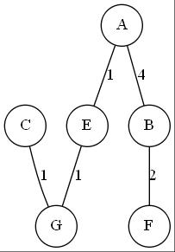
Prim step 5

Slide 25
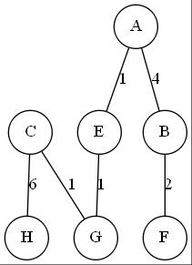
Prim step 6

Slide 26
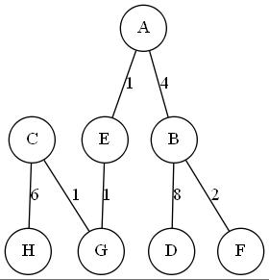
Prim final MST

Slide 27
Initial Graph

Slide 28
Kruskal step 1

Slide 29
Kruskal step 2

Slide 30
Kruskal step 3

Slide 31
Kruskal step 4

Slide 32
Kruskal step 5

Slide 33
Kruskal step 6

Slide 34
Kruskal final MST

