Slide 1
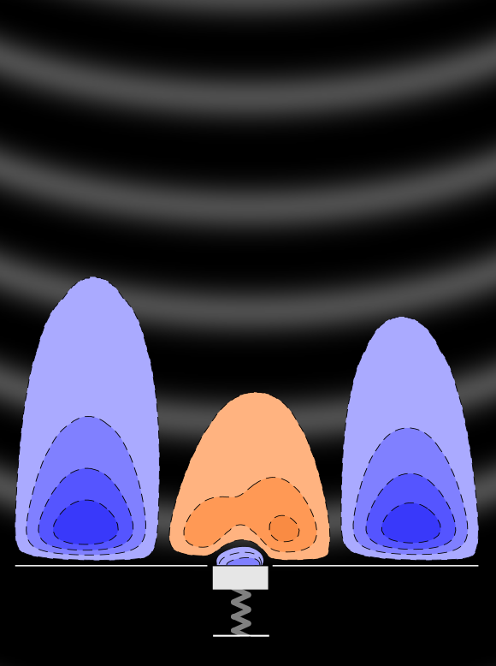
Design of Local Resonance Units for Tollmien-Schlichting Waves Attenuation
Author: Vivek Kande
Supervisors: Dr. ir. Theodoros Michelis
Pierre Champeaux
30th September 2026

Slide 2
Background and research gap
Research questions
Methodology
Stage-I
Stage-II
Stage-III
Conclusions

Slide 3
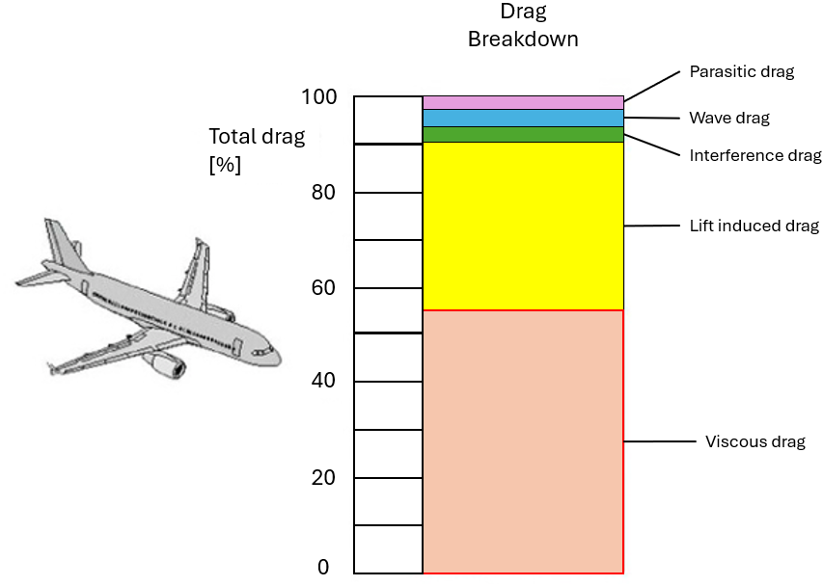
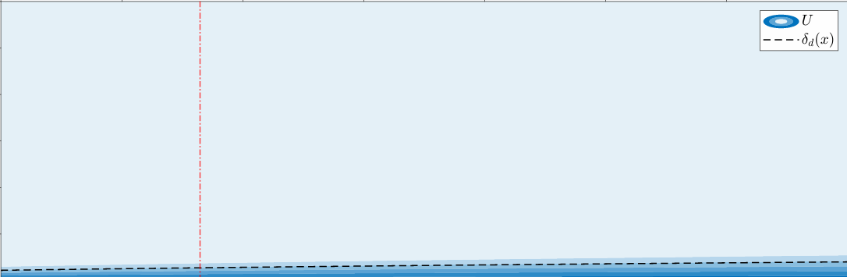




Motivation
$$U_{∞}$$
Aviation contributes to 5% global radiative forcing which is expected to more than double by 2050
Increasing Aircraft efficiency through aerodynamic improvements
$$y$$
$$(0,0)$$
Ricco et al. [1]
$$x$$
Notes:
Climate impact
Aerodynamic way
Drag reduction
Visoucs drag→ fuel
Fundamental approach
How does drag
Boundary layer

Slide 4
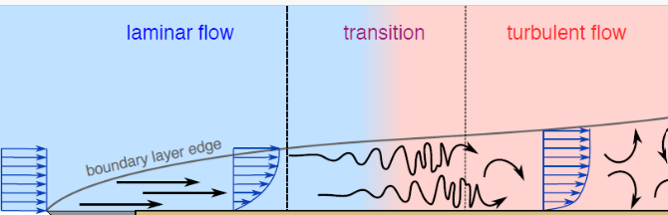
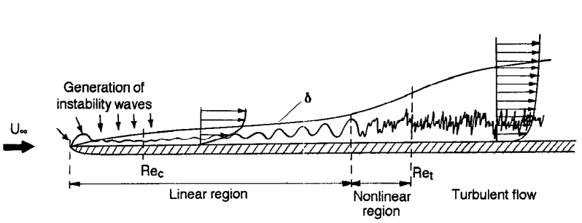
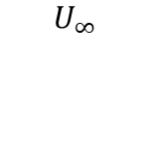


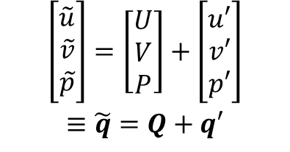
Boundary layer transition
External disturbances translate to flow instabilities that evolve and trigger transition.
External disturbances
$$U_{∞}$$
mean
perturbation
$$y$$
Avallone et.al [2]
$$\left[\begin{matrix}\begin{aligned}\tilde{u} \\ \tilde{v} \\ \tilde{p}\end{aligned}\end{matrix}\right]=\left[\begin{matrix}\begin{aligned}U \\ V \\ P\end{aligned}\end{matrix}\right]+\left[\begin{matrix}\begin{aligned}u′ \\ v′ \\ p′\end{aligned}\end{matrix}\right]$$
$$≡\tilde{q}=Q+q′$$
$$x$$
Kachanov [3]
Notes:
1) Gradient
Laminar to turbulent
Transition delay
How transition occurs (don’t mention waves)
2) If we decompose the flow field into—
Q=uvp
3) Linear region small amplitude

Slide 5
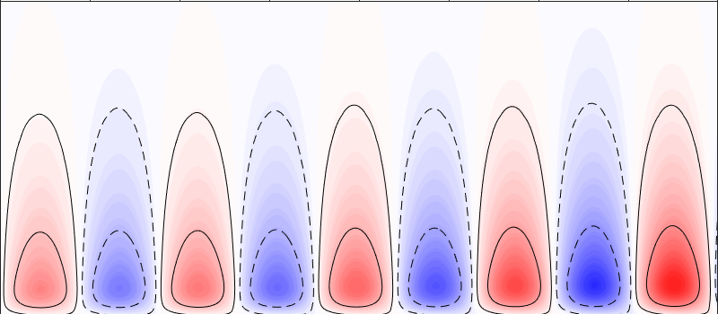
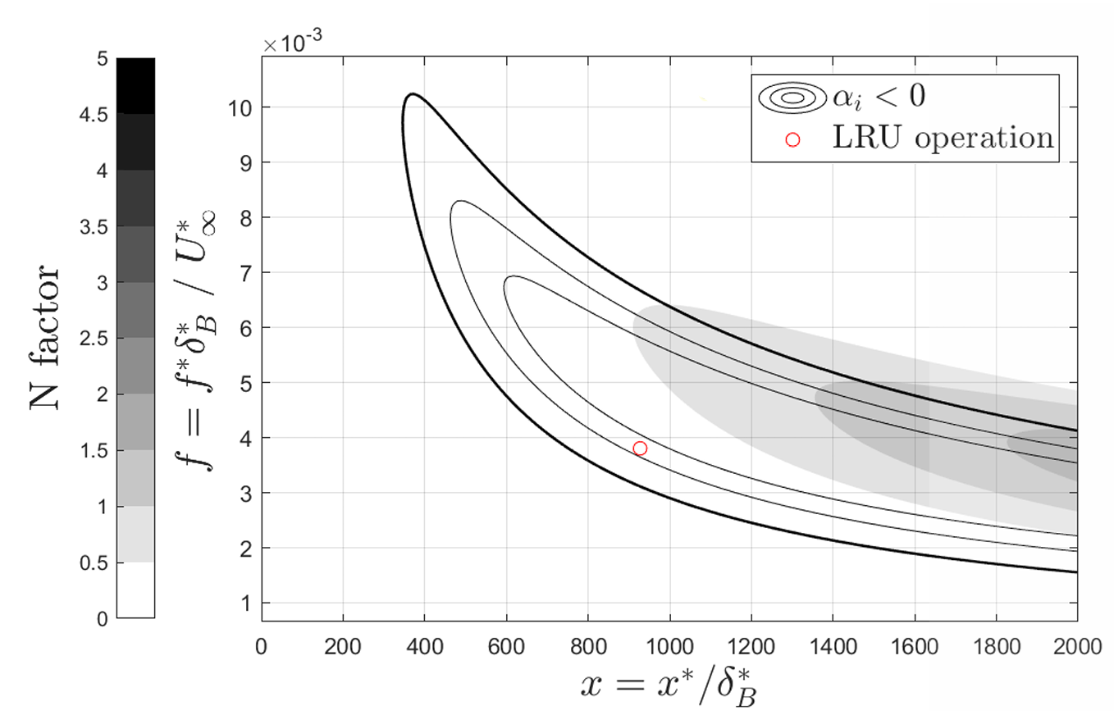


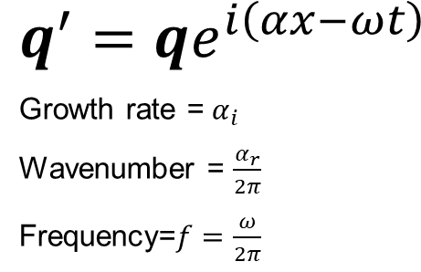
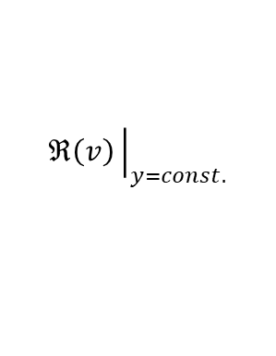
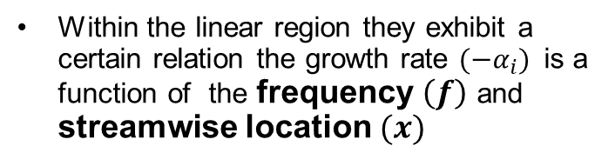
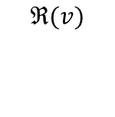
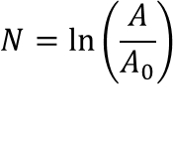
Linear stability
$$ℜ(v)$$
$$ℜ\left(v\right){\left.​\right|}_{y=const.}$$
Ansatz:
Complex Wavenumber
External disturbances
+
-
+
-
+
-
+
-
+
$$q^{′}=qe^{i\left(αx−ωt\right)}$$
Growth rate =${ α}_{i}$
Wavenumber = $\frac{α_{r}}{2π}$
Frequency=$f=\frac{ω}{2π}$
$$y$$
$$x$$
Kachanov [3]
Amplitude metric
Unstable region
Within the linear region they exhibit a certain relation the growth rate $(−α_{i})$is a function of the frequency $\left(f\right)$ and streamwise location $(x)$
$$N=\ln\left(\frac{A}{A_{0}}\right)$$
Champeaux [4]
Streamwise location
Notes:
Detailed look at linear region
Example instability (wall normal perturbation)-looks like a wave – harmonic nature
we can model this with a complex wave ansatz
Boundary layer- drag
Transition phenomena
Linear regime
Example wave
Complex ansatz
Evolution
Transition delay

Slide 6
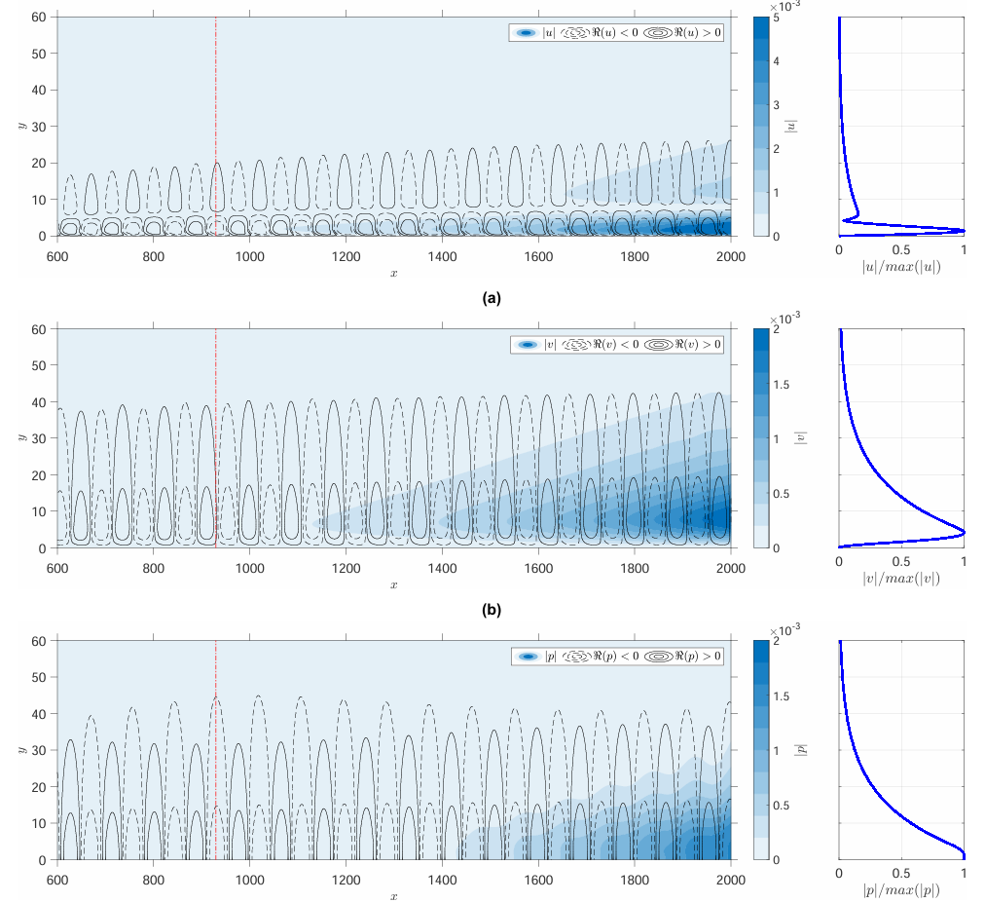












TS waves
$$u$$
$$q^{′}=q(y)e^{i\left(αx−ωt\right)}$$
$$y$$
2D waves with unique eigen functions/ shape functions
$$x$$
$$v$$
$$y$$
Unique relation between the perturbation quantities governed by the Navier stokes equation
$$q^{′}=q(x,y)e^{−iωt}$$
$$x$$
$$p$$
$$y$$
Wall admittance
$$Y=\frac{v}{p}$$
$$x$$
Notes:
One way to access or view this relation is through the lens of admittance

Slide 7


Flow control
Base flow modification
Direct wave control
Control element
Active
Passive
Controlled response
response
Controlled actuation
TS wave actuation
T.F
$$v_{c}=v_{c}(x,y,t)$$
$$v_{c}=TF∗p(x,y,t)$$
Notes:
It can be something like a plasma actuator or something very rudimentary like an oscillating plate driven by a motor
TF-Inherent dynamics of the system
4
→ Need for passive flow control

Slide 8

















Wave interference mechanism
$$Δφ$$
$$U_{∞}$$
$$x$$
$$2A′$$
$$δ_{99}(x)$$
$$+$$
$$2A_{out}$$
$$v=p_{w}∗Y$$
+
$$2A_{in}$$
$$y$$
$$x$$
$$(0,0)$$
C.E.
$$x$$
$$x_{C.E}$$
Input TS wave
Representative image →wave interference
Wall admittance $Y=\frac{v}{p_{w}}$
Amplitude → $\left|Y\right|$
Phase → $∠Y$
Attenuation or amplification →$ΔN$
Notes:
As mentioned earlier we operate entirely in the linear regime, hence classical wave phenomena superposition or interference
And an admittance maps would give us this relation

Slide 9
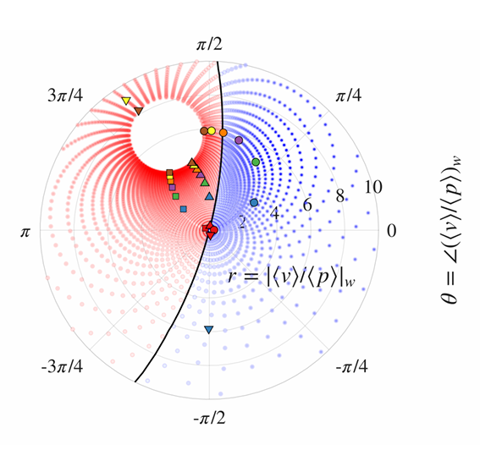







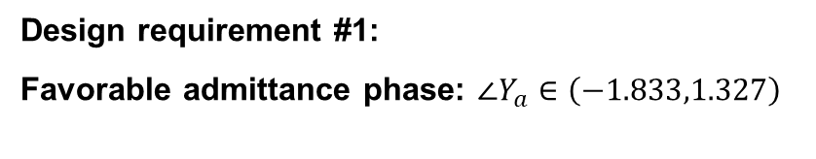


Surface admittance characterization
$$U_{∞}$$
$$δ_{99}(x)$$
$$v=v_{act}$$
$$y$$
$$(0,0)$$
act
$$x$$
$$x_{act}$$
Input TS wave
$$v_{act}$$
act
$$Y_{a}=\frac{{\left\langle v\right\rangle }_{w}}{{\left\langle p\right\rangle }_{w}}=\frac{{\left\langle v_{act}\right\rangle }_{w}}{{\left\langle p\right\rangle }_{w}}$$
Champeaux [4]
Input B.C
Admittance map
Output flow
Amplitude → $\left|Y\right|$
Phase → $∠Y$
Attenuation or amplification →$ΔN$
Design requirement #1:
Favorable admittance phase: $∠Y_{a}∈\left(−1.833,1.327\right)$
Notes:
We are establishing a design requirement

Slide 10
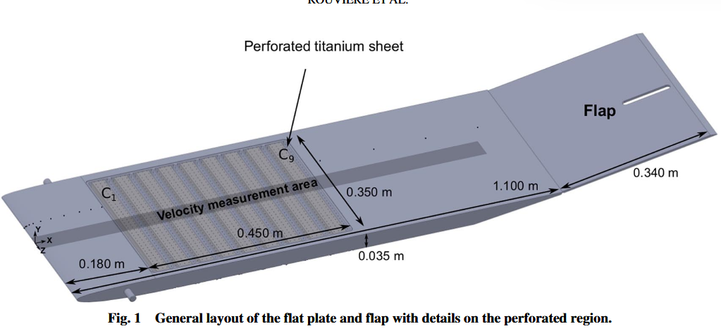
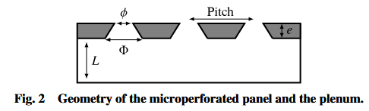
Passive control methods examples #1
TS wave excitation
The control element and the boundary layer have matching inertial properties: admittance matching
Internal dynamics: Periodic oscillations of airflow
Wall admittance modification
Maximum energy transfer→ The perturbation velocities and the response velocities are of comparable magnitudes
TS wave modulation:
Wave interference
Rouviere et al. [5]
Porous wall
Notes:
an example of a passive flow control with admittance modification
Mechanism, inherent transfer function
Additionally admittance matching→ max energy
Recirculation region→ focus on solid based

Slide 11
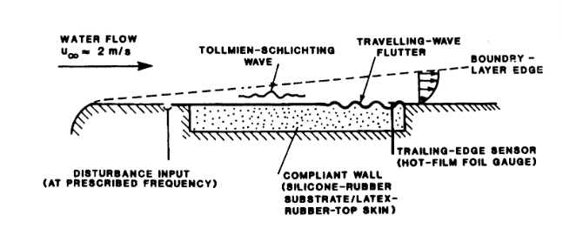
Compliant wall
Passive control methods example
TS wave excitation
The control element and the boundary layer have significantly different inertial properties: admittance mismatch
Internal dynamics: surface waves of compliant walls
Wall admittance modification
Low energy transfer: The response velocities significantly smaller than that of the input TS wave in air
Carpenter[6]
TS wave modulation:
Wave interference

Slide 12
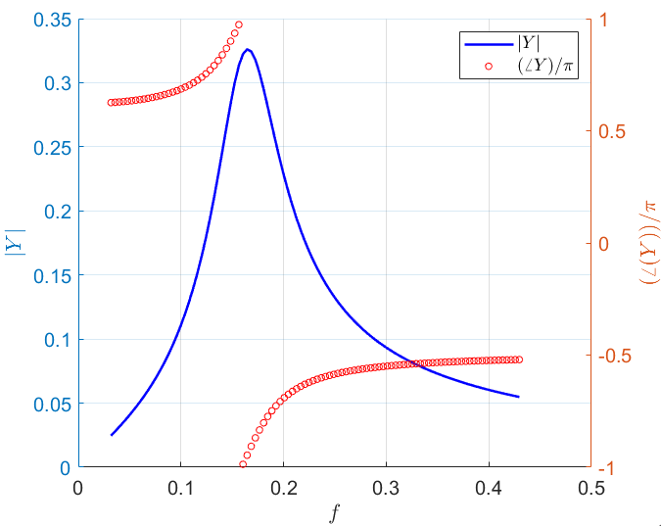
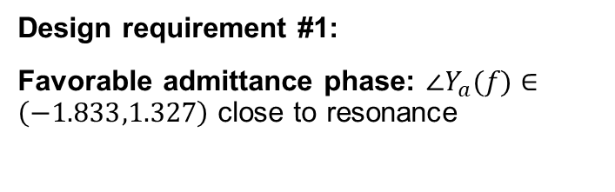





The resonance advantage
$$Y=Y(f)$$
Using resonance to overcome the admittance matching limitation
The natural phase variation of resonant systems mean that one can selectively tune the system with respect to the frequency of the TS wave to operate the right phase.
$$F(f, t)$$
$${ m}_{1}$$
$$k$$
$$η$$
Design requirement #1:
Favorable admittance phase: $∠Y_{a}(f)∈\left(−1.833,1.327\right)$ close to resonance
Maximum energy transfer at resonance frequency
Notes:
When you excite the system close to its natural frequency you have maximum energy transfer and hence max admittance amp.

Slide 13
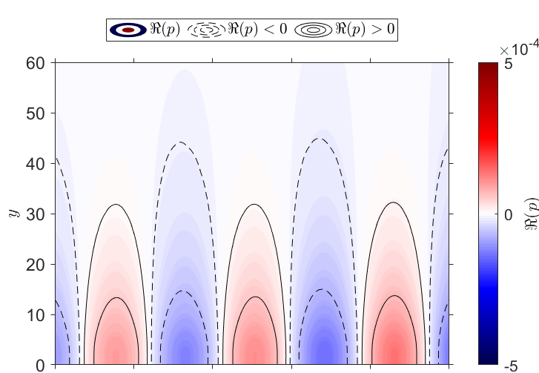
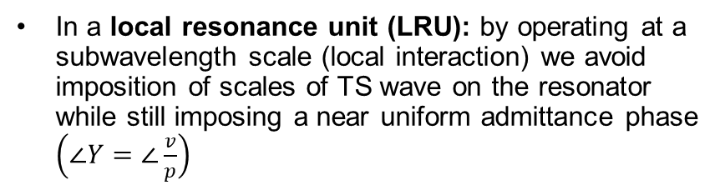

Scale separation (local resonance)
In a local resonance unit (LRU): by operating at a subwavelength scale (local interaction) we avoid imposition of scales of TS wave on the resonator while still imposing a near uniform admittance phase $\left(∠Y=∠\frac{v}{p}\right)$
Pressure perturbation
This local resonance condition is a premise for metamaterial application in multiple fields, where a periodic array of LRUs is implemented
Representative image of periodic array of LRUs
$$w≪λ_{TS}$$
Pressure load
Design requirement #2:
Must be tuned to operate at a subwavelength scale

Slide 14
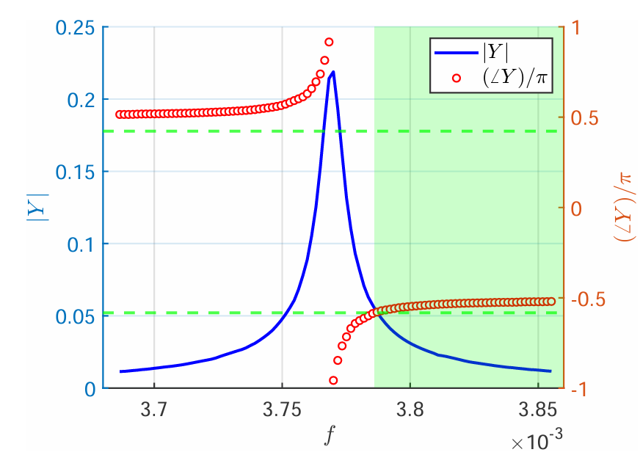
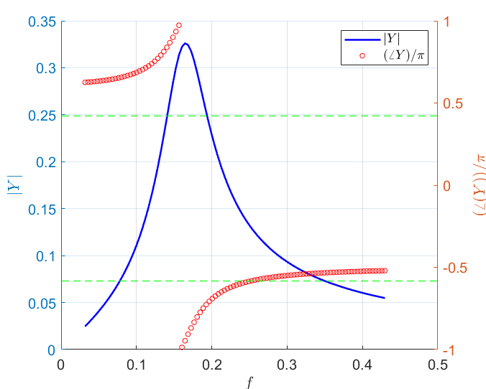
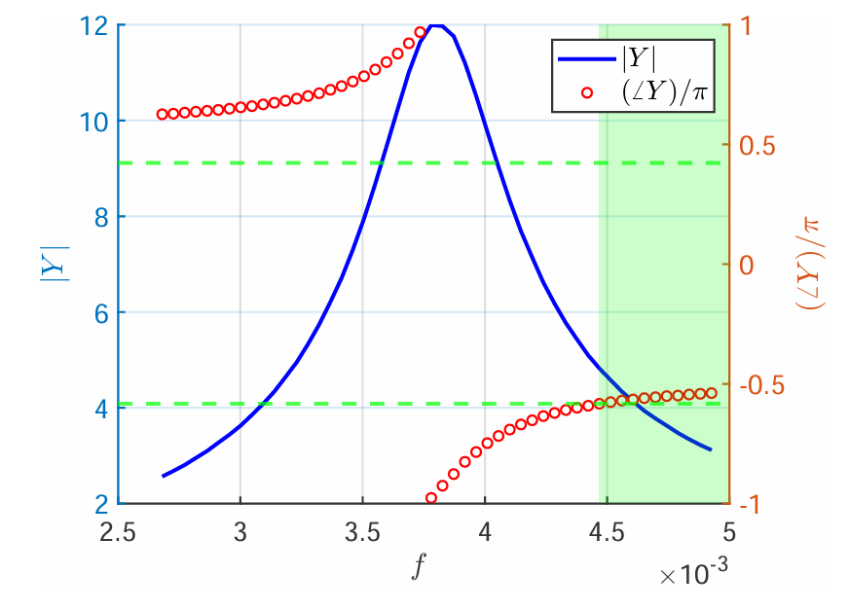
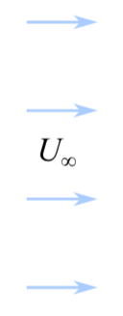
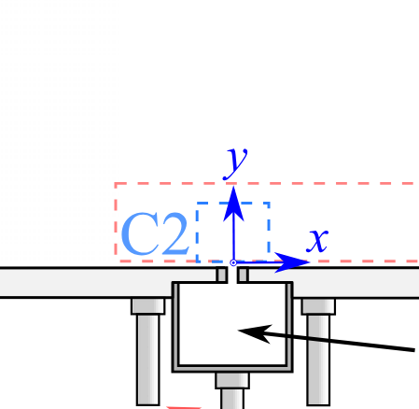
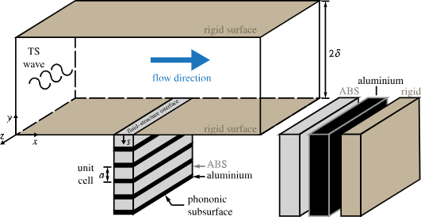
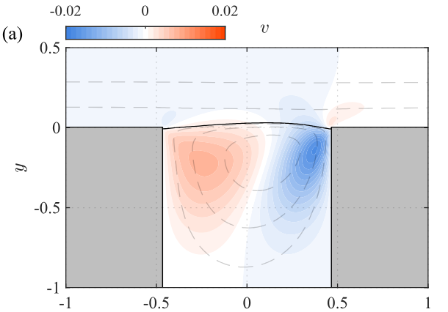




Local resonance concepts explored till now
Phononic subsurface
Spring mass system
Helmholtz resonator
Michelis et al.[8]
$$F(f, t)$$
$${ m}_{1}$$
Helmholtz resonator
$$k$$
$$η$$
Michelis et al.[7]
Phononic subsurface
Hussein et al.[9]
Notes:
Some of the resonance concepts explored till now.
Need to explore alternate

Slide 15
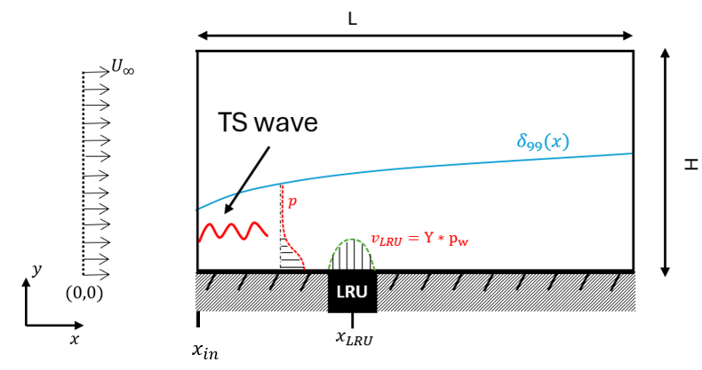
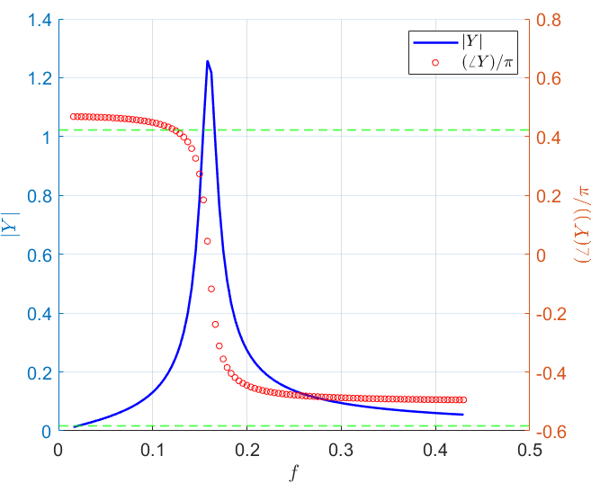
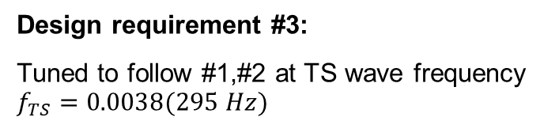
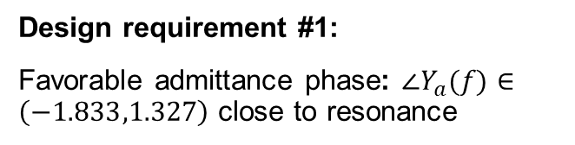

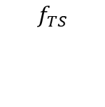
Recap and Problem definition
Hypothetical
system
TS wave excitation
Internal dynamics: wall normal oscillations
$$f_{TS}$$
Design requirement #1:
Favorable admittance phase: $∠Y_{a}(f)∈\left(−1.833,1.327\right)$ close to resonance
Admittance map
Wall admittance modification
Amplitude → $\left|Y\right|$
Phase → $∠Y$
Attenuation or amplification →$ΔN$
Design requirement #2:
Must be tuned to operate at a subwavelength scale
TS wave modulation:
Wave interference
Design requirement #3:
Tuned to follow #1,#2 at TS wave frequency $f_{TS}=0.0038(295 Hz)$
Notes:
Lack of research on concepts following #1 or the inability of the existing concepts to follow #1 brings us to the current work

Slide 16
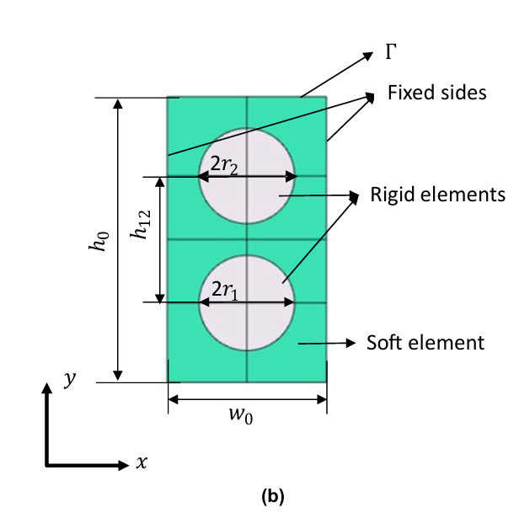
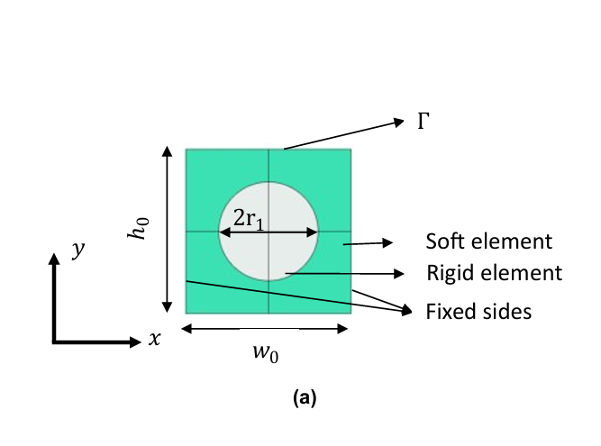
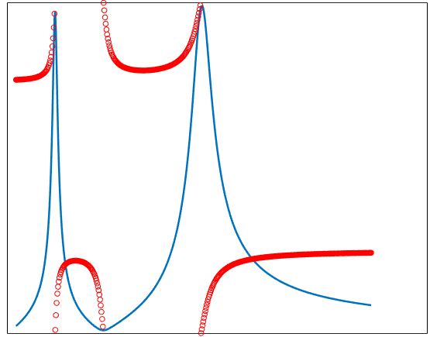
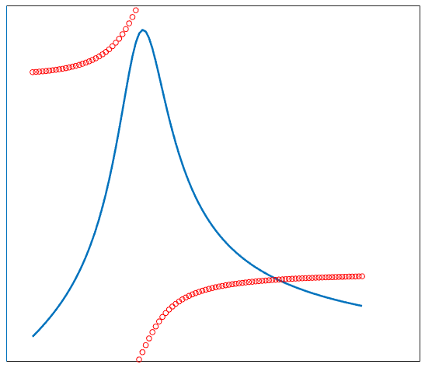













Alternative LRU concepts explored
Single mass composite resonator (SMCR)
Double mass composite resonator (SMCR)
$${ k}_{3}$$
$${ η}_{3}$$
$$F(f,t)$$
$$F(f, t)$$
$${ m}_{2}$$
$${ m}_{1}$$
$${ k}_{2}$$
$${ η}_{2}$$
$$k$$
$$η$$
$${ m}_{1}$$
$${ k}_{1}$$
$${ η}_{1}$$
Notes:
Lack of research on such
Although just like a simple spring mass system we don’t know if we can tune it, we also don’t know how the phase varies across different modes
Playing with phase shifts

Slide 17
Background and research gap
Research questions
Methodology
Stage-I
Stage-II
Stage-III
Conclusions

Slide 18
Research objective and questions (simplified)
Investigating the potential of composite resonators as LRU concepts designing them to achieve surface admittance suitable for TS wave attenuation as per the design criteria.
  How does the admittance phase of composite resonators vary across different resonance modes and how can we tune it?
  How can they be tuned to operate at a desired frequency while maintaining subwavelength dimensions?
  How much TS wave attenuation do the tuned designs result in?
Stage I
Conceptual exploration of admittance phase
Stage II
LRU Tuning
Stage III
TS wave interaction

Slide 19
Background and research gap
Research questions
Methodology
Stage-I
Stage-II
Stage-III
Conclusions

Slide 20
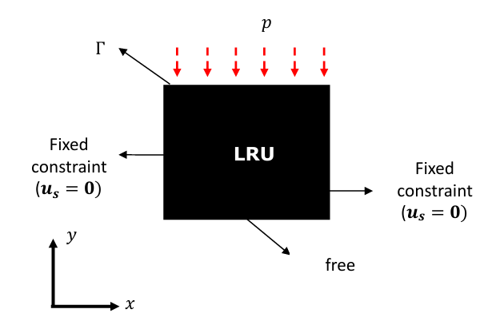
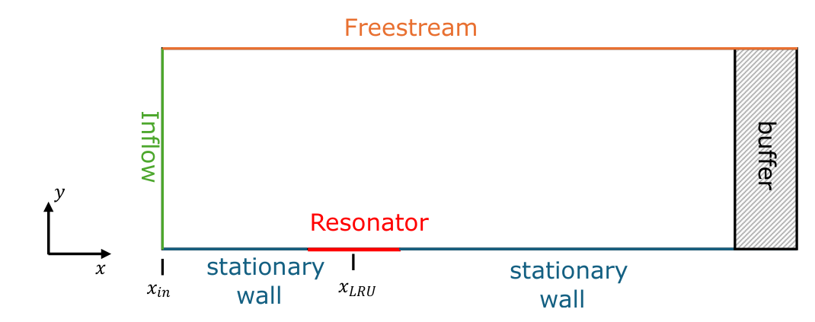










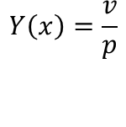


Methodology
Pressure load analysis: Linear elastic modelling in COMSOL
TS wave interaction: Harmonic Navier Stokes (HNS) equations solver
$$Y\left(x\right)=\frac{v}{p}$$
$$v=Y(x)∗⟨p_{w}⟩$$
L
$$U_{∞}$$
$$Y=\frac{v_{t}}{p}$$
TS wave
$$Re_{x_{LRU}}=3.5∗{10}^{5}$$
$$δ_{99}(x)$$
H
$$p$$
$$v_{LRU}=Y∗p_{w}$$
$$y$$
$$(0,0)$$
LRU
$$x$$
$$x_{in}$$
$$x_{LRU}$$
Notes:
Most part pressure load analysis
Uniform pressure load since the LRU is expected to see only a small part of the TS wave
Top shows BC
And the bottom shows problem schematic

Slide 21
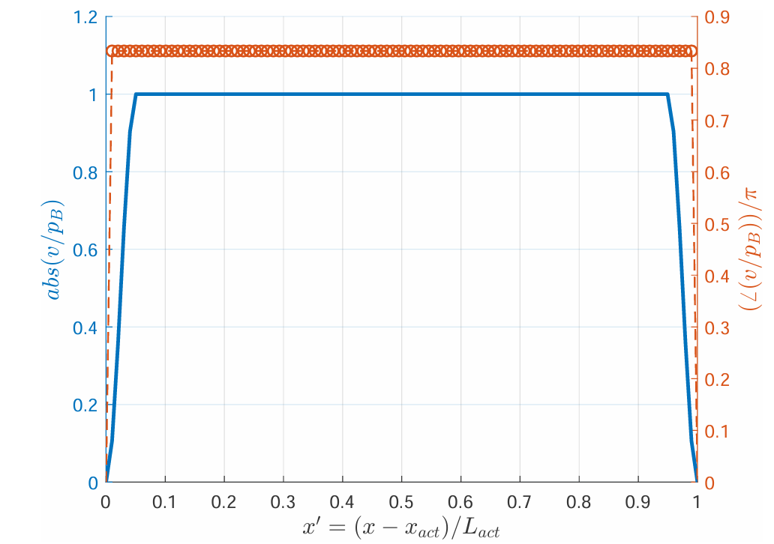
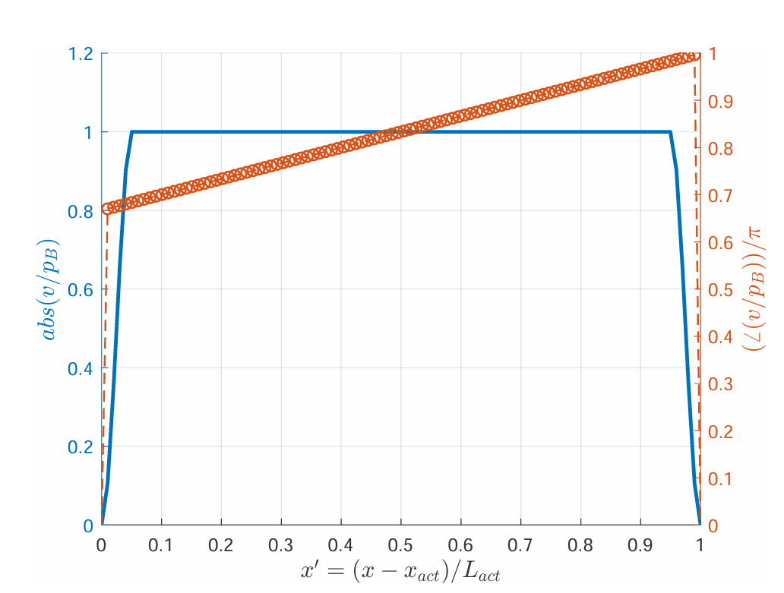











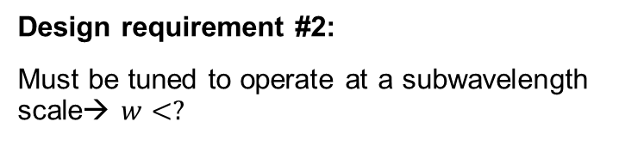
Scale separation limit
L
$$U_{∞}$$
Velocity at the wall is assigned independent of local pressure
Scale separation implies that the TS waves must be indifferent to local variations
Design requirement #2:
Must be tuned to operate at a subwavelength scale→ $w<?$
TS wave
$$δ_{99}(x)$$
H
$$p$$
$$v_{act}$$
$$v_{LRU}$$
$$y$$
$$(0,0)$$
Act
LRU
$$x$$
$$x_{in}$$
$$x_{act}$$
$$x_{1}$$
Average velocity phase is same in both cases
Const. phase
Linearly growing phase
Type-A
Type-B
Notes:
The requirement #2 doesn’t have the exact limit
We move to an active system to set the design requirement since we want some freedom in controlling the response
We test scale separation by examining one of its fundamental traits

Slide 22
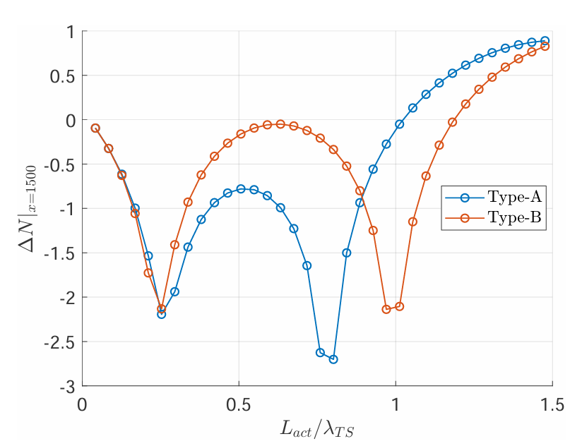
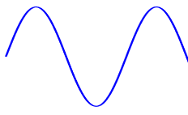

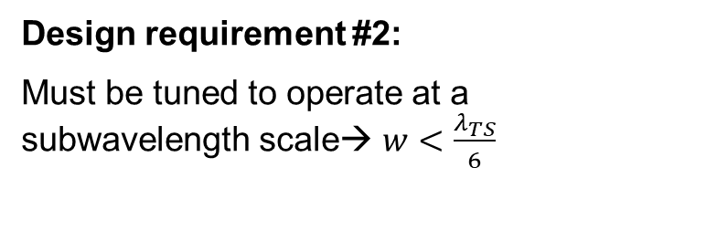


Scale separation limit
Modulation of TS wave amplitude measured downstream
$$U_{∞}$$
TS wave
$$δ_{99}(x)$$
H
$$p$$
$$v_{act}$$
$$y$$
$$(0,0)$$
Act
LRU
$$x$$
$$x_{in}$$
$$x_{act}$$
$$x_{1}$$
Design requirement #2:
Must be tuned to operate at a subwavelength scale→ $w<\frac{λ_{TS}}{6}$
$$\frac{λ_{TS}}{4}$$
$$w_{act}/λ_{TS}$$
Width of actuator
act
act
Notes:
The graph on right shows change in n factor at x1
x axis shows width of actuator
The ts wave must not be able to tell the difference between type a and type b.

Slide 23
Background and research gap
Research questions
Methodology
Stage-I
Stage-II
Stage-III
Conclusions

Slide 24
Objectives
  To examine admittance phase variation across different vibration modes of SMCR and DMCR.
  To determine how to tune them to obtain the desired admittance phase close to resonance.
24
Notes:
Exmaine modes
See if we can tune them

Slide 25
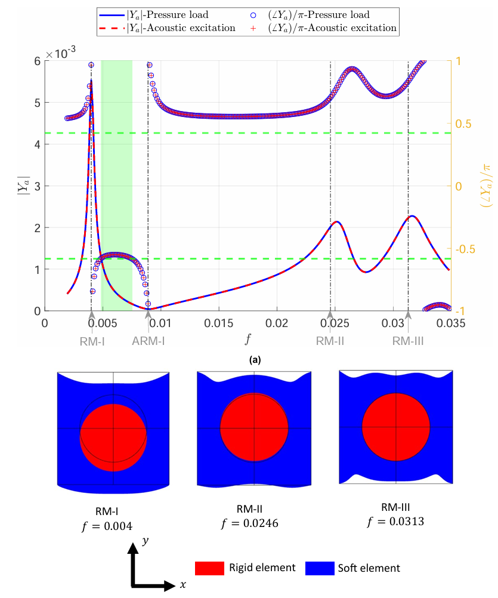








SMCR-numerical investigation
$$p$$
$$Γ$$
Soft element
Rigid element
$$h_{0}$$
$$2r_{1}$$
Fixed sides
$$y$$
$$w_{0}$$
Favorable phase region or Stable region
$$x$$
25
Notes:
different mode shapes (non uniform admittance phase at higher modes)
we see favorable phase only in a narrow region between rm-1 and arm -1
we disregard higher modes (low amp, high freq)

Slide 26

Primary Mode
Michelis et al.[8]
Helmholtz resonator
$$y$$
Michelis et al.[7]
Hussein et al.[9]
$$x$$
26
Notes:
Looks exactly the same as previous concepts

Slide 27










DMCR-numerical investigation
$$p$$
$$Γ$$
Fixed sides
2$r_{2}$
Rigid elements
$$h_{12}$$
$$h_{0}$$
2$r_{1}$
Soft element
$$y$$
$$w_{0}$$
$$x$$
27
Notes:
Additional peak, different mode response
They oscillate out of phase with each other

Slide 28



DMCR- Coupled resonance
Increasing $h_{12}$
1
2
$$h_{12}$$
3
4
$$y$$
$$x$$
28
Notes:
As they move close to each other we lose the favorable phase region between the resonance peaks
And the same story as they move further closer where we see the coupled resonance
And finally we see a single broad peak
So the addition of a mass or a degree of freedom did not give any advantage in realizing the favorable admittance phase close to resonance

Slide 29






Energy Transfer analysis
Hypothetical
system
$$y$$
$$\hat{p}\left(x\right)cos⁡(ωt)$$
$$\hat{v}\left(x\right)cos⁡(ωt+φ)$$
$$x$$
LRU
Work done on the LRU
Conclusion: Any passive linear LRU with single input single output (SISO)architecture are limited to a certain admittance phases achievable.
29
Notes:
Now We don’t know If we can tune these systems by changing shapes sizies or materials to affect the phase
But there is a fundamental issue limiting the admittance phase
That is understood by energy transfer analysis
-→ concusion on siso
This means this dream system is ahceivable oonly through energy inputs
In real systems this means that we are limited to post resonance conditions

Slide 30







Design phase points
Design requirement #1:
Favorable admittance phase: $∠Y_{a}(f)∈\left(−1.833,1.327\right)$ close to resonance
Design requirement #1:
Favorable admittance phase: $∠Y_{a}(f)∈\left(−1.833,1.327\right)$ close to resonance
Design requirement #2:
Must be tuned to operate at a subwavelength scale $w<\frac{λ_{TS}}{6}$
Design requirement #3:
Tuned to follow #1,#2 at TS wave frequency $f_{TS}=0.0038(295 Hz)$
SMCR systems
DMCR systems
Design phase point
$$∠Y_{a}=−1.745$$
30
Notes:
For the next stage we would focus on tuning the design phase point to have the desired frequency

Slide 31
Background and research gap
Research questions
Methodology
Stage-I
Stage-II
Stage-III
Conclusions

Slide 32
Objectives
  To tune the composite resonators such that they follow the subwavelength requirement and their design phase point is at TS wave frequency.
  Additionally tune them to increase the admittance amplitude
32

Slide 33





1D-Analytical modelling
$$p$$
$$v_{t}$$
Analytical parametric studies conducted to guide the numerical parametric studies
$$Y=\frac{S}{\sqrt{km}}\frac{iβ}{1−β^{2}−iη}$$
Design phase point
Notes:
We take an analytical approach
As you can see the admittance obtained from analytical sdof model and the smcr in comsol show a good match

Slide 34




Analytical investigation
Design phase point amplitude
Design phase point frequency
To increase the amplitude, one cannot rely on stiffness or mass alone
Design phase point
34

Slide 35


Role of material constraints
Ashby[9]
Notes:
To keep high amplitudes we want to explore different material choices

Slide 36









Tuned design admittance
Design requirement #1:
Favorable admittance phase: $∠Y_{a}(f)∈\left(−1.833,1.327\right)$ close to resonance
Design requirement #2:
Must be tuned to operate at a subwavelength scale $w<\frac{λ_{TS}}{6}$
Design requirement #3:
Tuned to follow #1,#2 at TS wave frequency $f_{TS}=0.0038(295 Hz)$
$$p$$
$$v_{t}$$
$$Γ$$
Rigid element
Fixed sides
$$h_{0}$$
Soft element
$$w_{1}$$
$$w_{0}$$
Notes:
Tuned design that meets all the design criteria

Slide 37




DMCR-numerical investigation
Frequency of design phase point -3
Admittance amplitude of design phase point -3
The amplitude achievable is limited again by the density and stiffness constraints together.
Notes:
Red line shows parameter space with the design phase point’s frequency being the ts wave frequency

Slide 38










Tuned design admittance
Design requirement #1:
Favorable admittance phase: $∠Y_{a}(f)∈\left(−1.833,1.327\right)$ close to resonance
Design requirement #2:
Must be tuned to operate at a subwavelength scale $w<\frac{λ_{TS}}{6}$
Design requirement #3:
Tuned to follow #1,#2 at TS wave frequency $f_{TS}=0.0038(295 Hz)$
$$Γ$$
$$p$$
rigid element-2
$$h_{2}$$
$$w_{2}$$
Fixed side
Fixed side
The coupled resonance phenomena doesn’t give us an amplitude advantage either
$$h_{0}$$
Soft element
rigid element-1
$$h_{1}$$
$$w_{1}$$
$$w_{0}$$
Design phase point
Notes:
Dmcr gave neither the phase advantage nor the amplitude advantage

Slide 39
Background and research gap
Research questions
Methodology
Stage-I
Stage-II
Stage-III
Conclusions

Slide 40
Objectives
  To find the order of TS wave attenuation achievable from the composite resonators
40

Slide 41








TS wave attenuation from SMCR
Spatial variation of admittance
$$U_{∞}$$
TS wave
$$δ_{99}(x)$$
H
$$p$$
Streamwise location
$$v_{LRU}=Y∗p_{w}$$
$$y$$
$$(0,0)$$
LRU
$$ΔN≈−1e−3$$
$$x$$
$$x_{in}$$
$$x_{LRU}$$

Slide 42



TS wave attenuation from DMCR
$$U_{∞}$$
TS wave
$$δ_{99}(x)$$
H
$$p$$
$$v_{LRU}=Y∗p_{w}$$
$$ΔN≈−1e−4$$
$$y$$
$$(0,0)$$
LRU
$$x$$
$$x_{in}$$
$$x_{LRU}$$

Slide 43
Background and research gap
Research questions
Methodology
Stage-I
Stage-II
Stage-III
Conclusions

Slide 44

Answers to the research questions
The admittance phase is outside the favorable limits except for a narrow range of post resonance frequencies
  How does the admittance phase of composite resonators vary across different resonance modes and how can we tune it?
  How can they be tuned to operate at a desired frequency while maintaining subwavelength dimensions?
  How much TS wave attenuation do the tuned designs result in?
Passivity limits the admittance phase values of SISO systems
No advantage from coupled resonance
The exact subwavelength limit was identified through scale separation test
Tuning workflow is provided to meet the operating conditions
$ΔN≈− {10}^{−4}$to $−{10}^{−3}$ (for air based boundary layer)

Slide 45





Recommendations
For a water based boundary layer the SMCR based LRUs can be further explored for optimization and practical implementation.
Although the attenuation of a single composite resonator based LRU is low, one can achieve cumulative attenuation through implementation in aperiodic array.
Considering the limitation of SISO type systems in admittance phase, multiple input multiple output (MIMO) type systems can be explored.
Further verification in fully coupled fluid structure interaction simulations.
TS wave
$$v_{LRU}=Y∗p_{w}$$
$$v_{LRU}=v_{t}$$
LRU
LRU
$$x_{LRU}$$
$$x_{LRU}$$
Notes:
water

Slide 46
References
[1]. P. Ricco, M. Skote, and M. A. Leschziner, “A review of turbulent skin-friction drag reduction by near-wall transverse forcing,” en, Progress in Aerospace Sciences, vol. 123, p. 100713, May 2021, ISSN: 03760421. DOI: 10.1016/j.paerosci.2021.100713.
[2] F. Avallone et al., Metamaterials and Fluid Flows, en, arXiv:2509.05371 [cond-mat], Sep. 2025. DOI: 10.48550/arXiv.2509.05371. Accessed: Jan. 12, 2026. [Online]. Available: http://arxiv. org/abs/2509.05371.
[3] Y. S. Kachanov, “Physical mechanisms of laminar-boundary-layer transition,” Annual review of fluid mechanics, vol. 26, no. 1, pp. 411–482, 1994.
[4] P. Champeaux, “Towards direct wave control of Tollmien–Schlichting instability,” en, Tech. Rep.
[5] A. Rouviere, F. Méry, J. Methel, O. Vermeersch, and M. Forte, “Experimental and Numerical Study on Wall Impedance Effects on Tollmien–Schlichting Waves,” en, AIAA Journal, pp. 1–12, Sep. 2021, ISSN: 0001-1452, 1533-385X. DOI: 10.2514/1.J060536. Accessed: Dec. 8, 2025. [Online]. Available: https://arc.aiaa.org/doi/10.2514/1.J060536.
[6] P. W. Carpenter, “Current status of the use of wall compliance for laminar-øow control,” en, 1997.
[7] T. Michelis, C. De Koning, and M. Kotsonis, “On the interaction of Tollmien–Schlichting waves with a wall-embedded Helmholtz resonator,” en, Physics of Fluids, vol. 35, no. 3, p. 034104, Mar. 2023, ISSN: 1070-6631, 1089-7666. DOI: 10.1063/5.0141685. Accessed: Dec. 8, 2025. [Online]. Available: https://pubs.aip.org/pof/article/35/3/034104/2882036/On-the interaction-of-Tollmien-Schlichting-waves.
[8] M.I. Hussein, S. Biringen, O. R. Bilal, and A. Kucala, “Flow stabilization by subsurface phonons,” en, ProceedingsoftheRoyalSocietyA:Mathematical,PhysicalandEngineeringSciences,vol.471, no. 2177, p. 20140928, May 2015, ISSN: 1364-5021, 1471-2946. DOI: 10.1098/rspa.2014. 0928. Accessed: Dec. 8, 2025. [Online]. Available: https://royalsocietypublishing.org/ doi/10.1098/rspa.2014.0928.
[9] T. Michelis, A. B. Putranto, and M. Kotsonis, “Attenuation of Tollmien–Schlichting waves using resonating surface-embedded phononic crystals,” en, Physics of Fluids, vol. 35, no. 4, p. 044101, Apr. 2023, ISSN: 1070-6631, 1089-7666. DOI: 10.1063/5.0146795. Accessed: Dec. 8, 2025. [Online]. Available: https://pubs.aip.org/pof/article/35/4/044101/2883065/Attenuatio n-of-Tollmien-Schlichting-waves-using.

Slide 47
Questions?

Slide 48
Backup slides

Slide 49



Wave interference mechanism (plots from results)
Baseline/ original TS wave
Location of control element
Additional wave resulting from admittance modification
Final modulated TS wave

Slide 50



SMCR-numerical investigation
$$p$$
$$v_{t}$$
$$Γ$$
Rigid mass
Increase in “k”
(more than “m”)
Fixed sides
$$h_{0}$$
Soft element
$$w_{1}$$
$$w_{0}$$
SMCR thickness
Increase in “m”
Increase in “m” and “k”
Rigid mass density
Rigid mass width
Notes:
Note the change in schematic of the smcr but the architcherutre remains same with rigid and soft

Slide 51
Compliant wall
Passive control methods examples #2
TS wave excitation
The control element and the boundary layer have significantly different inertial properties: admittance mismatch
Internal dynamics: surface waves of compliant walls
Wall admittance modification
Low energy transfer: The response velocities significantly smaller than that of the input TS wave in air
TS wave modulation:
Wave interference

Slide 52





Energy Transfer analysis
$$y$$
$$\hat{p}\left(x\right)cos⁡(ωt)$$
$$\hat{v}\left(x\right)cos⁡(ωt+φ)$$
$$x$$
LRU
Work done on the LRU
Conclusion: Any passive linear LRU with single input single output (SISO)architecture are limited to a certain admittance phases achievable.
52

