Slide 1
Lending club case study
Presenter: Aditya Karnik

Slide 2
Agenda
Introduction
Loan data exploration
Data overview
Data preparation and cleanup
Exploratory Data analysis:
Univariate analysis
Bivariate analysis
Multivariate analysis
Results and discussions
Summary and Conclusion

Slide 3

Introduction and problem statement
Lending Club is one of the largest online marketplace where people can apply for the loan at lower interest rate. Company wants to implement low risk approach while approving loans but at the same time does not want to lose the business.
This case study aims at providing insights by analysing historical data for approved loans which contains information about the charged off (defaulted) loans.

Slide 4



Loan Data Descriptions
This is a csv file having 39717 rows and 111 columns
This dataset contains Different categorical columns which are order categorical and unordered categorical variables and numerical variables.
Columns with all NA values: 54
Columns with NA values more than 30% but not all null: ['desc', 'mths_since_last_delinq', 'mths_since_last_record', 'next_pymnt_d’]
Other columns with Null values:
emp_title 2459
emp_length 1075
title 11
revol_util 50
last_pymnt_d 71
last_credit_pull_d 2
collections_12_mths_ex_med 56
chargeoff_within_12_mths 56
pub_rec_bankruptcies 697
tax_liens 39
Important Categorical variables:
Grades and subgrades
Issue date
Employment duration
Home ownership status
Loan verification status
Loan Purpose
Address state
Loan status
Derogatory public record
Important facts column:
Debt to income ratio
Annual income
Loan amount
Recoveries

Slide 5
Data cleaning and Derived metrics
boxplot analysis for the Numeric columns
Outlier Analysis
54 Columns with Null values removed
Removal of null columns
Data cleaning and Derived Metrics
Type Conversions
Type driven and Data driven metrics prepared
29 Numeric columns were corrected
Derived Metrics
Imputation
Numeric values using mean and median
Categorical values using modes
Cleaning of Unsignificant columns
Univariate analysis for the Numeric and categorical columns

Slide 6
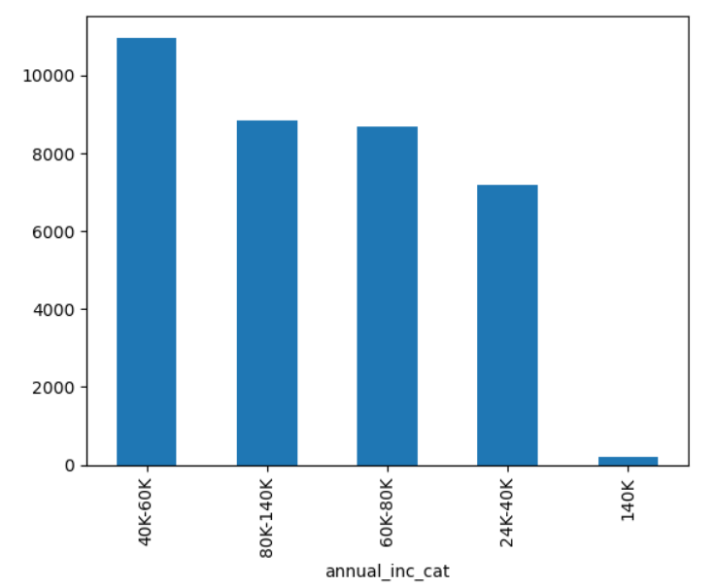
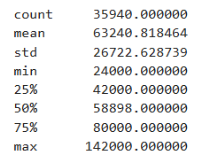
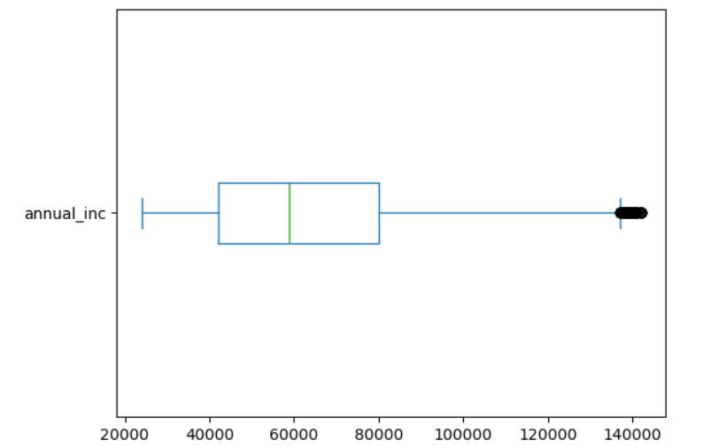
Annual income
Note: Annual income is ranging between 20K to 80K

Slide 7
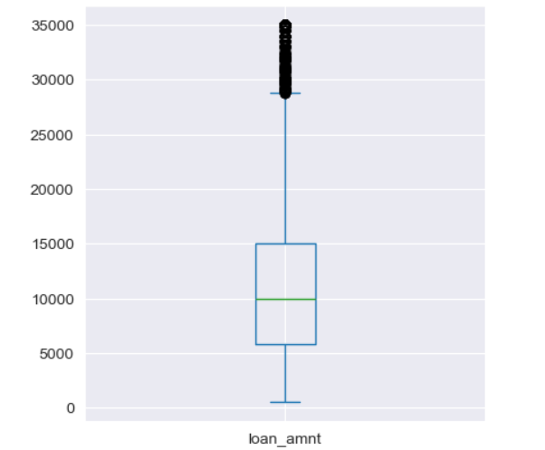
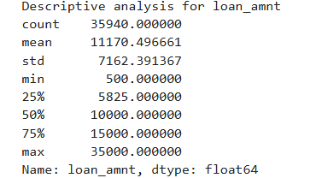
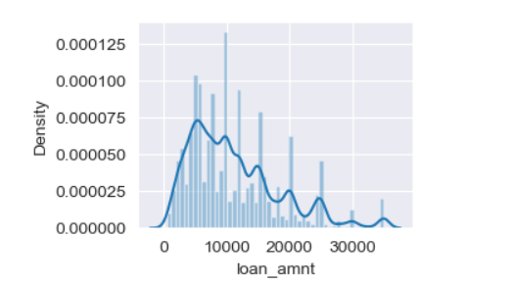
Loan Amount
Note: Maximum loan amounts are ranging between 5K to 15K

Slide 8
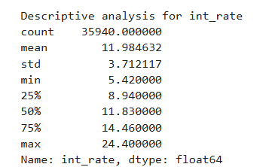
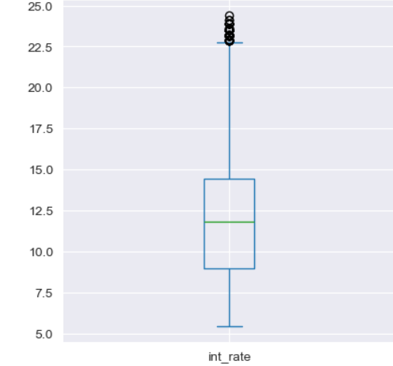
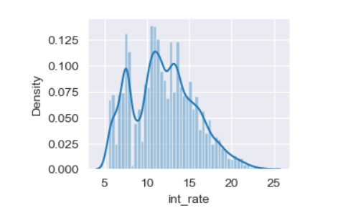
Interest Rate
Note: Maximum interest rates are ranging between 8% to 15%
But there are interest rates higher than 20% till 24.4%

Slide 9
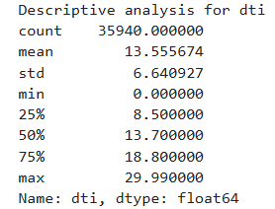
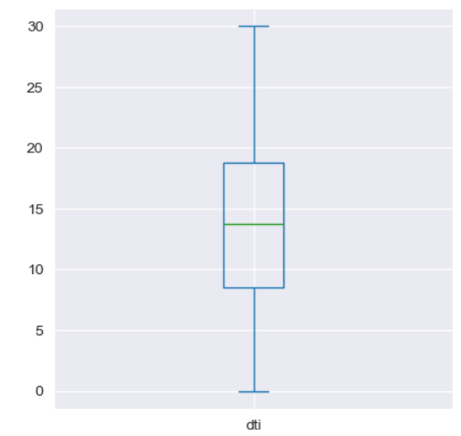
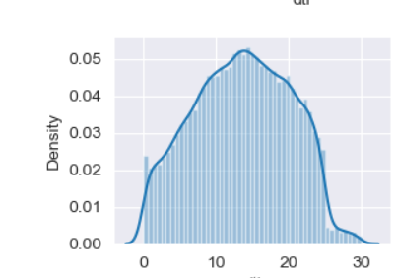
Debt to Income ratio
Note: Maximum debt to income are ranging between 8 to 19.
But there are DTI higher than 20, whereas some of them are 30

Slide 10
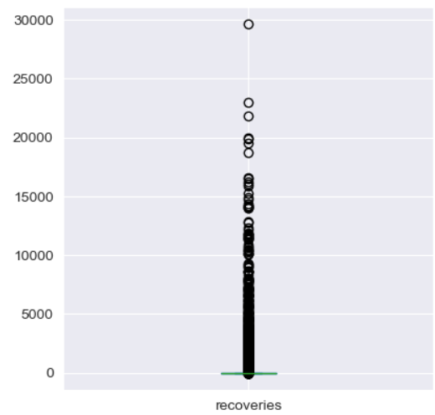
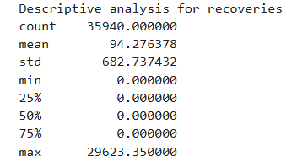
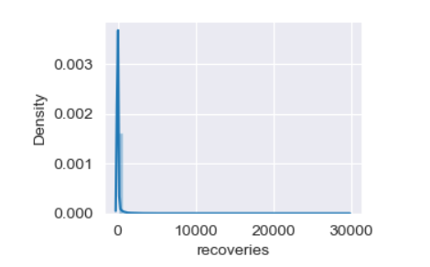
Recoveries
Note: No significant recoveries of the amounts

Slide 11
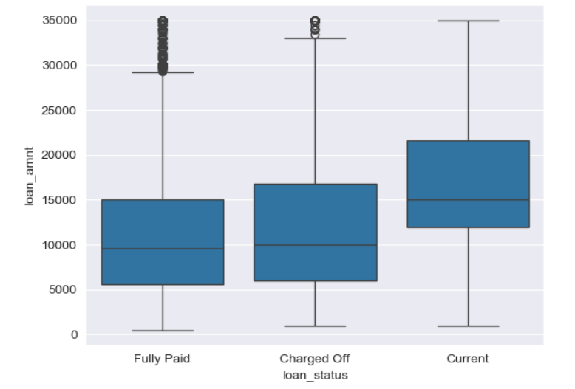
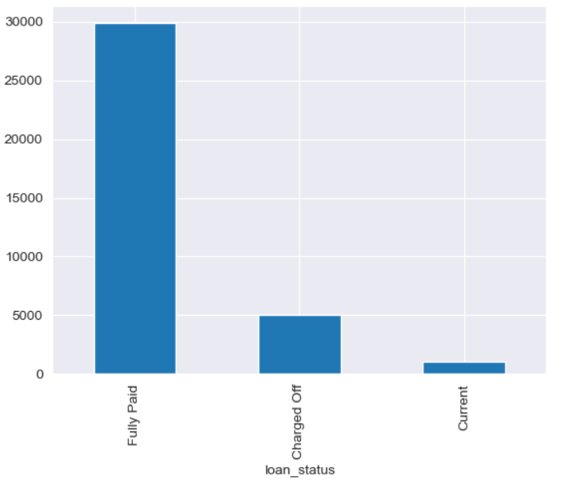
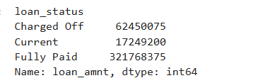
Loan status and Loan amounts
Note: Maximum defaulted loans ranged between 6K to 17K loan amounts. Whereas the fully paid loans are also ranging between the same. Count of applicants repaying the loan is more than the defaulted ones.

Slide 12
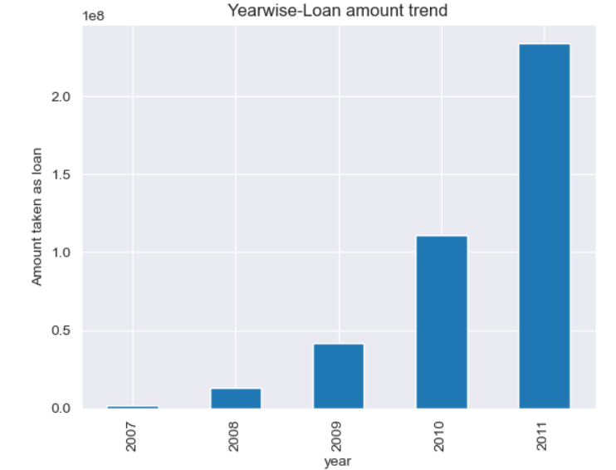
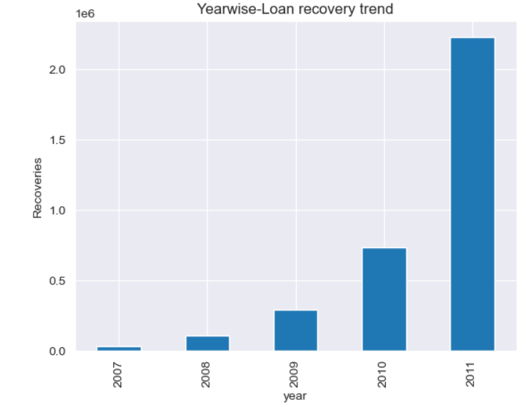
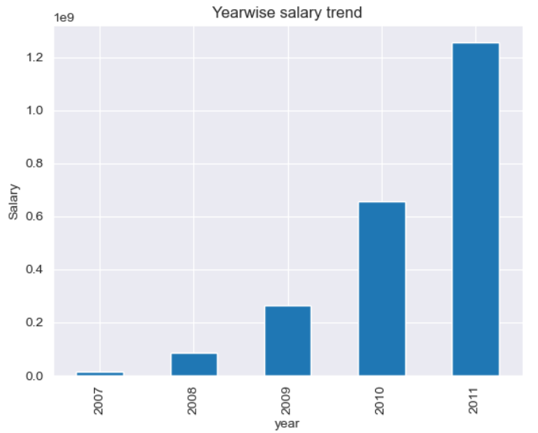
Year Vs Loan amount, Recoveries and Annual income
Note: As the purchasing power(income) is increasing with year. In 2011 it increased significantly. There is trend of taking more loans. There are some recoveries also seen but the amounts are insignificant.

Slide 13
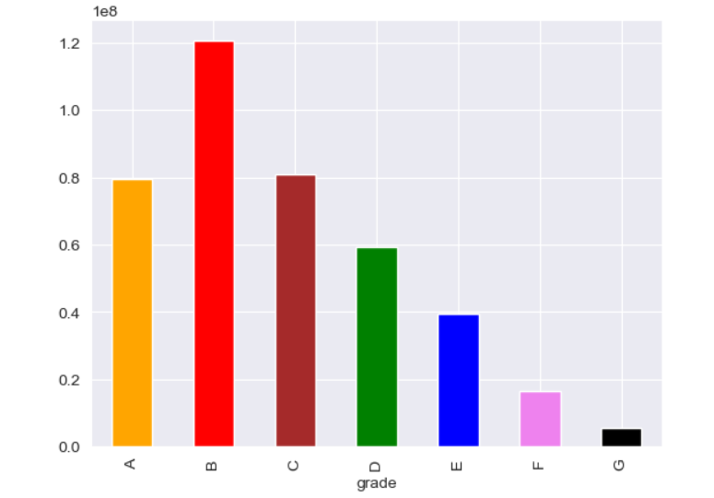
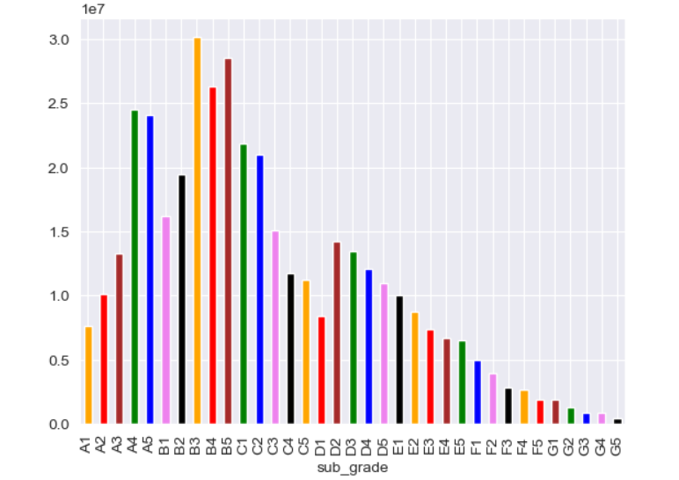
Grade Vs loan amounts
Note: Grade B loans are applied more and then Grade C and Grade A.
Subgrades A4, A5, B3-B5, C1-C3 and D2 are more popular.

Slide 14
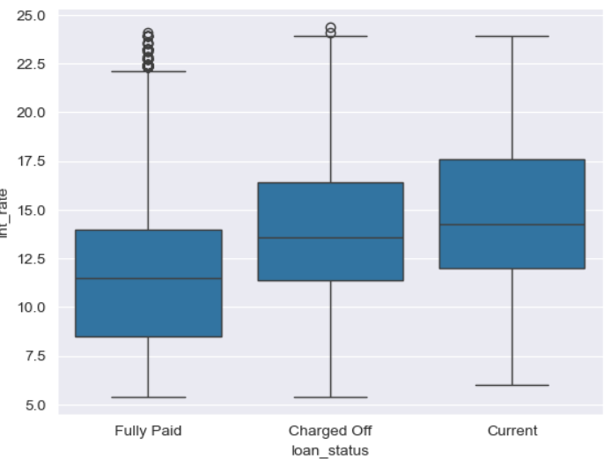
Interest Rates and Loan status
Note: The loans between 12% interest rates to 16% interest rates are more Prone to be defaulted compared to lower interest rates.

Slide 15
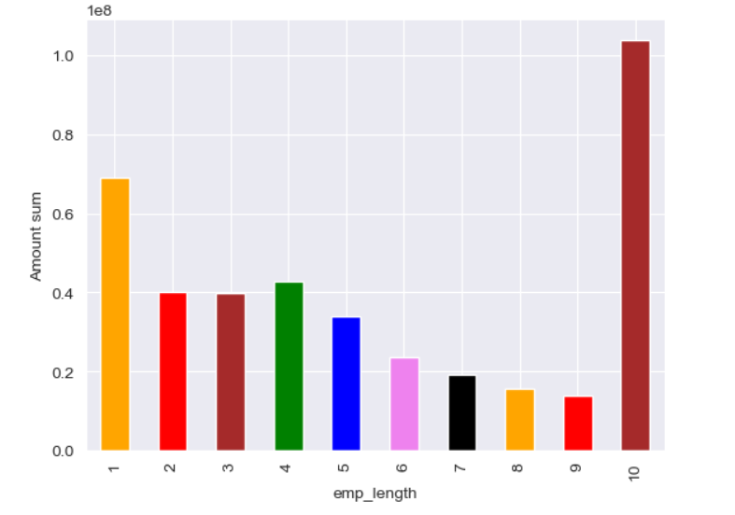
Employee Length Vs loan amount
Note: Employees having experience more than 10 years and less than 1 year take more loans compared to others.

Slide 16
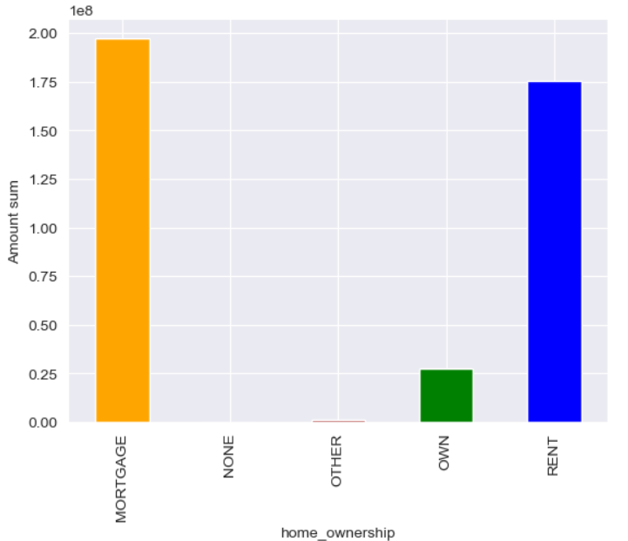
Home ownership Vs Loan Amount
Note: People with Mortgaged home and Rented home are more likely to take loans.

Slide 17
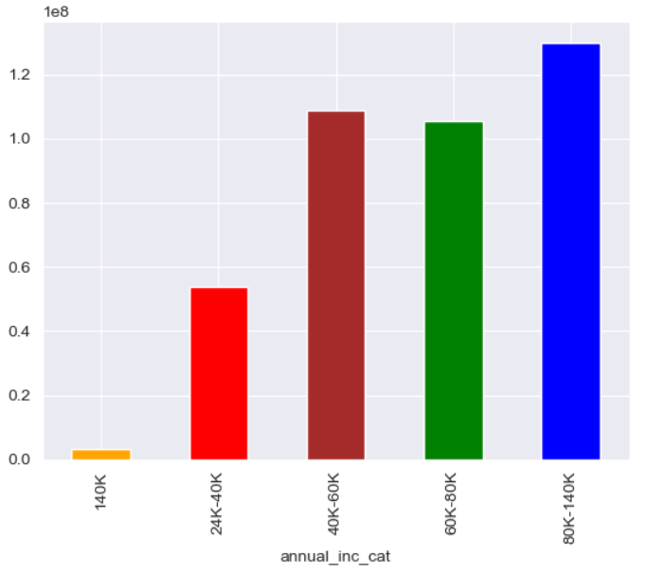
Annual income Vs Loan amount
Note: Applicants with Annual income more than 40K contribute to major loan portfolio

Slide 18
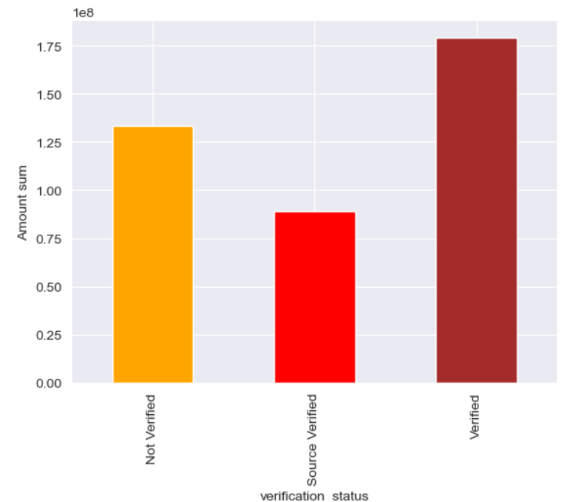
Verification Status Vs Loan Amount
Note: Applicants whose verification is done have taken more loans.

Slide 19
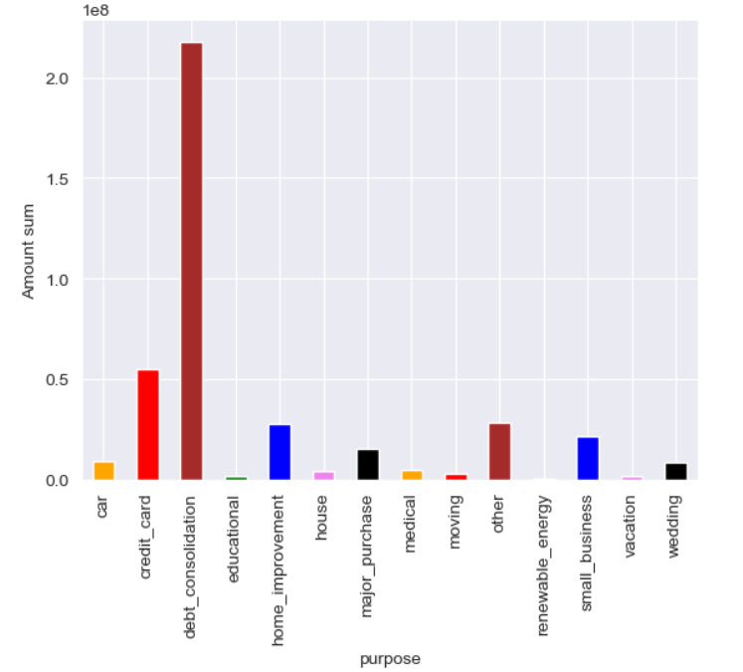
Purpose Vs Loan amounts
Note: Applicants take more loan for Debt consolidation

Slide 20
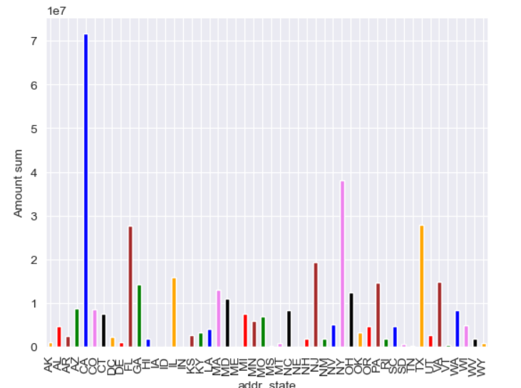
Address State Vs Loan amount
Note: Applicants from State CA, FL, NY, TX take more loan than other states

Slide 21
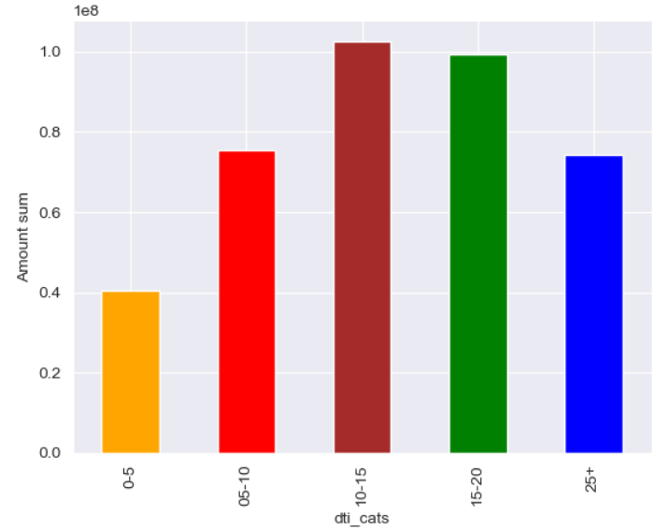
Debt to Income Vs Loan amounts
Note: Applicants with DTI 10 to 20 take more loans

Slide 22
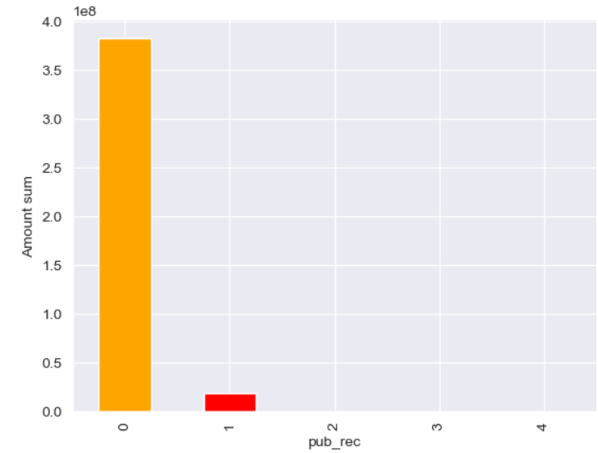
Derogatory public record Vs Loan amount
Note: Applicants with 0 derogatory records take loans, with 3 or 4 derogatory record do not take loans.

Slide 23
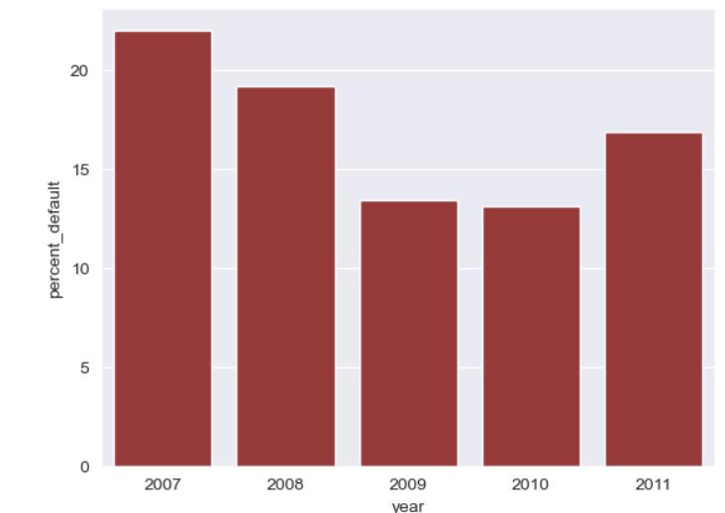
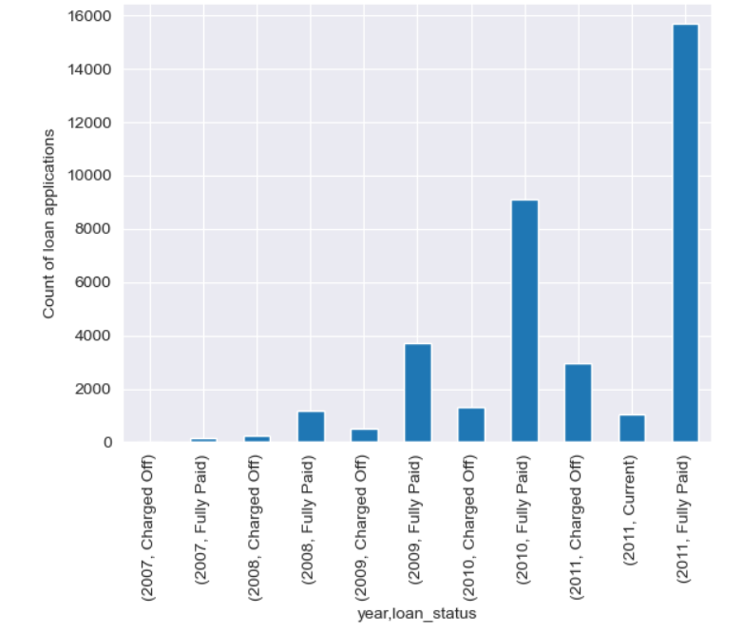
Year, Loan Status Vs Loan amounts
Note: Defaulted amounts are increasing every year along with the fully paid loans.
Percentage trend decreased till 2009 then it stagnated in 2010 and again increased in 2011. This signifies that As individuals take on more debt, it becomes harder to manage their finances even after increased income. This can lead to missed payments and ultimately, defaults.

Slide 24
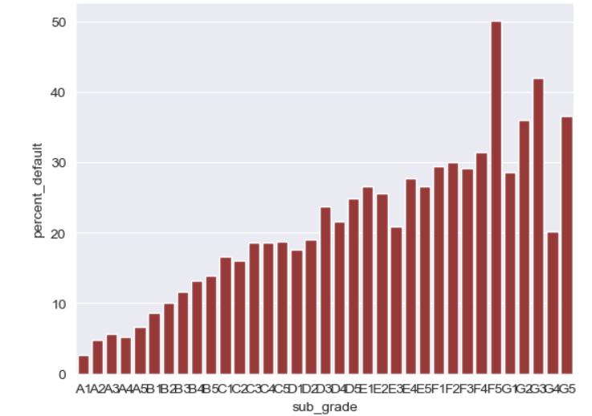
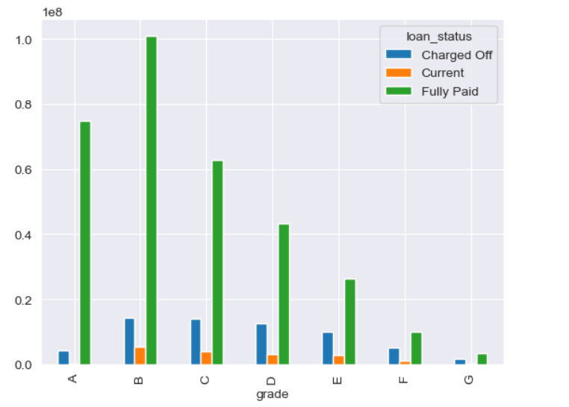
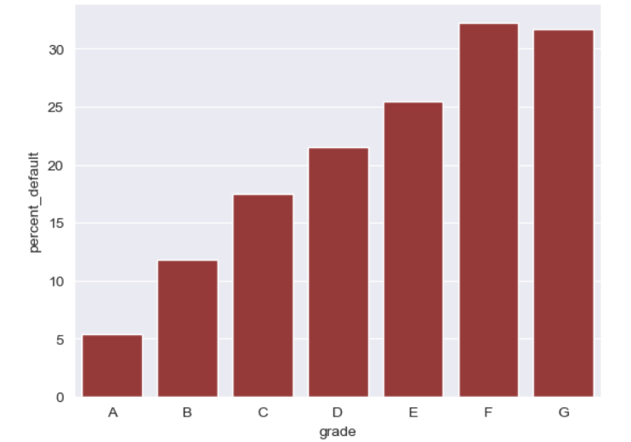
Grade, Loan Status Vs Loan amount
Note: Grade B, C and D have more charged off amounts but Grades E,F and G are more likely to default having default possibility more than 25%. Especially F5, G2,G3 and G5 are more likely to default.

Slide 25
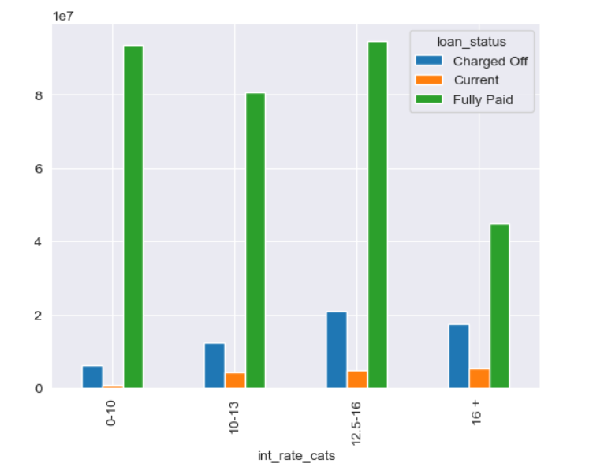
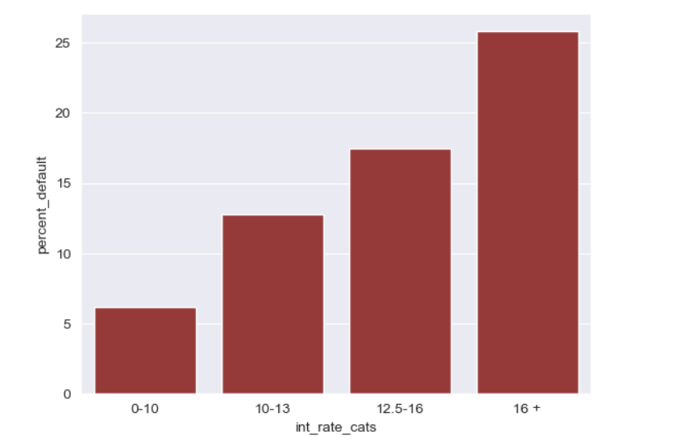
Interest Rates, Loan Status Vs Loan amounts
Note: Higher the interest rates more is the possibility of the default.

Slide 26
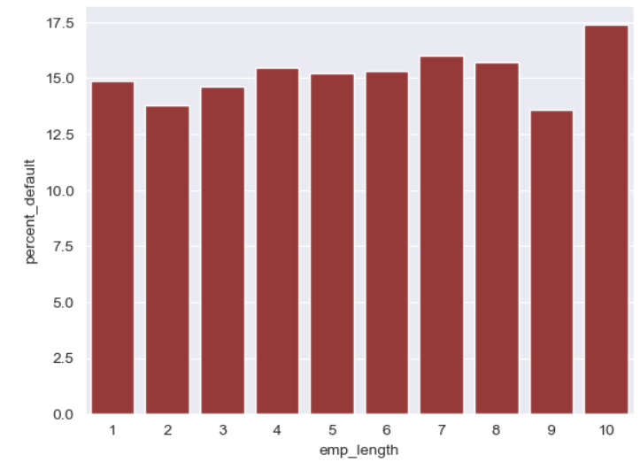
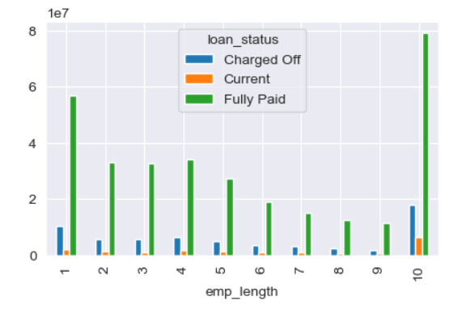
Employment Length, Loan status and Loan amounts
Note: Overall for all the experiences on an average loan defaults are between 12.5 to 15 percent but for employees having experience more than 10 years are having higher percentage of defaulting.

Slide 27
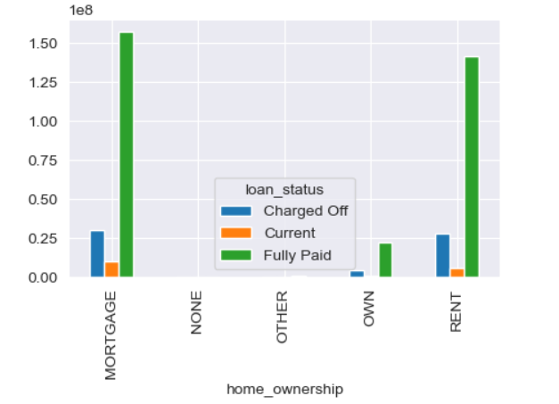
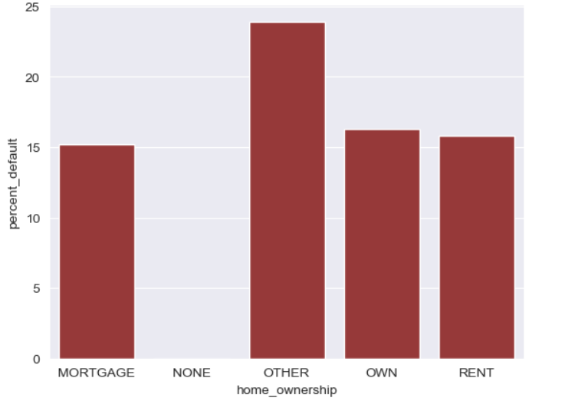
Home ownership, Loan Status Vs Loan amount
Note: People with Mortgaged home and Rented home are more likely to take loans and considering the percentages they contribute to significant defaults

Slide 28
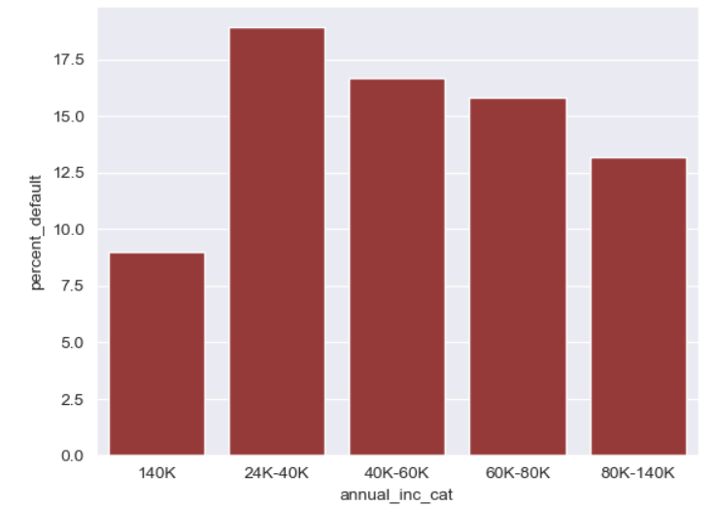
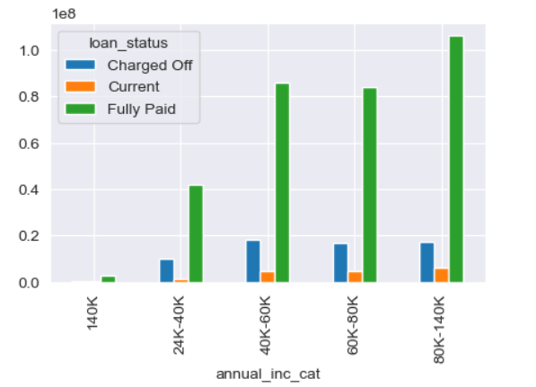
Annual income, Loan Status Vs Loan Amount
Note: Applicants with lower income are more likely to default. 24K to 40K income have more percentage of default

Slide 29
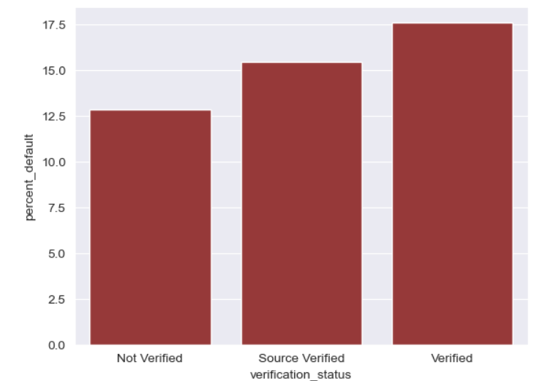
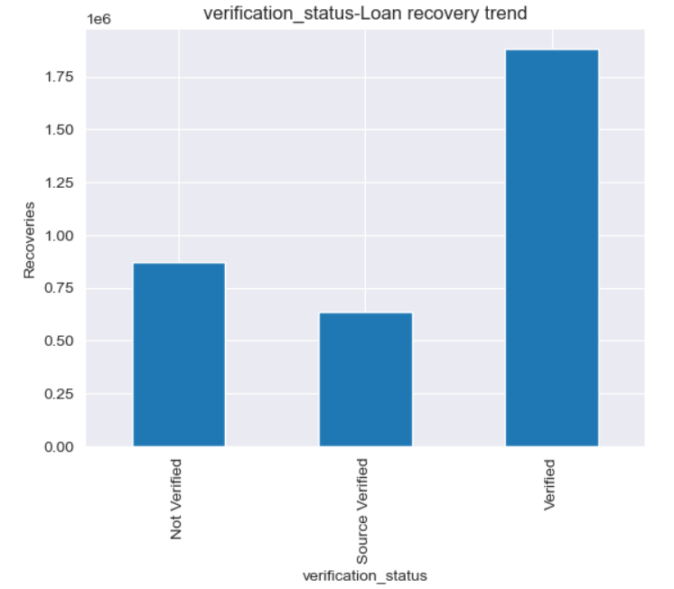
Verification status, Loan Status Vs Loan Amount, Recoveries
Note: Verified applicants are more likely to default, Even though recovery is found it is very insignificant considering the processed loan amount

Slide 30
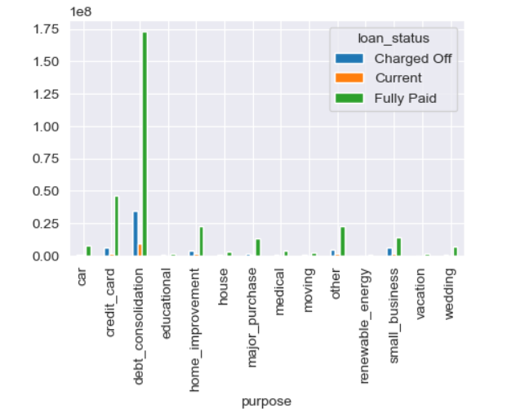
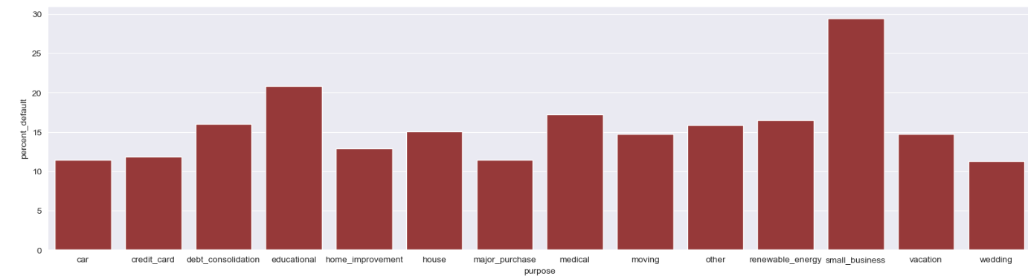
Purpose, Loan Status Vs Loan Amount
Note: Applicants taking loan for debt consolidation are highest contributor of the defaulters. Other than them, loans taken for small Businesses, Renewable energy, Other, medical and Educational purpose have higher default percentages.

Slide 31
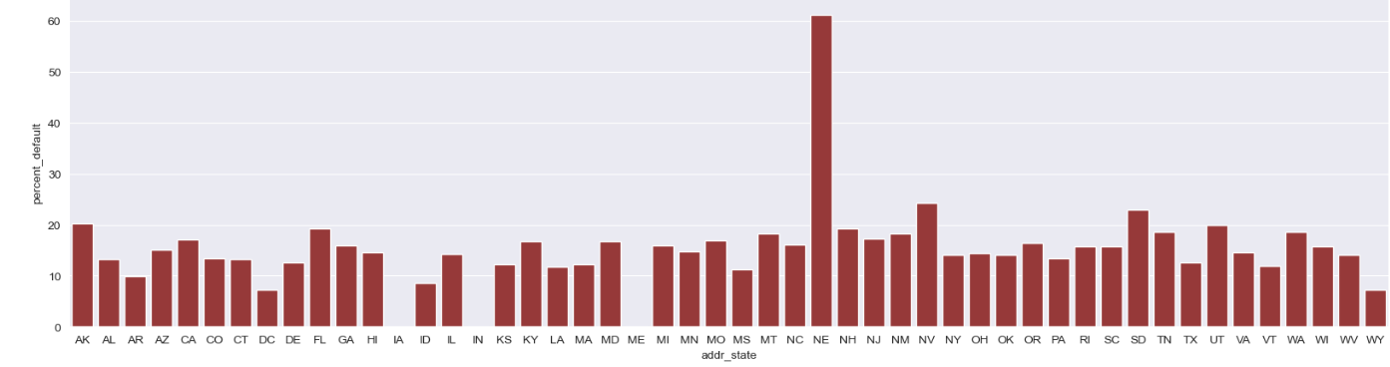

Address state, Loan Status Vs
Note: FL is one of the major contributor to the loan amounts, Applicants from FL are having more defaulting tendencies.

Slide 32


DTI, Loan status Vs Loan amounts
Note: As the DTI increases, tendency to default increases.

Slide 33


Derogatory public record, Loan Status Vs Loan Amounts
Note: Applicants with 1 or two derogatory records have more tendency to default.

Slide 34

Interest rate category, Loan status, grade Vs Loan Amount(Sum and Average), Count

Slide 35

Annual income category, Loan status, grade Vs Loan Amount(Sum and Average), Count

Slide 36

Loan amount category, Loan status, grade Vs Loan Amount(Sum and Average), Count

Slide 37

Loan amount category, DTI category, Loan status Vs Loan Amount(Sum and Average), Count

Slide 38



Public Record, Loan status, grade Vs Loan Amount(Sum and Average), Count

Slide 39
Observations Based on Multivariate analysis
Interest rate, Grade, Loan Status Vs Loan amount, counts
Grade A is taking loan with interest rates 0 to 10 only
Maximum defaults are in B, C and D
In B the one taking interest rate 10-12.5 have more defaulters
In C the one taking interest rate 12.5-16 have more defaulters
For 16+ interest rates grade D and E have more defaulters
Purpose, Grade, Loan Status Vs Loan amount, counts
Grade B,C,D and E have maximum defaulter with the purpose of debt_consolidation
State, Grade, Loan Status Vs Loan amount, counts
Grade A have max defaulters in states: CA, NJ
NY, FL, NJ and CA have maximum defaulters for A to E categories
Annual income, Grade, Loan Status Vs Loan amount, counts
Grade B,C and D have more defaulters for annual income 20K-60K
Grade E have more defaulters with annual income 40K to 60K
DTI, Grade, Loan Status Vs Loan amount, counts
For grade B,C,D,E maximum defaulters are in 10-20 dti
For grade A maximum defaulters are in 5-15 dti
Loan amounts categories, Grade, Loan Status Vs Loan amount, counts
Grade B,C and D have more defaulters with loan amount 0-21K
Grade E have more defaulters with 7K-21K
Sub-Grades, Loan Status Vs Loan amount, counts
A4 and A5 have more defaulters
B3,B4 and B5 have more defaulters
C1, C2, C3 have more defaulters
F1, E1,E2 have more defaulters
5) D2 has more tendency to default
Public record, Grade, Loan Status Vs Loan amount, counts
Grade F and G have in general high average in the defaulter, but having 0 or 1 public record among them is having high average amount defaulters.
Home ownership, Grade, Loan Status Vs Loan amount, counts
Mortgaged home ownership is more prone to be defaulted

Slide 40
Conclusions and suggestions
1. Grades B,C and D: Grades B, C, and D attract a significant portion of loan applicants, presenting a higher risk of default.
Thorough risk assessment is crucial for these grades, particularly for subgrades B3-B5, C1-C3, as well as D2.
2. Annual Income 20K to 60K and DTI: Applicants with annual incomes between 20,000 and 60,000 are more likely to apply for loans in grades B, C, and D, placing them within a higher-risk portfolio.These applicants often exhibit higher debt-to-income (DTI) ratios, typically ranging from 10 to 25+ or more. Careful monitoring of these factors is essential.
3. Reject loans with high amount for grades F and G: Grades F and G do not have many loan applicants but the loan applications are of high amounts. Very high amounts for these grades need to be rejected as they are more likely to be defaulted
4. Reduction in interest rates: Loan applications with higher interest rates are more likely to be defaulted. Lending club should consider reduction in the interest rates for reducing number of defaults.

Slide 41
Conclusions and Suggestions
5. Purpose and derogatory record: Loan applicant taking loan for debt consolidation should be properly verified. Also, applicant with zero and one derogatory public record tend to default as well. Risk should be assessed for them as well.
6. Improvement in the Recovery and Evaluation of covering Asset: From the Analysed details the recovery of the amount is not significant. Company needs to review the evaluation of the assets used as guarantee or cover in case of default.
7. Increase in the defaulting percentage due to significant increase in income in 2011: In 2011 the income has increased significantly which lead to higher loan applications but it also increased the defaulted loans.
As individuals take on more debt, it becomes harder to manage their finances. This can lead to missed payments and ultimately, defaults.
8. People with Rented house or Mortgage house: People with Rented house or Mortgaged house are more likely to defaulted as more operational cost leads to the missing payout for loans.

Slide 42


