Slide 1


Lariat Car Rental Model
By: Kandice Gunawan

Slide 2
Table of Contents
Lariat Fleet Rental Performance
Goal
Strategy 1
Strategy 2
Strategies (Combined)
Car Dashboard
Conclusion

Slide 3
Lariat Fleet Rental Performance (rental period: 1/1/18 – 11/11/18)
Base Values
Number of Cars | 4000
Total Number of Branch Locations | 50
Total Number of Transactions | 100,001

Slide 4

Goal
The purpose of this model is to optimize profit by minimizing costs and maximizing revenue.
Notes:
From the raw data given on the rental car fleet, I was able to create a model that can be used to analyze the data and extract insights.
I was able to use the model to optimize profit…

Slide 5
Strategy 1
Optimize profit by replacing bottom 5% of least profitable cars with top 5% of most profitable cars.

Slide 6
Strategy 2
Assume no market saturation at each branch locations, increase the most profitable car at the top 10 most profitable branch locations by 20 cars each.
Notes:
Mention by analyzing each location, getting the top 20% of cars at the 10 most profitable branch locations

Slide 7
Strategies (combined)
Main Goal: Combine 2 strategies (modifying number of cars and gross revenue to optimize forecasted profit)
Base
Strategy 1
Strategies (Combined)

Slide 8
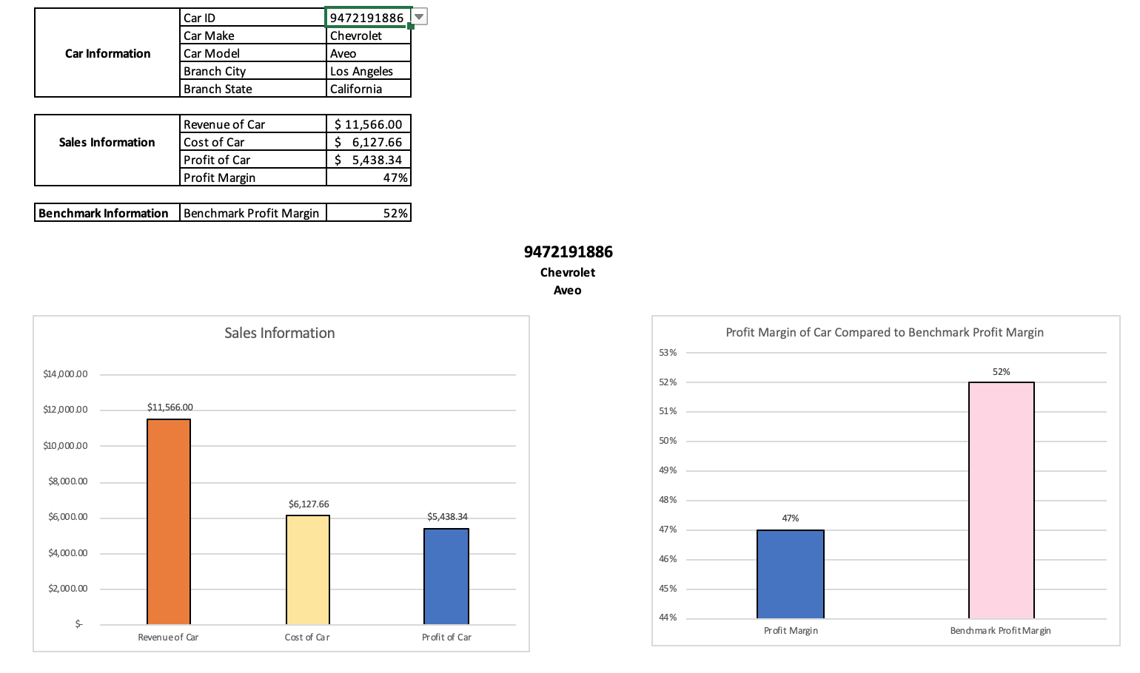
Individual car Dashboard
Notes:
Provide a tool for the company to make future recommendations This dashboard summarizes the car (make, model and branch location) and sales information (revenue, cost, profit) of each car by using the drop-down list at the Car ID level. The purpose of this dashboard is to visualize a summarized version of each car in order to make better-informed business decisions that will maximize revenue and minimize costs. Assuming the benchmark profit margin of each car is 52%, we are able to use this as a basis of comparison between benchmark profit margin and profit margin of each car.

Slide 9
conclusion
Strategy | Profit Increment
1 | 0.1%
2 | 0.1%
Combined | 0.2%
Base
Strategy 1
Strategies (Combined)
Notes:
-Recap of the goal
-Strategy 1
-Strategy 2
-Strategies (Combined)

Slide 10
Appendix
 |  | Base | Strategy 1 | Strategy 2 | Strategy (Combined)
 | Number of Cars | 4000 | 4000 | 4200 | 4200
 | Total Number of Branches | 50 | 50 | 50 | 50
 | Gross Revenue | $ 63,575,295 | $ 70,224,640.00 | $ 68,802,875.00 | $ 75,452,220.00
 | Average Gross Revenue Per Branch Location | $ 1,271,505.90 | $ 1,404,492.80 | $ 1,376,057.50 | $ 1,509,044.40
 | Total Cost of Car | $ 30,320,298 | $ 33,383,623 | $ 31,771,659.92 | $ 34,834,985.13
 | Profit | $ 33,254,997 | $ 36,841,016.87 | $ 37,031,215.08 | $ 40,617,234.87
 | Average Net Profit per Car | $ 8,313.75 | $ 9,210.25 | $ 8,816.96 | $ 9,670.77
 | Gross Profit Margin | 52.31% | 52.46% | 53.82% | 54%
 | Profit Increments |  | $ 3,586,019.79 | $ 3,776,218.00 | $ 7,362,237.79

