Slide 1

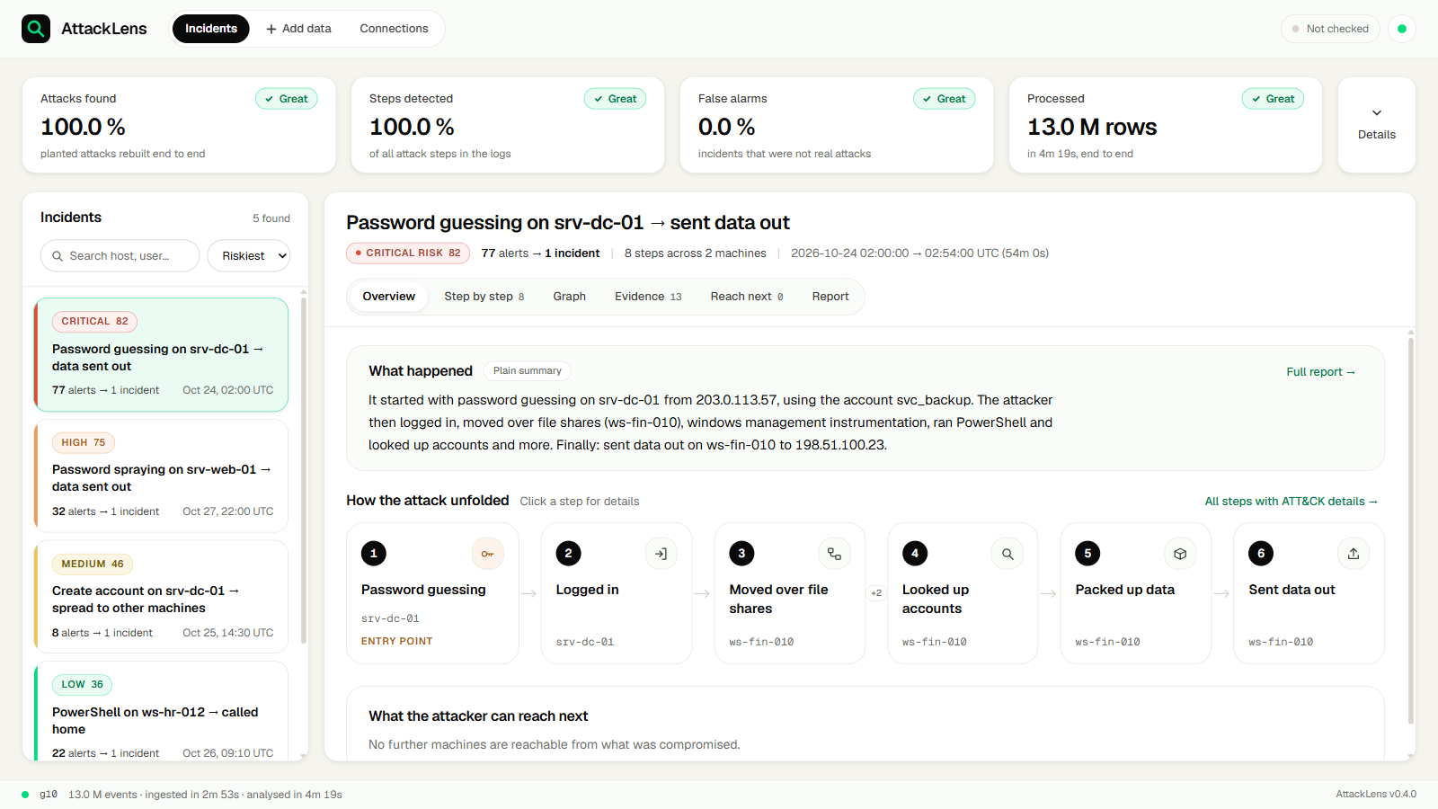

MITIGATA CYBERFORGE FINALS · PROBLEM 01
AttackLens
From 50 GB of raw security logs to one attack story: detected, labelled with MITRE ATT&CK, linked into a path, and explained.
100 %
0 %
23 min
attack steps found (10 GB)
false alarms (10 & 30 GB)
50 GB tier on a 16 GB laptop
Built for SOC analysts: one screen shows every attack in the logs, worst first, each as a labelled, ordered chain of steps with the evidence behind it.
Team Neuron
Harish Kandi · Veeranarayana Gorantla
Bengaluru · 1 November 2026
Notes:
Team Neuron: Harish Kandi and Veeranarayana Gorantla. AttackLens turns tens of gigabytes of raw logs into a handful of attack stories. The three numbers are measured: 100% detection and 0% false alarms on the 10 GB run (data/out/g10/eval_scorecard.json); 0% false alarms on 30 GB; the 50 GB-tier FortiGate set ran end to end in 22 min 47 s with 4.9 GB peak RAM (data/out/b2_n50/run_metrics.json).

Slide 2





Executive summary
AttackLens finds the hidden attack in 10–50 GB of logs and tells it as one story
The problem
100 %
0 %
Attack steps hide among millions of log lines across files, hosts and accounts; security tools alert one line at a time.
attack steps detected, 10 GB
false alarms, 10 GB and 30 GB
Our solution
Stream every line through DuckDB, detect with ATT&CK-labelled rules, link steps by host, user, IP and time, and rebuild each attack as an ordered path.
95.2 %
22 min 47 s
The proof
attack steps detected, 30 GB
50 GB tier, end to end
Scored against planted attacks: 100 % detection, 5 / 5 attacks rebuilt and 0 false alarms at 10 GB; 95.2 % detection and 0 false alarms at 30 GB.
4.9 GB
17–27 ms
What is new
Explainable links (every edge says why), attacker reach-next, a log tamper check and AI reports that never see raw logs, all offline on one laptop.
peak RAM at the 50 GB tier
to open an attack path (p95)
Covers all 7 must-have and all 5 bonus requirements of the brief, measured on one 16 GB laptop.
Notes:
Executive summary. Problem: attack steps are scattered across millions of lines and tools alert one line at a time. Solution: AttackLens streams the logs through DuckDB with a 5 GB memory cap, detects with MITRE ATT&CK-labelled rules (41 built-in rules, SigmaHQ rules via pySigma, 88 cloud rules), groups alerts into 5-minute episodes, links them with four explainable join rules, gates out noise, scores risk and rebuilds the attack path in kill-chain order, then shows what the attacker can reach next. Proof, from eval_scorecard.json: 10 GB run - detection 100%, labels 100%, attacks rebuilt 5 of 5, false alarms 0%; 30 GB run - detection 95.24%, labels 95.0%, rebuilt 4 of 5, false alarms 0%. Scale, from run_metrics.json: 50 GB-tier FortiGate set, 62.0 million lines, 22 min 47 s, 4.9 GB peak RAM. Opening an attack path takes 17-27 ms at p95.

Slide 3






Why AttackLens exists
Security tools raise alerts one at a time. Attacks happen as a story.
What AttackLens did with the 50 GB tier
No complete story
A failed login, a new admin account and a big upload look like three unrelated alerts.
97,500
raw alerts from detection rules
Linking takes an expert hours
25,000
The lines sit millions of rows apart, across files, hosts and accounts.
episodes (5-minute groups per entity)
Noise, or step three of a break-in?
3
ATT&CK mapping is done by hand and late, often after the data has left.
incidents an analyst can read
Notes:
This is the organiser's problem statement in three lines. The funnel on the right is from our own 50 GB-tier run: 97.5 thousand raw alerts, grouped into 25 thousand episodes, linked into 3 incidents.

Slide 4




What AttackLens does
Five steps, all automatic, from raw log lines to an analyst-ready story
STEP 1
STEP 2
STEP 3
STEP 4
STEP 5
Detect
Label
Connect
Explain
Look ahead
41 built-in rules, SigmaHQ rules and 88 cloud rules run as SQL over every event.
Each step gets an ATT&CK v20 technique and tactic, e.g. T1110.001 → Credential Access.
Steps are linked by shared host, user, IP and time: 77 alerts became 1 incident.
Timeline, attack graph and a plain-English report readable in a minute.
Shows what the attacker can reach next, e.g. srv-file-01 in 1 hop via svc_backup.
One real path from the 10 GB run
203.0.113.57
srv-dc-01
ws-fin-010
198.51.100.23
attacker IP
T1110 guessing
T1021 file shares
T1048 data out
Notes:
Detect, label, connect, explain, look ahead: exactly the five goals in the brief. The bottom band is the real critical incident from the 10 GB run: password guessing on the domain controller from 203.0.113.57, lateral move over SMB to ws-fin-010, then exfiltration to 198.51.100.23.

Slide 5











Architecture: one streaming pipeline, bounded memory
Raw logs in, attack stories out. Every stage writes a file you can re-run on its own.
Inputs
STAGE 1
STAGE 2
STAGE 3
STAGE 4
STAGE 5
STAGE 6
Log files: 9 formats (ECS, Windows, FortiGate, CSV, cloud JSON)
Ingest
Detect
Episodes
Link
Incidents
Publish
DuckDB → Parquet; every row counted
Each rule is one SQL query; Sigma via pySigma
5-min groups per entity; cap 25 k
4 keyed joins: host, user, IP, time
Risk score, attack path, reach-next
Incident JSON + narrative
SIEM pull: Splunk, Elastic, Sentinel, Syslog
Cloud pull: AWS, Azure, GCP
Integrity check
Eval harness
API + UI
Tamper verdict per log set: trusted / suspect / tampered
Scores each run against planted ground truth
FastAPI serves JSON from memory; React UI; a path opens in < 30 ms
DuckDB does the heavy work: all cores, 5 GB memory limit, spills to disk
Python never loops over raw events: it holds only episodes and incidents
Every stage reads and writes files: re-run or test any stage alone
Built with (all disclosed in the README): DuckDB · Parquet · FastAPI · Pydantic · pySigma + SigmaHQ rules · MITRE ATT&CK v20 · React · Vite · Cytoscape.js · Tailwind CSS
Notes:
Raw logs stream through six stages. Stage 1 ingest: one DuckDB COPY into Parquet partitioned by source, timestamp validity and day, with ingest_accounting.json counting rows in, ok and dropped per source. Stage 2 detect: every rule is one SQL query over the events view. Stage 2.5 episodes: 5-minute buckets per rule, host and user. Stage 3 link: four keyed equality joins. Stage 4 incidents: connected components, gate, risk, path dynamic programming, reach-next breadth-first search. Stage 5 publish: incident JSON plus narrative. DuckDB runs with a 5 GB memory limit and spills to disk, so a 50 GB tier fits a 16 GB laptop; Python only ever holds episodes, never raw events. All third-party components are disclosed, as the rules require.

Slide 6


How detection and linking work
Every step is explainable: which rule fired, which ATT&CK technique, and why two steps are linked
Four explainable link rules (keyed joins, never pairwise loops)
Detect and group
Rule | Links two steps when | Window | Why-linked sentence (10 GB incident)
R1 handoff | activity moves from one host to the next | 24 h | Activity moved from srv-dc-01 to ws-fin-010
R2 session | same host and same user | 2 h | Same session: svc_backup on srv-dc-01
R3 pivot | an account attacked in step i is used in step j | 72 h | Account svc_backup from step 1 used
R4 egress | data staged on a host is then sent out | 24 h | Data staged on ws-fin-010 sent out
41 built-in rules covering 31 ATT&CK techniques
SigmaHQ rules compiled by pySigma; 88 cloud rules for AWS, Azure and GCP
Each rule is one SQL query over all events; thresholds live in YAML, not code
Alerts are grouped into 5-minute episodes per rule, host and user; raw alert counts are kept
Labels follow ATT&CK v20: 15 tactics, technique and sub-technique
Noise gate
Risk score 0–100
Attack path
Keep a group only if it spans ≥ 2 ATT&CK tactics with confidence ≥ 65, or one signal has confidence ≥ 90.
Weighted by how deep in the kill chain each tactic is and how severe, plus hosts touched and alerts merged.
Dynamic programming keeps steps in kill-chain order; side branches are shown, never hidden.
Notes:
Detection: 41 built-in rules in config/rules.yaml covering 31 ATT&CK techniques, SigmaHQ rules compiled with pySigma, and 88 cloud rules. Each rule is one SQL query. Alerts are bucketed into 5-minute episodes by rule, host, source user, target user and destination host; merged_alert_count keeps the raw count (bonus B-3). Linking: four DuckDB equality joins, each with a time window: R1 handoff 24 h (weight 1.5), R2 session 2 h (1.0), R3 account pivot 72 h (1.3), R4 collection-to-exfiltration egress 24 h (1.2). Very busy 'hub' entities cannot be join keys for R2 or R3, which stops false links. Edge weight = rule multiplier x rarity x exp(-time gap / window). Gate: keep a component if it has at least 2 tactics and max confidence >= 65, or max confidence >= 90. Risk: weighted sum over tactics of ln(max severity), scaled to 90, plus up to 10 for hosts and merged alerts. Path: dynamic programming over time-sorted episodes that only steps forward in tactic order (or across a host handoff); branches scoring at least half the best are kept.

Slide 7

Benchmark results: 10 GB, 30 GB and 50 GB
Measured on one laptop (Intel i5-13420H, 16 GB RAM); every number comes from the run's own output files
Benchmark | 10 GB generated logs, 5 planted attacks | 30 GB generated logs, 5 planted attacks | 50 GB tier real FortiGate firewall logs
Log lines processed | 13.0 M | 39.1 M | 62.0 M
End-to-end time | 4 min 19 s | 9 min 56 s | 22 min 47 s
Throughput | 50,471 lines/s | 65,726 lines/s | 45,336 lines/s
Peak memory (RAM) | 2.6 GB | 3.1 GB | 4.9 GB
Raw alerts → incidents | 5,446 → 5 | 15,696 → 5 | 97,464 → 3
Attack steps detected | 100 % | 95.2 % | no answer key
Correct ATT&CK labels | 100 % | 95.0 % | no answer key
Attacks rebuilt in order | 5 of 5 | 4 of 5 | no answer key
False alarms | 0 % | 0 % | no answer key
Open one attack path (p95) | 27 ms | 17 ms | not measured
50 GB tier: real FortiGate data has no answer key, so accuracy is not measured there. 43.7 M of its 62.0 M lines share one timestamp second (a filler block) and are flagged, not analysed.
Notes:
Benchmark results, all from the runs' own output files. 10 GB (data/out/g10): 13,048,132 events, 258.5 s, 50,471 lines/s, 2,552.9 MB peak RSS, 5,446 raw alerts linked into 5 incidents; detection 100%, labels 100%, 5 of 5 attacks rebuilt in order, 0% false alarms; path API p95 26.94 ms. 30 GB (data/out/g30): 39,142,706 events, 595.5 s, 65,726 lines/s, 3,133 MB peak, 15,696 raw alerts into 5 incidents; detection 95.24%, labels 95.0%, 4 of 5 rebuilt, 0% false alarms; path p95 17.01 ms. 50 GB tier (data/out/b2_n50, FortiGate): 61,970,767 lines, 1,366.9 s, 45,336 lines/s, 4,937 MB peak, 97,464 raw alerts into 3 incidents; no answer key, so no accuracy figures.

Slide 8


How we measure accuracy, strictly
A separate evaluation harness scores every run against the planted answer key
A step counts as found only if it is within 10 minutes of the planted step, on the same host, with the same user or IP.
Built so we cannot cheat
A label counts as correct only if both the ATT&CK technique and the tactic match; a conflicting sub-technique is wrong.
Answer-key labels are stripped before ingest; detection reads raw log fields only
The harness is never tuned to look better; rules are tuned against it
Probe tests guard the harness itself and must pass on every commit
Every number on these slides is read from the run's own output files
About 1,900 automated tests, plus stress runs at 10, 30 and 50 GB
An attack counts as rebuilt only if all its steps sit in one incident, in the planted time order (sequence match ratio exactly 1.0).
A false alarm is any incident that matches no planted attack; we report the strict rate.
A metric with nothing to measure is reported as empty and never counts as a pass.
Notes:
Accuracy rules are taken from eval_scorecard.json: tolerance 600,000 ms (10 minutes); step match requires the time gap within tolerance AND the same host AND (same user OR same IP); a label is correct when the technique (parent or exact sub-technique; a conflicting sub-technique is wrong) AND the tactic match; an attack is rebuilt when all its steps are in the one matched incident, the LCS ratio in time order is 1.0 and the backbone positions follow the ground-truth order; a metric whose denominator is zero is null and passes no target. Integrity of the evaluation: generator labels (threat, rule, labels, event.kind, event.severity) are removed before ingest and never read by detection code; the harness has its own probe tests in backend/eval/test_probes.py that must pass on every commit.

Slide 9

10 GB: every planted attack found, zero false alarms
13.0 M
events processed, 0 dropped
4 min 19 s
end to end
2.6 GB
peak memory
5 / 5
attacks rebuilt in order
Generated ECS logs with 5 planted attacks. Detection 100 %, labels 100 %, false alarms 0 %.
Notes:
data/out/g10: detection 100, labels 100, rebuilt 100, strict false alarms 0. 258.5 s wall, 2,552.9 MB peak RSS, 13,048,132 rows in and ok. Path API p95 26.94 ms.

Slide 10
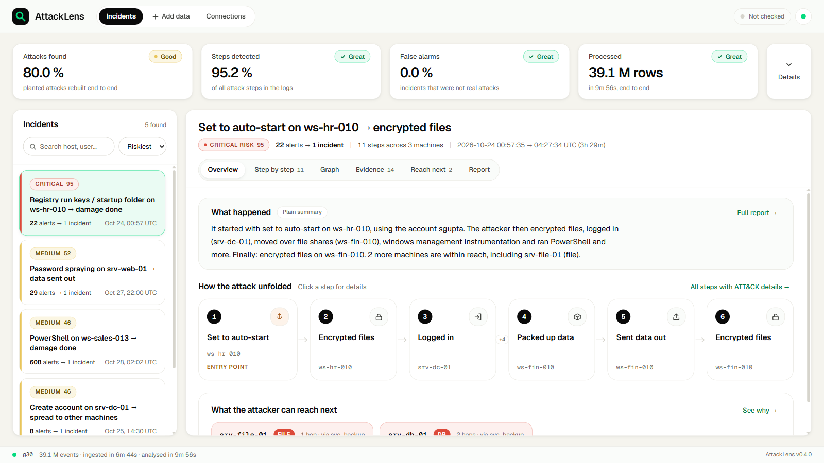
30 GB: 95 % of steps found, still zero false alarms
39.1 M
events processed, 0 dropped
9 min 56 s
end to end
3.1 GB
peak memory
4 / 5
attacks rebuilt in order
One miss: the first brute-force step of one attack split off under denser noise. Fix in progress.
Notes:
data/out/g30: detection 95.24, labels 95.0, rebuilt 80.0, strict false alarms 0. 595.5 s wall, 3,133 MB peak. The g30 report names the cause: the incident peel drops the S1 T1110 seed under denser noise. Be upfront about this if asked.

Slide 11
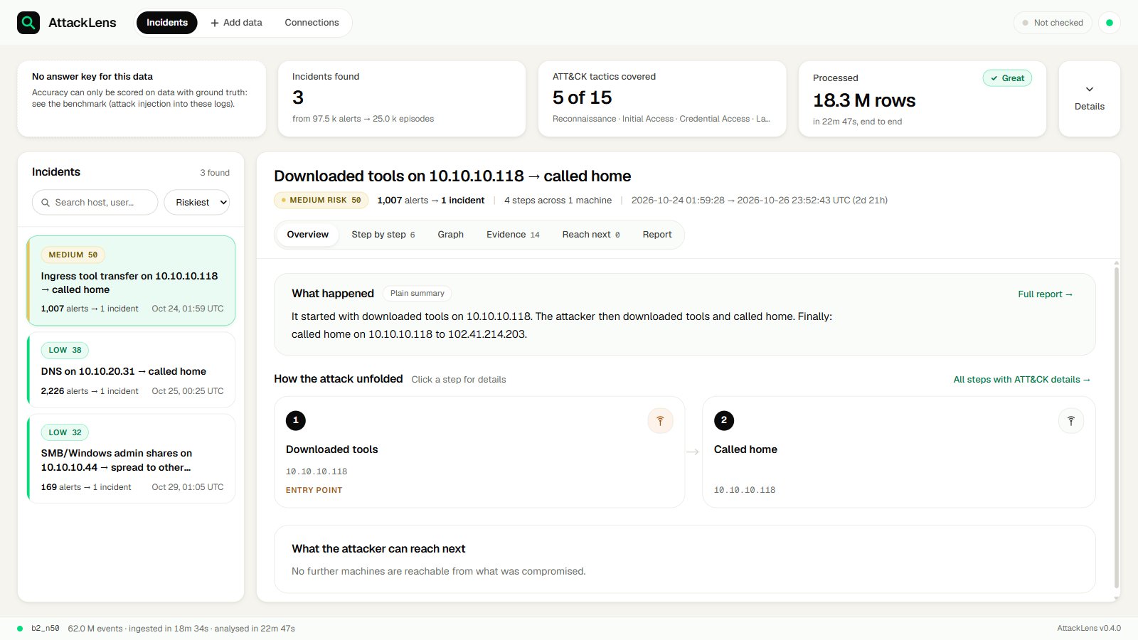
50 GB tier: real firewall logs, end to end in 23 minutes
62.0 M
FortiGate log lines
22 min 47 s
end to end
4.9 GB
peak memory
97.5 k → 3
alerts merged into incidents
No answer key, so accuracy is not scored. 43.7 M of the 62.0 M lines share one timestamp second (a filler block): kept and flagged, not used for detection. The other 18.3 M were analysed.
Notes:
data/out/b2_n50: 61,970,767 rows in; 43,681,495 flagged timestamp_pileup (kept with ts_ok=false, logged with the reason); 1,366.9 s wall; 4,937 MB peak; 3 incidents. Do not quote accuracy for this set.

Slide 12
Scales on a 16 GB laptop, far under target
Bars are measured; the dashed line is the organiser's Great target
End-to-end time
Peak memory
Great: under 60 min
Great: under 8 GB
4.9 GB
22.8 min
2.6 GB
3.1 GB
9.9 min
4.3 min
10 GB
30 GB
50 GB tier
10 GB
30 GB
50 GB tier
Even the 50 GB tier uses only 38 % of the 1-hour budget
Memory stays bounded: 4.9 GB at the 50 GB tier
Same laptop for all three runs. 10 GB and 30 GB: generated ECS logs. 50 GB tier: real FortiGate logs, 62.0 M lines.
Notes:
Time grows roughly with data size, and memory stays bounded because DuckDB streams and spills to disk. The dashed line is the brief's Great target: 1 hour and 8 GB. Measured end-to-end time: 4.3 min (10 GB, 13.0 M events), 9.9 min (30 GB, 39.1 M events), 22.8 min (50 GB tier, 62.0 M lines). Peak RAM: 2.6, 3.1 and 4.9 GB. Throughput: about 50,000 to 66,000 rows per second on the generated sets.

Slide 13
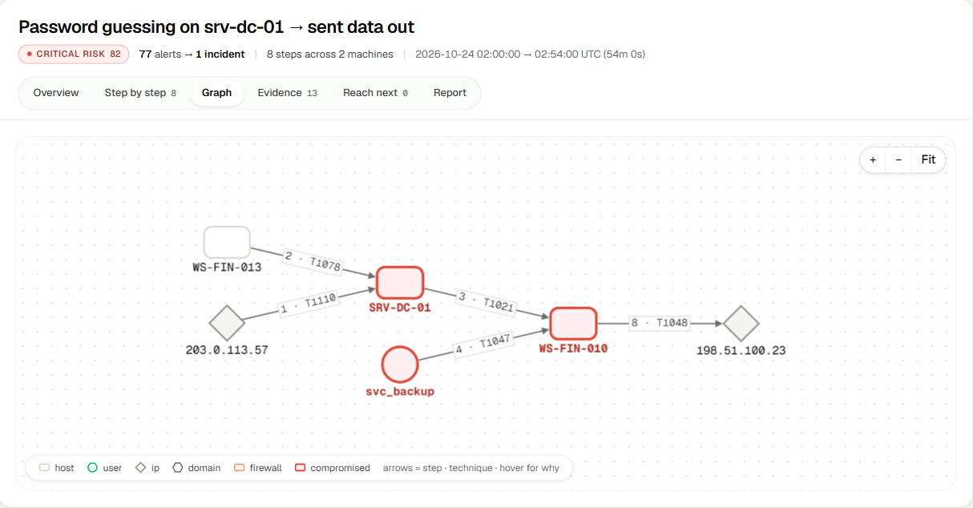
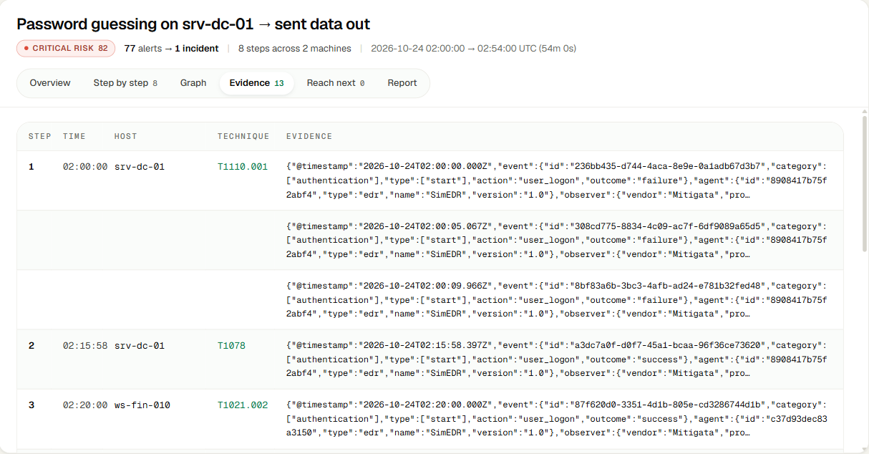
See the whole attack: graph and raw evidence
The critical incident from the 10 GB run: 77 alerts, 8 steps, 2 machines
Attack graph
Evidence
Hosts, users and IPs; each arrow is one step with its technique.
The exact raw log lines behind every step, so an analyst can verify.
Notes:
Graph and evidence from the critical incident in the 10 GB run. The evidence tab answers 'show me the log line': every step links back to the raw text it came from.

Slide 14
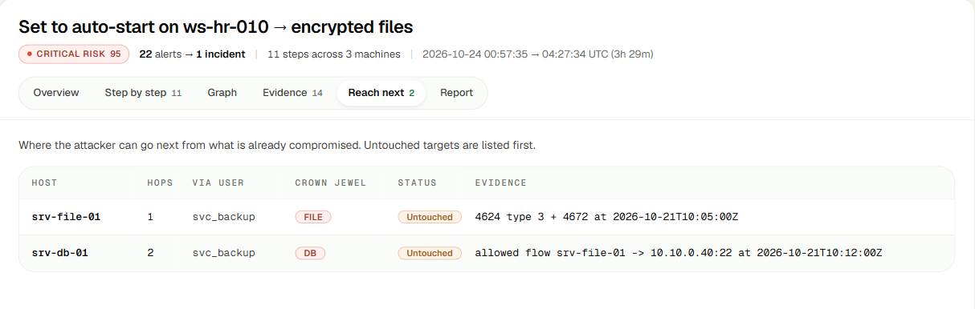


Know what the attacker can reach next
From the 30 GB run: ransomware incident on ws-hr-010, risk 95
srv-file-01
srv-db-01
Why it matters
1 hop via svc_backup · file server
Proof: logon 4624 type 3 + 4672 admin
2 hops via svc_backup · database
Proof: allowed flow srv-file-01 → 10.10.0.40:22
The analyst knows which crown jewels
to protect first, before the move.
Notes:
Reach-next is a breadth-first search from compromised hosts and accounts over admin rights and observed network flows. Each target comes with the log line that proves the path exists.

Slide 15
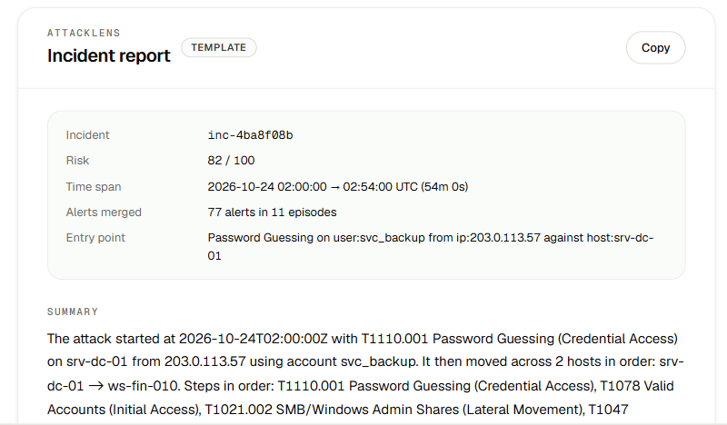



The incident report writes itself, safely
Plain English, ready to paste
Who, what, when, which hosts, which ATT&CK techniques, in order.
AI only sees placeholders
The model gets {{HOST_1}}, {{USER_1}} and enum values, never raw logs.
Never blocks the demo
No API key, any error or an unknown token → a deterministic template.
Same numbers as the UI
Risk, time span and alerts merged come from the same incident file.
Notes:
Bonus B-2. The narrative model never sees raw logs: entities are swapped for placeholders before the call and swapped back after. With no key, as in this demo, the deterministic template writes the report.

Slide 16
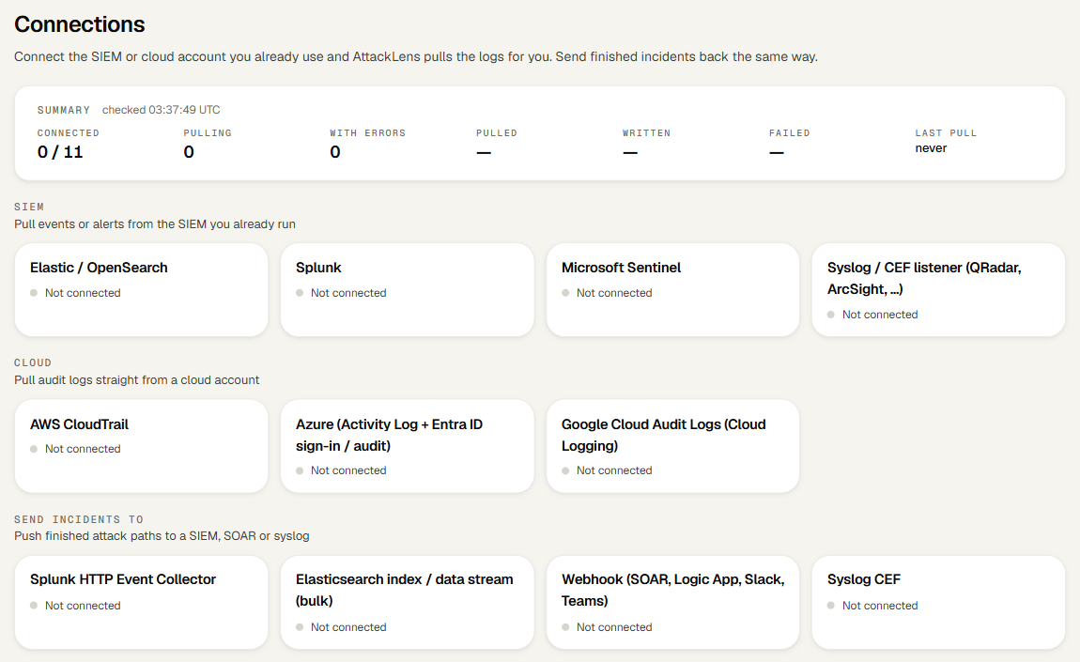




Pull logs straight from the SIEM or cloud you already use
Pull from a SIEM
Splunk · Elastic / OpenSearch · Microsoft Sentinel · Syslog / CEF (QRadar, ArcSight)
Pull from the cloud
AWS CloudTrail · Azure Activity Log + Entra ID sign-in · Google Cloud Audit
Send incidents back
Splunk HEC · Elasticsearch · Webhook (SOAR, Logic App, Slack, Teams) · Syslog
Or just add files
Upload logs, or point at a 10–50 GB file on the machine: no terminal
11 connectors built in (7 pull, 4 push). Each uses the customer's own credentials; today's demo runs on local files.
Notes:
AttackLens sits on top of the SIEM a SOC already runs: it pulls events or alerts, builds the attack story, and pushes finished incidents back to a SIEM, SOAR or chat. Be accurate: the connectors are built but need real credentials; we have not pulled from a live customer tenant at the venue.

Slide 17
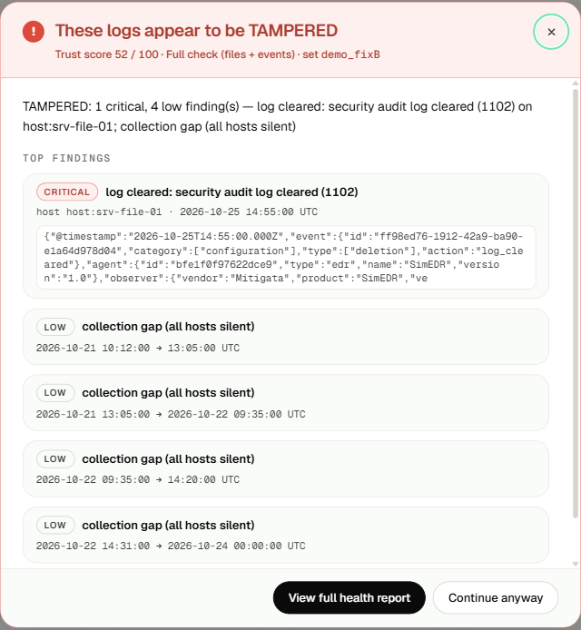
Can you trust the logs? Built-in tamper check
Before analysis, AttackLens checks every log set and gives it a trust score from 0 to 100 and a verdict:
TRUSTED
SUSPECT
TAMPERED
10 checks
File seal (hash)
Hosts going dark
Zeroed regions
Timestamp anomalies
Truncated tail
Duplicate lines
Log cleared (event 1102)
Embedded-time mismatch
Silence gaps
Rows dropped in ingest
Example (demo set): security log cleared (event 1102) on srv-file-01 plus collection gaps → TAMPERED, trust 52 / 100.
Notes:
Attackers clear logs. If the evidence is edited, the attack story is wrong. AttackLens runs ten integrity checks and writes integrity_report.json with a verdict. The screenshot is the demo set where the security log was cleared on srv-file-01: verdict TAMPERED, trust 52/100 (data/out/demo_fixB/integrity_report.json).

Slide 18
Every must-have and every bonus requirement covered
Must have
Bonus
FR-1
Stream without loading all into memory
62 M lines at 4.9 GB peak
B-1
Risk score, worst on top
e.g. CRITICAL 95, HIGH 75
FR-2
Detect suspicious events
41 rules + Sigma + 88 cloud rules
B-2
Plain-English incident report
Template, or LLM on placeholders
FR-3
Map to ATT&CK technique + stage
ATT&CK v20, 15 tactics
B-3
Raw alerts merged per incident
e.g. 77 alerts → 1 incident
FR-4
Link by host, user, IP and time
4 keyed joins (R1–R4)
B-4
New rule by editing config
rules.yaml and Sigma YAML
FR-5
Timeline and graph
Step-by-step and Graph tabs
B-5
Live mode
Tails new lines every 2 s
FR-6
What the attacker can reach next
Hops via accounts and network flows
Beyond the brief
FR-7
Simple API and README
GET /api/incidents/{id}/path
Docker Compose one-command start · log tamper check · SIEM and cloud connectors · about 1,900 automated tests
Notes:
Left is the brief's must-have list (FR-1 to FR-7), right is the bonus list (B-1 to B-5), each with the proof we can show live. FR-1: the 50 GB tier, 62.0 M lines, peaked at 4.9 GB RAM. FR-7: FastAPI endpoint GET /api/incidents/{id}/path plus a README. B-4: rules and thresholds are YAML in config/, Sigma rules are YAML. B-5: live mode tails new log lines every 2 seconds and recomputes only changed incidents.

Slide 19


How AttackLens meets the judging criteria
The five criteria from the hackathon rules, each backed by evidence shown in this deck
Technical execution
Innovation
Cybersecurity relevance
Usability
Impact
62.0 M log lines in 22 min 47 s at 4.9 GB peak RAM
DuckDB streaming with a 5 GB cap; every row accounted for
About 1,900 automated tests; one-command Docker start
Every link between steps explains itself in a sentence
Kill-chain-ordered attack path plus attacker reach-next
Tamper check before analysis; AI reports without raw logs
MITRE ATT&CK v20 labels: 15 tactics, techniques and sub-techniques
Sigma rules; Windows, FortiGate, CloudTrail, Azure and GCP logs
Built around the SOC analyst's investigation flow
Upload a file or point at one; no terminal needed
Incidents sorted by risk, each with a plain-English story
Graph, timeline and evidence; a path opens in 17–27 ms
97,500 raw alerts reduced to 3 incidents
77 alerts merged into 1 readable attack story
Runs offline on a 16 GB laptop, with no cloud cost
Notes:
Mapping to the hackathon judging criteria (PRD section 5: technical execution, innovation, cybersecurity relevance, usability, impact). Technical execution: data/out/b2_n50/run_metrics.json shows 61,970,767 rows in 1,366.9 s with 4,937 MB peak RSS; every ingest writes ingest_accounting.json. Innovation: explainable link rules R1-R4 with why_linked sentences, path dynamic programming in tactic order, reach-next breadth-first search over admin rights and network flows, ten-check log integrity verdict, placeholder-only LLM narrative. Cybersecurity relevance: ATT&CK v20 with 15 tactics, Sigma via pySigma, nine log formats, SIEM and cloud connectors. Usability: web UI with upload, risk-sorted incidents, report, graph, timeline, evidence; path API p95 26.94 ms at 10 GB and 17.01 ms at 30 GB. Impact: 50 GB tier 97.5 k alerts linked into 3 incidents; 10 GB critical incident merges 77 alerts.

Slide 20

Why AttackLens is different
A story, not alerts
Measured, never claimed
Runs on one laptop, offline
97.5 k raw alerts became 3 incidents an analyst can read in a minute.
A strict harness scores every run against planted ground truth. No number is typed by hand.
50 GB tier in 23 min at 4.9 GB RAM. No cloud, no network needed.
Nothing silently lost
Safe AI
Fits the SOC you have
Every log line is counted in, accepted or flagged, with the reason.
The report model sees placeholders like {{HOST_1}}, never raw logs.
Pulls from Splunk, Sentinel, Elastic, AWS, Azure, GCP; pushes incidents back to SIEM or SOAR.
Notes:
For a SOC like Mitigata's: the analyst gets the attack story, not another alert queue; the numbers are provable; it runs offline on a laptop; and the AI part is safe by design.

Slide 21


What we are fixing next
We report our weak spots as clearly as our strengths
30 GB: 1 of 5 attacks rebuilt only partly
50 GB tier has no answer key
The brute-force first step split off under denser noise. Fix: keep entry-point seeds attached.
Next: plant known attacks into the real FortiGate logs and score them with the same harness.
A filler block in the firewall logs
Connectors tested offline only
43.7 M lines share one timestamp second. Already handled: kept, flagged, excluded from detection.
Next: a live pull from a real Splunk or Sentinel tenant.
Where it goes next: the attack-story layer on top of an AI-run SOC such as Gordon AI.
Notes:
Judges reward honesty. These four items are real and come from our own stress reports (reports/stress/g30.md and the 50 GB-tier ingest accounting).

Slide 22

One attack story, not 97,500 alerts
AttackLens detects, labels, links and explains attacks in 10–50 GB of logs, on one laptop, with every number measured.
Run it yourself
Team Neuron
docker compose up -d
open http://localhost:8000
Harish Kandi
Veeranarayana Gorantla
Thank you · Live demo next
Notes:
Close on the one-line message, then switch to the live UI. The Docker command builds the image and serves the UI and API on localhost:8000.

