Slide 1
Jakarta Traffic Congestion Analysis
Early findings from 2023 peak-hour corridor speed data
Data source: Satu Data Jakarta / Data.go.id

Slide 2
Executive Summary
A first-pass diagnosis using corridor speed as congestion signal
The dataset has 576 observations across 12 months in 2023.
The raw file contains 48 unique corridor names, although the catalog title mentions 41 corridors.
Overall mean peak-hour speed is 32.25 km/h.
19 corridors have mean peak-hour speed below 30 km/h.
The pattern points to persistent corridor-level bottlenecks, not only a one-off monthly fluctuation.
Jakarta Traffic Congestion Analysis

Slide 3
Dataset Snapshot
Current analysis uses corridor speed; demand and road-capacity data are next layers
576
observations
12
months in 2023
48
unique corridor names
32.2 km/h
mean speed
Raw fields: periode_data, bulan, nama_jalan, kecepatan.
The speed column uses Indonesian decimal commas and is cleaned into numeric km/h.
The current dataset is useful for identifying slow corridors, but not enough for complete causal calibration.
Jakarta Traffic Congestion Analysis

Slide 4
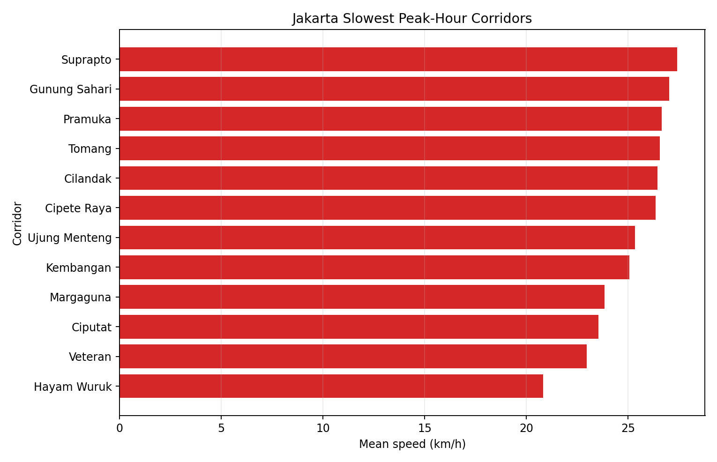
Slowest Corridors
Mean peak-hour speed by corridor, 2023
Rank | Corridor | Mean km/h | Obs.
1 | Hayam Wuruk | 20.82 | 12
2 | Veteran | 22.96 | 12
3 | Ciputat | 23.54 | 12
4 | Margaguna | 23.84 | 12
5 | Kembangan | 25.06 | 12
6 | Ujung Menteng | 25.33 | 12
Slowest corridor: Hayam Wuruk at 20.82 km/h.
These corridors are candidates for deeper bottleneck analysis.
Jakarta Traffic Congestion Analysis

Slide 5
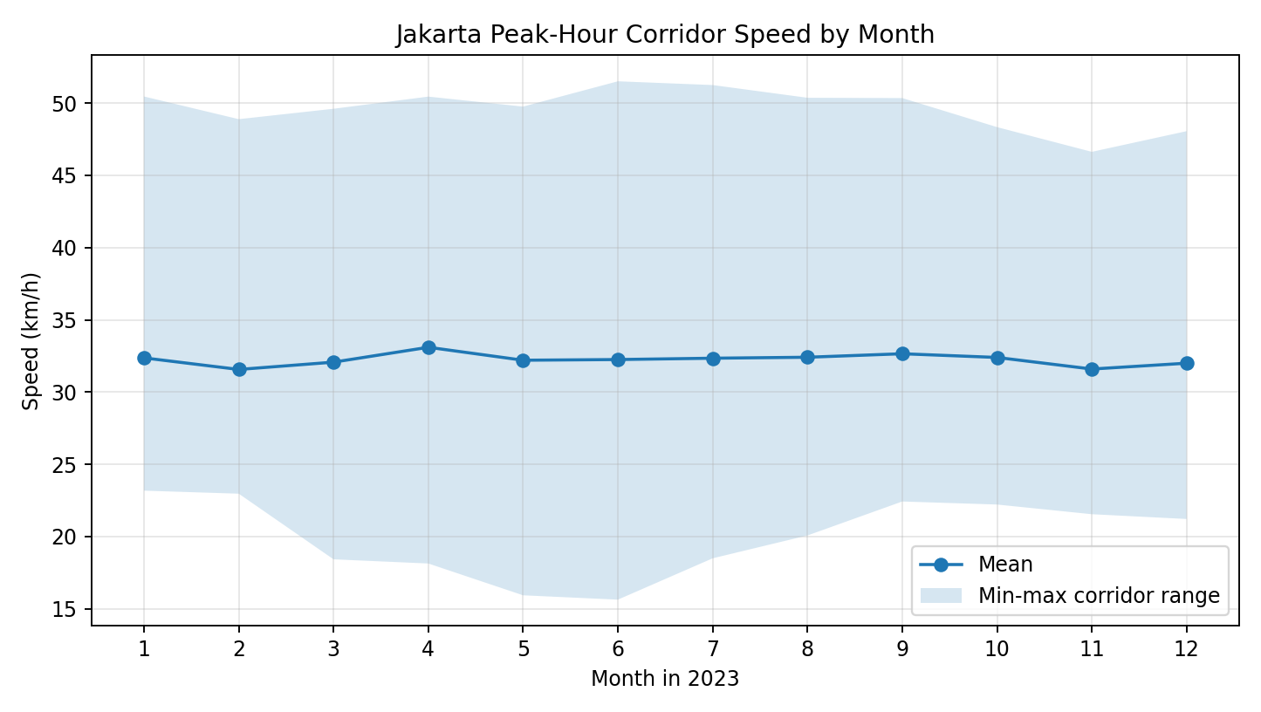
Monthly Pattern
Average speed varies, but congestion signal remains persistent
31.56 km/h
lowest monthly mean
2/2023
month
33.10 km/h
highest monthly mean
4/2023
month
Jakarta Traffic Congestion Analysis

Slide 6
How To Read The Congestion Mechanism
A simple demand-capacity story
Vehicle demand pushes more vehicles into limited corridor space.
At peak hours, density rises and effective capacity becomes binding.
Higher density reduces average speed.
Local slowdowns become bottlenecks.
Bottlenecks can create upstream queue-like waves, which is why traffic can remain slow even after the initial trigger changes.
Demand
Density
Speed drops
Bottleneck
Queue waves
Jakarta Traffic Congestion Analysis

Slide 7
Interpretation
What the current evidence supports
The corridor-speed dataset supports a bottleneck screening analysis.
Slow corridors can be prioritized for follow-up using demand, geometry, public transport, and incident data.
The data does not yet prove a full causal model of Jakarta congestion.
A defensible next step is to connect corridor speed with vehicle demand and a simplified traffic-flow simulation.
Jakarta Traffic Congestion Analysis

Slide 8
Connection To Thesis Enhancement
From thesis prototype to reproducible traffic analysis
Original thesis direction: fluid-inspired traffic modelling.
Repository enhancement: reproducible Python simulation and dashboard.
Jakarta repository: separate empirical case study using open data.
Future bridge: use Jakarta corridor speeds to calibrate scenario parameters in a simplified traffic-flow model.
Jakarta Traffic Congestion Analysis

Slide 9
Next Work
Data layers needed before stronger claims
Add BPS vehicle ownership and road-length context.
Find corridor-level volume or count data for Jakarta.
Map corridor speed to candidate bottleneck strength.
Compare simulated speed-density patterns against observed corridor speeds.
Document limitations explicitly before turning this into an article or paper draft.
Jakarta Traffic Congestion Analysis

Slide 10
Sources And Repository
Satu Data Jakarta / Data.go.id: Kecepatan Rata-rata di 41 Koridor Jalan Utama pada Jam Sibuk.
CSV file downloaded from the Satu Data Jakarta export endpoint.
Repository: https://github.com/kandref/jakarta-traffic-congestion-analysis
Generated deck: jakarta_traffic_congestion_findings.pptx
Jakarta Traffic Congestion Analysis

