Slide 1





Nearly Intrinsic Electron and Hole Transport in Channel Passivated WSe₂ Field-Effect Transistors with Graphene Contacts
Hsun-Jen Chuang, Zhixian Zhou
Wayne State University
Nirmal Jeevi Ghimire, Jiaqiang Yan and David Mandrus
University of Tennessee and Oak Ridge National Laboratory
Nano Fabrication and Electron Transport Laboratory, WSU
APS March meeting, March 2nd , 2015

Slide 2

Outline
Motivation
Experimental details
Results
Conclusion
Nano Fabrication and Electron Transport Laboratory

Slide 3
Motivation
TMD
Transition Metal Dichalcogenides
Ultra-thin and uniform channel
Surface smoothness
Mechanically flexible and strong.
Thermally stable
Reasonably good mobility
WSe₂ large hole mobility
Challenge:
Significant Schottky barriers at metal/WSe₂ contacts for both the electron and hole channels
Contact engeering:
Electrostatically dope graphene contacts by an Ionic Liquid gate
Air-Stable Surface Charge Transfer Doping of graphene contacts
(BV and F4-TCNQ)
To preserve the intrinsic channel properties
h-BN Encapsulation of the WSe₂ channel
Nano Fabrication and Electron Transport Laboratory
Notes:
However, With the large badgap, WSe2 often fail to form good ohmic contact with convention metal electrode which introduces the main challenge
In order to overcome this challenge we start with the study of contact engeering
Furthermore, in order to preserve the intrinsic channel properties of 2D TMDs, we will use h-BN to encapsulate the WSe2 channel.

Slide 4
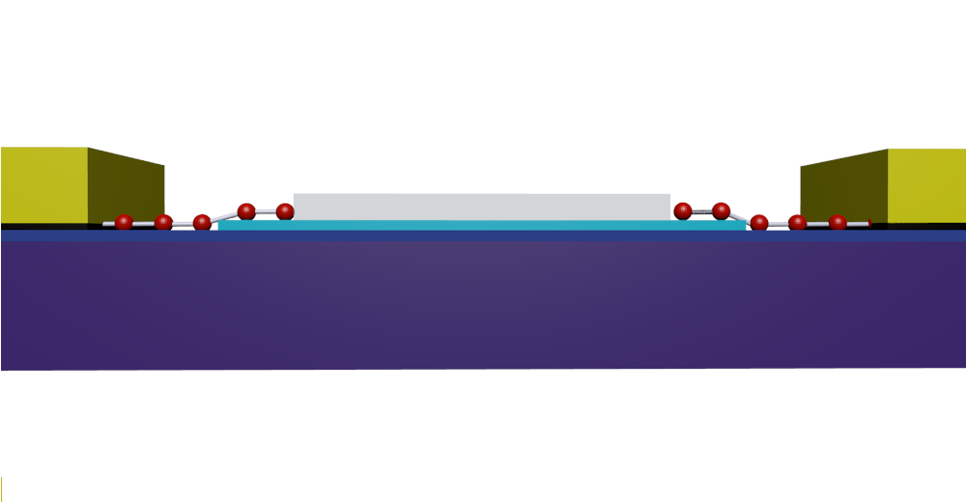
WSe₂ FET with IL gated grapehene contacts
Ionic Liquid gating
Au
+
+
-
-
-
-
-
-
-
-
Ionic Liquid
-
-
-
-
Mobile ions freeze below 180 K
-
-
-
Ionic Liquid (DEME-TFSI)
-
Drain
+
+
+
Source
+
+
+
+
+
+
+
+
+
+
+
+
+
+
+
Graphene
h-BN
Graphene
Si
Back Gate
H- J Chuang, et al., Nano Lett. 2014
Nano Fabrication and Electron Transport Laboratory
Notes:
In this work, we use graphene as electrode material with tunable work function to overcome
the limitations of metal electrodes to contact few-layer WSe2 FETs.
By using the extreemelylarge electric double layer capacticance of an ionic liquid gate, the work function of graphene can be modulated within an anormously large range to line it up the conduction and valence band edges.
As how does the Ionic liquid works, we demostrate in this graphe, when we apply top gate voltage the carriers will accumulate on the top ans bottom which gives the electrostatically doping on graphene contatcs and when we continusly apply top gate voltage on IL while cooling down the temp below IL the mobile ions will be forzen which allowed us to contniously doping on graphene

Slide 5
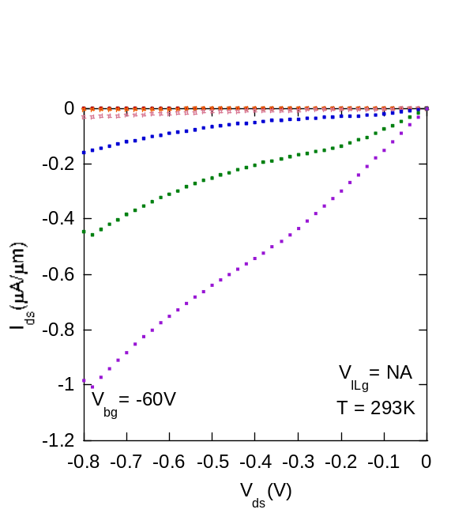
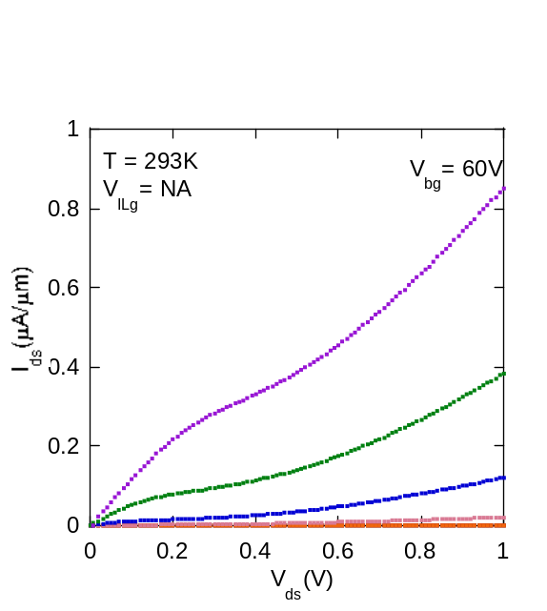
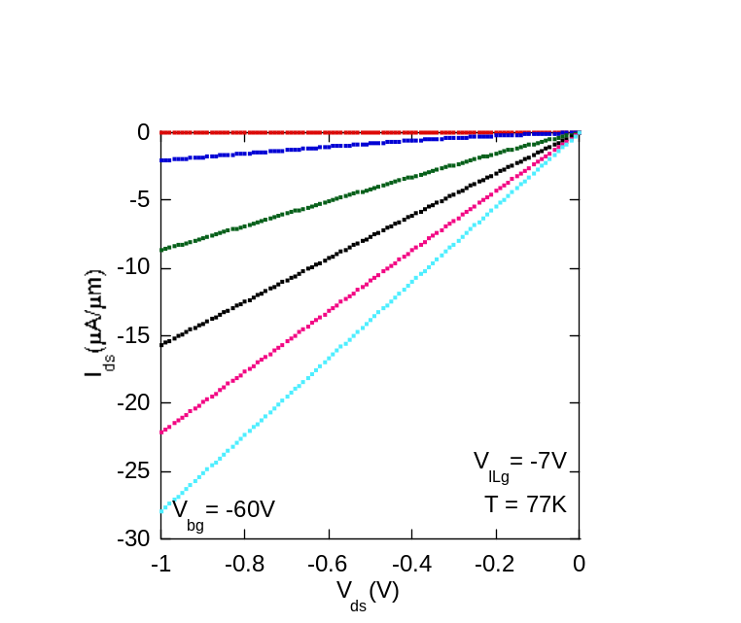
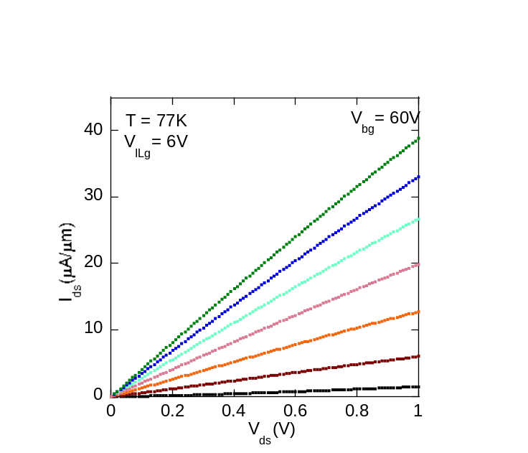



WSe₂ FET with IL gated grapehene contacts
Hole side
electrron side
E_{F}
E_{F}
Graphene
h-BN
H- J Chuang, et al., Nano Lett. 2014
Nano Fabrication and Electron Transport Laboratory
Notes:
Without applying IL gate voltage, the drain-source current is low and nonlinear, indicating of a significant Schottky barrier. After applying IL gate to electrostatically dope the graphene contacts, the IV curves become much more linear and their current values also increase dramatically, indicating significant reduction of the barrier height.

Slide 6
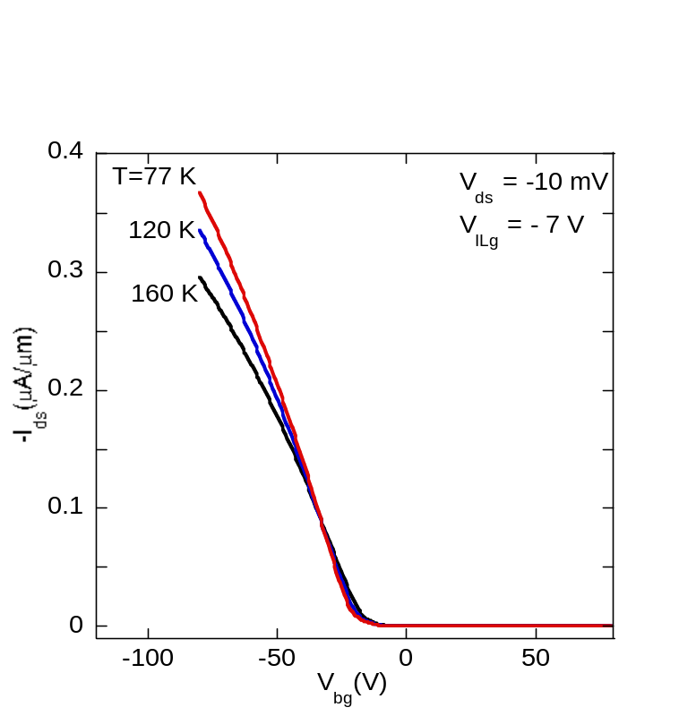
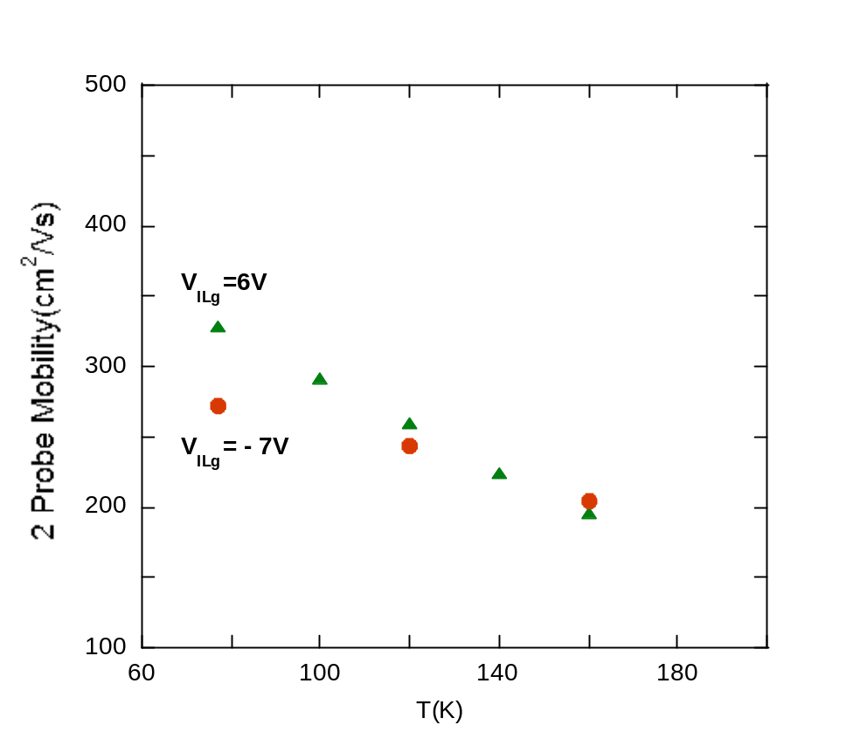
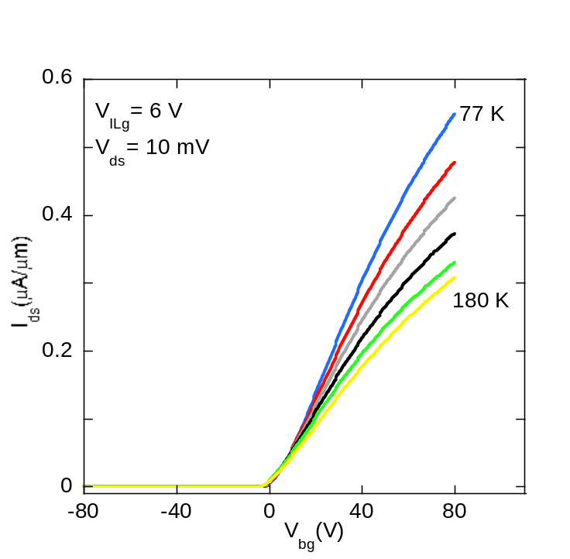
WSe₂ FET with IL gated grapehene contacts
H- J Chuang, et al., Nano Lett. 2014
    Two-probe field-effect mobility for both electrons and holes:
    relatively large
    increase with decreasing temperature, indicating intrinsic phonon limited channel behavior
Nano Fabrication and Electron Transport Laboratory
Notes:
The low resistance contacts enabled by the ionic liquid gate tuned graphene contacts make it possible to study the intrinsic channel properties of our WSe2 devices.

Slide 7
Improvement method
Contact engeering
Goal: low resistance Ohmic contacts
Ionic liquid gating
Good as a proof of principle, but not suitable for the real applications
Air stable molecular surface charge transfer doping of graphene contacts
Strong electron donor BV (Benzyl Viologen ) for Electron doping
Strong electron acceptor F4-TCNQ for hole doping
Intrinsic transport properties and performance limit of WSe2
as a channel material
Encapsulate the WSe₂ channel with h-BN to minimize the scatterings from the interface and substrate/dielectric
Nano Fabrication and Electron Transport Laboratory
Notes:
As a proof of principle, ionic liquid gating is effective in reducing the Schottky barrier at the graphene/WSe2 contacts.
However, methods to achive high electron- and hole-doping of graphene that yield more permanent and air-stable contacts are needed for practical device applcaitons.
For the rest of the talk, I will focus on air stable molecular doping methods to highly n- and p- dope graphene electrodes to achieve low barrier contacts for the electron and hole channels, respectively. Specifically, we will use strong electron donor, Benxyl Viologen to heavily n-dope and strong electron acceptor F4-TCNQ to heavily p-dope graphene electrodes.
Furthurmore, in order to preserve the intrinsinc transport properties and study the performance limit of WSe2 as a channel material, we have encapsulated the WSe2 channel with ultra clean, atmoically flat, and chemcially innert h-BN as substrate/dielectric and top capping layers.

Slide 8
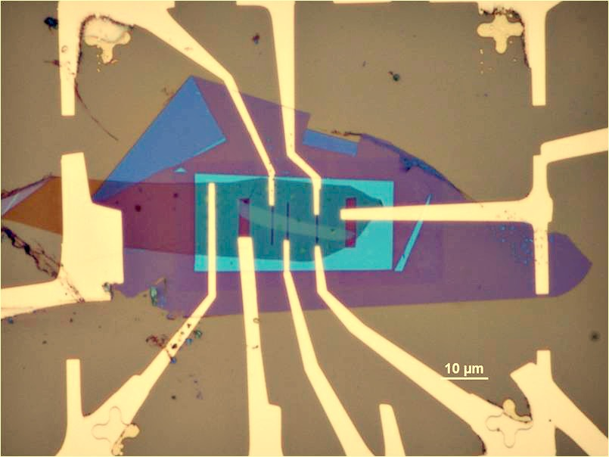
Device Fabrication
Nano Fabrication and Electron Transport Laboratory
Notes:
Here is a optical micrograph of a typical few layer WSe2 device encapsulated by bottom and top h-BN protection layers and contacted by graphene

Slide 9
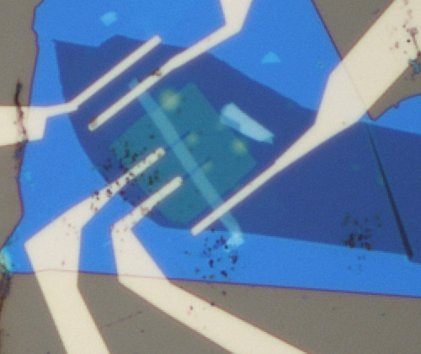
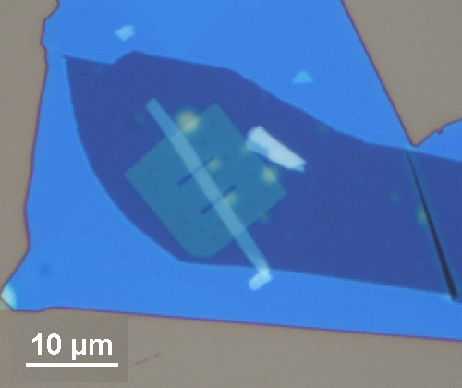
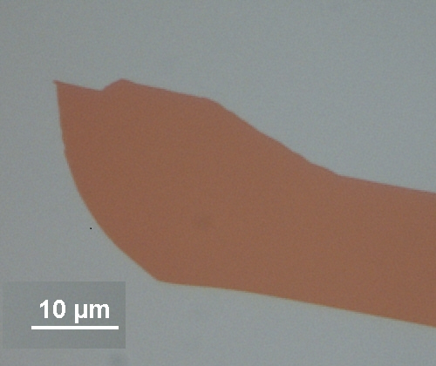
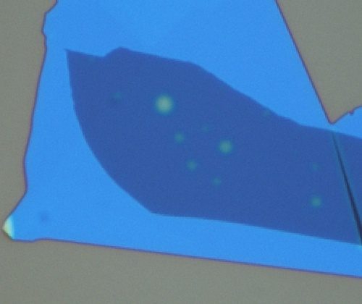
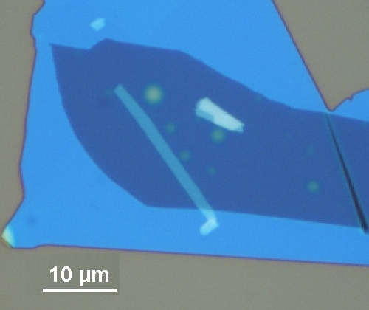
Device Fabrication
Where C_{bg} is determined to be 6.9×10⁻⁸ F cm⁻²
for 45nm hBN based on the parallel capacitor
model (C_{bg} = 3.5ε₀ / 20nm)
Wse₂ channel :
Length~ 13um /3.7um
Width ~1.6um
Thickness ~3.2nm
CVD graphene
Patterned
hBN
hBN
WSe2
graphite
Cross section
ILg
Au/Ti electrode
SiO₂
Si
Nano Fabrication and Electron Transport Laboratory
Notes:
Mutilayer of graphit is transfer to sub as a back gate electrode
For this device we will first check the two probe measurement by using BV and TCNQ doping method and compared to the IL doping methods. Follow with the four probe measurement which is needed in order to investigate the intrinsic WSe2 channel properties.

Slide 10
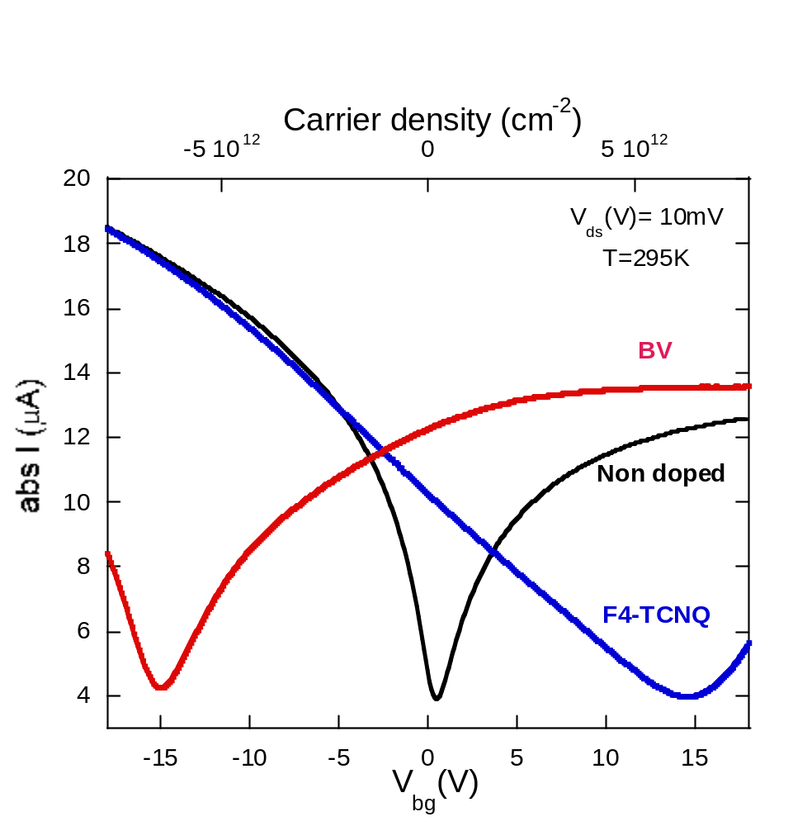
Molecular doping of graphene
Notes:
To begin with, we first testify the doping level of graphene by air stable molecular surface charge transfer doping method, as the result the large shift of the Diract point of graphene indicate that the BV and TCNQ gives the heavily n doping and doping g on graphene contacts respectively.

Slide 11
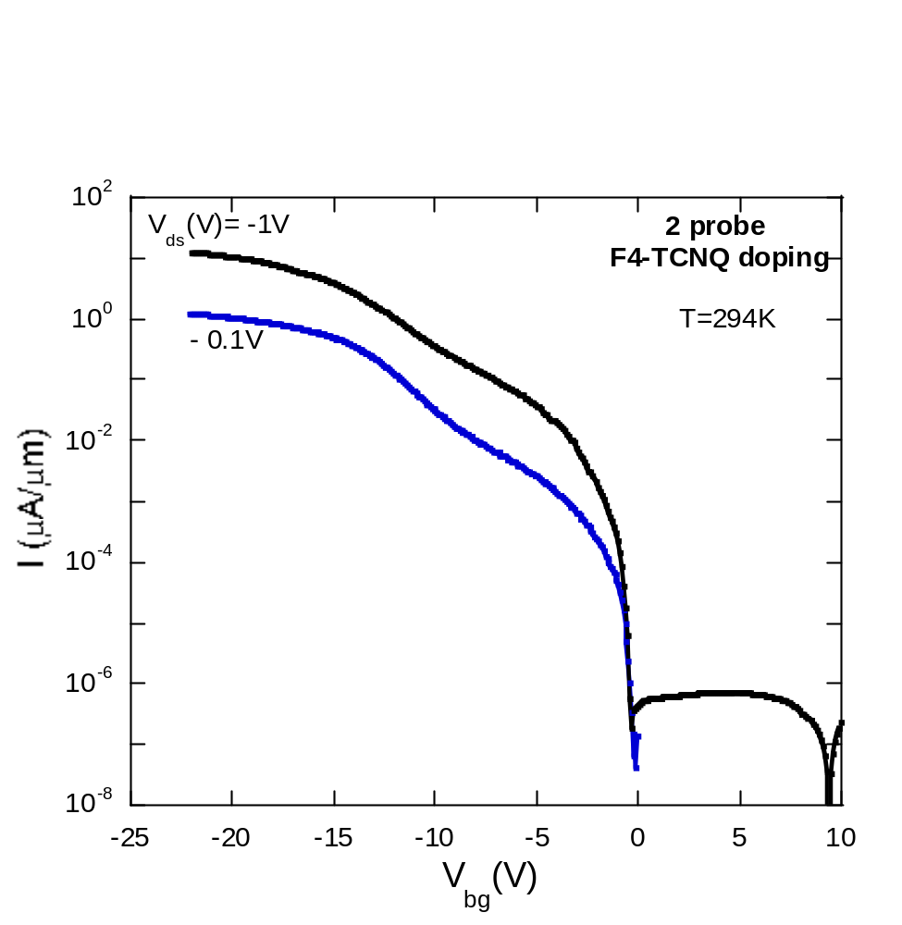
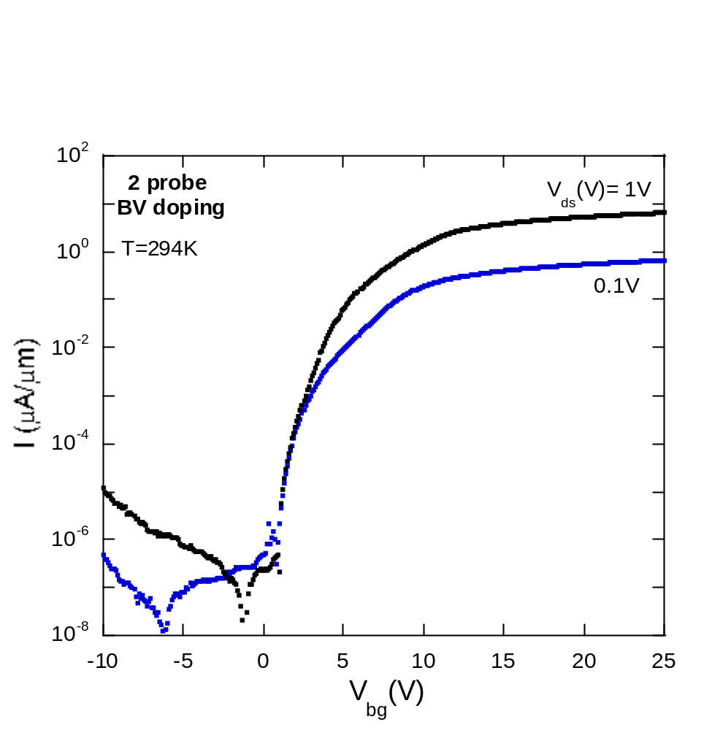
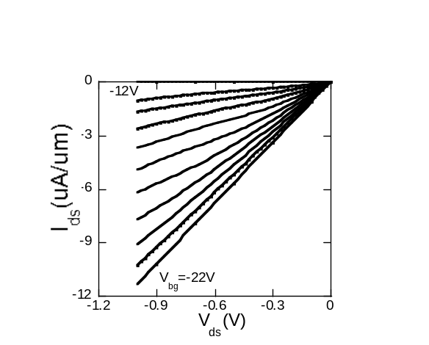
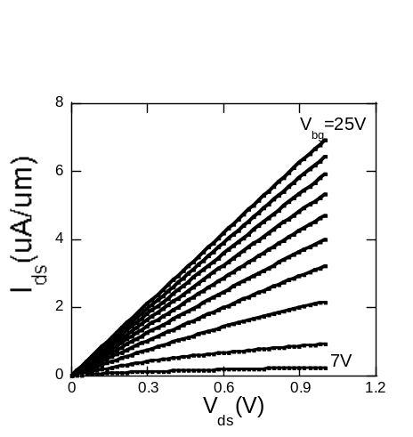
2 Probe Transfer and Output Characteristics of WSe₂
Device performance
Device Performance : On/Off ratio > 10⁷
Linear IV characteristics→ near Ohmic contacts
Nano Fabrication and Electron Transport Laboratory
Notes:
After VB and TCNQ doping on the graphene contacts device, the room temperature Transfer Characteristics show good device performance with an on/off ratio of 7 orders of magnitude. Also the linear IV characteristics indicate near Ohmic contact due to the reduction of the Schottky barrier

Slide 12
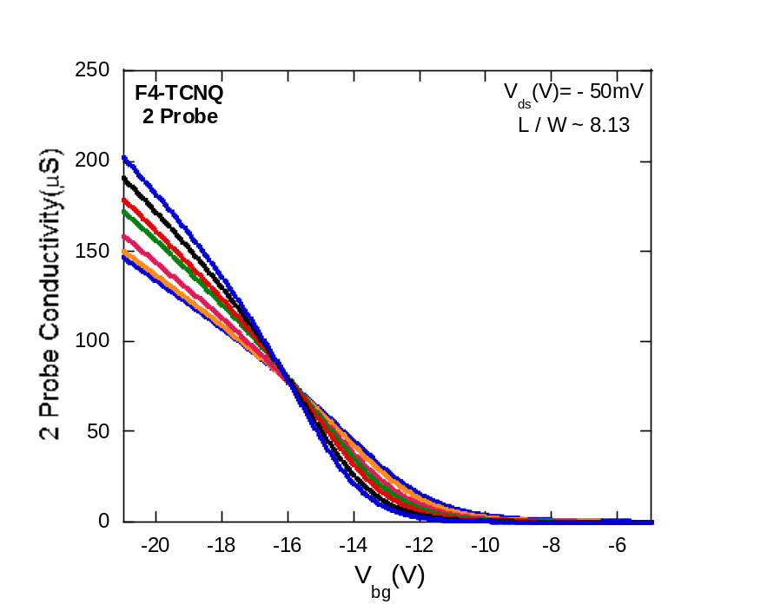
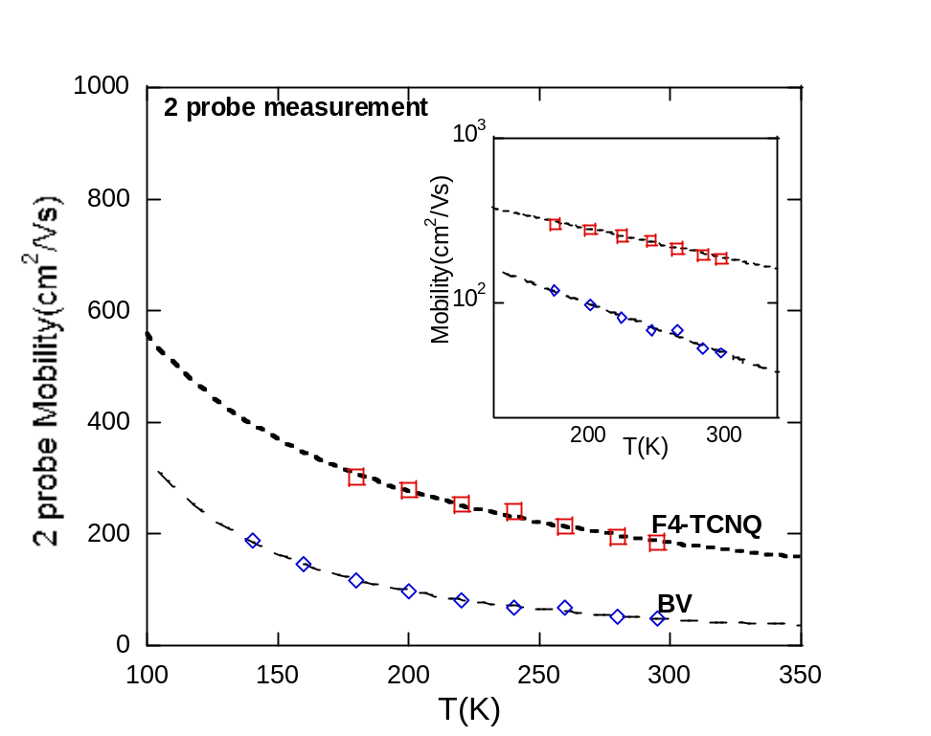
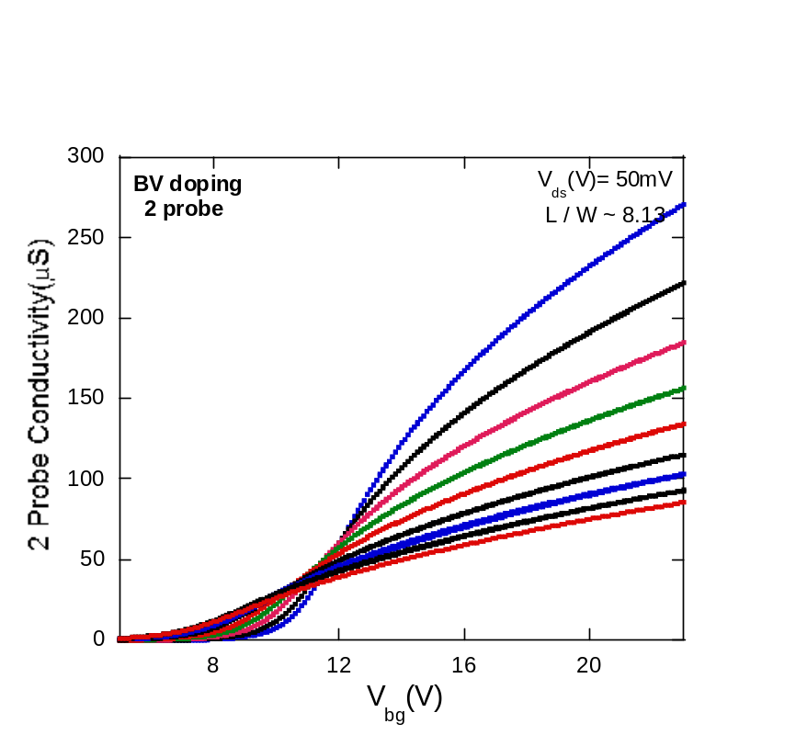



2 Probe Transfer Characteristics
2 probe
Drain
180 K
Source
294 K
140 K
294 K
Nano Fabrication and Electron Transport Laboratory
Notes:
In this slide The two probe transfer characteristics is showing
Metal-insulator transition on both electron and hole channel
Field-effect mobility extracted from the metallic region at higher gate voltages, where the conductivity increases with decreasing temperature
The gamma of electron is ~ 1.7 and for hole ~1.0
Next we will compare with the result of IL gated graphene devices,
We extract FE mobility from the linear part of metallic at high gate voltage

Slide 13
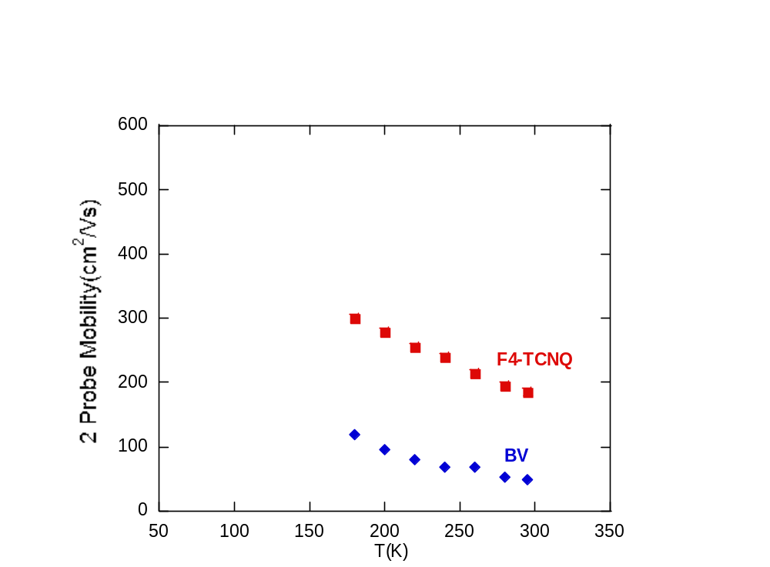
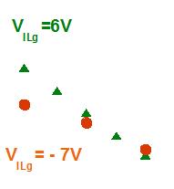
Comparison of molecular doping and ionic liquid gating
in improving Graphene contacts
H- J Chuang, et al.,
Nano Lett. 2014
Nano Fabrication and Electron Transport Laboratory
Nano Fabrication and Electron Transport Laboratory
Notes:
The 2 probe electron and hole mobilities of WSe2 devices with BV and F4-TCNQ doped graphene contacts are consistent with the mobility values of similar devices with ionic liquid gated graphene contacts, indicating the BV and F4-TCNQ has effectively reduced the Schottky barrier to achieve good electrical contacts.
To furthermore investigate the intrinsic properties of the WSe2 channel, 4 probe measurement is needed

Slide 14
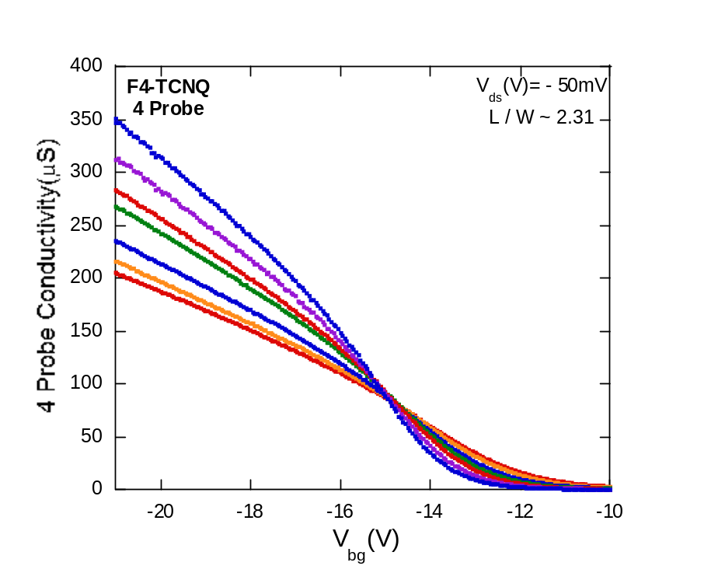
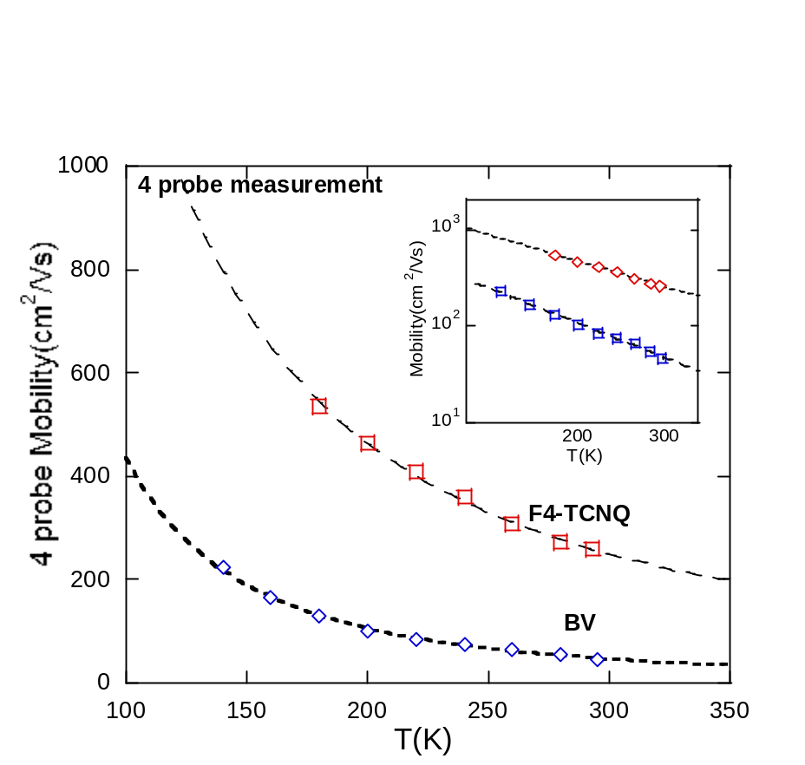
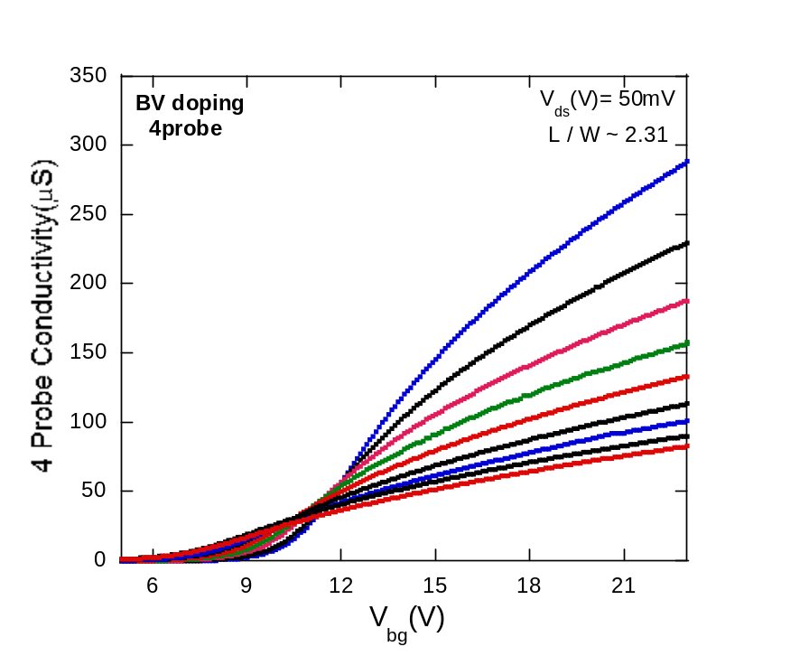
4 probe transfer characteristics
4 probe
Drain
180 K
Source
V2
V3
294 K
140 K
294 K
Nano Fabrication and Electron Transport Laboratory
Notes:
And again we extract the mobility by fitting the linear region at higher gate for both electron and hole side

Slide 15




4 probe transfer characteristics
4 probe
Drain
Source
RT hole mobility: 258 cm²/Vs
RT electron mobility: 46.5 cm²/Vs
m_{h} ~ 0.3 0.2 m₀
m_{e} ~ 0.9 m₀
γ_{e}~ 2.0 (and RT electron mobility)
similar to hBN encapsulated MoS₂
(Perera talk and Xu Cui et al.
http:// arxiv.org/abs/1412.5977 )
γ_{h} ~1.5
Suggest possibly different scattering
mechanisms
V2
V3
Klein, A., et al. Solar materials and solar cells, 1997energy
Nano Fabrication and Electron Transport Laboratory
Notes:
The Result is showing that hole mobility is higher than electron mobility, which can be attributed to the smaller effective mass of holes compared to electrons in WSe2, also the gamma value for electron side is similar to the gammar of MoS2 indicate the min. of charge impurity scattering of the device
Nevertheless, the gamma for hole is around 1.5 suggesting the possibly different scattering mechanisms for holes and holes in WSe2.
If people ask you about examples of different scattering mechanisms for electrons and phonons, you can say “possibly different electron-phonon coupling strength”.

Slide 16
Conclusion
Achieved nearly Ohmic contacts for both electrons and holes in WSe₂ FETs by using molecular doping of graphene contacts
Observed nearly intrinsic electron and hole mobility limited by phonon scattering in hBN encapsulated WSe₂
Difference in electron and hole mobility may be attributed to the different effective mass and scattering mechanisms for electrons and holes in WSe₂
Acknowledgment
NSF(DMR- 1308436)
This work was supported by
Nano Fabrication and Electron Transport Laboratory

