Slide 1

Intrinsic Transport Properties & Scattering Mechanisms in TMDs
Dept. of Physics & Astronomy
Kraig Andrews
Dr. Zhixian Zhou
Nanofabrication & Electron Transport Laboratory

Slide 2
Overview
Motivation
Introduction
Device Fabrication
Preliminary Results
Future Work & Conclusion

Slide 3
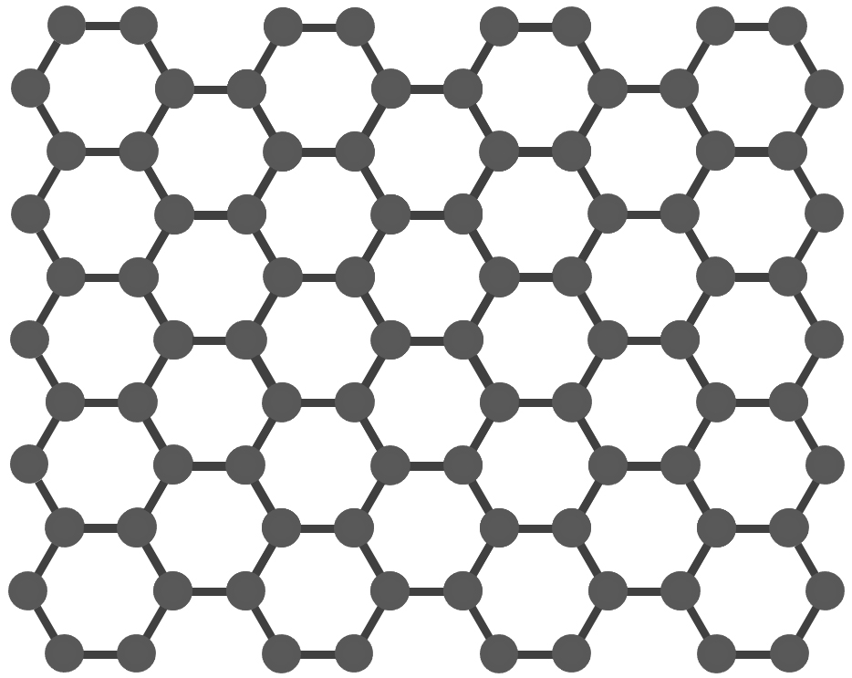
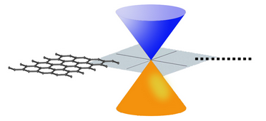
Graphene
High mobility
10⁴ cm²V⁻¹s⁻¹ at T_{room}¹
Upper limit 10⁵ cm²V⁻¹s⁻¹ at T_{room}²
High Young’s Modulus
No Bandgap³
Low I_{on}/I_{off} ratio
Notes:
Upper limit is for suspended graphene (i.e. removed substrate)

Slide 4
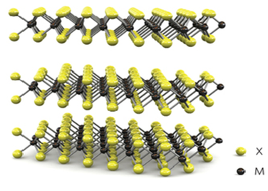
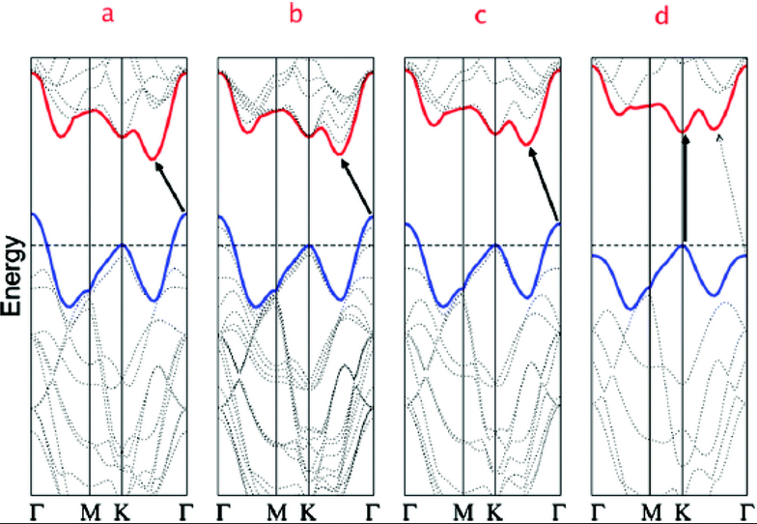
TMDs
Transition Metal Dichalcogenides (TMDs)
Transition Metal Chalcogen
Mo, W, V S, Se, Te
MX₂
(MoS₂, MoSe₂, WSe₂, WS₂)
Unique Band structure³
Extremely Strong
High I_{on}/I_{off} ratio > 10⁶
Notes:
Band structure for (a) bulk MoS2, (b) four-layer MoS2, (c) bi-layer MoS2, and (d) Monolayer MoS2. Shows transition from indirect bandgap to direct bandgap. Arrows indicate the lowest energy transitions.

Slide 5
Challenges
Contact Resistance
Study p-WSe₂ doping effects
Quantum transport properties
Performance limits

Slide 6
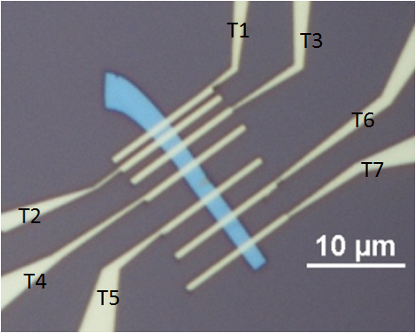
Contact Resistance
Approach
2D/2D Contacts
Lowering SBH
Doping
0.05% Nb doped WSe₂

Slide 7
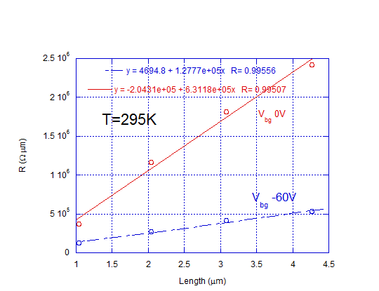
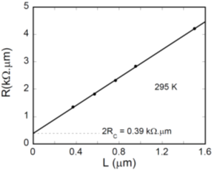
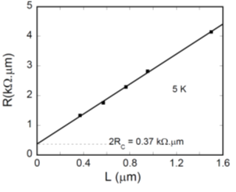
Results
Notes:
Contact Resistances for 0.05% Nb doped WSe2 at room temp (R_{c} = 2.35 kΩ μm), 0.5% Nb doped WSe2 at room temp (R_{c} = 0.195 kΩ μm) and at 5K (R_{c} = 0.185 kΩ μm).

Slide 8
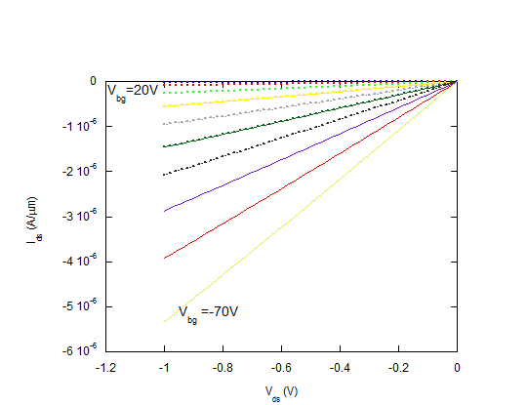
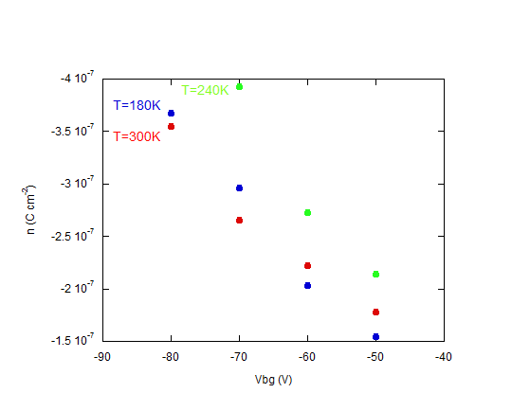
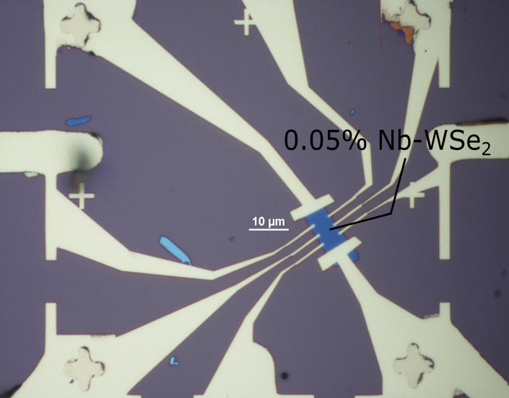
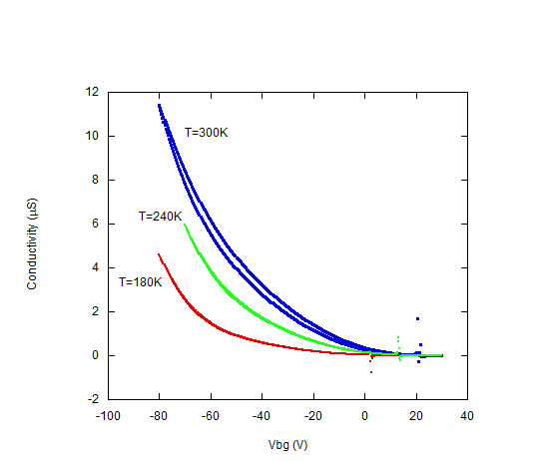
Mobility

Slide 9
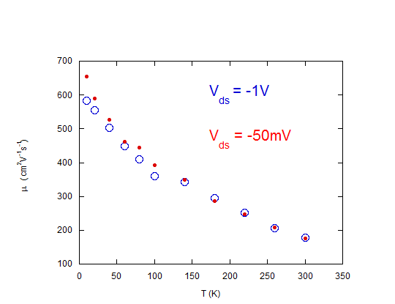
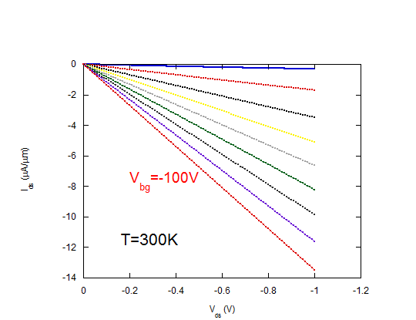
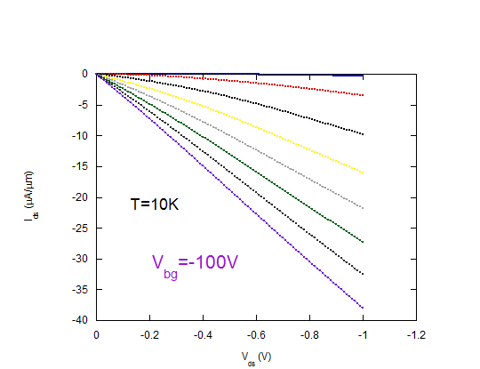
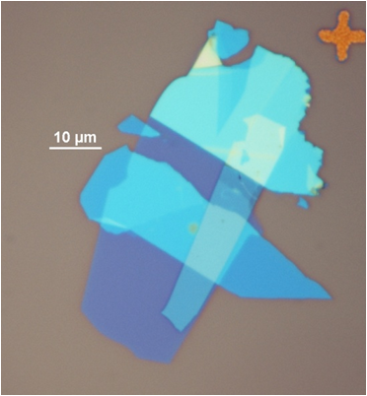
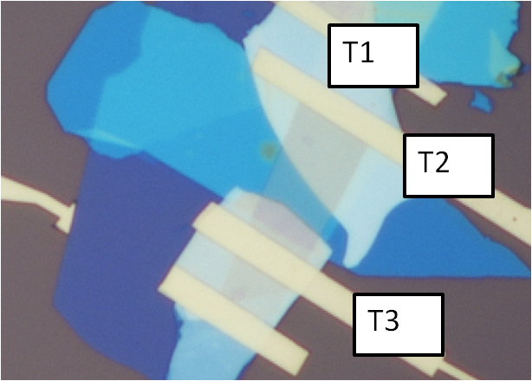
Mobility

Slide 10
Quantum Transport
Integer Quantum Hall Effect (IQHE) & Shubnikov-de Haas (SdH) oscillations
Low Temperature (< 4K)
High Magnetic Field (~10 T)
High µ at Low T Required

Slide 11
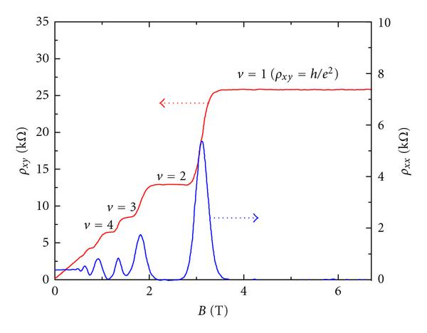
IQHE
Notes:
Integer quantum hall effect in an Indium gallium arsenide (InGaAs) heterostructure.

Slide 12
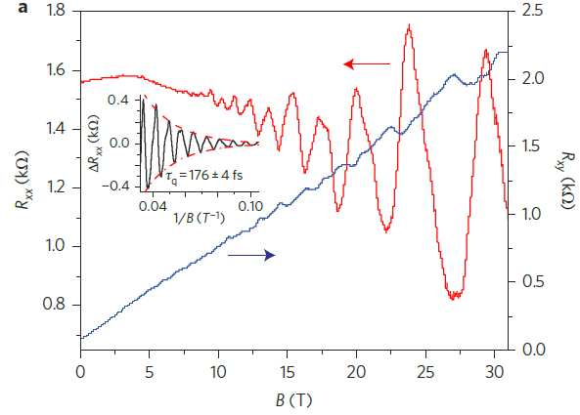
SdH & IQHE in MoS₂

Slide 13
SdH Oscillations
Cyclotron mass of electrons and holes
Carrier lifetimes
τ_{q} = 0.18 ps in 1L MoS₂⁵ & τ_{q} = 0.12 ps in ~10 nm BP⁶
A
Notes:
Cyclotron mass is the mass of electrons/holes at the Fermi level.

Slide 14
Performance Limits
Theoretical 1L mobility at T=295K⁷
~320-410 cm²V⁻¹s⁻¹
Experimental mobility at T=295K⁸
~200 cm²V⁻¹s⁻¹
I_{on}/I_{off} > 10⁷, I_{on} ~ 300 μA/μm
How to close theoretical/experiment gap

Slide 15
Summary
2D/2D contact strategy to lower R_{contact}
Improve μ through hBN encapsulation
Determine quantum properties using low T and high B environment
Room T performance limits

Slide 16
Acknowledgements
The authors would like to acknowledge:
Nanofabrication and Electron Transport Laboratory students:
Hsun Jen Chuang, Bhim Chamlagain, Meeghage Madusanka Perera, Arthur Bowman III, Upendra Rijal, and Sagar Paudel
Committee Members: Dr. Zhixian Zhou,
Dr. Jian Huang, Dr. Ashis Mukhopadhyay, Dr. Mark Cheng

