Slide 1
SIH 2026 · PROBLEM STATEMENT 26102 · MINISTRY OF STATISTICS AND PROGRAMME IMPLEMENTATION
MPLADS Sentinel
Risk indicators for review of MPLADS works:
anomalies, fraud risk, delays and duplicate works, with the evidence attached.
Built on 77,312 real works from the public eSAKSHI extract · 700 MPs · 765 districts
[Team name and members]
Notes:
Open with the one-line promise: every MPLADS work gets a risk indicator with its evidence, for a human reviewer. Say 'for review' out loud; we never call anything fraud.

Slide 2
THE PROBLEM
Too many works, too few reviewers, and no single view
WORKS IN THE EXTRACT
SANCTIONED
COMPLETED
DISTRICTS
77,312
₹4,742 crore
54%
765
Lok Sabha and Rajya Sabha
75% disbursed so far
41,650 of 77,312
700 MPs recommending
▸ A district office cannot read tens of thousands of work records looking for the few that need a second look.
▸ The warning signs are scattered: a cost far above what the description predicts, the same asset recorded twice, one project split to stay under a limit, works stalled for years.
▸ Oversight has to respect scope: a district sees its district, an MP sees works recommended in their constituency, citizens see where money went.
▸ Any flag must come with evidence a reviewer can check, in English and Hindi, and every action must leave an audit trail.
MPLADS Sentinel · SIH 2026 · PS 26102 · Risk indicators for review, never findings of fraud
2
Notes:
Frame the scale with the four numbers. The point is triage: the system decides where to look first, people decide what it means.

Slide 3
HOW IT WORKS
From a spreadsheet extract to a scoped review queue
eSAKSHI extract
ML pipeline
Fusion
FastAPI
Dashboard
77,312 works, 34 columns
public data
work type (56 types)
expected cost, rules
anomaly, duplicates
splits, delay model
soft-OR of 6 channels
percentile bands
severe-rule floor
JWT, 4 roles
row-level scoping
hash-chained audit
React, English and Hindi
review, cases, learning
citizen view
▸ The full pipeline runs in 194 seconds on an RTX 5060; uploads are scored by the same saved models.
▸ Thresholds live in YAML config; the proxy label's flags are never model inputs (leakage rule enforced in code).
MPLADS Sentinel · SIH 2026 · PS 26102 · Risk indicators for review, never findings of fraud
3
Notes:
Walk left to right. Emphasise that fusion is transparent: six channels, fixed weights from config, percentile bands so the queue size stays workable.

Slide 4
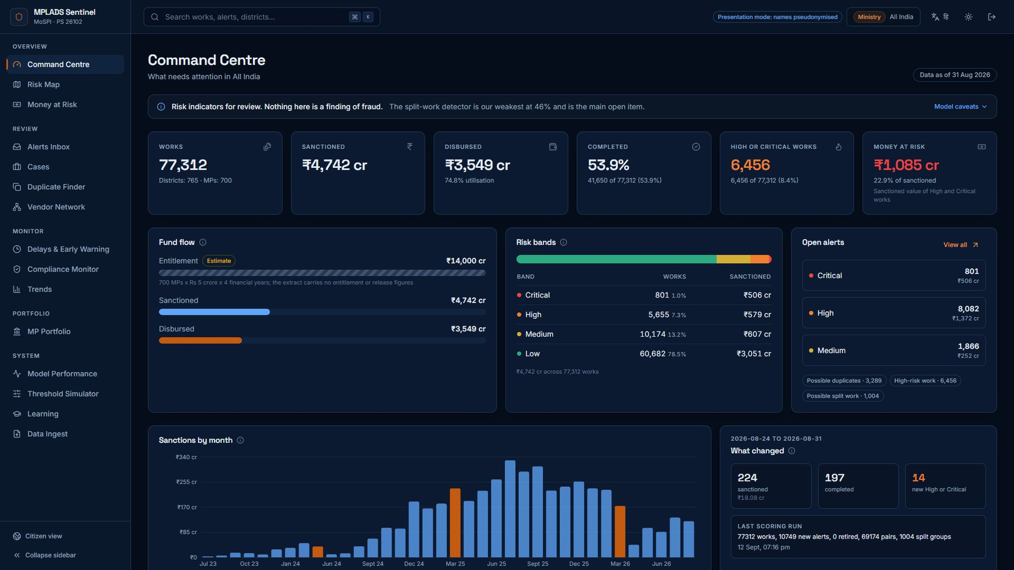
COMMAND CENTRE
Where to look first, with the denominator always shown
HIGH OR CRITICAL WORKS
6,456
8.4% of all works
MONEY AT RISK
₹1,085 crore
22.9% of sanctioned value
OPEN ALERTS
10,749
works, duplicate groups, splits
Bands are percentiles: top 1% Critical, next 4% High, so the queue stays a workable size.
MPLADS Sentinel · SIH 2026 · PS 26102 · Risk indicators for review, never findings of fraud
4
Notes:
Point at money at risk and its share of sanctioned value. The caveat strip on every page says what the numbers are and are not.

Slide 5
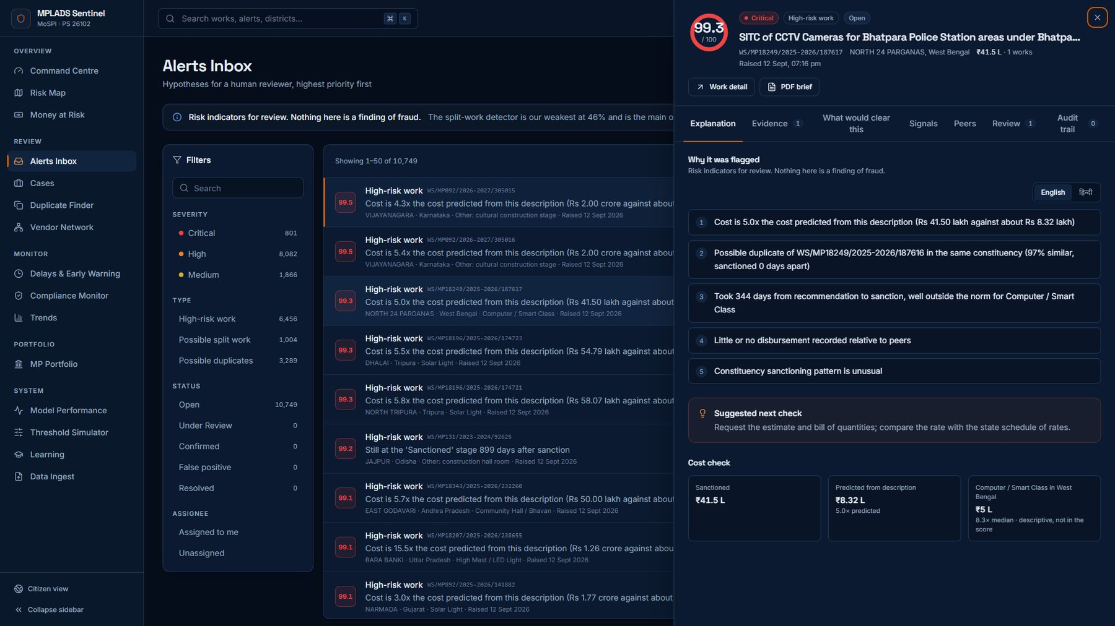
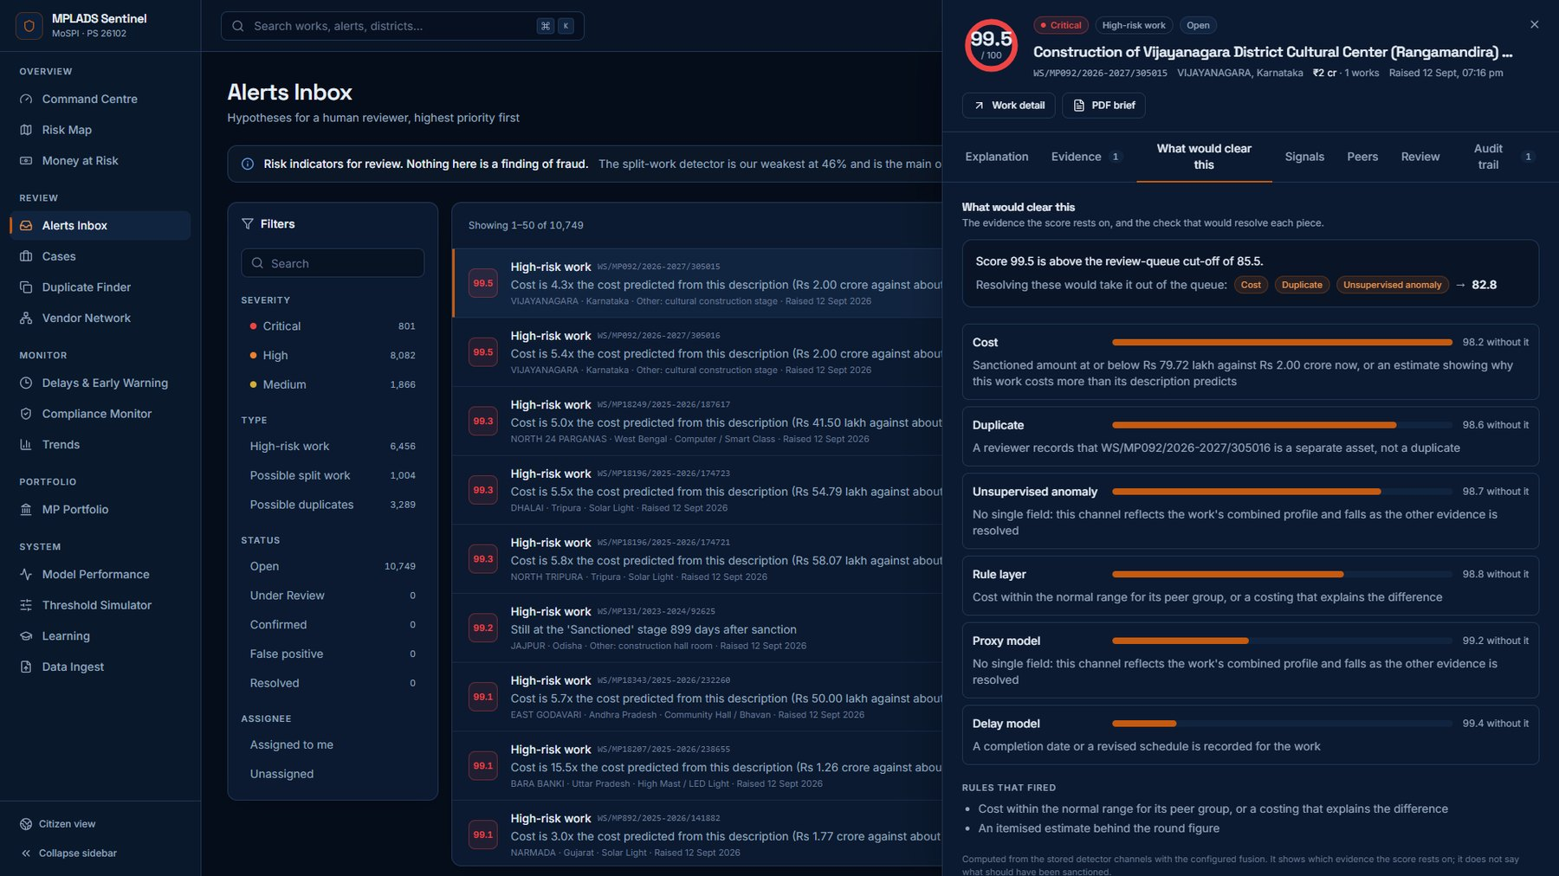
ALERTS INBOX
Every flag explained in English and Hindi
▸ Keyboard triage (j, k, e), an evidence drawer with reasons, detector channels, peer cost comparison and the audit trail.
▸ "What would clear this" names the evidence a score rests on and the check that would resolve it, never what should have been sanctioned.
MPLADS Sentinel · SIH 2026 · PS 26102 · Risk indicators for review, never findings of fraud
5
Notes:
The Bhatpara CCTV example: two works flagged as duplicates and over-cost. The drawer shows why, and the reviewer can clear it: different police stations and wards, and the cost model grouped CCTV with computers.

Slide 6
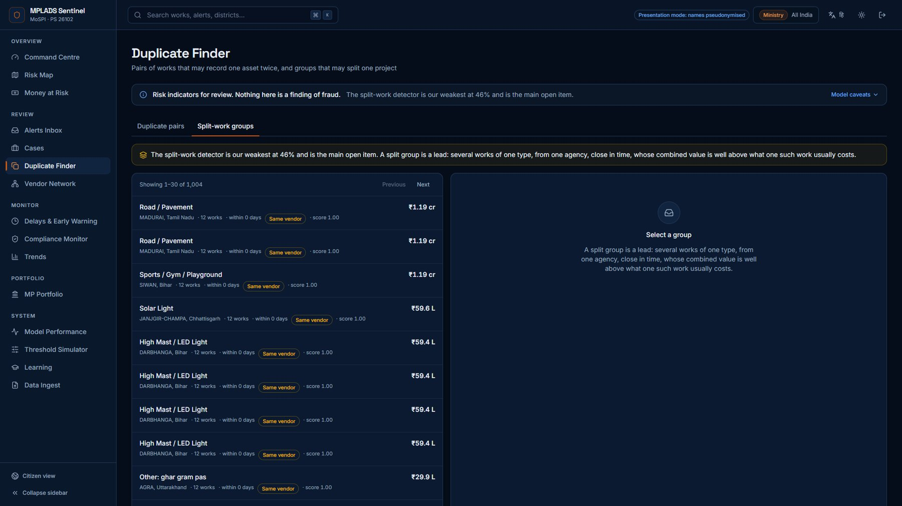
DUPLICATES AND SPLIT WORKS
One asset recorded twice, or one project cut into pieces
DUPLICATE PAIRS SCORED
69,174
3,618 groups, 17,482 works
SPLIT-WORK GROUPS
1,004
6,801 works, 492 with one vendor
OUR WEAKEST DETECTOR
The split-work detector flags only 46% of planted split groups. It is the main open item, and the dashboard says so wherever splits appear.
MPLADS Sentinel · SIH 2026 · PS 26102 · Risk indicators for review, never findings of fraud
6
Notes:
Madurai: twelve road works from one agency sanctioned the same day, each just below a round amount. Then say plainly that split detection is the weakest detector.

Slide 7
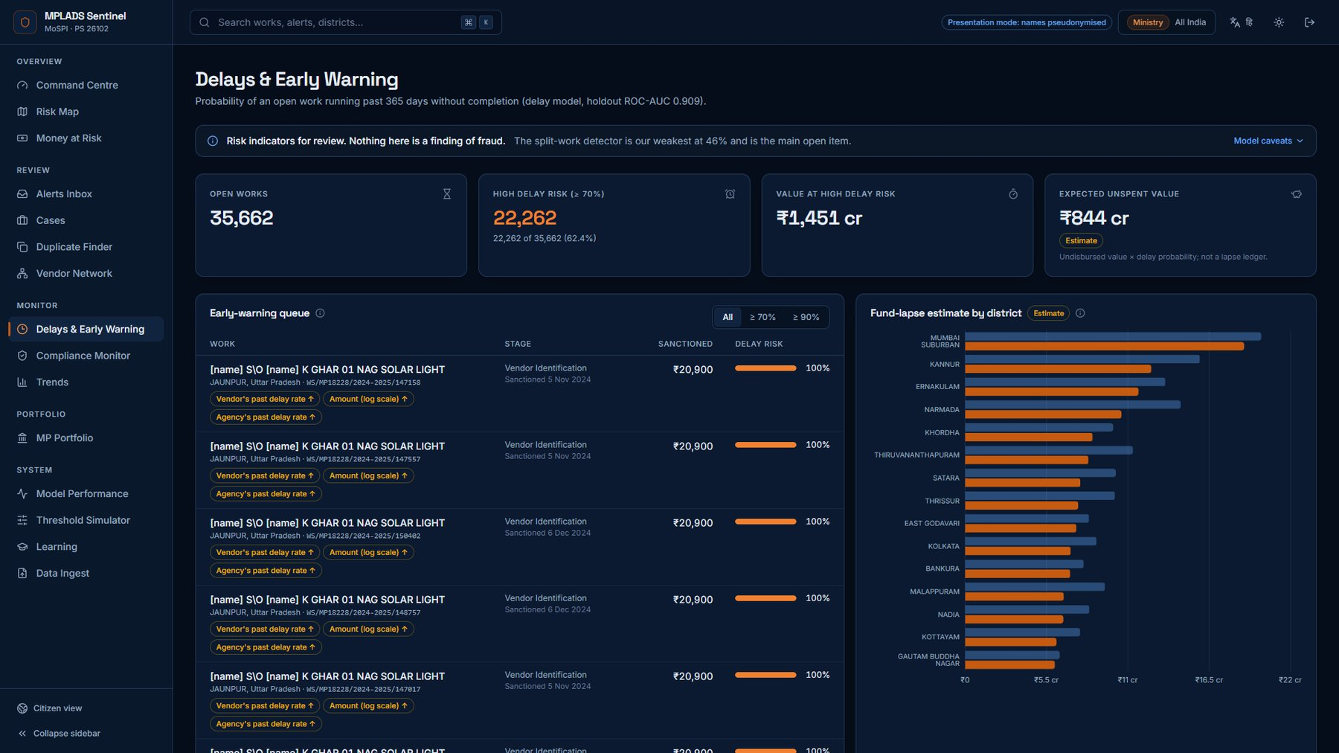
DELAYS AND EARLY WARNING
Which open works are likely to run past a year
HOLDOUT ROC-AUC
0.909
PR-AUC 0.873 on 2,023 labelled works
HELD-OUT CONSTITUENCIES
27
3,890 works removed before any fitting
▸ Time-split ROC-AUC 0.873 inside training.
▸ Fund-lapse figures are labelled estimates: the extract has no release ledger.
MPLADS Sentinel · SIH 2026 · PS 26102 · Risk indicators for review, never findings of fraud
7
Notes:
The honest check is the holdout: whole constituencies removed before anything was fitted.

Slide 8
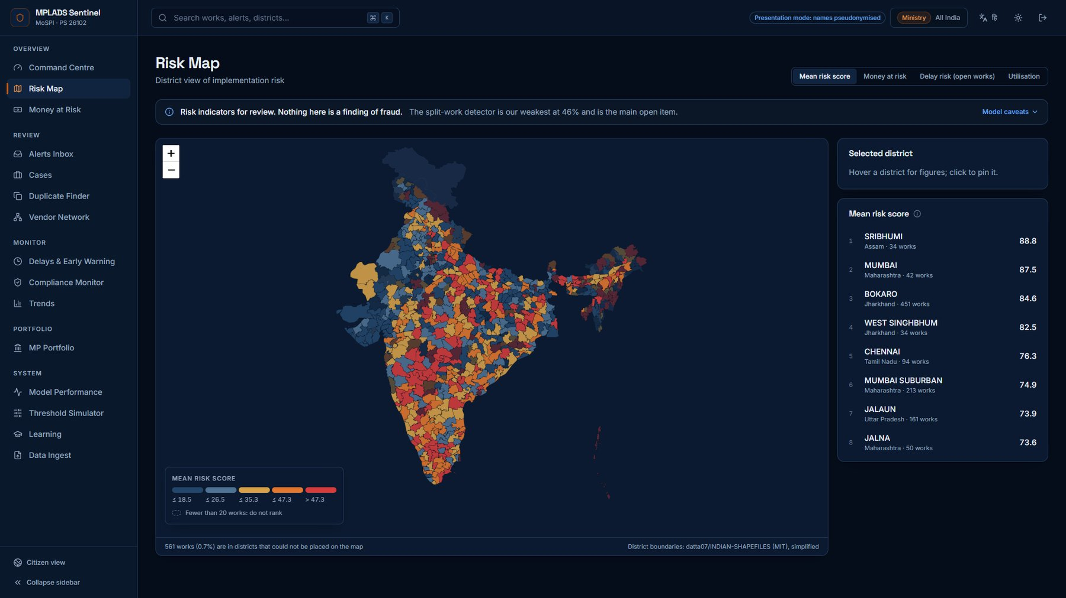
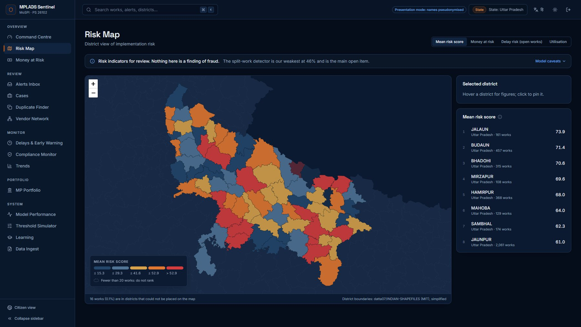
FOUR ROLES, ONE SOURCE OF TRUTH
Everyone sees exactly their scope, enforced on every query
▸ Ministry: all India. State: its state. District: its office (270 works for Lucknow). MP: implementation risk of works recommended in their constituency, never a judgement of the Member.
▸ An out-of-scope id answers 404, so the API does not even confirm it exists. End-to-end tests log in as each role to prove it.
MPLADS Sentinel · SIH 2026 · PS 26102 · Risk indicators for review, never findings of fraud
8
Notes:
Left is the ministry map, right the same page for the Uttar Pradesh officer. Mention the MP framing explicitly.

Slide 9
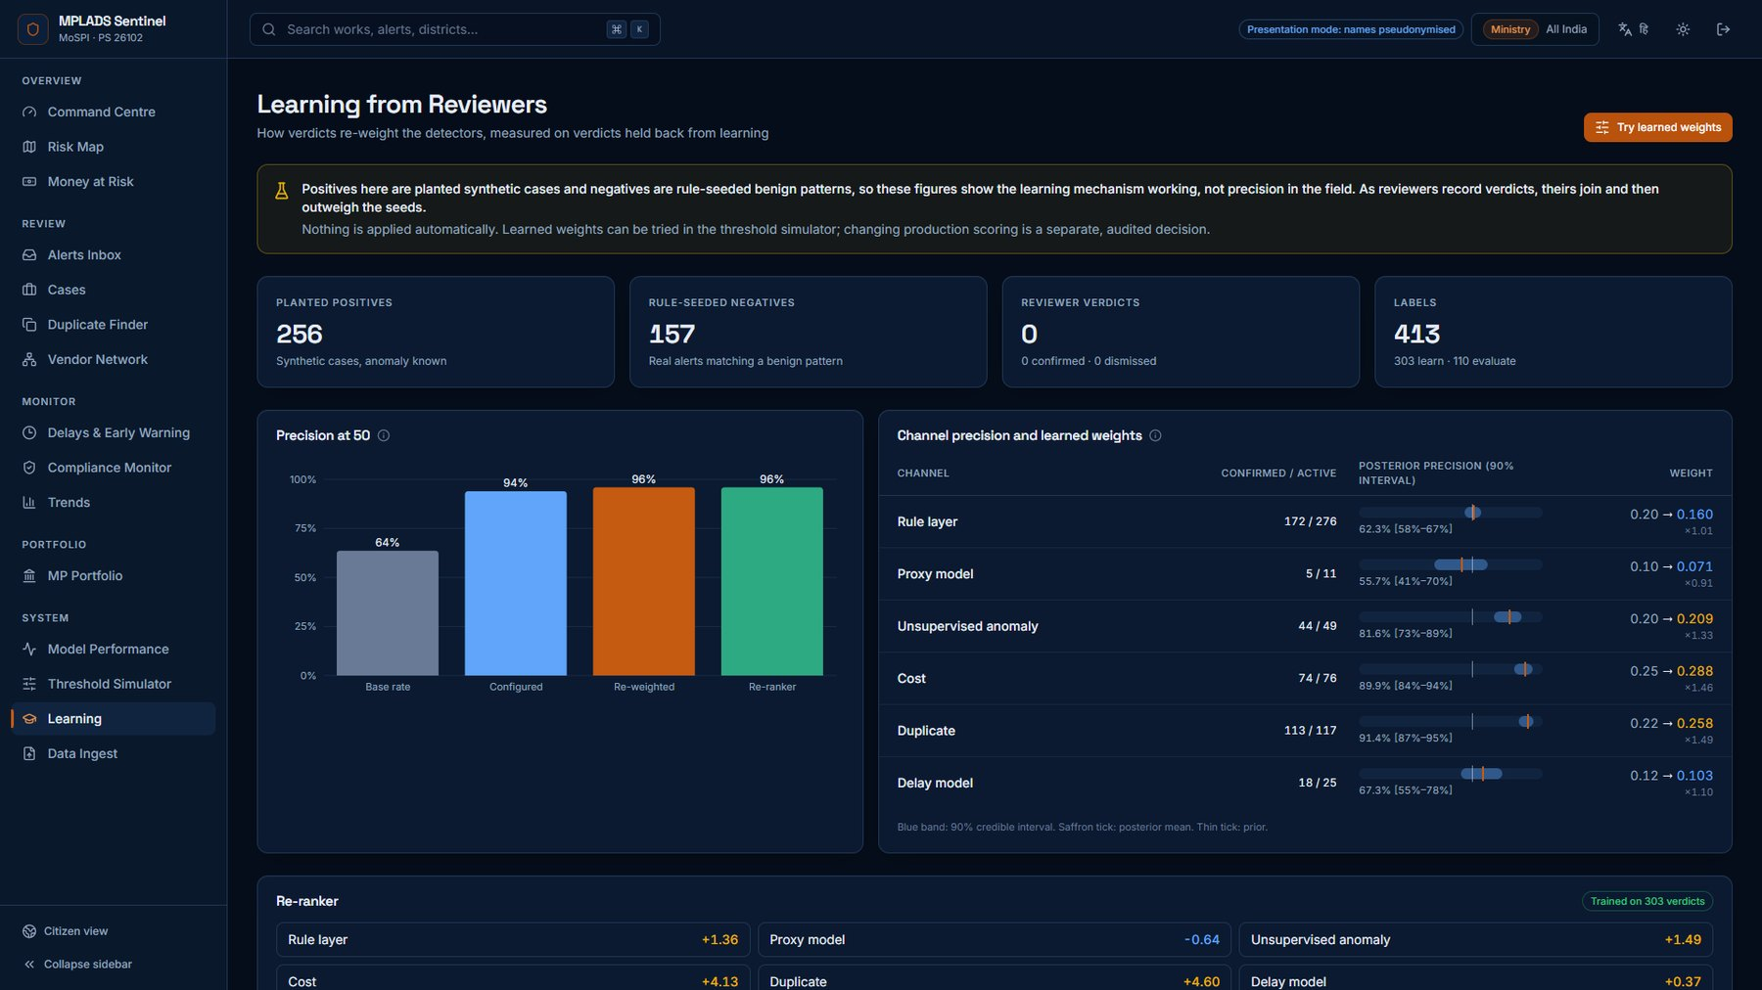
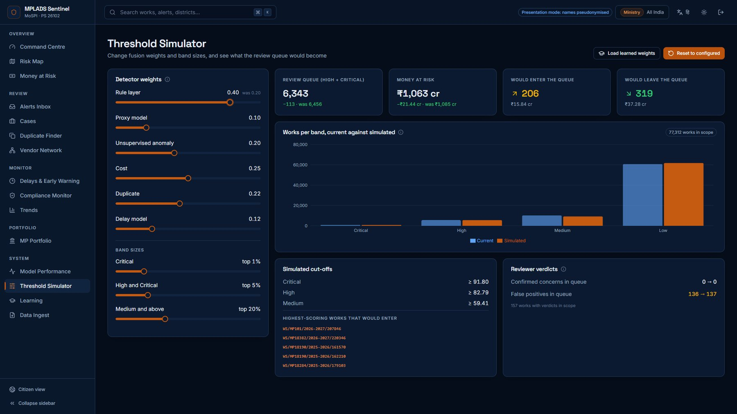
LEARNING FROM REVIEWERS
Verdicts re-weight detectors, measured on held-back labels
▸ On 110 held-back labels, precision at 50 is 0.94 with configured weights and 0.96 with the re-ranker (base rate 0.64).
▸ Labels so far are planted synthetic cases and rule-seeded benign patterns: this shows the mechanism, not field precision. Nothing is applied automatically; the threshold simulator shows what a change would do first.
MPLADS Sentinel · SIH 2026 · PS 26102 · Risk indicators for review, never findings of fraud
9
Notes:
Be careful with the wording here: the precision is on planted and seeded labels. Real verdicts replace them as reviewers work.

Slide 10
HOW WE MEASURED
Planted anomalies, judged in each detector's own queue
Detector | Fired on planted | Found in top 5% of queue | Top 10%
Inflated cost | 97% | 79% | 95%
Implausibly fast completion | 100% | 100% | 100%
Duplicate works | 73% | 45% | 55%
Split work | 46% | 5% | 46%
▸ Proxy-label model PR-AUC 0.94: it learns the dataset's hand-written rule label, not verified fraud, so this measures learnability of rules.
▸ Expected-cost model: typical error 1.4x, R² 0.77, out of fold.
▸ Global top-5% recall targets from step 2b were not met for any detector; per-queue recall is the fair measure and is reported as it is.
Injection recall shows detector sensitivity to anomalies of the patterns we planted. Planted cases are cleaner than real ones, so these are an upper bound on how obvious such cases are, not a fraud detection rate.
MPLADS Sentinel · SIH 2026 · PS 26102 · Risk indicators for review, never findings of fraud
10
Notes:
This slide is where we earn trust. Read the split-work row aloud and the proxy caveat.

Slide 11
ACCOUNTABILITY AND PRIVACY
Built for a public repository and a public audience
Presentation mode
Audit trail
MP and vendor names become stable pseudonyms; beneficiary names and phone numbers in descriptions are masked. Every screenshot here was taken in it.
Every status change, verdict, note, export and brief is appended to a SHA-256 hash chain; editing, deleting or re-hashing any event is detected.
Citizen view
Framing
Public and read-only: what was sanctioned, spent and completed by district. No scores, no flags, no work ids.
Alerts are hypotheses for review. MP views describe implementation by executing agencies. No rankings of people.
MPLADS Sentinel · SIH 2026 · PS 26102 · Risk indicators for review, never findings of fraud
11
Notes:
Mention the citizen view with a live click if time allows.

Slide 12
LIMITS AND NEXT STEPS
What we would do with the ministry's data
LIMITS
NEXT
▸ Split-work detection flags 46% of planted groups: needs vendor identifiers and sanction-authority limits.
▸ Vendors are identified by name only (no PAN or GSTIN), so network links are name similarity.
▸ The extract has no release ledger or entitlement: fund flow and lapse are labelled estimates.
▸ No verified fraud labels: every model learns patterns or proxies, never ground truth.
▸ Link PFMS payments and sanction orders to close the ledger gaps.
▸ Collect reviewer verdicts in pilot districts; retrain the re-ranker on them.
▸ Add geotagged photos for completion checks on fast-completed works.
▸ Deploy behind government SSO with the same role scopes.
MPLADS Sentinel · SIH 2026 · PS 26102 · Risk indicators for review, never findings of fraud
12
Notes:
End on what is genuinely open. Judges respect a team that knows its weak spots.

Slide 13
Thank you
MPLADS Sentinel: risk indicators for review, with the evidence attached.
Live demo: demo.ps1 · Citizen view: /public
Notes:
Switch to the live demo.

