Slide 1


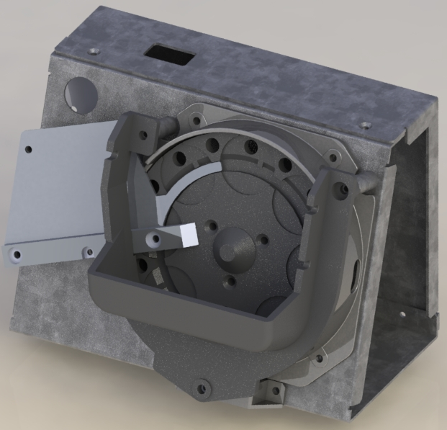
Technical Specifications
KnY-100
Coin feeder
Dimensions(W x D x H mm) | 200mm x 160mm x 158mm
Weight | 3 kg
Hopper Capacity | 50 Coins
Diameter Of Feederable Coins | 15 mm ~ 31 mm
Thickness of Feederable Coins | 1 mm ~ 3 mm
Speed | 250 Cpm (Mixed Coin)
Power | 24 Vdc
Communication Protocol | RS-232 to USB
Operating Temperature | +10 ℃ <> +45 ℃
Trouble-Free ! Low Cost !

