Slide 1
Partek Analysis
Notes for Kane

Slide 2
QA/QC
 | Recommended: Partek | Bioinformatician | Used
Counts | 600-15000 | >300 | 400-15000
Detected Features | 500-4000 | >300 | 300-4000
% Mitochondrial Counts | 0-10% | <10% | 0-10
Steps:
QA/QC
For the counts: the software did not allow a minimum of 300
Noise reduction
Normalisation

Slide 3
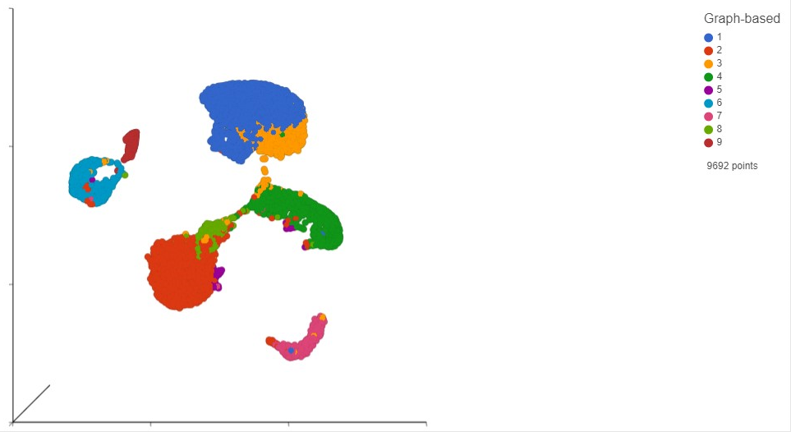
UMAP
9 clusters

Slide 4
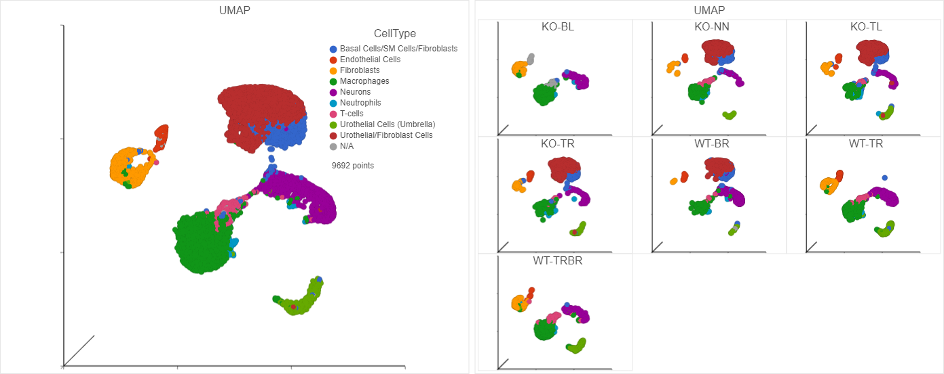
Cell Annotations
Annotated by mostly referring to the PanglaoDB database (searched against mouse and also (if present) specifically for bladder tissue datasets)
The urothelial/fibroblast cluster (dark red) also had proliferative markers and thus could be tumor cells
Human PSA cannot be searched under partek due to alignment with mouse
Couldn’t find k-ras or male HY antigen (smcy)
Could not find GSTT2 expression

Slide 5
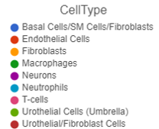
UMAP (by sample)
Outlier Samples?
One of the KO samples (KO-BL) looks different to the other KO samples
One of the WT samples (WT-BR) looks different to the other WT samples
However, the recommendation was that these samples should not be discarded based on UMAP

Slide 6
UMAP (by sample)
The urothelial/fibroblast cluster (dark red) is likely to be/contain the tumor cells
If it is tumor cells, why is it missing from 3 mice (KO-BL, WT-TR and WT-TRBR)?
Based on urinary PSA its hard to determine if the ss-RNAseq aligns with tumor burden due to inconsistent data and low urine volume
However, based on bladder weights, the data makes more sense
The samples for which the tumor cell cluster (dark red) is missing (KO-BL, WT-TR and WT-TRBR) have the lowest bladder weights (highlighted)
Sample | Urinary PSA | Bladder Weight
KO-BL | No data | 0.0034
KO-NN | 0.35 | 0.2488
KO-TL | 0.73 | 0.0467
KO-TR | 15.05 | 0.0545
WT-BR | 0.01 | 0.0898
WT-TR | 0.26 | 0.0067
WT-TRBR | No data | 0.0053

Slide 7
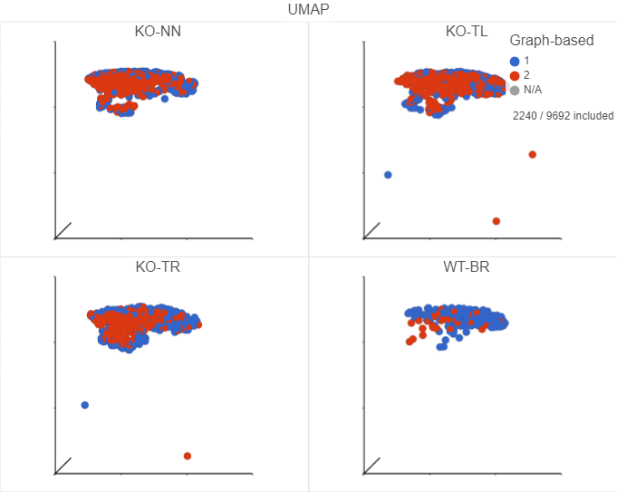
Cluster 1: Urothelial/Fibroblasts
Further sub-clustering of the urothelial/fibro (+tumor cells) cluster shows differences between the WT sample and the three KO samples
The samples may not have been exchanged/outliers and instead it is just due to differences in tumor burden between the mice
Thus if the KO-BL and WT-BR were to be removed, only KO mice would have the ‘tumor cluster’ and therefore any comparison between WT and KO would be confounded
We would be comparing tumor vs. non tumor instead of WT vs KO

Slide 8
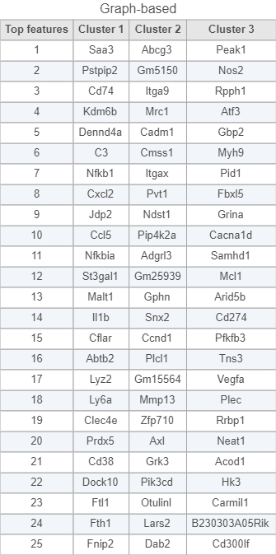
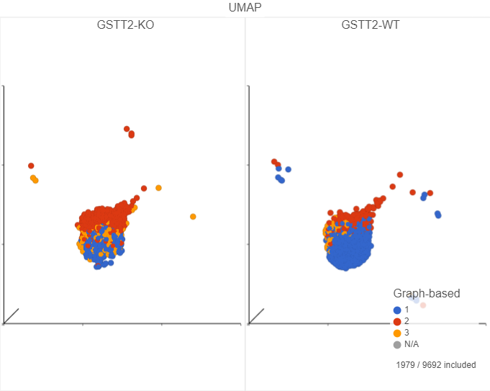
Subclustering
Macrophages (but not neurons/T-cells) could be subclustered

Slide 9
Next steps:
Final analysis to be done with all samples
Main data to obtain:
Top differentially expressed genes between WT and KO samples (independent of cluster)
Kegg analysis WT vs. KO (independent of clusters)
Top differentially expressed genes between WT and KO samples within individual immune clusters (we mainly want to do macrophages)
Sub-clustering of macrophages

