Slide 1

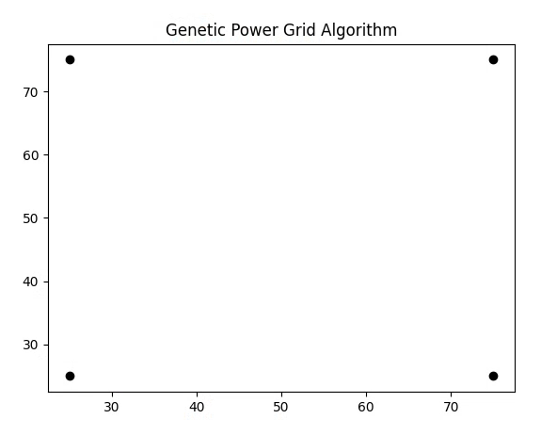
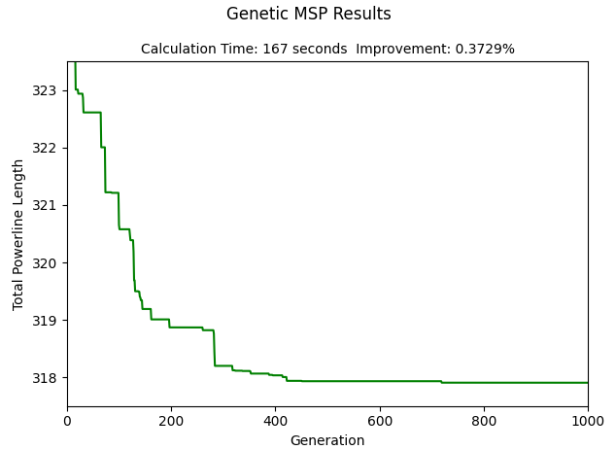
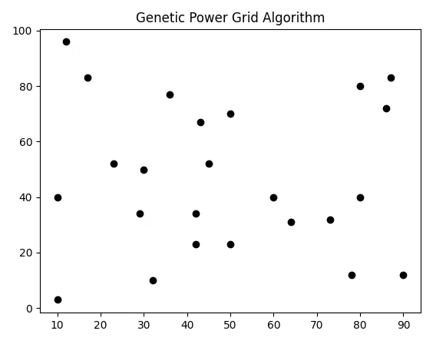
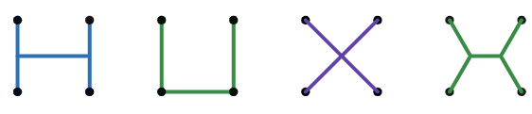
Genetic algorithms
Initialization
Evaluation
Selection
Crossover
Mutation
Criteria not reached
3.000 3.000 2.828 2.732

