Slide 1


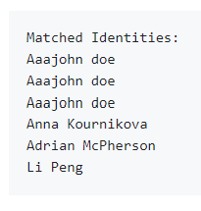

EXTRACTION SERVICE
Preprocessing
Scale, resize, and normalize the input image
Embedding
Select model, create embedding
STORAGE
RETRIEVAL SERVICE
Catalog
FAISS index & Metadata
FAISS INDEX
Create load and save Faiss Index
Gallery
Images of people
SEARCH
Search Index Given Embedding

Slide 2
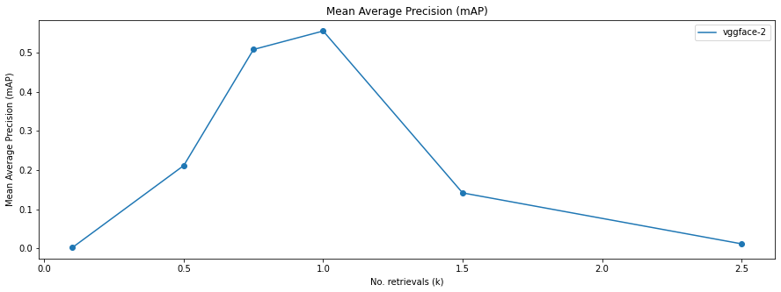
blur intensity

