Slide 1


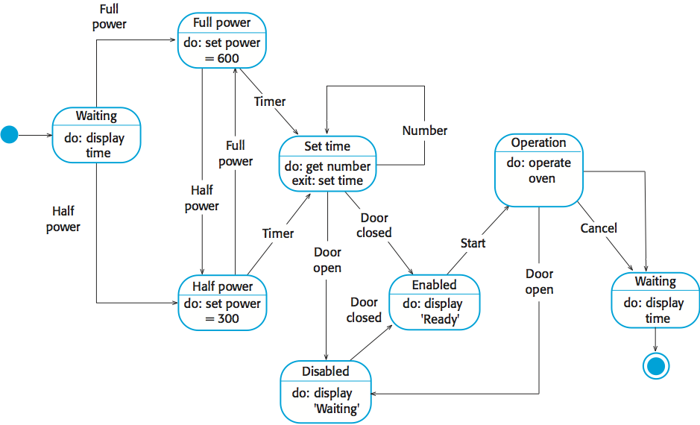
Research: A short summary of your research providing key related works; Be critical. Use appropriate citation.
UFCFXK-30-3: Digital Systems Project
Student name:
Project Title:
A QR Code link to your video submission
Abstract:
The abstract includes a short description of the project. It should not exceed one paragraph. Ideally, it should summarise the key points of your project including the project idea and scope.
Design, Implementation & Testing
State Diagram
Aims and objectives:
A very short description of the aims of the project and an outline of the objectives.
e.g. The project objectives are:
…
…
…
…
Implementation artefacts (if any)
Can include other diagrams that verify the implementation process (e.g. class diagram etc.)
or
A screenshot of your GUI or ‘code output so far’ or similar
Testing
Details regarding your testing strategy
Planning and Management: This section will include your planning and management.
Key requirements:
Provide key requirements with short description if required.
Functional
The application must allow the user to switch between multiple object detection models( Faster R-CNN, YOLO)
The system must generate image and video data predictions based on the chosen model and dataset.
The application must provide LIME analysis for object detection models.
The application must allow users to focus on specific labels in single- and multi-class object detection settings.
The application must provide Layer-Wise LIME for more detailed explainability.
The application must allow users to focus on specific labels in single-class and multi-class detection settings
Users must be able to upload and select from multiple datasets for analysis.
Use should be able to save or export the generated explanations.
The user should be able to adjust key parameters, such as the number of perturbations in LIME or the layers to analyse in Layer-wise LIME
Non-functional
The tool must have a user-friendly interface.
The tool must ensure consistency in LIME and Layer-wise LIME.
The tool must be able to handle errors, providing clear error messages and logs for troubleshooting.
The tool should be compatible with both CPU and GPU environments
The tool must allow users to customise the visualisation of predictions and explanations (e.g., colour schemes, bounding box styles)
The tool should maintain a consistent performance level for datasets with varying sizes and complexities
References: References and citations should be in UWE Harvard style

