Slide 1
Medical Insurance Cost
Analysis & Prediction
Data Analytics using Python, AI & Machine Learning
YOUR
PHOTO
1,338
individuals
7
variables
0.984
Random Forest R²
Presenter: [Your Name]
Problem: understand factors associated with medical insurance charges and predict expected costs.
Medical Insurance Cost Analysis | Graduation Presentation | 1

Slide 2
1. The Data
Dataset and preparation
1,338
observations
7
variables
0
missing values
0
duplicates
• Target variable: charges — a continuous numerical value.
• Inputs: age, sex, BMI, children, smoker and region.
• The prepared dataset was checked before modelling.
Key features
• age — age of individual
• sex — categorical
• bmi — body mass index
• children — dependents covered
• smoker — smoking status
• region — residential region
• charges — target
Medical Insurance Cost Analysis | Graduation Presentation | 2

Slide 3
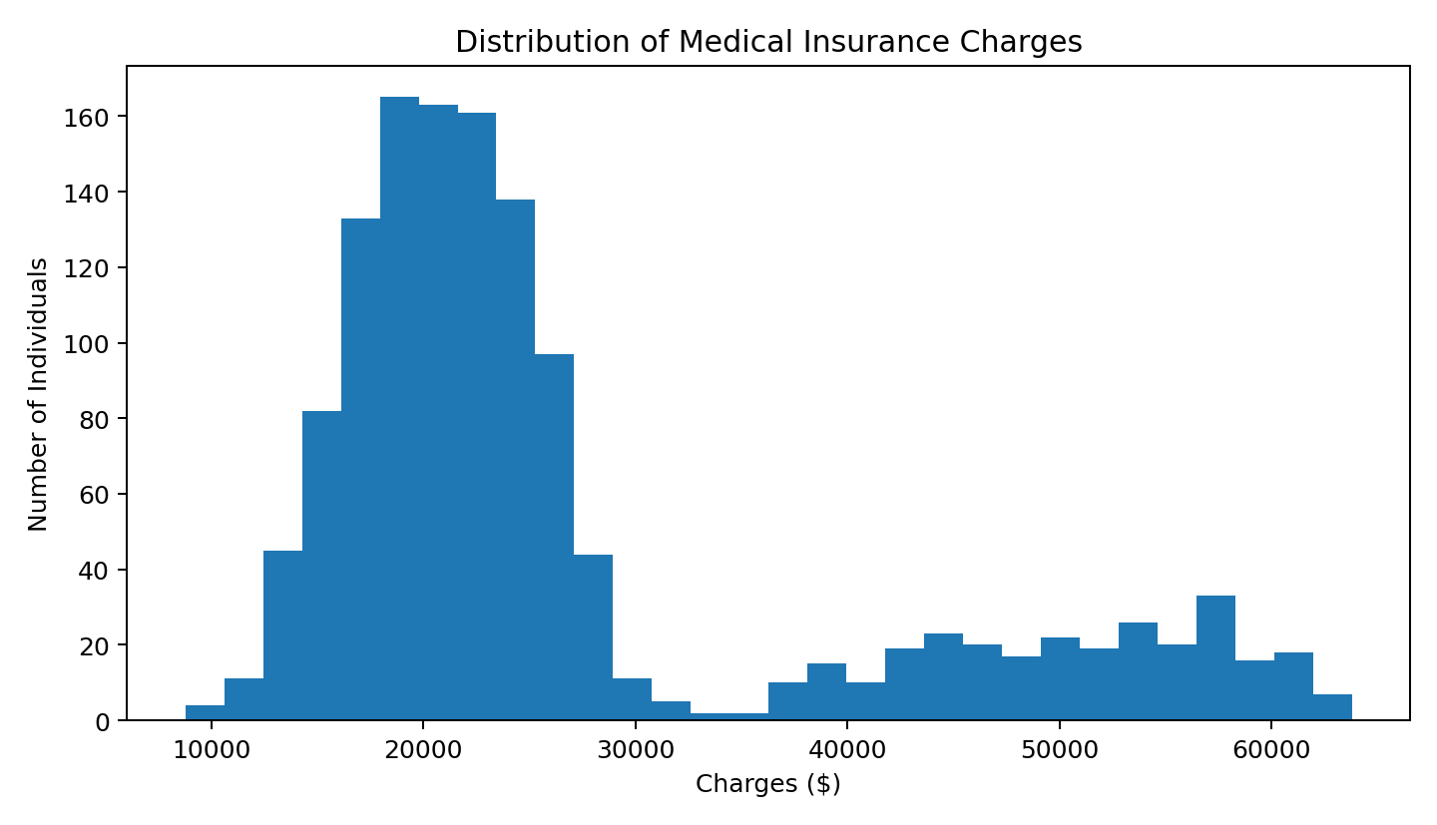
2. Visualization — What Did We Find?
The distribution of medical charges
Charges are right-skewed: most individuals are in the lower and middle cost range, while a smaller group has much higher charges.
$26,948
mean charge
$22,391
median charge
• The mean is above the median.
• High-cost observations pull the average upward.
Medical Insurance Cost Analysis | Graduation Presentation | 3

Slide 4
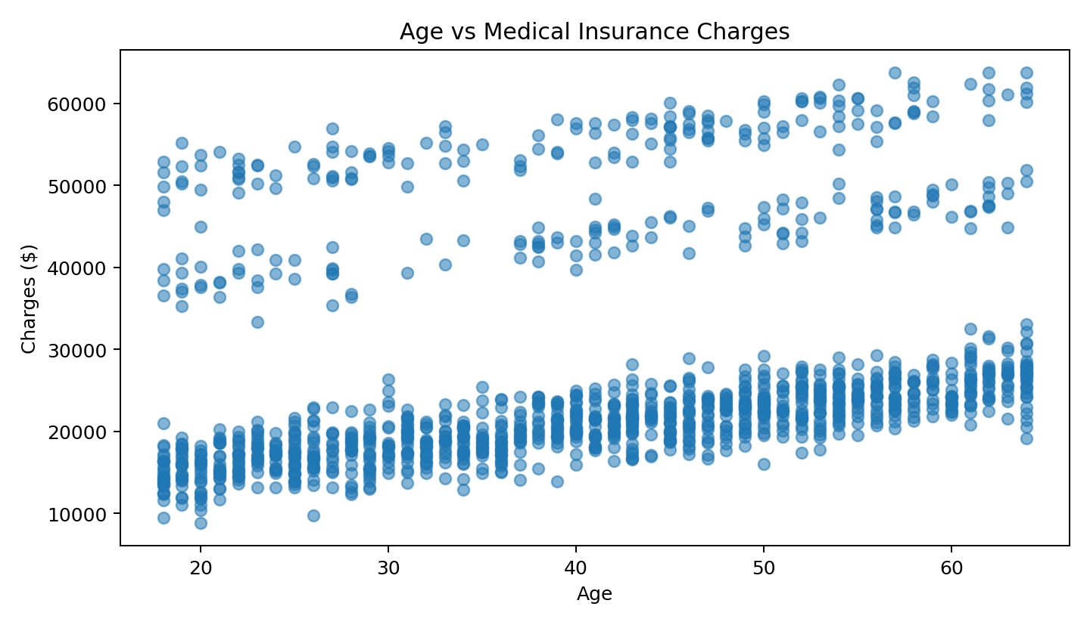
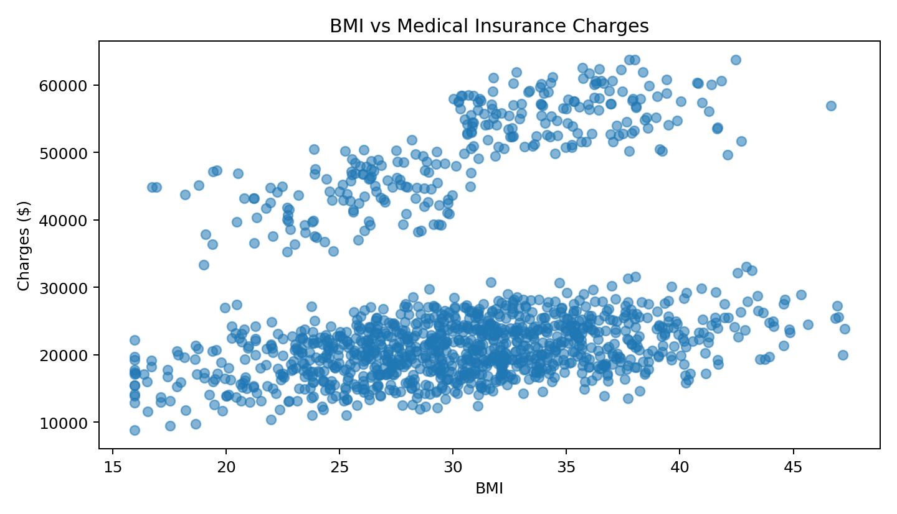
2. Visualization — Relationships & Key Finding
Looking beyond simple averages
Age vs charges: r ≈ 0.26
BMI vs charges: r ≈ 0.21
Both are weak positive relationships.
Smoking status showed the strongest observed difference:
Non-smokers ≈ $20,780 | Smokers ≈ $50,466 | ≈2.4× higher
Medical Insurance Cost Analysis | Graduation Presentation | 4

Slide 5
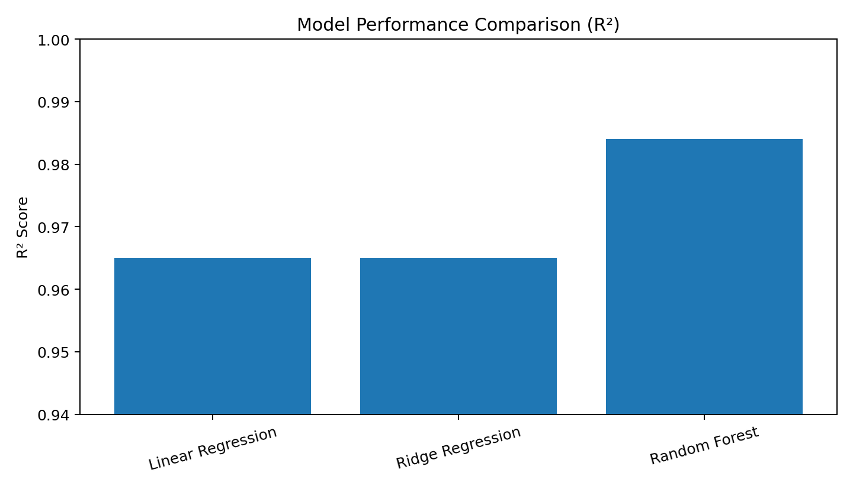
3. Prediction Model
From exploration to machine learning
• Regression was selected because charges are continuous.
• The model uses age, BMI, children, sex, smoking status and region.
• I compared Linear Regression, Ridge Regression and Random Forest.
• Random Forest combines many decision trees and averages their predictions to capture non-linear patterns.
Test-set R² comparison
Linear Regression: 0.965 | Ridge: 0.965 | Random Forest: 0.984
Medical Insurance Cost Analysis | Graduation Presentation | 5

Slide 6
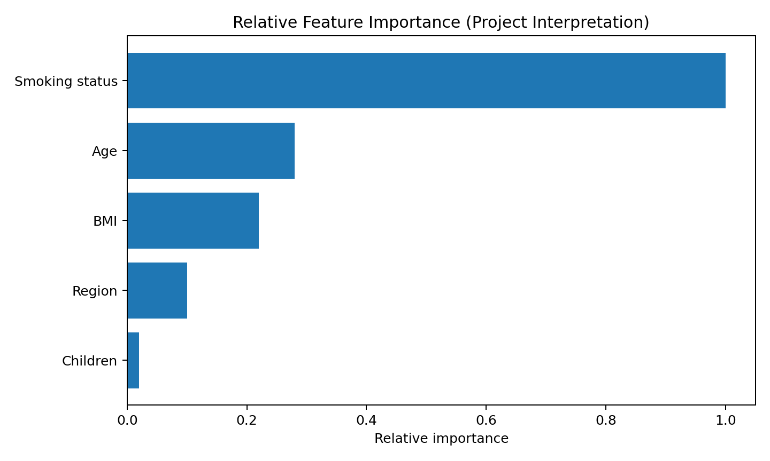
4. Results, Reliability & Discussion
How well did the model perform?
$1,297
Random Forest MAE
$1,643
Random Forest RMSE
0.984
test R²
0.982
5-fold CV mean R²
• MAE measures the typical absolute prediction error.
• RMSE penalizes larger errors more strongly.
• R² describes the proportion of variation explained by the model.
• Five-fold cross-validation produced a mean R² of 0.982, close to the 0.984 test R².
• Accuracy, precision and recall are classification metrics; this project predicts a continuous charge, so MAE, RMSE and R² are the appropriate reported metrics.
• K-Means identified four broad customer segments.
Improvement: validate the workflow on additional datasets and continue tuning the model.
Medical Insurance Cost Analysis | Graduation Presentation | 6

Slide 7
5. Closing — Key Findings
From raw data to machine-learning insight
≈2.4×
higher average charges for smokers
0.984
Random Forest test R²
0.982
5-fold CV mean R²
4
K-Means segments
• Smoking status showed the strongest observed difference in charges.
• Age and BMI showed weaker positive relationships.
• Random Forest gave the strongest test-set performance among the three models compared.
• Cross-validation supported the consistency of the model result.
• The project demonstrated a complete analytics workflow: data preparation → visualization → modelling → evaluation → segmentation.
Thank you — Questions?
Medical Insurance Cost Analysis | Graduation Presentation | 7

