Slide 1


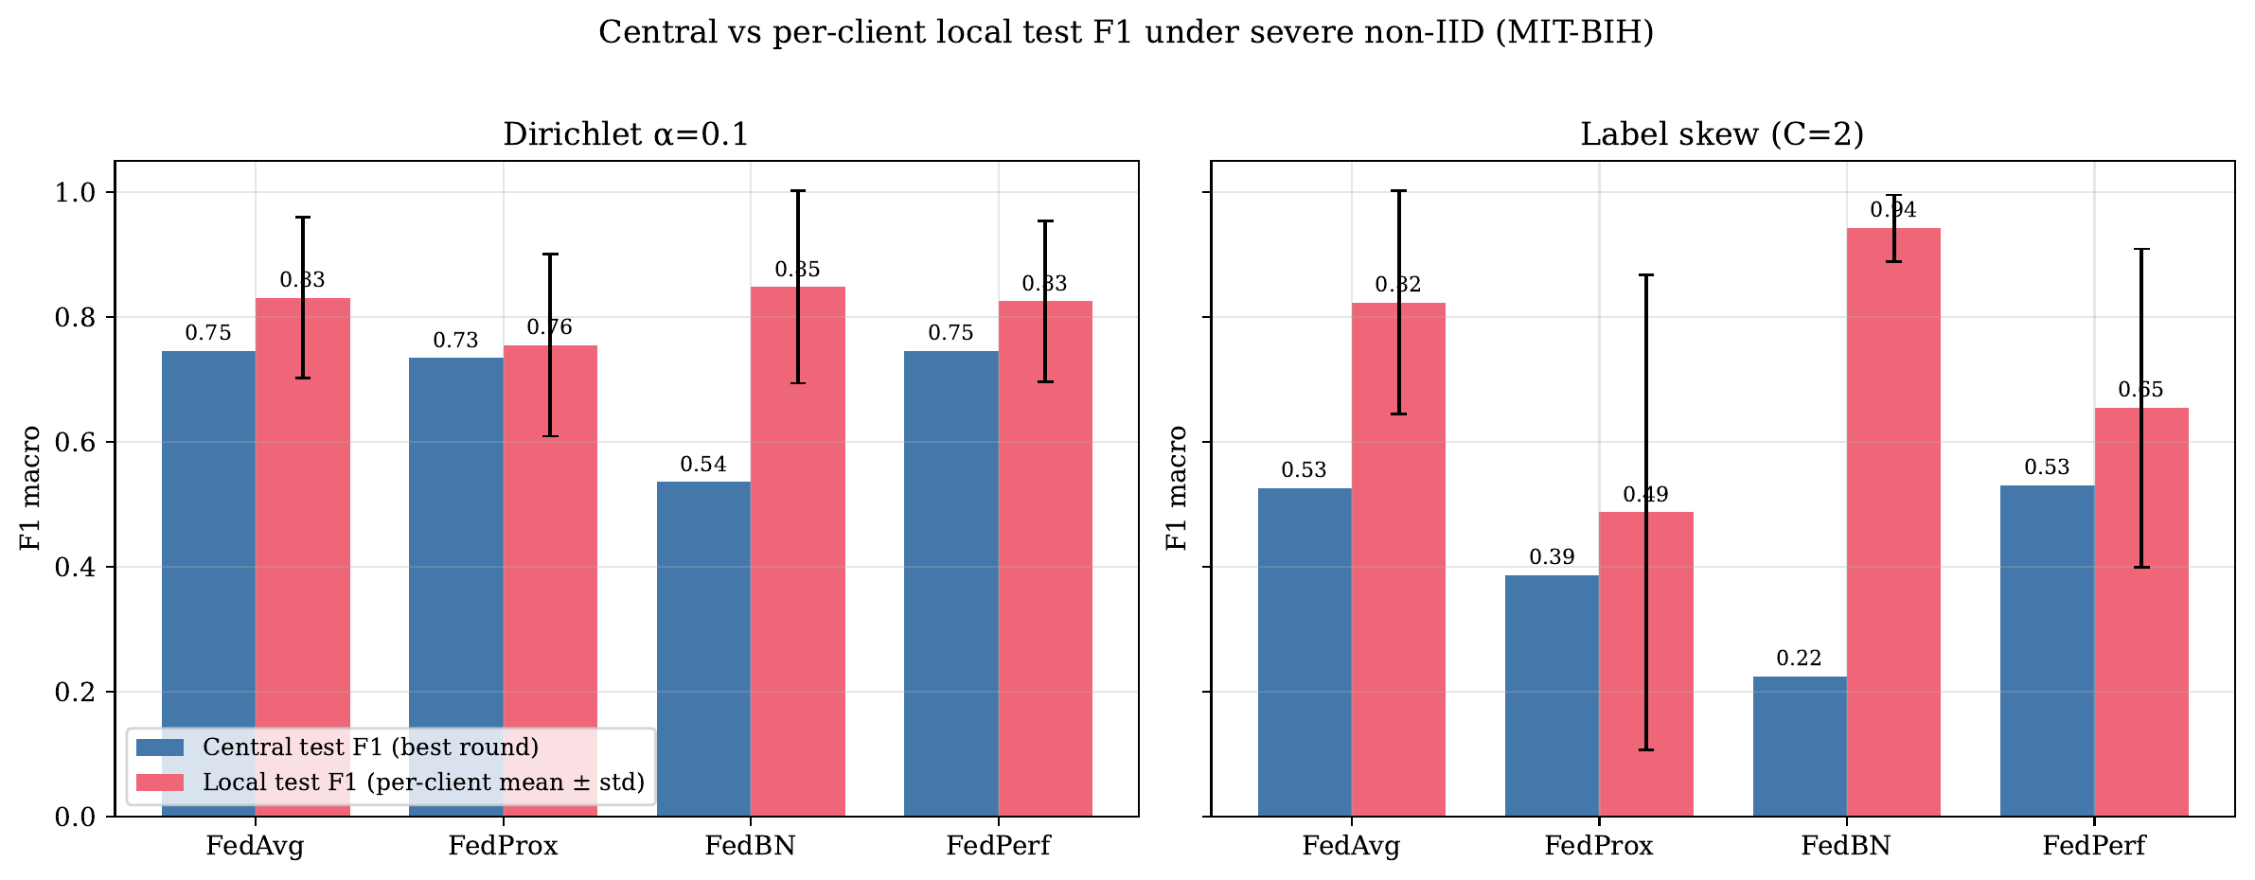
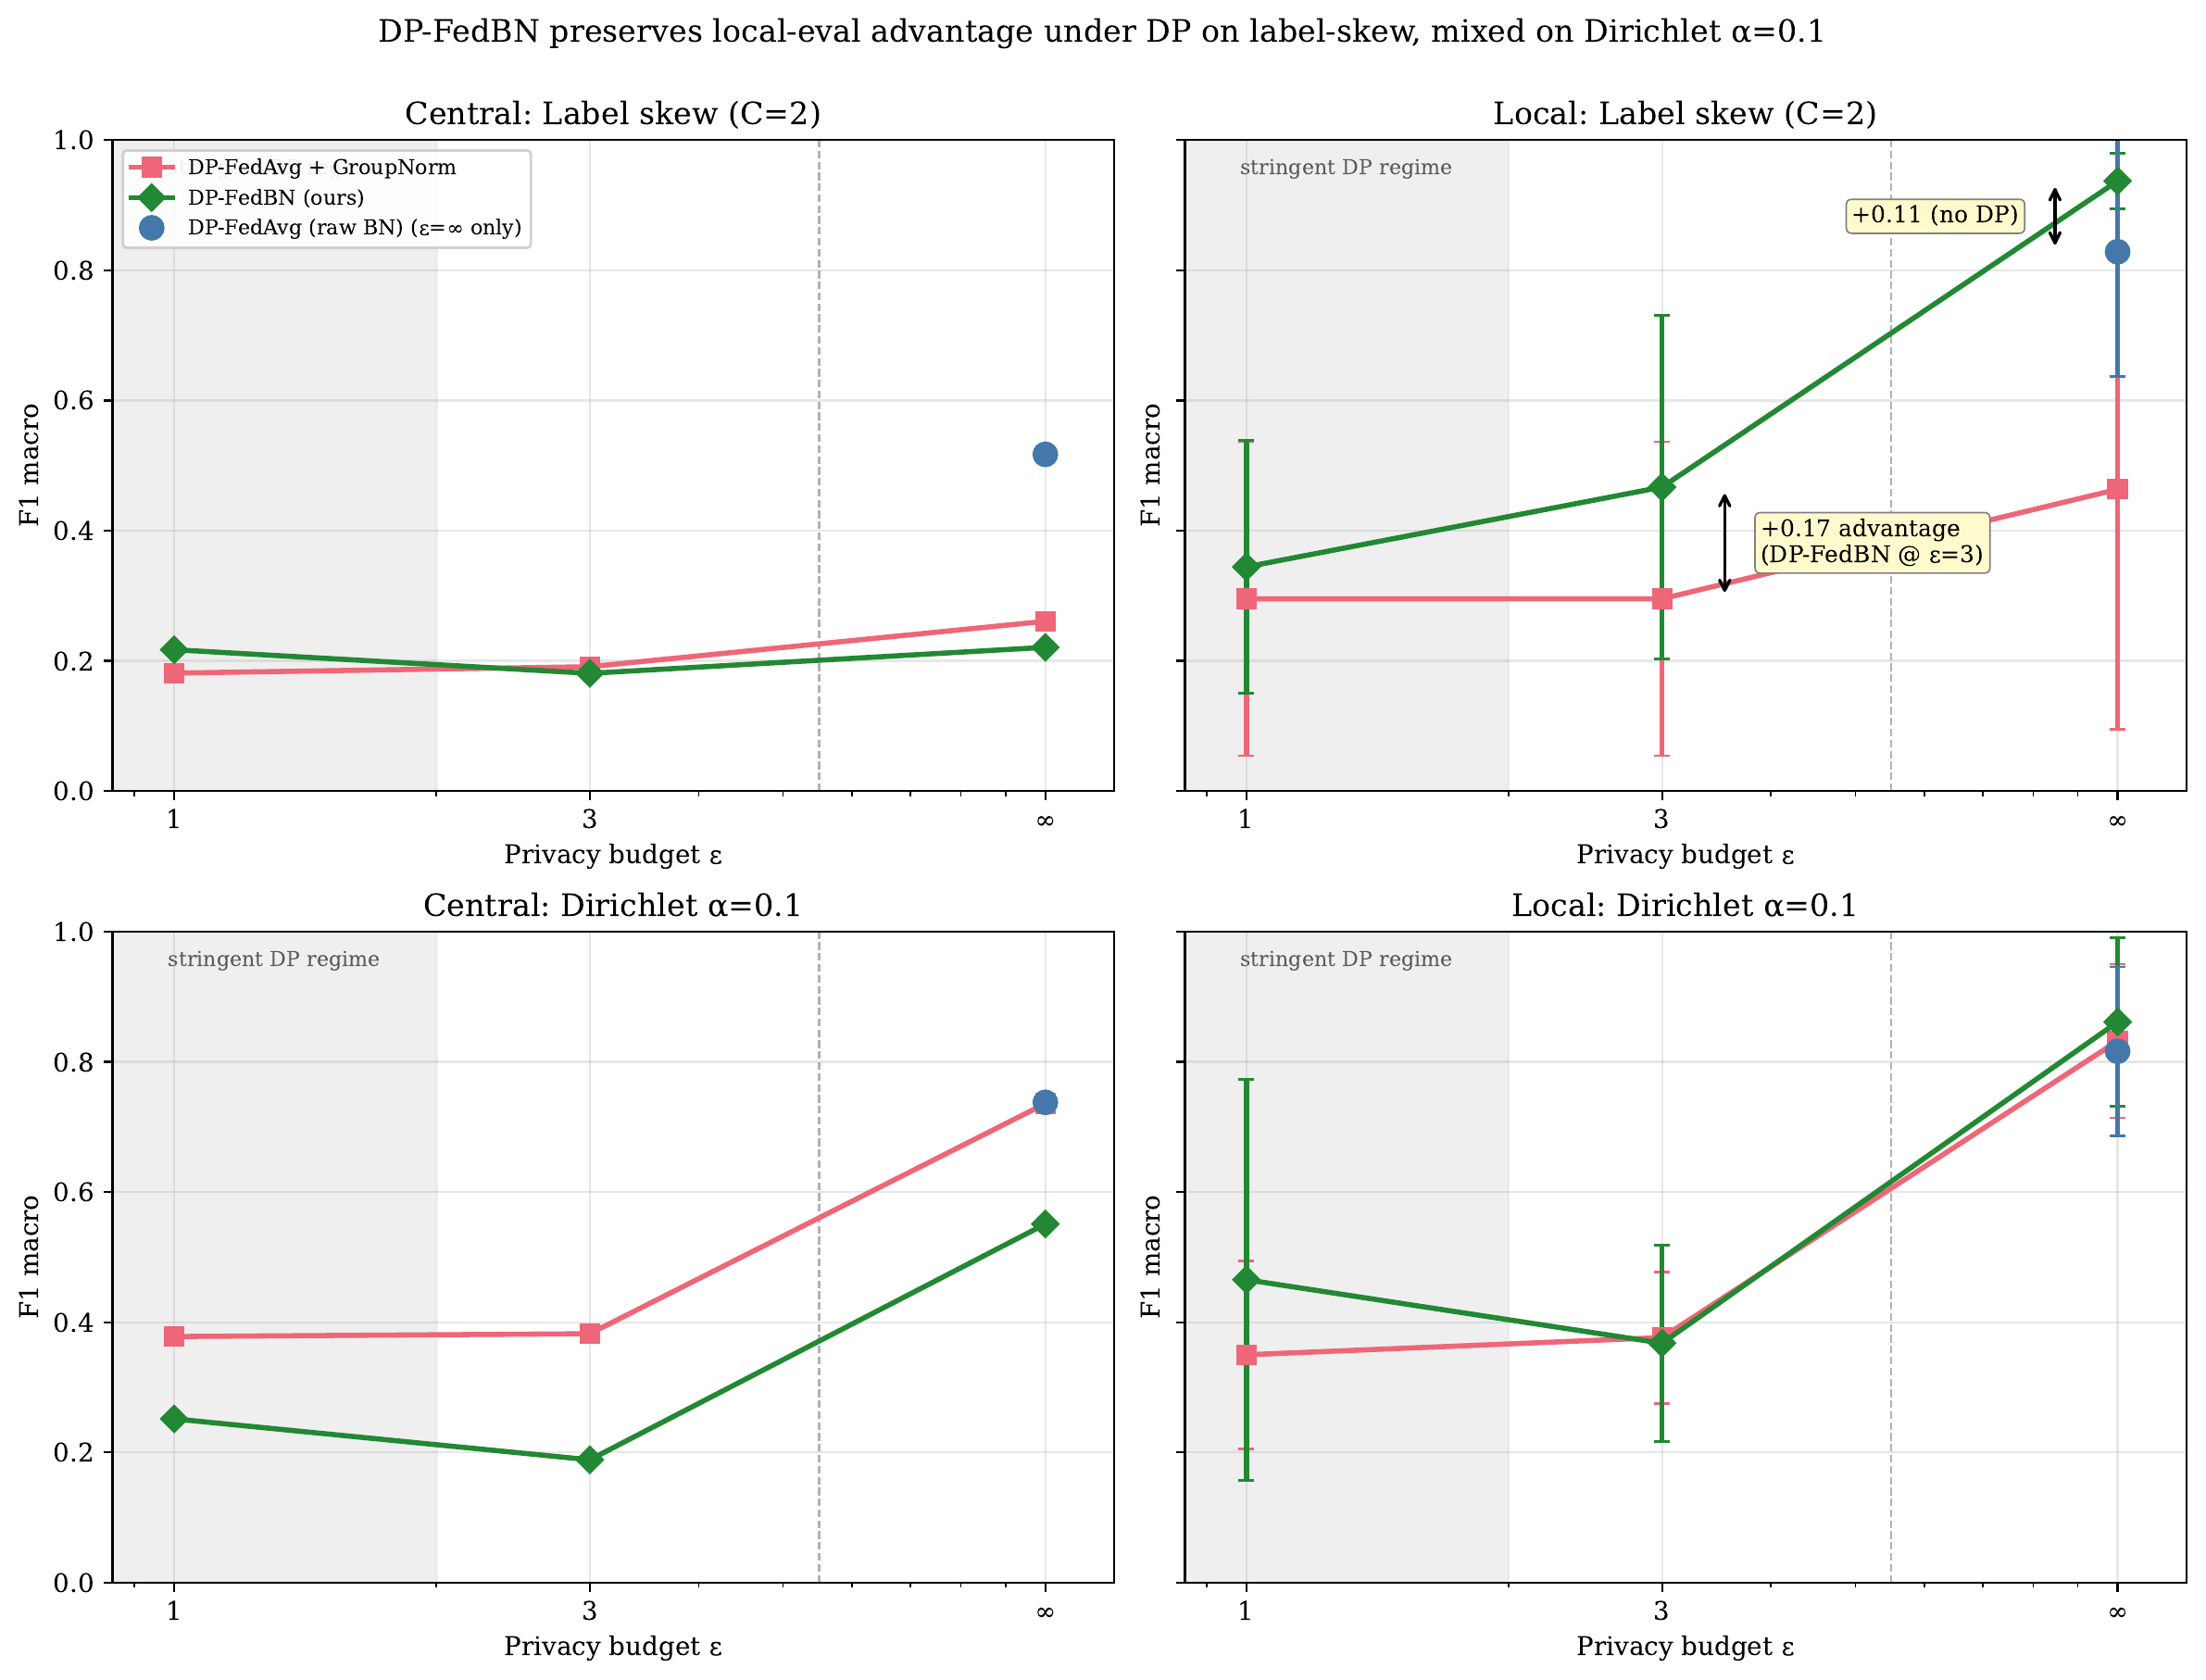
EGE ÜNİVERSİTESİ
Mühendislik Fakültesi · Bilgisayar Mühendisliği Bölümü
When Does Federated BatchNorm Help under Differential Privacy?
An Eval-Regime Characterization of DP-FedBN on Medical ECG Classification
Efe Deniz Bağlar · Advisor: Prof. Dr. Hasan Bulut · İzmir 2026
1. Introduction — The BatchNorm–Privacy Tension
4. Result 1 — The Eval-Regime Flip is Task-Agnostic
• Federated learning (FL) trains models across hospitals without sharing patient data; differential privacy (DP-SGD) adds a formal guarantee to the updates that are shared.
• FedBN keeps each client's BatchNorm (BN) statistics local — a per-site domain adapter that is the key to non-IID medical data.
• But BN is incompatible with DP-SGD: per-sample gradients are ill-defined, and Opacus's ModuleValidator refuses any model containing BatchNorm.
• The standard fix — replace BN with GroupNorm — removes the very mechanism FedBN depends on.
• Question: can we keep FedBN's personalization and satisfy record-level DP — and when does it actually help?
• On severe non-IID, FedBN ranks worst on pooled-central F1 but best on per-client local F1.
• MIT-BIH label skew C=2: FedBN central 0.224 (lowest) vs. local 0.942 (highest) — a +0.72 flip.
• Replicates on PTB-XL (different task): FedBN−FedAvg = −0.116 central / +0.123 local — task-agnostic.
2. Method — DP-FedBN (Dual-Optimizer)
Central (blue) vs. per-client local (red) macro-F1 on MIT-BIH. FedBN: lowest central, highest local.
• Key idea: BN parameters and running statistics never cross the federation boundary, so they need no DP. Apply DP-SGD only to the parameters that are actually shared.
• Per client, each round:
– Freeze BN → Opacus's ModuleValidator now accepts the model (freeze-then-unfreeze trick).
– opt_A (AdamW + Opacus PrivacyEngine): non-BN params → per-sample clipped + Gaussian-noised (DP-SGD).
– opt_B (plain AdamW): BN params → updated locally, no DP.
– Server: FedAvg-average non-BN params; BN stays local (FedBN rule).
• Gives record-level (ε, δ)-DP on everything that leaves the client while preserving FedBN's per-client BN.
• First record-level DP-SGD composition of FedBN with explicit Opacus engineering (vs. the party-level Laplace "DP-FedBN" mention in ADCOL, ICML'23).
5. Result 2 — Under DP, the Edge is Partition-Dependent
• Naive DP-FedAvg on a BN model is structurally impossible — Opacus REFUSES it at every finite ε. This motivates DP-FedBN.
• Label skew (specialty-clinic regime): DP-FedBN keeps a +0.17 local-F1 edge over GroupNorm at ε=3 (+0.05 at ε=1).
• Dirichlet α=0.1 (proportional skew): edge vanishes/reverses (PTB-XL −0.234 at ε=3) — GroupNorm wins. DP noise hits per-client BN with no cross-client averaging to smooth it.
3. Experimental Setup
• Datasets: MIT-BIH Arrhythmia — 109,453 beats, 5-class AAMI, 360 Hz; PTB-XL — 21,388 records, binary Normal/Abnormal, Lead II, 100 Hz.
• Model: 4-block 1D-CNN, ~437k params, 5 BatchNorm modules. K = 5 clients, AdamW, batch 96.
• Non-IID partitions (6): IID, quantity skew, Dirichlet α ∈ {1.0, 0.5, 0.1}, label skew C = 2.
• Privacy: ε ∈ {1, 3, ∞}, δ = 1e-5, clip C = 1.0, Opacus 1.5. Methods: DP-FedAvg (raw BN), DP-FedAvg+GroupNorm, DP-FedBN.
• Two eval regimes: Central F1 (pooled holdout) vs. Local F1 (per-client). ~40 configurations, single seed (42).
Privacy–utility frontier (MIT-BIH). DP-FedBN (green) keeps a clear local edge on label-skew at ε=3; mixed on Dirichlet.
6. Conclusions & Practitioner Rubric
• The eval-regime flip is real and task-agnostic — always report both central and local F1.
• Rubric: label-truncated sites (specialty clinics) + local deployment → DP-FedBN; proportional case-mix (general hospitals) → DP-FedAvg+GroupNorm; strict pooled-central requirement → FedAvg/FedPerf, not FedBN.
• Limitations: single seed, 5 clients, ECG-only, fixed CNN. Repro: github.com/kanemoda/MedicalFL · Opacus 1.5 · PyTorch 2.4.
Notes:
<number>

