Slide 1
Using Synthetic Control Arms to Improve Clinical Trials
Steven Schwager
Medidata Solutions
Joint work with Antara Majumdar, Medidata Solutions
R/Medicine 2019 – September 14, 2019

Slide 2
Content Outline
Introduction
Data Standardization
Frequentist SCA
Bayesian SCA
Illustrative Example

Slide 3
RCT as the Gold Standard
RCTs require a certain number of patients be enrolled in treatment and control arms
Learn from accumulated data
Accumulation of Clinical Trial Data over Time
Getting the objective number of patients to enroll in the control arm can pose ethical and/or operational challenges.
Notes:
RCTs have served as gold standard for evaluating new treatments against a placebo control or a standard of care. Over the years, that has lead to accumulation of large volumes of data on patients who received placebo control or standard of care under similar clinical and prognostic conditions. Which in turn, has presented us with the opportunity to collectively learn from accumulating data. And I am going to refer to that as historical clinical trial data.

Slide 4

A Synthetic Control Arm (SCA) is an alternative to an active control arm in a clinical trial
SCA is constructed from individual patient-level data collected from sources outside of the current clinical trial
Notes:
One way of solving this problem, is to use data from previous clinical trials that address similar research objectives and have patients who meet similar inclusion/exclusion criterion.
Likely to improve scientific rigor and contribute to increase in efficiency in the turnaround time required to get life altering treatments to patients.

Slide 5


Using RCTs to Construct an SCA
Trial 1 Trial 2 Trial 3 Current Trial
Treat1 Treat2 Treat3 Treat4
SoC1 SoC2 SoC3 SCA
SoC = Standard of Care
Patients randomized to TreatI or SoCI for I=1,2,3

Slide 6
SCAs Add Value to Drug Development
SCAs can be useful for:
Early clinical development go/no-go decisions
Confirmatory single arm trials
Accelerated approval trials
Trials when RCTs are compromised by availability of experimental product outside the current trial
Notes:
Reduce false-positives

Slide 7
Data Sources for SCA
Real World Data
Historical Clinical Trial Data
Data features:
Regulatory quality is present by design
Endpoints are well-defined
Finding novel biomarker data can be challenging
Data features:
Unknown data quality & missing data can be problematic
Non-standard endpoints can be constructed
Initial number of patients is large (Big Data)
Synthetic Control Arm (SCA)

Slide 8



Creating a Disease-Specific Control Data Set: SCA
Archive of Studies
Candidate Studies
Control Patient Pool
Match & Compute
Results
Medidata:
17K Studies
>4.7M Patients
Standardize
Population Attributes
Treatment vs Control
Response Rates
Survival Curves
Adverse Event Frequencies
Bivariate Correlations
Filters for Dynamic Subgroup Analyses
Current 1-arm Study in Disease X
Inclusion / Exclusion
Experimental patients from archive
Control patients from archive
Sponsor’s Specific Indication, Line of Therapy...
Experimental patients from current study
Sponsor’s Requirements

Slide 9
Frequentist SCA
Select historical patients who match current trial patients on relevant baseline characteristics
Post-matching, perform analysis as usual; compare treatment to control results
Matching methods available: Propensity Scores, IPTW (Inverse Probability of Treatment Weighting), Mahalano-bis Distance, Gradient matching, Instrumental variable

Slide 10
R Computation for Frequentist SCAs
Matching on propensity scores, Mahalanobis distance, nearest neighbor, caliper, more – options in R include:
MatchIt https://gking.harvard.edu/matchit
Ho, Imai, King, & Stuart, 2011, J Stat Software, MatchIt …
Matching http://sekhon.berkeley.edu/matching
Sekhon, 2011, J Stat Software, The Matching package for R
Matching using Inverse Probability of Treatment Weighting:
Twang https://cran.r-project.org/web/packages/twang/index.html
iptw function (Toolkit for Weighting and Analysis of Nonequivalent Groups)
Ridgeway, McCaffrey, et al, 2015, RAND Tutorial for twang

Slide 11
Example: Frequentist SCA
https://www.medidata.com/en/insight/institute-focr/

Slide 12
ASCO Poster

Slide 13
Thinking Behind Bayesian SCA
“It is important to understand that the probability models used in Bayesian analysis are expressions of personal or group uncertainty and do not need to be based on randomization. Therefore in principle non-randomized studies can be analysed in exactly the same manner as randomized comparisons.”
Spiegelhalter, Abrams, and Myles (2004), Bayesian Approaches to Clinical Trials and Health-Care Evaluation

Slide 14
Bayesian SCA
Incorporate historical clinical trial data via construction of priors Pocock’s seminal paper (1976, J Chron Dis) first proposed Bayesian borrowing from historical clinical trials
Direct borrowing: “Yesterday’s posterior is today’s prior”
Discounted and dynamic borrowing:
Mixture prior (Mutsvari, Tytgat and Walley, 2015, Pharma Stat)
Power prior (Ibrahim and Chen, 2000, Stat Sci)
Commensurate prior (Hobbs, Sargent & Carlin, 2011, Bayes Anal)
Meta-Analytic-Predictive (Neuenschwander et al., 2010, Clin Trials)

Slide 15
R Computation for Bayesian SCA
CRAN Task View: Bayesian Inference
https://cran.r-project.org/web/views/Bayesian.html
Wide variety of Bayesian packages for general & specific models
Suitable options for SCA priors include
Mixture prior – bmixture (Bayes for finite mixture of distributions), MCMCpack [see Brard, Hampson, et al, 2019, BMC Med Res Method]
Power prior – R2jags (using R to run JAGS) [see Hong, Fu, & Carlin,
Commensurate prior – R2jags 2018, Appl Statist / JRSSC]
Meta-Analytic-Predictive prior – RBesT (R Bayes Evidence Synthesis Tools) [see Weber, Li, Seaman, Kakizume, & Schmidli, 2019, arXiv]

Slide 16
Borrowing Information From Historical Trials
For confirmatory trials, this should be agreed upon well in advance between trial sponsor and regulatory agency.
For non-confirmatory trials and sponsor internal decision making, this can be a synthesis of recommendations by the clinical lead and the statistical lead and the business objective of the company.
An analysis to examine sensitivity to prior information is highly recommended.
Notes:
** Add statement that degree of borrowing can range from full (naïve borrowing, a0 = 1) through down-weighted (0 < a0 < 1) to none (ignoring historical data, a0 = 0) **

Slide 17
Suppose only one historical trial is available
To construct a frequentist SCA, we would need to select historical patients from this one trial that closely match individual patients in the current treatment arm.
In contrast, a Bayesian SCA can be constructed without the need to select exact patient matches to the current treatment arm. Bayesian selection of historical patient data can be accomplished at the study level.

Slide 18
Selection of Historical Data for Bayesian SCA
Bayesian selection of historical patient data requires careful consideration, at the study level, of:
Evaluation of similarity between current trial and historical data in the Inclusion / Exclusion Criteria of the current data.
Clinical expertise on the relevance of historical data, for example: changing response to standard of care over time, evolving duration of chemotherapy, etc.
Refraining from naïve historical borrowing: In collaboration with clinical experts, evaluate how much down-weighting of the historical information is necessary.
Quality of historical data – regulatory-grade data can be a reliable source.
Notes:
This does not imply the Bayesian SCA is less rigorous in the choice of historical data. On the contrary,

Slide 19
Example: Bayesian SCA in Early Development
Indication: Hematology
Response: Complete Remission (CR)
CR ~ Binomial(1, p) = Bernoulli(p)
p ~ Beta(a, b)
Historical Control:
Response Rate = 0.57, n = 200
Current Control:
Response Rate = 0.80, n = 25
Historical Control
n = 200
Current Control
n = 25
Notes:
Illustrate how Bayesian SCA can aid ED go/no-go decision.

Slide 20
Power prior (Ibrahim and Chen, 2000)
Use historical control data likelihood and data discounting parameter for the historical data, to construct a prior for the parameter p.
π(p| D₀, a₀) α {[L(p; D₀)]^a₀} × π₀(p)
where
L(p; D₀) = likelihood based on the historical data
a₀ = parameter to discount historical data; 0 ≤ a₀ ≤ 1
π₀(p) = initial prior for historical data

Slide 21
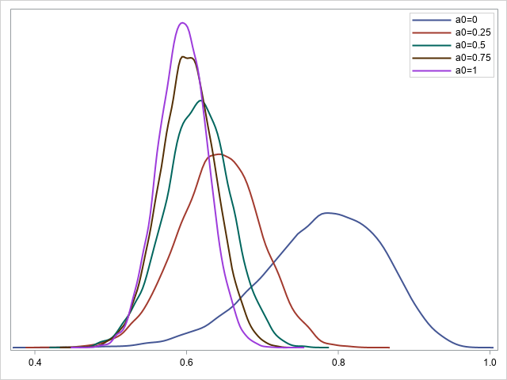
Posterior trade off
Naïve borrowing
to
Incorporation of expert opinion
Historical control:
CR = 0.57; n=200
Current control:
CR = 0.80; n=25

Slide 22
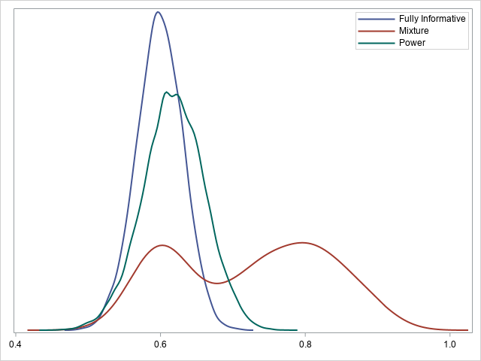
Compared to Full and Mixture Posteriors
Borrowing full information from the historical data
Mixture of 50% borrowed historical data and 50% uniform prior
Discounting historical data with a₀ = 0.50

Slide 23
Key Distinguishing Features
Bayesian SCA
Frequentist SCA
Incorporates both historical clinical trial data and expert opinion
Can incorporate any amount of historical data – even a small amount
Can be computationally challenging
Incorporates historical clinical trial data
Generally requires availability of a large amount of historical data
Computationally straightforward
Notes:
Some distinctions between Bayesian and Frequentist versions of an SCA…
Bayesian SCA offers a mechanism for combining both historical clinical trial data and expert opinion in a formal statistical analysis framework.

Slide 24
Concluding Remarks
SCAs present the opportunity to factor historical information into the current trial
Historical control data should be carefully selected – all stakeholders must be in agreement on the choice
Should available historical data on the control arm be completely ignored, or should decisions be made in light of all available data?

