Slide 1
Tachyarrhythmia in pediatric acute myocarditis is associated with increased mortality: A report from Kids’ Inpatient Database
Laxmi V. Ghimire, MD Lakes Region General Hospital Section of Pediatrics and Cardiology
Notes:
Good afternoon everyone. I am Laxmi. I am a pediatric cardiologist by training. I have interests in data science and machine learning. I am relatively new to R. My topic today to discuss two-step approach ie combining machine learning and conventional statistical analysis method to explore risk factors for mortality in pediatric myocarditis.

Slide 2
Overview
Short introduction to KID
Clinical question
Analytic approach
Results/Discussion
Notes:
My talk is broadly divided into 4 parts. At first, I will give you a quick overview of KID- dataset. Then mention, clinical question. I will go through the analytic approach. And, finally, will go through results and discussion.

Slide 3
Kids’ Inpatient Database (KID)
Part of the HCUP(Healthcare Cost and Utilization Project) database family
Includes most children’s hospitals, <21 yrs
Common and rare pediatric conditions
~3 million unweighed encounters/year
Published every 3 years
Notes:
Read the slide

Slide 4
Pediatric myocarditis
Inflammation of the heart muscles
Estimated annual incidence: 1-2/100,000 children – requires multi-center collaboration or a national database
Clinical feature: asymptomatic to heart failure
Diagnosis: clinical exam, echocardiogram, cardiac MRI, biopsy
Management: supportive and symptomatic

Slide 5
Clinical questions that can be answered using KID
Mortality rate (as outcome)
Length of hospitalization
Geographic and ethnic disparities in outcome
Age-stratified outcome
Associated diagnoses and outcome prediction

Slide 6
Objective
Examine the use of a machine learning algorithm(for screening) in combination with traditional logistic regression modeling(for validation) for risk factor exploration in pediatric myocarditis.
Notes:
There is a complex relationship between risk factors and the associated outcomes, so makes it challenging to identify important risk factors.
This approach is especially challenging for diseases or conditions that are rare like myocarditis.
With the help of ML we might be able to reveal hidden patterns of outcome-altering risk factors.

Slide 7
Analytic approach
Descriptive statistics (survey package)
ML predictive modeling (caret, ranger packages)
Logistic regression modeling (survey, stats, questionr packages)

Slide 8
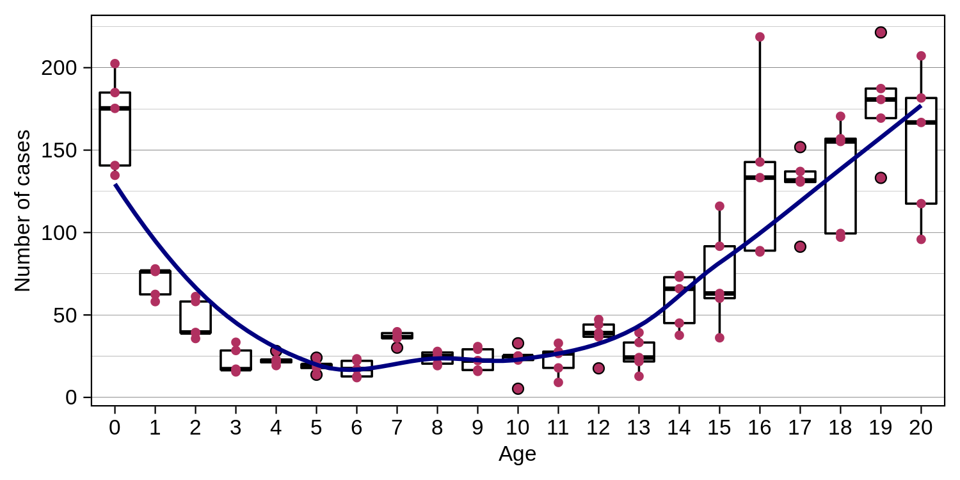
Myocarditis hospitalization cases by age
Total cases: 7200

Slide 9
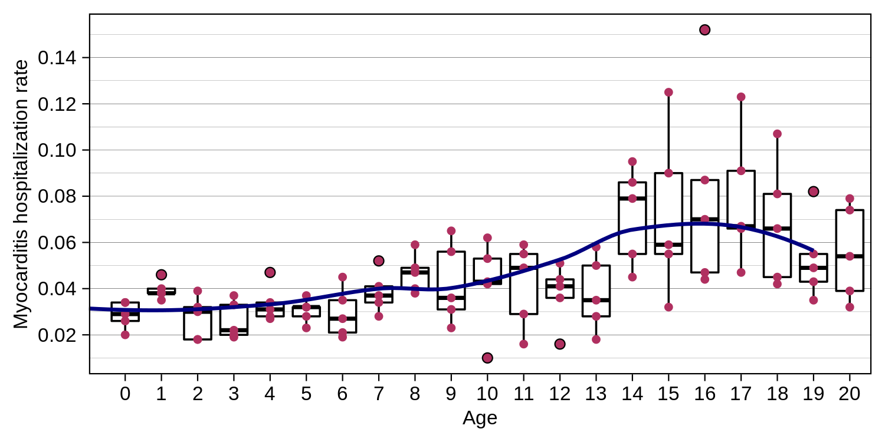
Rate of hospitalization due to myocarditis
Hospitalization rate: 4.7 per 100,000

Slide 10
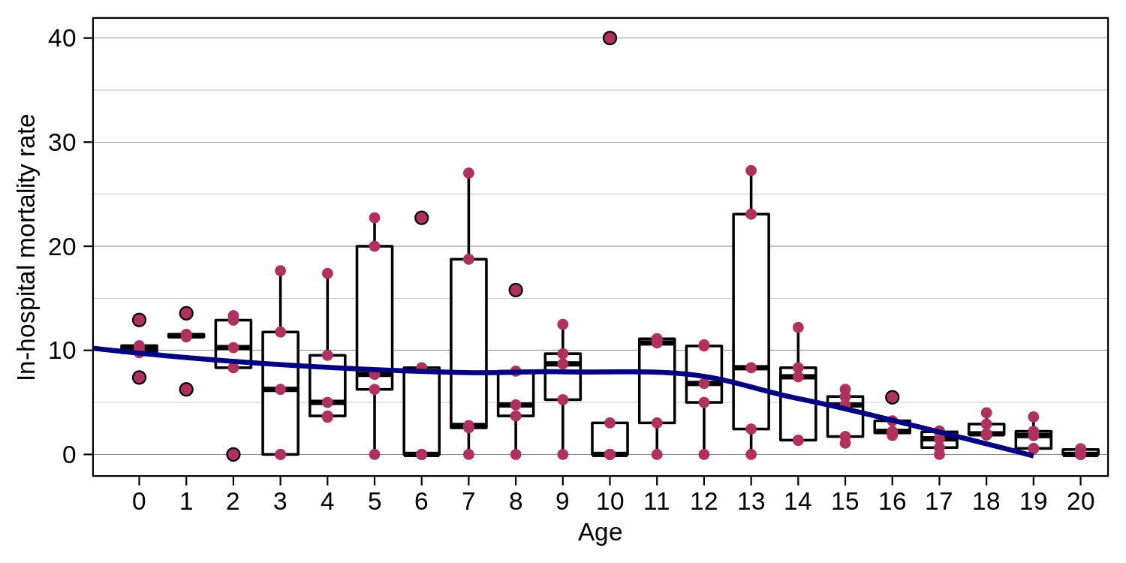
Myocarditis in-hospital mortality rate
Mortality rate: 4.9%

Slide 11
Mortality prediction
What associated diganoses put patients with myocarditis at increased risk for mortality?
Notes:
With this information, we were interested to find out what other associated diagnoses put patients with myocarditis with increased risk for mortality?

Slide 12
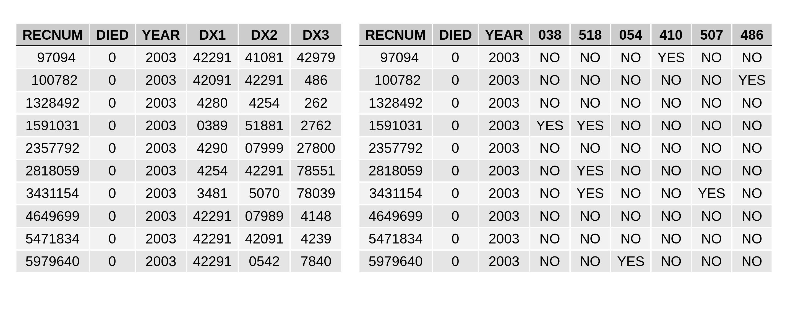
Data table transformation
Transform all associated diagnoses into categorical variables
Left: KID datatable; Right: Transformed datatable
Notes:
We transformed associated diagnosis table with the extracted data records where each column described an associated ICD-9 category code (first three digits) with a 2-level (“Yes” or “No”) categorical variable type.

Slide 13
Preprocessing and Analysis
Preprocessing
Synthetic minority oversampling technique (SMOTE) to address class imbalance: mortality is a rare event (~5%)
Predictive modeling
Random forests algorithm (ranger package)
Resampling using repeated cross-validation technique
Notes:
For modeling, the caret package for R was used by calling the ranger package
To address class imbalance, resampling was performed using the SMOTE() function from the DMwR package.
For mortality prediction, we aimed to select a model with sufficiently low false negative predictions and sufficiently high sensitivity.
The final model selected had an accuracy rate of 0.771, Cohen’s kappa of 0.207. Sensitivity, specificity, positive and negative predictive values were 0.806, 0.769, 0.168, and 0.986, respectively

Slide 14
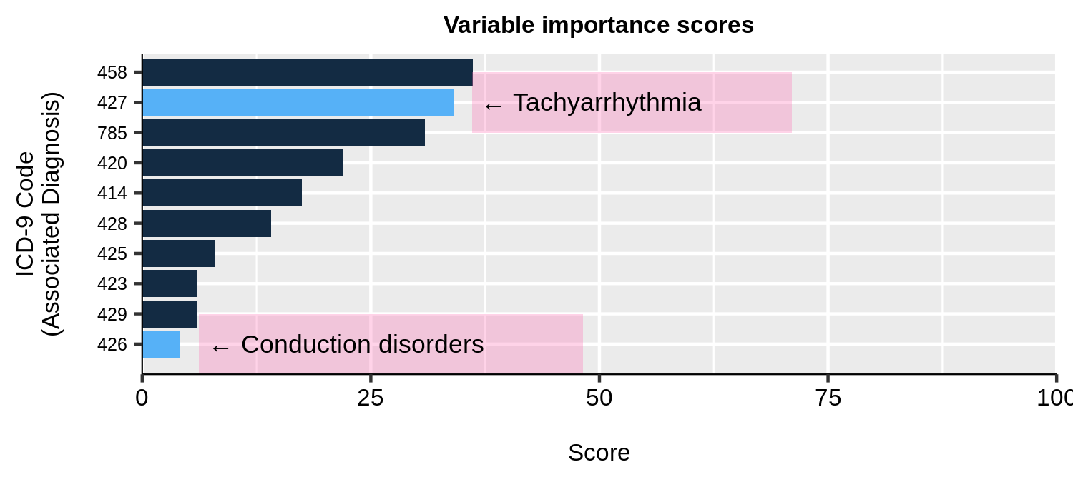
Cardiac variable analysis
Using caret::varImp() → filtering ICD codes 390-459 → top 10 hits

Slide 15
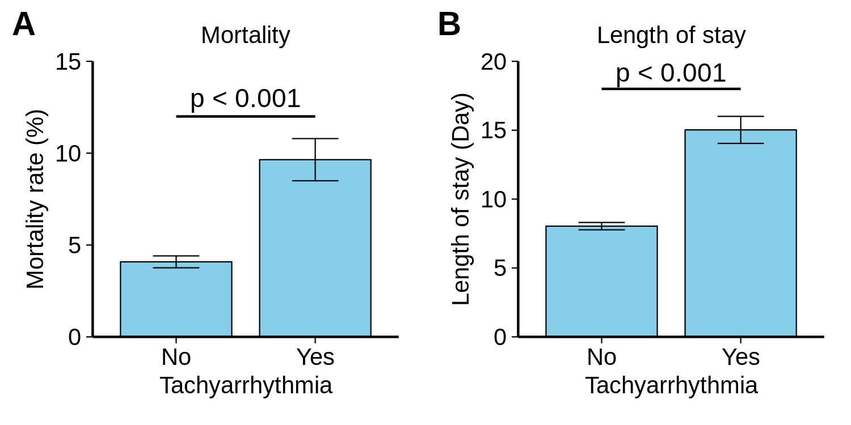
Tachyarrhythmia is associated with worse outcomes
Mortality and length of stay are both increased in association with tachyarrhythmia diagnosis

Slide 16
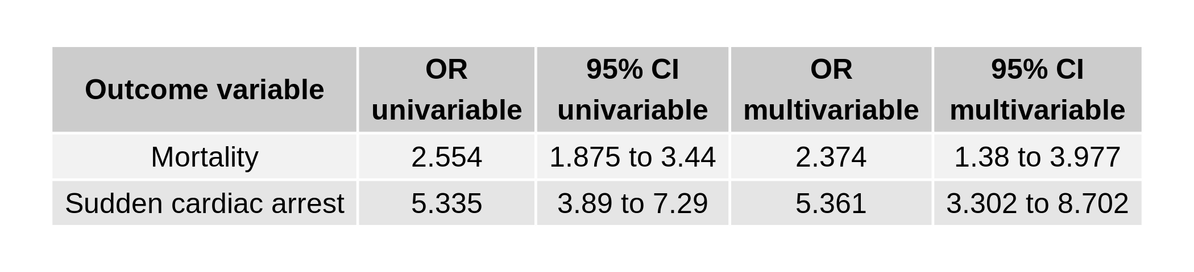
Tachyarrhythmia is associated with worse outcomes
Conventional logistic regression modeling for validation

Slide 17
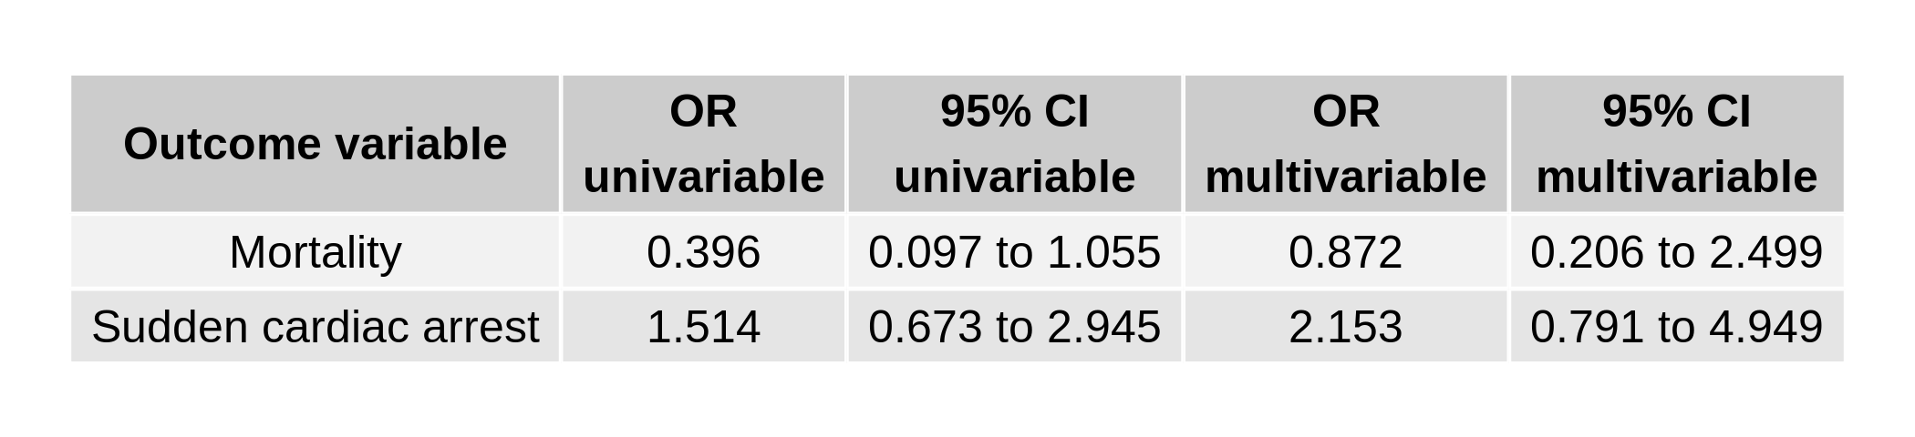
Tachyarrhythmia, but not heart block, is associated with worse outcomes
Conduction disorders are not associated with worse outcomes.
Conventional logistic regression modeling for validation

Slide 18
Summary & Conclusion
Tachyarrhythmias in pediatric myocarditis are associated with worse outcomes: – Mortality – Sudden cardiac arrest – Length of stay
A screening-validation two-step approach for risk factor analysis
Particularly useful for risk factor identification in rare diseases
Notes:
First bullet point
-second bullet point: Two-step approach to conduct risk factor exploration by performing machine learning predictive modeling for variable importance followed by conventional linear regression analysis for validation. This approach may be especially useful for risk factor identification in rare diseases.

Slide 19
Acknowledgement
Fu-Sheng Chou, MD PhD – A neonatologist who loves R and data science – Collaboration / fee for service available – E-Mail: ribo.neo.stat@gmail.com
Hung-Wen Yeh, PhD – Biostatistician at Children’s Mercy Hospital, Kansas City – E-Mail: hyeh@cmh.edu

