Slide 1


Deriving and quantifying impact of biomedical research publications
Kenneth McLean

Slide 2
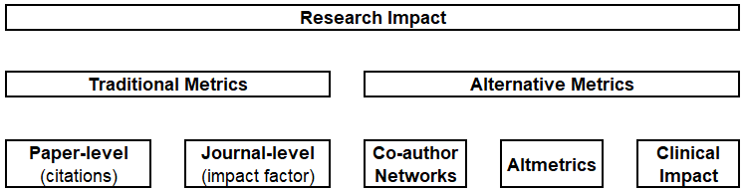
Research impact
Demonstrating the impact of research is essential to evidence its value to stakeholders.
Notes:
(e.g. public, collegues, research or funding organisations).
Furthermore, although traditional (citation- or journal-based) metrics of research impact remain highly regarded, the scope of research impact has broadened to emphasise engagement and direct patient benefit.

Slide 3
ImpactR
There are individual packages are available to explore the impact of research in R.
ImpactR aims to consolidate data from existing packages into a holistic and useful quantification of research impact.
Notes:
User-friendly.
Informative.
Open access.
Holistic.

Slide 4
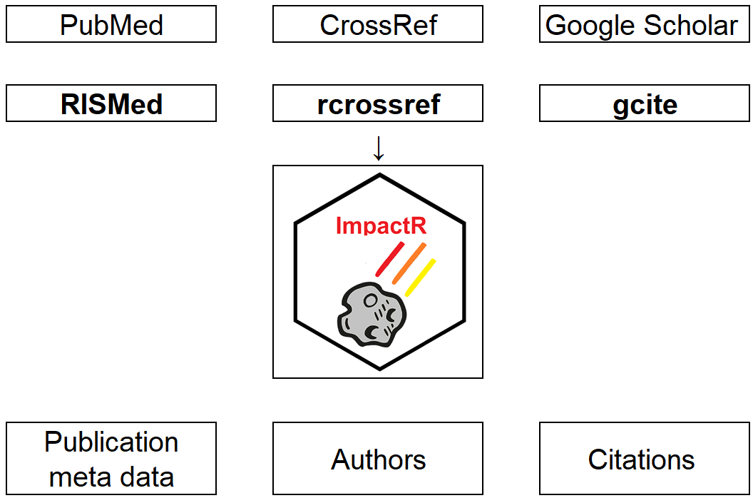
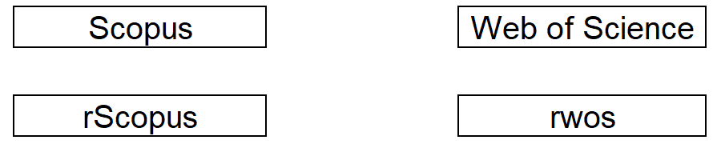
Traditional impact sources
CrossRef (rcrossref)
PubMed
(RISMed)
Publication meta data
Authors
Citations
Google scholar
(gcite)

Slide 5
Traditional impact sources
CrossRef (rcrossref)
PubMed
(RISMed)
Publication meta data
Authors
Citations
Google scholar
(gcite)
Open Access Authentication

Slide 6
Traditional impact sources
CrossRef (rcrossref)
PubMed
(RISMed)
Publication meta data
Authors
Citations
Google scholar
(gcite)
Notes:
The “ImpactR” package aims to consolidate functionality from a range of existing packages (including RISMed, rcrossref, rAltmetric, scholar) into holistic and useful quantifications of biomedical research impact.
Emphasise together into 1 coherent metrics.

Slide 7
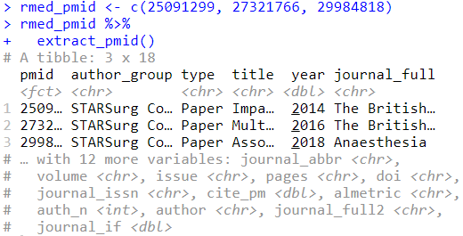
Functionality
Notes:
For the next section, I’ll demonstrate how using just PMID and ImpactR functions how impact data can be easily derived.
I’ll be using PMID, but works equally well with DOI.

Slide 8
extract_pmid()
Notes:
With just the extract_pmid function you get a informative tibble.
This provide basic information needed for citation (year, journal, volume, etc).
Also provides citations from pubmed, overall altmetric score, and journal impact factor.

Slide 9

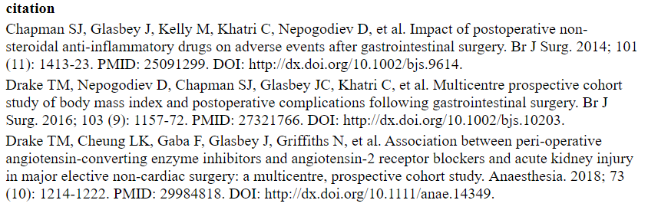
cite_publication()
Notes:
Can be directly used with cite_publications to produce a formatted citation.
This is customisable (vancover format default).
Useful for CVs or for publication lists from an individual, research group, etc (whether static or shiny app).

Slide 10

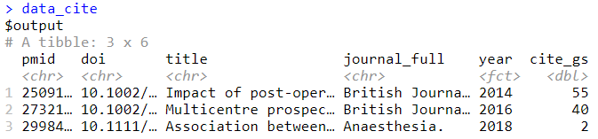
impact_cite()
It will incorporate data from google scholar (if the publications are listed on an account).

Slide 11
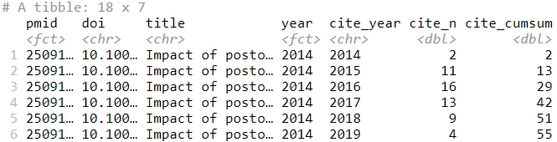
impact_cite()$time
It supplies citations over time in a long format.

Slide 12
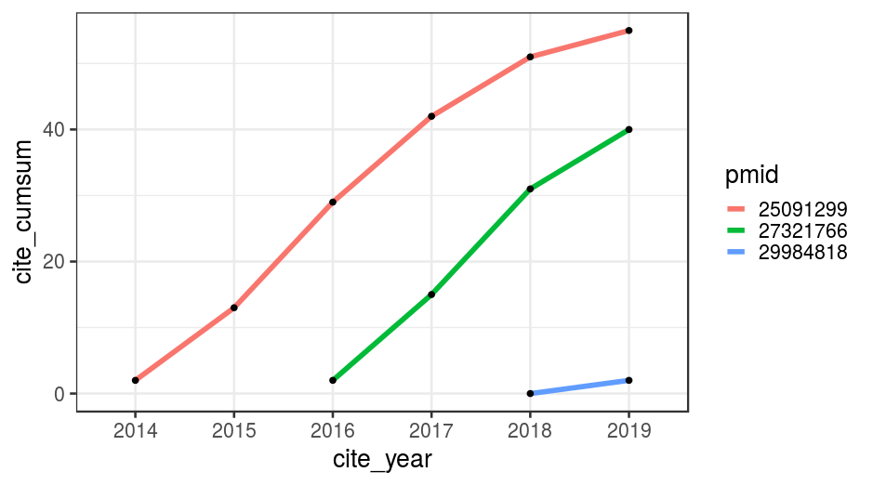
impact_cite()$time
Notes:
Can be used directly for visualisation.

Slide 13

impact_cite()$metric
Citation metrics track and measure citations to provide an indication of the impact of an author or group.
This will return common metrics including:
Notes:
Citation metrics like H-index are controversial, but are still in use.
This will calculate several common metrics *JUST* for the papers supplied.

Slide 14
Co-authorship Networks
Understanding authorship relationships across publications can be a challenging task.
Scale of research is increasing, with potentially 1000s of authors involved in some publications.

Slide 15
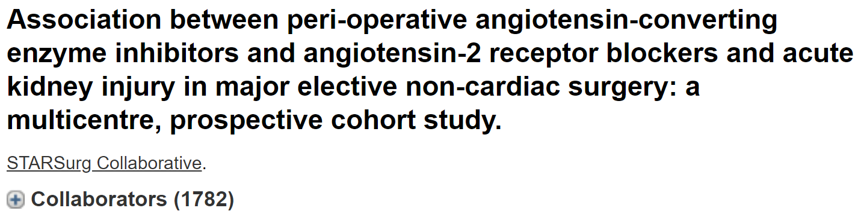
Co-authorship Networks
Understanding authorship relationships across publications can be a challenging task.
Scale of research is increasing, with potentially 1000s of authors involved in some publications.

Slide 16

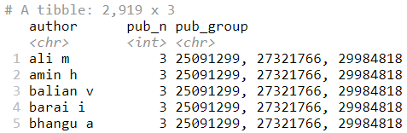
impact_auth()$auth_out
Notes:
Uses the output directly from extract_pmid.
Produces a tibble of unique authors across the publications, along with with the total number, and name of publications.

Slide 17

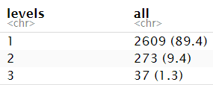
impact_auth()$auth_out
Notes:
This allows you to easily derive summary stats – for example the degree of involvement in the papers.
This also provides data for co-authorship network visualisation (functions to facilitate in development)

Slide 18
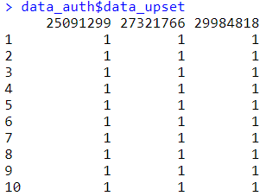
impact_auth()$data_upset
Notes:
It can also provide data in an appropriate format for Venn diagrams / UpSet plots (better for visualising multiple sets).

Slide 19
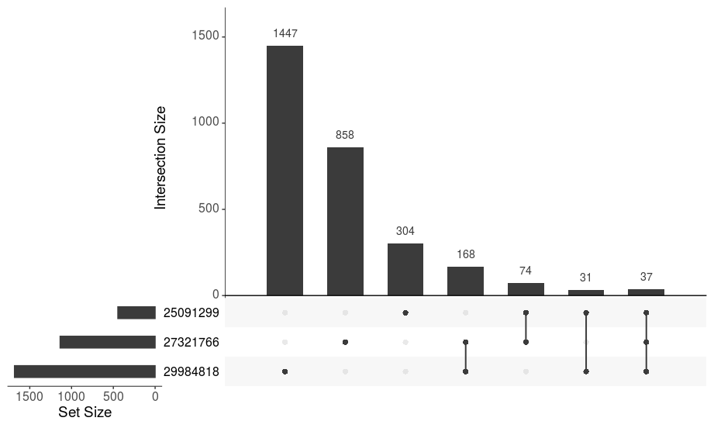
impact_auth()$data_upset
Notes:
This can be used directly to visualise relationships between co-authorship.

Slide 20


Alternative impact measures
On-line attention and engagement for research is now well recognised as important alternative metrics.
Quicker to accumulate + can predict future citations.

Slide 21
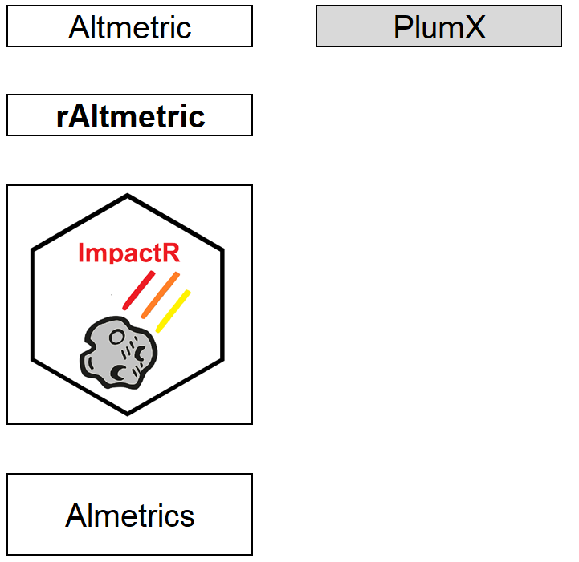
Alternative impact sources

Slide 22
Alternative impact sources

Slide 23
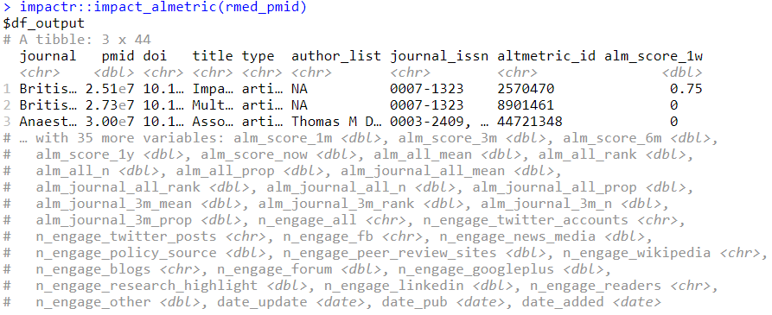
impact_altmetric()
Notes:
Using just the PMID, you get a clean, wide-format tibble of almost all data available via altmetric API.
This can easily be joined to other datasets via pmid or doi.

Slide 24
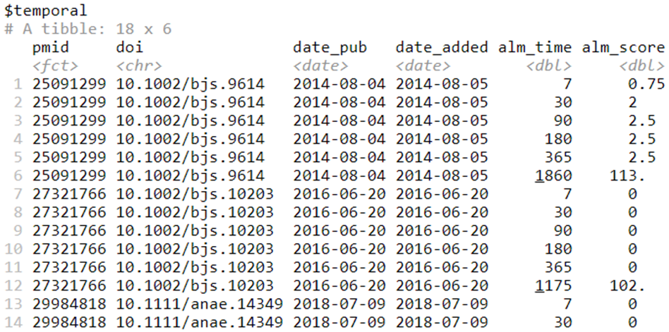
impact_altmetric()$temporal
Notes:
You then get a long-format dataset on altmetric score over time.
Regular intervals of 1 week, 1 month, 3/6/12 months, then current altmetric.

Slide 25
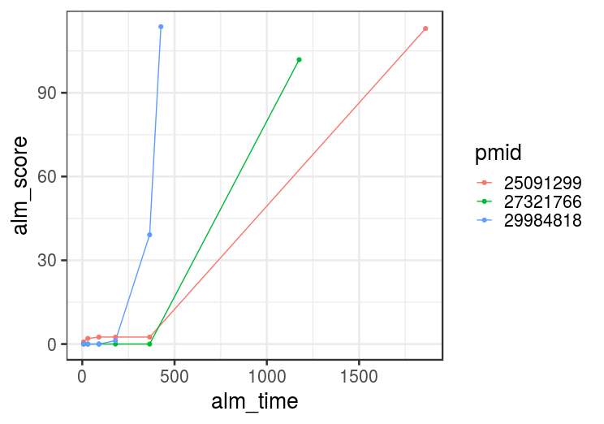
impact_altmetric()$temporal

Slide 26
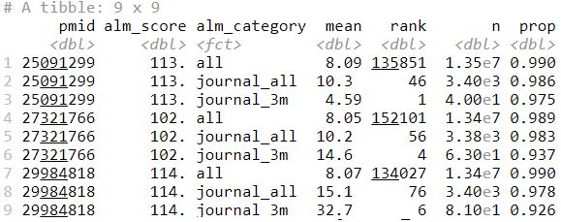
impact_altmetric()$rank
Notes:
However altmetric only makes sense in context …
For example it’ll benchmark the altmetric score relative to (1) all papers tracked by altmetric, (2) all from that journal, (3) all from that journal (within 3 months).

Slide 27
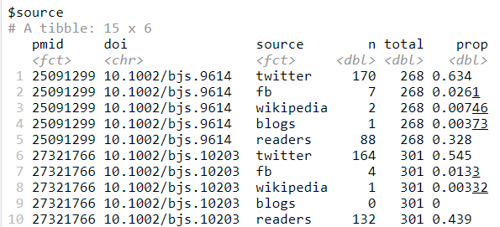
impact_altmetric()$source
Notes:
Finally, it’ll provide breakdown of *where* the altmetric score is derived.

Slide 28
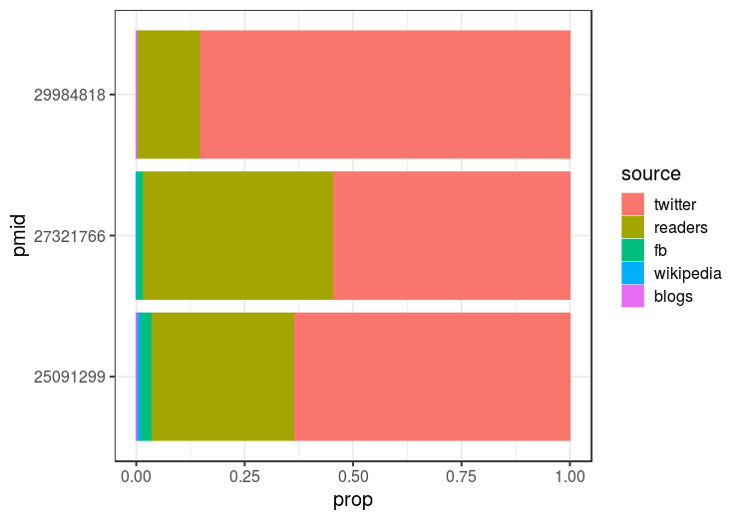
impact_altmetric()$source
Notes:
Can be directly visualised to enhance understanding.

Slide 29
Summary
ImpactR provides a holistic view of impact using a set of simple and integrated functions.
Output designed for easy analysis or visualisation.
Relevant for individual researchers or groups.
Can track impact in real-time (e.g. Shiny app).
Notes:
Using just PMID …

Slide 30
Next steps
In active development:
Expand citation data sources (e.g. optional integration of WoS / Scopus).
Facilitate co-author network visualisation.
Migrate from GitHub → CRAN
Monitor for new open repositiories.

Slide 31



@kennethmclean92
github.com/kamclean
k.a.mclean@ed.ac.uk

