Slide 1
1
0011
1011
0
0001
1001
01
11
0111
1111
0101
1101
00
10
011
111
0110
1110
001
101
0010
0100
1100
1010
010
110
000
100
0000
1000

Slide 2
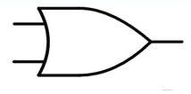
HA
HA

Slide 3
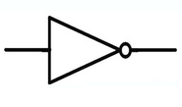
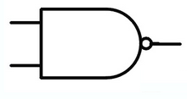

Slide 4
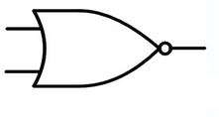

Slide 5
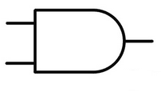

Slide 11
Positive Edge Triggered FF
Negative Edge Triggered FF

Slide 13
2 | (2,4) ×(3,5)
3 | × | ×
4 | ×(3,7) | (5,7) | ×
5 | × | × | ×(1,2) ×(4,6) | ×
6 | × | × | ×(1,4) ×(6,8) | × | (2,4) ×(4,8)
7 | × | × | (2,6) ×(1,2) | × | (2,4) | ×(2,8) (2,4)
8 | × | × | ×(2,6) ×(1,4) | × | (2,4) | ×(2,8) | (2,4)
 | 1 | 2 | 3 | 4 | 5 | 6 | 7

