Slide 1
JWT教學
組員：蔡昀霖、糠依婷
2019/03/07

Slide 2
OUR PROCESS
連接虛擬機器
連接網路埠
更改檔案
依序啟動服務
請求授權

Slide 3
1.
連接虛擬機器

Slide 4
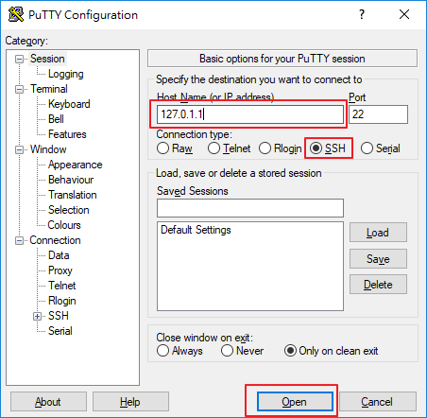
使用PuTTy連接

Slide 5
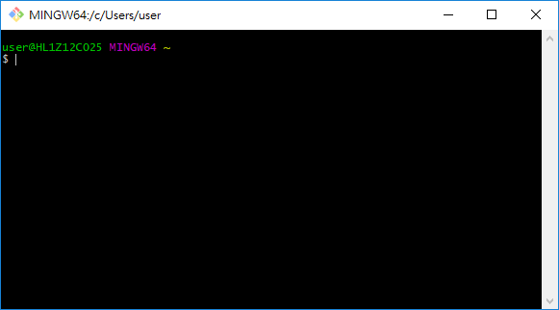
也可以選擇用Git Bash連接

Slide 6
2.
連接網路埠

Slide 7
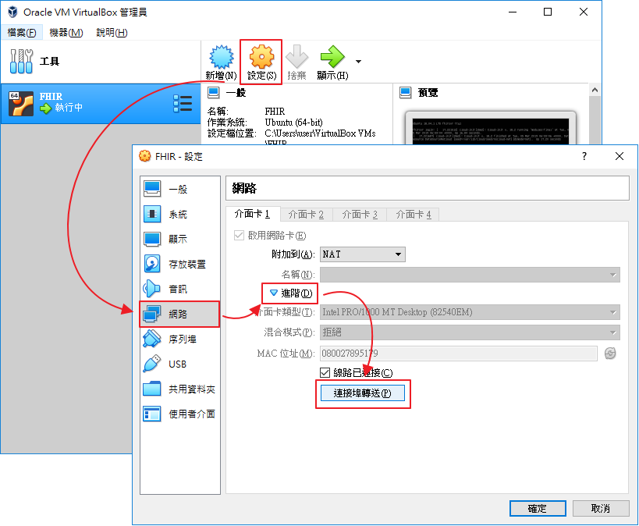
虛擬機器-->設定-->網路-->進階-->連接網路埠

Slide 8
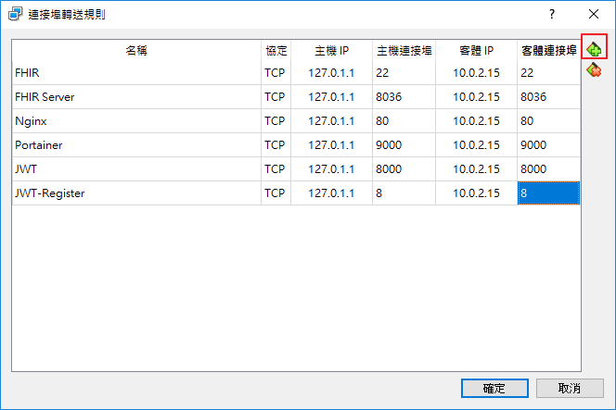
增加連接埠

Slide 9
3.
更改檔案

Slide 10
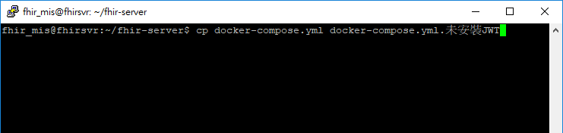
備份檔案
指令：cp docker-compose.yml docker-compose.yml.未安裝JWT

Slide 11
cd fhir-server nano docker-compose.yml
將右邊的文字複製到yml檔案中
version: '3'
services:
api:
image: saydo/fhir-server:3.6.4
restart: always
ports:
- "8036:8080"
volumes:
- "/data/hapi/3.6.0/lucenefiles:/usr/local/tomcat/lucenefiles"
environment:
MODE: JWT
JWT_ISSUER: "www.tzuchi.com.tw"
JWT_SECRET: "H7gO"
WHITELIST_SECRET: "www.tzuchi.com.tw"
DATABASE_DRIVER: "com.mysql.jdbc.Driver"
DATABASE_URL: "jdbc:mysql://172.18.0.3:3306/hapi_fhir_360?autoReconnect=true&useUnicode=true&characterEncoding=utf-8"
DATABASE_USERNAME: "hapi_fhir_360"
DATABASE_PASSWORD: "UukeZbY98Q4rHTNYcURDSbJLyJ7cRwbF"
HIBERNATE_DIALECT: "org.hibernate.dialect.MySQLDialect"
SERVER_BASE: http://10.0.2.15:8036
healthcheck:
test: nc -vz localhost 8080
interval: 15s
timeout: 5s
retries: 15
database:
image: mysql:5.7
volumes:
- "/data/mysql/fhir-server/:/etc/mysql/conf.d"
environment:
MYSQL_ROOT_PASSWORD: "HkeA0cI7MDgbyFru65Mm1izFTImN66gT"
MYSQL_DATABASE: 'hapi_fhir_360'
MYSQL_USER: 'hapi_fhir_360'
MYSQL_PASSWORD: UukeZbY98Q4rHTNYcURDSbJLyJ7cRwbF
ports:
- "3306:3306"
healthcheck:
test: mysqladmin ping -u root --password=HkeA0cI7MDgbyFru65Mm1izFTImN66gT
interval: 15s
timeout: 5s
retries: 15
healthboard:
image: pickonefish/healthboard
ports:
- "8090:80"
jwt_backend:
image: saydo/homevisit-backend:1.2.1
restart: always
ports:
- "8000:8000"
volumes:
- "/data/homevisit/backend:/usr/local/tomcat"
environment:
WHITELIST_SECRET: www.tzuchi.com.tw
JWT_ISSUER: www.tzuchi.com.tw
JWT_SECRET: H7gO
#JWT_REGISTER_ENABLED: "false"
FHIR_BASE_URL: http://10.0.2.15:8036/baseDstu3/
SERVER_PORT: 8000
DATABASE_HOST: 172.18.0.4
DATABASE_PORT: 3306
DATABASE_NAME: homevisit
DATABASE_USERNAME: homevisit
DATABASE_PASSWORD: Ch9g
SPRING_JPA_HIBERNATE_DDL_AUTO: update
healthcheck:
test: nc -vz localhost 8000
interval: 15s
timeout: 5s
retries: 15
jwt_database:
image: mysql:5.7
volumes:
- /data/homevisit/mysql/:/etc/mysql/conf.d
environment:
MYSQL_ROOT_PASSWORD: W360
MYSQL_DATABASE: homevisit
MYSQL_USER: homevisit
MYSQL_PASSWORD: Ch9g
ports:
- 3316:3306
healthcheck:
test: mysqladmin ping -u root --password=W360
interval: 15s
timeout: 5s
retries: 15

Slide 12
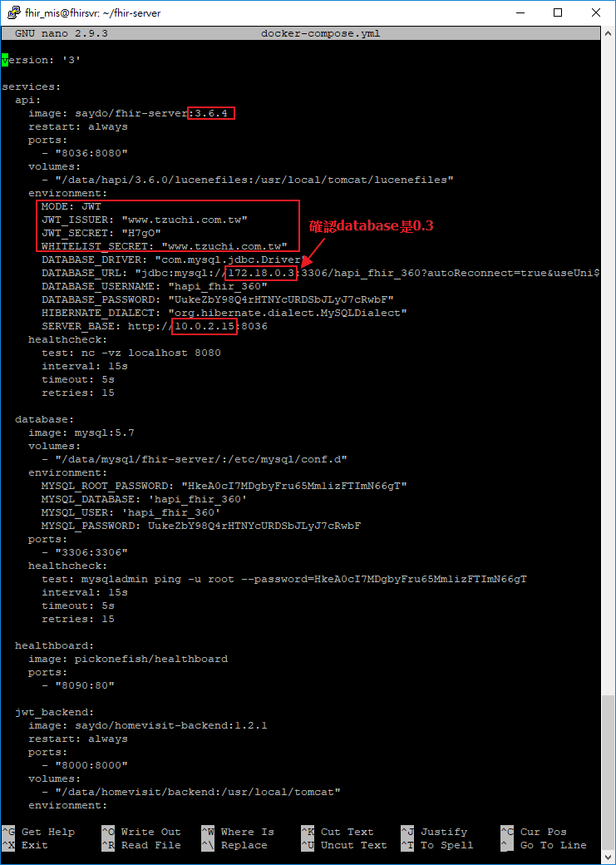
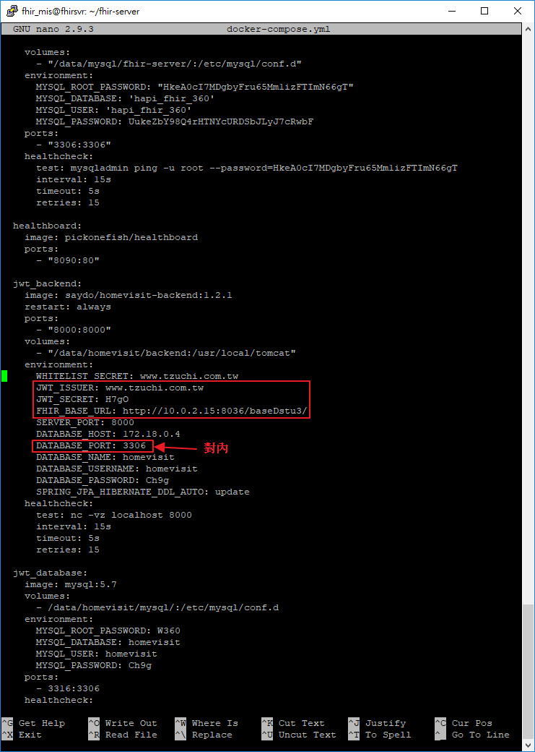
注意紅線框起來的地方
是否相同

Slide 13
🔌
4.
依序啟動服務

Slide 14
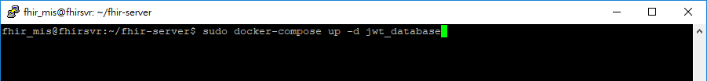
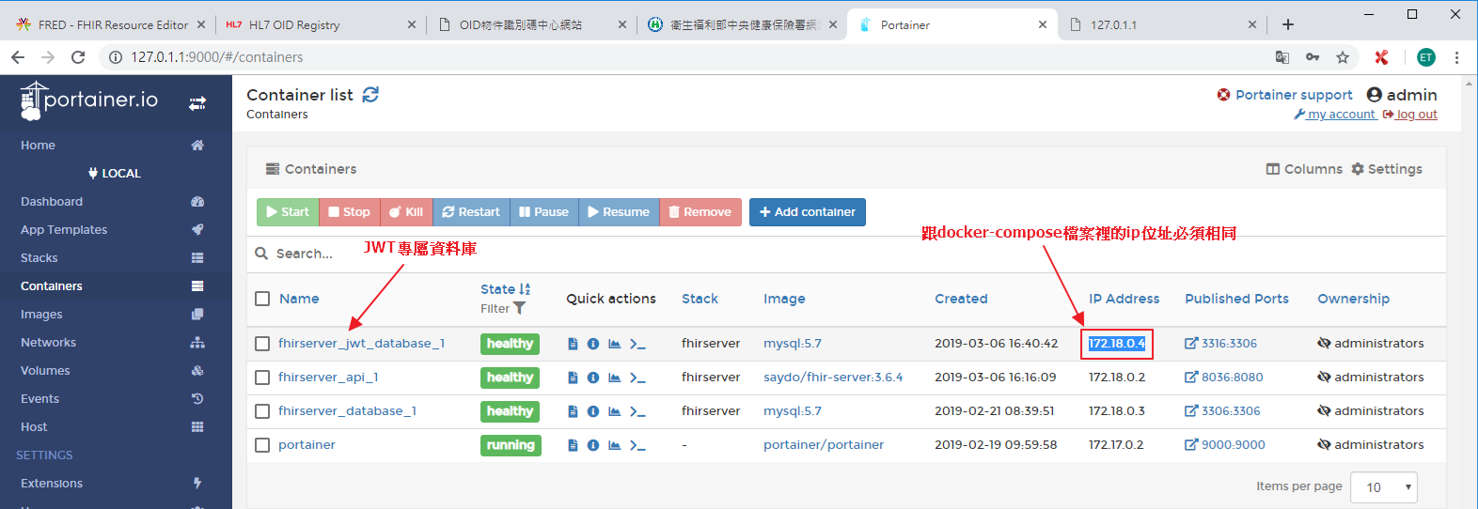
sudo docker-compose up -d jwt_database

Slide 15
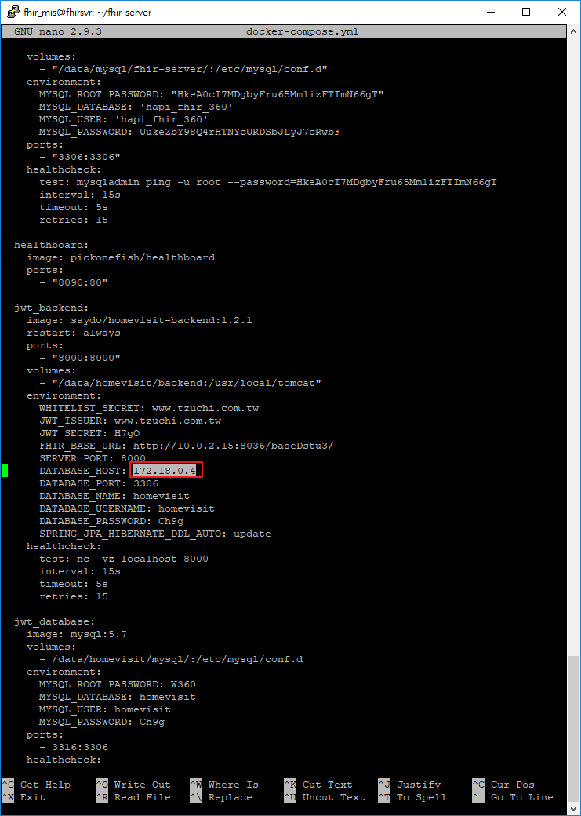
注意紅線框起來的地方
與網站顯示的ip是否相同

Slide 16
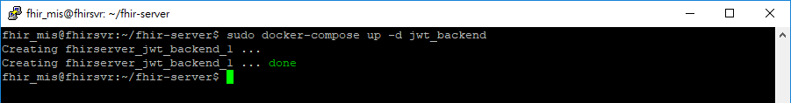
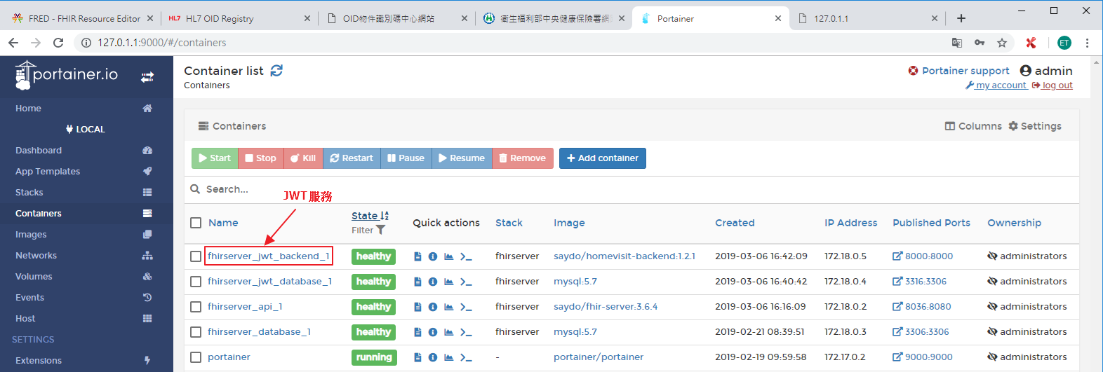
sudo docker-compose up -d jwt_backend

Slide 17
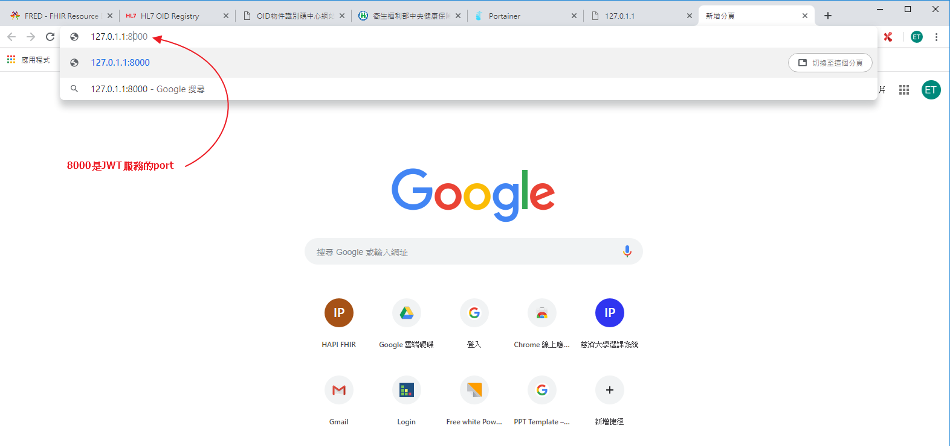
127.0.1.1:8000

Slide 18
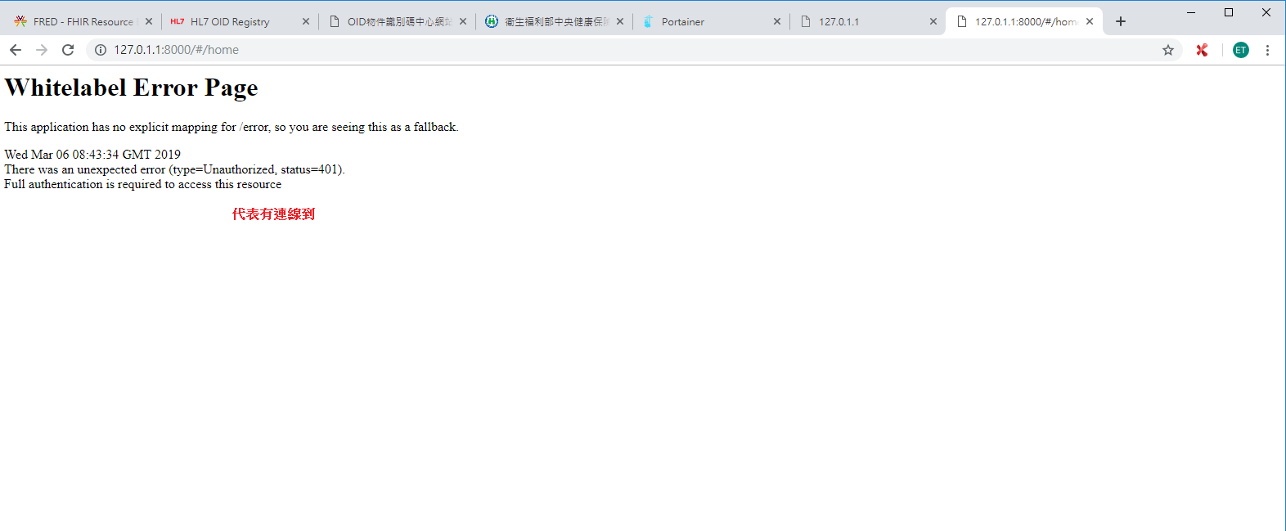
Backend啟動成功

Slide 19
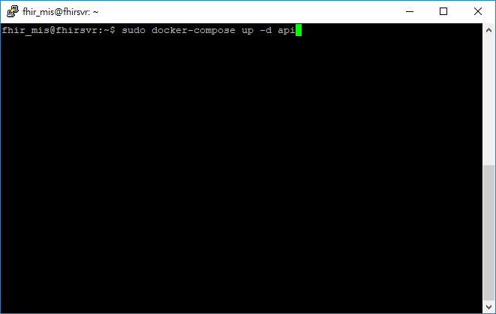
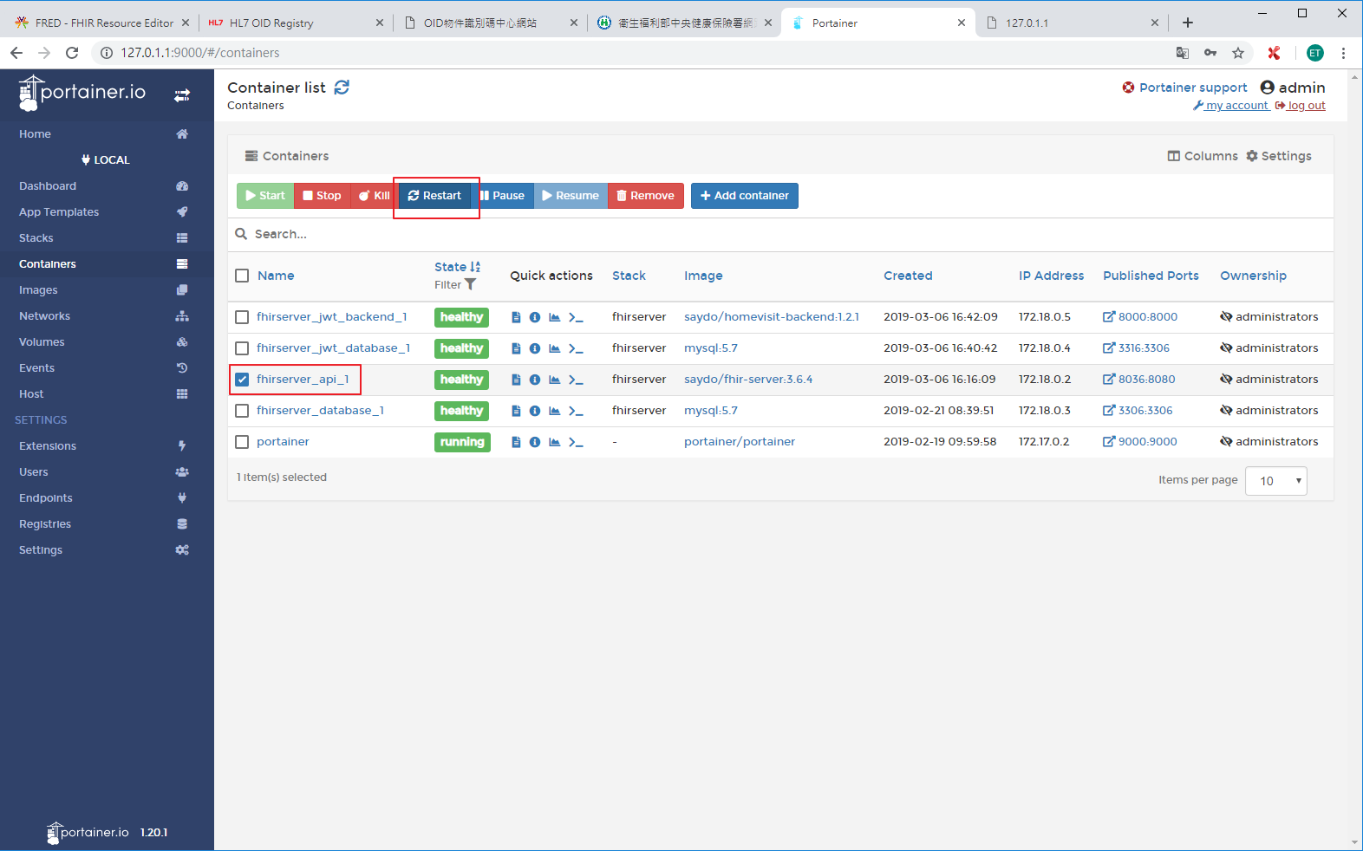
sudo docker-compose up -d api

Slide 20
5.
請求授權
🔑

Slide 21
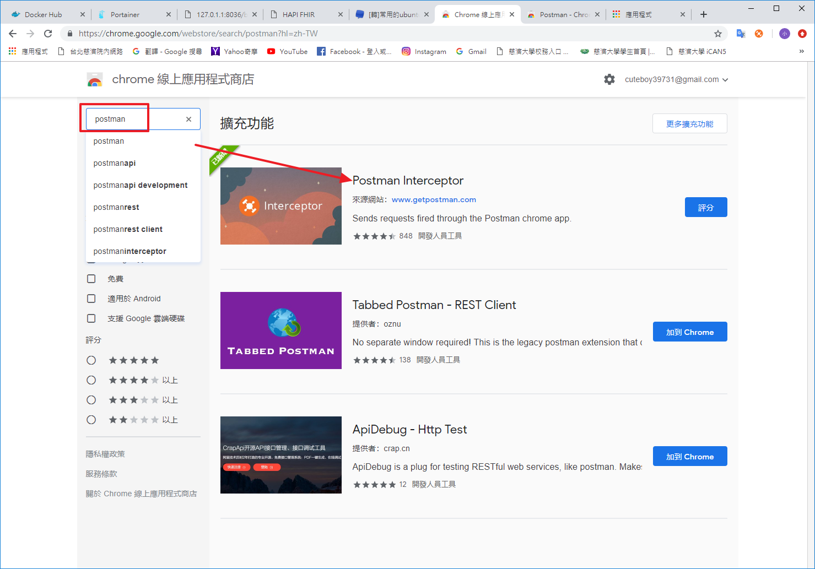
先下載postman chrome商店中搜尋postman

Slide 22
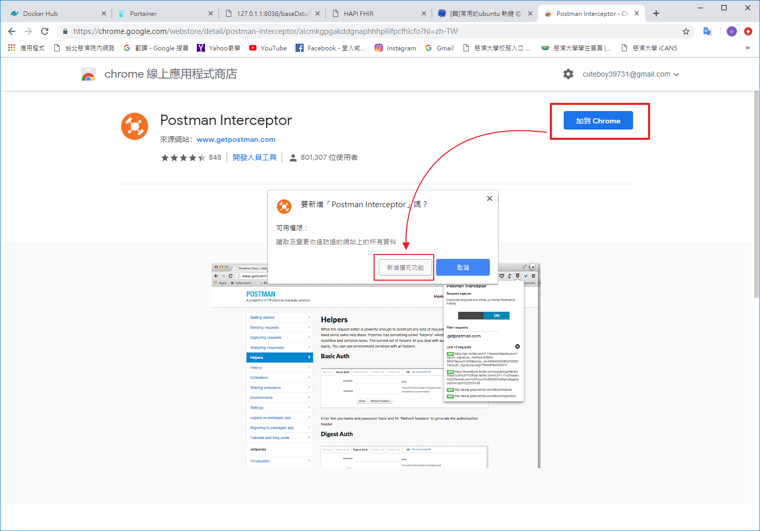
將postman加到chrome

Slide 23
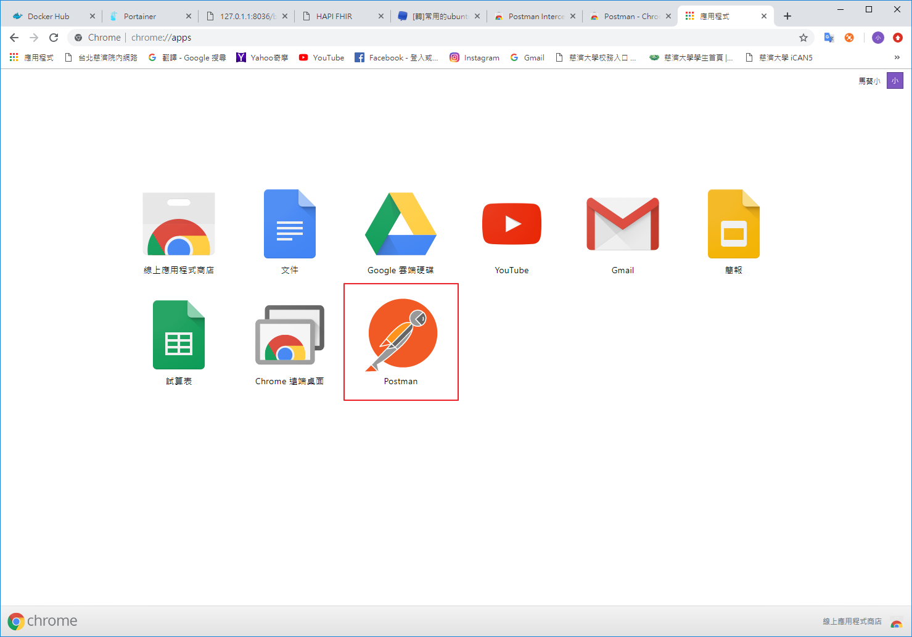
下載完成

Slide 24
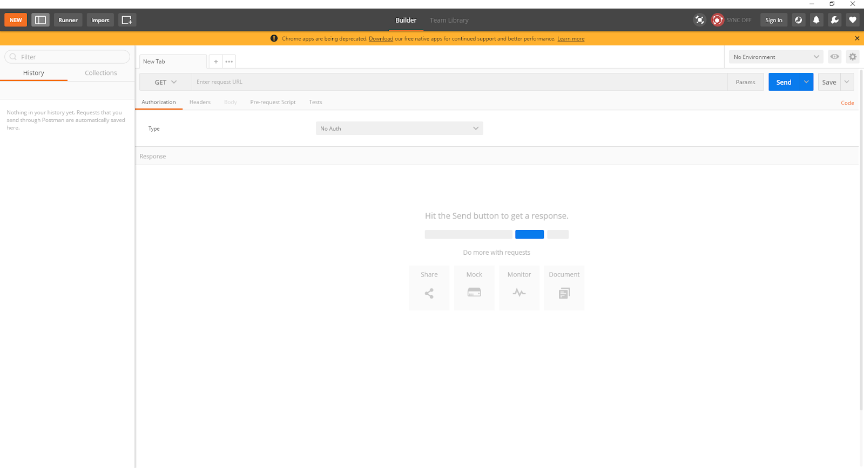
開啟postman
Post 新增
Get 查詢
Del 刪除

Slide 25
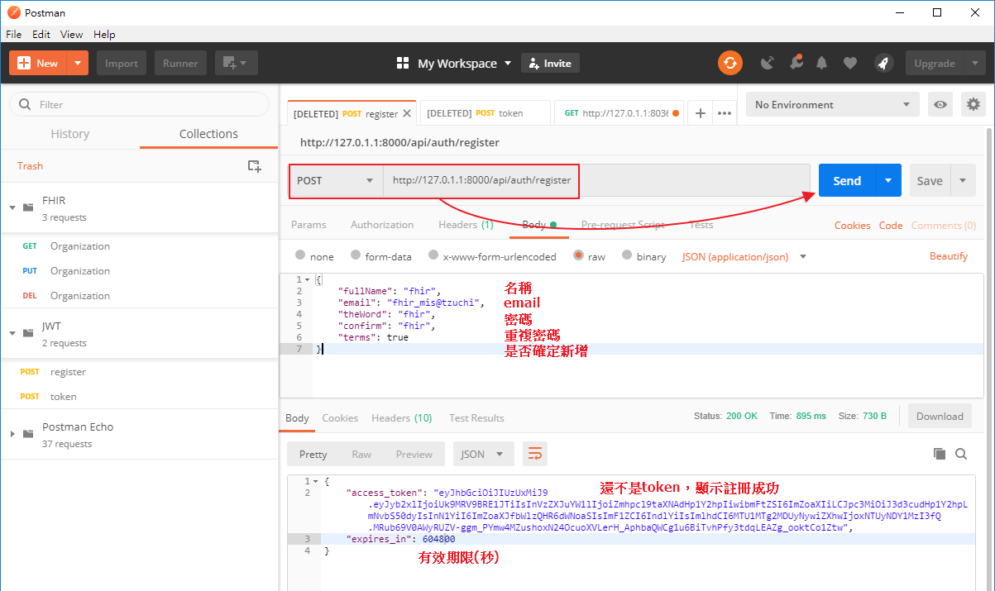
http://127.0.1.1:8000/api/auth/register

Slide 26
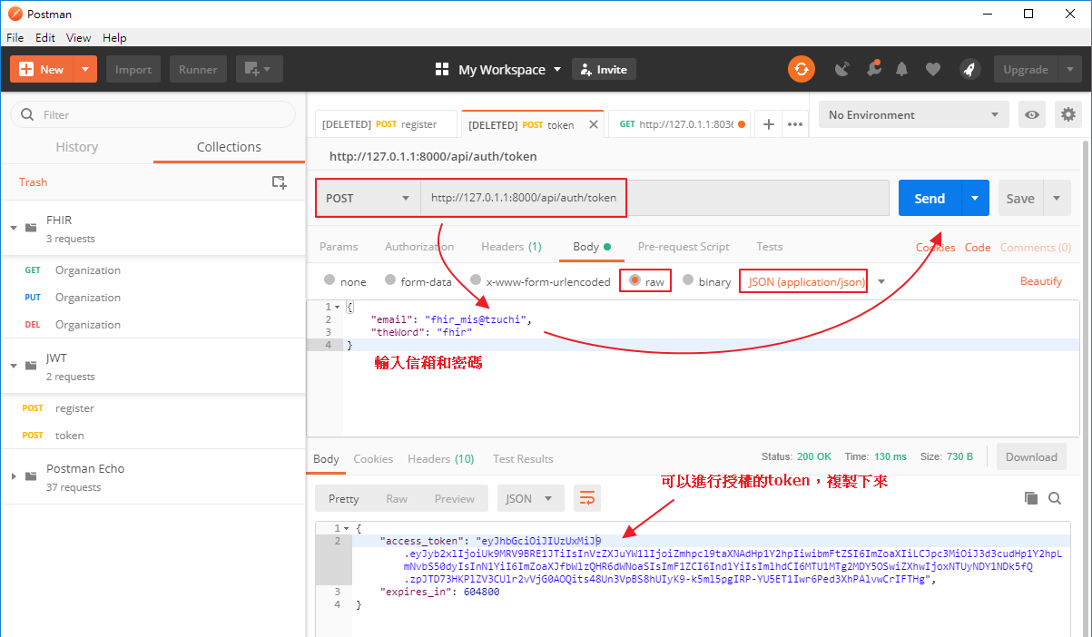
http://127.0.1.1:8000/api/auth/token

Slide 27
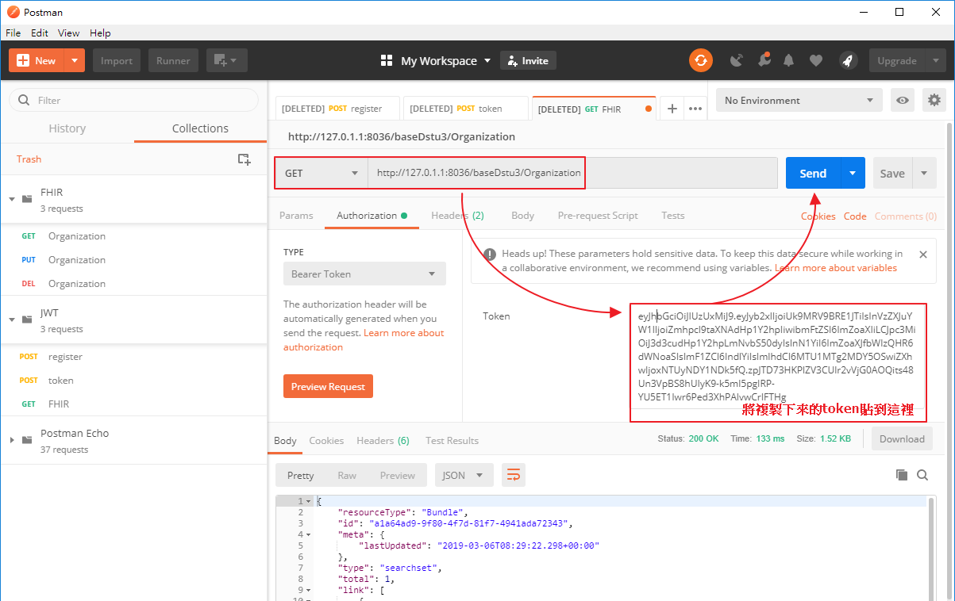
http://127.0.1.1:8036/baseDstu3/Organization

Slide 28
COMPLETE!
😉

