Slide 1
TransitAI UTM
Teacher-facing demo deck
Campus transport chatbot prototype
Shows exactly how the prototype meets the rubric: interactive screen, problem solving, and administrator manual support.
Interactive
Free text, quick actions, phone UI
AI evidence
Intent confidence, RAG-style retrieval, proof trace
Truthful data
Public route labels + simulated timing boundary
MECS0033-52 Artificial Intelligence
Group 5

Slide 2
Rubric fit: high-score evidence
TransitAI UTM Prototype
Originality / Interactive Screen
Problem Solving
Admin Manual
• Phone-frame app with real inputs and outputs
• Intent confidence visible to marker
• RAG-style source panel
• Resolution proof is tied to the report logic
• Schedule uncertainty
• Route confusion
• Arrival uncertainty
• Delay notification gap
• Feedback / escalation
• Component/function map
• Data-source truth policy
• Configuration guide
• Screenshots and troubleshooting
Main scoring risk reduced: the prototype now clearly labels what is public route data and what is simulated POC behavior. The demo-time control prevents night presentation from making every route look closed.

Slide 3
Data truth policy
TransitAI UTM Prototype
Public route listing aligned
BAS A/B/C/D/E/F/G/H labels and public stop sequences
Public stop labels
CP, KTDI, KTHO, KTR, KDOJ, N24, P19, T02, T08, V01, etc.
Prototype mappings
FC → N24 / Cluster Area; FKE → P19 / FKE Area
Simulated POC data
Next departure, operating hours, headway, live arrival ETA, delay status
Presentation wording: “Route names and stop sequences follow public UTM/KDOJ listings where available. Timetable/ETA values are simulated because no live verified feed is connected to this 10% POC.”

Slide 4
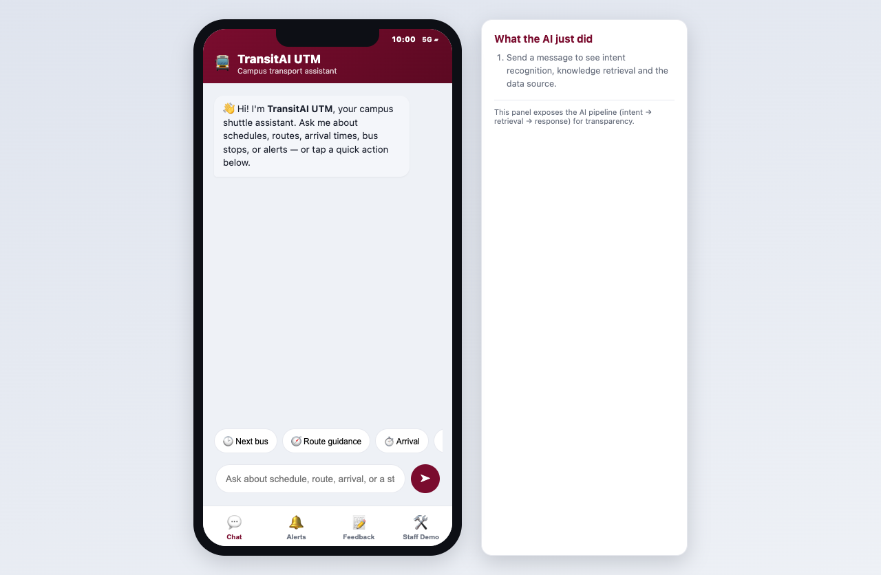
Prototype first screen
TransitAI UTM Prototype
What to point out
• Phone status time now visible
• No install, no backend
• Input and output shown immediately
AI visibility
• Intent recognition
• Knowledge retrieval
• Grounded response
• Source note
Home/chat, quick actions and AI pipeline panel.

Slide 5
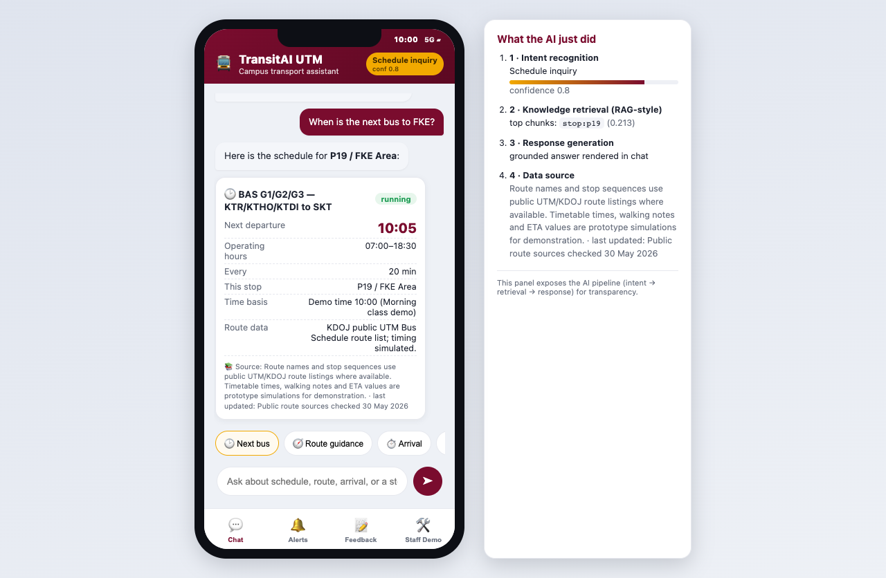
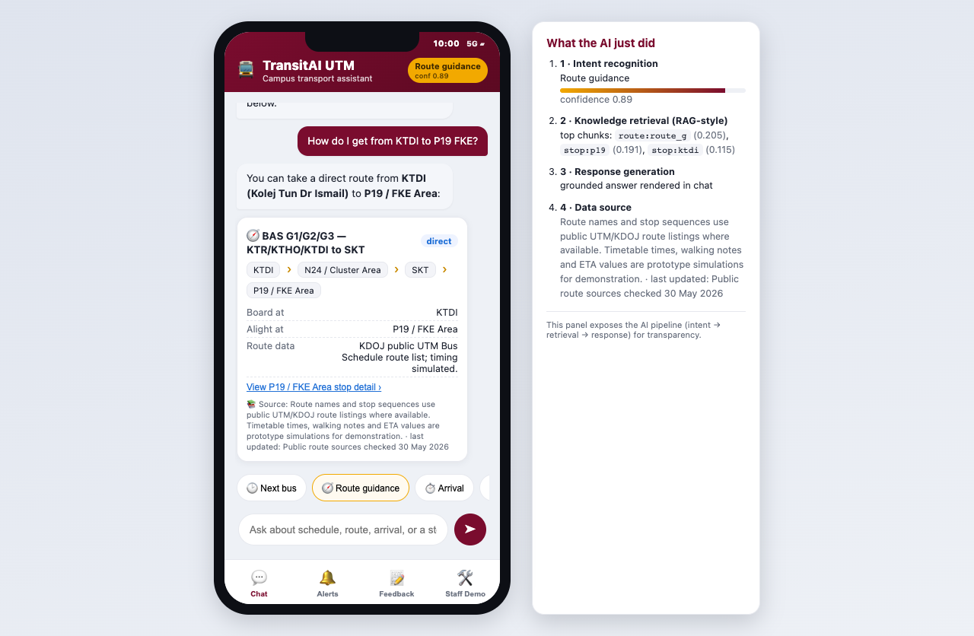
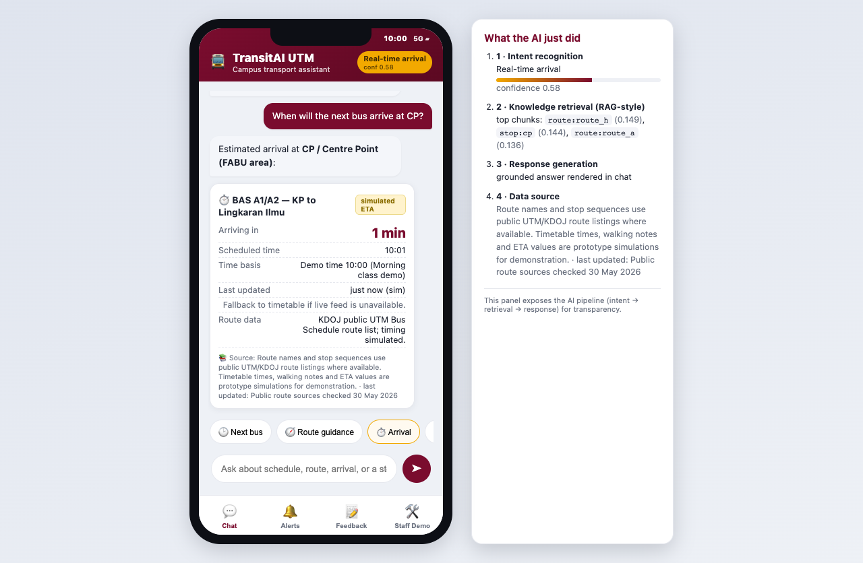
Student flows: schedule, route, arrival
TransitAI UTM Prototype
Schedule: demo time + source note
Route: BAS G stop sequence
Arrival: simulated ETA
The marker sees the real problem being solved: students can ask natural questions instead of searching static notices. Each answer states the data source and simulation boundary.

Slide 6
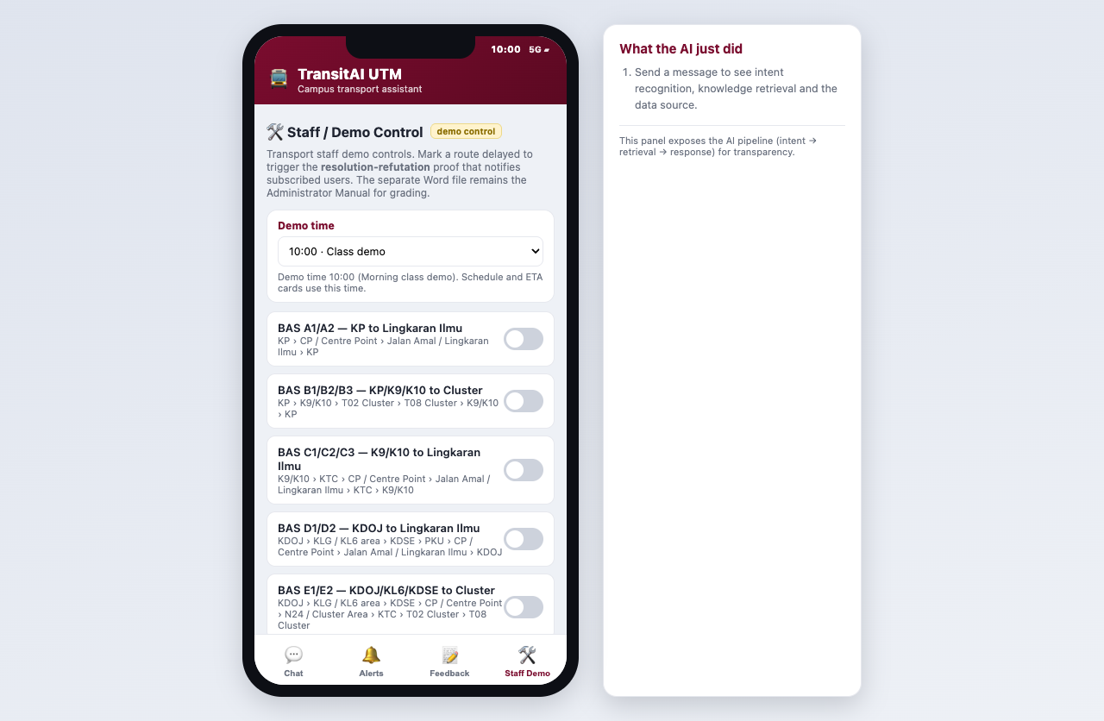
Staff Demo time control
TransitAI UTM Prototype
Why it was added
At night, live device time makes route cards show “closed now.” Demo time gives repeatable morning/lunch/evening/night scenarios.
How to demo
Use 10:00 for normal service. Use 20:30 only when intentionally showing closed-service behavior.
Staff Demo controls with fixed demo time.

Slide 7
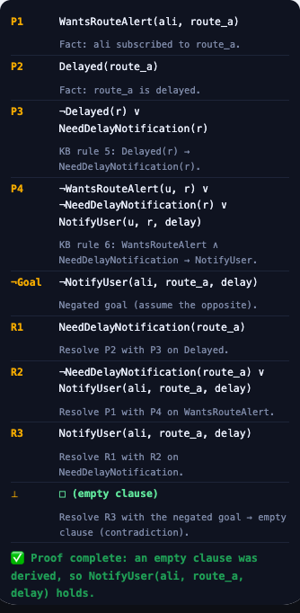
Originality highlight: resolution proof
TransitAI UTM Prototype
What it proves
From P1 WantsRouteAlert(ali, route_a), P2 Delayed(route_a), and rules P3/P4, the engine derives NotifyUser(ali, route_a, delay).
Why it is not just UI
Unification and resolution are computed by resolution.js. The proof only runs when the user is subscribed and the route is actually marked delayed in app state.
Demo line
“This proof matches Figure 5.2 in our report and drives the Alerts screen.”
Proof trace crop

Slide 8
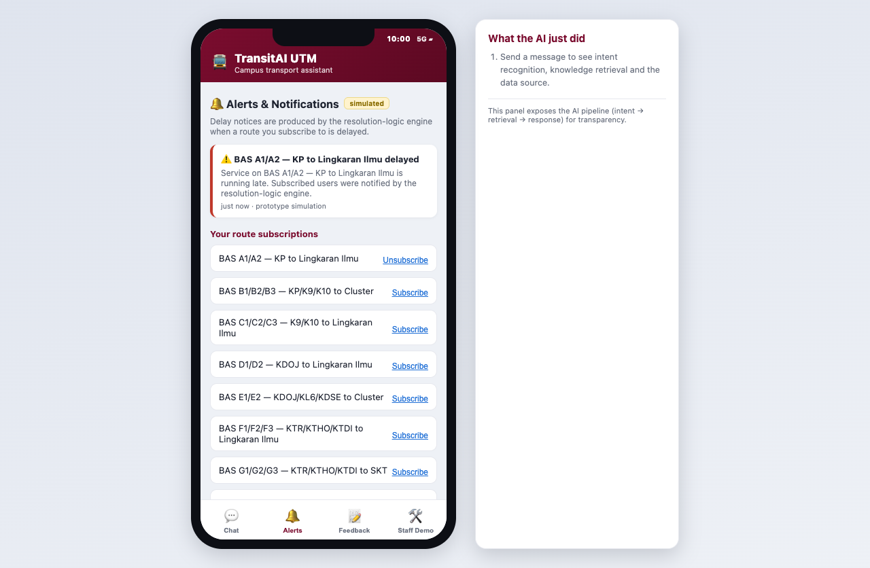
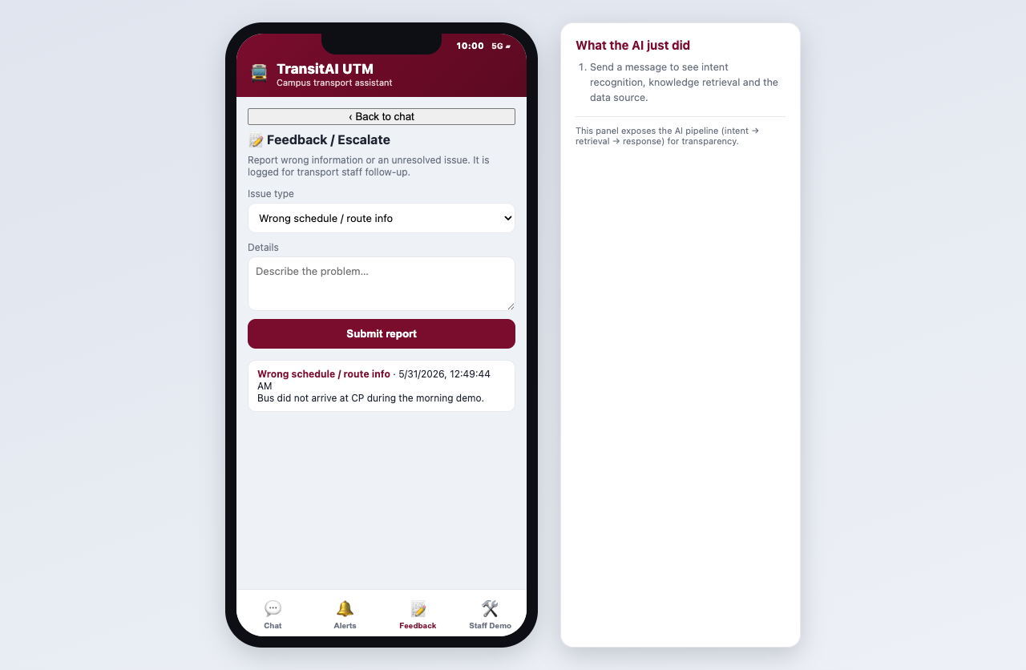
Staff Demo outcome: alerts and feedback
TransitAI UTM Prototype
Alerts after proof-triggered delay
Feedback escalation log
These two screens close the loop for both user pain points: proactive delay notification and staff follow-up when information is wrong or incomplete.

Slide 9
Architecture shown in the POC
TransitAI UTM Prototype
User input
Intent
Retriever
Response
Staff proof
→
→
→
→
Typed query or quick action
classify() + confidence
Top KB chunks + source note
Grounded answer card
Resolution derives NotifyUser
The side panel exposes the same pipeline live during the demo, so the grader can see the AI concept rather than only a static app screen.

Slide 10
Demo checklist
TransitAI UTM Prototype
Before presenting
Scoring moments
• Open prototype/index.html or serve prototype folder at localhost:8000
• Staff Demo -> Demo time -> 10:00
• Keep the AI pipeline panel visible
• Say timing/ETA are simulated POC data
• Use BAS G example for KTDI to P19/FKE
• Schedule card: source + time basis
• Route card: stop sequence
• Staff Demo: toggle BAS A delayed
• Proof trace: empty clause
• Alerts: notification appears
• Manual: Word file has full process
Final message: a reliable local POC with transparent data boundaries is stronger than a fragile live API demo.

