Slide 1
STM32 SystemWorkbench
GENIX CORPORATION
Since 2018. 04. 06.

Slide 2
18.05.26 – Short Key
1. Search
Search - Text - Workspace : Ctrl + Alt + G
2. Open Declaration : F3
3. Open Call Hierarchy : Ctrl + Alt + H
4. Build all : Ctrl + B
5. Run : Ctrl + F11
6. Debug : F11

Slide 3
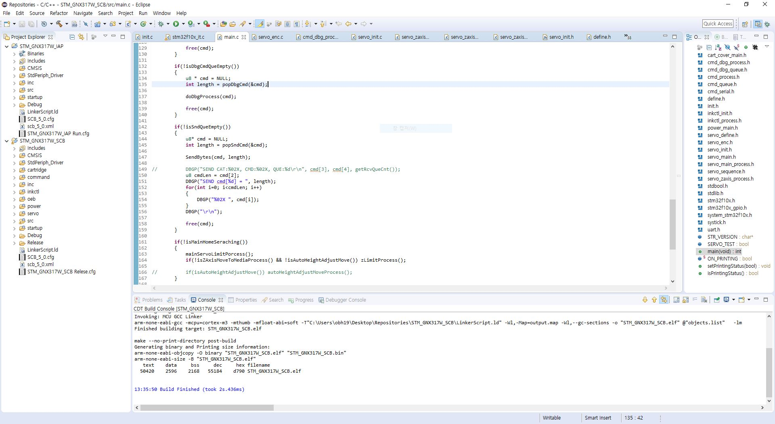
18.04.06 - SW
- Compile

Slide 4
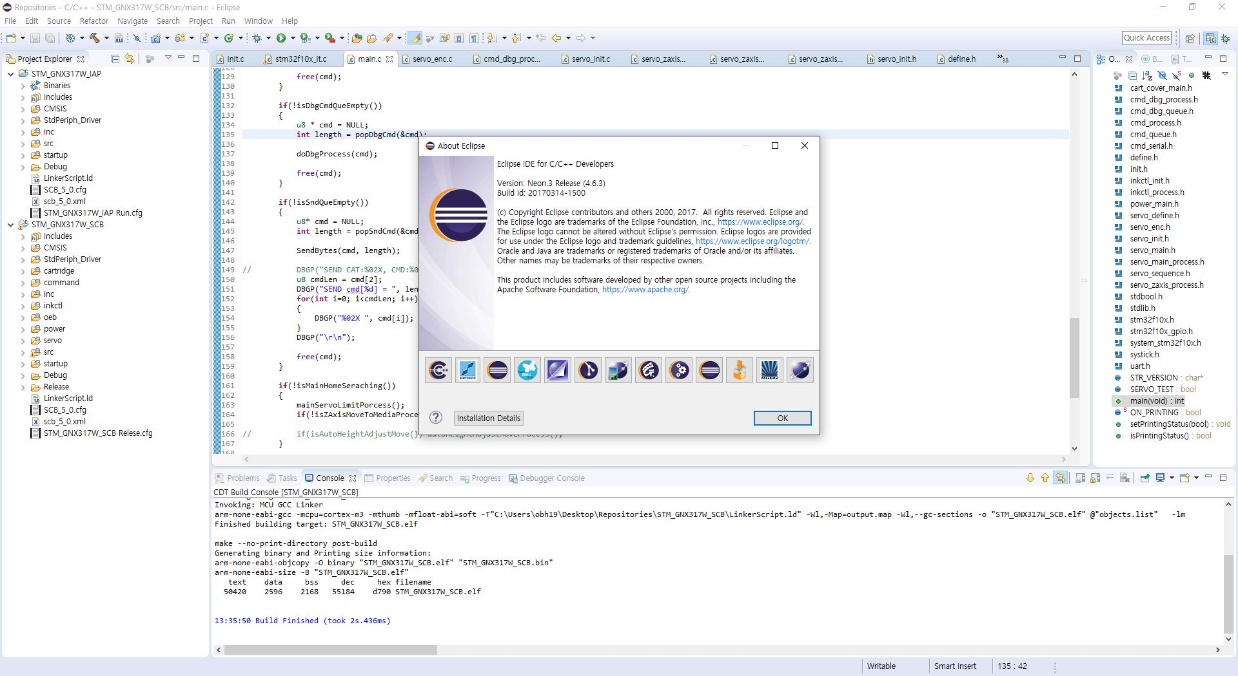
18.04.06 - SW
- Compiler information

Slide 5
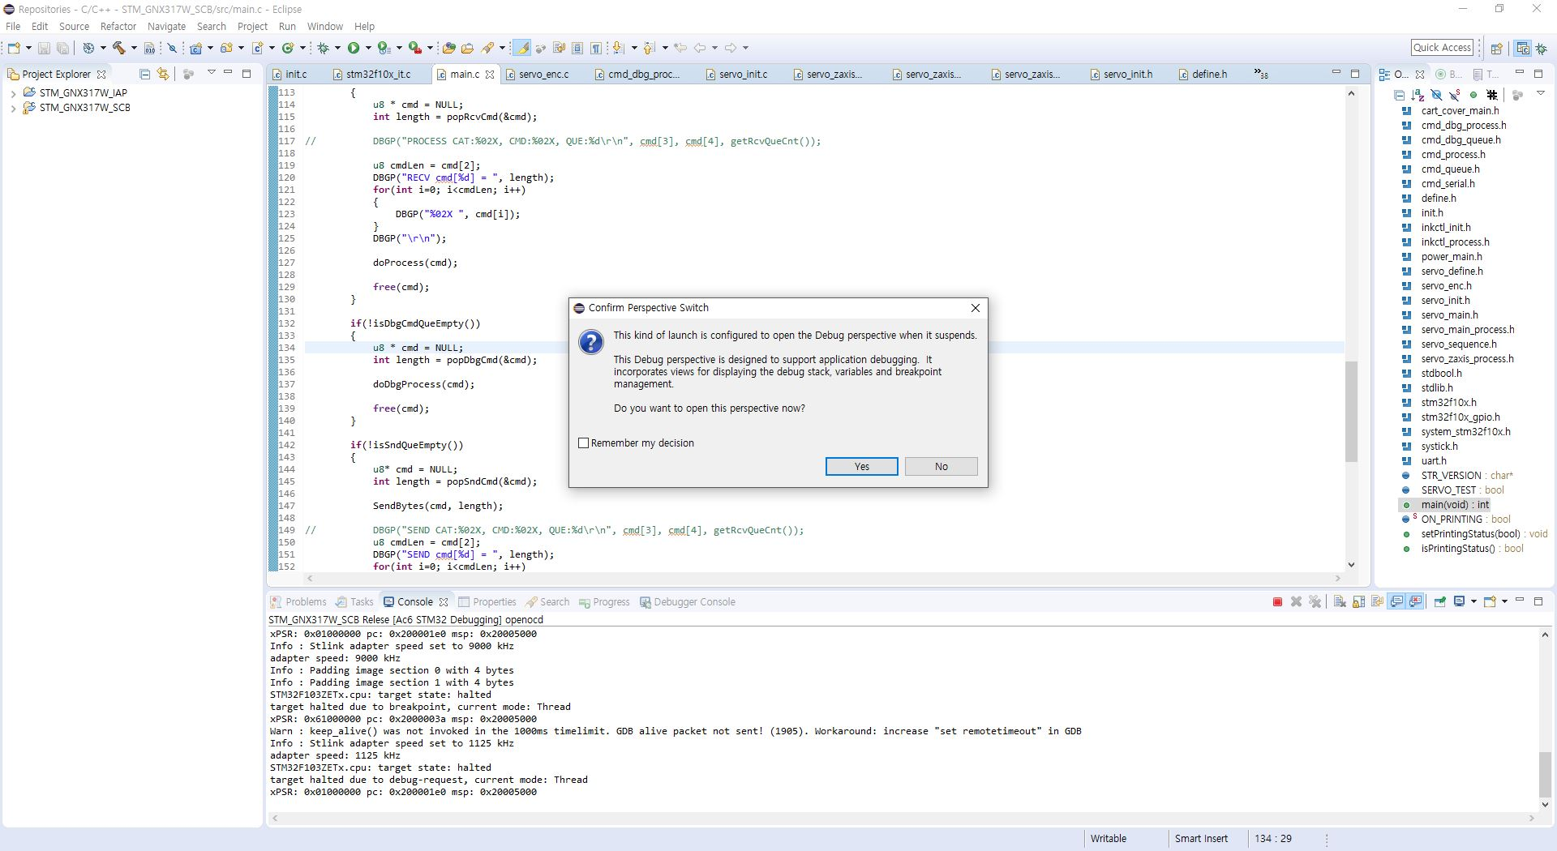
18.04.06 - SW
- Debug mode (Yes)
Notes:
Perspective : 관점, 시각

Slide 6
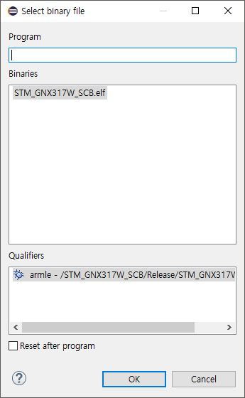
18.04.06 - SW
- Debug mode (Yes)

Slide 7
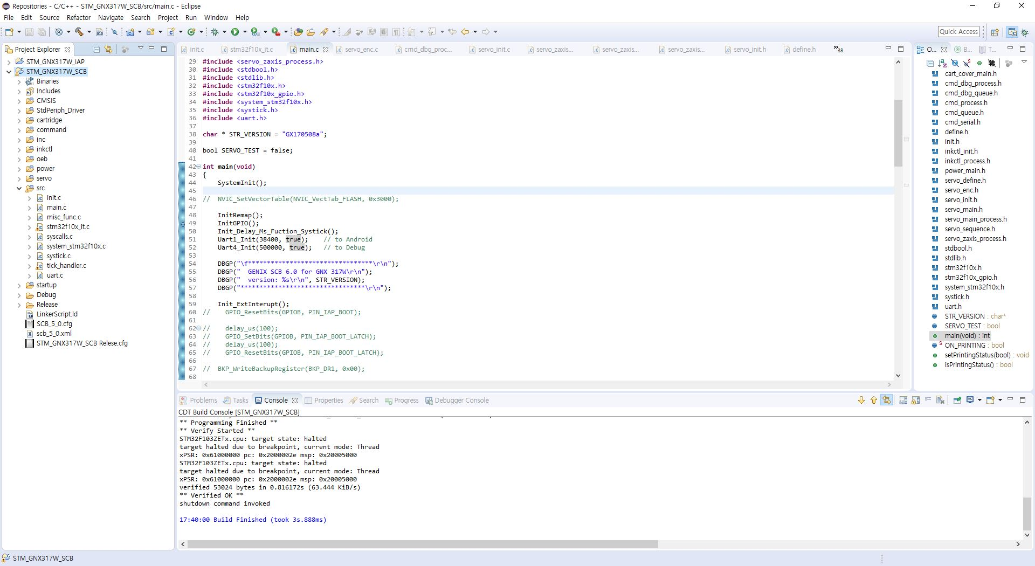
18.04.06 - SW
- Compile

Slide 8
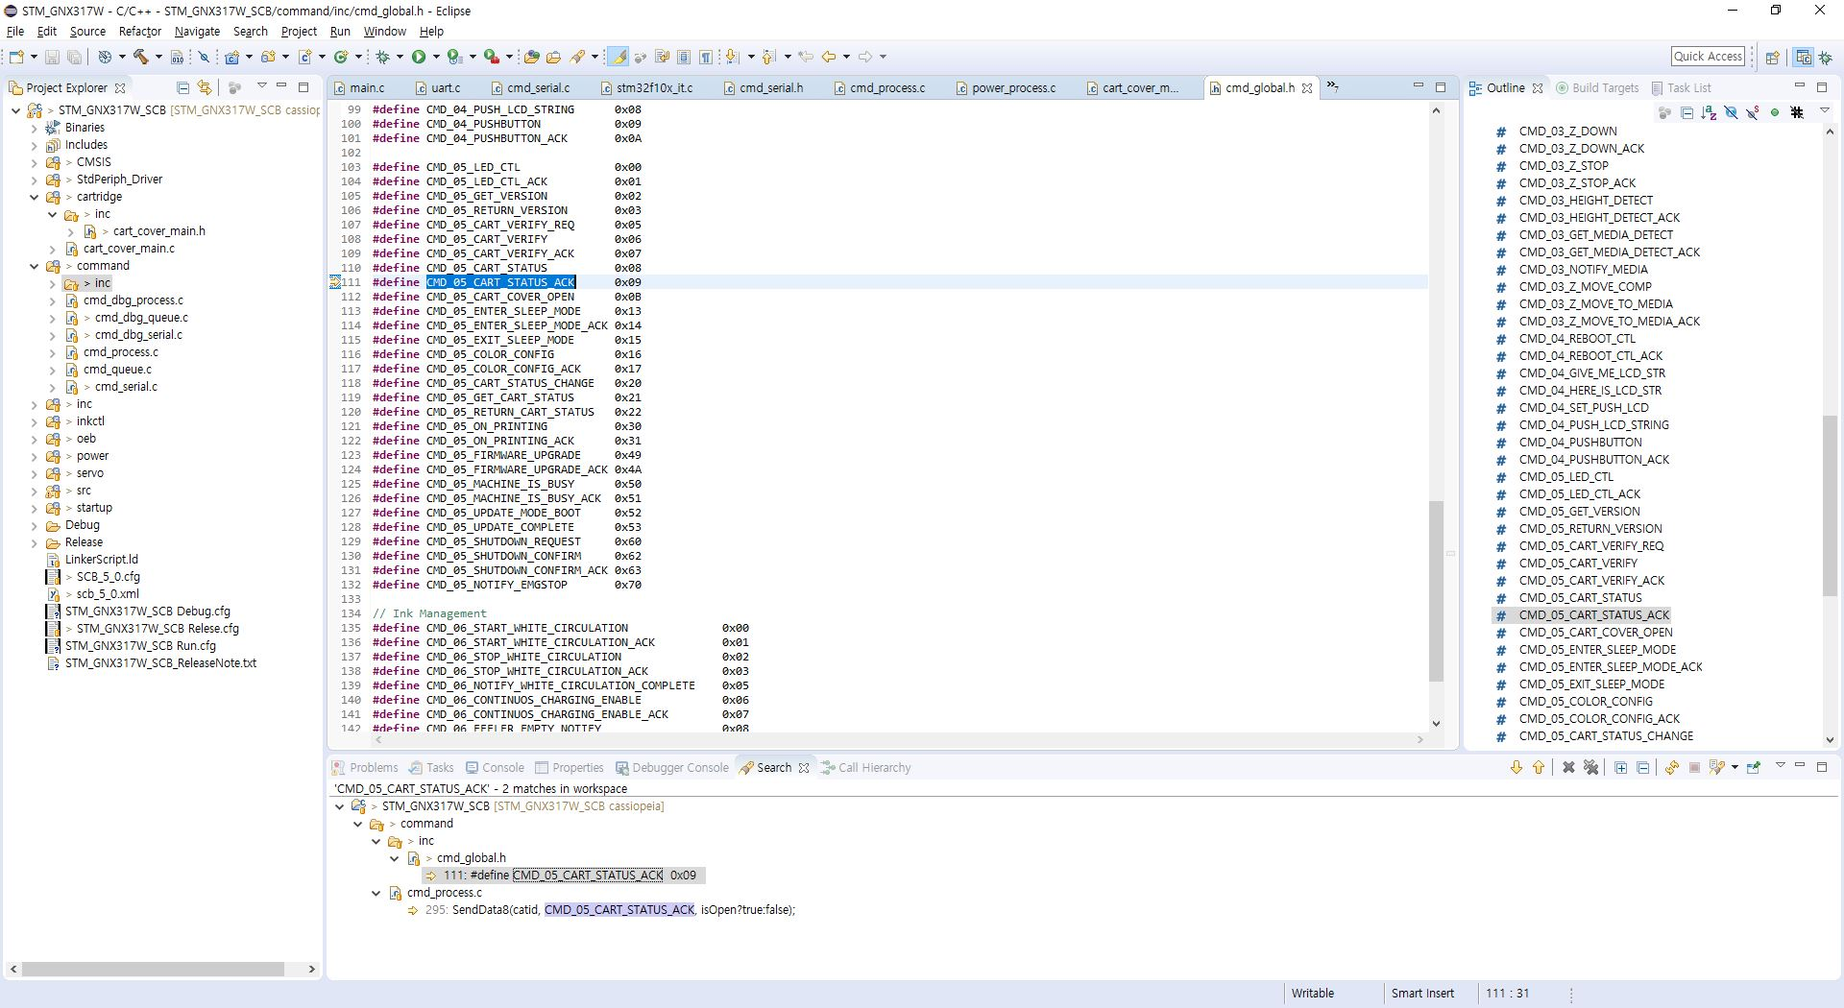
18.05.26 – Search
Search (Search - Text - Workspace [Ctrl + Alt + G])

