Slide 1
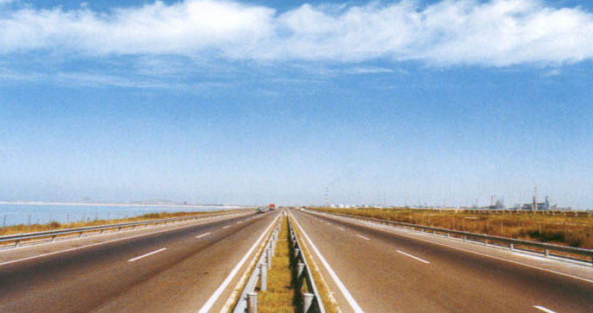
Boot Linux Faster
  USTC
  Fengguang Wu
AKA 2006 Linux kernel conference
Sep 16, 2006

Slide 2
WE NEED FAST BOOT
everybody likes it
everybody cares
we are put to shame by
  Windows with Prefetcher...
  Mac OS X with BootCache...

Slide 3
the expert way
less services
less fonts
less features
light weight GUI
...
false && depmod -a
keep ...
slim & fluent

Slide 4
the hacker way
kernel init=/bin/sh

Slide 5
the shortcut
  suspend
  &
  resume

Slide 6
the comprehensive way
  hey, let's do all possible
  to ensure
  fast boot with all the goodies!

Slide 7
Embedded Systems
  CE Linux Forum
  http://tree.celinuxforum.org/pubwiki/moin.cgi/BootupTimeResources
  http://tree.celinuxforum.org/pubwiki/moin.cgi/BootupTimeReductionHowto
  OLS2006
  Improving Linux Startup Time Using Software Resume (and other techniques)
  https://ols2006.108.redhat.com/reprints/kaminaga-reprint.pdf
  Linux Bootup Time Reduction for Digital Still Camera
  https://ols2006.108.redhat.com/reprints/park-reprint.pdf

Slide 8
Major Roadblocks
I/O seek frenzy
  1k ~ 10k files on startup
  5k * 8ms = 40s
buggy apps
  silly spins / sleeps
    IDE probe delays – up to 3s
  Dave Jones: Why Userspace Sucks
CPU hogs

Slide 9
General Solutions
scheme
bootchart
prelink
parallelization
preload(focus)
defrag
helps
Analyze
CPU
CPU / IO idles
I/O wait / seeks
I/O seeks

Slide 10
Kernel Tricks
kernel options
  kernel quiet ide3=noprobe
  mount -o noatime
kexec for fast reboot
  run a new kernel instantly
parallel device initialization
  ongoing work by Greg KH

Slide 11
kexec mini HOWTO
kernel CONFIG_KEXEC=y
install kexec-tools
hack /etc/init.d/reboot
# try kexec, then fall back to reboot
/sbin/kexec -e
/sbin/reboot -d -f -i
load a kernel and reboot
# kexec -l /vmlinuz \
--append="$(</proc/cmdline)" -x
# reboot

Slide 12
Prelinking
idea
  prelink(modify) ELF libs and apps
  to speed up dynamic linking
benefits
  C++ apps linking to many libs
    GNOME / KDE
  load time not run time
  CPU bound not I/O bound

Slide 13
Parallelization
Overlapping execution with I/O.
most distributions on the way
SUSE already there
  LSB initserv/chkconfig tools
Ubuntu shows the future
  upstart

Slide 14
SUSE LSB boot
dependency based
  LSB standard header
      ### BEGIN INIT INFO
      # Provides: cron
      # Required-Start: $remote_fs $syslog $time
      # Should-Start: $network sendmail postfix
      # Required-Stop: $remote_fs $syslog
      # Default-Start: 2 3 5
      # Default-Stop: 0 1 6
      # Description: Cron job service
      ### END INIT INFO

Slide 15
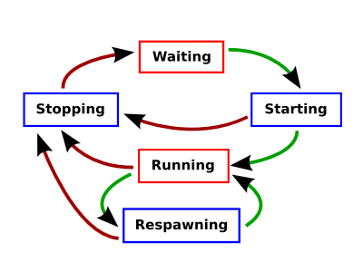
Ubuntu Upstart
event based
components
  init
  jobs
  events
goal
  to replace init,
  and cron, inetd, ...
job life-cycle

Slide 16
Preload
startup is I/O bound
goal
  reduce I/O wait
  better I/O utilization
steps
  collect I/O trace
  preload files
  defrag files

Slide 17
Distribution Solutions
debian
  preload
ubuntu
  readahead
gentoo
  readahead-list-early
  readahead-list
suse
  boot.preload_early
  boot.preload
  earlykdm
fedora
  readahead_early
  readahead
  xdm preload

Slide 18
Reports
not so
favorable
preload.sf.net
  65s to 85s reported by its author
  53s to 51s reported by Carlos Villegas
ubuntu readahead
  49s to 49/50s from Carlos Villegas
suse boot.preload
  42.2s to 41.9s from Fengguang Wu

Slide 19
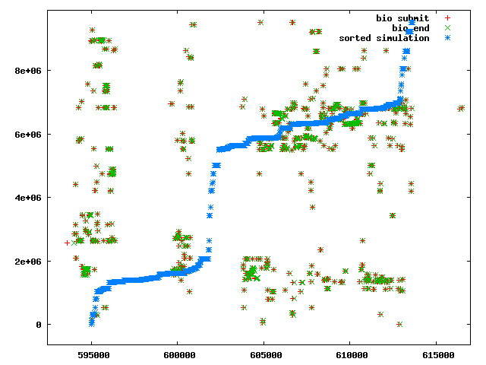
Ideal Preload
complete in background
read in order
Random
vs
Sorted

Slide 20
fcache by Jens Axboe
prime mode
  mirror read data to cache device
normal mode
  serve data from cache device
merits and demerits
  turn random accesses to linear ones
  perfect layout, optimal I/O
  not quite linux way

Slide 21
the Flavours
fcache
perfect
kernel solution
specialized
weird
for enduser

Slide 22
the Flavours
fcache
perfect
kernel solution
specialized
weird
for enduser
filecache
good enough
kernel+userland
general purpose
easy deployment

Slide 23
Proposed Solution
I/O trace
  /proc/filecache interface and tools
preload
  request for all files ASAP, so that I/O scheduler knows the global picture
  schedule the bulk requests in kernel
data layout
  poor man's defragger for ext3

Slide 24
Collecting I/O Traces
strace
LD_PRELOAD
/proc/<pid>/map
fboot
(kernel module)
SUSE
gentoo-wiki.com
preload.sf.net
Andrew Morton

Slide 25
strace Practice
  To trace KDE startup initiated from KDM, we have to strace two kdm processes and the X process (PIDs 3703, 4100 and 9573):
  # strace -f -F \
  -p3703 -p4100 -p9573 \
  -e trace=open \
  -o strace.kdm

Slide 26
/proc/filecache inodes view
  # echo -n index > /proc/filecache
  # cat /proc/filecache
  # filecache 1.0
  # ino size cached cached% state refcnt dev file
  472353 8 0 0 -- 29 03:42(hdb2) /lib
  1205314 91 92 100 -- 65 03:42(hdb2) /lib/ld-2.3.6.so
  16289 8 0 0 -- 38 03:42(hdb2) /etc
  472394 4 0 0 -- 30 03:42(hdb2) /lib/tls
  233608 1242 1056 85 -- 65 03:42(hdb2) /lib/tls/libc-2.3.6.so
  65203 651 496 76 -- 2 03:42(hdb2) /bin/bash
  1205315 261 160 61 -- 10 03:42(hdb2) /lib/libncurses.so.5.5

Slide 27
/proc/filecache pages view
  # echo -n /bin/bash > /proc/filecache
  # cat /proc/filecache
  # file /bin/bash
  # flags R:referenced A:active U:uptodate D:dirty W:writeback M:mmap
  # idx len state refcnt
  0 46 RAU___ 1
  47 12 RAU___ 1
  60 13 RAU___ 1
  73 4 __U___ 1
  77 4 RAU___ 1
  81 2 __U___ 1
  83 6 RAU___ 1

Slide 28
filecache Merits
convenient
no overhead
shows cache usage
shows fs metadata
I/O trace for any task
  take snapshot0; run task;
  take snapshot1
  diff snapshot1 snapshot0

Slide 29
Preload Steps
  setup queue parameters
  for each fs:
    readahead fs metadata
    wait for fs mount
    readahead files in parallel
  wait for IO complete
  restore queue parameters

Slide 30
I/O Schedule
read-ahead requests
  IOPRIO_CLASS_IDLE
  served on disk idle or in batch
  need fix deadline and anticipatory
on pending read
  find the read-ahead request
  queue it for submission
  need fix all elevators

Slide 31
ext3 data layout
allocation group
  fs divided into equal sized groups
  default to 80x128M for a 10G fs
allocate strategy (orlov)
  spread out "top-level" directories
  ensure locality for normal inodes
  makes unbalanced use of groups
    dumpe2fs /dev/hda2 | grep free

Slide 32
ext3 top-level dirs
concept
  directories on the fs root
  or: chattr -T dir
orlov
  find a moderate spare group
oldalloc
  find the most spare group (for all dirs)

Slide 33
ext3 poor man's defrag
mount -o remount,oldalloc /
mkdir /.defrag-habitat
mount -o remount,orlov /
for f in $files
do
  cp $f /.defrag-habitat/tmpf
  rm $f
  mv /.defrag-habitat/tmpf $f
done

Slide 34
Put it Together
elementary tools
  /proc/filecache snapshot
# filecache --snapshot --dump ./fc
# ls ./fc
bdev hdb2 hdb3
  readahead files in parallel
# readahead-fs ./fc/hdb2

Slide 35
Put it Together
front-end tool
  collect I/O trace
# bootcache start firefox
$ firefox &
$ sleep 10s
# bootcache stop firefox
  preload files
# bootcache preload firefox
$ firefox &

Slide 36
Let's go...
Debian: 95s to 68s down 28%
SUSE: 49s to 50-60s up 10%
What goes wrong?

Slide 37
lock contention
$ ps -C readahead-fs m -o \
pid,tid,class,pri,pcpu,stat,wchan:14,comm
PID TID PRI %CPU STAT WCHAN COMMAND
9413 - - 1.1 - - readahead-fs
- 9413 24 0.1 Sl+ futex_wait -
- 9414 21 0.0 Dl+ sync_buffer -
- 9415 21 0.0 Dl+ real_lookup -
- 9416 21 0.0 Dl+ real_lookup -
- 9417 21 0.0 Dl+ sync_buffer -
- 9418 21 0.0 Dl+ real_lookup -
- 9419 21 0.0 Dl+ real_lookup -
...

Slide 38
lock contention
[<c01616c8>] sync_buffer+0x60/0x77
[<c03acbf6>] __wait_on_bit+0x58/0x61
[<c03acc7f>] out_of_line_wait_on_bit+0x80/0x88
[<c016175a>] __wait_on_buffer+0x31/0x33 <= wait I/O
[<c01ae0a5>] ext3_find_entry+0x16c/0x3d4
[<c01ae57d>] ext3_lookup+0x3c/0xe4
[<c016e214>] real_lookup+0xb5/0xd4 <= acquire mutex
[<c016e4c4>] do_lookup+0x94/0x9f
[<c016ec66>] __link_path_walk+0x797/0xe56
[<c016f369>] link_path_walk+0x44/0xba
[<c016f6b8>] do_path_lookup+0xe2/0x240
[<c016fb3b>] __user_walk_fd+0x48/0x5d
[<c0169dfb>] vfs_stat_fd+0x22/0x59
[<c0169e52>] vfs_stat+0x20/0x24
[<c016a530>] sys_stat64+0x1b/0x37
[<c0102cd3>] syscall_call+0x7/0xb

Slide 39
iopen
problem
  call sequence: open(); read()
  stuck in open(), before requesting I/O
  can't tell I/O elevator the global picture
open by inode
  ext3 inode number == offset inside fs
  no path lookup
  no lockup

Slide 40
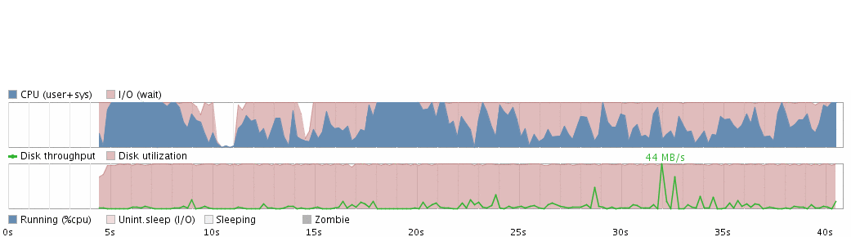
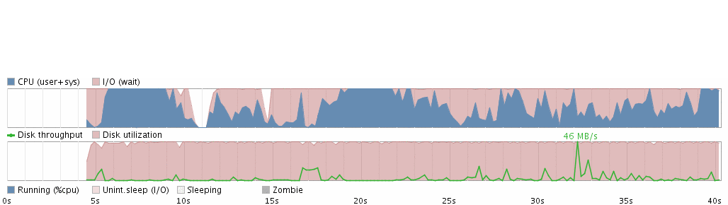
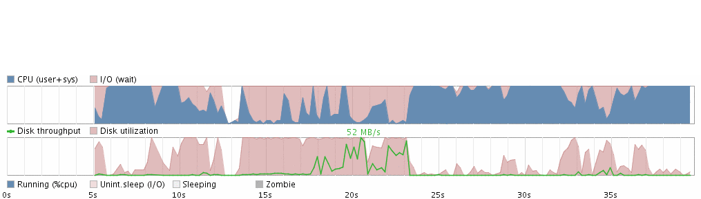
SUSE Bootcharts
plain
preload
filecache

Slide 41
Conclusion
startup time remains the same
still suffers from a lock contention
  leave as future work
seek frenzies reduced
KDE startup is now CPU bound
  time to show off your dual core CPU ;-)
  I'll go for prelink ^_^

Slide 42
Thank you.

Slide 43



Acknowledgment

Slide 44
Ongoing Projects
  Google Summer of Code 2006
  Improve the Debian Boot Process
  http://initscripts-ng.alioth.debian.org/
  Rapid linux desktop startup through pre-caching
  http://code.google.com/p/pagecache-tools/
  upstart: init daemon replacement
  http://www.netsplit.com/blog/work/canonical/upstart.html

Slide 45
Resources
  bootchart: Boot Process Performance Visualization
  http://www.bootchart.org
  Analyzing and Improving GNOME Startup Time
  http://www.gnome.org/~lcolitti/gnome-startup/analysis/
  10 Things Apple Did To Make Mac OS X Faster
  http://www.kernelthread.com/mac/apme/optimizations/
  kernel facilities for cache prefetching
  http://marc.theaimsgroup.com/?t=114655640400004&r=2&w=2
  Linux: Boot Time Speedups Through Precaching
  http://kerneltrap.org/node/2157

Slide 46
Resources
  SUPER preloading
  http://en.opensuse.org/SUPER_preloading
  preload - adaptive readahead daemon
  http://sourceforge.net/projects/preload
  Startup Time in the 21st Century: Filesystem Hacks and Assorted Tweaks
  https://ols2006.108.redhat.com/reprints/lahaise-reprint.pdf
  Gentoo Linux Prelink Guide
  http://www.gentoo.org/doc/en/prelink-howto.xml

Slide 47
Bootup Phases
device initialization
  BIOS...........................................
  kernel.................................
system loading
  init scripts..................
  GUI desktop environment...........
we optimize RC/GUI uptime
users care STARTUP time
^{STARTUP}
^{RC}
^{GUI}

Slide 48
Main Technique Types
do it faster
do it in parallel
do it later
don't do it at all

Slide 49
Under the Hood
open() / stat()
  for each dir:
    read dir metadata
    read dir data
read()
  read file metadata // get blocks
  read file data

Slide 50
Linux Cache Model
One common cache?
.
cache device
| |
| <-----------------> |
file /bin/ls | |
|<---------------------> | |
|<---------------------> | |
| <-----------------> |
| |
| |
file /lib/ld.so | |
|<---------------------> | |
| | |
| | |
|<---------------------> | |
| <-----------------> |
| |
| |

Slide 51
Linux Cache Model
.
One file, one cache!
device /dev/hda1 file /dev/hda1
| |
| <-----------------> |
file /bin/ls | |
|<---------------------> | |
|<---------------------> | |
| <-----------------> |
| |
| |
file /lib/ld.so | |
|<---------------------> | |
| | |
| | |
|<---------------------> | |
| <-----------------> |
| |
| |

